Slide 1
Medical Surgical Department
Patient Discharge Process
1st Presentation Date: June 24th 2025

Slide 2
Quality Story:
PLAN
Patient Education
Goal(s): What are you trying to accomplish?
KOM Target: 80% RN completion of the discharge cover page at discharge. Intent to ultimately affect the Dean Value satisfaction scores and reimbursement. Current KOM Status: Project started March 2025 with compliance = 31.8% with completing discharge cover page. Goals met in April = 86.7% and May = 92.6% completion rate.
Background: Explain what the original situation was. Why was a change recommended? (e.g. variation, poor outcome, etc.)
Noted decreased in discharge satisfaction scores on HCAHPS measures, as well as a decrease in reimbursement on the Dean Value Contract (DVC). This project is a branch of the greater DVC Score-Satisfaction Domain Project lead by Amy Hermes.
Driver: Explain why the project is critical to SH. Why does it relate to the strategic plan?
The driver for this QM is to achieve patient satisfaction and loyalty evident by the HCAHPs score related to discharge. Intent is to increase patient discharge satisfaction scores, which will affect the service pillar. Ultimately, the finance pillar would also be affected by improving the DVC reimbursement.
Team:
Project Leader: Naomi Franklin RN & Marissa Brady RN Members: Med Surg/ICU RN staff

Slide 3
Changes:
DO
List the changes that have been made leading to improvements.
What? | Why? | When?
Discharge folders created containing discharge information (AVS) and specific cover letters. | Simplify discharge information given to patients. Information all on one page for easy access and highlighting important/most relevant information. | March 1st, 2025, and ongoing
Bright colored stickers added to discharge folder given at discharge asking for patients/families to complete Press Ganey satisfaction survey. | Bright stickers to draw attention, in hopes of getting more patient feedback via satisfaction surveys. Increasing the number of returned surveys will allow for a better representation of the patients we treat. | March 1st, 2025, and ongoing
Share discharge folders and cover letters with attendees at the Patient Family Advisory Committee Meeting. | Important to get consumer feedback to improve processes. | Spring 2025 and will revisit in upcoming meeting.
1:1 meetings and emails to RN staff sharing project with the what, why, where, how of the project. | Ensure all nursing staff understand importance of project and need for providing patient education. | January 29th, 2025 (email) and 1:1 conversations in February 2025
Chart review for compliance of providing/documenting discharge cover letter. | Encourage staff buy-in and participation of project with email and team reward if goal percentage accomplished. | March 15th, 2025, and ongoing
Project shared at inpatient staff meetings. | Encourage staff buy in and ownership of project success. Understanding where to find discharge folders and where to find discharge cover page in epic. | April 8th and 10th 2025 June 10th and 12th, 2025
Email communication sent to staff who had lower compliance rates providing additional education on expectations and purpose of project. | Provide additional education and address any barriers to compliance. | April 24th, 2025
Information shared with team addressing HCAHPS discharge scores. | Reporting up to share results with the DVC Score – Satisfaction Domain Project as this is a branch of that work. | Last met April, 2025

Slide 4
Measures:
STUDY
Include graphs of your measurement, results of surveys, etc. Include benchmarks or comparative data when available.

Slide 5
Findings:
ACT
Results: Did you accomplish your goals?
We did not meet our goal the first month. Our second month we were able to meet our goal. We were 86.7% in the month of April and 92.6% in May.
Lessons Learned: What did you learn as a result of this project? Unexpected discoveries? Problems or barriers?
Higher census seems to decrease compliance, especially when there are several discharges at the same time. There was initial confusion about which patients should be getting the discharge cover letter as there are several patient classes (inpatient medical, surgical, observation, swing bed, hospice) as well as if the same discharge information should be provided to patients going to into placement facilities. Majority of staff recognize that this is an incredibly valuable project and want to perform at high levels to ensure the best discharge experience for their patients as it affects satisfaction, quality care and safety, and readmissions.
Next Steps: What actions are you going to take in the next 60 days ?
Action: | Assigned To: | Due Date:
Monitor monthly progress and re-educate staff who are not performing at a high level in real time via 1:1 and email communication, as well as educate new hires. | Marissa Brady and Naomi Franklin | Next 60-day project cycle and ongoing
Continue to report findings to the HCAHPS Discharge focus group during monthly meetings (reporting up to Amy Hermes as the DVC Score – Satisfaction Domain Project) | Marissa Brady and Naomi Franklin | Next 60-day project cycle and ongoing
Monitor outcomes in relation to DVC scores/reimbursement – this is challenging due to the lagging reported data. | DVC Project Team | Next 60-day project cycle and ongoing
Project Leader is Recommending the Following:
QM Council approval for completion of project?: Enter YES or NO Project still in progress, project to continue: Enter YES or NO

Slide 6
Inpatient
Onboarding New Employees
1st Presentation Date: 12/17/2024, 02/25/2025, 04/22/2025,
Document Last Presented: 06/24/2025

Slide 7
Quality Story:
PLAN
Onboarding – Inpatient
Goal(s): What are you trying to accomplish?
KOM Target: Enhance onboarding of new employees by addressing orientation checklists to ensure that they are practical, concise, and consistently implemented with all new employees by June 2025. Phase 1: Redesign the Inpatient Registered Nurse orientation checklist by March 1st, 2025. Phase 2: Rework current orientation binder to create an improved onboarding experience for nursing staff (in collaboration with Clinical Education) by April 1st. Phase 3: Implement new onboarding process and binder with new RN hire and obtain feedback throughout orientation and adjust process as indicated. Phase 4: Following phases will include replicating the same process in addressing orientation checklists for other disciplines (CNAs, HUCs, CM, and SS). Current KOM Status: Phase 1: Goal Met. Phase 2: Goal Met. Phase 3: To be implemented with next new RN hire. Phase 4: Not started.
Background: Explain what the original situation was. Why was a change recommended? (e.g. variation, poor outcome, etc.)
There has historically been challenges with onboarding new staff, leading to opportunities for improvement with adequate orientation checklists, qualified preceptors, and consistent scheduling. Administration has challenged each department to enhance onboarding practices.
Driver: Explain why the project is critical to SH. Why does it relate to the strategic plan?
This project will enhance employee satisfaction and promote staff retention. In turn, it will also affect patient satisfaction and each pillar (quality/safety, service, people, growth, and finance).
Team:
Project Leader: Heather Kleinbrook Members: Jennifer Wagner, Naomi Franklin, Inpatient nursing team. Sam Stoltz. Nikki Rowin.

Slide 8
Changes:
DO
List the changes that have been made leading to improvements.
What? | Why? | When?
Present and review progress regarding project in staff meetings. | Continue to garner staff support and acceptance of project. Encourage feedback into process, content, and workflow. | December 2024 and ongoing.
Monthly meetings with team and added stakeholders (clinical nurse educator, informatics nurse) | Keep project on track. Ensure meeting goals and target dates. Designated group project work. | January 15th, 2025 and February 12th, 2025.March 12th, April 15th, May 14th.
Finalize RN orientation checklist and share with Addy Miller for formatting. Completed and shared with staff or additional edits. | Completion of checklist with specific orientation items, strategies and resources for learning, and evidence of competence. | February 12th, 2025 and ongoing.
Begin work on RN Orientation binder (Collaboration with Clinical Nurse Educator and Informatics Nurse), case studies and critical thinking tools. | Rework current binder to make it relevant to current needs. Develop relevant case studies congruent to common diagnoses seen on the unit. Engage Informatics nurse in next meetings. | February 12th, 2025 and ongoing.
Final edits to orientation competency and EPIC competency checklists sent to Addy. | Formatting and editing to be completed to implement final draft of checklists with any new RN employees. Last item due for binder completion. | June 10th, 2025.
Consideration of adding Case Studies to orientation binder. | Case studies provide enhanced learning opportunities by using real situations to develop critical thinking and problem-solving skills with staff. | May 14th,m 2025 – ongoing.

Slide 9
Measures:
STUDY
Include graphs of your measurement, results of surveys, etc. Include benchmarks or comparative data when available.
Action Item | Due Date | Goal Met
IP Manager to work with CNO and nurse leaders to determine need to pre- and post- task rating system. Is this a regulatory requirement? | December 1st, 2024. | Goal Met.
Nurse Leaders to consider request of project team to utilize assistance of Clinical Nurse to assist with onboarding process. | December 10th, 2024. | Goal Met.
Invite Clinical Nurse to next Project Meeting (January 15th) if appropriate. | December 10th, 2024. | Goal Met.
Redesign the Inpatient Registered Nurse orientation checklist. | March 2025. | Goal Met. Working with Addy on formatting final draft.
Work with Informatics nurse on development of Epic orientation checklist specific to Inpatient Department | April 2025 | Goal Met.
Rework current orientation binder to create an improved onboarding experience for nursing staff (in collaboration with Clinical Education) | May and June 2025 | Goal Met.
Implement new onboarding process with new hire. | TBD – plan to implement with next RN hire | Not Met.
Recreate process to address CNA, HUC, CM, and Social Work checklists | TBD | Not Met.

Slide 10
Findings:
ACT
Results: Did you accomplish your goals?
In progress. Met goals with creating new workflow and onboarding binder. Will implement with next RN hire and evaluate process by seeking input from staff.
Lessons Learned: What did you learn as a result of this project? Unexpected discoveries? Problems or barriers?
This project is a grand challenge, but if we can get it done right with the Registered Nurse group, it will be much less labor intensive rolling out to other disciplines. Project will always be a work in progress as needs change, policies are updated, and priorities for orientation evolve.
Next Steps: What actions are you going to take based on your findings? (e.g. roll out to additional units; modify and make additional improvements; abandon the effort; change course?)
Action | Assigned to: | Due Date:
Implement new onboarding process/binder with next RN hire – process to begin on day 2 during clinical orientation. | Sam Stoltz and Inpatient Preceptor | Completion within next 60-day project cycle.
Continue to develop relevant case studies for inclusion in the onboarding binder. | Jennifer Wagner and Team | Next 60-day project cycle and ongoing.
Begin process of developing orientation binders for other disciplines by replicating process. | Project Team | Summer 2025
Project Leader is Recommending the Following:
QM Council approval for completion of project?: Enter YES or NO Project still in progress, project to continue: Enter YES or NO

Slide 11
Medical-Surgical Department
Increase in Swing Bed Admissions
1st Presentation Date: 06/27/2023
Document Last Presented: 06/24/2025

Slide 12
Quality Story:
PLAN
Swing Bed
Goal(s): What are you trying to accomplish?
KOM Target: Increase Swing Bed patient admissions to >41 this year (Jan – Dec 2025) to match pre-COVID numbers. January = 3, February = 6, March = 1, April = 4, May = 1; Annual total thus far = 15.
Background: Explain what the original situation was. Why was a change recommended? (e.g. variation, poor outcome, etc.)
During COVID, Swing Bed admissions declined due to the need to maintain open beds for acute care patients. Now that we are moving to our new post-COVID norm, it feels like we are in a place to open more beds to transitional care patients.
Driver: Explain why the project is critical to SH. Why does it relate to the strategic plan?
Supports several areas of the strategic plan. Most obvious, it supports the bottom line financially, but it also keeps beds filled which guarantees staff hours and boosts staff satisfaction. It also enhances relationships with other hospitals by taking their patients to open beds for more acute needs which makes us good partners.
Team:
Project Leaders: Heather Kleinbrook Members: Case Managers, Social Workers, Inpatient Rehab Staff, Nurses, and Hospitalists

Slide 13
Changes:
DO
List the changes that have been made leading to improvements.
What? | Why? | When?
Discussion and identification of potential Swing Bed candidates in Daily Huddle | Want to keep appropriate SWB candidates in our organization for further care. Review outside referrals for appropriateness and coverage. | 04/26/23 and ongoing daily
Address Project in Staff meetings | Encourage staff buy-in and enforce positive aspects of SWB stays. Encourage staff to promote our SWB Program within community and among inpatients that may benefit from services. | 06/13/23 and ongoing
Marketing Push – collaborative effort to create new marketing material with PR team | Market to outside sources to promote program and services to increase appropriate utilization. | March 2025
Meeting with SSM Madison – Mike Godfrey, Amy Hermes, and IP Services | Educate on SH SWB Program and market program to increase appropriate referrals. | March 12, 2025
Mike Godfrey (SSM Madison) to have Stacy Salasa (lead RN) connect with IP Services Manager to set up a visit for SH to go to SSM to present on SWB program. | Presentation will allow us to get in front of SSM transition team to discuss program options and benefits to enhance appropriate referrals. | TBD – Heather has reached out to address without response
Develop communication tool using Epic Inbox to receive direct referrals from SSM Madison. | Allow pipeline for referrals and direct communication. Heather met with Nikki Rowin on 3/11/2025 to discuss needs and address Epic functionality. SW have access but uncertain of CM access. Nikki to investigate. | TBD – Waiting on a response from Nikki Rowin.
Set up quarterly meetings with SSM Madison Team and SH Team. | Continue to relationship building, identify what is going well as well as opportunities for improvement with referral process | March 12th, 2025 June 2nd, 2025 – MIKE/SSM CANCELLED Next meeting set for September 2025
Heather to connect with Colleen Koski (contact from Chris Brabant) at HSHS | Opportunity to learn from colleague who engaged in development of a strong SWB program at a different entity. Contact made with response to date. | April 18th, 2025 – no response from Collen

Slide 14
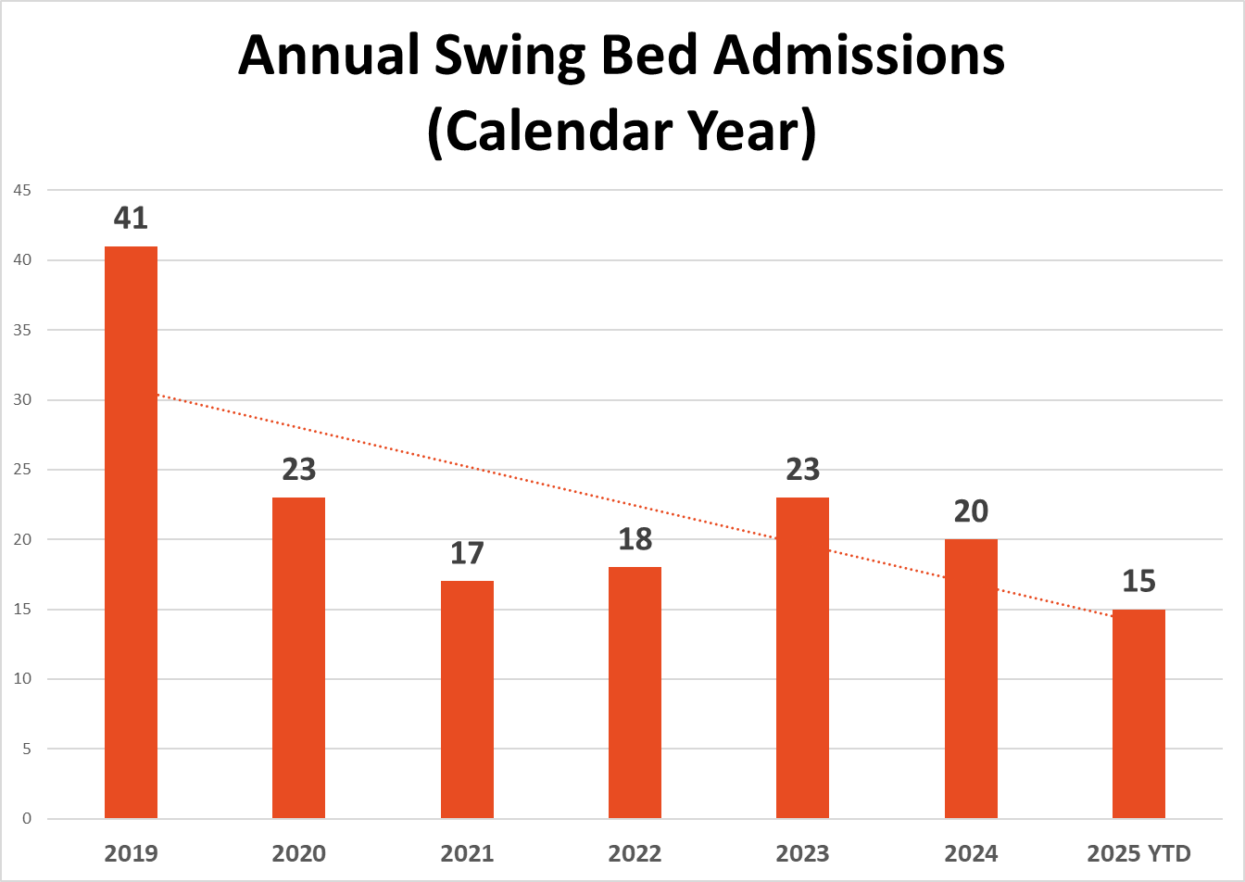
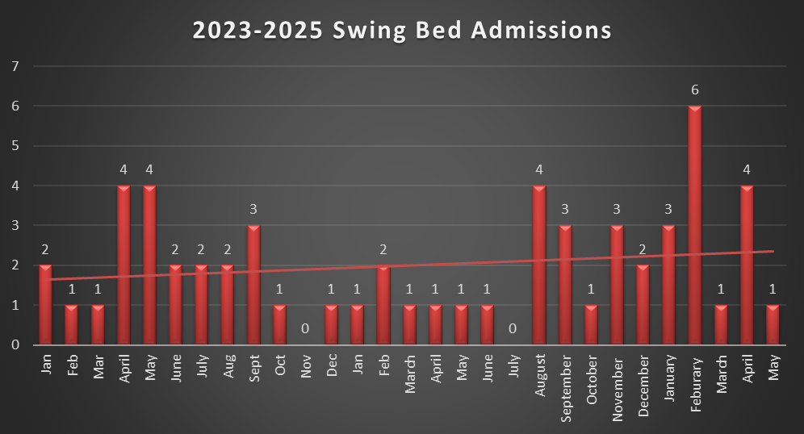
Measures:
STUDY
Include graphs of your measurement, results of surveys, etc. Include benchmarks or comparative data when available.

Slide 15
Findings:
ACT
Results: Did you accomplish your goals?
Ongoing.
Lessons Learned: What did you learn as a result of this project? Unexpected discoveries? Problems or barriers?
Inpatient team is more receptive to SWB admissions and keeping appropriate patients at SH for transitional care needs. This encompasses all disciplines, including rehab services. Continued efforts at collaborating with outside entities is challenging and ultimately out of our control.
Next Steps: What actions are you going to take based on your findings? (e.g. roll out to additional units; modify and make additional improvements; abandon the effort; change course?)
Action | Assigned to: | Due Date:
Continue to encourage SWB utilization among SH inpatients. | Heather and IP Team | Ongoing.
Conduct quarterly meetings with SSM-Madison (Mike Godfrey), as well as set up a visit with their transitional care team for continued collaboration. | Heather | Efforts have been made to connect with care team without success – next monthly meeting scheduled for September 2025
Set staff up with direct line for referrals in EPIC. | Nikki Rowin | End of June.
Project Leader is Recommending the Following:
QM Council approval for completion of project?: Enter YES or NO Project still in progress, project to continue: Enter YES or NO

Slide 16
Geriatric Psychiatry
Onboarding New Employees
1st Presentation Date: 08/27/2024, 12/17/2024, 02/25/2025, 04/22/2025
Document Last Presented: 06/24/2025

Slide 17
Quality Story:
PLAN
Onboarding - GPU
Goal(s): What are you trying to accomplish?
KOM Target: Enhance onboarding of new employees by developing an orientation binder encompassing all Geriatric Psychiatry disciplines, addressing all aspects of patient care. Specific discipline checklists will serve as attachments. Phase 1: Draft binder for all staff review. Phase 2: GP staff review and provide feedback to project team. Phase 3:Finalization of binder with feedback of newly hired team members. Phase 4: Implement process with new employees (May and June 2025). Current KOM Status: Phase 1: Goal met. Phase 2: Goal Met. Phase 3: Goal Met. Phase 4: In Process. New hire employees currently working with new orientation process. Will obtain feedback throughout orientation and adjust process as indicated.
Background: Explain what the original situation was. Why was a change recommended? (e.g. variation, poor outcome, etc.)
There has historically been challenges with onboarding new staff, leading to opportunities for improvement with orientation processes, qualified preceptors, and consistent scheduling of orientation time. Administration has challenged each department to enhance onboarding practices.
Driver: Explain why the project is critical to SH. Why does it relate to the strategic plan?
This project will enhance employee satisfaction and promote staff retention. In turn, it will also affect patient satisfaction and each pillar (quality/safety, service, people, growth, and finance).
Team:
Project Leader: Heather Kleinbrook Members: Tammy Arndt, Erin Boettcher, Stacy Wendt, GP nursing team

Slide 18
Changes:
DO
List the changes that have been made leading to improvements that occurred in the last 60 days.
What? | Why? | When?
Present and review progress regarding project in GP staff meeting. | Continue to garner staff support and acceptance of project. Achieve favorable feedback from all staff on new orientation binder. Consider staff feedback for process improvement going forward. | April 2nd and 3rd, 2025, June 4th and 5th, ongoing.
Monthly Team Meetings. Extend Invite to Sam Stoltz | Keep project on track. Ensure team is meeting goals and target dates. Designated time for group project work. Input from Clinical Nurse Educator on processes and implementation. | March 12th April 7th April 7th
Develop EPIC Competency Checklist | Need to capture EPIC training for new employees who may not have exposure to EPIC, as well as train on GP specifics. | April 2025.
Develop abbreviated GP RN Checklist | Need to capture tasks not identified in orientation binder, along with method of competency. | April 2025.
Develop process for managing binders | Need to identify owners to ensure new employees are getting binders, as well as having responsibility of ordering supplies, making copies, updating information, etc. | April 2025.
Implement new workflow / orientation process with new RN hires | Determine what is working as well as opportunities for improvement, allowing for adjustments during implementation phase. | May 14th - ongoing

Slide 19
Measures:
STUDY
Include graphs of your measurement, results of surveys, etc. Include benchmarks or comparative data when available.
Action Item | Due Date | Goal Met
Project team to have draft binder for all staff review. | December 2024 | Met.
GP staff to review draft binder and provide feedback to project team. | February 2024 | Met.
Finalize onboarding binder and ask new hires to review and provide feedback. | March 2025 | Met.
Implement onboarding process with new hires. | May and June 2025 | In progress.
Recreate process to address CNA, HUC, SW, and Activity Therapist. | June 2025 | Not Met.

Slide 20
Findings:
ACT
Results: Did you accomplish your goals?
In progress. Met goals with creating new workflow and onboarding binder. Currently evaluating new onboarding workflow by seeking input from new hires on process.
Lessons Learned: What did you learn as a result of this project? Unexpected discoveries? Problems or barriers?
This project is a grand challenge, but if we can get it done right with the Registered Nurse group, it will be much less labor intensive rolling out to other disciplines. Project will always be a work in progress as needs change, policies are updated, and priorities for orientation evolve.
Next Steps: What actions are you going to take based on your findings? (e.g. roll out to additional units; modify and make additional improvements; abandon the effort; change course?)
Action | Assigned to: | Due Date:
Continue to assess implementation process with new RN hires, taking feedback to adjust process and materials. | Project Team and RN staff providing orientation to new hires | Next 60-day cycle period.
Streamline process for ensuring new employees receive binders their first day of orientation to the floor. Have electronic copies available for HUC to create binders as needed. | Inpatient services manager and HUC. | June 2025 and ongoing.
Begin process in developing orientation binders for other disciplines by replicating process. | Project Team | Summer 2025.
Project Leader is Recommending the Following:
QM Council approval for completion of project?: Enter YES or NO Project still in progress, project to continue: Enter YES or NO

Slide 21
Emergency Services
Isolation Signage
1st Presentation Date: August 22, 2023
Document Last Presented: June 24, 2025

Slide 22
Quality Story:
PLAN
Isolation Signage
Goal(s): What are you trying to accomplish?
KOM Target: 95% of ED patients being admitted will have isolation signage indicated Current KOM Status: 50% (May); 100% (June Data as of 06/11/2025)
Background: Explain what the original situation was. Why was a change recommended? (e.g. variation, poor outcome, etc.)
Patients that come through the ED do not always have proper signage in place. Since COVID, staff have not been as diligent. This exposes other departments as well as not communicated when patient is admitted.
Driver: Explain why the project is critical to SH. Why does it relate to the strategic plan?
Prevent other staff from getting ill and decrease transmission to other patients.
Team:
Project Leader: Tina Strandlie, Bill Wilson Members: ED Staff

Slide 23
Changes:
DO
List the changes that have been made leading to improvements.
What? | Why? | When?
Staff not following policy | Discussed at staff meeting and everyone a few staff still did not have the quick way to put someone on Isolation, this was changed. | June 4, 2025
Communication with inpatient | Staff are continuing to do face to face reporting including isolation precautions | On going
Staff accountability | Just in time communication and follow up | May 2025

Slide 24
Measures:
STUDY
Bill Wilson continues to collect data for this project

Slide 25
Measures:
STUDY
Bill Wilson continues to collect data for this project

Slide 26
Findings:
ACT
Results: Did you accomplish your goals?
Yes –
Lessons Learned: What did you learn as a result of this project? Unexpected discoveries? Problems or barriers?
Staff do not take credit for the work they do. I frequently am in the department and can see the stay wearing PPEs, using signage, discussing with ancillary departments what precautions in place, they weren’t putting it in the computer. This was very difficult to hardwire because EPIC has made changes over time but not all staff received the changes.
Next Steps: What actions are you going to take based on your findings? (e.g. roll out to additional units; modify and make additional improvements; abandon the effort; change course?)
Continue to monitor documentation. The next all RN meeting topic is Defensive Documentation. We have an ER RN who is an expert on defensive documentation. She has testified in many court cases regarding nursing documentation and what is or is not in the chart.
Project Leader is Recommending the Following:
QM Council approval for completion of project?: Enter YES Project still in progress, project to continue: Enter YES

Slide 27
Emergency Management
Mass Casualty Plan
1st Presentation Date: June 27th, 2023
Document Last Presented: June 24, 2025

Slide 28
Quality Story:
PLAN
Active Threat Drill
Goal(s): What are you trying to accomplish?
KOM Target: Finalize reunification plan by September 1, 2025. Current KOM Status: 5% completed
Background: Explain what the original situation was. Why was a change recommended? (e.g. variation, poor outcome, etc.)
It has been several years since we had an active threat drill and it did not go well. Staff did not receive proper education, there were more questions then answers, staff felt unprotected and without the tools they need. It also caused extreme anxiety from several staff.
Driver: Explain why the project is critical to SH. Why does it relate to the strategic plan?
Recently there was an active threat event at a school 12 miles from our hospital. We decided it was time we educated the staff properly and work with our Stoughton PD for the safety of staff/patients/visitors.
Team:
Project Leader: Tina Strandlie, Jen White, Jason Schoville, Andrew Boryczka, Kala Bingham (Dean), Sergeant Carson Hoeper (Stoughton PD) Members: Emergency Management Committee

Slide 29
Changes:
DO
List the changes that have been made leading to improvements.
What? | Why? | When?
Action Plan assignments and areas of improvement | Learn from the event to improve processes. Discussed at EM meeting in June and assigned duties | Complete by September 1, 2025
Reunification Planning | Next steps in Active Threat | 6/25/2025 meeting

Slide 30
After Action Plan
Can we text 911? Yes. Call center doesn’t routinely monitor this but if they are aware of an active threat, they will monitor
Panic alarm locations – several staff didn’t know where the panic alarms were and how to activate. This is being discussed at staff meetings as well as plant ops asking staff to activate (off line) to test them.
Communicating to other departments – paging may not be an option based on where the threat is. Several staff have ability to text other departments. Discussed having a text group of Forum members for this type of situation
Community Health and Wellness Building – minimal places to go to and windows in all the rooms. Discussed safe places and opportunities if they need to barricade. Don’t let the threat in and how to prevent this.
Rally points – discussing at staff meetings of where you can go to be in a safe place, this is fluid
Social Media – no one should use social media during an event or after. This causes a distraction to law enforcement when securing location. Others may show up and cause more distractions that don’t have business here.
Outpatient center is working on a safety plan for weather, medical alert and active threat
Schedule an active threat drill and implement command center for education at that level
Reunification locations and process
How often to have drills/paging

Slide 31
Findings:
ACT
Results: Did you accomplish your goals?
Emergency management requirements is an ongoing process.
Lessons Learned: What did you learn as a result of this project? Unexpected discoveries? Problems or barriers?
Communication and open discussion for staff. The more we are including staff in this process and taking their feedback/suggestions the more they are comfortable with the process. We need to add this to house wide orientation and then hardwired in the departments. This is a life skill as many of us were not taught this in school like our future generations.
Action: | Assigned To: | Due Date:
Begin developing Reunification Plan | Tina | 06/25/2025
After Action Plan assignments completion | Tina | 09/01/2025
Project Leader is Recommending the Following:
QM Council approval for completion of project?: NO Project still in progress, project to continue: Yes

Slide 32
Emergency Services
Patient Follow up after missing work and worker’s comp restrictions
1st Presentation Date:2/25/2025
Document Last Presented June 24, 2025

Slide 33
Quality Story:
Patient Follow-up After Missing Work and Work Comp Restrictions
PLAN
Goal(s): What are you trying to accomplish?
KOM Target: Implementation of Preventative Health Nurse Practitioner to provide follow up visit after missing work due to injury or illness or to clear from work comp restrictions by June 2025. There will be 4 phases. Phase 1: Establish Billing practice. Phase 2: Communication with local businesses for available services. Phase 3: Develop process flow for patients including registration/clinic space/EPIC AVS updates. Phase 4: Implementation (small test of change before full implementation with mock patients from beginning to end) Current KOM Status: Currently 25% complete. Phase 1: Finalizing billing practices – in process. Phase 2: early stages of communication with business – in process Phase 3: in progress Phase 4: trialing follow up on work comp patients beginning.
Background: Explain what the original situation was. Why was a change recommended? (e.g. variation, poor outcome, etc.)
Patient call the ED/UC for return to work note or evaluation after an injury or illness to return to work. This could either be worker’s comp, personal injury, or illness. We would like to streamline this for Jen Mora to see these patients with a scheduled visit.
Driver: Explain why the project is critical to SH. Why does it relate to the strategic plan?
Reduce non-emergent/urgent visits to the urgent cares and ED. This will also provide patient satisfaction because it is difficult for them to get into see a primary care provider.
Team:
Project Leader: Tina Strandlie, Jen Mora Members: Sarah Watkins

Slide 34
Changes:
DO
List the changes that have been made leading to improvements.
What? | Why? | When?
Initial meeting | Communication Billing Implementation | April 2025
Local Businesses-worker’s comp claims and return to work non-worker’s comp | Jen scheduling follow up appointments. Work with HUC to send a copy to Jen for scheduling. Including suture removal and return to work. Emails have been sent to all ED staff and providers as well as how to find Jen Mora in follow up care for the AVS | July 2025 – in progress
EPIC | Change AVS to include Jen’s number for follow up visit- anyone that gets note to miss work and any work comp visit | After implementation
Billing | How does this service get paid | May/June 2025
Significant exposures other companies | Patients from outside agencies that have significant exposure can be seen virtually to start paperwork and lab work. hours. Patient still there, can send the patient over for lab work. | July 2025 – in progress (Have seen Stoughton School staff employees, appointment is made) Expanding to dentist and other clinics
Educate ED providers/staff | ED staff will need to be aware of adding Jen’s information to AVS for follow up. | June 2, 2025

Slide 35
Measures: Total worker’s comp in ED 2025 to date
STUDY

Slide 36
Findings:
ACT
Results: Did you accomplish your goals?
We are continuing to work this out a piece at a time. This is a multilevel project as we are adding pieces at a time
Lessons Learned: What did you learn as a result of this project? Unexpected discoveries? Problems or barriers?
Multiple managers/directors have been involved with this. Brochures needed to be vetted, payment/charging needed to be reviewed, we would gain traction and someone else would “pump the brakes.” I am sending Jen patient information for review and to make follow up phone calls so we continue to move forward with the patient population we know we can serve.
Next Steps: What actions are you going to take based on your findings? (e.g. roll out to additional units; modify and make additional improvements; abandon the effort; change course?)
Action: | Assigned To: | Due Date:
Establish billing practice | Jen/Tina/Sarah | July 1st
Determine clinic space/scheduling | Jen | July 1st
Project Leader is Recommending the Following:
QM Council approval for completion of project?: Enter YES or NO Project still in progress, project to continue: Enter YES or NO

Slide 37
Emergency Services/ Urgent Care
Onboarding– New Hires
1st Presentation Date: June 25, 2024
Document Last Presented: June 24, 2025

Slide 38
Quality Story:
PLAN
Orientation
Goal(s): What are you trying to accomplish?
KOM Target: Implement improved onboarding of new employees by ensuring application to hire to first 6 months are smooth, organized and easy for staff to navigate by April 30, 2025 (6 phases/steps to completion) Current KOM Status: Phases 1, 2 and 3: completed; Phase 4: in process; Phases 5 & 6: not yet met
Background: Explain what the original situation was. Why was a change recommended? (e.g. variation, poor outcome, etc.)
Onboarding plays a crucial role in employee retention. A strong onboarding program sets a positive first impressions, ensuring a smooth transition for new staff, familiarization with processes, resources and the culture of the organization. This leads to staff feeling valued and correlates with lower turnover rates.
Driver: Explain why the project is critical to SH. Why does it relate to the strategic plan?
Employee satisfaction and projected decrease in turnover related to not feeling valued or that they don’t belong. This ultimately can improve quality of care delivered and patient satisfaction.
Team:
Project Leader: Tina Strandlie, Kelly Harrington Members: ER & Urgent Care Staff

Slide 39
Changes:
List the changes that have been made leading to improvements that occurred in the last 60 days.
DO
What? | Why? | When?
Define stages of Onboarding | As employees are onboarded, they slowly become more acclimated and develop awareness of the culture at an organization. | Feb 2025
Determine timing/length of each stage |  | Feb/March 2025
Define what the support looks like in each stage, compare current versus desired practices. | It’s important to change and grow throughout various stages to ensure staff growth is continuing and not stagnant | Feb/Mar 2025
Explore customization of onboarding stages or scheduling and timing based on employee attributes, skills and background. |  | April 2025

Slide 40
Measures:
STUDY
Individual goals/steps built to create a successful onboarding experience
Action Item | Due Date | Goal Met
Review UC, ER checklists to separate out what is a clinical skill that needs to be taught/reviewed vs onboarding/basic acclimation to the unit | Jan 15, 2024 | Goal Met
Define stages of Onboarding, points of intersection with new employees that require different levels of support. | Feb 28, 2025 | Goal Met
Define what the Onboarding support looks like in each stage. | May 1, 2025 | Goal Met
Review newly defined stages and Onboarding planning with employee (recent hires <1 yr). Make changes or adjustments as needed. | July 1, 2025 | In process
Educate and implement consistent onboarding with new employees in ER/UC and obtain feedback from staff during routine manager check-ins during probationary period | Aug 1, 2025 | Not met
Implement consistent onboarding with all new employees in ER/UC and obtain feedback from staff during routine manager check-ins during probationary period | TBD | Not met

Slide 41
Findings:
ACT
Results: Did you accomplish your goals?
Project in process
Lessons Learned: What did you learn as a result of this project? Unexpected discoveries? Problems or barriers?
Orientation previously included all ancillary departments and time spent in each department. This has not happened for several years and we are bringing it back. Sam Stoltz will be the new Education person and I said I would start the process for her as I have 3 new hires – 2 RNS and a manager. Kelly has prior experience, and we will be co-leads. Onboarding becoming the focus, and while it’s integral with orientation, it’s very different.
Next Steps: What actions are you going to take based on your findings? (e.g. roll out to additional units; modify and make additional improvements; abandon the effort; change course?)
Change project direction and ensure impact is value-added to all new hires and ER/UC leadership. Collaborate with most recent hires in both ER and UC Educate and implement. Goal of the next 3 new hires in department.
Project Leader is Recommending the Following:
QM Council approval for completion of project?: NO Project still in progress, project to continue: YES

Slide 42
Urgent Care
Supply Management
1st Presentation Date: 6/24/2025
Document Last Presented: 6/24/2025

Slide 43
Quality Story:
PLAN
UC Supply Ordering
Goal(s): What are you trying to accomplish?
KOM Target: Development and implementation of a standardized ordering and supply management process including ordering tools with Par levels, expiration monitoring, room stocking and utilization of the Multiview system by Oct. 1, 2025. Current KOM Status: Completed 2 of 8 steps; 2 currently in process
Background: Explain what the original situation was. Why was a change recommended? (e.g. variation, poor outcome, etc.)
Change is recommended due to new Urgent Cares opening and/or expanding hours. There was significant variation in how supplies were getting ordered for each site [Amazon; Multiview; Walmart, etc.], the quantities [PAR levels], and overall process for supply management at the Urgent Cares. I also identified that in addition to patient care supplies, other items such as EVS products, linens, and FNS items were all being handled differently by different staff members [MUC x 1 person; OUC x 4+ people].
Driver: Explain why the project is critical to SH. Why does it relate to the strategic plan?
We did not have a standardized process for ordering supplies for offsite Urgent Cares. This primarily impacts the Financial pillar in several ways: staff time related to ordering, total cost in relation to budget, and reduction of expired product.
Team:
Project Leader: Kelly Harrington Members: Megan Maki, Kim Trinkle, Amy Brown, Angela Kunze

Slide 44
Changes:
List the changes that have been made leading to improvements that occurred in the last 60 days.
DO
What? | Why? | When?
Created digital ordering spreadsheet on sharepoint for patient care supplies | Removed paper ordering; allows all staff to make supply requests; creates digital “paper trail” if questions/concerns about past orders | Nov 2024
Additional items ordered from FNS, Linens, EVS products added to digital ordering platform | A variety of tools and people were being used to gather these items. Combining this ordering process with supply ordering provided one-stop for staff when requesting items. | Feb-Apr 2025
EVS products workflow streamlined for how contracted cleaning team members requested supplies | There are different cleaning teams at each UC, each requesting supplies in a different way to different people. | May 2025– in progress
Create stocking and outdate materials, consistent for all UC sites. Request staff feedback. | Inconsistent processes and number of outdated items not routinely being identified. | June 2025

Slide 45
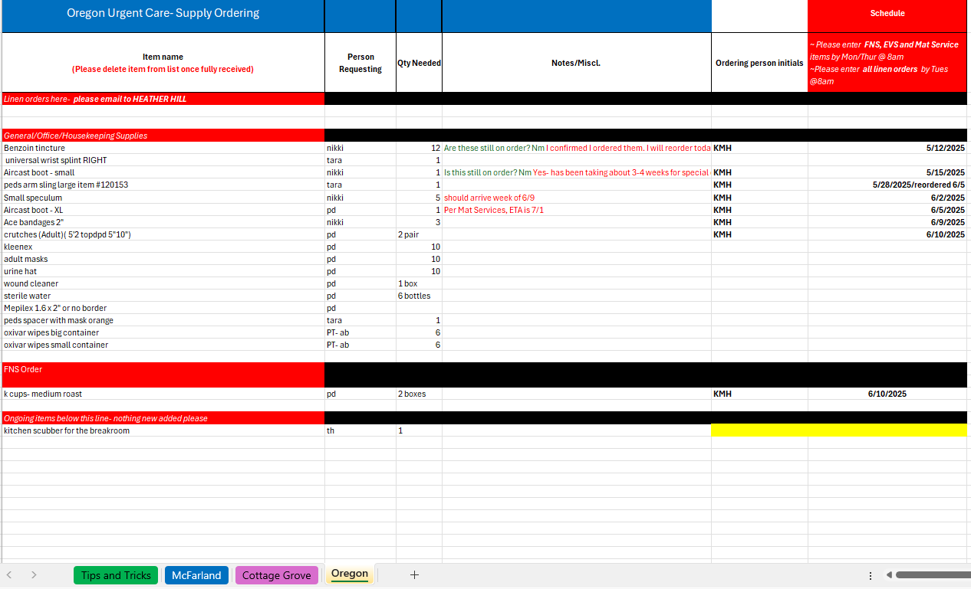
Measures:
STUDY
Include graphs of your measurement, results of surveys, etc. Include benchmarks or comparative data when available.
Stoplight measures will be provided at next QM cycle.

Slide 46
Findings:
ACT
Results: Did you accomplish your goals?
In progress
Lessons Learned: What did you learn as a result of this project? Unexpected discoveries? Problems or barriers?
Spreadsheet can be adopted in various settings. I have already been approached by two managers regarding the use of this sheet for their department.
Next Steps: What actions are you going to take in the next 60 days ?
Action: | Assigned To: | Due Date:
Develop and implement schedule of stocking and outdating, consistent with all 3 UCs | All UC staff, Kelly | 6/15; implement by 7/1
Contact remaining cleaning teams re: new process for requesting needed supplies at UC | Angie & Kelly | 7/1/25
Obtain all SAP items stocked at UC in the form of labels from Mat. Services. Compare with actual in stock items at all sites. | Dacia- labels Megan, Kim, Angie, Kelly- comparing | 8/1/25
Meet with Accounting and Mat Services Mgr to discuss PAR levels and cost savings (% decrease, per pt cost, etc.) | Dacia, Danielle, & Kelly | 8/1/25
Project Leader is Recommending the Following:
QM Council approval for completion of project?: Enter YES or NO Project still in progress, project to continue: Enter YES or NO

Slide 47
Laboratory
CAP Self – Inspection Follow-up
1st Presentation Date: 4.2025
Document Last Presented:4.2025

Slide 48
Quality Story:
PLAN
Lab CAP Self-Inspection Follow-up.
Goal(s): What are you trying to accomplish?
KOM Target: - Correct all deficiencies identified during the Laboratory CAP self inspection by July 1st 2025. A total of 17potential deficiencies were identified. Current KOM Status: 17 of 17 Currently completed.
Background: Explain what the original situation was. Why was a change recommended? (e.g. variation, poor outcome, etc.)
As part of the Laboratory’s accreditation with the College of American Pathologists (CAP) we are required to complete a self inspection every other year opposite our on-site survey and correct any deficiencies prior to that survey. The lab completed this self evaluation in January and February this year. A total of 18 possible deficiencies were identified for correction.
Driver: Explain why the project is critical to SH. Why does it relate to the strategic plan?
The standards are intended to help ensure quality of laboratory services in accordance with standards.
Team:
Project Leader: Kyle Sippel Members: Lab Staff and medical direction.

Slide 49
Changes:
DO
What? | Why? | When?
Self inspection was completed, and list of deficiencies was compiled. |  | Feb 2025
Addresses specific deficiencies individually – see Measure slide for deficiency specifics.

Slide 50
Measures:
STUDY
Include graphs of your measurement, results of surveys, etc. Include benchmarks or comparative data when available.
Deficiency | Completion |  | Deficiency | Completion
1. No record for pathologist visits and activities | Yes |  | 9. Current policy for sample labeling does not match our current practice | Yes
2. Director Approval for on call pathologists as clinical consultants | Yes |  | 10. Outpatient transfusion are not being sent home with instructions for RXNs. | Yes
3. No formal policy for pathology samples that do not need to be sent for pathology and which samples that can be done as microscopic only. | Yes |  | 11. Completed reactions forms need to be scanned into EPIC and procedure needs to reflect this. Or consider the on-line RXN procedure | Yes
4. No lot crossover procedures for non-waived kits. | Yes |  | 12. Thermometers in the Freezer are both located on the top. Need to look at both fridge and freezer for different temp zones. | Yes
5. No procedures to address scanning items into Epic and verification of the scan | Yes |  | 13. Unable to determine records of control establishment for new lots once archived | Yes
6. Patient ID procedures does not address hearing or speaking impaired, or language barriers. | Yes |  | 14. Unable to find documentation of corrective actions for lots that are archived. | Yes
7. No training for valets transporting specimens. | Yes |  | 15. Use of bright field microscopy, need to update CSF cell count from WBC to TNC. | Yes
9. Reagent package inserts are not always available. | Yes |  | 16 Not procedure for colter operations found | Yes
 |  |  | 17. ESR procedures not included what to do for interferences . | Yes

Slide 51
Findings:
ACT
Results: Did you accomplish your goals?
Yes All deficiencies corrected.
Lessons Learned: What did you learn as a result of this project? Unexpected discoveries? Problems or barriers?
No significant deficiencies identified related to patient safety or result quality. Most deficiencies are related to a minor variation from the CAP standard or situations where our policies does not match our practice and needs updating. No Significant challenges encountered.
Next Steps: What actions are you going to take based on your findings? (e.g. roll out to additional units; modify and make additional improvements; abandon the effort; change course?)
Project Leader is Recommending the Following:
QM Council approval for completion of project?: Enter Yes Project still in progress, project to continue: Enter NO

Slide 52
Sleep Lab
Succession Planning
1st Presentation Date: 8.2024
Document Last Presented: 4.2025

Slide 53
Quality Story:
PLAN
Sleep Center Succession Planning
Goal(s): What are you trying to accomplish?
KOM Target: Create a succession plan for all duties currently being performed by Dottie, and Star, (retiring staff) 4 main non-clinical tasks areas have been identified. Create a succession plan including necessary policy and procedures, plus identify who will be responsible and create a training plan with designated time to take over. Current KOM Status: 1 of the 4 identified areas has been completed.
Background: Explain what the original situation was. Why was a change recommended? (e.g. variation, poor outcome, etc.)
The sleep lab for years had 2 techs. These tech are responsible and have the knowledge and training for all departmental operations including patient and order management, regulatory compliance (AASM accreditation), supply management, and scheduling for example. Both staff have expressed the expectation to retire with the next couple years. 1 has given official notice of retirement upon completion of our regulatory re-accreditation with AASM in 2026. 2 new sleep tech have recently been hired but currently have minimal involvement in these non-clinical duties. At this point we do not have a specific plan for who will cover these non-clinic duties as well as overall staffing and coverages as they potentially reduce hours and fully retire. Additionally, the registration staff person who is responsible for scheduling and daytime communication with patients has also indicated the desire to retire in near future.
Driver: Explain why the project is critical to SH. Why does it relate to the strategic plan?
The project will ensure an orderly transition of all the non-clinical duties to newer staff. We will be able to ensure all tasks have been re-assigned and the new responsible persons have been properly trained. This will also help us to determine our specific needs related overall departmental staffing and the best way to replace the clinical hours and meet the needs of our patients. This project will also help to provide additional knowledge related to these operations and accreditation requirements for the non-sleep tech manager.
Team:
Project Leader: Kyle Sippel Members: Sleep Tech, Sarah Watkins, Registrations.

Slide 54
Changes:
DO
List the changes that have been made leading to improvements.
What? | Why? | When?
Tasks needing to be passed along were identified. 4 Specific tasks were identified. - Supply Management, policy management, AASM regulatory compliance, and Natus system management. |  | Nov and Dec 2024 - Ongoing
Staff continue to identify different tasks that are currently being completed that will need to be re-assigned. A logbook was created for these different tasks. | This log book will service as our actual succession plan as we progress though the process. | March 2025 – ongoing
Dottie has begun to provide detail and instructions in the logbook for each task to begin to create the basis for procedures. | It is necessary to create a specific SOP for these tasks to ensure things a delegated appropriately and new staff are trained. | March 2025 – ongoing
Staffing succession: Natalee our new ASTEP intern has begun her training in Sleep medicine. |  | March 2025 – Ongoing Goal for Certification – March 2026

Slide 55
Measures:
STUDY
Include graphs of your measurement, results of surveys, etc. Include benchmarks or comparative data when available.
Tasks identified requiring succession planning. ** Currently project task if focused on the staffing succession – Sleep Intern training.
Task | Lead | Responsible | Training TimeFrame | Status
Supply Management | Dottie | Emily | 2024 | Completed 2.2025
Policy Management | Dotttie/Star | Emily and Kyle | 2025 | Goal End of 2025
AASM Regulatory Compliance | Dottie | Emily | 2025-Jun 2026 | Goal June 2026 This will be developed and trained as we complete the 2026 re-certification process.
Natus Maintenance | Dottie | Emily | 2025 | Goal End of 2025
Sleep Intern | Dottie coordinator Other Trainers Star and Emily | Natalee | 2025-1st Qtr 2026 | Goal – Registry by March 2026

Slide 56
Findings:
ACT
Results: Did you accomplish your goals?
No
Lessons Learned: What did you learn as a result of this project? Unexpected discoveries? Problems or barriers?
Due to staffing and training needs, the project’s current focus was shifted to the staffing succession and training of our Sleep Intern Natalee. Natalee currently has approximately 250hrs out of the required 1000hrs of training to complete the ASTEP and be eligible for certification. At her current FTE – Estimated to complete required hours – April 2026. ASTEP allows Natalee to conduct her own studies along with and reviewed by a supervising registered tech. This tech can be scheduled their own patients simultaneously Beginning in July we will begin scheduling Natalee her own patient. It will be most efficient to carry out the succession plan implementation and training over the course of preparation for re-accreditation
Next Steps: What actions are you going to take based on your findings? (e.g. roll out to additional units; modify and make additional improvements; abandon the effort; change course?)
Action 1: Continue with Natalee’s training Assigned to: All sleep staff Due 4/2026 Action 2: Complete List of potential tasks with assignments Assigned to: Kyle and Dottie Due Aug 2025 Action 3: Develop the transition plan for those tasks to be completed in conjunction re-accreditation prep. Assigned to: Kyle and staff Due Aug 2025 (Plans created)
Project Leader is Recommending the Following:
QM Council approval for completion of project?: Enter NO Project still in progress, project to continue: Enter YES

Slide 57
Sleep Lab
Visitor Sleeping
1st Presentation Date: 2.2025
Document Last Presented: 2.2025

Slide 58
Quality Story:
PLAN
Sleep Center – Visitor Sleeping
Goal(s): What are you trying to accomplish?
KOM Target: Implementation of a new guest sleeping options by June 2025 – 4 steps on the project identified. Current KOM Status: 3 of the 4 steps completed.
Background: Explain what the original situation was. Why was a change recommended? (e.g. variation, poor outcome, etc.)
Many of our sleep studies require a parent or caregiver to stay over night with the patient. Sometimes that care giver can sleep in room2, but quite often there is patient that room or the age/situation requires the caregiver is in the room with the patient. Currently we have a roll-away bed that the caregiver will sleep on. This bed is quite old, and springs are starting to loosen. Additionally, it needs to have dedicated lined and needs to be maintained by EVS. We have been approached by EVS manager to see if we could look for an alternative option that would be easier time and physically to maintain. She stated that it is very low, and staff are having to bend over quite far to change linen and make up mattress which is causing some back discomfort.
Driver: Explain why the project is critical to SH. Why does it relate to the strategic plan?
The project would remove some repetitive low bending by EVS staff improving ergonomics and minimizing back strain.
Team:
Project Leader: Kyle Sippel Members: Angie Rowin – EVS, Sleep Staff, Dacia – Mat Services.

Slide 59
Changes:
DO
List the changes that have been made leading to improvements.
What? | Why? | When?
Sleep worked with Angie from EVS to discuss different options. Removable bed vs sleeping recliner. Staff evaluated a recliner option that we currently had in Day Surgery. The determined it would work well. | Determine the best options for the dept. A recliner options was felt best. | Dec 2024
Materials Services reviewed all options available under our Vizient contracts for a sleep recliner. A suitable options was not found under our contracts. |  | Feb-March 2025
Manufacture information was provided to Dacia regarding a chair in use in Day Surgery. Sleep is using this currently when patients need a recliner. She will be reaching out to them to acquire a quote and more information. |  | 4/3/2025
Reviewed options from multiple vendors both contracted and non. | Ensure we are getting the chair that we need but at the best price. | May 2025
Decision made on which options we are wanting to pursue, and Materials Service manager in final discussion with vendor to try and get best pricing. |  | May 2025

Slide 60
Measures:
STUDY
Include graphs of your measurement, results of surveys, etc. Include benchmarks or comparative data when available.
Task | Assigned to | Completed | Notes
Determine best options for guest sleeping arrangements for room 1 | Evs Manager and sleep staff | 12.2024 | Staff decided on a recliner option, similar to chair in day surgery.
Materials services to provided options with physical sample for staff to evaluate | Materials Services Manager | 5.2025 | * Could not find a good options from a Vizient contract. Looking into the manufacture of the DS chair.
Staff to select the appropriate chair model | Sleep staff and Materials Services Manager | May 2025 | Chair should be able to sleep guest as well as to perform a sleep study for patients who only sleep in a recliner. Decision was made end of May which chair staff would like. Dacia completing final negations with vendor.
Chair to be purchased and installed.

Slide 61
Findings:
ACT
Results: Did you accomplish your goals?
No 3 of the 4 steps completed
Lessons Learned: What did you learn as a result of this project? Unexpected discoveries? Problems or barriers?
Could not find a good options from a Vizent contract. 2 different Vizient vendors evaluated and only one could provide options we wanted. That vendor would not provide a sample for review and no return policy creating some purchase risk. Staff recommend the DS chair (Vendor ISO) as the best option. The chair staff wanted came in above the $5000 capitol mark and will need Admin approval.
Next Steps: What actions are you going to take based on your findings? (e.g. roll out to additional units; modify and make additional improvements; abandon the effort; change course?)
Action 1: Get a final quote from ISO on the chair Assigned to: Dacia Due by 6/17/2025 Action 2: Submit SBAR and request to Admin Council Assigned to: Kyle Due by 6/17/2025 Action 3: If Approved: Submit PO to vendor and purchase Assigned to : Kyle and Dacia Due by 6/27/25
Project Leader is Recommending the Following:
QM Council approval for completion of project?: Enter NO Project still in progress, project to continue: Enter YES

Slide 62
Plant Operations
New Employee Orientation Competency checklist
1st Presentation Date:2-14-2025
Document Last Presented:4-2-2025

Slide 63
Quality Story:
PLAN
Employee Orientation Competency checklist
Goal(s): What are you trying to accomplish?
KOM Target: Implement an improved new employee orientation competency checklist by December 2025. Current KOM Status: 20% completed
Background: Explain what the original situation was. Why was a change recommended? (e.g. variation, poor outcome, etc.)
Help new employees understand the systems that operate within the building. For new employee orientation, we will separate building systems by years they were built so training will include building systems that operate inside that building partition including Life Safety systems, electrical, plumbing and Security. This separation will help new employees understand the building systems that operate within the building envelope. Our plan is to break this up into building sections which will give us time to break down and report each section as we progress to the 100% goal.
Driver: Explain why the project is critical to SH. Why does it relate to the strategic plan?
Having new Plant Operations staff understand the facility faster will promote longevity and improve their confidence with Maintenance & Security.
Team: Rob Maurer and Jason Schoville
Project Leader: Jason Schoville and Rob Maurer Members: Current Plant Operations Staff

Slide 64
Changes:
DO
List the changes that have been made leading to improvements.
What? | Why? | When?
Kickoff meeting to review project needs and determine schedule. | To bring the team together to share project goals, identify opportunities and discuss next steps. | February 12, 2025
Revise check list by building section/year built | Training will include building systems that operate inside that building partition including Life Safety systems, electrical, plumbing and Security. This will make it easier for training purposes as it can be confusing when its not separated out. | 1956 building – April 2025 1975/1995 – TBD SHOC - TBD Offsite locations – TBD
1956 Orientation Competency Checklist. | Deliverable for April QM meeting | April 2, 2025, completion date
1975 Orientation Competency checklist | Deliverable for June QM meeting | June 12, 2025, completion date
Introduction to the department | Deliverable for August QM meeting

Slide 65
Measures:
STUDY
Current Orientation checklist
New Employee Orientation Competancy Checklist
1975 Building | Training Date | Initials of Trainer
Lower Level
240Kw Cat Generator
Chiller
AHU 6 Return
Water Heaters
75 Electrical Main Panel Distribution
Kitchen dishwasher Boiler
75 Radiant heat loop
Brivo Panel
Diesel Fuel capacity monitor
RO system
Kitchen Gas shut-off
Elevator B equipment room/Reset procedure
Fire Alarm Control panel training
Fire procedures-Process when alarm goes off
Smoke detectors/Duct Detectors/Heat Detectors/Pull Stations
Disable/Enable points on Fire alarm control panel
Softener System-also feeds boiler
Medical Vacuum
Medical Air
75 Air Compressor-ties to 95
Medical Gas Storage Room
IT ClosetEmergency Phone Switches
1st floor
Med Flight duties and night time ground lights
Medical Imaging/MRI Suite
MRI Suite Code
MRI Equipment room
2nd Floor
OR Suite
Sterile Processing Dept./OR Suite
Old Cardio Rehab space
Rauland Nurse call system-OR Managers office
Door Codes
75 Roof
75 Penthouse
AHU 6 Supply
AHU 7 and condenser
AHU-8
Chiller Condenser
Trainers Printed Name |  | Trainers Initials
New Employee Printed name |  | Date
New Employee signed name

Slide 66
Findings:
ACT
Results: Did you accomplish your goals?
Yes, we completed the first step in renovating the orientation checklist
Lessons Learned: What did you learn as a result of this project? Unexpected discoveries? Problems or barriers?
We found that we will need to add an additional separate pages for Life Safety, Security and Clinics. Life safety was implemented within the building separations, and we needed to create a department introduction page that covered the basics of the department.
Next Steps: What actions are you going to take based on your findings? (e.g. roll out to additional units; modify and make additional improvements; abandon the effort; change course?) Who is responsible? When is action due?
Action 1: Revise checklist for 1956 building Assigned to: Jason and Rob Due By: 04/2025 Action 2: Checklist for 1975 building Assigned to: Jason and Rob Due By: 06/2025 Action 3: Introduction to department Assigned to: Jason and Rob Due By: 08/2025
Project Leader is Recommending the Following:
QM Council approval for completion of project?: Enter YES or NO Project still in progress, project to continue: Enter YES or NO

Slide 67
Plant Operations
SHOC-Monthly compliance asset management
1st Presentation Date:4-22-2025
Document Last Presented:

Slide 68
Quality Story:
PLAN
SHOC-Monthly Compliance and asset mgmt.
Goal(s): What are you trying to accomplish?
KOM Target: Adding all monthly compliance assets to the Facility One smart print while creating Preventative Maintenance work orders to ensure compliance is being met Current KOM Status: 20% Complete
Background: Explain what the original situation was. Why was a change recommended? (e.g. variation, poor outcome, etc.)
New building, fresh start to ensure monthly compliance tasks are completed by NFPA code. Paperwork for the fire extinguishers is completed but having the assets on the print helps Plant Operations locate device faster.
Driver: Explain why the project is critical to SH. Why does it relate to the strategic plan?
To inhibit any infractions from DNV regarding the SHOC building and to build an asset management system identical to what was accomplished at the Main Hospital building.
Team:
Project Leader: Rob Maurer, Jason Schoville Members: Plant Operations Team

Slide 69
Changes:
DO
List the changes that have been made leading to improvements.
What? | Why? | When?
CAD drawings sent to Facility One | Adding information to Smart-Print | 1-16-2025
Reached out to EUA for better CAD drawing | Found the lower-level print was missing valuable information. | 2-21-2025
Roof, 1st floor SHOC added to Smart-print | Met with Facility One Client Manager. | 3-1-2025
Lower-level CAD drawing issue | Facility One CAD designers readjusting CAD print to align with current building | 3-17-2025
Lower-level CAD drawing completed by F1 designers | Multiple issues corrected. | 4-11-2025
Lower-level imported into SH Facility One program | Final step in starting project. | 4-11-2025
Added Fire Extinguishers to smart print-Created PM | To stay with in NFPA compliance. | 6-1-2025

Slide 70
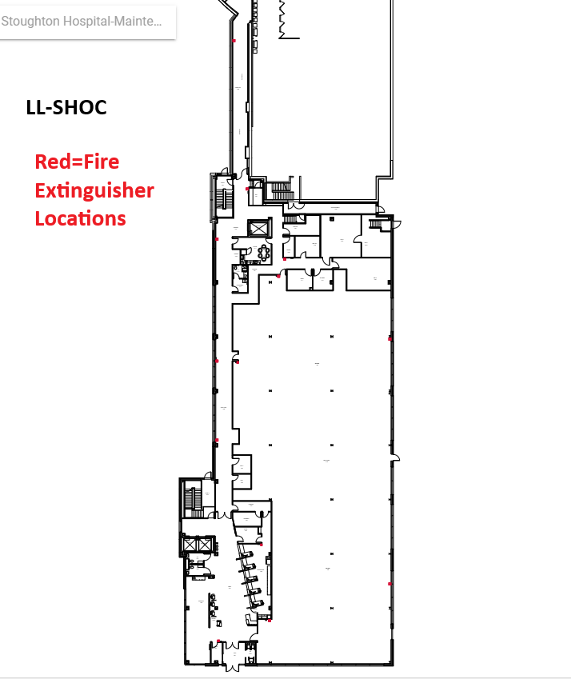
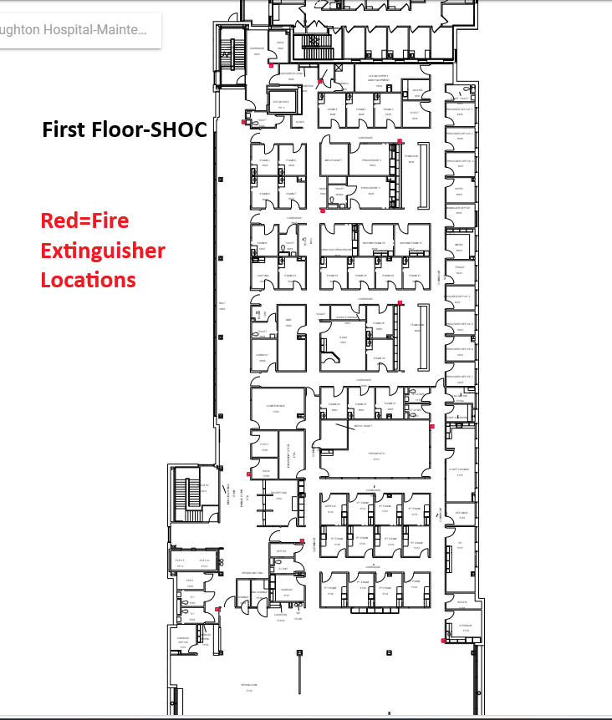
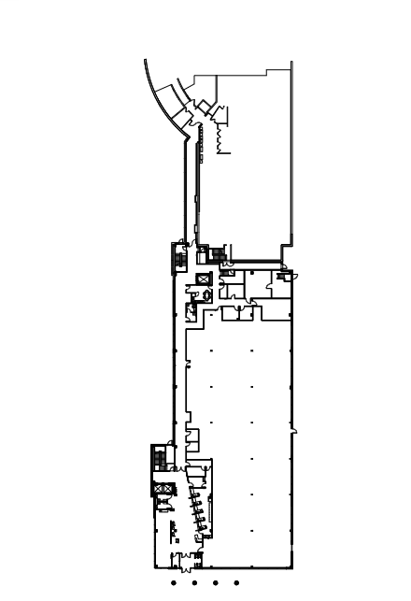
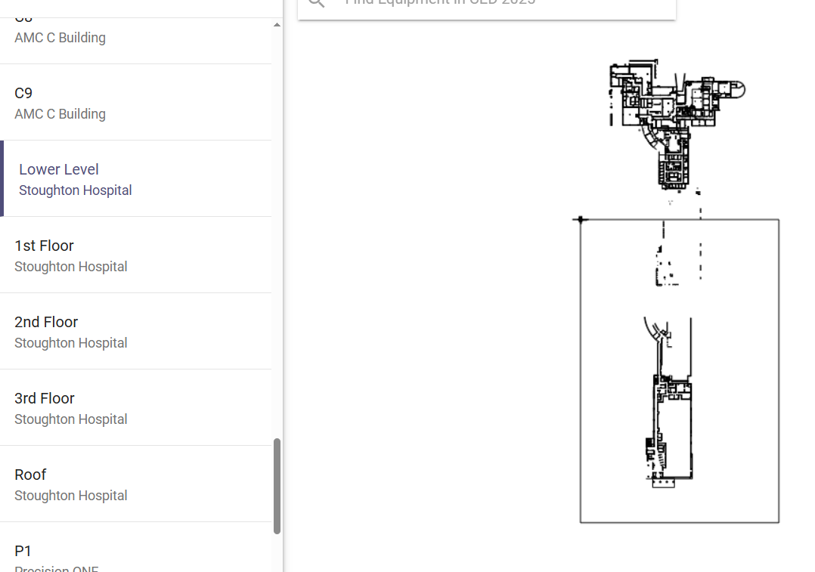
Measures:
STUDY
Include graphs of your measurement, results of surveys, etc. Include benchmarks or comparative data when available.
Issues with drawing
Cleaned up version of
drawing

Slide 71
Findings:
ACT
Results: Did you accomplish your goals?
Project is underway
Lessons Learned: What did you learn as a result of this project? Unexpected discoveries? Problems or barriers?
Having correct CAD drawings from EUA would have simplified this process. I have a CAD program to view but do not have the ability to edit or clean up the drawing. Relying on other professionals to complete the task at hand became problematic.
Next Steps: What actions are you going to take based on your findings? (e.g. roll out to additional units; modify and make additional improvements; abandon the effort; change course?) Who is responsible? When is action due?
Action 1: Add fire extinguishers-Create PM Assigned to: Rob Maurer Due By: 6-1-25 Action 2: Add Emergency Lights (EML)-Create PM Assigned to: Rob Maurer Due By: 8-1-25 Action 3: Assigned to: Due By:
Project Leader is Recommending the Following:
QM Council approval for completion of project?: Enter YES or NO Project still in progress, project to continue: Enter YES or NO

Slide 72
Medical Imaging
New Employee On-boarding
1st Presentation Date: 4/22/2025
Document Last Presented:6/24/2025

Slide 73
Quality Story:
PLAN
New Employee On-boarding
Goal(s): What are you trying to accomplish?
KOM Target: Review and Improve New Employee Onboarding by 7/15/2025. (5 phases to completion) Current KOM Status: Phase 1- in progress
Background: Explain what the original situation was. Why was a change recommended? (e.g. variation, poor outcome, etc.)
Onboarding plays a crucial role in employee retention. A strong onboarding program sets a positive first impression, smooth transition for new staff, familiarization with processes, resources and the culture of the organization. This leads to staff feeling valued and correlates with lower turnover rates.
Driver: Explain why the project is critical to SH. Why does it relate to the strategic plan?
New employee retention is tied to proper onboarding and training. Having a standardized onboarding process can increase retention as well as satisfaction in the workplace. This supports our People standard at Stoughton Health.
Team:
Project Leader: Sara Sturmer Members: Medical Imaging Staff

Slide 74
Changes:
List the changes that have been made leading to improvements that occurred in the last 60 days.
DO
What? | Why? | When?
Collect existing documents for review. | Initiate review to identify opportunities | April 2025
Review of checklists on-going | Due to staffing challenges, CV PACS go-live, and SHOC go-live slow start to project review. | May / June 2025

Slide 75
Measures:
STUDY
Include graphs of your measurement, results of surveys, etc. Include benchmarks or comparative data when available.
Phase 1
Review and update existing New Employee Checklists
Validate checklists available for each location, job description, and for contracted agency.
Phase 2
Review and update existing Orientation Training Checklist by job description. Clarify instructions and condense, if necessary.
Phase 5
Share on-boarding process with employees and implement consistency with new employees.
Phase 3
Phase 4
Update existing New Employee Welcome Letter to include 1st week employment schedule and future training expectations.
Provide to new employee Friday prior to orientation and email HR copy.
Improve Orientation Binder with updated forms, relevant documents including those above for training new employee.
Involve new and past employees in review of items on checklist to ensure understanding and accuracy.

Slide 76
Findings:
ACT
Results: Did you accomplish your goals?
New project, just getting started.
Lessons Learned: What did you learn as a result of this project? Unexpected discoveries? Problems or barriers?
We have a system that needs a little tweaking to improve organization and clarity.
Next Steps: What actions are you going to take in the next 60 days ?
Action: | Assigned To: | Due Date:
Review checklist | Sara | 7/01/2025
Meet with employees | Sara | 7/15/2025
Project Leader is Recommending the Following:
QM Council approval for completion of project?: Enter YES or NO Project still in progress, project to continue: Enter YES or NO

Slide 77
Registration
Ortho Surgery Scheduling
1st Presentation Date: 02/25/2025
Document Last Presented:06/24/2025

Slide 78
Quality Story:
PLAN
Ortho Surgery Scheduling
Goal(s): What are you trying to accomplish?
Our goal is to transition the scheduling of appointments that accompany an orthopedic surgical procedure from the Ortho nurse to the scheduling team. KOM Target: Implementation of Scheduling Appointments following Surgical Scheduling. Current KOM Status: Planning of the project (Step 2/5)
Background: Explain what the original situation was. Why was a change recommended? (e.g. variation, poor outcome, etc.)
Currently the Ortho Nurse schedules approximately 4 appointments with every surgical case. We have 440 Orthopedic surgical cases budgeted for 2025, this means in today’s flow Kristin is scheduling roughly 1760 appointments.
Driver: Explain why the project is critical to SH. Why does it relate to the strategic plan?
To give more time back to the Orthopedic nurse to focus on patient care and support the clinic. There is also an opportunity to schedule additional visits, like therapy visits at the time of the initial scheduling, thus reducing touches.
Team:
Project Leader: Jennifer Bothum Members: Kristin Brickl, Nic Kvamme, Jo Deen Hettenbach, Sarah Watkins

Slide 79
Changes:
DO
What? | Why? | When?
Protocol Transfer | RN uses smart phrases in EPIC, transferring from EPIC for Reference | April
Protocol Grid Creation | Transferring protocol to Grid for Schedulers to reference | May/June
Scheduled Meetings with Ortho RN | Review Notes, confirm correct information in Grid | June

Slide 80
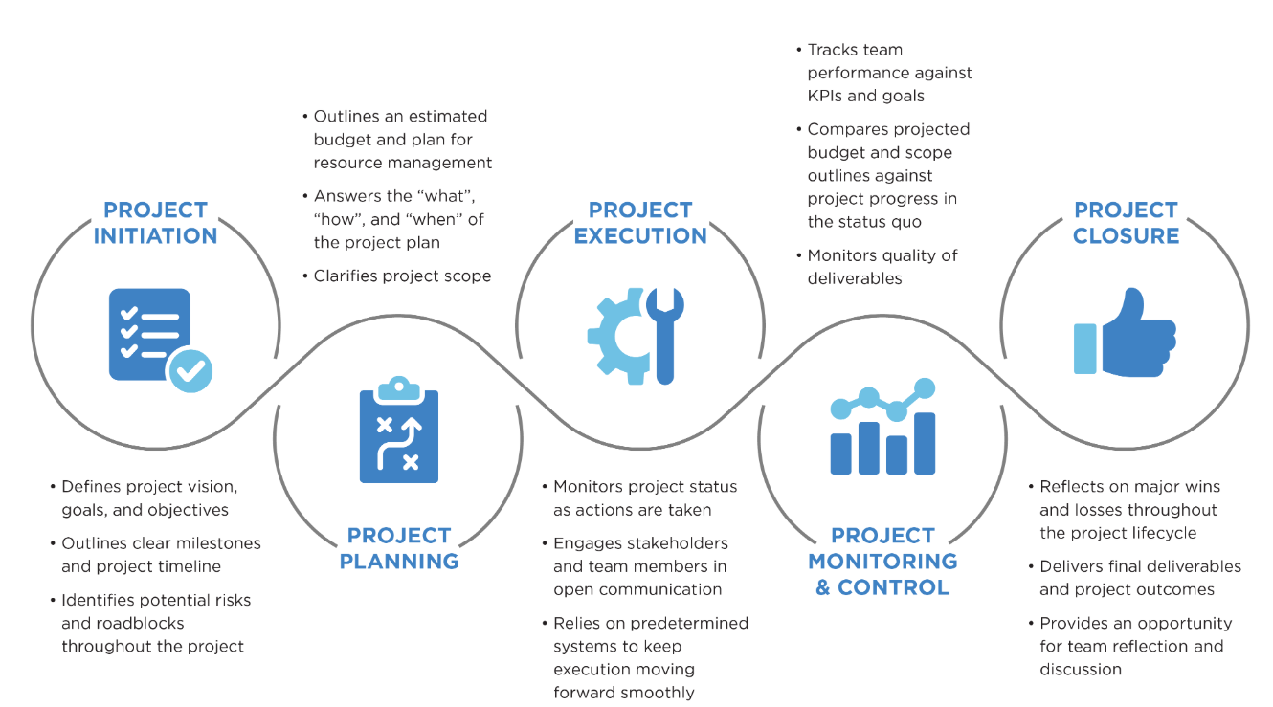
Measures:
STUDY

Slide 81
Findings:
ACT
Results: Did you accomplish your goals?
No, it’s still a work in progress
Lessons Learned: What did you learn as a result of this project? Unexpected discoveries? Problems or barriers?
Probably should have settled into SHOC first before tackling this project RN has a lot of information and knowledge in her head
Next Steps: What actions are you going to take in the next 60 days ?
Action: | Assigned To: | Due Date:
Documenting all scheduling protocols in grid | Jennifer | July 15, 2025
Ensure there is documented protocols for the most common procedures | Jennifer | July 15, 2025
Training and documenting flows | Jennifer/Kristin | August 15, 2025
Project Leader is Recommending the Following:
QM Council approval for completion of project?: No Project still in progress, project to continue: Yes

Slide 82
HIM
New Employee Onboarding
1st Presentation Date: 2/25/2025
Document Last Presented: 6/24/2025

Slide 83
Quality Story:
PLAN
New Employee Onboarding
Goal(s): What are you trying to accomplish?
KOM Target: Improving the onboarding process by 09/2025. Current KOM Status: Step 2/5 Completion
Background: Explain what the original situation was. Why was a change recommended? (e.g. variation, poor outcome, etc.)
All departments were asked to evaluate our onboarding process. The hospital-wide turnover for new employees in January 2025 was 13.61%
Driver: Explain why the project is critical to SH. Why does it relate to the strategic plan?
Onboarding can play an important role in retaining new hires. A formal onboarding process helps set up your employees for success. It should include orientation, any necessary materials, meetings with stakeholders, shadowing and training, and an ongoing mentorship. We added a new position to the Revenue Cycle to specifically focus on onboarding.
Team:
Project Leader: Sarah Watkins, Victoria Valdez Members: Bev Pope

Slide 84
Changes:
DO
What? | Why? | When?
Recurrent Meetings with Bev | To coordinate training schedules for our new employees | Ongoing
Met with Bev and Sarah | To review onboarding checklist for new hire | May 2025
Met with Bev and Sarah | To review onboarding schedule for new hire | June 2025

Slide 85
Measures:
STUDY
Action Item | Completion | Completed
Initiation | Completed | January 2025
Planning | Completed | 3/4/2025
Execution | In Progress
Monitor and Control
Closure

Slide 86
Findings:
ACT
Results: Did you accomplish your goals?
No
Lessons Learned: What did you learn as a result of this project? Unexpected discoveries? Problems or barriers?
Staff feedback is invaluable
Action: | Assigned To: | Due Date:
Execution/Implementation – as soon as new coder starts | Victoria | June/July 2025
Monitor and Control – complete 30-day check-in with new coder to solicit feedback on ‘what went well’ and ‘what didn’t go well’ | Victoria | July/August 2025
Project Leader is Recommending the Following:
QM Council approval for completion of project?: No Project still in progress, project to continue: Yes

Slide 87
HIM
HIM Department Coding Policy Review
1st Presentation Date: 2/25/2025
Document Last Presented: 6/24/2025

Slide 88
Quality Story:
PLAN
HIM Department Coding Policy and Procedures
Goal(s): What are you trying to accomplish?
KOM Target: Completion of coding policy reviews and updates by August 26, 2025 Current KOM Status: 80% completion
Background: Explain what the original situation was. Why was a change recommended? (e.g. variation, poor outcome, etc.)
Coding department policies did not have a schedule for reviews/updates. This project will get them current and moved into the policy and procedure manual in SharePoint. This will keep everyone on the same page to ensure consistency, have policies reviewed annually, and keep current with coding and workflow updates.
Driver: Explain why the project is critical to SH. Why does it relate to the strategic plan?
There isn’t a schedule keeping coding policies on an annual review schedule to be compliant.
Team:
Project Leader: Victoria Valdez Members: Coding Department

Slide 89
Changes:
DO
What? | Why? | When?
Gathering policies | Understanding of the work that needs to be done-so I can measure progress | January-May
Met with Addy | To learn the P&P publishing process | 3/11/2025
Review and draft policies UC/ED facility P&P drafted Day surgery Telehealth CAH/IP Ortho clinic Outpatient diagnostic Cardiology Podiatry/wound General surgery Series accounts Urology Waiting WQ Failed simple visits Combined accounts Cancer Registry, in process | To ensure they are current and compliant | Began in March, ongoing

Slide 90
Measures:
STUDY
Department Policy | Reviewed | Drafted | Published
UC/ED Facility Leveling | Yes | Yes | No
Clinic Facility E/M | Yes | Yes | No
Ortho Clinic | Yes | Yes
Outpatient Diagnostic | Yes | Yes
Cardiology | Yes | Yes
Podiatry/Wound Clinic | Yes | Yes
General Surgery | Yes | Yes
Series Accounts | Yes | Yes
Day Surgery | Yes | Yes | No
Observation | Yes | Yes
CAH-IP | Yes | Yes
Urology | Yes | Yes
Accounts in Waiting | Yes | Yes
Failed Simple Visits | Yes | Yes
Combined Accounts | Yes | Yes
Claim Edits
Cancer Registry | In process
Retail Services
Labs not meeting medical necessity
Denials
Telehealth | Yes | Yes

Slide 91
Findings:
ACT
Results: Did you accomplish your goals?
No
Lessons Learned: What did you learn as a result of this project? Unexpected discoveries? Problems or barriers?
Reaching out to my team to review drafts has a lot of value-they know the screens and the flow best Don’t try to draft several policies into one day😵‍💫
Next Steps: What actions are you going to take based on your findings? (e.g. roll out to additional units; modify and make additional improvements; abandon the effort; change course?)
What | Who | When
Draft remaining policies | Victoria | By June 30th
Begin publishing policies | Victoria | July 1st
Use published policies to train staff | Victoria | Beginning July 1st
Project Leader is Recommending the Following:
QM Council approval for completion of project?: No Project still in progress, project to continue: Yes

Slide 92
Patient Financial Services
Self-Administered Drugs Analysis
1st Presentation Date:4/22/2025
Document Last Presented:6/24/2025

Slide 93
Quality Story:
PLAN
Self-Administered Drugs Analysis
Goal(s): What are you trying to accomplish?
KOM Target: Maximize Revenue when billing Self-Administered Drugs by 08/26/2025. Current KOM Status: In progress, review 100% Complete
Background: Explain what the original situation was. Why was a change recommended? (e.g. variation, poor outcome, etc.)
Self-administered drugs are defined as medications that can be prescribed by a provider and taken at home. These are billed under Revenue Code 637 when acquired for and given to the patient while at Stoughton Health. Payers typically do not cover these charges, so we write them off.
Driver: Explain why the project is critical to SH. Why does it relate to the strategic plan?
Some of these drugs can be expensive, so it’s a good opportunity to review to ensure most appropriate coding/billing. Also, billing rules and industry standards are ever changing.
Team:
Project Leader: Jordan Sweeney Members: Billing Department, Pauline Cass, Sarah Watkins

Slide 94
Changes:
List the changes that have been made leading to improvements that occurred in the last 60 days.
DO
What? | Why? | When?
Completed reviewing the report of all self-administered drugs written off in FY2024. | Gather information/volume/cost | May 2025
Consulted with PARA | Revenue Cycle consultants to assist with research | June 2025
Met with Sarah Watkins | Review findings | Monthly
Scheduled bi-annual rx file review for new drug analysis | Review for potential revenue and billing updates | June 2025

Slide 95
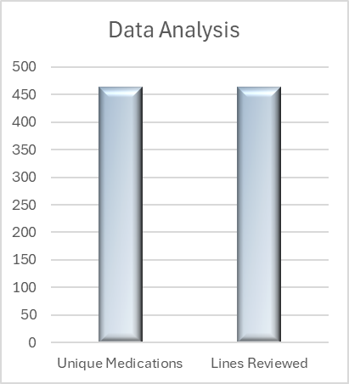
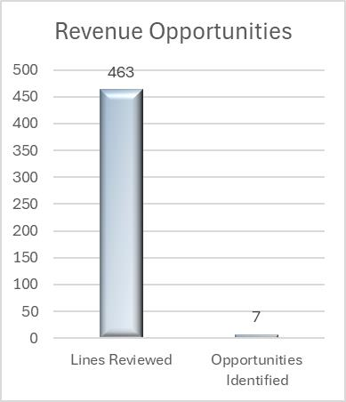
Measures:
STUDY
Data Analysis
463 unique medications
463 lines reviewed
100% Complete
Revenue Opportunities
463 lines reviewed
7 / 1.5% potential opportunities identified

Slide 96
Findings:
ACT
Results: Did you accomplish your goals?
No, I have not completed my goal.
Lessons Learned: What did you learn as a result of this project? Unexpected discoveries? Problems or barriers?
Payer policies and industry standards are ever changing The same medication can be billed a number of ways (dosage/method of admin)
Next Steps: What actions are you going to take in the next 60 days ?
Action: | Assigned To: | Due Date:
Review PARA analysis | Jordan | June 2025
Additional tickets as needed | Jordan | June 2025
Review claims once ticket is worked | Jordan | June-July 2025
Project Leader is Recommending the Following:
QM Council approval for completion of project?:NO Project still in progress, project to continue: YES

Slide 97
Anesthesia
Controlled Substance Documentation
1st Presentation Date: June 25, 2024
Document Last Presented: June 27, 2025

Slide 98
Quality Story:
PLAN
Controlled Substance Documentation
Goal(s): What are you trying to accomplish?
KOM Target: 0-1 Waste discrepancies per month and maintained for a minimum of 6 months to ensure hardwiring 0 Administration Discrepancies per month and maintained for a minimum of 6 months to ensure hardwiring Current KOM Status: Waste Discrepancies Unmet: (see graphs) for past 2 months: April 6, May 1 Administration Discrepancies Met: 0 for past 2 months
Background: Explain what the original situation was. Why was a change recommended? (e.g. variation, poor outcome, etc.)
Organizations using controlled substances must have policies and procedures in place for disposing of these substances and to avoid potential drug diversion as well as environmental pollution. Facilities must maintain adequate and detailed records, but individual healthcare systems impose their own specific requirements. Some, for example, require drug disposal to be witnessed. However, recordkeeping systems must be robust and frequently audited to prevent diversion. Navigating this system can be complex, and since all regulations are subject to change, it requires vigilance and expertise.
Driver: Explain why the project is critical to SH. Why does it relate to the strategic plan?
Quality/Safety and Financial: The consequences of poor or lax monitoring can be significant. In addition to risk of patient and employee harm, fines of up to $10,000 per violation can be levied against facilities that are judged to have lapses in accountability.
Team:
Project Leader: Amy Hermes and Deb Dahlke Members: CRNA Team

Slide 99
Changes:
DO
List the changes that have been made leading to improvements.
What? | Why? | When?
Review of April and May discrepancies and SZP reports from team. | To identify trending and barriers. Involved 3 different providers and one student. | June 9, 2025
Issues identified | (3)Forgot to chart a dose that was given, so waste documentation was off Critical patient requiring multiple medications simultaneously and extensive documentation, forgot to chart a dose (2) Multiple logins to review documentation | June 9, 2025
Continuing to research cost for Epic alerts reminding them, they still had waste to document | Looking into this option for Stoughton to help with human factor of forgetting. | June-July, 2025 (budget for FY 2026)

Slide 100
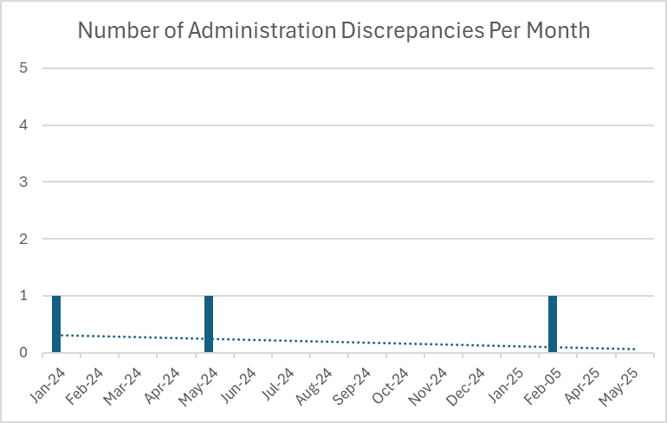
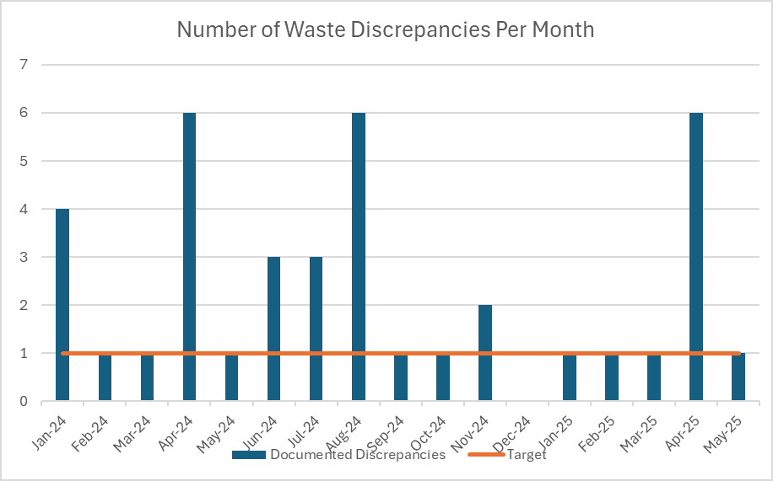
Measures:
STUDY
Include graphs of your measurement, results of surveys, etc. Include benchmarks or comparative data when available.

Slide 101
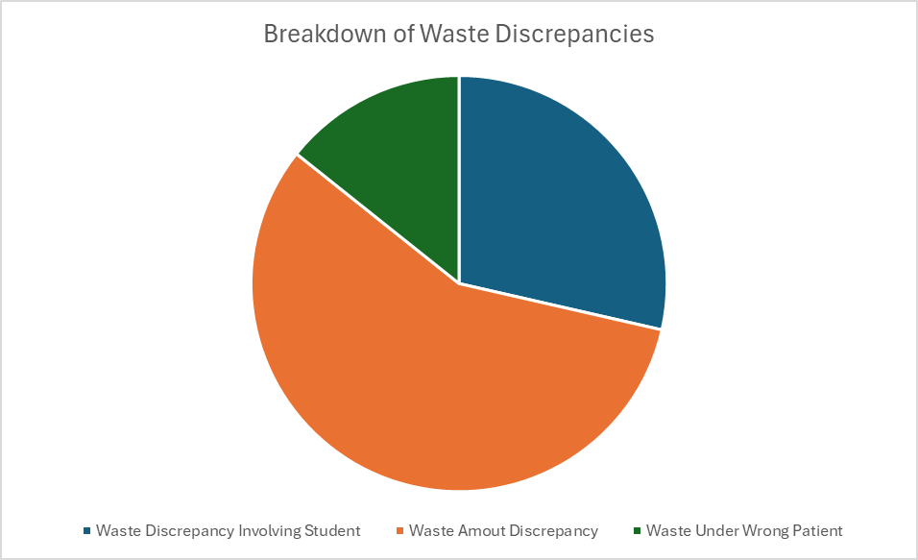
Measures:
STUDY
Include graphs of your measurement, results of surveys, etc. Include benchmarks or comparative data when available.

Slide 102
Findings:
ACT
Results: Did you accomplish your goals?
No
Lessons Learned: What did you learn as a result of this project? Unexpected discoveries? Problems or barriers?
All waste was documented, however discrepancy resulted in the amount wasted. CRNAs are titrating medications given throughout the surgical cases, which can result in ending waste being off at the end of the case. A SRNA was involved in 2 cases.
Next Steps: What actions are you going to take in the next 60 days ?
Action: | Assigned To: | Due Date:
April and May information shared with Lead CRNA. | Amy Hermes | June 9, 2025
Working with Epic to determine pricing for interface that would alert CRNAs to complete documentation (used at SSM with almost 100% accuracy) | Amy Hermes | July 18, 2025
Project Leader is Recommending the Following:
QM Council approval for completion of project?: No Project still in progress, project to continue: Yes

Slide 103
Stoughton Health Leadership Team
DVC Score-Satisfaction Domain
1st Presentation Date: June 25, 2024
Document Last Presented: June 24, 2025

Slide 104
Quality Story:
PLAN
DVC Score – Satisfaction Domain
Goal(s): What are you trying to accomplish?
KOM Target: Satisfaction Domain Max Performance Score 20% Current KOM Status: November DVC Scorecard (timeframe July1, 2023-June 30, 2024) currently at 17.5% We are currently above 3 of the 4 goals in the Satisfaction Domain. Improvement was noted in the Satisfaction with Discharge instructions (89%-91% ) Goal is 94%.
Background: Explain what the original situation was. Why was a change recommended? (e.g. variation, poor outcome, etc.)
The Dean Value-based Contract (DVC) is a written contractual arrangement in which the payment for health care goods and services is tied to predetermined, mutually agreed upon terms that are based on clinical circumstances, patient outcomes, and other specified measures of the appropriateness and effectiveness of the services rendered. It identifies a set of outcomes, mutually recognized by payors and specifies a formula that determines the net price to be reimbursed for goods and services rendered. The measures being monitored are Quality (various infection rates), Satisfaction ( rank your hospital high, provider and nurse communication, discharge instructions), Efficiency (30day readmissions, 1 day hospital stays.
Driver: Explain why the project is critical to SH. Why does it relate to the strategic plan?
The drivers for this QM is overall achieving the patient satisfaction and loyalty evident by the HCAHPs score. Given reimbursement from Dean tied to the patient satisfaction measures under the Satisfaction Domain, the other driver of this QM is financial. We want to be able to achieve high satisfaction/loyalty along with receiving the highest rate for performance.
Team:
Project Leader: Amy Hermes Members: Patient Care Leader Team (Heather Kleinbrook, Pauline Cass, Dr. Menet, Jen Wagner, others as identified)

Slide 105
Changes:
DO
List the changes that have been made leading to improvements.
What? | Why? | When?
Continuing to meet monthly to review data and discuss any changes/barriers | Metrics for our DVC payments are lagging. So important to ensure that we are monitoring on an ongoing basis. | Last met April 2025
Responsiveness of hospital staff | This question was noted to be lower in February. Although not part of this QM, Amy will be following up on the questions that roll up under this section to report off at next HCAPS meeting. There were changes made to the questions that rolled out to this overall metric. How often did you get help in getting to the bathroom or in using the bedpan as soon as you wanted? During this hospital stay, when you asked for help right away, how often did you get help as soon as you needed? | Ongoing monitoring.
Discharge Folders | These were rolled out on March 1. RNs involved in this process working on monitoring for staff compliance. | Ongoing.
Follow Up Phone Calls | CM team is completing follow up phone calls on all inpatients, assessing perception of discharge process and thoughts for improvements. | Ongoing.

Slide 106
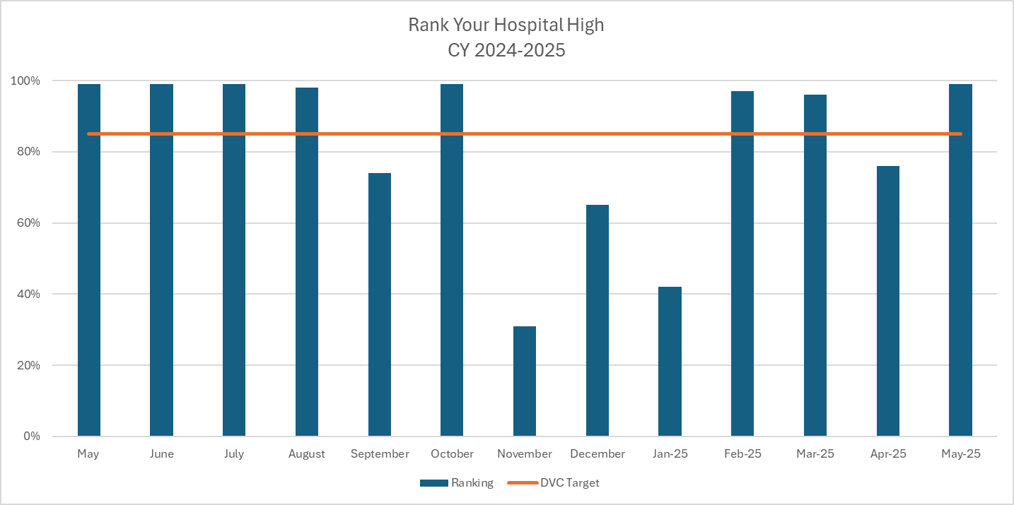
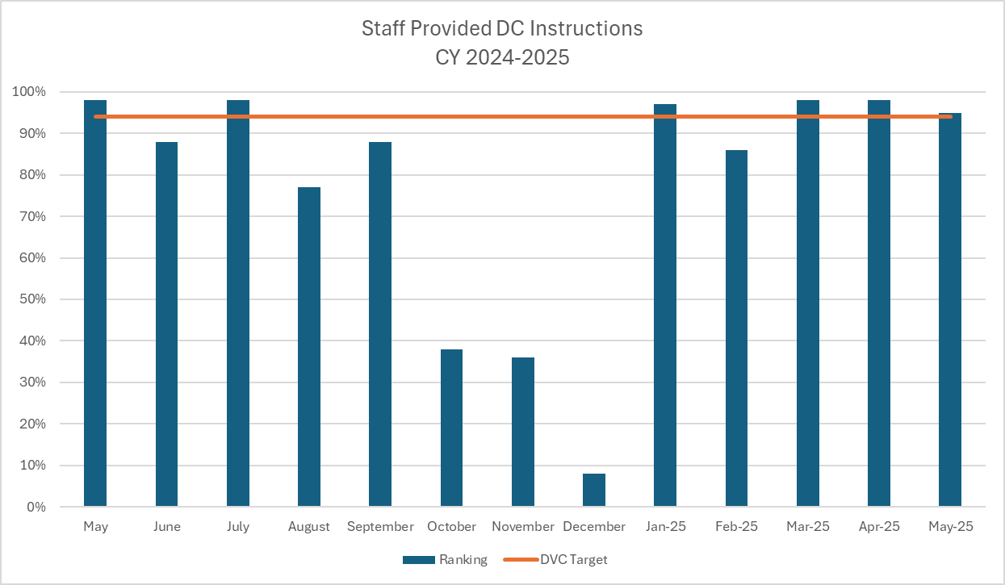
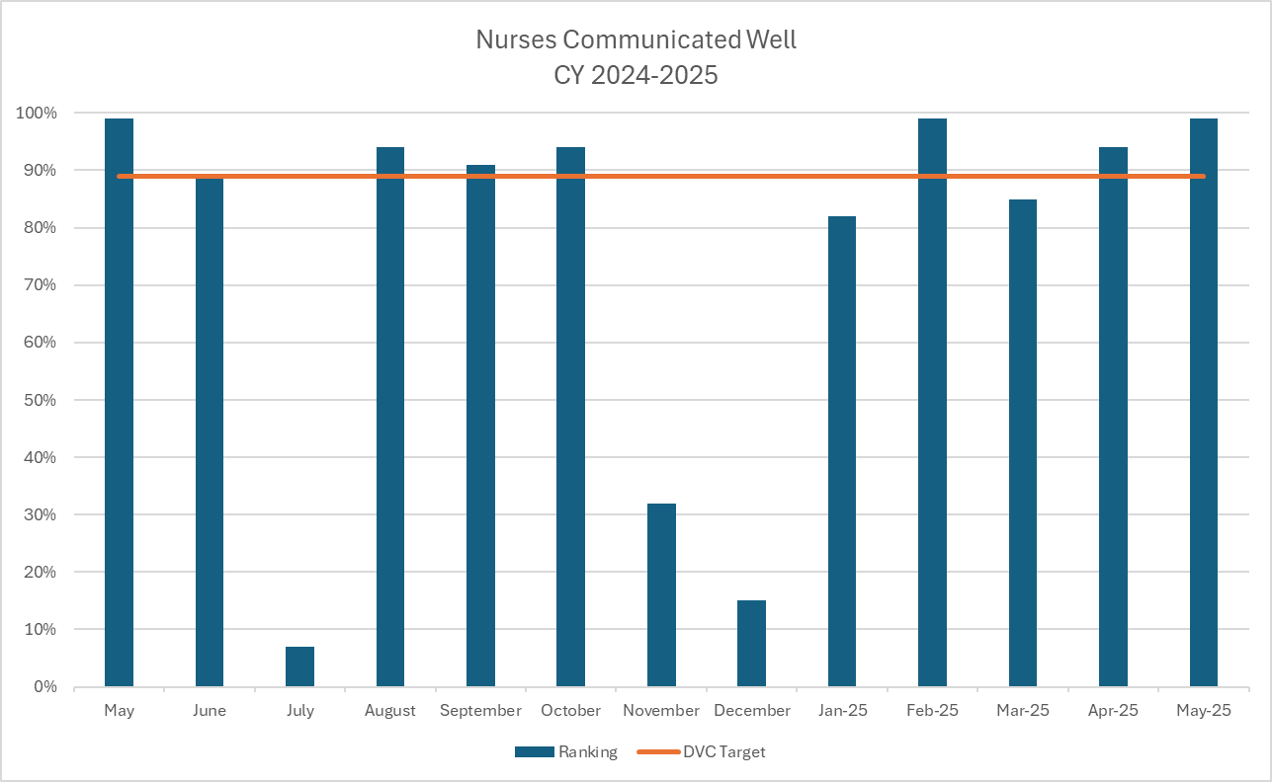
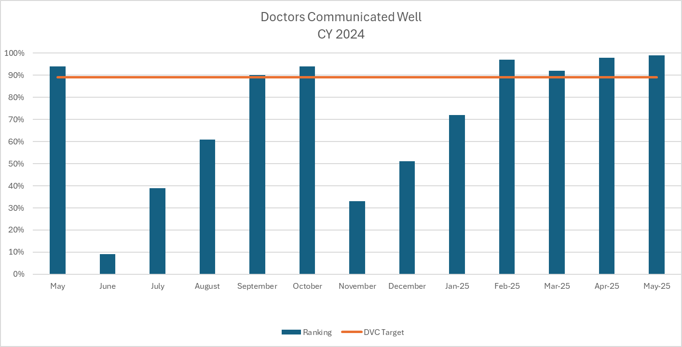
Measures: Graphs represent CY2024 and CY 2025
STUDY
Current DVC Ranking 99%
Goal 85%
Current DVC Ranking 95% Goal 94%
Current DVC Ranking 99%
Goal 89%
Current DVC Ranking 99% Goal 89%

Slide 107
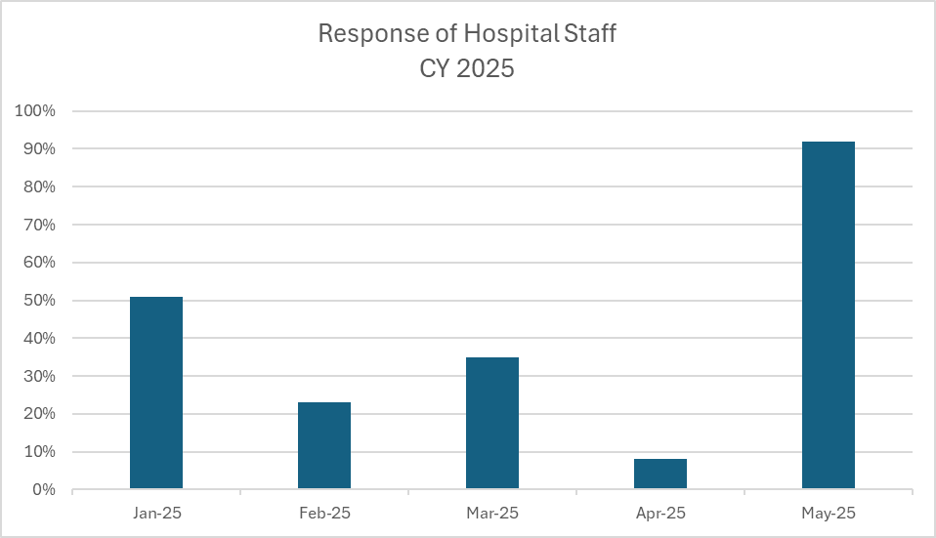
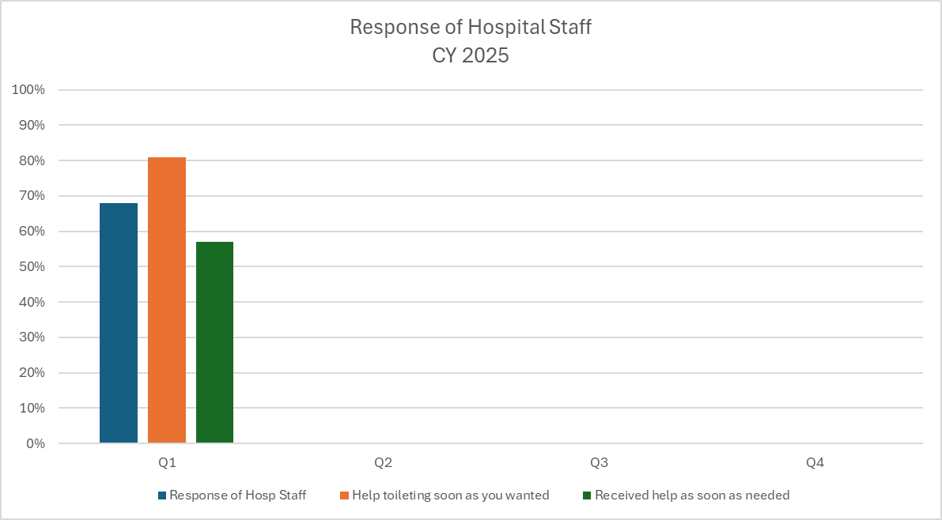
Measures: New Measure Being Watched
STUDY

Slide 108
Findings:
ACT
Results: Did you accomplish your goals?
Currently 3 of 4 areas in the Satisfaction Domain of the DVC Scorecard are above the goal set.
Lessons Learned: What did you learn as a result of this project? Unexpected discoveries? Problems or barriers?
Patient Concierge rounding is going well, not only for the patients but also for the team doing the rounding. They are enjoying the patient interaction and seeing the value for doing this. While we need to continue to focus on the 4 areas of the Satisfaction Domain, we also need to watch the “responsiveness to staff” category.
Next Steps: What actions are you going to take in the next 60 days ?
Action: | Assigned To: | Due Date:
Continue to monitor HCAHP/DVC Scores | Amy Hermes | Throughout next 60-day cycle.
Monitor compliance in discharge notes/folders | Naomi Franklin/ Marissa Brady | Throughout next 60-day cycle.
Continue with follow up phone calls. | Case management and RN team (weekends). | Throughout next 60-day cycle.
HCAHPS meeting with MS Team regarding “responsiveness to staff” | Manager, ADM, MS Team | July 16, 2025
Project Leader is Recommending the Following:
QM Council approval for completion of project?: NO Project still in progress, project to continue: YES

