Slide 1
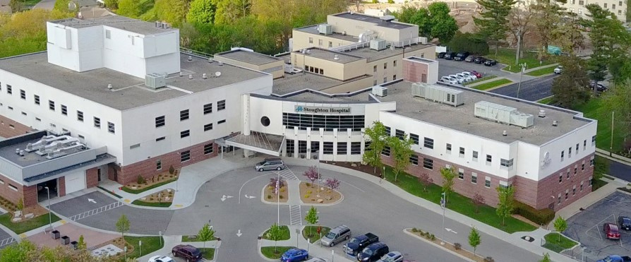


Stoughton Health Governing Board Meeting
March 26, 2025

Slide 2
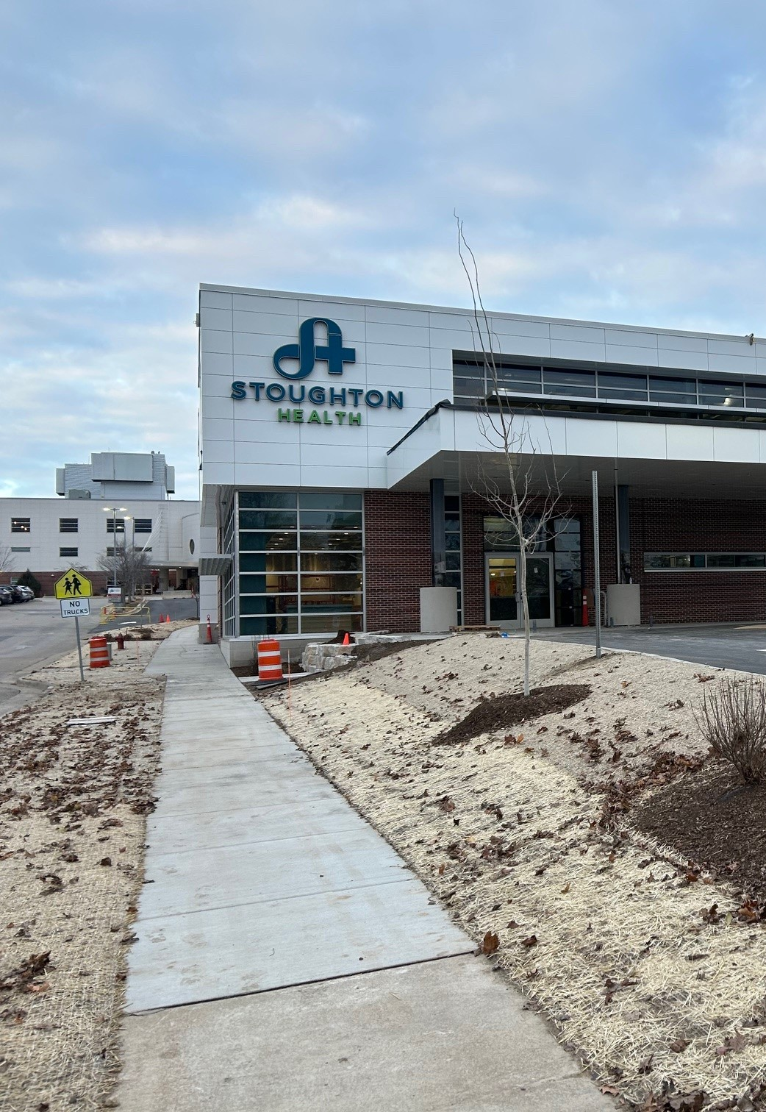

Agenda
Call to Order
Review/Approve January 22, 2025 Governing Board Meeting Minutes
Trustee Education – SSM Health
New Business/Old Business
SSM Updates
Committee Updates
Administration Team Updates
  Chief of Staff Report
  Open Discussion / Adjournment

Slide 3



Meeting Minutes
Request Motion to Approve January 22, 2025 Governing Board Meeting Minutes.

Slide 4



Trustee Education
Jolynn Suko
SSM Health WI
Regional Vice President, Strategy and Business Development
James Meacham
SSM Health WI
Vice President, Affiliate Partnerships

Slide 5

Stoughton Health and SSM Health
Strategy Alignment
Q1 2025

Slide 6
SSM Strategy – What is top of mind?
  Conceptual Mode
  Service Frameworks
  Applied Models for Strategy
  Considerations
What financial models drive value at SSM?
  Capitation
  Risk Pool Overview and Impact
Agenda
How do we partner with like minded affiliates?
  Wisconsin Affiliate Strategy

Slide 7
SSM Strategy: What is top of mind?
Jolynn Suko
SSM Health WI: Regional Vice President Strategy and Business Development

Slide 8
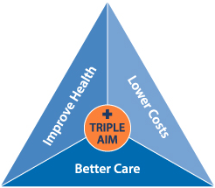
Why do we exist as healthcare providers?
Patient Experience
Population Health
Lowering the cost of care per capita
Notes:
The "Triple Aim" refers to a framework in healthcare that aims to simultaneously improve the patient experience of care, improve the health of populations, and reduce the per capita cost of healthcare, all considered together as three key goals to strive for within a healthcare system; it was defined by the Institute for Healthcare Improvement (IHI).
Key points about the Triple Aim:
Three components:
Patient experience: Enhancing the quality and satisfaction of care received by individuals.
Population health: Improving the overall health outcomes of a community or population.
Cost reduction: Lowering the per capita cost of healthcare delivery.
Goal:
To achieve a balanced approach where improvements in one area do not come at the expense of the others.

Slide 9

Why do we want to lower cost of care?

Slide 10
How should we organize ourselves to deliver the Triple Aim?
“Textbook” or Ideal(?) Conceptual Model Example
Care Delivery in Neurosciences
CONTINUUM OF CARE
Primary Services:
Outpatient Rehabilitation
Infusion Services
Triage, dx & initial Tx of:
Migraine*
Seizure Disorders
Alzheimer’s Disease
Neuromuscular Disorders
Memory Loss/ Cognitive Impairment*
Multiple Sclerosis
Stroke
Spine Disorders
Peripheral Neuropathy
Secondary Services:
Botox Treatment
Rehabilitation I/P
Electrodiagnostic Studies
Spasticity Tx
Clinical Trials
Ongoing management of chronic neurologic diseases (e.g., MS, ALS, Parkinson’s)
Tertiary Services:
Deep Brain Stimulation
Complex Spine Surgery
Stereotaxic Radiosurgery
Epilepsy Surgery
Pituitary Disorder Surgery
Cerebral Aneurysm
Endovascular Tx
Skull base surgery
Neuro-Oncology**
Broad
< 10 miles from patients’ homes, may be enhanced via telehealth in shortage areas
Regional
< 100 miles from patients’ homes, includes hands on treatment
Centralized
<300 miles from patients’ homes, hands on services with quality implications for volume etc.
Geographic Footprint
Potential Market
Local
Local, Regional
Local, Regional, National
Majority of care for patients with these conditions could be delivered in primary care, with neuroscience consultation prn.
** Majority of care for patients with this condition may receive treatment locally, in conjunction with large academic center.
Notes:
In the absence of a system that we have – it is nice to think about an ideal state – that would rationalize resources, focus on cost, quality and value
Give example – Neuro
Right Care
Right Place
Right Cost

Slide 11
Applied Real World Models
to Deliver Value

Slide 12

Ambulatory Care Service Leveling Framework
Updated December 2023
 | Low Acuity |  | Primary / Episodic |  | Higher Acuity
Facility Level | Virtual / Home | Retail | Primary / Urgent Care | Specialty Facility | Ambulatory Destination Center
Attributed Lives | N/A | N/A | 10,000+ | 35,000+ | 70,000+
Complexity | Basic | Basic | N/A | Basic | Basic
Size |  |  | 1 to 3 modules 7,000 to 20,000 sq. ft. | 3+ modules 20,000 sq. ft or greater
Scope of Services | Remote Monitoring Self Testing Algorithm-based Diagnosis & Treatment Virtual Providers Home Health Remote Education | Advanced Practice Providers (APPs) Point of Service Lab Pharmacy Employer-based Clinic Immunizations Care Management Programs Nutrition Wellness DME Retail Sales | Family Medicine / Primary Care / Value Based Care w/ extended hours InstaCare Care Team Support, e.g., care management, dietitian, care educator, pharmacist Physical Therapy Basic Imaging Point of Care Lab Phlebotomy Virtual/ rotating specialists Comprehensive Care Team Mental Health Integration | Increase access Cost appropriate Multi-Specialty Clinic Imaging Spoke focus Internal Medicine Pediatrics Behavioral Health Ambulatory Surgical Center Imaging Center Birthing Center | Increase access Cost appropriate Multi-Specialty Clinic Major imaging Hub focus Ambulatory Surgical Center Endoscopy Accreditation / COE
Examples (not conclusive) |  |  | Primary Care and/or Urgent Care Clinics Value Based Care (VBC) Senior Clinics | Memorial Clinic Bountiful Clinic | Salt Lake Clinic Utah Valley Clinic Alta View Clinic Southridge Clinic

Slide 13
Acute Care Service Leveling Framework
Updated November 2020, Approved by CBC and Enterprise Leadership
 | Lower Acuity |  |  |  |  |  |  | Higher Acuity
Facility Level | Specialty OP Facility | Neighborhood Hospital | Rural Hospital | Rural Small Community Hospital | Community Hospital |  | Regional Referral Center | Quaternary Hub
Attributed Lives | 30,000+ | 55,000+ | 5,000+ | 20,000+ | 100,000+ |  | 250,000+ | 600,000+
Complexity | Basic | Basic | Basic | Basic / Moderate | Basic / Moderate |  | Moderate / High | High
Size |  | 6-20 beds | 10+ beds | 20-40 beds | 20-100 beds |  | 200+ Adult beds 50+ Peds beds | n/a
Scope of Services | Freestanding ED Imaging Center Ambulatory Surgical Center (ASC) | Medical/Surgical beds 7-10 ED stations Level 1 Birthing/Nursery (800-1000 deliveries) 2 ORs (for mostly C-sections) | Medical/Surgical beds 3-4 ED stations 1-2 ORs Level 1 Birthing/ Nursery | Specialists Medical/Surgical beds 4-10 ED stations Imaging (MRI) 4-10 ORs IP surgery (General Surgery, Orthopedics) Level 1 Birthing/Nursery | Specialists Medical/Surgical beds 6-16 ICU beds 10+ ED stations Imaging (specialty 1 per modality) Level 1 Birthing/ Nursery (1000 births) IP surgery (General Surgery, Orthopedics, GYN, ENT, Urology) |  | All community hospital services Sub-Specialists 30+ ED stations 16+ ORs 30+ ICU beds Level 3 Birthing/ Level 3 NICU 16+ Rehab beds Critical care Cath Lab/EP Bi Plane/TAVR Interventional Radiology Cancer center Radiation Oncology Neurosurgery | All regional referral hub services Level 4 Birthing/ Level 3 NICU (IMED), Level 4 NICU (Primary) Major Trauma Transplant Structural Heart Complex Cancer Complex Neuro Peds Sub-specialty IMRT
Potential Variations (SBC Triad Decision Rights) | OP Behavioral Health Radiation Oncology IMRT Surgical Robotics | Imaging Center ASC | Swing Beds (SNF License) OP Infusion | Swing Beds (SNF License) OP Infusion 4-6 ICU beds IP Surgery (GYN, ENT, Urology) Total Joints Bariatrics | TCU (SNF License) Level 2 Birthing/Level 2 NICU (2000 births) Surgical Robotics Total Joints Bariatrics IP psych Radiation Oncology Infusion/Medical Oncology PET IMRT IP Rehab Cath Lab Interventional Radiology
Examples (not conclusive) | FED (Hurricane, Saratoga Springs, Desert Color / St. George – 2023, North Ogden – 2026) ASC (Salt Lake, St. George, Saratoga Springs, etc.) Tellica | Saratoga Springs NHH | Sevier Valley Mt. Pleasant Delta Fillmore Garfield | Heber Park City Orem Community | LDS Hospital American Fork Alta View Riverton Layton Logan |  | McKay-Dee Utah Valley St. George | IMED Primary Children’s
Notes:
Alignment with Intermountain’s Strategies
Alignment with Intermountain’s strategies identified in the proposal template.
Is the project identified in the plan of an existing Strategic A3?
List KPIs the project is expected to both positively and negatively impact, as identified in the A3
Major risk factors that could impact success
Description of the most critical elements in case the scope needs to be reduced
Other viable options to address the problem/opportunity

Slide 14
How is SSM WI developing its strategy in the next 12-18 months?

Slide 15
Strategy is built upon foundational work
One Wisconsin Vision: 2022
Regional Leadership Team Structure 2023
One Wisconsin Board: 2022-2024
One Wisconsin Providers: 2024 and in process
Operating Model Educational deployment: Regional Thinking, Common Language
5 Market Based Strategies (in process):
  Fond du Lac Strategy Retreat – Q3 2024
  Baraboo Q1 2025
  Ripon/ Waupun Q2 2025 (TENTATIVE/ DRAFT)
  Janesville/ Monroe Q2 2025 (TENTATIVE/ DRAFT)
  Madison Q3 2025 (TENTATIVE/ DRAFT)
Strategic Analytics: Perception Market Integrity, Centralized Market Share Data

Slide 16
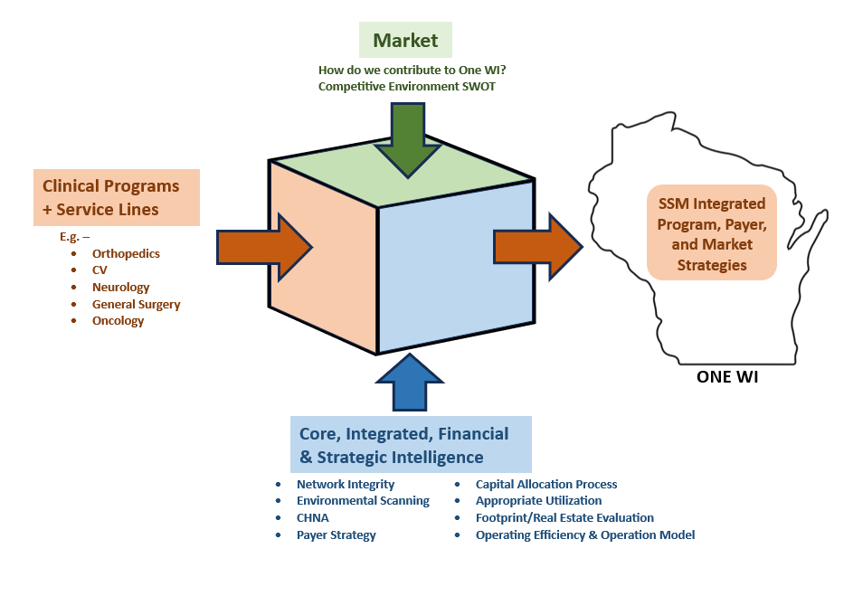
Strategy Inputs: SSM WI Region

Slide 17
Questions for consideration from a SSM Health care delivery perspective for defined Service Areas:
What are strategic areas of strength within defined Service Area and should be areas of emphasis in future planning efforts?
What strategic opportunities (in alignment with conceptual models) are present to differentiate within Service Areas?
Access throughout the overall service area is critical element to success, how do we collaborate to facilitate greater access for our patients (including leveraging technology)?
Given current ambulatory footprint and utilization, how could we re-imagine specialty care to create greater access and efficiency (value) of services? What should service offerings in each market look like?
How do we partner with our affiliates to create mutual value for each other, our patients and our communities?
Notes:
Joan

Slide 18
Questions

Slide 19
Financial Models Driving Value
Jim Meacham
SSM Health WI: Vice President, Affiliate Partnerships

Slide 20
What is a Capitated Model?
A Capitated Model of insurance coverage is a payment system where a healthcare provider receives a fixed, predetermined amount of money per patient per month, regardless of how many services they provide to that patient, essentially placing the financial responsibility for managing patient care costs on the provider, incentivizing preventive care and cost-effective treatments rather than simply billing for each individual service rendered.

Slide 21

All You Can Eat Buffet
Fixed Entry Price of $10 per person
Analysis showed average customer eats $7
Daily Costs:
Food $1,000
Staff, Rent, Facilities $1,000
Total Daily Cost $2,000
Scenario:
Profitable Day – 300 Customers
Breakeven Day – 200 Customers
Losing Money – 150 Customers
If I price too low and too many big eaters show up, I lose money. Even if I don’t get overeaters, I need to understand the risk of volume of customers versus my food cost and my retail price.

Slide 22
How do capitated models drive value?
Risk Pool Overview
IDN Medical
& Pharmacy Claims
Risk Pool
Capitation
Pool
Surplus/(Deficit)
Non-IDN Medical
& Pharmacy Claims
Other Pool Costs
$
Premium/Revenue
Health Plan
Retention
Health Plan
Operating Income
Operating Expense
Other Revenue/Income

Slide 23

Accountability of the IDN Members
How a risk pool works
Dean Health Plan
SSM Health
Steward of the premium dollars
paid by employers
Manages claim processing
Other standard health plan
processes
Manages economic risk of members
Delivers value proposition:
  Right Care
  High Quality
  Affordability

Slide 24
Integrated Delivery Network (IDN) Definition and Reasoning
For purposes of this discussion, and from a SSM Health perspective, IDN facilities are considered any health provider assuming “risk” under Risk Pool Capitation and non-IDN providers assume no “risk”.
Whether a provider is considered IDN or non-IDN, from a SSM Health perspective there is alignment with creating value for patients served by creating appropriate access and ensuring care is delivered in most effective and lowest cost setting

Slide 25
How do we partner with like minded affiliates?

Slide 26
How does vision impact decision making as an Affiliate Hospital?
Partner to align on scope of services in service area to ensure appropriate access and delivering greatest value
  Provision of care in ambulatory locations when appropriate
Ensure care coordination within IDN for downstream referrals to assist with care efficiencies and quality
  Tertiary and Quaternary Care
Partner in marketplace to reinforce value care proposition to help lower cost of healthcare in the community

Slide 27
Wisconsin Affiliate Strategy: 2024 – 2025 Roadmap
Strengthen Affiliate Relationship & Structure
Evaluate Partnership Structure through lens of mutual goals & value proposition
Add more structure and set clear mutual expectations.
- Proactive joint long-term planning versus short-term reactions in marketplace
Leverage new SSM affiliate leader position to improve consistency of communication
Implement best practices from other regions, and nationally, to strengthen alignment.
Complete an assessment of SSM Health offerings within each affiliate market (providers, sites of care, services)
Engage in mutual strategic planning sessions (after the asset assessment is completed) in collaboration with local leaders; develop a plan in each market outlining mutual strategies to optimize partnership

Slide 28
Questions?

Slide 29

Updates
Matt Kinsella / Dawit Tesfasilassie

Slide 30

Committee Updates
Executive Committee
Finance Committee
Governance Committee
Quality Committee
Audit Compliance/Risk Management Committee

Slide 31

Executive Committee
Upcoming Meeting: Wednesday, April 23, 2025 at 7:15 a.m.

Slide 32
Finance Committee
Overview of February 28, 2025 Finance Committee Meeting
  January 2025 Financials
  Policy 2.10: Financial Assistance Policy Changes
  Discussion of Debt Management Strategy
  Future Capital Purchase Discussion: Robotics
Upcoming Meeting: Friday, April 18, 2025 at 7:15 a.m.

Slide 33
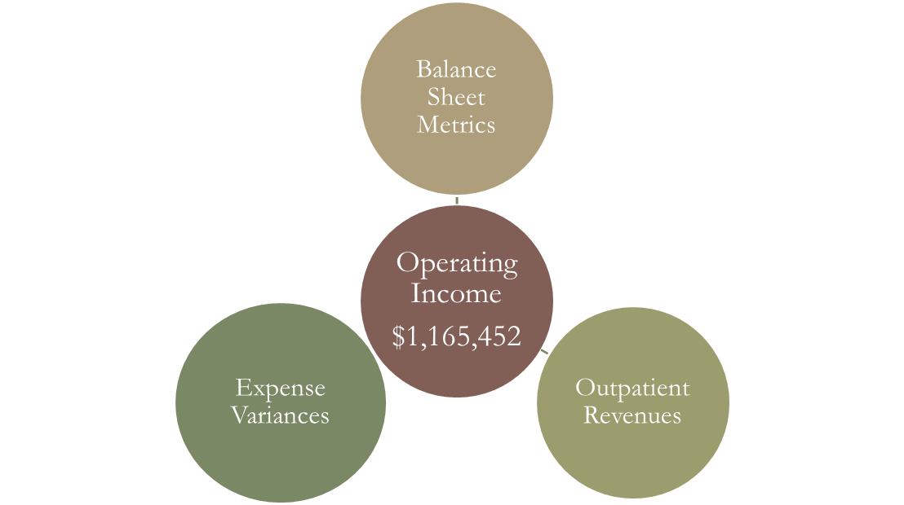
January 2025 Financials
Request Motion to Approve January 2025 Financial Statements.

Slide 34
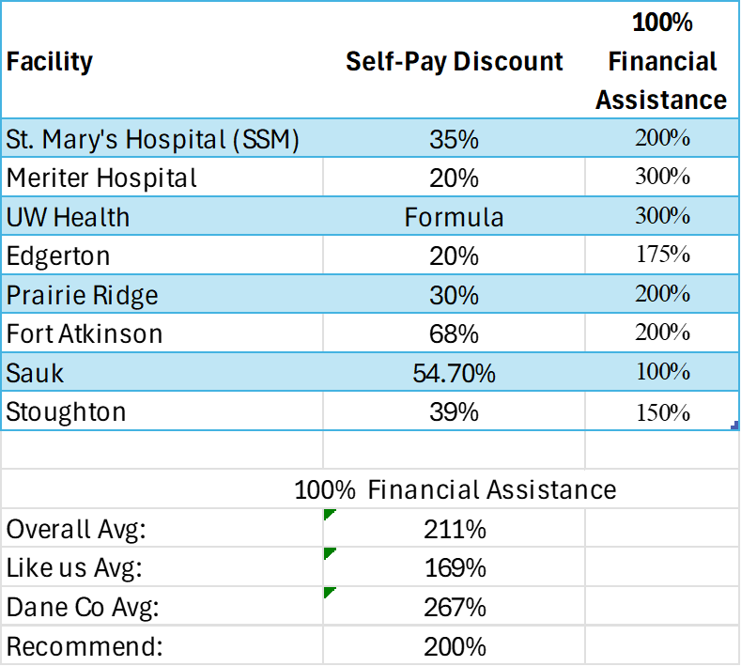
Policy 2.10: Financial Assistance Policy
Recommended Changes:
Self Pay Discount – 39% to 45%
100% Financial Assistance – 150% of Federal Poverty Level (FPL) to 200% of FPL
Additional Advanced Practice Providers Added
Request Motion to Approve changes to Policy 2.10: Financial Assistance Policy.

Slide 35
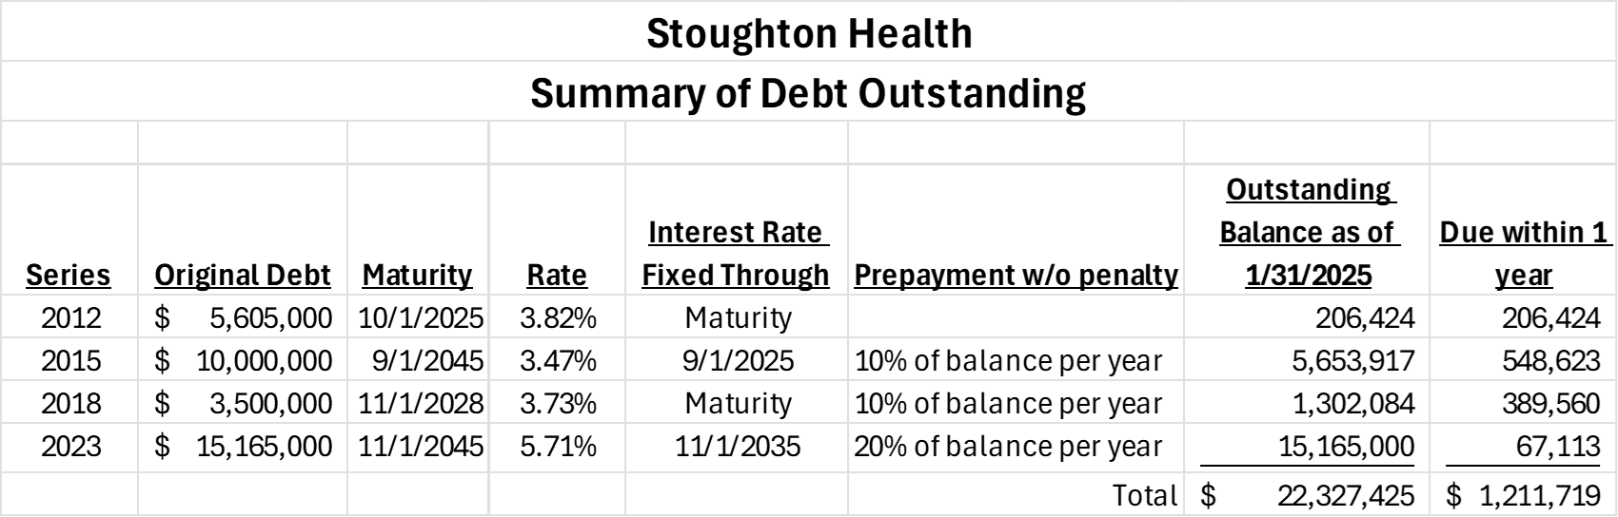
Discussion of Debt Management Strategy
Strategies to Explore for Future Meetings
2015 Bonds Paid off
Prepayment of 20% ($3M) on 2023 Bonds
Prepayment of 10% ($130,000) on 2018 Bonds

Slide 37
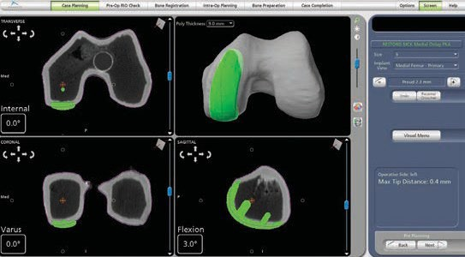
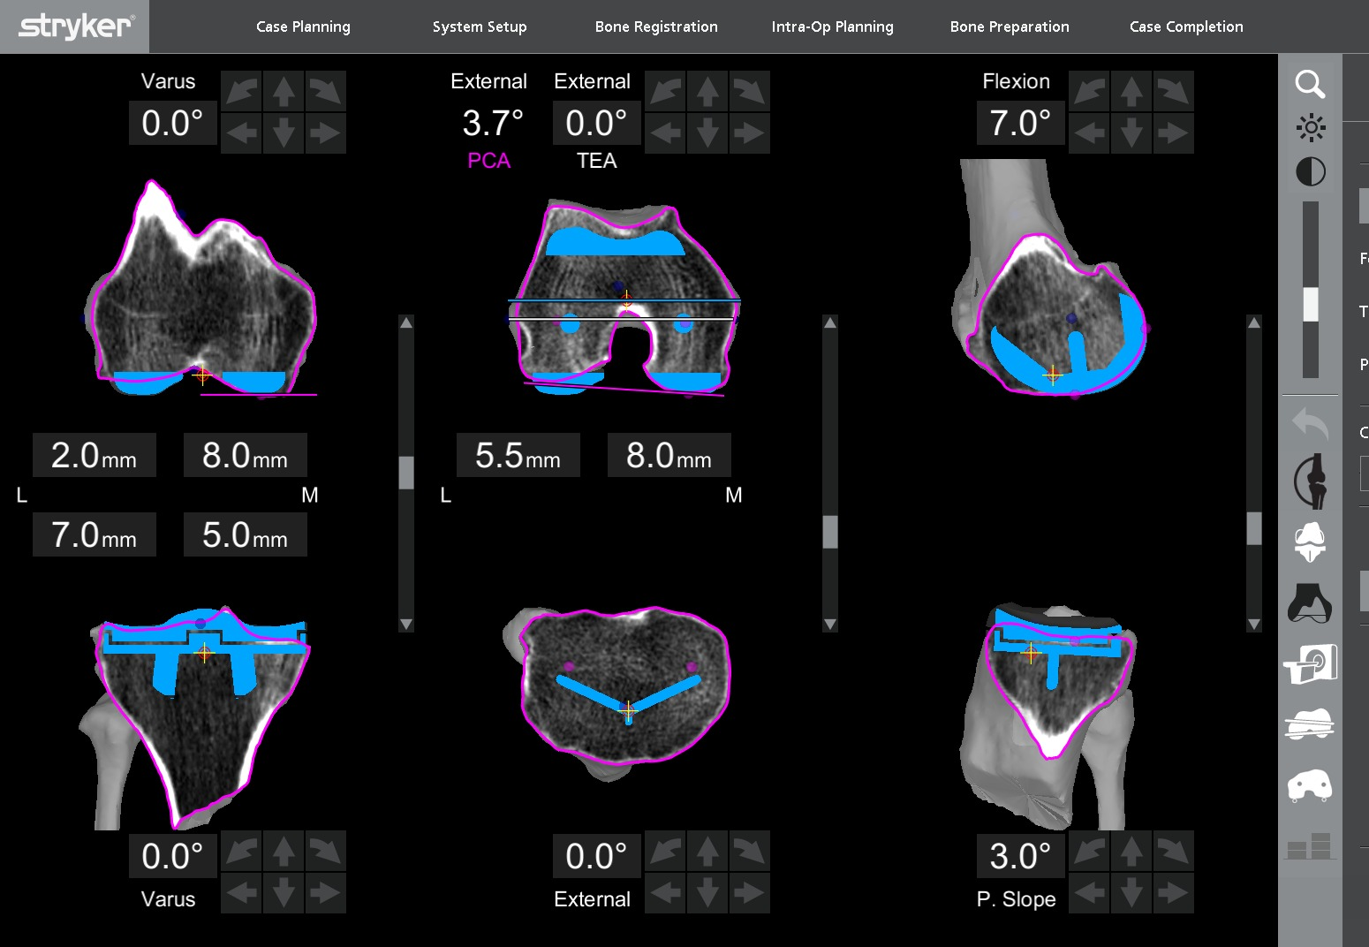
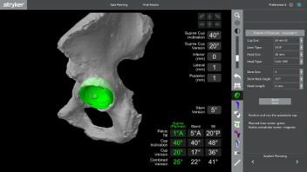
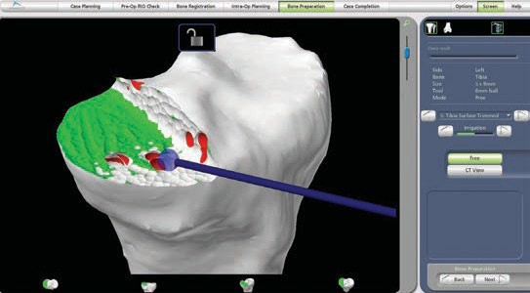
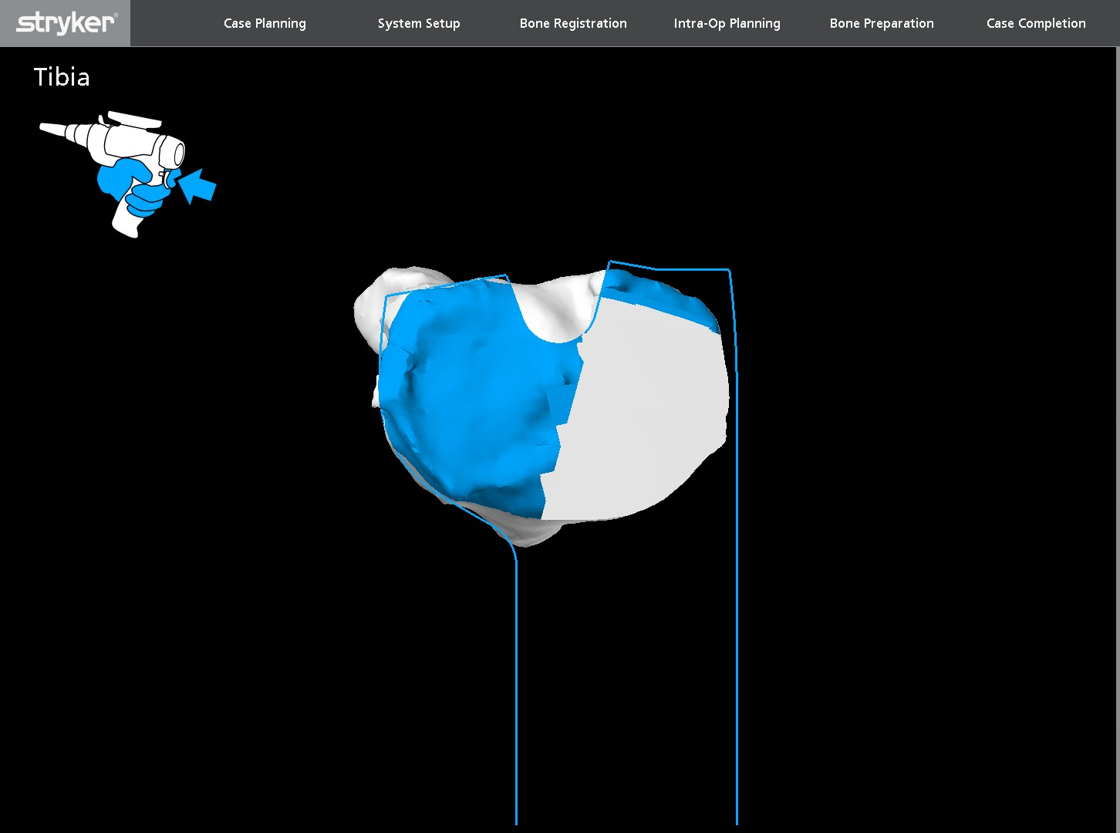
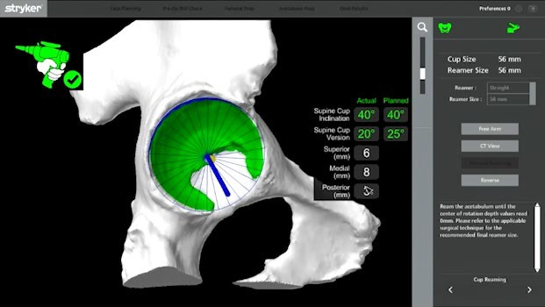
Mako SmartRobotics™
Combines three key components, 3D CT-based planning, AccuStop™ haptic technology and Insightful Data Analytics**, into one platform which which has demonstrated enhanced outcomes for total hip, total knee and partial knee patients compared to manual surgery.¹⁻³
Know more.
Cut less.^{†4-8}
**Access to data analytics offering requires execution of a separate agreement.
† For Mako Total Knee application, “cut less” refers to less soft tissue damage and greater bone preservation compared to manual surgery.⁴⁻⁸ For the Mako Total Hip and Partial Knee applications, “cut less” refers to greater bone preservation as compared to manual surgery.⁴⁻⁸

Slide 38
Governance Committee
Upcoming Meeting: Thursday, April 17, 2025 at 7:15 a.m.

Slide 39
Quality Committee
QM Council Updates
  Review QM Council Meeting Minutes
    February 25, 2025
  Review QM Council Dashboards
    Cohort A – February 25, 2025
Upcoming Meeting: Tuesday, April 22, 2025 at 9:00 a.m.

Slide 40

Closed QM Projects
February 25th Meeting – Cohort A
GPU Utilization Review | Geriatric Psychiatry
Blood Culture Contamination Rate Reduction | Laboratory
Imaging Use of Power Ports | Medical Imaging

Slide 41
Audit Compliance/Risk Management Committee
Overview of February 28, 2025 Audit Compliance/Risk Management Committee Meeting
  Stoughton Hospital Association Tax Deferred Annuity 403(B) Plan FY2024 Audit Statement of Work Approval
  FY2025 Audit, Tax & Cost Report Preparation Request for Proposal Process (RFP)
  Internal Control Review
Upcoming Meeting: Friday, April 18, 2025 at 8:30 a.m. (immediately following Finance Committee)

Slide 42
CEO Summary
Chris Brabant

Slide 43

WHA Advocacy Day

Slide 44
Expanded Cardiology Service
Interventional Spine & Pain Clinic
General Surgery
2nd Orthopedic Surgeon
Service Line Expansion

Slide 45
CFO Summary
Michelle Abey

Slide 46
February 2025 Financial Statements
Operating Income
$471,276
Balance Sheet Metrics
Outpatient Revenues
Expense Variances
Request Motion to Approve February 2025 Financial Statements.

Slide 47
Capital Spend Summary
FY 2025 Routine Capital Budget: $4,000,000
Approved to Date: (812,485)
Requested Capital Items: (430,679)
Remaining FY 2025 Capital: $2,756,836

Slide 48
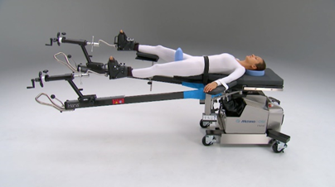
Capital Request: Hana Table
HANA allows for precise placement of leg, so incision can be made directly in front of hip, rather than through back or side.
Rotating table permits increased range of motion so surgeon can properly position and align socket, ball, and femur. Table allows surgeon to position patient's legs independently and provide traction.
Cost to purchase new Hana Table is $104,093 with maintenance contract of $9,900 per year. Expected useful life ➔ 10 years.
Purchase would improve current patient outcomes and allow for Robotic surgeries in the future.
Request Motion to Approve Capital expenditure of $104,093 plus maintenance contract for $9,900 per year for purchase of a Hana Table for the Operating Room.

Slide 49
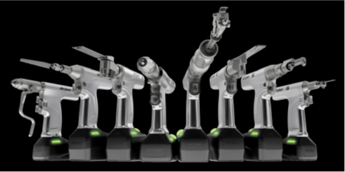
Capital Request: Power 9 System for OR
Current System no longer serviced by manufacturer starting in 2027.
New Power 9, which is primarily used by the orthopedic team, offers more advanced features and greater power capabilities than current Power 8.
Utilization:
  Power 8 usage (March 2024 to date): 299 cases. ~25 cases/month
  FY 2025 projected cases (orthopedic and podiatry): 459 cases.
  Power 9 potential usage for dental cases.
Recommend leasing new Stryker Power 9 by 3/31, to avoid 4/01 cost increase of $44,000 over 5-year lease term. Would receive additional $21,000 in incentives if purchased by 3/31.
Request Motion to Approve Capital up to $326,586 to lease a Power 9 System for the Operating Room.

Slide 50
March Month-to-Date

Slide 51
Multi-Specialty Clinic Updates
Podiatry Clinic
- Dean Health Plan/Medica approved paneling Dr. Lind
- 10 more clinic visits in February than in January – 6 surgical cases
Welcome new Specialty Clinic Manager – Pam Engelhart
JoDeen Hettenbach

Slide 52

Stoughton Health Outpatient Center (SHOC) Updates
Ribbon Cutting / Open House:
April 23, 2025 at 4:30 p.m.

Slide 53
CNO Summary
Amy Hermes

Slide 54
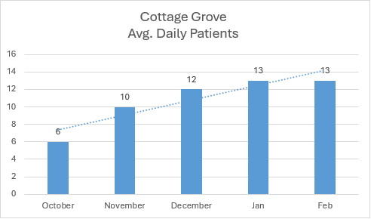
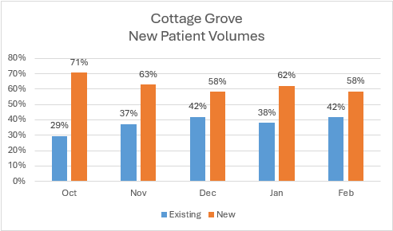
Cottage Grove Urgent Care

Slide 55
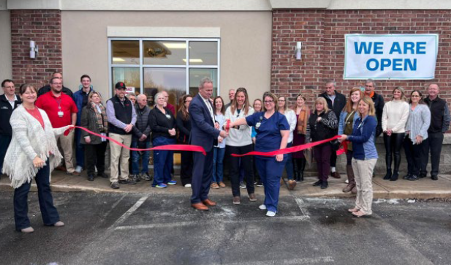
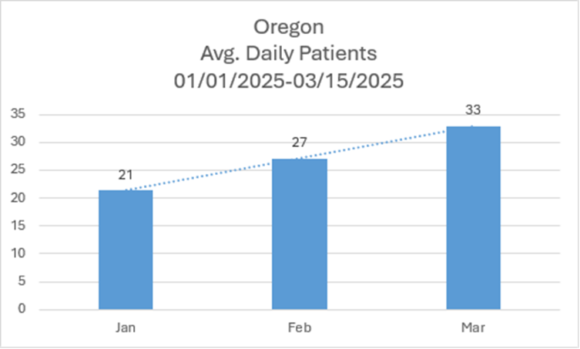
Oregon Location Expansion
Oregon Expanded Hours as of February 24th:
Monday-Friday 8 a.m. to 8 p.m.
Saturday and Sunday 9 a.m. to 5 p.m.

Slide 56
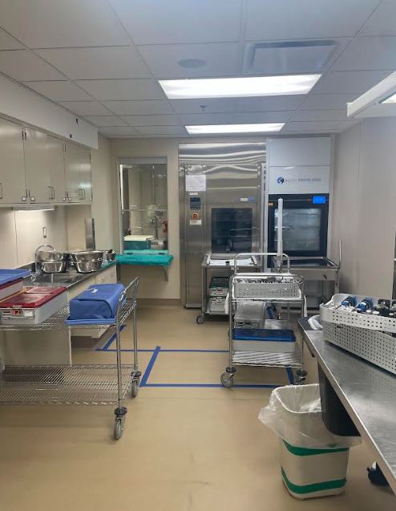
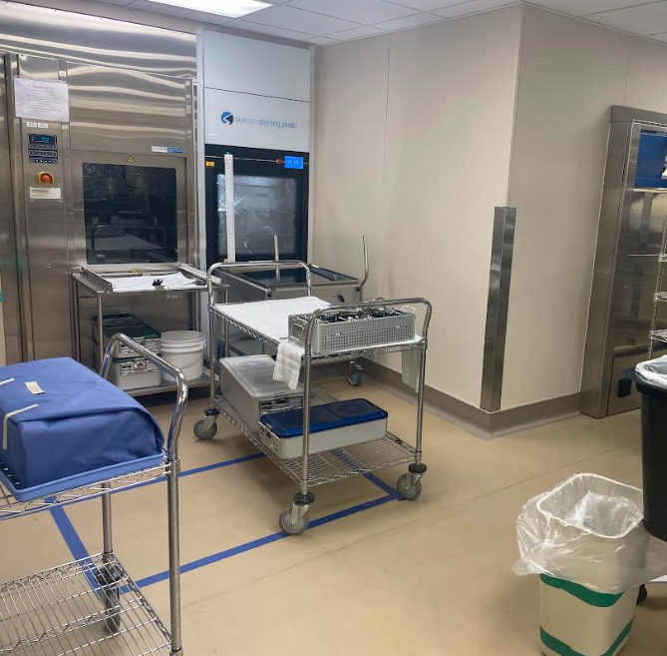
Sterile Processing Department (SPD)
Phase 2 Completed
  Install of large sterilizer
  Install of first washer
Phase 3 Begins 3/24/2025.
  Removing the old washer
  Installing second new washer
  Installing Pass Through Window

Slide 57

Root Cause Analysis (RCA)
Plant Operations - Power Outage
On 03/02/2025 at approximately 11:45 am, the hospital experienced a power outage requiring all hospital generators to turn on placing the hospital on emergency power.
Affected areas included the hospital and DMG clinic. SHOC and east neighbors, streetlights, and traffic lights were impacted on a short-term basis.
A squirrel chewed conductor wires causing the power failure. Stoughton Utilities made required repairs; however, the hospital was responsible for 3 damaged wires that fed our switch gear. Generators turned on and functioned properly to initiate emergency power.
Power pole conductors not designed to be enclosed like a transformer box. We currently have two conductors, and the team is exploring a third conductor placed as a backup, so if there is a loss of power it will roll to a third conductor and not shift to generator power.

Slide 58
MCE Meeting Minutes – January 2025
Utilization Review: Current Average Length of Stay is 2.06 days which is well below the 96 hour (4 days). Swing bed admissions are up compared to FYTD24.
Radiologist Concerns: Dr. McGuire provided update on current staffing and anticipated timeline for achieving full staff coverage.

Slide 59
MCE Meeting Minutes – February 2025
MRI: MRI volumes lower than expected due to current staffing (we only have one MRI technologist). A traveler has been secured.
Radiologist Concerns: Continued discussion regarding delays and imaging interpretations. It might be reasonable to look at other options. Will ask Dr. McGuire for updates at the April meeting.
Reviewed the following RCAs:
  Med error-Risperdal instead of ropinirole was given. Processes were reviewed and opportunities identified. Education provided to pharmacist and nurses.
  Needle with suture material in Urology clinic. Policy updated to and re-education provided related to sharp handling and disposal.
  Potential EMTALA concern in the urgent cares with providers determining appropriateness to treat patients based on conversations overheard at the registration desk. Re-education provided to UC team.

Slide 60
MEC Meeting Minutes –March 2025
Radiologist Update: Per recent discussion with Dr. McGuire, staffing has improved. Will continue to monitor and explore alternative options if needed.
Clinical Advisors: Appointed clinical advisors reviewed. Dr. Lively, Cardiac and Pulmonary Rehab and Dr. Mendelin, Pathology, will be joining MEC.

Slide 61

2024 Annual Performance Evaluation
Emergency Management

Slide 62
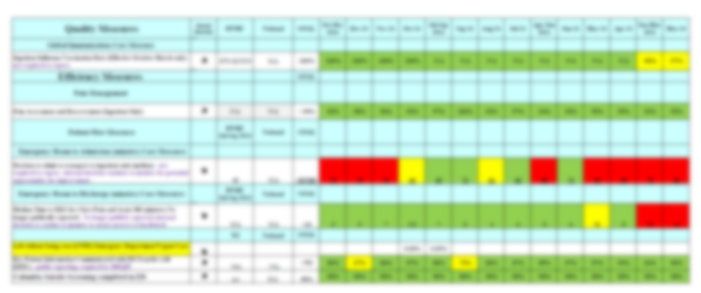
Quality/Safety Report Card – Q1 FY2025

Slide 63
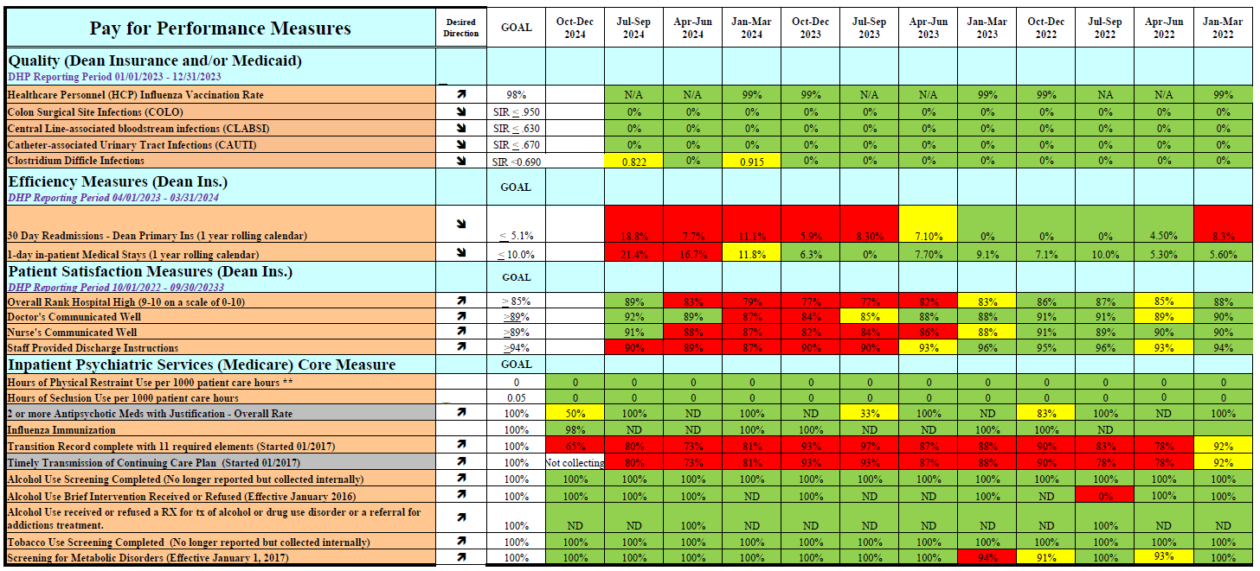
Quality/Safety Report Card – Q1 FY2025 P4P

Slide 64
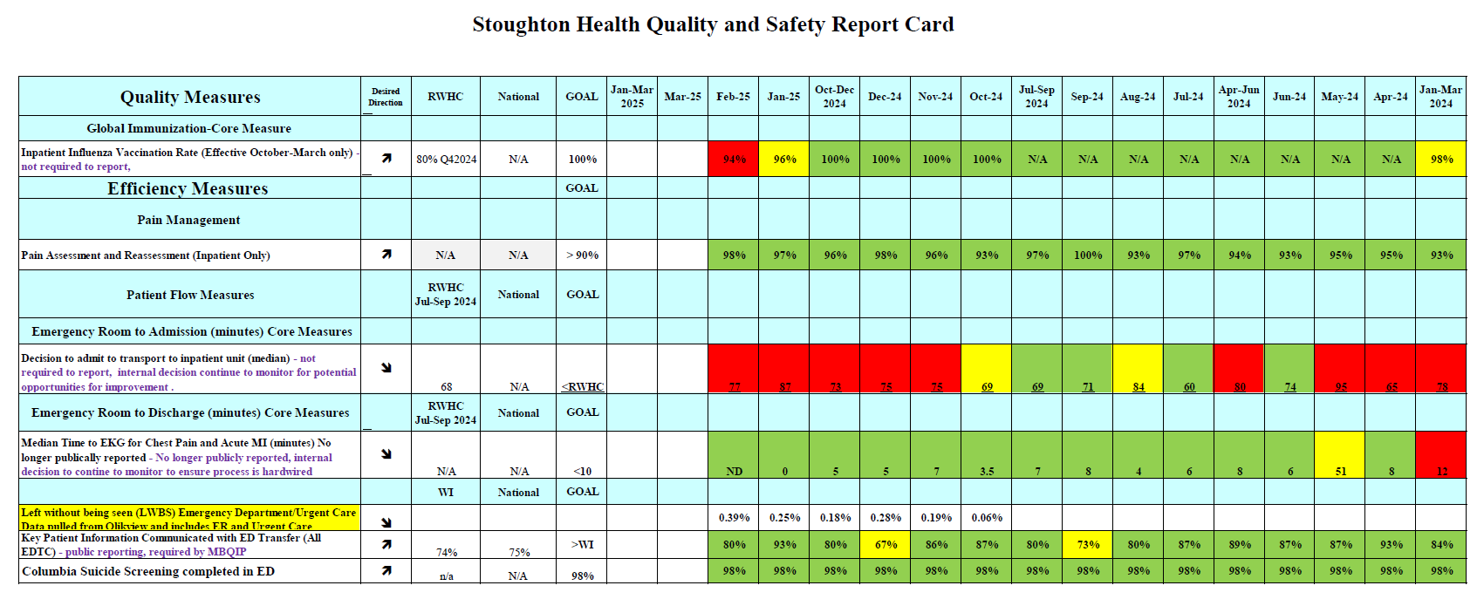
Quality/Safety Report Card – Q1 FY2025 ED

Slide 65
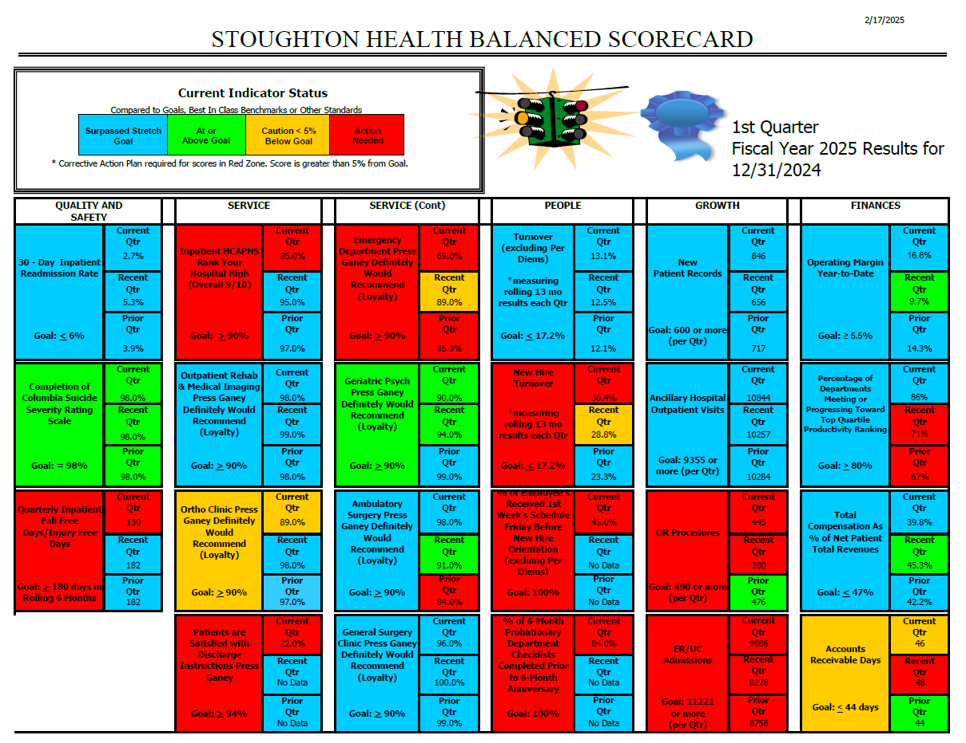

Slide 66
Patient Safety– January 2025
Security/Safety: Discussion regarding training for an active shooter drill in April. To be held in the SHOC.
Global Immunization (Influenza): 100% for MedSurg/ICU, 98% GPU
DNV: Reviewing DNV chapters in preparation for survey this fall,
which will be our CMS validation survey.
Medication Administration in Clinics: Once SHOC is up and running would like to research best practice for medication administration in the clinic setting. Will add the clinic managers to this meeting.

Slide 67
Infection Prevention – January 2025
Use of Nozin: Researching best practice information related to the use of NOZIN for Surgical Preop and Postop nasal Decolonization for total joint patients.
Employee Influenza Vaccination Rates: Deadline for influenza vaccination was November 15 this year. We are at 97% vaccination for total number of employees. Increase in waivers noted with 3 medical and 6 religious waivers turned in.
Disinfection Opportunities with EVS: Individual staff are monitored for 22 surfaces cleaned utilizing the UV surface marking validation in each location audited. December was 100%.
Top Five Reportable Diseases in 2024:
  COVID-19 Hospital Admissions 42
  Chlamydia 23
  E Coli (Shiga toxin/ETEC/EPEC) 19
  Campylobacteriosis 11
  Lyme Disease 11

Slide 68
Consent Agenda
MCE Meeting Minutes – January 2025 / February 2025
MEC Meeting Minutes – March 2025
2024 Annual Performance Evaluation – Emergency Management
  Quality/Safety Report Cards – Q1 FY2025 | P4P | ED
  Balanced Scorecard FY2025 Q1
Patient Safety Meeting Minutes – January 2025
Infection Prevention Meeting Minutes – January 2025
Request Motion to Approve Consent Agenda.

Slide 69
VP, HR, Campus Planning, Operational Support Services Summary
Chris Schmitz

Slide 70
HR/Facilities Updates
Facility Updates:
Alano offer to purchase
Parking post-opening of the outpatient center
BioMedical Equipment Management - Reset
Human Resources Updates:
Health insurance loss ratios
Season for performance evaluations and annual education
Onboarding of new Clinical Managers

Slide 71

Staffing Updates

Slide 72
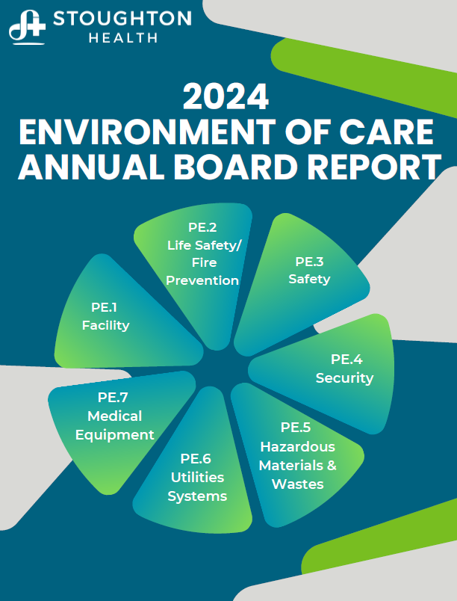
Request Motion to Approve Environment of Care Annual Board Report.

Slide 73
Foundation/Marketing/PR/ Business Dev. Director Summary
Laura Mays

Slide 74



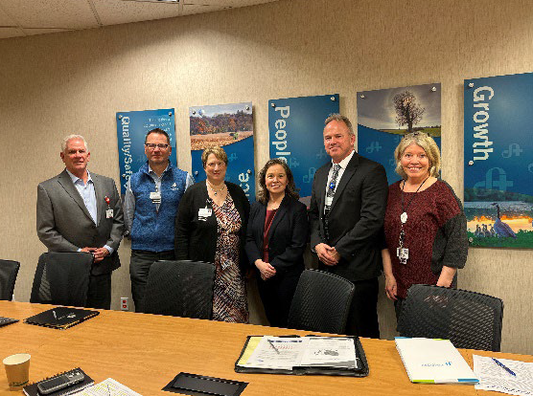

PR/Marketing Report

Slide 75

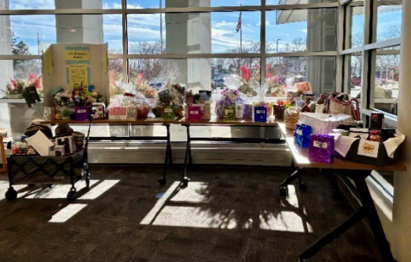
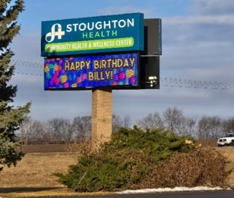

Events/Fundraisers
Basket Raffle

Slide 76
Foundation Dashboard

Slide 77
Director, Engagement & Experience Summary
Andy Boryczka

Slide 78
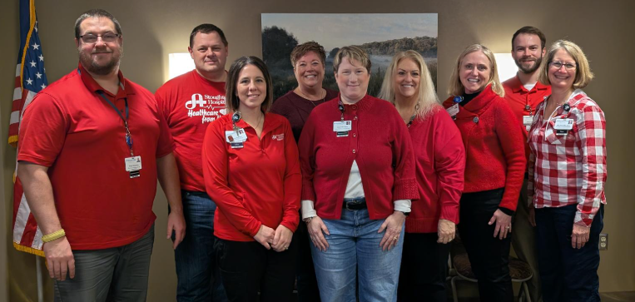
Director, Engagement & Experience Updates
Excellence Together Team Updates
Employee Engagement Survey
Awards

Slide 79

Director, Engagement & Experience Updates
Excellence Together Team Updates
Beat the Winter Blues
  Employees for Employees Team (E4E) offered a Hawaiian style lunch to staff
Caught in the AAACTS
  Employees were celebrated by the Standards Team for being spotted showing kindness to staff and visitors
Patient and Family Advisory Council (PFAC)
  Customer Excellence is working to build up our team and put their feedback into action

Slide 80

Director, Engagement & Experience Updates
Employee Engagement Survey
Contracted through Energage
Sent out to staff on 3/19
Closes 4/3
Results should be available by 4/10
All staff encouraged to participate
Feedback will be used for future Leadership Days as well as in the strategic plan

Slide 81
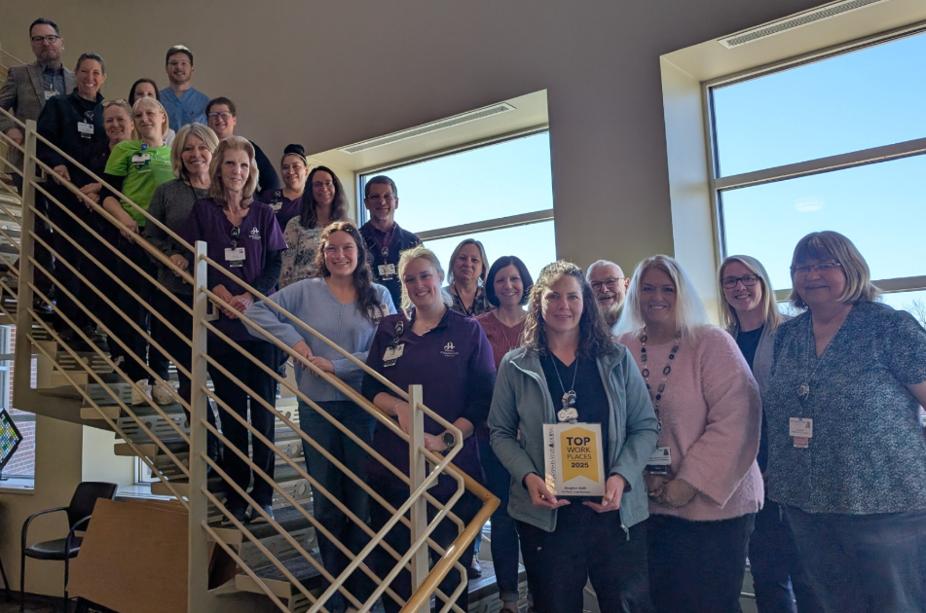

Director, Engagement & Experience Updates
Awards
Stoughton Health was recognized for being Madison’s Top Large Workplace at the Wisconsin State Journal Madison Top Workplaces Awards presentation on 3/19.

Slide 82
Chief of Staff Report
Dr. Aaron Schwaab

Slide 83

Request Motion to Approve One-Year Appointments.
One-Year Appointments
Janis Tupesis, MD, Emergency Medicine, SWEA, Active
Pupinder Jaswal, MD, Radiology, Madison Radiology, Courtesy
Yoginder Vaid, MD, Radiology, Madison Radiology, Courtesy
Michelle Romero, MD, Radiology, Madison Radiology, Courtesy
George Stohr, DO, Radiology, Madison Radiology, Courtesy
Jesse Boyett Anderson, MD, Pediatric Cardiology, UW Health, Courtesy
Imitiaz Ahmed, MD, Radiology, Madison Radiology, Courtesy
Stephen Philip, MD, Cardiology, UW Health, Courtesy
Evan Klein, MD, Cardiology, UW Health, Courtesy
Mark Gonwa, MD, Radiology, Madison Radiology, Courtesy
Wael Abdalla, MD, Radiology, Madison Radiology, Courtesy*
Flagged Files: None at this time

Slide 84
Two-Year Re-Appointments
Request Motion to Approve Two-Year
Re-Appointments.
Brian Bachhuber, MD, Cardiology, SSM Health, Courtesy *
Thomas Teelin, MD, Cardiology, UW Health, Courtesy *
Aurangzeb Baber, MD, Cardiology, UW Health, Courtesy
Ford Ballentyne, MD, Cardiology, UW Health, Courtesy
Anne Kilby MD, Ophthalmology, SSM Health, Active *
Aaron Schwaab, MD, General Surgery, Stoughton Health, Active *
Abigail Dahlberg, MD, Emergency Medicine, SWEA, Active *
Mark Belligan, PA, Emergency Medicine, SWEA, AHP *
Brian Martinson, PA, Emergency Medicine, SWEA, AHP *
Brad Johnson, PA, Emergency Medicine, SWEA, AHP *
Mary Hickner, DPM, Podiatry, Independent, Active *
Mary Embrescia, MD, Psychiatry, ITP, Courtesy *
Neza Bharucha, MD, Psychiatry, ITP, Courtesy *
Cathleen Handke, APNP, ITP, AHP
Cassandra Sung, MD, Pediatric Cardiology, UW Health, Courtesy *
Andrea Rock, MD, Pediatric Cardiology, SSM Health, Courtesy *
Roderick Deano, MD, Cardiology, UW Health, Courtesy
Shannon McCormack, DO, Hospital Medicine, Beam Healthcare, Active
Talya Spivak, DO, OBGYN, SSM Health, Active
John Hoopes, CRNA, Anesthesia, Sto Health, AHP *
Flagged Files: None at this time.

Slide 85

Open Discussion

Slide 86

Adjourn
Thank you for attending!

