Slide 1

Governing Board Meeting
May 28, 2025

Slide 2
Agenda
Review/Approve March 26, 2025 Governing Board Meeting Minutes
Trustee Education - Stoughton Health’s Processes for Providing a Safe Work Environment
New Business – Strategic Planning Rollout Plan
SSM Updates
Committee Updates
Chief of Staff Report
Administrative Team Updates
Open Discussion/Adjournment

Slide 3

Review and Approval of March 26, 2025 Governing Board Meeting Minutes
Request Motion to Approve March 26, 2025 Governing Board Meeting Minutes.

Slide 4

Trustee Education
Stoughton Health’s Process for Creating a Safe Work Environment

Slide 5
Stoughton Health’s process on Creating A Safe Work Environment
BOD Presentation May 2025

Slide 6
Our Process
Daily:
Safety Zone portal and 8:30 daily leadership huddles
Code Strong
Lockdown
Monthly:
Emergency Management
  Scheduled drills
    Statewide or County Coordination
    Ex. Mass casualty, active shooter drill, tornado drills
Annually:
Inservice Education
  -Relias software screenshot
  - Content created from University of Texas based on requlations like OSHA, etc…
Security vulnerability Analysis
  Required by DNV
  Many different types
    Hazard….
Facility Planning
  Example of actions: Swipes, security cameras, locked cells, lock-down process
  Future planning: Metal detectors, main entry redo, security roles?

Slide 7
Our Process
Daily:
Safety Zone portal and 8:30 daily leadership huddles
Monthly:
Emergency Management
  Scheduled drills
    Statewide or County Coordination
    Ex. Mass casualty, active shooter drill, tornado drills
Annually:
Inservice Education
  -Relias software screenshot
  - Content created from University of Texas based on requlations like OSHA, etc…
Security vulnerability Analysis
  Required by DNV
  Many different types
    Hazard….
Facility Planning
  Example of actions: Swipes, security cameras, locked cells, lock-down process
  Future planning: Metal detectors, main entry redo, security roles?

Slide 8
Our Process
Daily:
Safety Zone portal and 8:30 daily leadership huddles
Monthly:
Emergency Management
  Scheduled drills
    Statewide or County Coordination
    Ex. Mass casualty, active shooter drill, tornado drills
Annually:
Inservice Education
  -Relias software screenshot
  - Content created from University of Texas based on requlations like OSHA, etc…
Security vulnerability Analysis
  Required by DNV
  Many different types
    Hazard….
Facility Planning
  Example of actions: Swipes, security cameras, locked cells, lock-down process
  Future planning: Metal detectors, main entry redo, security roles?

Slide 9
Our Process
Reviewed at…
How we define goals.
Bi-annual Safety Survey

Slide 10
Daily

Slide 11
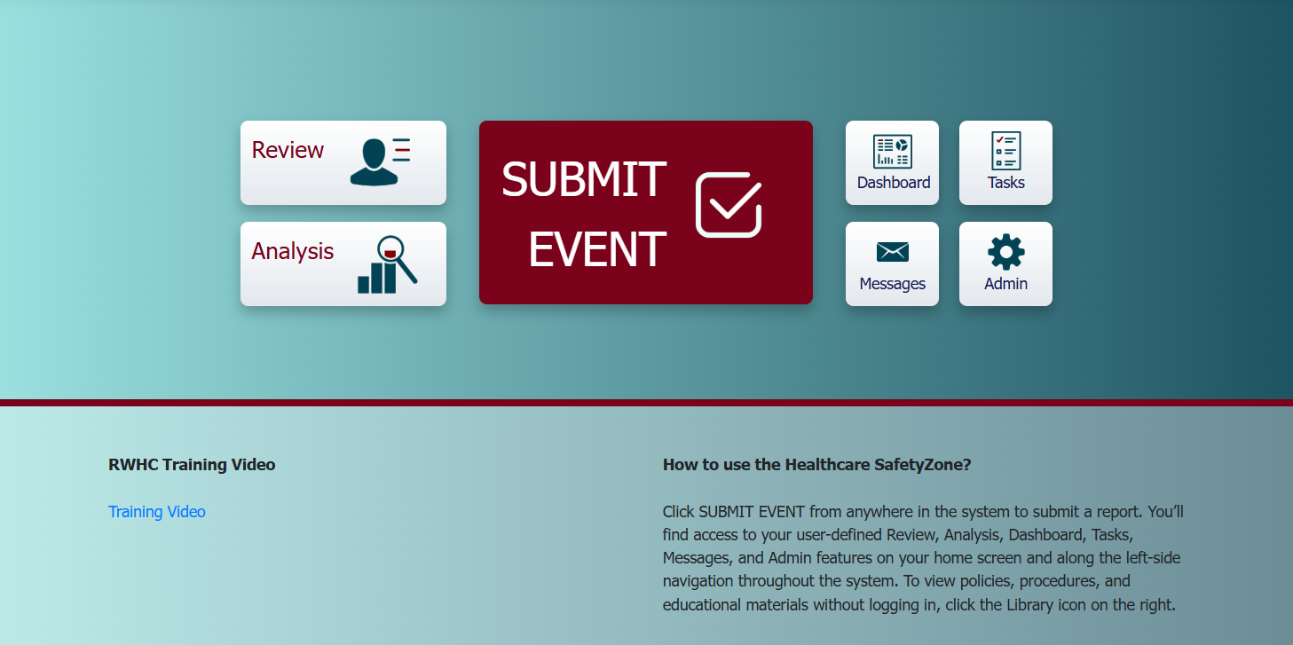
SH’s PnP on Event Reporting
Event
Safety Zone software
Centralized Reporting and Tracking

Slide 12
Monthly

Slide 13
SH’s PnP on Event Reporting
Insert Graph of common themes
  Slips, trips, falls
  Environmental
  Behavior events
  Medication Mgt

Slide 14
Annually

Slide 15
Security Vulnerability Analysis
DNV Requirement to Complete a Security Risk Vulnerability Assessment (SVA)
2025 Key Concern Identified
  Entry with a Weapon
What You Can Do
See Something, Say Something
Know your surroundings and you need to evacuate quickly, what is your route
Adhere to established hospital policies regarding safety and security

Slide 16

Security Vulnerability Analysis
Anxiety vs Actual Events

Slide 17
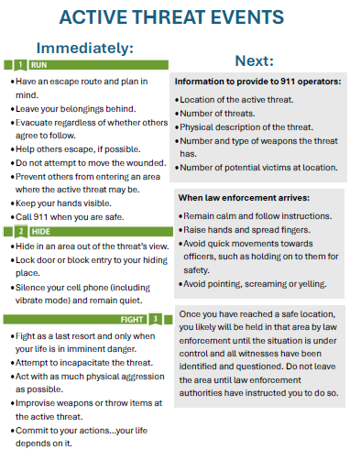
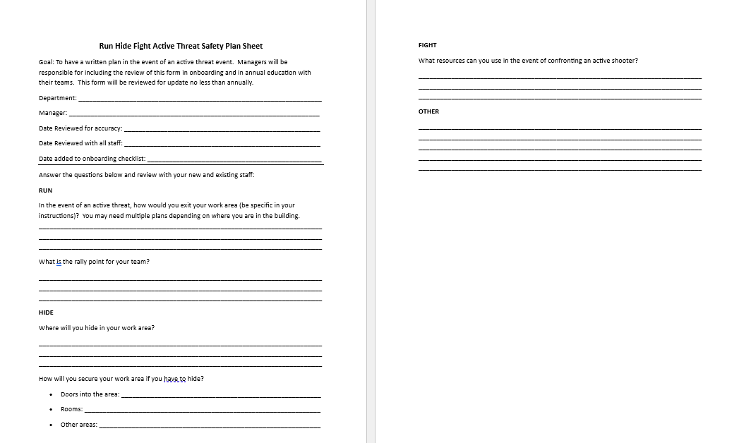
Examples of Education and Exercise

Slide 18
Show report for panic alarms and behavioral threats

Slide 19
Two Content Layout with Table
First bullet point here
Second bullet point here
Third bullet point here
Class | Group A | Group B
Class 1 | 82 | 95
Class 2 | 76 | 88
Class 3 | 84 | 90

Slide 20
Show graphic from Jason re graphic of locked doors and cells, cameras, panic alarms, badge swipe

Slide 21
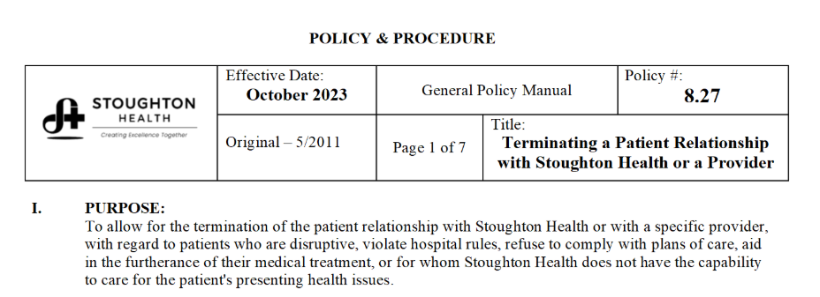
Patients with bad behavior
Show Banner
Something from Jen White – PNP

Slide 22
Looking ahead

Slide 23
Looking Ahead
3 to 1 person
MFP excercise
Front entry/design
On/off stage
Vendor Registration
Design/landscaping
Ongoing active shooter planning events

Slide 24
Questions?

Slide 25

SSM Health Updates
Dawit Tesfasilassie | Matt Kinsella

Slide 26
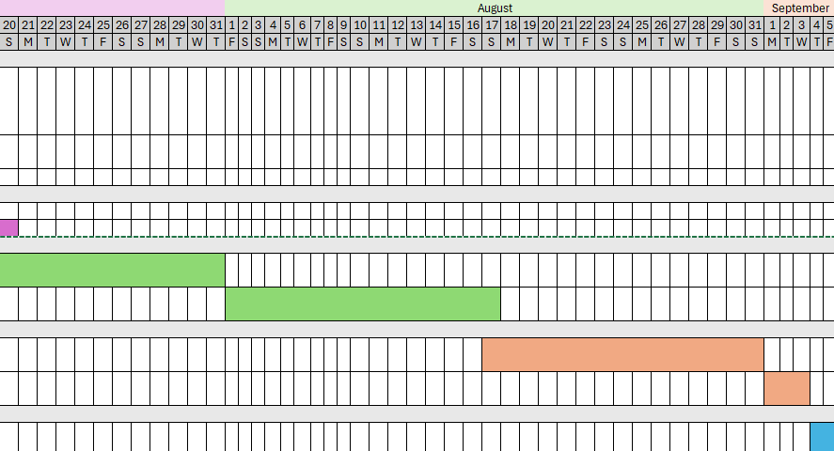
Strategic Planning Rollout Plan

Slide 27
Executive Committee Updates
Overview of April 23, 2025 Executive Committee Meeting
Capital Requests:
- Ultrasonic Washer for Robot
- Stryker Mako Robotic System
March 2025 Financials
Quarterly Compliance Committee Report

Slide 28
Approvals by Executive Committee
Capital Requests:
Ultrasonic Washer for Robot
Stryker Mako Robotic System
March 2025 Financials
Quarterly Compliance Committee Report

Slide 29
Finance Committee Updates
Overview of April 18, 2025 Finance Committee Meeting
March 2025 Financials
Capital Requests
Debt Management Strategy
Community Health Needs Assessment (CHNA) Implementation Strategy Review and Approval

Slide 30
Retirement of 2015 Bonds at Interest Reset Date &
Prepayment - 2018 & 2023 Bonds
Effect on Days Cash on Hand = ~ 55 days

Slide 31
Recommended Motions
Motion to Approve the Resolution As Presented in Packet to Retire 2015 Bonds at Interest Reset Date – September 1, 2015
Motion to Approve the Resolution as Presented for Prepayment of 2018 & 2023 Bonds at the amount allowed to be prepaid without penalty – prepayment date estimated to be June 17, 2025

Slide 32

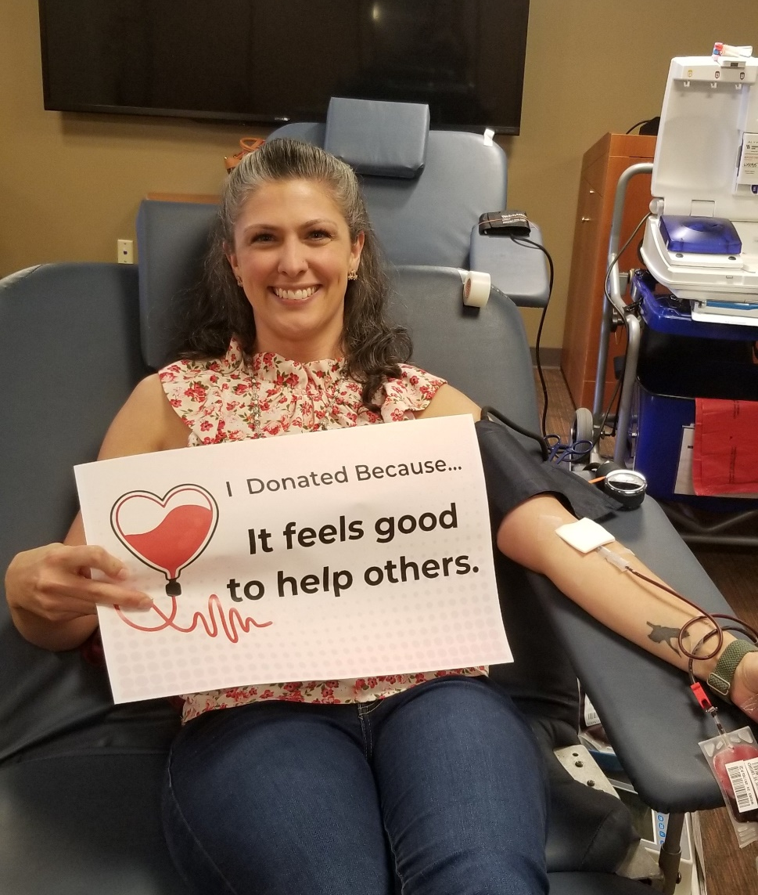

Community Health Needs
Implementation Strategy

Slide 33
Key priorities identified
Chronic Conditions
Injury & Safety
Mental Health & Substance Use
Reproductive Justice

Slide 34
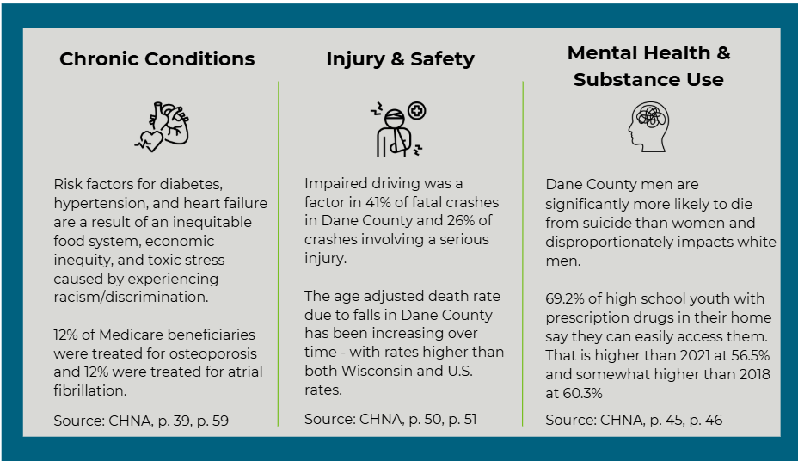
Stoughton Health Implementation Plan Priorities

Slide 35
Community Health Needs Assessment Implementation Strategy Review and Approval
Request Motion to Approve 2025 – 2027 Community Health Needs Assessment Implementation Strategy.

Slide 36
Governance Committee Updates
Overview of April 17, 2025 Governance Committee Meeting
Review of 2025 Conflict of Interest Statement Summary
2026 Governing Board Nominations
Board Self-Evaluation – Next one will be coming out in early June!

Slide 37
Quality Management Committee Updates
Quality Management Committee Updates
Review of QM Council Meeting Minutes
Review QM Council Dashboard

Slide 38

Closed Quality Management Council Projects
March 25, 2025 – Cohort B
Material Services, Nurse Server Cabinet Design and Restocking Process
April 22, 2025 – Cohort A
Registration, Registration Onboarding
PFS, Contract Build in Epic

Slide 39
Audit Compliance/Risk Management Committee Updates
Overview of April 18, 2025 Audit Compliance/Risk Management Committee Meeting
Auditor Presentations/Final Selection of Auditor

Slide 40

Final Selection of Auditor

Slide 41
Chief of Staff Report
Dr. Aaron Schwaab

Slide 42
One Year Appointments
Philip Budihardjo, MD, Radiology, Madison Radiology, Courtesy
George Cherian, MD, Radiology, Madison Radiology, Courtesy
Benjamin Cooper, MD, Radiology, Madison Radiology, Courtesy
Jon Kralik, MD, Radiology, Madison Radiology, Courtesy
Peter Marogil, MD, Cardioloy, UW Health, Courtesy
Matthew Rodgers, MD, Sleep Medicine, Courtesy
Sally Horne, MD, Neurology, Beam Healthcare, Active
TJ Dyer, DDS, Dental, Center for Oral & Maxillofacial Surgery, Courtesy
Terra Green, APNP, SWEA, AHP
Flagged Files: None at this time
Request Motion to Approve One Year Appointments.

Slide 43
Two-Year Reappointments
Janice Hesler, APNP, ITP, AHP*
Ewa Alexander, MD, Sleep Medicine, SSM Health, Courtesy*
Tina DeGroot, APNP, Stoughton Health, AHP*
Karen Pletta, MD, Pediatrics, UW Health, Courtesy*
Brad Wagner, CRNA, Anesthesia, Stoughton Health, AHP*
Cameron Weess, PA-C, Stoughton Health, AHP*
Flagged Files: None at this time
Jacob Anderson, MD, Radiology, Courtesy, Madison Radiology*
Mehul Doshi, MD, Radiology, Courtesy, Madison Radiology*
Frederick Joachim, MD, Radiology, Courtesy, Madison Radiology*
Nicholas Kolanko, MD, Radiology, Courtesy, Madison Radiology*
Joshua Riebe, MD, Radiology, Courtesy, Madison Radiology*
Eric Monat, MD, Radiology, Courtesy, Madison Radiology*
Mary Woodman, PA-C, AHP, Emergency Medicine, SWEA*
Skylar Larsen, MD, Emergency Medicine, Active, SWEA*
Jennifer Mirrielees, MD, Emergency Medicine, Active, SWEA*
Jennifer Roth, APNP, Emergency Medicine, AHP, SWEA*
Matthew Tattersal, MD, Cardiology, UW Health*
Kerline Ductan, MD, Hospital Medicine, Beam Health, Active*
Christina Blake, APNP, ITP, AHP*
Request Motion to Approve Two-Year Reappointments.

Slide 44
CEO Summary Report
Chris Brabant
Service Line Expansion
Retreat Reminder

Slide 45
Service Line Expansion
Expanded Cardiology Service
Interventional Spine & Pain Clinic
2nd Orthopedic Surgeon

Slide 46


2025 Governing Board Retreat
Guest Speaker
Jamie Orlikoff
Orlikoff & Associates
Grand Geneva Resort, Lake Geneva
  September 4-5, 2025

Slide 47
CFO Summary Report
Michelle Abey
April 2025 Financials
May Gross Revenues Month-to-Date
Sale of Property for Highway 51 Project
Capital Request: Dean Rooftop HVAC Unit
Stoughton Health Outpatient Center (SHOC) Updates
IRS Form 990

Slide 48
April 2025 Financials
Operating Income
$1,314,871
Balance Sheet Metrics
Revenues
Expense Variances
Request Motion to Approve April 2025 Financial Statements.

Slide 49
May Gross Revenues Month-To-Date 2025

Slide 50
Sale of Property for Highway 51 Project
Project: Reconstruction of US Hwy 51 from Roby Road & Hwy 51 to the south side of County Hwy. B/AB & US Hwy. 51 in the town of Dunn
SH Affected Property at Community Health & Wellness Center – 3162 County Hwy. B
Construction Scheduled for 2026 & 2027
Appraisal Done by WI DOT - $30,850
Request Motion to Approve Sale of Property for Highway 51 Project to the WI Department of Transportation for $30,850 and authorize the corporate officers to execute any needed documentation.

Slide 51
Capital Request: Dean Rooftop HVAC Unit
One of the HVAC rooftop units serving Dean Clinic is original and has exceeded its life expectancy of 20 years.
By replacing this with a new Rooftop unit, energy costs will drop significantly due to being more energy efficient.
The anticipated lead-time on a roof top HVAC unit is 16-18 weeks.
The life expectancy for a rooftop unit with proper maintenance is 20 years. This new RTU will follow the same weekly, monthly, and semi-annual preventative maintenance schedules as all other units to achieve the longest life expectancy.
Request motion to approve budgeted capital expenditure of $273,014 for the replacement of Dean’s South HVAC Rooftop Unit.

Slide 52
Stoughton Health Outpatient Center (SHOC) Updates
All Services Moved in:
    Cardiac Rehab
    Rehab Services – PT, OT, ST
    Multi-Specialty Clinics – Cardiology, General Surgery, Orthopedics, Podiatry, Urology, Wound
  Connector Tunnel Usage
  Kiosk Usage
  Budget Update

Slide 53
FY2024 - IRS Form 990
Prepared by Eide Bailly
Best Practice: Board of Directors have an opportunity to review prior to filing
Return Due: August 15, 2025
Please get any questions or comments to Michelle by June 15, 2025.

Slide 54
CNO Summary Report
Amy Hermes
Growth Update – Sterile Processing Department
MCE/MEC Meeting Minutes
Annual Clinical Services Evaluation
Patient Safety Meeting Minutes
Infection Prevention Meeting Minutes

Slide 55
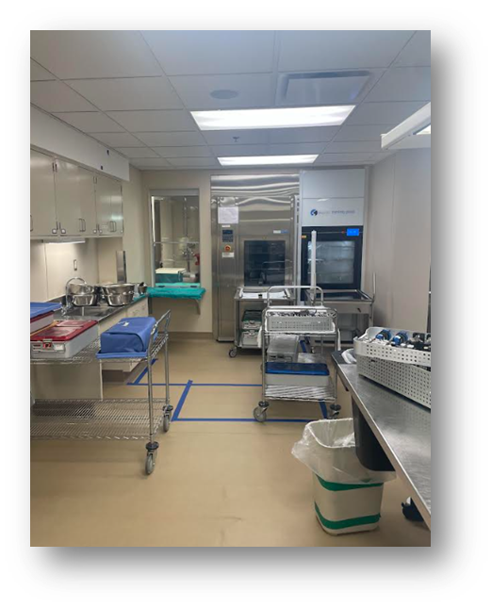
Growth Update – Sterile Processing Department
Final phase: Flooring will be as follows:
  Thursday 5/29 @ 3pm: Barrier Install & Start Demo
  Friday 5/30: Flooring Install
  Saturday 5/31: Flooring Install
  Sunday 6/1: EVS Terminal Clean
  Monday 6/2 @ 5am: Remove Barriers/ move items back into the clean side

Slide 56
MCE Meeting Minutes – March/April 2025
Approved formulary additions and will take to MEC for final approval.
Loss of power RCA completed.
Providers discussed the need for tap and go capabilities.
Traveler hired in for MRI, so we expect to see increased exams.
Four deaths in March. All were called in to Statline, as per policy and conditions of participation. None of those patients were eligible as donors.

Slide 57
MEC Meeting Minutes – May 2025
Dr. Lind was appointed to MCE.
Requested approval for formulary additions.
Dr. Kaji in Cardiology is departing 8/1 - transitioning out as Zenith Group starts.

Slide 58
Annual Clinical Services Evaluation – 2024
CMS requirement to review clinical services contracts annually
CNO & Chief of Staff review findings
Full report included in packet
Request Motion to Approve Annual Clinical Services Evaluation Report as presented in the Governing Board packet.

Slide 59
Patient Safety Meeting Minutes
Continuing to monitor controlled substance documentation discrepancies.
1 event where the wrong medication was dispensed and administered to the patient (ropinirole was ordered and risperidone was given—this was the RCA we completed)
Barcode scanning continues to improve. Raising goal to 98%.
Working with RWHC to set up non-violent crisis training.

Slide 60
Infection Prevention Meeting Minutes
Reviewed the use of Nozin for reduction in risk of infection for all surgical patients.
Continued surveillance of measle cases in the US.
Reported off on work being done for safer transportation of instruments from clinics and Urgent Care’s.

Slide 61

Approval of Consent Agenda
Request Motion to Approve Consent Agenda.

Slide 62
VP, HR, Campus Planning, Operational Support Services Summary Report
Chris Schmitz
Annual Evaluation Report to Board
  Facility Updates

Slide 63
Annual Performance Evaluation Summary
Staff Competency Assessment Measurement Period Results: A total of 404 evaluations were completed over this measurement period including both annual and introductory evaluations.
Required Manager Follow Up Items with 9 employee annual evaluations.
No Action Items with introductory evaluations in this period. 402 of 404 or 99.5% of all performance evaluations, both annual and introductory, for the measurement period are complete as of April 30, 2025.
Annual Evaluation Results
325 of 326 or 99.7% of annual evaluations were completed on-time through April 30, 2025
1 of 326 or 0.3% of annual evaluations are not yet complete
Introductory Evaluation Results
76 of 77 or 99% were completed on time.
Due to confusion related to completing introductory evaluation in Dec. 2024 or being unaware of need to complete annual evaluation in April 2025.
1 of 77 or 1% is not yet complete due to the employee being off work on a medical absence.

Slide 64
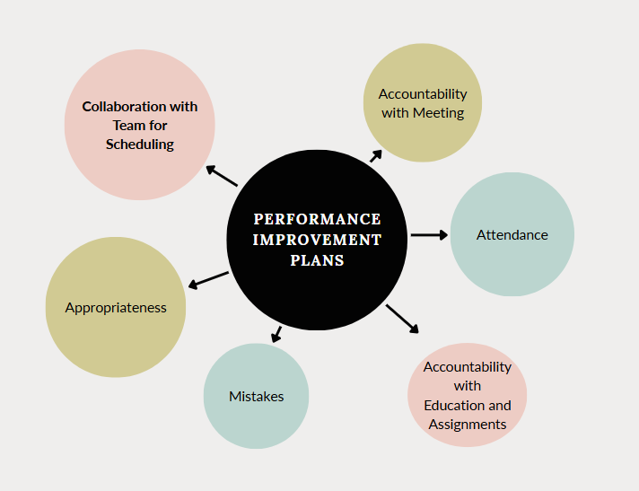
Annual Performance Review Performance Improvement Plans
Spring 2025

Slide 65
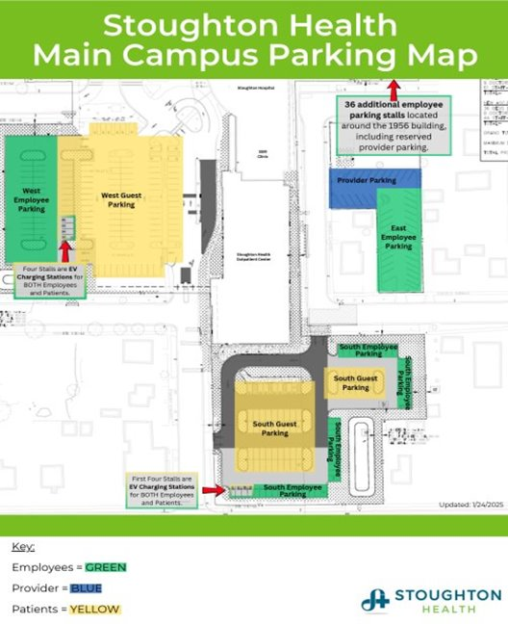
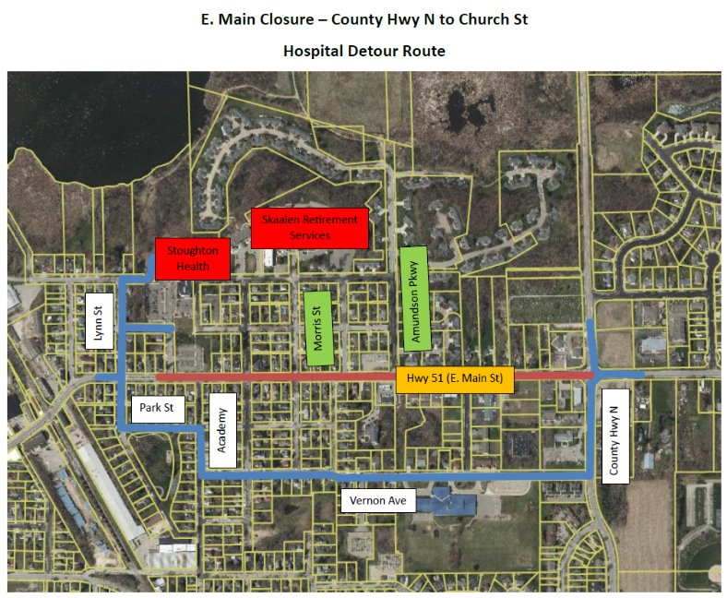
Facility Updates

Slide 66
Director, Engagement & Experience Summary Report
Andy Boryczka
Employee Recognition – DAISY and BEE Update​
Patient and Family Advisory Council​
2025 Employee Engagement Survey Results and Ongoing Support Timeline​

Slide 67
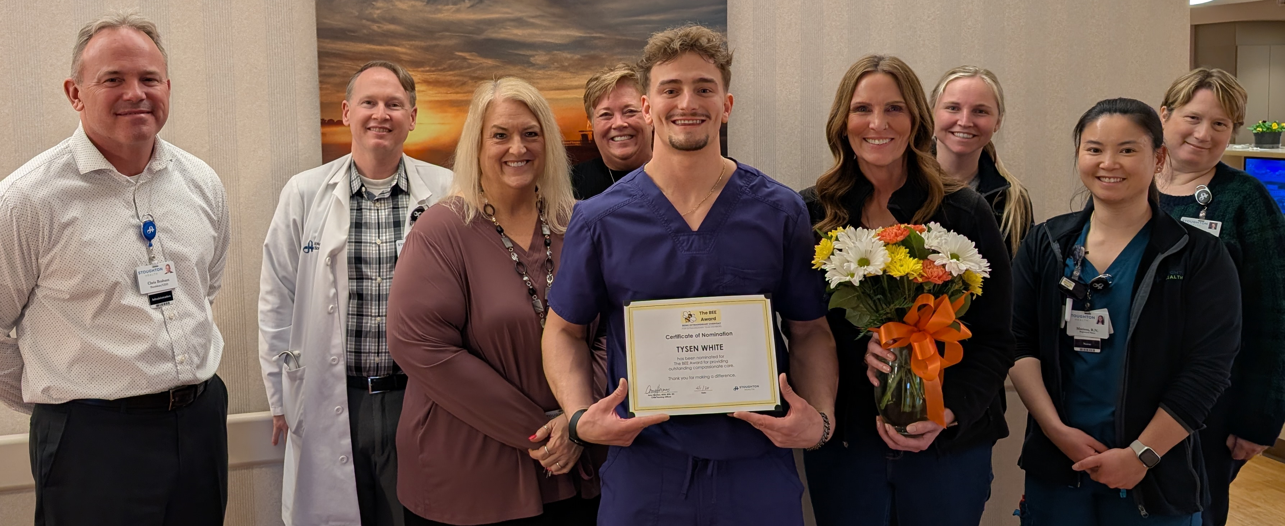
DAISY and Bee Awards Update
By the Numbers:
113 – Total nominations as of 5/14/2025
40 - Nominations that went to Med Surg staff
6 – The most nominations for a single staff person
Notes:
Share updates on participation - brisk

Slide 68
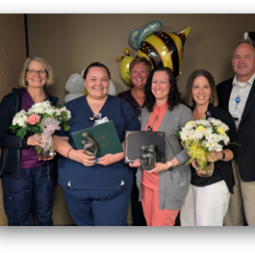
Daisy and Bee Honorees
Celebration
5/6/2025 or winners were honored
Bee Award Honoree: Alison Baillies, Radiology Technologist
Daisy Award Honoree: Jessica Johnson, RN
Winners were selected by the Customer Experience Team

Slide 69
Daisy and Bee Going Forward
Evaluation:
Surveyed nominees about their experience
Based on feedback from staff making minor changes
  Multiple nominees
  Moving to a free meal from the café v. $5 off at the gift shop

Slide 70
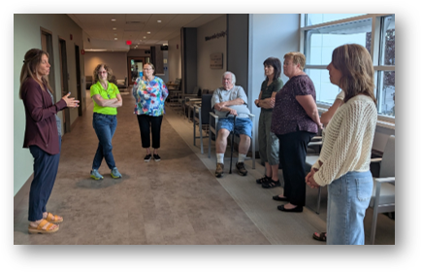
Patient & Family Advisory Council (PFAC)
Giving perspective:
5 community members
Multiple staff:
  Customer Experience Team members
  Valets
  Admin team
Giving input on things like:
  Signage in the SHOC
  Discharge paperwork
Recruitment is ongoing

Slide 71
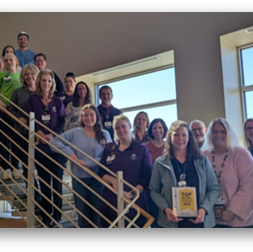
2025 Top Large Workplace Award
We’re Number 1!
Awarded Top Large Workplace in the Madison area
Thanked staff with a gift from our online store

Slide 72
2025 Employee Engagement Survey
By the Numbers:
85% response rate
Workplace Experience Score dropped 3% to 81% (12% above benchmark)
All other themed areas performed extremely well (but did drop slightly from 2024)

Slide 73
2025 Employee Engagement Survey
Themes in Comments:
Areas staff commented positively about:
  Communication
  Connection to purpose
  Feeling valued
Areas staff identified as areas of opportunity:
  Feeling valued
  Staffing levels
  Communication

Slide 74
2025 Employee Engagement Survey
The answer to all your questions is to ask more questions:
There are no “good” or “bad” results
Results and comments direct questions
Leading productive discussions and creating action plans with frontline staff and their supervisors creates the change staff and SH wants to see.

Slide 75
2025 Employee Engagement Survey
March and April
Staff complete survey
Results received
May and June
Meetings with teams begin
September and October
Check-in survey
April and May
AC reviews scoring
Follow up meetings to discuss data and action plans begins
Ongoing Cycle
Quarterly rounding with Director of Engagement and Experience
Notes:
This the cycle of data collection, analysis, discussion, communication, planning and operationalization moving forward.
We will eventually get to a quarterly survey or check in to gauge success in turning staff voice into action.
Engagement goals are being included in manager goals for performance.

Slide 76
2025 Employee Engagement Survey
Questions?
Homework:
Going forward, what information would be useful for me to provide you?
Notes:
Like our frontline staff I want to know what you would like to know more about in terms of culture architecture at SH. Please let me or a member of AC know if there are topics you’d like me to review with this group.
Send out MS Form with questions for them top get back to me.

Slide 77
Foundation/Marketing/PR/Business Development Director Summary Report
Laura Mays
PR/Marketing Report
Events/Education
Foundation – Fundraisers/Events
Foundation Dashboard
Partners Updates

Slide 78


PR/Marketing Report

Slide 79
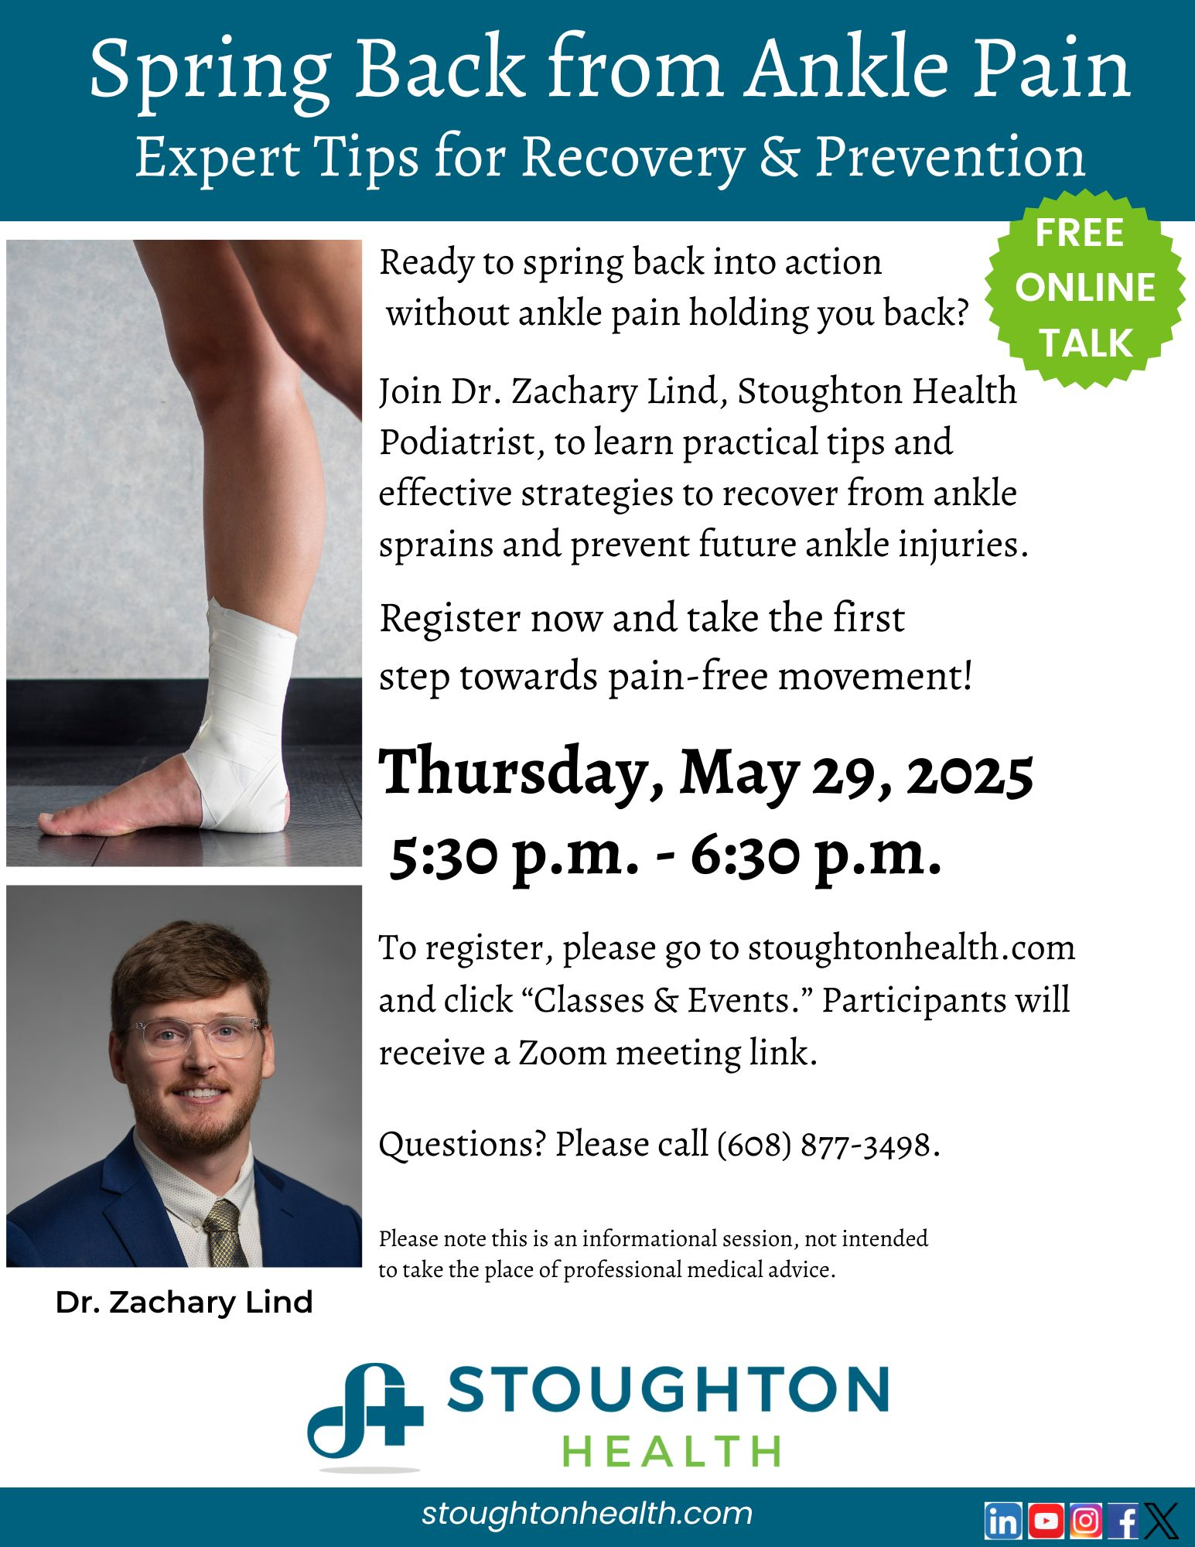
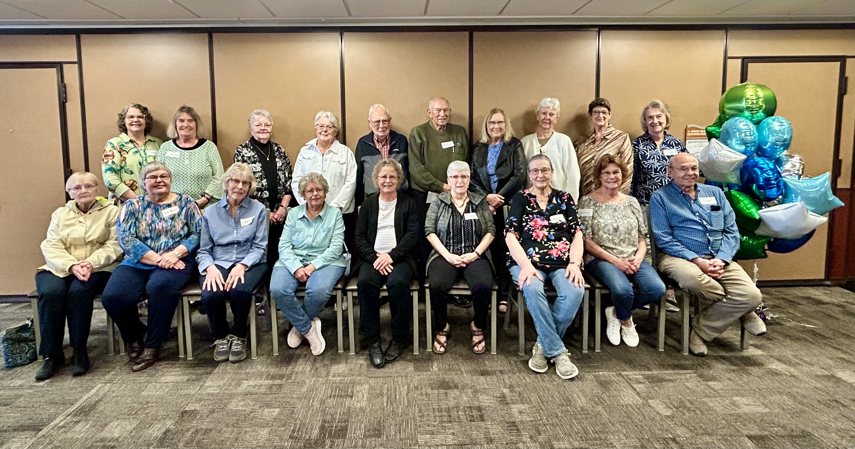
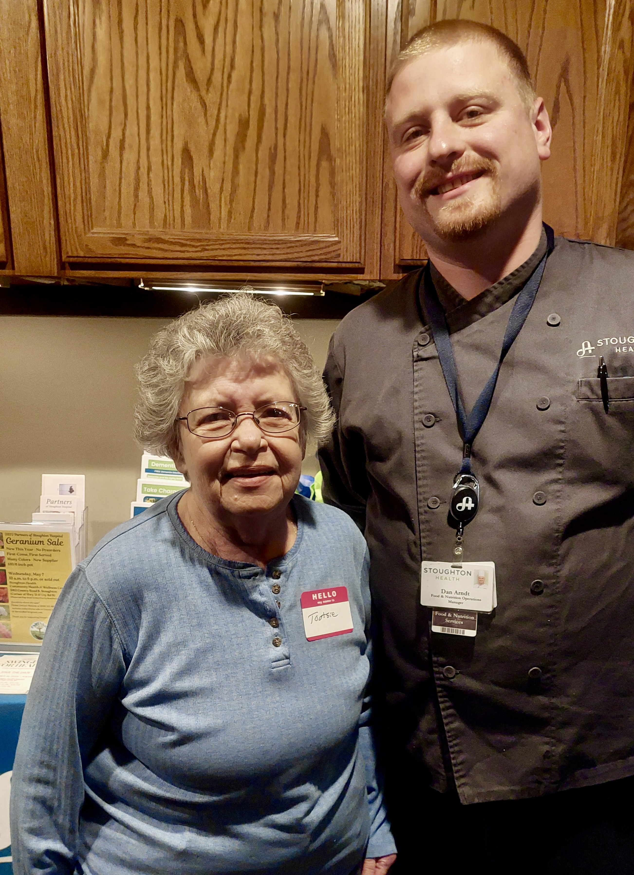
Events/Education

Slide 80

Foundation – Fundraisers/Events

Slide 81
Foundation Dashboard

Slide 82

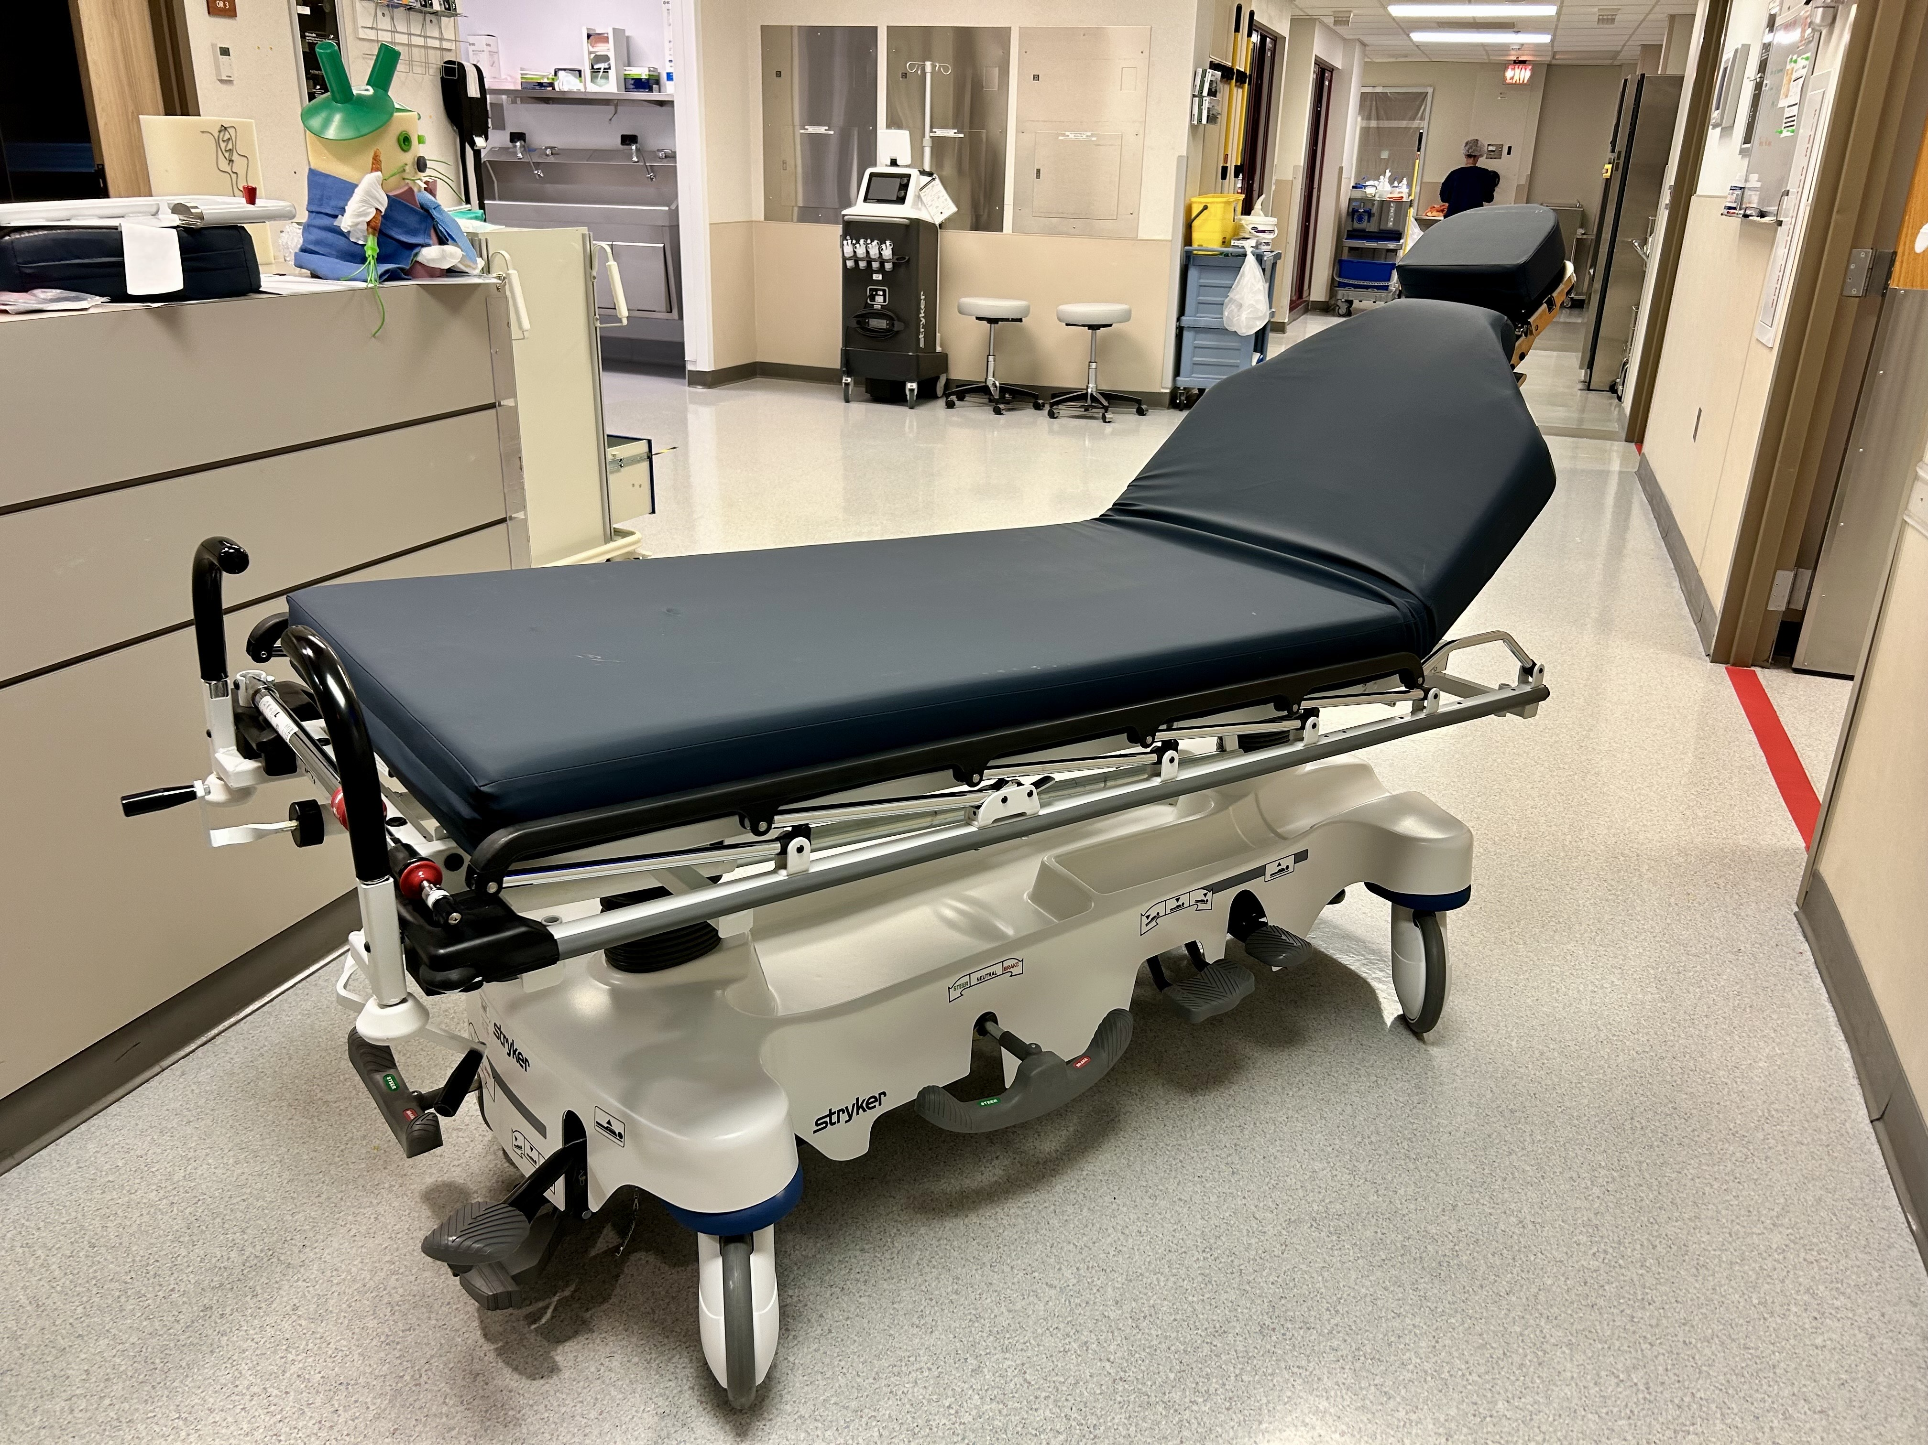
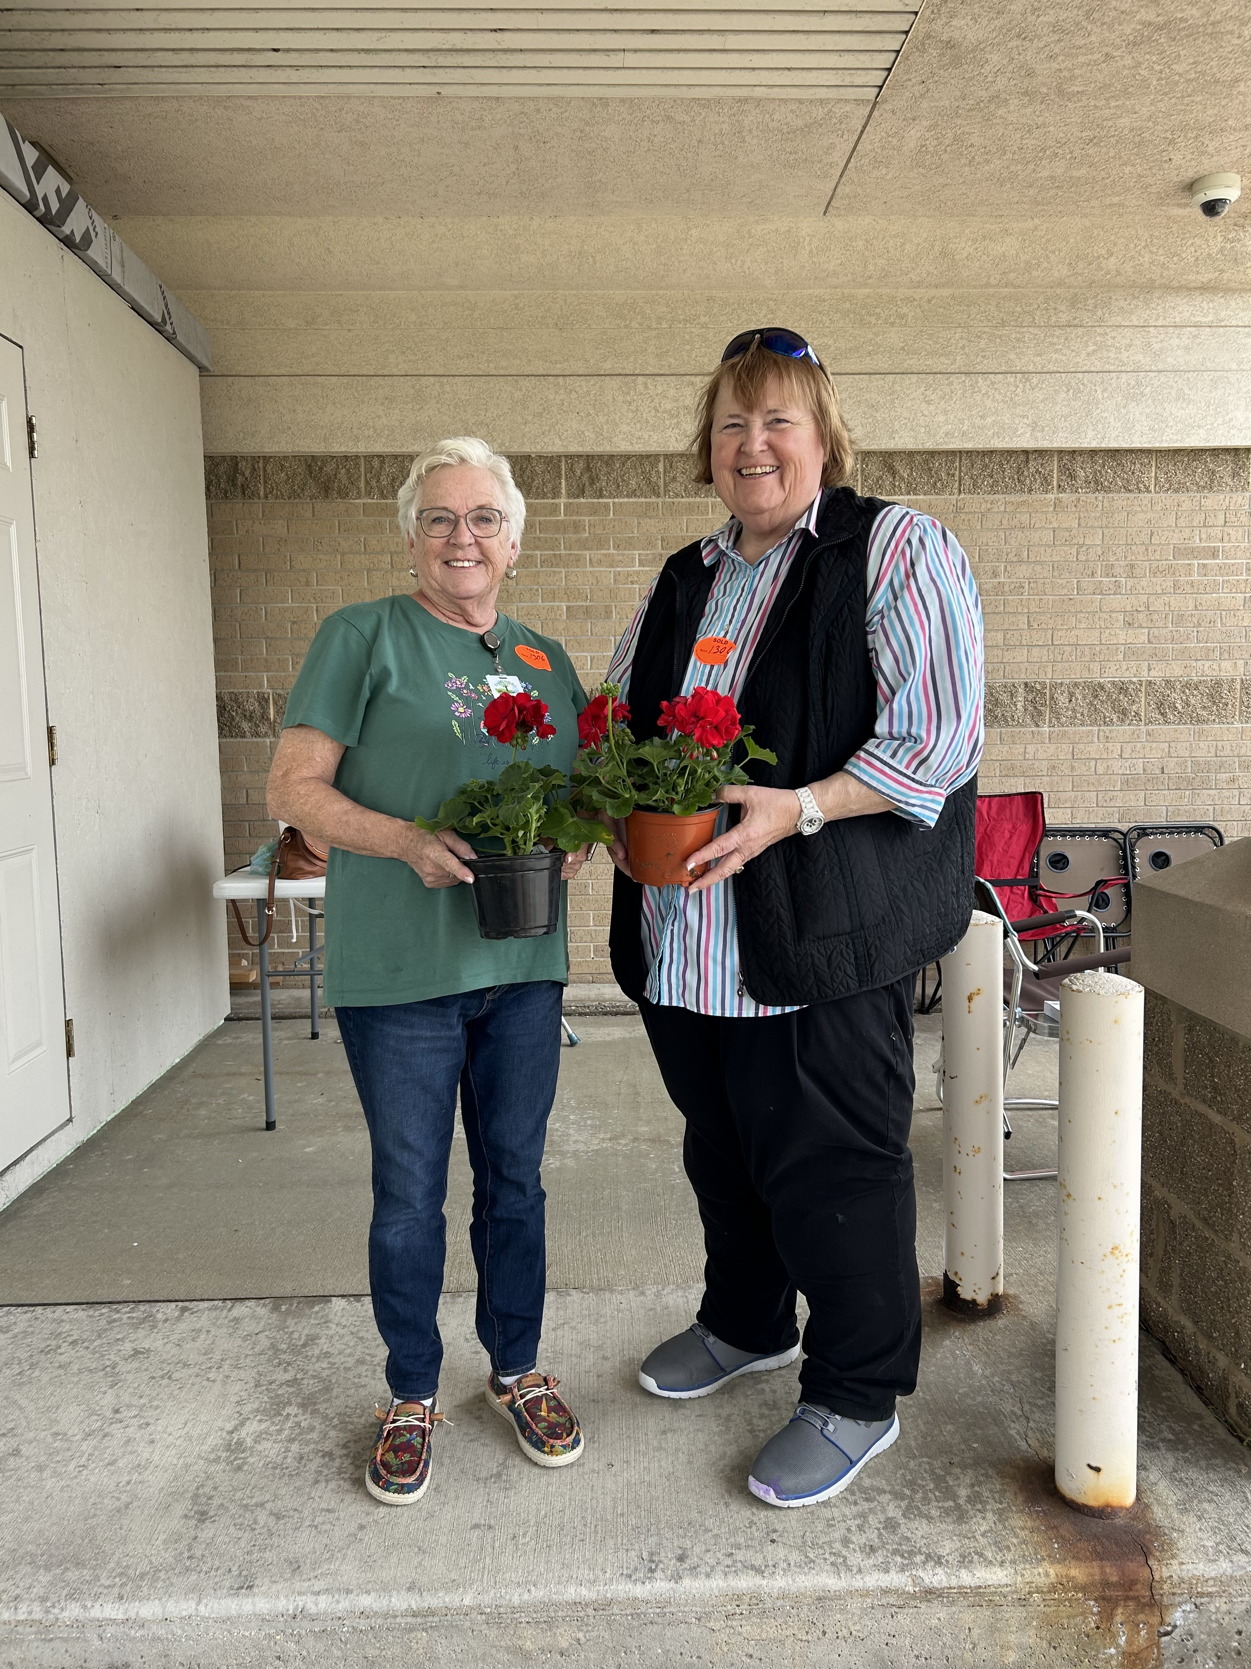
Partners Updates

Slide 83
Open Discussion

Slide 84
Adjournment
Thank you for attending

