Slide 1
Executive Committee
April 23, 2025

Slide 2
Agenda
Review/Approve December 18, 2024 Executive Committee Meeting Minutes
Capital Requests:
Ultrasonic Washer for Robot, $110,740
Stryker Mako Robotic System, $920,000
March 2025 Financials – April Month-To-Date
Quarterly Corporate Compliance Committee Report
Service Line Updates
Open Discussion
Adjournment

Slide 3
Review and Approval of December 18, 2024 Executive Committee Meeting Minutes
Request Motion to Approve December 18, 2024 Executive Committee Meeting Minutes.

Slide 4
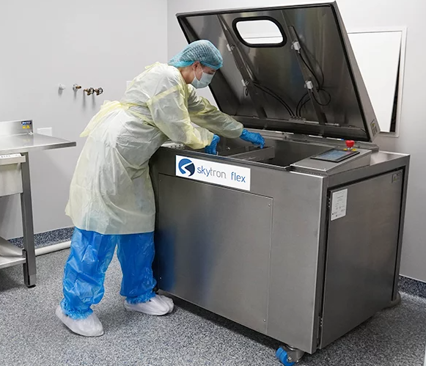
Capital Request: Skytron Flex Ultrasonic Washer Disinfector
With the upcoming implementation of robotics, the sterile processing department (SPD) will need to purchase a new ultrasonic washer disinfector that can effectively integrate with robotic systems for cleaning surgical instruments.
This surgical instrument washer-disinfector is versatile and can process large loads of cannulated, non-cannulated, and robotic instruments.
The need for an ultrasonic washer was carefully vetted with the SPD project team to confirm that there is adequate electrical and plumbing infrastructure to support the new equipment.
Request Motion to Approve on Behalf of the Governing Board FY2025 Capital for $110,740 for an Ultrasonic Washer.

Slide 5
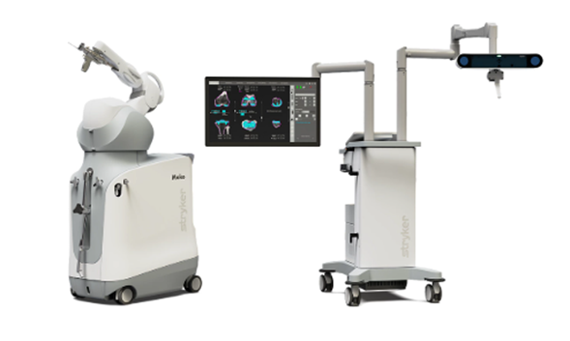
Capital Request: Stryker Mako SmartRobotics Robot
The Stryker Mako SmartRobotics system is a robotic-arm assisted surgery platform used in joint replacement procedures allowing surgeons to create personalized surgical plans based on 3D CT scans and guide the robotic arm during surgery for precise implant placement
The Mako system is expected to evolve further, with future applications such as the shoulder surgery module coming in 2026.
Key benefits of the Mako system include:
Increased surgical precision and alignment accuracy.
Faster recovery times and reduced postoperative pain compared to traditional methods.
Minimally invasive procedures that reduce trauma to surrounding tissues.
Recruit orthopedic surgeons who are accustomed to using the advanced technology.
Attract individuals who view robotics as a cutting-edge advancement in healthcare.
Request Motion to Approve on Behalf of the Governing Board capital of $920,000 to purchase the Stryker Mako SmartRobotics Robot.

Slide 6
March 2025 Financials
Operating Income
$1,391,701
Balance Sheet Metrics
Revenues
Expense Variances

Slide 7
March 2025 Financials
Request Motion to Approve March 2025 Financials.

Slide 8
April Gross Revenues Month-To-Date 2025

Slide 9
Quarterly Corporate Compliance Committee Report
Certifications & Accreditations
Grievances
QM Projects Completed Re: Compliance Risk
UHC Compliant
New Subpoenas
Request Motion to Approve the Quarterly Corporate Compliance Committee Report.

Slide 10
Service Line Updates
Podiatry
March = 125 Podiatry Clinic Visits - ~10 patients per day in clinic – had budgeted to get there in June 2025
12 Surgeries through March 31st – 8 less than budget; April to date – 8 surgical cases
New Cardiology Provider Group – starting August 1, 2025
Spine & Pain Management Program

Slide 11
Open Discussion

Slide 12
Adjournment
Thank you for attending

