Slide 1
Cardiology Clinic
Cardiac HEAL Program
1st Presentation Date: September 5th, 2024
Document Last Presented: March 25th, 2025

Slide 2
Quality Story:
PLAN
Cardiac HEAL Program
Goal(s): What are you trying to accomplish?
KOM Target: Creation and initiate Secondary Prevention Program (Complete – November 2024) Identify and Implement documentation template [Billing/Coding] (Complete – October 2024) Evaluate quality of life metrics for heart failure in pilot group via health-related quality of life tool (COOP). (complete– April 2025) Current KOM Status: KOM 1 & 2 – complete, KOM 3 – complete
Background: Explain what the original situation was. Why was a change recommended? (e.g. variation, poor outcome, etc.)
A community needs assessment identified chronic illness, with heart failure (HF) as a priority. The Cardiology Clinic serves many patients with chronic conditions, including HF. Heart failure was identified by the team as the priority chronic illness diagnosis. A gap in current practice exists, as not all HF patients qualify for secondary preventative services like Cardiac Rehab due to LVEF and other factors. An opportunity was identified to create a secondary prevention program focused on exercise, lifestyle modification, and patient-driven goals for change management. The Cardiac-HEAL program aims to enhance cardiovascular health and quality of life for HF patients through evidence-based programming, exercise, advanced lifestyle modifications, and guideline-directed medical therapy (GDMT).
Driver: Explain why the project is critical to SH. Why does it relate to the strategic plan?
1. Cardiac HEAL program aligns with Community Needs Assessment 2. Aim to improve patients Health Related Quality of Life (HRQoL) Cardiac HEAL Program will focus on: Physical Fitness Overall Health Quality of Life 3. Potential for Cost Savings. Literature suggests that secondary prevention programs can translate into cost savings by reducing readmission rates. (cost on average is $15K – 25K per patient). 4. New Revenue stream Cardiac HEAL sessions allow for billable
Team:
Project Leader: Jonathan Milton Members: Tina DeGroot, Nikki Rowin, Rhonda Tesmer, Victoria Valdez, Andrew Saul, Sarah Callan

Slide 3
Changes:
DO
List the changes that have been made leading to improvements.
What? | Why? | When?
Gather project team | To ensure the necessary stakeholders are involved in the project | Sep-24
Discuss opportunities and goals | To align the team on the purpose and objectives of the program | Sep-24
Develop program | To create a clear framework for the program's design and execution | September 2024 - October 2024
Create / Analyze documentation template | To ensure the program is compliant with billing and coding standards | September 2024 - October 2024
Initiate pilot program | To start testing the program with a select group of patients | November 2024
Run Pilot | To provide evidence-based interventions for heart failure patients | November 2024 - March 2025
Collect and analyze data | To assess the program's impact and identify areas for improvement | Apr-25
Evaluate outcomes | To refine the program based on initial results and feedback | May-25
Discuss next steps | To determine whether the program should be expanded or modified | May-25

Slide 4
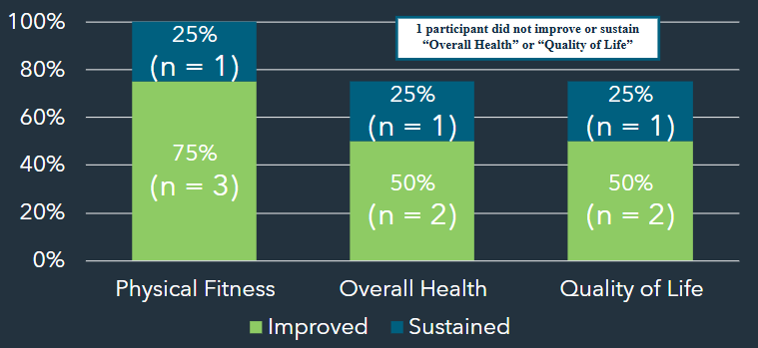
Measures:
STUDY
Include graphs of your measurement, results of surveys, etc. Include benchmarks or comparative data when available.
Pilot Patient Facts
Ejection Fraction 45%-60%
Age 55-83
100% of pilot patients under 70 demonstrated an improved or sustained coop in all categories
Of those subset of pilot patients, varied in number of sessions between 4 & 11

Slide 5
Findings:
ACT
Results: Did you accomplish your goals?
Completed QI initiative with supporting our patients with Heart Failure
Lessons Learned: What did you learn as a result of this project? Unexpected discoveries? Problems or barriers?
Early Initial thoughts: Identified need for new HRQoL tool (consider replacing COOP) Expand age group to Adult & Older Adult (not limited to only the older adult) Identified need for probably more structured 4 session program, 40 min (meets current matrix) Following program --> Transition and offer Group Medical Visits (GMVs)
Next Steps: What actions are you going to take based on your findings? (e.g. roll out to additional units; modify and make additional improvements; abandon the effort; change course?)
-Group Medical Visit Training – Grant Funded -Financial Analysis – ongoing auditing as needed -Investigate National benchmarking opportunities for Rural Health HF programs -Utilize Certified Wellness Practitioner within the context of supporting GMVs
Project Leader is Recommending the Following:
QM Council approval for completion of project?: Enter YES or NO Project still in progress, project to continue: Enter YES or NO

Slide 6
Cardiac Rehabilitation
Electronic Phase 3 exercise referral
1st Presentation Date: 11/28/23
Document Last Presented:7/3/24

Slide 7
Quality Story:
PLAN
Electronic Phase 3 exercise referral
Goal(s): What are you trying to accomplish?
KOM Target: 80% of Phase 3 exercise referrals to be placed electronically vs a paper referral Current KOM Status: 100% completed. The CRR15 order was created and went live on 2/13/25. Testing was done for about 1 week and the ticket was closed on 2/19/25. Starting using at CR on 3/1/25 through 5/7/25. We have had 4 patients who have SSM provider where the CRR15 referral was placed. 100% of these referrals were placed successfully.
Driver: Explain why the project is critical to SH. Why does it relate to the strategic plan?
Eliminate paper referral to be scanned into EPIC Decrease wait times for a patient to start the phase 3 exercise program. Prevent from paper referral getting misplaced or lost “in transit” via fax Make it easier for our SSM providers to place a referral for exercise for their patients
Background: Explain what the original situation was. Why was a change recommended? (e.g. variation, poor outcome, etc.)
All of our other referral were placed electronically except for the phase 3 exercise referral which was paper. We would to make it consistent with all of our referrals from SSM providers to be placed electronically
Team: Cardiac Rehab staff
Project Leader:Cardiac Rehab team Members: Melissa Trumm, Melanie Pavolonis, Madie Mehlhoff and Cathy Grabowski

Slide 8
Changes:
DO
List the changes that have been made leading to improvements.
What? | Why? | When?
Figure out if we session numbers vs unlimited, expiration date/needing a new referral yearly or can it be ongoing and change comment ; if not, place ticket to create a new phase 3 referral order | To better represent the purpose of the phase 3 exercise program | 7/3/24- message sent to Nikki for update; response from Nikki is “I see an update on the ticket just now stating, “We do not have an ETA as of yet. We will assign an analyst to this as soon as resources allows.” 2/13/25-CRR15 referral was created and went live. Tested with Dr. Lively and closed the ticket on 2/19/25
Create smart phrase in EPIC to send to SSM providers to ask for phase 3 referral | To make it easy for our SSM providers to place Phase 3 referral | Jan 1, 2024-Completed
Test the current EPIC Phase 3 referral on a incoming phase 3 patient of Dr. Lively’s | To see if Dr. Lively can place referral easily and if she can change expiration date and # of sessions if need; also will this referral drop into our workque | 2/13/25- CRR15 referral completed and went live. Dr. Lively was able to successful place a CRR15 order and the ticket was closed on 2/19/25

Slide 9
Measures:
STUDY
Include graphs of your measurement, results of surveys, etc. Include benchmarks or comparative data when available.
Completed CRR 15 order
Smartphrase sent to PCP to place CCR15 order
Dear Dr. *** ,
Your patient, *** , has completed our Phase 2 Cardiac/Pulmonary Rehab program or they are a current participant in the Phase 3/Maintenance exercise program at the Cardiac/Pulmonary rehab program at Stoughton Health. Your patient would like to continue exercising in our Phase 3/Maintenance exercise program for *** (enter year).
The Phase 3/Maintenance exercise program is an independent exercise program where patients who have either completed our phase 2 cardiac/pulmonary rehab program or patients/community members with one or more cardiac risk factors can come to exercise 2-3 days/week for 45-60 min. These patients can self-monitor their own heart rates, blood pressures, exercise intensity levels and overall progression of exercise when involved in this program. Staff is available for questions, concerns or if health related issues come up.
If you would like your patient to continue in this program, please submit an order for CRR15, select Phase 3/Maintenance and select Stoughton Hospital as the location of service. Also use a diagnosis of *** or ***.
Please contact us if you have any questions/concerns or if you feel this patient is no longer appropriate for this program. Thank you for the opportunity to participate in the care of your patient.
Sincerely,
Exercise Physiologist
Stoughton Cardiac Rehab and Wellness
Phone: (608) 873-2314
Fax: (608) 877-3489

Slide 10
Findings:
ACT
Results: Did you accomplish your goals?
Yes. Epic completed the CRR15 build and went live on 2/13/25. We moved forward with testing it w/ Dr. Lively and there were no issues so the ticket was closed on 2/19/25. Cardiac Rehab staff then moved forward with implementing the CRR15 referral into our workflow. From 3/1/25-5/7/25, we had a total of 4 patients who had SSM providers move into our Phase 3/maintenance program. Our SSM providers were successful at placing the electronic CRR15 referral with no issues.
Lessons Learned: What did you learn as a result of this project? Unexpected discoveries? Problems or barriers?
Working with Epic to make changes is a long process. If we would have any other projects that would require Epic to be a major contributor, would make sure to have a flexible timeline to have it completed. Comments from Dr. Lively: “Loving that I can do this electronically and it is easy” and the CR staff is finding that we are receiving these referrals quickly which helps prevent a delay in patients from starting the next step of the program. .
Next Steps: What actions are you going to take based on your findings? (e.g. roll out to additional units; modify and make additional improvements; abandon the effort; change course?)
Will look to ask the committee to close this project as we have successful had the electronic referral (CRR15) created and have implemented it with no issues.
Project Leader is Recommending the Following:
QM Council approval for completion of project? YES Project still in progress, project to continue: NO

Slide 11
Occupational Health
Health Promotion and Injury Prevention in the Workplace
1st Presentation Date: 12/3/2024
Document Last Presented: 05/27/2025

Slide 12
Quality Story:
PLAN
Injury Prevention
Goal(s): What are you trying to accomplish? Prevent injuries, reduce burden of work compensation injuries, early return to work, reduce worker’s compensation cost, employee retention
KOM Target: This project will be a completion project to full implementation of return-to-work process, new and current employee functional screening by December 2025. Indirect impact will include increased employee retention, increased employee engagement, and decreased worker compensation loss ratio. (6 steps to reach completion) Steps: 1) Develop functional screens for assessing physical ability to meet physical demands of the job. 2) Implement functional screens for new employees. 3) Update job descriptions with new job strength charts. 4)Determine plan for completing physical screens on current employees: including what departments are priority for assessment, frequency for each department, and follow up if do not meet demands. 5) Consult legal for employees that do not pass functional screens for new employees, current employees, and employees returning to work after surgery, injury, or illness. 6)Complete functional screens on current employees. Current KOM Status: 50% completed Develop functional screens for assessing physical ability to meet physical demands of the job. Completed Implement functional screens for new employees. Completed Update job descriptions with new job strength charts. In progress Determine plan for completing physical screens on current employees: including what departments are priority for assessment, frequency for each department, and follow up if do not meet demands. Not started Consult legal for employees that do not pass functional screens for new employees, current employees, and employees returning to work after surgery, injury, or illness. Not started Complete functional screens on current employees. Not started
Background: Explain what the original situation was. Why was a change recommended? (e.g. variation, poor outcome, etc.)
After attending Combined Sections Meeting through APTA (American Physical Therapy Association) in which an organization shared their injury prevention/worker’s comp process. This started the conversation about preventing injuries with the goal of significantly and positively impacting the departments to reduce injuries. This will be done by modifying behaviors through education, resources and activities. A decrease in work injuries, reduced burden of worker comp cost, and early return to work support employee well-being to retain employees.
Driver: Explain why the project is critical to SH. Why does it relate to the strategic plan?
Preventing injuries before they happen supports our overall employee well-being, shows our employees we care for them, and leads to retaining our workforce. We provide safe, quality care to the community and to our employee community as well. When an injury does occur, quick access to first aid is pivotal to decreased days off and increased employee satisfaction.
Team:
Project Leader: Liz Touchett Members: Jen Mora

Slide 13
Changes:
DO
List the changes that have been made leading to improvements.
What? | Why? | When?
Evaluate new employees utilizing job strength functional screen | Evaluating to make sure new employees can fully meeting the physical demands of the job to reduce risk of injury in the workplace. Feedback on whether screenings meet needs or not. | December 2024
Job categories and workflow beyond the physical job description – return to work, new hire, competencies, manager roles | Review workflows identified and compliance with ADA laws beyond the scope of the rehab QM project. | January 2025
Develop frequency and process for evaluating current employees' ability to meet physical demands of their job | Employees are evaluated prior to starting work, but do not get re-evaluated at this time. With an aging workforce, we should be evaluating employees on a regular basis to ensure they are still physically able to meet job duties. | Start April 2025
Evaluate current employees based on above process. | Evaluating current employees to determine their ability to physically meet demands of current role reduces risk of injury by identifying employees that may not be able to meet the physical demands and developing a process for strengthening or re-assignment of job roles. | TBD
Update job descriptions | Work with HR to make sure job descriptions have the correct job category | Start April 2025
Meet with Forum to review job categories and discuss implementation of functional screens for current employees | The managers know their employee’s job duties best, so they can verify the correct job strength category is determined. Managers have reviewed all jobs and confirmed correct job strength. | Completed May 2025

Slide 14
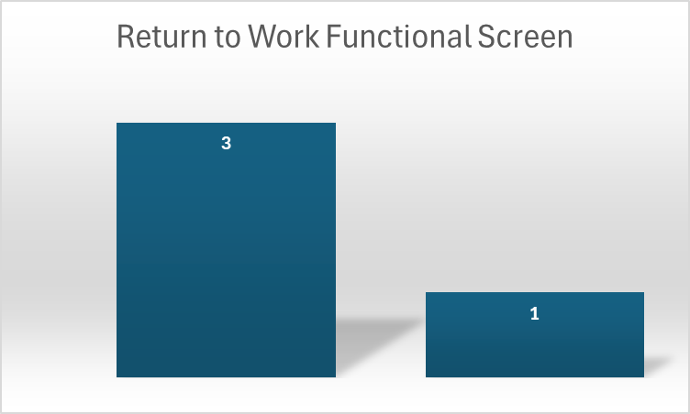
Measures:
Include graphs of your measurement, results of surveys, etc. Include benchmarks or comparative data when available.
STUDY
STUDY
18 pre-employment physicals, all passed
4 Return to Work Functional Screens completed, 3 passed, 1 limitations due to injury- March 1^{st-}May 6th

Slide 15
Findings:
ACT
Results: Did you accomplish your goals?
Finalize job categories– completed May 2025
Lessons Learned: What did you learn as a result of this project? Unexpected discoveries? Problems or barriers?
Complexity of return-to-work process and needing to involve legal.
Next Steps: What actions are you going to take based on your findings? (e.g. roll out to additional units; modify and make additional improvements; abandon the effort; change course?)
This project will impact all hospital staff, so it’s important to get all managers and administration support. HR will also need to assist with the changing of job descriptions. Finalized job categories in May 2025. Begin updating job descriptions May 2025 to be complete by June 30th, 2025. Determine cadence and implement functional screens of employees by fall 2025.
Project Leader is Recommending the Following:
QM Council approval for completion of project?: NO Project still in progress, project to continue: YES

Slide 16
Rehab Services
Inpatient Workflow
1st Presentation Date: 11/26/2024
Document Last Presented: 03/25/2025

Slide 17
Quality Story:
PLAN
Inpatient Workflow
Goal(s): What are you trying to accomplish?
KOM Target: All inpatient and medical evaluations to be completed within 48 hours (about 2 days) of admissions. (Note that during the week staff’s true goal is to have the evaluation completed in 24 hours.) Geri-psych evaluations to be completed within 72 hours (about 3 days) Added: In-patient PT hours reflect 10% .9/.95 FTE on a weekly basis. Added: In-patient OT hours reflect 10% .75 to .82 FTE on a weekly basis. Current KOM Status: We are tracking for the next month.
Background: Explain what the original situation was. Why was a change recommended? (e.g. variation, poor outcome, etc.)
We currently do not have any written standards for inpatient evaluations.
Driver: Explain why the project is critical to SH. Why does it relate to the strategic plan?
As surgical services grow so must our therapy services to ensure quality care for our clients.
Team:
Project Leader: Melissa Monte Members: Skyler Debilzen, Emily Devine, Kathy Forbes, Emily Grosse, Diane Johnson

Slide 18
Changes:
DO
List the changes that have been made leading to improvements.
What? | Why? | When?
Our team has come up with an OT and PT schedule to monitor weekly FTE for inpatient. New key outcome measure set up to help assess progress toward goal. | Help determine staffing needs | April 2025-June 2025
Updates have been made to the PT and OT inpatient binders to help train staff with new dot phrases created for documentation. | We have moved away from using flowsheets to make documentation more uniform between inpatient and outpatient care. | March 20th
Lists were created for what can be done when there is high and low census. | Helps guide staff if they are needing help or have more time available. | April 2025

Slide 19
Measures:
STUDY
Include graphs of your measurement, results of surveys, etc. Include benchmarks or comparative data when available.
Surgeries
Week 1: Monday 4 surgeries ; Tuesday 0 surgeries
Week 2: Monday 3 surgeries; Tuesday 3 surgeries
OT Schedule (.75 to .82 FTE)
Monday: Diane inpatient until 2:30 (6 hours)
Tuesday: Diane inpatient all day (8 hours)
Wednesday: Week 1 Kathy inpatient until 2:30; Week 2 Kathy inpatient all day (5-8 hours)
Thursday: Kathy inpatient until 2:30 Friday (6 hours)
Friday: Diane starts in outpatient and goes to inpatient by 10:00 (5 hours)
PT Schedule: (.9 to .95 FTE)
Monday: 9-6 (9.5 hours)
Tuesday: Week 1- 7:45-4:30 (8.25 hours); Week 2- 8:30 to 5:30/6:00 (9-9.5 hours)
Wednesday: 8-4:30 (8 hours)
Thursday: 8-2 (6 hours)
Friday: 8-2 (6 hours)

Slide 20
Findings:
ACT
Results: Did you accomplish your goals?
We are currently tracking for all of our key outcome measures.
Lessons Learned: What did you learn as a result of this project? Unexpected discoveries? Problems or barriers?
Our team has come up with a schedule for both OT and PT based on past findings and we are tracking FTEs. Flowsheets have been eliminated to help with cross training between inpatient and outpatient. Ongoing challenge - the variability of the caseload from day to day and week to week, but our team has come up with lists to assist with times of high and low census.
Next Steps: What actions are you going to take based on your findings? (e.g. roll out to additional units; modify and make additional improvements; abandon the effort; change course?)
Continue to tack over the next month FTEs and evaluations to help assess progress towards our key outcome measures.
Project Leader is Recommending the Following:
QM Council approval for completion of project?: NO Project still in progress, project to continue: YES

Slide 21
Pharmacy
Medication Ordering Workflow
1st Presentation Date: May 27, 2025
Document Last Presented: May 27, 2025

Slide 22
Quality Story:
PLAN
Medication Ordering Workflow
Goal(s): What are you trying to accomplish?
KOM Target: Develop medication ordering cards, including PAR levels, for 100% of pharmacy-stocked medications, excluding IV medications (these are in the DuoStation with pre-determined PAR levels), with a completion date of December 2025. Current KOM Status: 82/797 medications (10% completion)
Background: Explain what the original situation was. Why was a change recommended? (e.g. variation, poor outcome, etc.)
With our medication wholesaler switch to Cardinal, the SSM contract stated we could no longer receive medication orders on Saturday. Our current medication ordering is a replenishment system and we order as medications are used. This is a manual process and sometimes means medication orders are missed when stock is low. This has become a larger issue now that we need to anticipate medication usage for the weekend. Establishing a minimum stock to have on hand (PAR level) will assist with ensuring we have enough medications for the weekends.
Driver: Explain why the project is critical to SH. Why does it relate to the strategic plan?
This project supports the Quality and Safety Pillar, ensuring we have needed medications for patients in a timely manner. It also helps pharmacy continue to be fiscally responsible, supporting the Finance Pillar. Our current wholesaler charges a “small order fee” for any order under $1000 and we would like to ensure our orders are over this amount most of the time to avoid the fee. Given the rising prices of medications, having a standardized, streamlined workflow will also help us order at the lowest contracted price.
Team:
Project Leader: Paige Swatek, Ari Zimbric Members: Pauline Cass, Ryan Lund, Elizabeth Jacobson

Slide 23
Changes:
DO
What? | Why? | When?
Created bins for medication cards | To have a centralized area for ordering information | March 2025
Determined fast-moving medications in the pharmacy | These medications are ordered most often, creating more opportunity for error | April-May 2025
Create medication cards, with PAR levels | To identify levels to reorder medications and provide a visual cue when medications have been ordered | Beginning May 2025

Slide 24
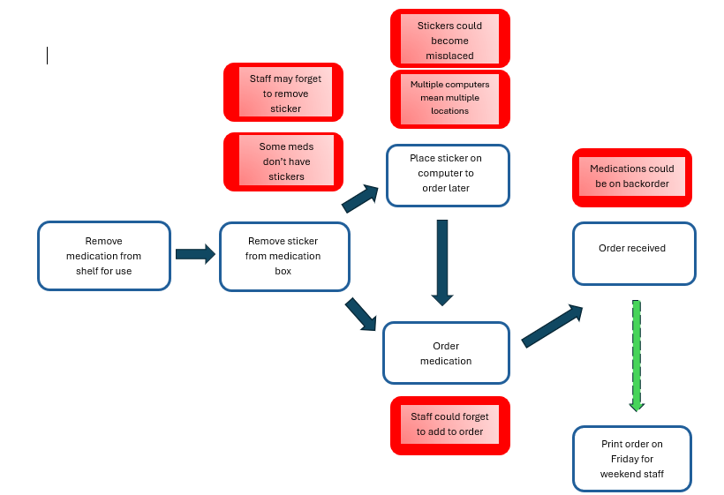
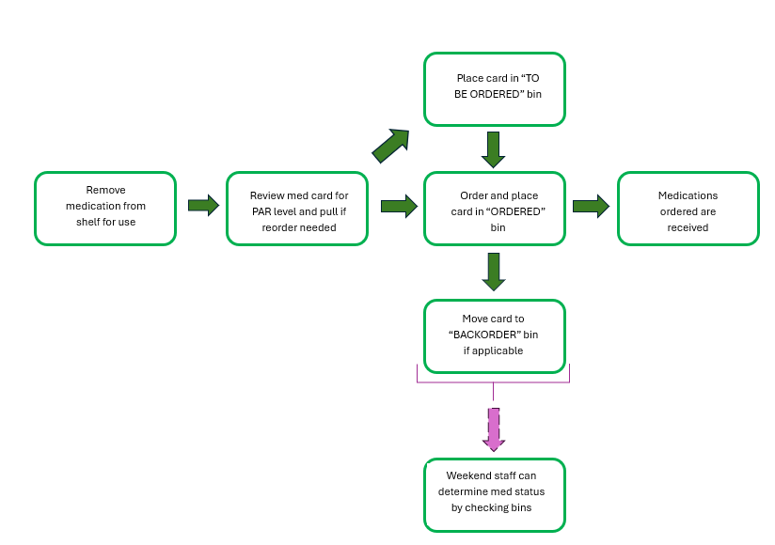
Measures:
STUDY
Current Medication Ordering Workflow:
Proposed Medication Ordering Workflow:
Note:
Indicates areas for potential workflow disruption

Slide 25
Findings:
ACT
Results: Did you accomplish your goals?
No-new project
Lessons Learned: What did you learn because of this project? Unexpected discoveries? Problems or barriers?
Many medications are not currently stored in bins—this means there is no place to put the cards. After discussion, the decision was made to order bins to store medications on our rolling shelves. (As a bonus, this will keep the medications from falling off shelves) This project initially focused on fast movers, but we determined it would be better to complete for the majority of medications.
Next Steps: What actions are you going to take based on your findings? (e.g. roll out to additional units; modify and make additional improvements; abandon the effort; change course?)
Action: | Assigned To: | Due Date:
Create master list of medications | Ari/Paige | ongoing
Research and order med bins | Ari/Paige/Elizabeth | June 30, 2025
Project Leader is Recommending the Following:
QM Council approval for completion of project?: NO Project still in progress, project to continue: YES

Slide 26
Pharmacy
New Employee Onboarding
1st Presentation Date: March 25, 2025
Document Last Presented: May 27, 2025

Slide 27
Quality Story:
PLAN
New Employee Onboarding
Goal(s): What are you trying to accomplish?
KOM Target: 100% Completion of New Employee Onboarding Program implementation by June, 2025 Current KOM Status: 5/6 steps completed (83% completion)
Background: Explain what the original situation was. Why was a change recommended? (e.g. variation, poor outcome, etc.)
The SH goal for new employee turnover is less than 28.6%. Since June 2024, we have not met this goal as an organization, with turnover rates between 30.16% and 38.18%. Standardized, comprehensive department onboarding programs were recommended to help us reach this goal.
Driver: Explain why the project is critical to SH. Why does it relate to the strategic plan?
New employee retention is integrally tied to proper onboarding and training. Having a standardized onboarding process can increase retention as well as satisfaction in the workplace. This supports our People Pillar at Stoughton Health.
Team:
Project Leader: Pauline Cass Members: Tom Kostecki, Brianna Jacques, Elizabeth Jacobson, Ryan Lund, Paige Swatek, Ari Zimbric, Erin Roberts

Slide 28
Changes:
DO
What? | Why? | When?
Met with all new employees from the past year | To gather suggestions for improvement to onboarding process | December 2024-January 2025
Developed pre-employment checklist | To ensure readiness for new employees on Day 1 | December 2024
Developed manager checklist | To ensure all administrative items are covered Week 1 | February 2025
Developed weekly touch base checklist | To ensure standardized documentation for training | May 2025

Slide 29
Measures:
STUDY
Successful New Employee Onboarding
Checklist for pre-start date activities developed
Manager checklist for first week developed
Binder created which contains hospital and department-specific information
Training checklist developed for first 4 weeks of employment
Preceptor training guide developed
Weekly Touch base forms developed for preceptor and employee
Binder reviewed with annual policy review or as needed for new pharmacy colleagues

Slide 30
Findings:
ACT
Results: Did you accomplish your goals?
Goals still in progress
Lessons Learned: What did you learn because of this project? Unexpected discoveries? Problems or barriers?
Staff wants more feedback during the onboarding process—this prompted the addition of daily preceptor touch bases and more formal weekly feedback sessions Information retention has been increased using a tell/show/do/review method
Next Steps: What actions are you going to take based on your findings? (e.g. roll out to additional units; modify and make additional improvements; abandon the effort; change course?)
Action: | Assigned To: | Due Date:
Develop preceptor training guide | Pauline | June 30, 2025
Project Leader is Recommending the Following:
QM Council approval for completion of project?: NO Project still in progress, project to continue: YES

Slide 31
Surgical Services
Ambulatory Infusion Center (AIC)
Improving Workflow
Presentation Date: March 25, 2025

Slide 32
Quality Story:
Ambulatory Infusion Center (AIC)
Improving Workflow
PLAN
Goal(s): What are you trying to accomplish?
KOM Target: Full implementation of improved AIC workflow to decrease infusion denials. (3 steps in the process to reach full implementation – analyze/develop/implement) Current KOM Status: 1) analyze – in progress
Background: Explain what the original situation was. Why was a change recommended? (e.g. variation, poor outcome, etc.)
Breakdown of communication and workflows within AIC, Prior-Auth, and pharmacy. Patients being scheduled prior to obtaining all approvals successfully. Leading to patient dissatisfaction, and potential delay in patient care.
Driver: Explain why the project is critical to SH. Why does it relate to the strategic plan?
A key target for prior authorization pharmacy and scheduling in an ambulatory care center is to minimize the time spent on the prior authorization process while maximizing successful approvals, ensuring timely access to necessary medications for patients while adhering to insurance guidelines; this can be achieved by streamlining workflows, utilizing technology, and proactively identifying medications that require prior authorization to avoid delays in patient care.
Team:
Project Leader: Sandra Bryan-Armstrong Members: Sarah Watkins, Jennifer Bothum, Pauline Cass, and Tom pharmacy, Ambulatory Surgery Team

Slide 33
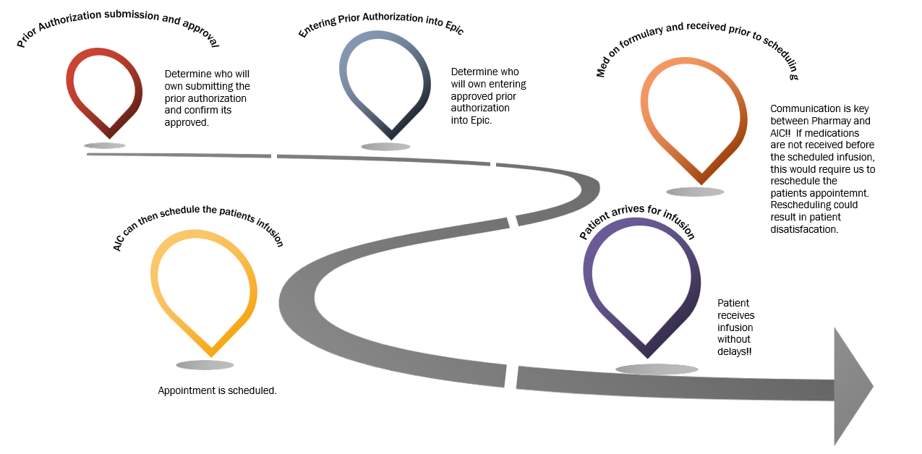
Measures:
STUDY
Include graphs of your measurement, results of surveys, etc. Include benchmarks or comparative data when available.

Slide 34
Changes:
DO
List the changes that have been made leading to improvements.
What? | Why? | When?
Bev did a current state analysis | We were evaluating our night and weekend AIC patient discrepancies took time to document workflow. | February
Jen and prior auth team meeting coming to standardize process | Ensure accuracy and make sure all our I’s are dotted and T’s are crossed. | March
Tom in pharmacy to be looped in then we get to that point. | Pharmacy plays a role in infusions. Will support DS team when transitioning over care plan entry. | April/May

Slide 35
Findings:
ACT
Results: Did you accomplish your goals?
In progress.
Lessons Learned: What did you learn as a result of this project? Unexpected discoveries? Problems or barriers?
We know that better communication is needed with Surgical Services HUC and RNs of the importance of prior authorization and the cadence of scheduling. Sometimes scheduling patients, the hours for AIC are 9:00 am – 5:00 pm. Staff were scheduling to fit their schedule and not the needs of the patient. We now have an RN to be here for those hours.
Next Steps: What actions are you going to take based on your findings? (e.g. roll out to additional units; modify and make additional improvements; abandon the effort; change course?)
1) Pharmacy to transition ownership of entering treatment plan into EPIC to Day Surgery Nurses by August 2025. 2) Determine if scheduling will be transitioned to Registration or remain with AIC by August 2025.
Project Leader is Recommending the Following:
QM Council approval for completion of project?: NO Project still in progress, project to continue: YES

Slide 36
Surgical Services
Stabilization of Staffing
1st Presentation Date: 3.26.24
Document Last Presented: 5.27.2025

Slide 37
Quality Story:
PLAN
Stabilization of Staffing
Goal(s): What are you trying to accomplish?
KOM Target: 50% Reduction of agency use by July 1, 2024. 100% reduction of agency use by October 1, 2025. Current KOM Status: Agency usage at the start of the project was 6.3 FTE. As of June 2025, we will be at 1.9 FTE, which reflects a 70% reduction (The only travel staff being used are Surg Techs)
Background: Explain what the original situation was. Why was a change recommended? (e.g. variation, poor outcome, etc.)
Wisconsin annual personnel survey early submissions reported registered nurse (RN) vacancy rates in the double digits for the first time since 2005. The frontline technical positions of certified nursing assistant (CNA), surgical tech, respiratory therapist and licensed practical nurse (LPN) round out the top five vacancy rates in the 2021 early surveys with digit vacancy rates in 2021 for seven of the 17 professions tracked in WHA’s annual workforce reports.
Driver: Explain why the project is critical to SH. Why does it relate to the strategic plan?
While the use of agency has allowed for surgeries to continue as normal, financially this cannot be sustained. Continuity is important for both the safety of our patients, but also in establishing and sustaining “our team” which is important of the culture of the surgical services department.
Team:
Project Leader: Amy Hermes, Sandra Bryan-Armstrong Members: HR, Jane McGuire

Slide 38
Changes:
DO
List the changes that have been made leading to improvements.
What? | Why? | When?
ST student started December 16th as 0.8 needing hands on involvement to complete her certification. Part of our “grow your own” program. | Lack of applications has made us focus harder on trying to “grow our own” ST. | She has completed all 125 required cases and is fully certified.
An additional surgical tech student applied for a PRN position in SPD and was hired. | Lack of applications has made us focus harder on trying to “grow our own” ST. | This student is set to graduate in May 2026 and plans to transition into the tech role after graduation.
Recruitment of STs continues to be challenging, we have had 2 applications since 9.28.24. One wanted more money, and one was not qualified. | Unclear as to why there is so few STs. We are looking to try to hire more sterile processing techs and OR assistants that may then return to school for ST. | Ongoing recruitment of sterile processing techs and OR assistants.
 | .

Slide 39
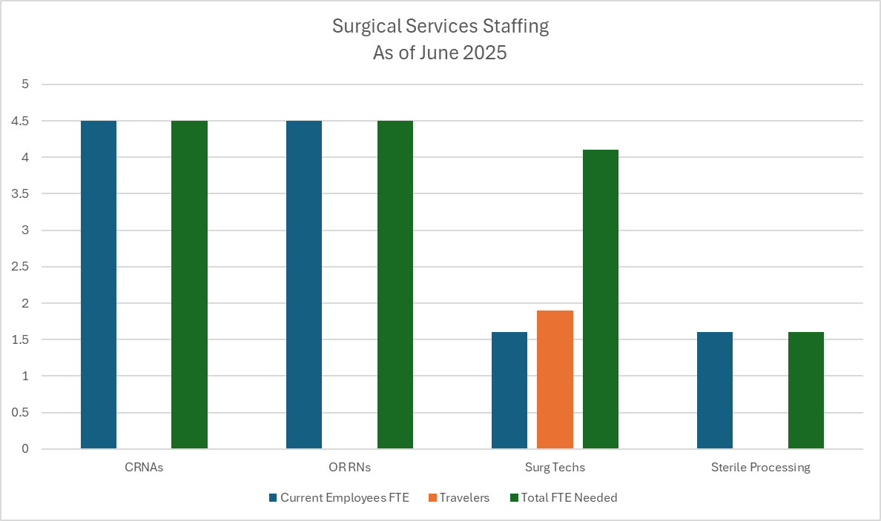
Measures:
STUDY
Include graphs of your measurement, results of surveys, etc. Include benchmarks or comparative data when available.

Slide 40
Findings:
ACT
Results: Did you accomplish your goals?
Agency usage at the start of the project was 6.3 FTE. As of June 2025, we have made a 70% reduction. The only travelers currently needed/being used are STs.
Lessons Learned: What did you learn as a result of this project? Unexpected discoveries? Problems or barriers?
Surgical techs continue to be difficult to hire. To address this, we’ve hired RNs with surgical tech experience, which is more cost-effective than utilizing surgical tech travelers. We’ve also hired a surgical tech for the weekender on-call position, which is considered PRN as it only involves call hours, and an OR RN for the same role. These positions are not counted as full-time equivalents (FTEs). Additionally, we have posted PRN positions for First Assist Surgical Techs, OR RN circulators, and SPD techs. Being creative with staffing has been crucial to stabilizing the team, and cross-training staff has further supported team stability.
Next Steps: What actions are you going to take based on your findings? (e.g. roll out to additional units; modify and make additional improvements; abandon the effort; change course?)
Continue “grow our own STs” with OR assists and sterile processing techs - ongoing Continue to work with Black Hawk Tech taking SPD and ST students. – ongoing Although we have continued to need to use travelers, have been negotiating to reduce rates of pay. Will continue to work to reduce costs of traveler. – ongoing
Project Leader is Recommending the Following:
QM Council approval for completion of project?: No Project still in progress, project to continue: Yes

Slide 41
Environmental Services
Hazardous Waste Accumulation Area Inspection
Presentation Date: March 25, 2025
Document Last Presented: December 3, 2024

Slide 42
Quality Story:
PLAN
Hazardous Waste Accumulation Area Inspection
Goal(s): What are you trying to accomplish?
KOM Target: Full implementation of a Hazardous Waste Accumulation Inspection program. (4 steps to reach full implementation) Current KOM Status: 50% (2 of 4 steps have been completed)
Background: Explain what the original situation was. Why was a change recommended? (e.g. variation, poor outcome, etc.)
During DNV survey it was documented and cited that no weekly documented inspection for a small quantity generator of the central accumulation area. Weekly inspection is a must looking for leaking and for deterioration of containers caused by corrosion or other factors.
Driver: Explain why the project is critical to SH. Why does it relate to the strategic plan?
This project supports full compliance with the NIAHO standards and conditions of participation of our accreditation program and CMS. As well as our quality and safety pillars.
Team: Environmental Services (EVS) and Environment of Care (EOC)
Project Leader: Angie Rowin Tippit Members: Pauline Cass, Emily Syring and Jason Schoville. As well as key members of the EOC Committee.

Slide 43
Changes:
DO
List the changes that have been made leading to improvements.
What? | Why? | When?
Create a document for weekly inspections of hazardous accumulation area. Document must include identification, description, date, including looking for leaking containers, deterioration, corrosion or other factors. | To be in full compliance with NIAHO standards and Conditions of Participation. A method for monitoring frequency, measures of effectiveness and evidence of compliance. | October 8th, 9th, and 10th. The Hazardous Waste Accumulation Area Inspection Log was created and implemented with first and second inspection occurred on 10/9/2024 and 10/10/2024. Completed
Weekly scheduling of inspections of hazardous accumulation site scheduled on Outlook for both manager and coordinator. | Ongoing scheduling was created in Outlook for weekly calendar tasks/reminders to complete inspection/monitoring. | 10/30/2024 Completed
Education was provided to manager and coordinator. | Required within 60 calendar days of survey end date. | 10/10/2024 Completed
Hazardous Material and Medical Waste Management Plan was updated to include the Hazardous Waste Accumulation Area Inspection Log. | Required within 60 calendar days of survey end date. | 10/31/2024 Completed Revised on 03/12/2025
Standing agenda item for Environment of Care Committee meetings to be review HWAAI | Meetings occur Every other month | Placed on agenda for April, June and August.
Audit findings will be completed for 3 consecutive Environment of Care Committee meetings. | To demonstrate compliance/conformity to sustain compliance. | First report April 2025 – completed Second report June 2025 Third Report August 2025

Slide 44
Measures:
STUDY
Include graphs of your measurement, results of surveys, etc. Include benchmarks or comparative data when available.
Action Steps: | Completion:
Hazardous Waste Accumulation Log | Completed: October 8, 2024
Two times a week inspections | Completed: Weekly inspections started October 8, 2024.
Hazardous Materials Education | In progress: to be completed by end of June.
Hazardous Waste Accumulation Log audit findings a standing EOC meeting agenda item. | In progress: April 2025 agenda - Completed June 2025 agenda August 2025 agenda

Slide 45
Findings:
ACT
Results: Did you accomplish your goals?
No: In progress
Lessons Learned: What did you learn as a result of this project? Unexpected discoveries? Problems or barriers?
Switching from a very small generator (VSG) to a small generator in 2024 changes the compliance in some areas of collection with Hazardous Materials and Medical Waste Management. In 2025, we moved back to VSG as we did not accumulate over 220 lbs. each month. However, we will continue this best practice of monitoring at collection site.
Next Steps: What actions are you going to take based on your findings? (e.g. roll out to additional units; modify and make additional improvements; abandon the effort; change course?)
Hazardous Waste Awareness training for selected EVS staff – June 30, 2025 Continue weekly inspections – On going. Report audit finding results at 3 consecutive EOC meetings to ensure compliance with the DNV NIAHO standards and conditions of participation of our accreditation program and CMS planning. – August 2025
Project Leader is Recommending the Following: To continue process of improving, monitoring and managing of waste.
QM Council approval for completion of project?: Enter YES or NO Project still in progress, project to continue: Enter YES or NO (till September 23, 2025)

Slide 46
Environmental Services Onboarding New Employees
3rd Presentation Date March 25, 2025
Document last presented: December 3, 2024

Slide 47
Quality Story:
PLAN
Onboarding New Employees
Goal(s): What are you trying to accomplish?
KOM Target: Implement updated/improved new employee onboarding by August 1, 2025 (4 Phases to reach full implementation) Current KOM Status: Phase one: Review/Revise current check-off list, completed. Phase two: Planning, completed. Phase three: Education, in progress and Phase four, implementation, not started.
Background: Explain what the original situation was. Why was a change recommended? (e.g. variation, poor outcome, etc.)
All departments were challenged to evaluate our onboarding processes. The hospital-wide turnover for new employees in February 2025 was 12.25.
Driver: Explain why the project is critical to SH. Why does it relate to the strategic plan?
Onboarding plays an important role in retaining new hires. A formal onboarding process helps promote success of new staff. The key to new hire satisfaction is a well-planned orientation, a positive/supportive environment, assigning a mentor, proper training, and proper tools/materials.
Team:
Project Leader: Angela Rowin Tippit and Emily Kirby Members: Some EVS staff.

Slide 48
Changes:
DO
List the changes that have been made leading to improvements.
What? | Why? | When?
Review EVS New Hire checklist and job description. | Checklist needs revision and improvement to improve the new hires experience. | September 2024 completed. Revisions were made in November/December. However, revision are ongoing as we go the process.
Team meetings to discuss continued planning of education and implementation. | Team building, staff acceptance, input, and to garner staff support. | September 2024 to August of 2025.
Present project at next staff meeting and review checklist. | Staff engagement. | December 2024
Competencies have been added to onboarding checklist | By observing all new staff education has been completed in training. | March 2025

Slide 49
Measures:
STUDY
Action steps | Completion
Review/Revise | Completed: December 2024
Planning | Completed
Education | In Progress
Implementation | Not started

Slide 50
Findings:
ACT
Results: Did you accomplish your goals?
No
Lessons Learned: What did you learn as a result of this project? Unexpected discoveries? Problems or barriers?
It is a work in progress…beginning stages. We agree the new employee checklist for new hires is the first step to review/revise/improve. Manager/Coordinator have drafted a reviewed/revised form and found that this is a continued work in progress. It is a difficult time with recruiting, staffing, increased work loads but are willing to take on the added work to make this successful. The challenges of completing an improved checklist. Did we capture everything? We continue to make and add improvement changes.
Next Steps: What actions are you going to take based on your findings? (e.g. roll out to additional units; modify and make additional improvements; abandon the effort; change course?)
Bring department checklist final draft to seek input from staff at next EVS team meeting in June. Review/Revise all job descriptions by July 1st . Together as a team what is everyone's role to ensure a positive onboarding experience is achieved with new staff. i.e.; education, mentors, break buddies, positive communication, etc. with a new employee (TBD).
Project Leader is Recommending the Following:
QM Council approval for completion of project?: No Project still in progress, project to continue: Yes

Slide 51
Food and Nutrition Services
Hot Meals for Patients for Dinner
1st Presentation Date: 3/28/23
Document Revised on: 05/07/2025

Slide 52
Quality Story:
PLAN
Hot Meals for Patients for Dinner
Goal(s): What are you trying to accomplish?
KOM Target: Trial providing one hot entrée with sides by June 2023. Intent is to maintain steady Press Ganey food satisfaction scores by offering hot dinner options. Current trending reports great variability of overall food satisfaction ranging from 6th – 90th percentile. Target Percentile: 90th or greater. Current KOM Status: Med Surg: 76th percentile for quality of meals this past quarter, 67th percentile for last quarter. Geri-Psych 97th percentile for Quality of meals for two quarters, 99th for this past quarter.
Background: Explain what the original situation was. Why was a change recommended? (e.g. variation, poor outcome, etc.)
We originally orchestrated a thoughtful menu with a diverse number of menu items. Since COVID and the staffing shortage we have had to pair down our offerings. Those patients with a history of receiving hot menu options perpetuate score quality low, based on expectations or previous experiences.
Driver: Explain why the project is critical to SH. Why does it relate to the strategic plan?
Research on providing a great employee experience tells us that patients judge us by 3 things Floor, Food and Service. If one of these is out of place or not up to the patient’s standards, then our Press Ganey scores will reflect negative patient satisfaction.
Team:
Project Leader: Dan Arndt & Autumn Kumlien Members: Ricky Quesada, Roxanne Lehman, Melanie Jess, Dianne Kelly, Shelby Thorson, Cindy Blanchar, Natalee Gerber & Kevin Propp

Slide 53
Changes:
DO
List the changes that have been made leading to improvements.
What? | Why? | When?
Eliminating hot food offerings as a dinner choice implemented to accommodate for lack of staff so needed to shorten the menu and make trays disposable. | COVID-19 and lack food service workers in the greater Dane county area. | June 2021.
Patients commented on food selection using Press Ganey Scores. | We have a regular base of patients that remember what we used to offer. | Pre-COVID.
Meat Lasagna or Vegetarian Lasagna with Green Beans and a Dinner roll was trialed. | To accommodate the need and or request for hot meals from patients within our staffing capabilities. | April 2023
Hot Bar is now being offered for lunch and or dinner Monday-Friday. | To offer a hot food option for patients for the dinner hour. | June 2023-Present
Presented a Prep Cook requisition to Administrative Council. | Utilize Prep cook to help prepare diet friendly options for specialized diets. | October 2023-Present
Started offering Grilled Cheese/Grilled Ham and Cheese during the dinner hour as a hot sandwich option. | Patients were requesting hot sandwich option. | October 2023-Present

Slide 54
Changes:
DO
List the changes that have been made leading to improvements.
What? | Why? | When?
FNS hired Kevin Propp, Assistant Chef & Baker, with previous experience working for Stoughton Health in the FNS department. | This took some duties & responsibilities off our patient cook, which freed her up to prepare more patient menu items. | November 2023
Trialing “new” diet friendly menu items. | Patient Cook now has more time to devote to the patient menu with hiring of Assistant Chef. | December 2023
Rough draft of “new” patient menu completed. | To begin to offer patients more diet friendly meal options. | January 2024
Training for cooking of new patient menu items. | So, each staff member can deliver a constantly good product | May 2024
New Menu items will need to be tested for using the IDDS testing model. | So patients who have IDDS specific diets could order the new items per diet. | July 2024
All new items have been tested and categorized according to IDDS. | So, patients who have IDDS specific diets could order the new items per diet. | August 2024
Implemented New Menu and brought back the use of China. | To give patients more options and create a more formal dining experience. | October 20, 2024
Implemented a stand along survey that Guest Services rounds a few days a week | To get real time feedback and to see how the Press Ganey comments compare to this feedback. | November 1, 2024

Slide 55
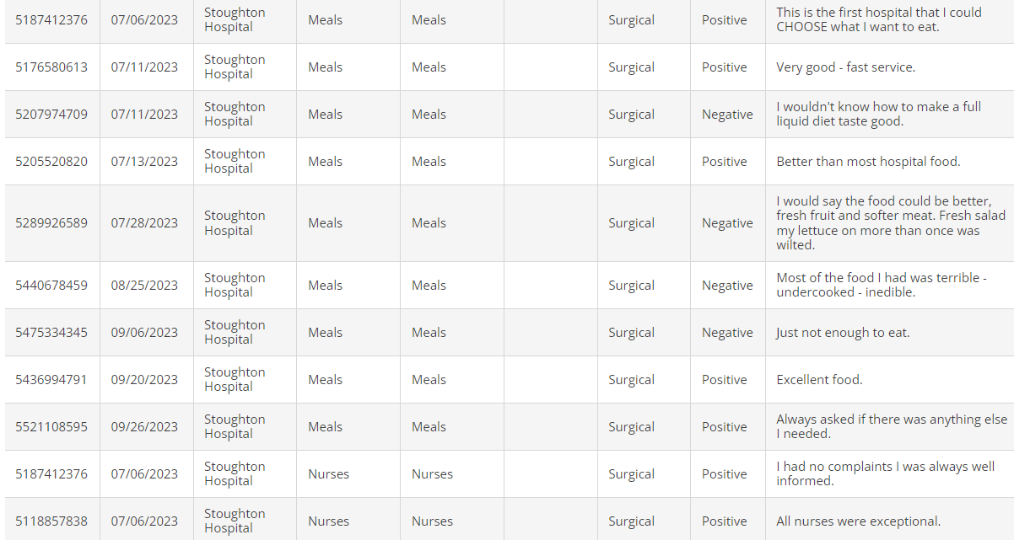
Measures:
STUDY
Press Ganey (Med-Surg.)
Most Recent below..

Slide 56
Measures:
STUDY
Press Ganey
Geri-Psych
Most Recent below..

Slide 57
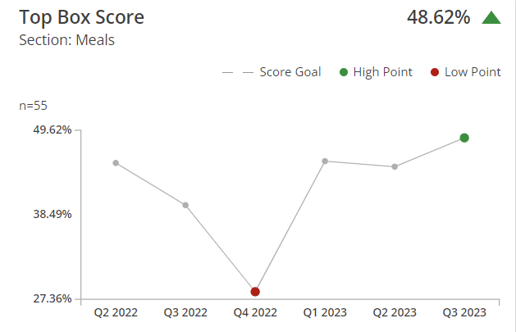
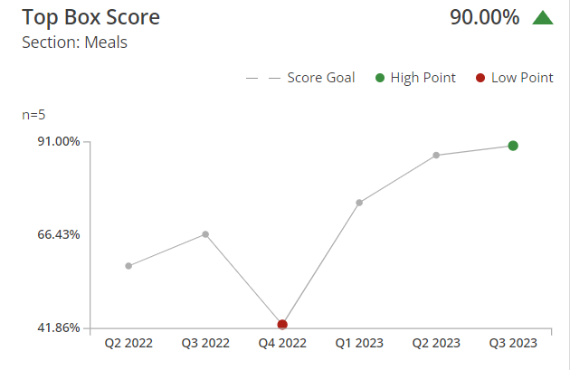
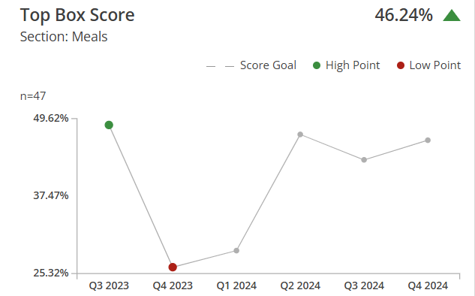
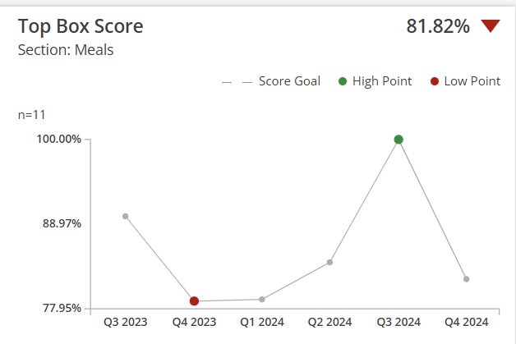
Geri-Psych.
Med-Surg.
Most Recent below..
Most Recent below..

Slide 58
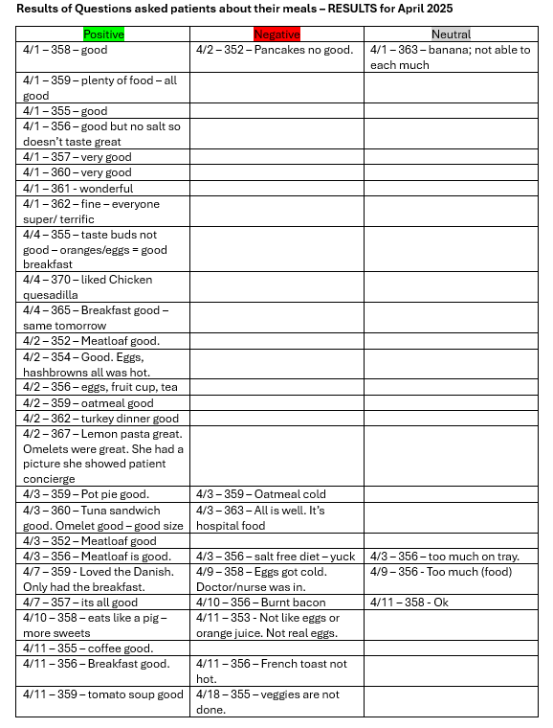
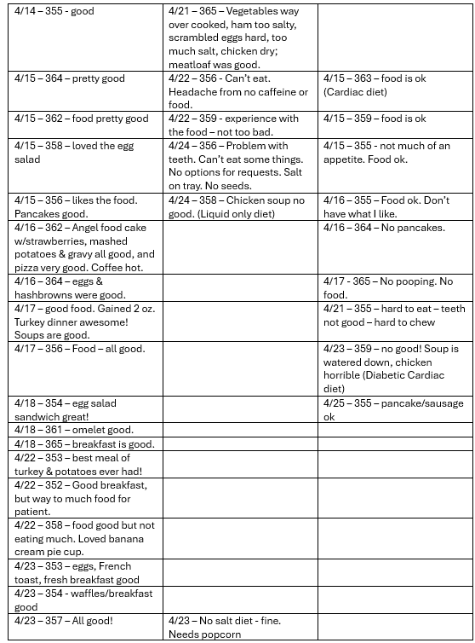
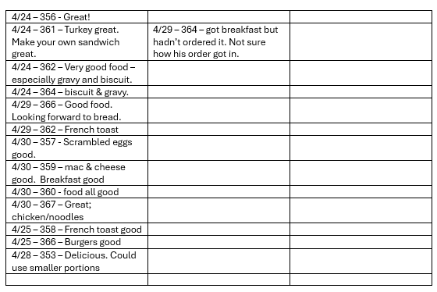

Slide 59
Findings:
ACT
Results: Did you accomplish your goals?
1. Med Surg is continuously improving as shown in previous slides. Geri-Psych remains above the 90th percentile for the third quarter in a row.
Lessons Learned: What did you learn as a result of this project? Unexpected discoveries? Problems or barriers?
So far, we have discovered that there are a few patients who like this offering, but many still get sandwiches. We did also discover that this offering caused anxiety over the need for increased cooking skills by P.M FNS staff. When making one hot entrée special for dinner it is very hard to accommodate our top three restrictive diets ordered (cardiac, diabetic, low sodium). After researching this more, we discovered that our Food Service distributors do not make diet friendly options that are of our quality. We have found the need for a prep cook, to help create diet friendly menu options.
Next Steps: What actions are you going to take based on your findings? (e.g. roll out to additional units; modify and make additional improvements; abandon the effort; change course?)
Continue to Train staff on how to cook “new” menu items. Test new menu items to help classify IDDS. Print updated menus Once staffing is back to normal will implement new menu. For now, new menu is offered Monday-Friday and its word of mouth. New Menu is now implemented, now we will be tracking and trending for the next 6 months to see if our implementation has made a difference. Compare Press Ganey Survey results within house survey results.
Project Leader is Recommending the Following:
QM Council approval for completion of project?: NO Project still in progress, project to continue: YES

Slide 60
Food and Nutrition Services
Patient Meal Ordering Software
1st Presentation Date: 3-13-25
Document Last Presented: 05/27/2025

Slide 61
Quality Story:
PLAN
Patient Meal Ordering Software
Goal(s): What are you trying to accomplish?
KOM Target: New software program is researched, picked, approved, and 100% implemented by May of Fiscal Year 2026 (5 phases to reach full implementation) Current KOM Status: Phase 1: Research Phase, just getting started
Background: Explain what the original situation was. Why was a change recommended? (e.g. variation, poor outcome, etc.)
In November 2024 Horizon our current system gave us a notice that our system was going to be reaching its “end of life” with service updates.
Driver: Explain why the project is critical to SH. Why does it relate to the strategic plan?
This system is very critical to Stoughton Health because it interfaces with Epic to ensure patients will be on the correct diet and the food they receive corresponds with there diet.
Team: Kevin Propp, Roxanne Lehman, Melanie Jess, Shelby Thorson, Ricky Quesada, Victoria Camiou.
Project Leader: Autumn Kumlien and Dan Arndt

Slide 62
Changes:
List the changes that have been made leading to improvements that occurred in the last 60 days.
DO
What? | Why? | When?
FNS Operations Manager, FNS Nutrition Coordinator and VP HR/Facility Operations met and determined new patient ordering software is needed. | Received notification that Horizon is reaching end of life | December 2024

Slide 63
Measures:
STUDY
Include graphs of your measurement, results of surveys, etc. Include benchmarks or comparative data when available.
Phase 1 | Research | In Progress
Phase 2 | Approval and Purchase
Phase 3 | Interface completion
Phase 4 | Education
Phase 5 | Go-Live (May 2026)

Slide 64
Findings:
ACT
Results: Did you accomplish your goals?
Lessons Learned: What did you learn as a result of this project? Unexpected discoveries? Problems or barriers?
Next Steps: What actions are you going to take in the next 60 days ?
Action: | Assigned To: | Due Date:
Kickoff meeting to introduce project, determine key stakeholder and begin researching platform options. | Dan | May 2025
Determine/finalize what platform to purchase. | Dan | July 2025
Gather in put from RWHC hospitals about systems preferred. | Dan/Ricky/Autumn | May 2025
Schedule demo’s for top two software's. | Dan/Ricky/Autumn | May 2025
Project Leader is Recommending the Following:
QM Council approval for completion of project?: NO Project still in progress, project to continue: YES

Slide 65
Orthopedic Team
Total Hip Arthroplasty/Total Knee Arthroplasty Patient Reported Outcome-Based Performance Measures (THA/TKA PRO-PM Program)
Co Leads: Clark Collins, PA-C & Kristin Brickl, RN.
Program 1st Presented: May 27th, 2025 :
Document Last Presented: March 2025

Slide 66
Quality Story:
PLAN
THA & TKA PRO-PM Program
Goal: To enhance and prioritize patient-centered care and improve treatment outcomes by collecting and utilizing patient reported self assessment data to inform clinical decision–making, drive quality improvement and public reporting for our initial total hip & total knee arthroscopy cases.
KOM Target: 1.To achieve a 90% THA & TKA PRO-PM program pt completion rate among eligible hip and knee surgery patients within three months 8.1.2025 of implementation (5.1.2025) with the Oberd Registry. Current KOM Status: Soft launch Implementation of the Oberd tool workflows & education of staff and pts
Background:
Implementation of a THA & TKA PRO-PM Program offers advantages to the practice for enhanced clinical decision makings from the pts perspective, ability to track patients progress over time and facilitates shared decision-making empowering patients to participate in their care. These valid measures from the program may also be used to support payer contracts and marketing reputations.
Driver: Explain why the project is critical to SH. Why does it relate to the strategic plan?
Patient reported outcome measure programs enhance quality improvement initiatives that are patient centered for shared decision making and enhanced patient experience. The THA & TKA PRO –PM program will support the Orthopedic groups practice efficiency and public reporting for improved payer contracting and marketing reputation for referral growth.
Team:
Project Leaders: Clark Collins, PA, Kristin Brickl, RN & JoDeen Hettenbach Members: Orthopedic Providers, Clinical Team, JoDeen Hettenbach, QM reporting lead, Marketing & Oberd Registry Lead

Slide 67
Changes:
List the changes that have been made leading to improvements that occurred in the last 60 days.
DO
What? | Why? | When?
Vendor Assessment Selection, compliance and Contract Completion | Fiscal stewardship, HIPAA Compliance, Reporting support and IT compatibility. | Fall, 2024
Training and Education Training on Oberd Registry | 1. Provide initial overview to all ortho staff members on administration, data entry, and interpretation. Begin workflow draft & pilot with team. | Feb 2025
Submit THA/TKA PRO-PM for a QM program approval | THA/TKA PRO-PM programs is an important program for improving patient centered care, enhanced clinical shared decision making and public reporting quality metrics. | March 20th, 2025.
Draft and Pilot Workflow – | Vetting workflow with IPAD tools with pts and staff to insure ease of use, workable and sustainable. Consideration of both staff and pt burden to administer the tool. Meet with Oberd monthly for optimization review and reporting templates (4.2) (5.2) (5.7) | 5.7.2025
Oberd Tool Templates Updates | Updated communication protocols within Oberd’s Tools for both email and text communications. Edited templates for enhanced personalization from OrthoTeam adding Dr Raval photo and call to action in communications. | 5.7.2025
Oberd IPAD Usage by Pt during clinic visit | Initiated with Clark and vendor Lead Kaitlyn | 5.8.2025
Oberd Reporting options vs hard data dump | Working with Vendor on options within Tableau | 5.7.2025

Slide 68
Changes:
List the changes that have been made leading to improvements that occurred in the last 60 days.
DO
What? | Why? | When?
Monthly review of Data for process improvement and sharing with key stakeholders at ortho mtg | Clark and Kristin > 46 pt enrolled 40 pts completed - | 4.12.25
Provide comprehensive training to all Ortho staff members & key stakeholders on administration, workflow, data entry, and interpretation and reporting of the THA/TKA PRO – PM program. | Clark and Kristin | 4.12.25
Draft and Distribute workflow, pt educational materials for patients explaining the purpose and benefits of PROMs | Kristin & JoDeen | 4.2.25
Oberd Monthly Optimization mtg – Starts April 2nd | Clark, Kristin | 4.2.25
Monthly review of Data for process improvement and sharing with key stakeholders at ortho mtg | Clark and Kristin | 4.12.25

Slide 69
Measures:
STUDY

Slide 70
Findings:
ACT
Results: Did you accomplish your goals?
In progress
Lessons Learned: What did you learn because of this project? Unexpected discoveries? Problems or barriers?
Working mtgs with vendor support Kaitlyn very helpful. We are a manual contract with is nuanced.
Next Steps: What actions are you going to take in the next 60 days ?
Action: | Assigned To: | Due Date:
Monthly review of Data for process improvement and sharing with key stakeholders at ortho mtg | Clark and Kristin | Monthly Staff mtg
IPAD Office Completion Option | Clark and Kristin | June 5
Draft and Distribute workflow, pt educational materials for patients explaining the purpose and benefits of PROMs | Clark and Kristin | June 5
Oberd Mid Month Optimization mtg – | Clark and Kristin
Project Leader is Recommending the Following:
QM Council approval for completion of project?: Enter YES or NO Project still in progress, project to continue: Enter YES or NO

Slide 71
Material Services
Improvement for ordering department supplies
1st Presentation Date: March 25, 2025
Document Last Presented: May 27, 2025

Slide 72
Quality Story:
PLAN
Improvement for ordering department supplies
Goal(s): Improve department ordering process.
KOM Target: To review and improve the ordering processes in all identified department areas by completing 4 main steps. Current KOM Status: 32% Completed 6 of 19 currently identified ordering areas/department.
Background: Explain what the original situation was. Why was a change recommended? (e.g. variation, poor outcome, etc.)
The ordering templates in MV, which each department uses, are outdated with items which are no longer used and don’t always include current needed items. Departments do not currently have par levels set, this creates issues with too much or not enough department stock. Storeroom items are not all labeled with Multiview item numbers, creating confusion when ordering. High use items should be made stock and stored in Material Services. Not all items have product id #’s, creating extra work manual work to order.
Driver: Explain why the project is critical to SH. Why does it relate to the strategic plan?
This project supports the Finance pillar by creating more efficient ordering processes, so departments spend less time ordering. Reduce the need for emergency or overnight deliveries.
Team:
Project Leader: Dacia Brunner Members: Nancee Linnerud and Roberta Sarow

Slide 73
Changes:
DO
List the changes that have been made leading to improvements that occurred in the last 60 days.
.
What? | Why? | When?
Ortho Stoughton - Updated MV ordering templates, printed labels for storeroom. | This Department was moving to the new SHOC location, and we wanted ensure they were set up in their new storeroom right from the start. | March-April 2025
General Surgery - completed all four improvement steps | Also changing locations, so we focused on that department the past few months. | March-April 2025
Urology - completed all four improvement steps | They were moving to SHOC location and had previously been coming down materials storeroom to shop for supplies, which created extra inefficiencies for both department staff and for Material Services team. | March-April 2025
RT – Set the department up with a MV ordering license and login so they could place orders thru Multiview electronically | Before this change, staff was coming down to storeroom to shop and pull items from shelves themselves. | April-May 2025

Slide 74
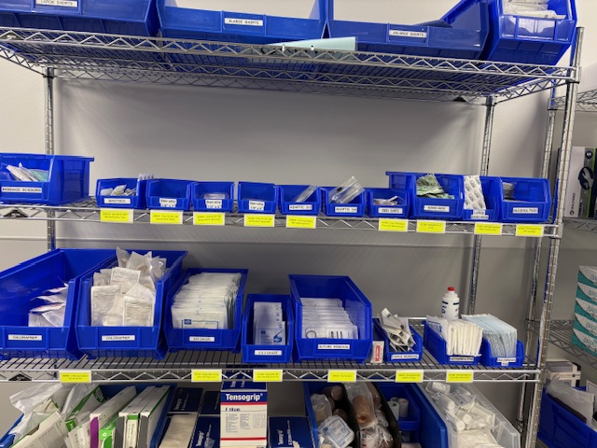
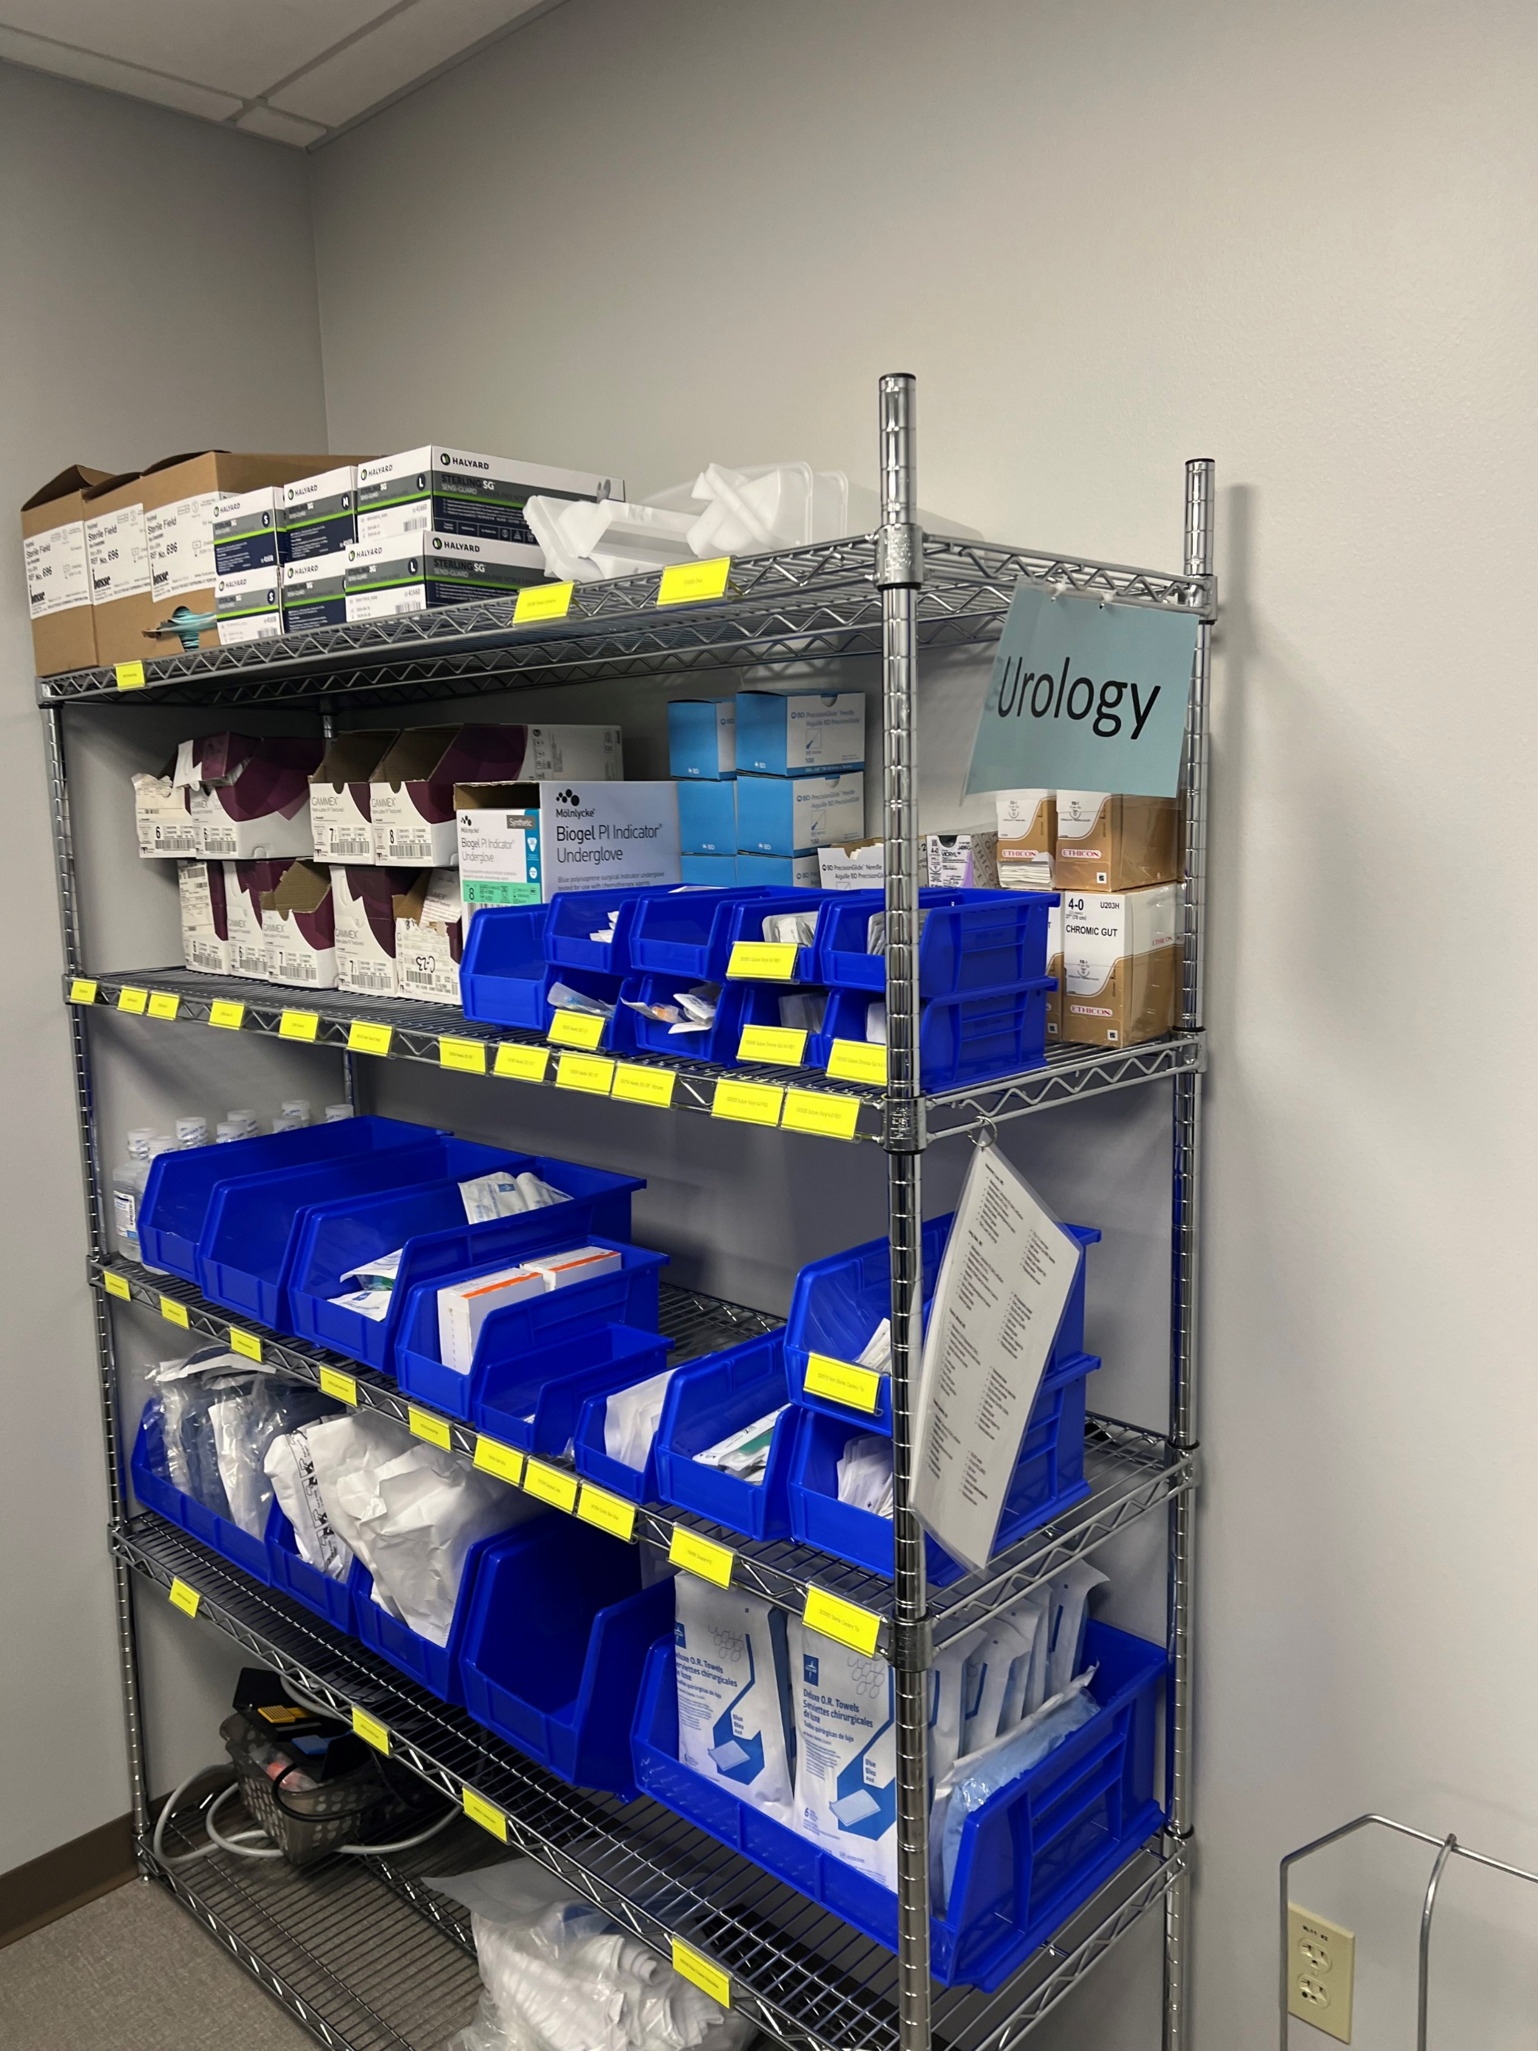
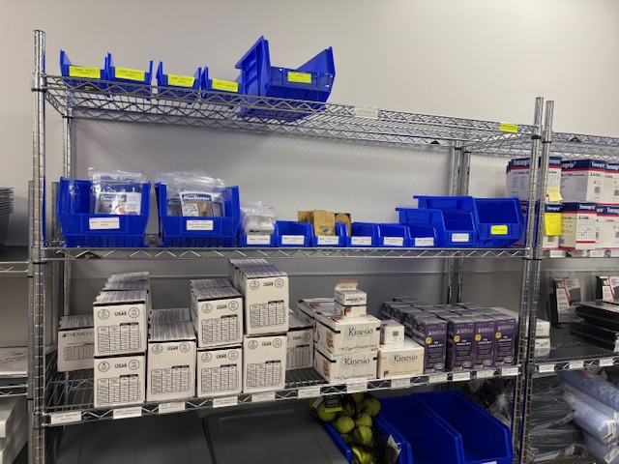
Measures:
STUDY
Ordering AREA | Template Updated | Correct items Stocked | Storeroom Labeled | Electronic Ordering
EVS | X | X | X | X
OR/Sterile Supply | X | X |  | X
Day Surgery | X | X | X | X
Anesthesia | X |  |  | X
Urgent Care locations
PT/OT/Cardiac Rehab | X |  |  | X
Urology | X | X | X | X
General Surgery | X | X | X | X
Foot Clinic | X | X | X | X
Ortho Stoughton | X |  | X | X
Lab/Sleep Lab
Geri Psych
Podiatry
Wound
Respiratory Therapy |  |  |  | X
Imaging/Scanning
Pharmacy
Cardiology | X | X | X | X
Ortho Madison |  |  |  | X

Slide 75
Findings:
ACT
Results: Did you accomplish your goals?
We have now completed 6 of 19 departments. 1 – Templates are updated. 2-Correct Items are being Stocked and item numbers set up for all items a department needs to order. 3-Storerooms are labeled. 4 – Ordering is being done electronically.
Lessons Learned: What did you learn as a result of this project? Unexpected discoveries? Problems or barriers?
Updating the ordering templates creates less confusion when individuals are placing orders. It also ensures correct items are stocked in materials storeroom when usage determines that is most efficient. Labeling stockrooms with Item numbers and Par levels is key to time savings and accuracy when placing supply orders in Multiview. Taking a laptop to place orders directly into Multiview while in the stockrooms creates one less step.
Next Steps: What actions are you going to take in the next 60 days ?
Action: | Assigned To: | Due Date:
Finish labeling Anesthesia and OR storerooms | Nancee/Roberta/Dacia | 07/2025
Finish labeling PT/OT/Cardiac Rehab at SHOC and then Oregon PT | Nancee/Roberta/Dacia | 07/2025
Finish validating Ortho STO stocked items and implement Ortho Mad | Nancee/Roberta/Dacia | 07/2025
Project Leader is Recommending the Following:
QM Council approval for completion of project? NO Project still in progress, project to continue: YES

Slide 76
Accounting
Cash Spreadsheet Overhaul
1st Presentation Date: 09/24/2024
Document Last Presented: 5/27/2025

Slide 77
Quality Story:
PLAN
Cash Spreadsheet Overhaul
Goal(s): What are you trying to accomplish?
KOM Target: Improve cash reconciliation file functionality with formulas and increase daily reporting received to reduce daily reconciliation questions. Current KOM Status: 60% Target Completion: June 30th, 2025
Background: Explain what the original situation was. Why was a change recommended? (e.g. variation, poor outcome, etc.)
The current cash posting spreadsheet is based off the spreadsheet used to post to SAP. Formulas have not always been updated, and items have not always been added in a user-friendly way – both on the PFS (inputs) side but also on the Accounting side. Improvements will also help training/usage for new staff.
Driver: Explain why the project is critical to SH. Why does it relate to the strategic plan?
Daily cash posting and monthly accounting reconciliations can be time consuming and streamlining and overhauling the current spreadsheet will help to increase our efficiency and accuracy. This will free up time to work on other projects – and increased accuracy will help find and fix issues prior to impacting external customers.
Team:
Project Leader: Danielle Kapanke & Kendra Saul Members: Accounting and PFS teams.

Slide 78
Changes:
DO
List the changes that have been made leading to improvements.
What? | Why? | When?
Start experimenting with formula improvements for items identified in meeting. | See what capabilities Excel has to streamline this process. | April-June 2025
Identify additional reports to reduce investigation time | Work with PFS | April-June 2025
First draft of new spreadsheet is complete – entering PFS testing phase with dual entry in new and old sheets. | Reviewing what is working and looking for improvements on PFS side. | Currently – Mid May
Review PFS spreadsheets for Accounting entry tests. | Make sure that new PFS sheets within the new file are matching old cash spreadsheet functionality. | Mid-End of May
Fully transition to new spreadsheet | Will continue to trouble shoot new items as they arise, but target to be completely using the new cash spreadsheet by June. | June 1st

Slide 79
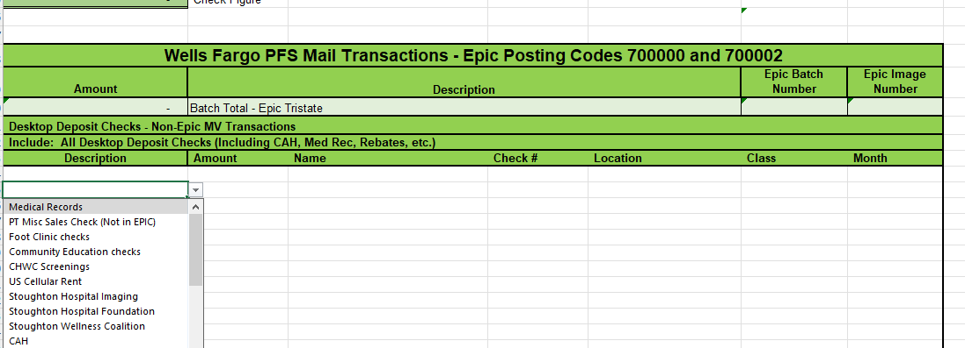
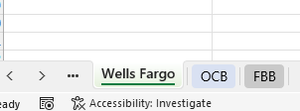
Measures:
STUDY
New spreadsheet uses drop downs with frequent selections to simplify entry.
Spreadsheet is broken into different tabs for the different banks/accounts that are being tracked with both PFS and Accounting checks on each one.
Testing reports for PFS to run and look for errors prior to submitting to accounting.
Thumbs up from Kendra after her second day of using the spreadsheet alongside the old one.

Slide 80
Findings:
ACT
Results: Did you accomplish your goals?
Not completely yet. The current spreadsheet is a work in progress. We have made changes, and the new file is in the testing phase. We are working out kinks as we dual enter in the file with the PFS team. The next step will be testing the accounting side on the PFS spreadsheets and working through any issues. Hoping to fully transition to the new spreadsheet by the end of May.
Lessons Learned: What did you learn as a result of this project? Unexpected discoveries? Problems or barriers?
Time to move forward with changes we have already identified as necessary and prepared. Due to the nature of a cash reconciliation, things will always change, and we can continue developing and engineering features in excel, but we need to advance and test all the changes that have been made. Then, we can start benefiting from the efficiencies they will create.
Next Steps: What actions are you going to take based on your findings? (e.g. roll out to additional units; modify and make additional improvements; abandon the effort; change course?)
Continue Dual entry with PFS for the next couple of weeks After close is complete start testing of PFS spreadsheets by accounting Continue to troubleshoot existing issues and testing functionality – this will be ongoing for a while Targeting full implementation of new spreadsheet by June 2025
Project Leader is Recommending the Following:
QM Council approval for completion of project?: No Project still in progress, project to continue: Yes

Slide 81
Accounting
Upgrade Multiview and Convert QuickBooks
1st Presentation Date: 1/23/2024
Document Last Presented: 5/27/2025

Slide 82
Quality Story:
PLAN
Upgrade MV and Convert QuickBooks
Goal(s):
KOM Target: Upgrade Multiview to V23 by April 30, 2025. After the upgrade to V23, reassess the need to convert Quick Books to Multiview. Current KOM Status: We successfully upgraded to V23 on April 15, 2025. We have reassessed the need to convert Quick Books to Multiview and have decided not to make the conversion at this time.
Background:
Since this project was started, Multiview released a new version of their software (V23). Unlike prior version releases, the change from V22 (our current version) to V23 is significant and changes the software to a web-based interface. Prior version releases have had minimal changes and impact to the way we use the software. Since this one is such a big change, MV is requiring us to upgrade our test environment and perform testing in that environment before upgrading our production environment. It is important that we ensure the system is working correctly before we upgrade to the new version in our production environment so we can continue to process transactions. We also need to become familiar with the software so we can be more efficient when we start using it.
Driver:
We need to upgrade to the new version so we can take advantage of enhancements to the software. This needs to be completed before we can continue with the assessment of whether to convert QuickBooks financials to Multiview Financials.
Team:
Project Leader: Brian Swain Members: Accounting Team

Slide 83
Changes:
DO
What? | Why? | When?
Schedule the conversion to V23 and troubleshoot any issues. | To complete the upgrade and resolve any issues as soon as possible. | April 2025
Provide support for end users and fix any issues after conversion. | To ensure end users are able to perform the tasks in MV that they need to in order to complete their necessary job functions. | April 2025 and forward
Learn more about TechSoup, a website that offers discounts on subscriptions to non-profit organizations. | To determine if we can obtain a QuickBooks license for less than what we’re currently paying which is one of the reasons we were considering converting Quick Books to Multiview. | April – May 2025
Sign up for TechSoup | To obtain a license for $80 per year per entity instead of $65 per month ($780 per year) | April – May 2025

Slide 84
Measures:
STUDY
Upgrade Multiview to Version 23:
We upgraded on April 15. As expected, there were a few issues to fix and some support provided to end users, but it was very minimal and now we are up and running.
Assess need to convert Quick Books to Multiview for the Foundation, MRI JV and Gift Shop:
We have decided not to convert Quick Books to Multiview for the three entities for the following reasons:
One of the main drivers was cost. We have found a different way to realize cost savings, through TechSoup.
Initially, we thought that Multivew would end up being more efficient. After learning what it would take to convert and maintain the entities in Multiview, we now feel that it will not be more efficient and will likely add additional workload for the accounting team. This would especially be true during the initial setup and conversion of each entity. We don’t believe this would be the best use of the Team’s time considering we already have a system that meets our current needs.

Slide 85
Findings:
ACT
Results:
We have successfully converted to Version 23. We have decided not to convert Quick Books to Multiview for the Foundation, MRI JV and Gift Shop.
Lessons Learned: What did you learn as a result of this project? Unexpected discoveries? Problems or barriers?
There are some changes in the way security is setup in Version 23 which requires a change to our internal process. The changes are good, as they enhance security, but will require a different workflow for us. V23 takes some time to get used to. The change from a forms-based interface to a web-based interface is a different look and feel. Setting up new entities in Multiview is a complicated process. It would either require a consulting project with Multiview or a lot of extra time for the Accounting Team to try and set them up ourselves.
Next Steps: What actions are you going to take based on your findings? (e.g. roll out to additional units; modify and make additional improvements; abandon the effort; change course?)
Continue to help users as they use V23 Troubleshoot any processes that need further addressing in V23
Project Leader is Recommending the Following:
QM Council approval for completion of project?: Yes Project still in progress, project to continue: No

Slide 86
PR/Marketing
Onboarding New Employees
1st Presentation Date: 03/25/2025
Document Last Presented: 05/27/2025

Slide 87
Quality Story:
PLAN
New Employee Onboarding
Goal(s): What are you trying to accomplish?
KOM Target: Implement updated/improved new employee onboarding by 9/30/2025. (4 steps to reach full implementation) Current KOM Status: Step 1: Initiation, completed. Step 2: Planning, in progress.
Background: Explain what the original situation was. Why was a change recommended? (e.g. variation, poor outcome, etc.)
The PR/Marketing department used a generalized onboarding checklist that was not tailored to the PR/marketing team or the Community Health & Wellness Center (CHWC). Developing a more customized process was recommended to better align with specific department needs and administration’s initiative to improve onboarding across all departments.
Driver: Explain why the project is critical to SH. Why does it relate to the strategic plan?
A strong onboarding process sets employees up for long-term success. Tailoring it to the PR/Marketing department enhances engagement, productivity, and collaboration. This initiative aligns with the strategic plan by building a knowledgeable workforce and improving overall efficiency.
Team: PR/Marketing
Project Leader: Kate Stanard Members: Laura Mays, Linda Schaefer, Kelly Perna

Slide 88
Changes:
List the changes that have been made leading to improvements that occurred in the last 60 days.
DO
What? | Why? | When?
Set initial meeting with PR Director. | Develop goals and interventions to meet project needs. | February 17, 2025
Review current onboarding checklist/process for the PR/Marketing department. | Reviewing the current process helped identify gaps and ensure a more tailored, effective onboarding approach. | March 5, 2025
Met with police officer to determine plan in case of an emergency. | To ensure all CHWC is informed on what to do if there is an emergency, and to document the plan in the binder to go over with new employees. | April 16, 2025
Review/gather additional marketing-specific policies to add to checklist | To ensure new team members are aligned with department standards, brand guidelines, and compliance requirements from the start, promoting consistency and reducing onboarding errors. | April 16, 2025
Have PR team review job descriptions | Job descriptions will be added to the onboarding checklist/binder. | April 30, 2025

Slide 89
Measures:
STUDY
Action Item | Completion
Initiation | Completed
Planning | In progress
Execution
Closure

Slide 90
Findings:
ACT
Results: Did you accomplish your goals?
Ongoing.
Lessons Learned: What did you learn as a result of this project? Unexpected discoveries? Problems or barriers?
We learned that the marketing department needs a tailored onboarding process due to our off-site location and unique needs that differ from other departments. After meeting with the officer, we learned how important it is to have a clear emergency plan in place, including where to meet and what our best options are in different situations. Since we are a small department and don’t experience many changes, it’s especially important to make sure this information is shared with new coworkers during onboarding.
Next Steps: What actions are you going to take in the next 60 days ?
Action: Begin making changes to the general checklist (alter it to PR/Marketing). | Assigned To: Kate | Due Date: 5/20/2025
Develop plan for new employees first week in department, mentor, welcome potluck, tour of building, go over panic button, etc | Kate | 6/2/2025
Create an online folder with all new onboarding items for PR and a binder to have out at CHWC. | Kate | 6/10/2025
Meet with PR team to determine next steps, how often we would like to review this, etc. | Kate | 6/17/2025
Develop plan for new employees first week in department, mentor, welcome potluck, tour of building, go over panic button, etc | Kate | 5/15/2025
Project Leader is Recommending the Following:
QM Council approval for completion of project?: Enter YES or NO Project still in progress, project to continue: Enter YES or NO

Slide 91
Foundation
Employee Giving
1st Presentation Date: 9/24/2024
Document Last Presented: 3/25/2025

Slide 92
Quality Story:
PLAN
Employee Giving
Goal(s): What are you trying to accomplish?
KOM Target: Have 40% of employees give to the Stoughton Hospital Foundation. 155 employees out of 386 employees (number of employees on 10/1/2024) Current KOM Status: % of Employees giving FY24 final: 35%, 134/383 employees FY25 current: 51%, 195/386 employees (as of 5/6/2025)
Background: Explain what the original situation was. Why was a change recommended? (e.g. variation, poor outcome, etc.)
Stoughton Hospital Foundation Strategic Plan has a goal that states to increase employee total participation rate to at least 40%. With constant changes of the number of employees and use the number of employees from the first day of the fiscal year, it is growing increasingly harder to reach the goal of at least 40%.
Driver: Explain why the project is critical to SH. Why does it relate to the strategic plan?
Financial - greater % of employees giving back helps when writing for grants or asking for money.
Team:
Project Leader: Taylor Simonson Members: Laura Mays and Taylor Simonson

Slide 93
Changes:
DO
List the changes that have been made leading to improvements.
What? | Why? | When?
Added ask in new employee orientation |  | Post COVID-19
Created EWC (employees who care) | To give an incentive to employees who choose to donate through payroll deduction | October 2022
Jump or Join at the Benefits Fair | To increase the number of employees enrolled in payroll deduction. 9 employees increased giving 9 employees started payroll deduction | November 13, 2024
Researched # of Per Diam Employees | Explore if makes a difference and follow up from previous presentation | November 13, 2024
Held a Hospital Department Basket Raffle | Create additional ways for employees to donate | March 5-14, 2025

Slide 94
Measures:
STUDY
Include graphs of your measurement, results of surveys, etc. Include benchmarks or comparative data when available.
147 of
337
144 of
358
134 of
383
195
of
386
As of 3/13/2024
FY 2022 FY 2023 FY 2024 FY 2025

Slide 95
Measures:
STUDY
Include graphs of your measurement, results of surveys, etc. Include benchmarks or comparative data when available.
92
25
52
15
3
12
Results from Basket Raffle Fundraiser
Results of Per Diem Employees (FY24)
Employees who donated to the basket raffle (BR)
134 of
383
24 of
84
110 of
299
All Employees Per Diem Without Per Diem
Employees who also donated in FY24
Employees who’s first donation was BR
Employees who have already donated in FY25
35%
28%
27%
Employees who donated in FY25 for the first time
Employees who have donated to SH, but not in FY24

Slide 96
Findings:
ACT
Results: Did you accomplish your goals?
Yes. We found that by adding in new competitive ways for employees to donate to the Foundation, increases the amount of employees donating.
Lessons Learned: What did you learn as a result of this project? Unexpected discoveries? Problems or barriers?
People are looking for new opportunities. It is good to do a rotation to make things new and exciting, like adding in competitions.
Next Steps: What actions are you going to take based on your findings? (e.g. roll out to additional units; modify and make additional improvements; abandon the effort; change course?)
Buddy Program – an employee currently giving recurring payroll, helps get another to join, and gets an incentive. Explore competition options for departments Foundation Board will review new ideas during Strategic planning process
Project Leader is Recommending the Following:
QM Council approval for completion of project?: YES Project still in progress, project to continue: NO

Slide 97
Human Resources
UKG Centralized Coaching and Discipline
1st Presentation Date: 5/28/24
Document Last Presented: 3/25/25

Slide 98
Quality Story:
PLAN
UKG Centralized Coaching and Discipline
Goal(s): What are you trying to accomplish?
KOM Target: 100% employee coaching or discipline using UKG platform. Current KOM Status: Original UKG solution 100% completed with Forum meeting on 07/18/24. There is a need to pivot to another tool for ease functionality of intended process. Current status on OnBase solution 100% completed.
Background: Explain what the original situation was. Why was a change recommended? (e.g. variation, poor outcome, etc.)
Stoughton Health has no centralize process for assuring employee coaching over discipline decision making. Stoughton Health has made great progress accepting new UKG performance evaluation tool. The goal is to centralize our processes to assure greater consistency when disciplining employees.
Driver: Explain why the project is critical to SH. Why does it relate to the strategic plan?
Inconsistency in how we deal with employee performance creates issues around fairness and a liability for the organization. SH strives to be a transparent and employee friendly organization.
Team:
Project Leader: Chris Schmitz Members: Tonya Stenback, Melissa Kitelinger and Jenifer Kenrick

Slide 99
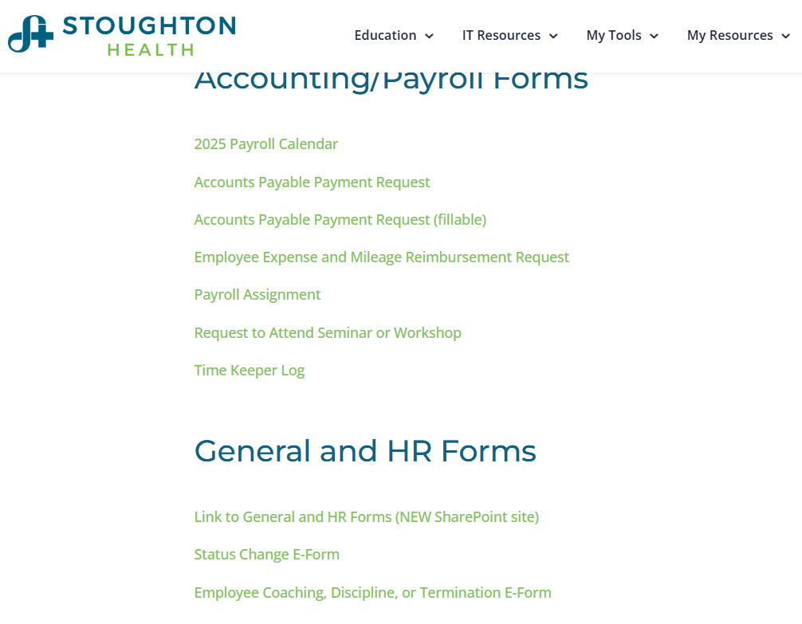
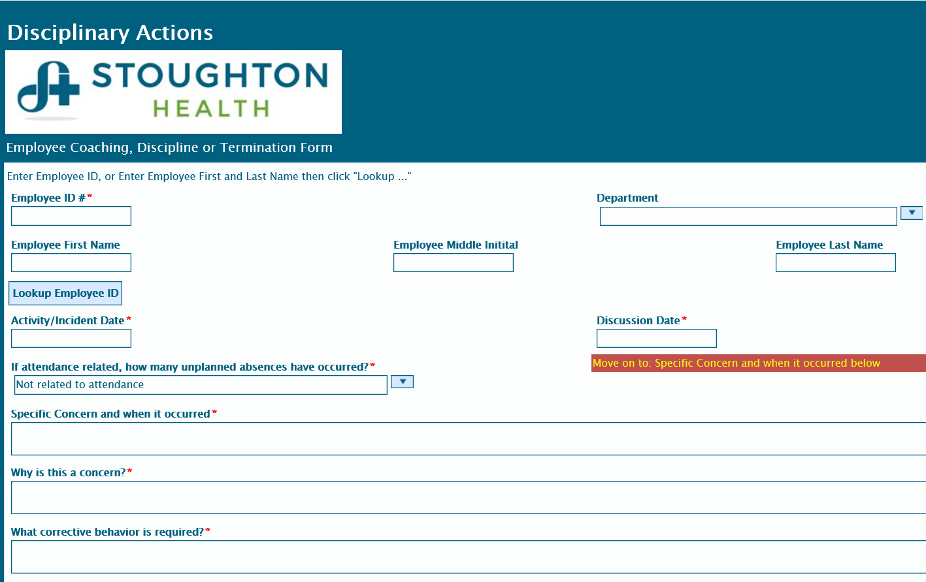
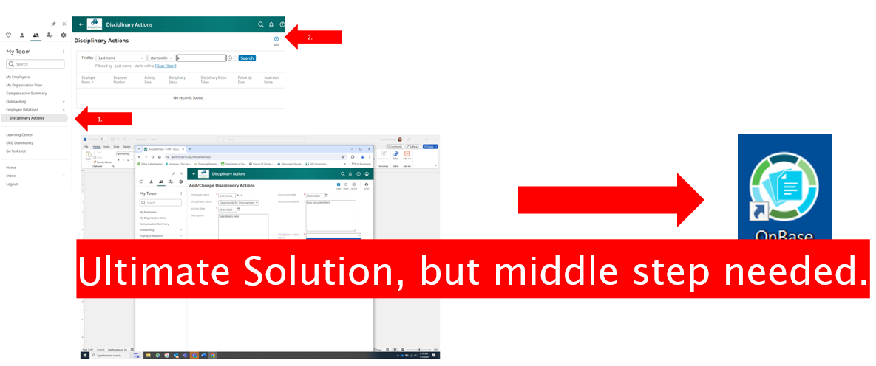
Changes:
List the changes that have been made leading to improvements that occurred in the last 60 days.
DO
What? | Why? | When?
New tool available for use | To centralize, streamline and create greater consistency with our processes. | Available now. All new coaching and discipline of any kind is communicated using this tool.

Slide 100
Measures:
STUDY
Fully completed using new disciplinary process.

Slide 101
Findings:
ACT
Results: Did you accomplish your goals?
The new tools is completed by leader then submitted to HR electronically. HR prints off form, secures necessary signatures, meets with employee and scans signed document into OnBase personnel file.
Lessons Learned: What did you learn because of this project? Unexpected discoveries? Problems or barriers?
Some leaders are still resistant to use a standardized process for employee coaching. There have been two examples since the last presentation to QM.
Next Steps: What actions are you going to take in the next 60 days ?
Action: | Assigned To: | Due Date:
Measure leader sentiments on using new process | Chris | 5/27/25
Project Leader is Recommending the Following:
QM Council approval for completion of project?: Enter YES or NO Project still in progress, project to continue: Enter YES or NO

Slide 102
Human Resources
New Hire Scheduling in EPIC
5.27.2025
5.27.2025

Slide 103
Quality Story:
PLAN
New Hire Scheduling in EPIC
Goal(s): What are you trying to accomplish?
KOM Target: 100% of new hires are scheduled by HR versus going through the Registration department. Current KOM Status: All new hire are currently scheduled by Registration
Background: Explain what the original situation was. Why was a change recommended? (e.g. variation, poor outcome, etc.)
We strive to provide the best new hire onboarding experience possible. At times, when scheduling a new hire, it can feel like a long phone call requiring many phone transfers.
Driver: Explain why the project is critical to SH. Why does it relate to the strategic plan?
Sarah Watkins is open to training HR staff on how to register a new hire. This would provide a more seamless new hire experience at one of the first interactions with Stoughton Health. HR is open to doing this task if it means a better new hire experience and increases hew hire retention.
Team:
Project Leader: Jenifer Kenrick Members: Tonya Stenback, Melissa Kitelinger and Chris Schmitz

Slide 104
Changes:
List the changes that have been made leading to improvements that occurred in the last 60 days.
DO
What? | Why? | When?
Secure EPIC training | Streamline onboarding process | Done by June 15th
Measure current turnaround times from start to finish of existing process | Streamline onboarding process

Slide 105
Measures:
STUDY
Track Time of New Hire Call Now vs. post HR scheduling?

Slide 106
Findings:
ACT
Results: Did you accomplish your goals?
Track times of current scheduling start to end to establish a benchmark.
Lessons Learned: What did you learn as a result of this project? Unexpected discoveries? Problems or barriers?
TBD
Next Steps: What actions are you going to take in the next 60 days ?
Action: | Assigned To: | Due Date:
Schedule EPIC training | Jenifer, Melissa and Tonya | June 15th
Initiate new hire HR scheduling into EPIC | Jenifer, Melissa and Tonya
Track time spent with HR now scheduling for a 4-week period | Jenifer, Melissa and Tonya | Implementation up to 8/1/2025
Project Leader is Recommending the Following:
QM Council approval for completion of project?: Enter YES or NO Project still in progress, project to continue: Enter YES or NO

