Slide 1
Stoughton Health
Governing Board Meeting
November 25, 2024

Slide 2
Agenda
Call to Order
New/Old Business
Adjournment
SSM Updates
Committee Updates
Administration Team Updates
Chief of Staff Report

Slide 4
Governing Board Meeting Minutes
Meeting Minutes
* Request Motion to Approve September 13, 2024 Governing Board Meeting Minutes *

Slide 5
Trustee Education
Cardiac HEAL Program
Jonathan Milton, MSN, APNP, ACCNS-AG

Slide 6
The Cardiac HEAL Program℠ (Heart Exercise & Advanced Lifestyle-management) Jonathan D. Milton APNP-Clinical Nurse Specialist DNP Candidate May 2025

Slide 7
Cardiology: Chronic Disease Management
Illness
Wellness
Notes:
Good morning. I’d like to introduce my APP-CNS colleague Jonathan. Jonathan joined our cardiology team about 4 months ago. He has 7 years of acute care ICU training and spent clinical time as a CNS student working in OP cardiology clinic. For those of you not familiar with the CNS arm of the Advance Practice Nurse we are MSN , and or Doctorally prepared and tend to focus on populations of people or health. We not only are able to function in the medical model, (3P's, diagnosing, ordering labs, prescribing etc) but spend student clinical hours learning effective strategies for quality improvement, leadership, finance, management etc. The CNS is also accountable for influencing our populations individual/community from wellness to illness and back to wellness. So in essence we work across disciplines and the organizations. For most, this means assessing chronic illness from and IP to OP to Community health lens.
The Quality Improvement Project that Jonathan is going to present is his doctoral work and fits perfectly with the goal of influencing not only the individual, but the communities overall Cardiovascular health.

Slide 8
Community Health Needs Assessment 2022-2024
Priority #2: Chronic Disease Management
26.5% adults in Dane County are limited in any activity because of physically, mental or emotional problems
WI annually spends ~3.9billion – 4.1billion in healthcare and loss productivity costs in Diabetes & heart disease alone
Action Plan: Educational offerings for Cardiac Health

Slide 9
Identifying the Gap
Heart failure (HF) is:
- Chronic and progressive
- Ejection Fraction (EF) | ECHO
- Covalve disease, heart attacks, high BP
The management of HF:
- Lifestyle modifications
- Pharmacology – 4 pillars for management
Role of cardiac rehabilitation (CR):
- Strengthen the heart and improve overall health
- Secondary vs. Primary prevention
Gap:
- CMS no coverage for EF >35%
- Reduced access in rural areas
(German et al., 2022)
(Heidenreich et al., 2022)
Notes:
In 2014, CMS expanded coverage for cardiac rehab (CR) services to patients with stable HFrEF ≤35% and New York Heart Association (NYHA) class II to IV symptoms despite being on optimal HF therapy for at least six weeks.
*Stable is defined as patient who have not had recent (≤6 weeks) or planned (≥6 months) major cardiovascular hospitalizations or procedures.

Slide 10
Evidence Based Practice
30-day readmissions
Guided exercise and lifestyle modifications
Mean total cost ($15,618 - $25,264 per patient)
Improved perceived quality of life
5581 steps decrease risk of all-cause mortality
(German et al., 2022)
(Hosein Adadi et al., 2020)
(Kwok et al., 2021)
(Zhou et al., 2023)

Slide 11
Purpose
To create the “Cardiac HEAL program” (Heart Exercise and Advanced Lifestyle-management)℠ to enhance cardiovascular health and support quality of life for geriatric patients with heart failure.
Improve Cardiovascular Outcomes
Enhance Patient Adherence
Support Quality of Life

Slide 12
Aims
Improve Cardiovascular Outcomes:
30-day unplanned heart failure hospital re-admissions
ED visits
Enhance Patient Adherence:
Pharmacological
lifestyle changes, physical activity and dietary modification
Support Quality of Life:
Sustain and improve patient-reported outcomes
COOP

Slide 13
Pilot Program | Patient Eligibility
Eligibility:
Heart Failure Diagnosis
Older Adult (≥65 years of age)
Patients who do not qualify for CR under CMS guidelines
Pilot program capacity: Enroll at least 5 patients – 10 patients max

Slide 14
Controls Implemented
QI project exemption status approved by Edgewood College IRB
Quality Improvement & Risk Management oversight
Stoughton Health Administrative Council Approval
Interprofessional Team

Slide 15
Proposed Timeline for Project Completion
Current state:
Admitting pilot patients on a rolling basis
4 patients enrolled as of November 2024

Slide 16
Proposed Timeline for Project Completion
Current state:
Admitting pilot patients on a rolling basis
4 patients enrolled as of November 2024

Slide 17
Thank you – Questions?

Slide 18
SSM Health Updates
Dawit Tesfasilassie / Matt Kinsella

Slide 19
New Business
Michelle Abey/Dan DeGroot

Slide 20
CEO Transition Corporate Resolutions (Michelle Abey)
Resolution for Check Signing Authority, Stoughton Hospital Association
Appointment of Class B Director, Stoughton Hospital Imaging, LLC
* Request Motion to Approve Resolution for Christopher P. Brabant to serve as President and CEO of the organization and shall have the authorities outlined in Article XI of the Stoughton Hospital Association By-Laws including but not limited to check signing authority for the Corporation. *
* Request Motion to Appoint Christopher Brabant as Class B Director, Stoughton Hospital Imaging, LLC to replace and serve the remaining term of Daniel C. DeGroot. *

Slide 21
Credentialing by Proxy (Dan DeGroot)
Introduction to Telemedicine Credentialing by Proxy; What Hospitals and Telehealth Companies Need to Know:
Medicare Conditions of Participation allow process for streamlined credentialing of telemedicine-based practitioners.
Permits hospital receiving telemedicine services ("originating site") to rely on privileging and credentialing decisions made by hospital or entity providing telemedicine services ("distant site").
Considerations:
Originating site must enter into written agreement with distant site.
Medical staff by-laws should include provisions for credentialing by proxy.
Both originating and distant site entities must be accredited with The Joint Commission for proxy credentialing to work.

Slide 22
Committee Updates

Slide 23
No October Meeting
Executive Committee

Slide 24
Overview of Friday, November 22, 2024 Finance Committee Meeting
October 2024 Financials
Financial Assistance Policy (FAP) / EMTALA Policies
Investment Review: ZCM Advisory Group
November Month-to-Date Financials
Community Health Needs Assessment (CHNA)
Capital Request: Infusion Pump Replacement
Finance Committee

Slide 25
Overview of Friday, November 22, 2024 Finance Committee Meeting
October 2024 Financials
Financial Assistance Policy (FAP) / EMTALA Policies
Investment Review: ZCM Advisory Group
November Month-to-Date Financials
Community Health Needs Assessment (CHNA)
Capital Request: Infusion Pump Replacement
Finance Committee

Slide 26
October 2024 Financials (Michelle Abey)
Operating Income
$690,981
Balance Sheet Metrics
Outpatient Revenues
Expense Variances
* Request Motion to Approve October 2024 Financial Statements as presented. *

Slide 27
Overview of Friday, November 22, 2024 Finance Committee Meeting
October 2024 Financials
Financial Assistance Policy (FAP) / EMTALA Policies
Investment Review: ZCM Advisory Group
November Month-to-Date Financials
Community Health Needs Assessment (CHNA)
Capital Request: Infusion Pump Replacement
Finance Committee

Slide 28
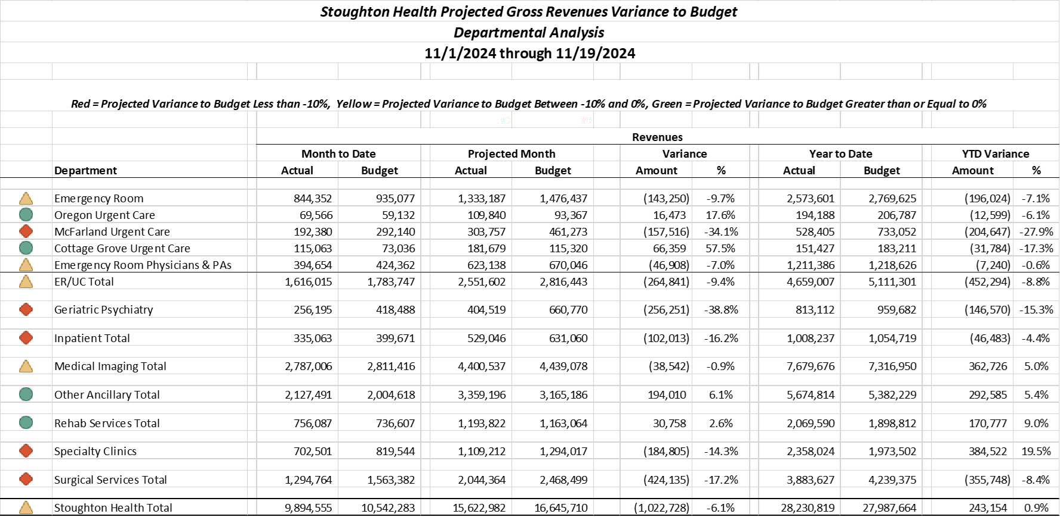

Slide 29
Overview of Friday, November 22, 2024 Finance Committee Meeting
October 2024 Financials
Financial Assistance Policy (FAP) / EMTALA Policies
Investment Review: ZCM Advisory Group
November Month-to-Date Financials
Community Health Needs Assessment (CHNA)
Capital Request: Infusion Pump Replacement
Finance Committee

Slide 30
Financial Assistance Policy (FAP) / EMTALA Policies (Michelle Abey)
501(r) Required Elements in FAP
Eligibility criteria including which physicians/services are covered under the policy
Basis for calculating amounts charged
Method for applying for financial assistance
Billing & collection policy
Measures to widely publicize policy
EMTALA – stabilize all patients presenting to the ED regardless of ability to pay

Slide 31
Overview of Friday, November 22, 2024 Finance Committee Meeting
October 2024 Financials
Financial Assistance Policy (FAP) / EMTALA Policies
Investment Review: ZCM Advisory Group
November Month-to-Date Financials
Community Health Needs Assessment (CHNA)
Capital Request: Infusion Pump Replacement
Finance Committee

Slide 32
Community Health Needs Assessment (CHNA) (Laura Mays)
Collaborative Efforts
Since 2013: Partnered with:
Group Health Cooperative, Unity Point Health Meriter, SSM Health, UW Health, and Public Health Madison and Dane County
Together, we form the Healthy Dane Collaborative (HDC)
This collaborative, data-driven approach ensures we continue to prioritize the most pressing health needs within our community.
Defining Our Community – Why Dane County
Stoughton Health’s primary service area includes Dane County communities of: Stoughton, Oregon, McFarland, and Cottage Grove.
Dane County residents comprise:
71% of Inpatient cases
78% of Emergency Department patients
74% of Other Outpatient (rehab, lab, urgent care)
59% Outpatient Surgery

Slide 33
Community Health Needs Assessment (CHNA)
Assessment & Prioritization Process:
CHNA and Implementation Plan provided every three years
Collect and Review Secondary data: U.S. Census Bureau, WHA, WI Dept. of Health Services, County Health Rankings, CDC, National Cancer Institute, Public Health Madison and Dane County, etc.
Primary Data Sources: One-on-one interviews, community conversations with organizations and partners, focus groups – including Stoughton May 6, 2024 & Oregon May 8, 2024
Clinical Provider Survey
Prioritization Process – analyze, synthesize data and select priority areas as collaborative
Key Focus Areas:
Chronic Conditions
Injury and Safety
Mental Health and Substance Use
Reproductive Justice
Commit to understanding cross-cutting issues – food insecurity, housing, access to care, preventative health and transportation.

Slide 34
Community Health Needs Assessment (CHNA)
Present to Hospital Governing Board for Approval:
Make the Full CHNA report available to the public:
Add to website
Hard copies available if requested
* Request Motion to Approve 2025-2027 Community Health Needs Assessment (CHNA). *

Slide 35
Overview of Friday, November 22, 2024 Finance Committee Meeting
October 2024 Financials
Financial Assistance Policy (FAP) / EMTALA Policies
Investment Review: ZCM Advisory Group
November Month-to-Date Financials
Community Health Needs Assessment (CHNA)
Capital Request: Infusion Pump Replacement
Finance Committee

Slide 36
Capital Request:
Infusion Pump Replacement

Slide 37
Capital Request: Infusion Pump Replacement (Michelle Abey)
Cost to purchase: ~$132,000 + implementation – useful life of 7 years
Savings of ~$525,000 over the life of the pumps to own
Enhanced features:
Automatic drug library updates
Electronic Pump Finder
Reporting features
Intuitive touchscreen for ease of use
Prime backs to reduce air bubbles in tubing
*Request Motion to Approve $140,000 of Fiscal Year 2025 Capital for the Purchase and Implementation of Ivenix infusion pumps.

Slide 38
Overview of Friday, November 22, 2024 Finance Committee Meeting
October 2024 Financials
Financial Assistance Policy (FAP) / EMTALA Policies
Investment Review: ZCM Advisory Group
November Month-to-Date Financials
Community Health Needs Assessment (CHNA)
Capital Request: Infusion Pump Replacement
Finance Committee

Slide 39
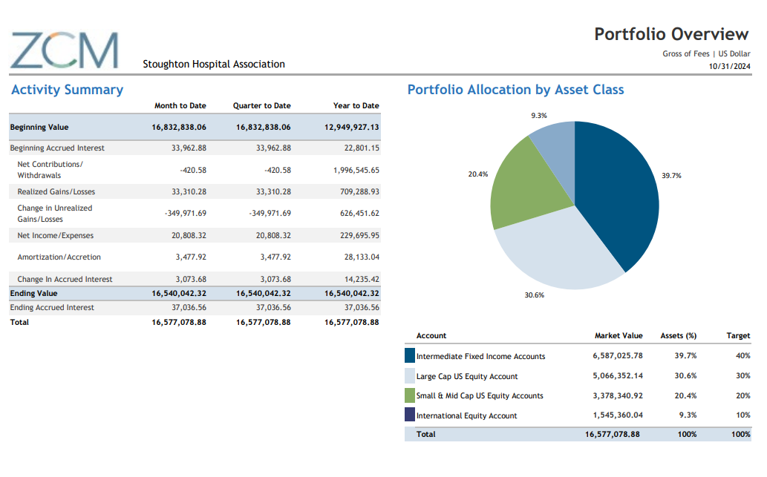
Investment Review – ZCM Advisory Group (Michelle Abey)

Slide 40
Upcoming Meeting: January 9, 2025
Governance Committee

Slide 41
Review QM Council Meeting Minutes – September 2024
Review QM Council Dashboards – September 2024
Upcoming Meeting: December 3, 2024
Quality Committee

Slide 42
Review QM Council Minutes (Donna Olson)
Closed CI Projects – September 2024:
Fixed Dose Kcentra® for Anticoagulation Reversal
Fluorescent Surface Monitoring
Café POS system
Purchasing Workflow Process

Slide 43
Overview of Friday, November 22, 2024 Audit Committee Meeting
Stoughton Hospital Association FY2024 Audit Review and Acceptance
Audit Compliance/Risk Management Committee

Slide 44
FY2024 Audit Review and Acceptance (Kris Krentz)
Unmodified, "Clean" Opinion
Significant Estimates: Collectability of Patient Receivables & Estimated Third-Party Payor Settlements
Significant Disclosures: Long-Term Debt – Terms & maturities & financial covenants
Corrected and Uncorrected Misstatements • No misstatements detected as a result of audit procedures.
No Difficulties Encountered in Performing Audit.
* Request Motion to Approve Stoughton Hospital Association FY2024 Audit Report and Governance Letter. *

Slide 45
VP HR, Campus Planning & Operational Support Services Summary
Chris Schmitz

Slide 46
Facilities Updates
Active capital improvements to café, surgical services, Oregon Urgent Care, and Community Health & Wellness Center
Continued plumbing issues in 1956 building
Added EV installation ports through ChargePoint
Solar project
Purchased residential homes at 700, 708, and 724/728 (TriCor)
Renters in all three properties
Future of Al’Anon home

Slide 47
Staffing Updates
Trends in Resignation Notices:
Our Response
WFD Education Grants
Aggressive pay range increases for entry level and Tech staff
Changes to Retirement plan design

Slide 48
Staffing Updates
Welcome Chris!
Current leadership openings:
Ortho Surgeon (rescheduled)
Clinic Manager
Director of Experience and Engagement
Still Challenging Openings: Medical Assistants, Surg Techs (with 5K sign-on bonus), Rad Techs, CNA’s, Select RN positions

Slide 49
CFO Summary
Michelle Abey

Slide 50
Quarterly Corporate Compliance Committee Report
2 Requests to Amend PHI
4 HIPAA Breaches
Annual Risk Assessment Completed
DSPS Complaint
Grievances Resolved To Date
* Request Motion to Approve Quarterly Corporate Compliance Committee Report. *

Slide 51
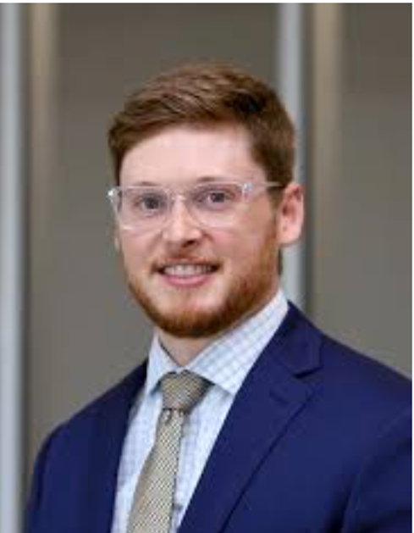
Multi-Specialty Clinic Updates
Zachary Lind, DPM | Podiatry Services
Foot and Ankle Surgery | Diabetic Food Wound Care
Clinic Beginning December 16th
Clinic Phone: (608) 501-6205
DHP (Medica) continues to deny request to panel Dr. Lind.
Board officer meeting with Medica on December 11th.

Slide 52
Stoughton Health Outpatient Center (SHOC) Updates
Bond Funds Entirely Drawn
Expenditures through 11/30/2024: $19,413,251
JP Cullen to be completed mid-February
First patients seen – week of April 28th
Tour Tonight – 4 pm – Meet East Side of Hospital
Departments Moving:
Cardiac Rehab
Stoughton Rehab Services (SWAC)
Multi-Specialty Clinics – Cardiology, General Surgery, Orthopedics, Podiatry, Urology

Slide 53
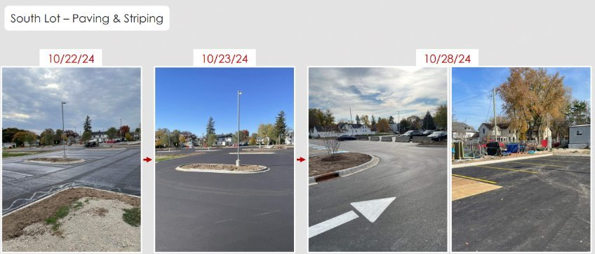
Stoughton Health Outpatient Center (SHOC) South Lot Paving and Striping

Slide 54
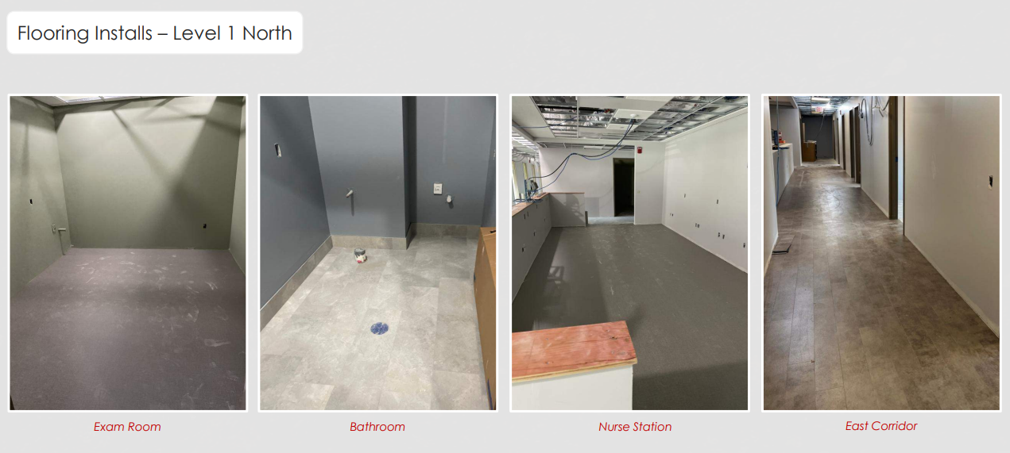
Stoughton Health Outpatient Center (SHOC) Flooring Installs – Level 1 North

Slide 55
CNO Summary
Amy Hermes

Slide 56
DNV Survey Update
Major Non-Conformity (NC) (Category 1) Findings:
NC 1-1 Patient Rights Restraint or Seclusion: Staff Training Requirements
NC 1-2 Physical Environment Life Safety Management System
Minor Non-Conformity (NC) (Category 2) Findings:
NC 2-1 Patient Rights Grievance Procedure
NC 2-2 Patient Rights Care in a Safe Setting: Patients at Risk of Harm to Self or Others Physical Environment Facility
NC 2-3 Physical Environment Hazardous Material Management

Slide 57
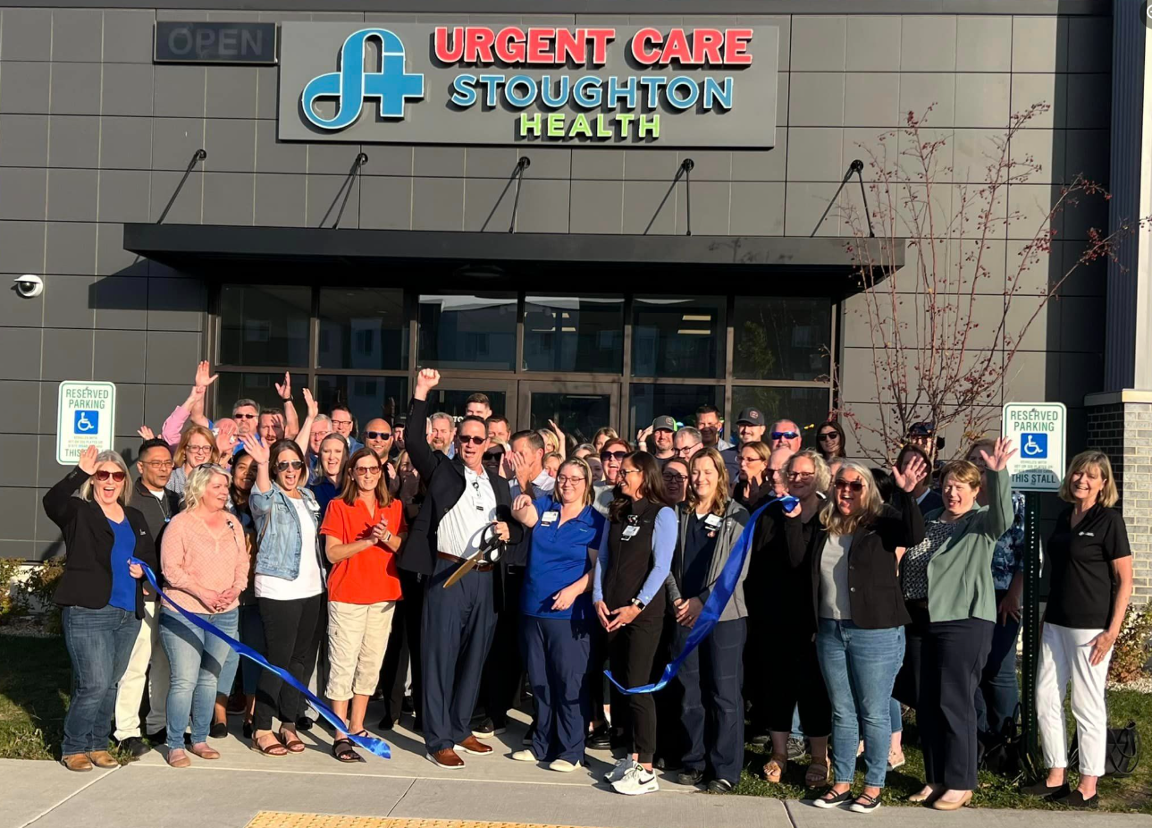
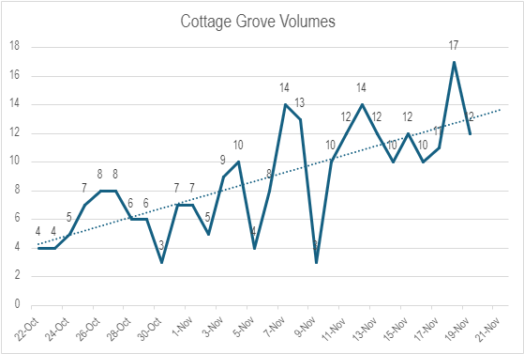
Cottage Grove Urgent Care
Patient Count by Zip Code
City | Count | % of Patients
Cottage Grove | 119 | 56%
Deerfield | 13 | 6%
Sun Prairie | 10 | 5%
Total Patients: (as of Nov. 17th) | 211
New Patients: | 140
New Patient %: | 66%

Slide 58
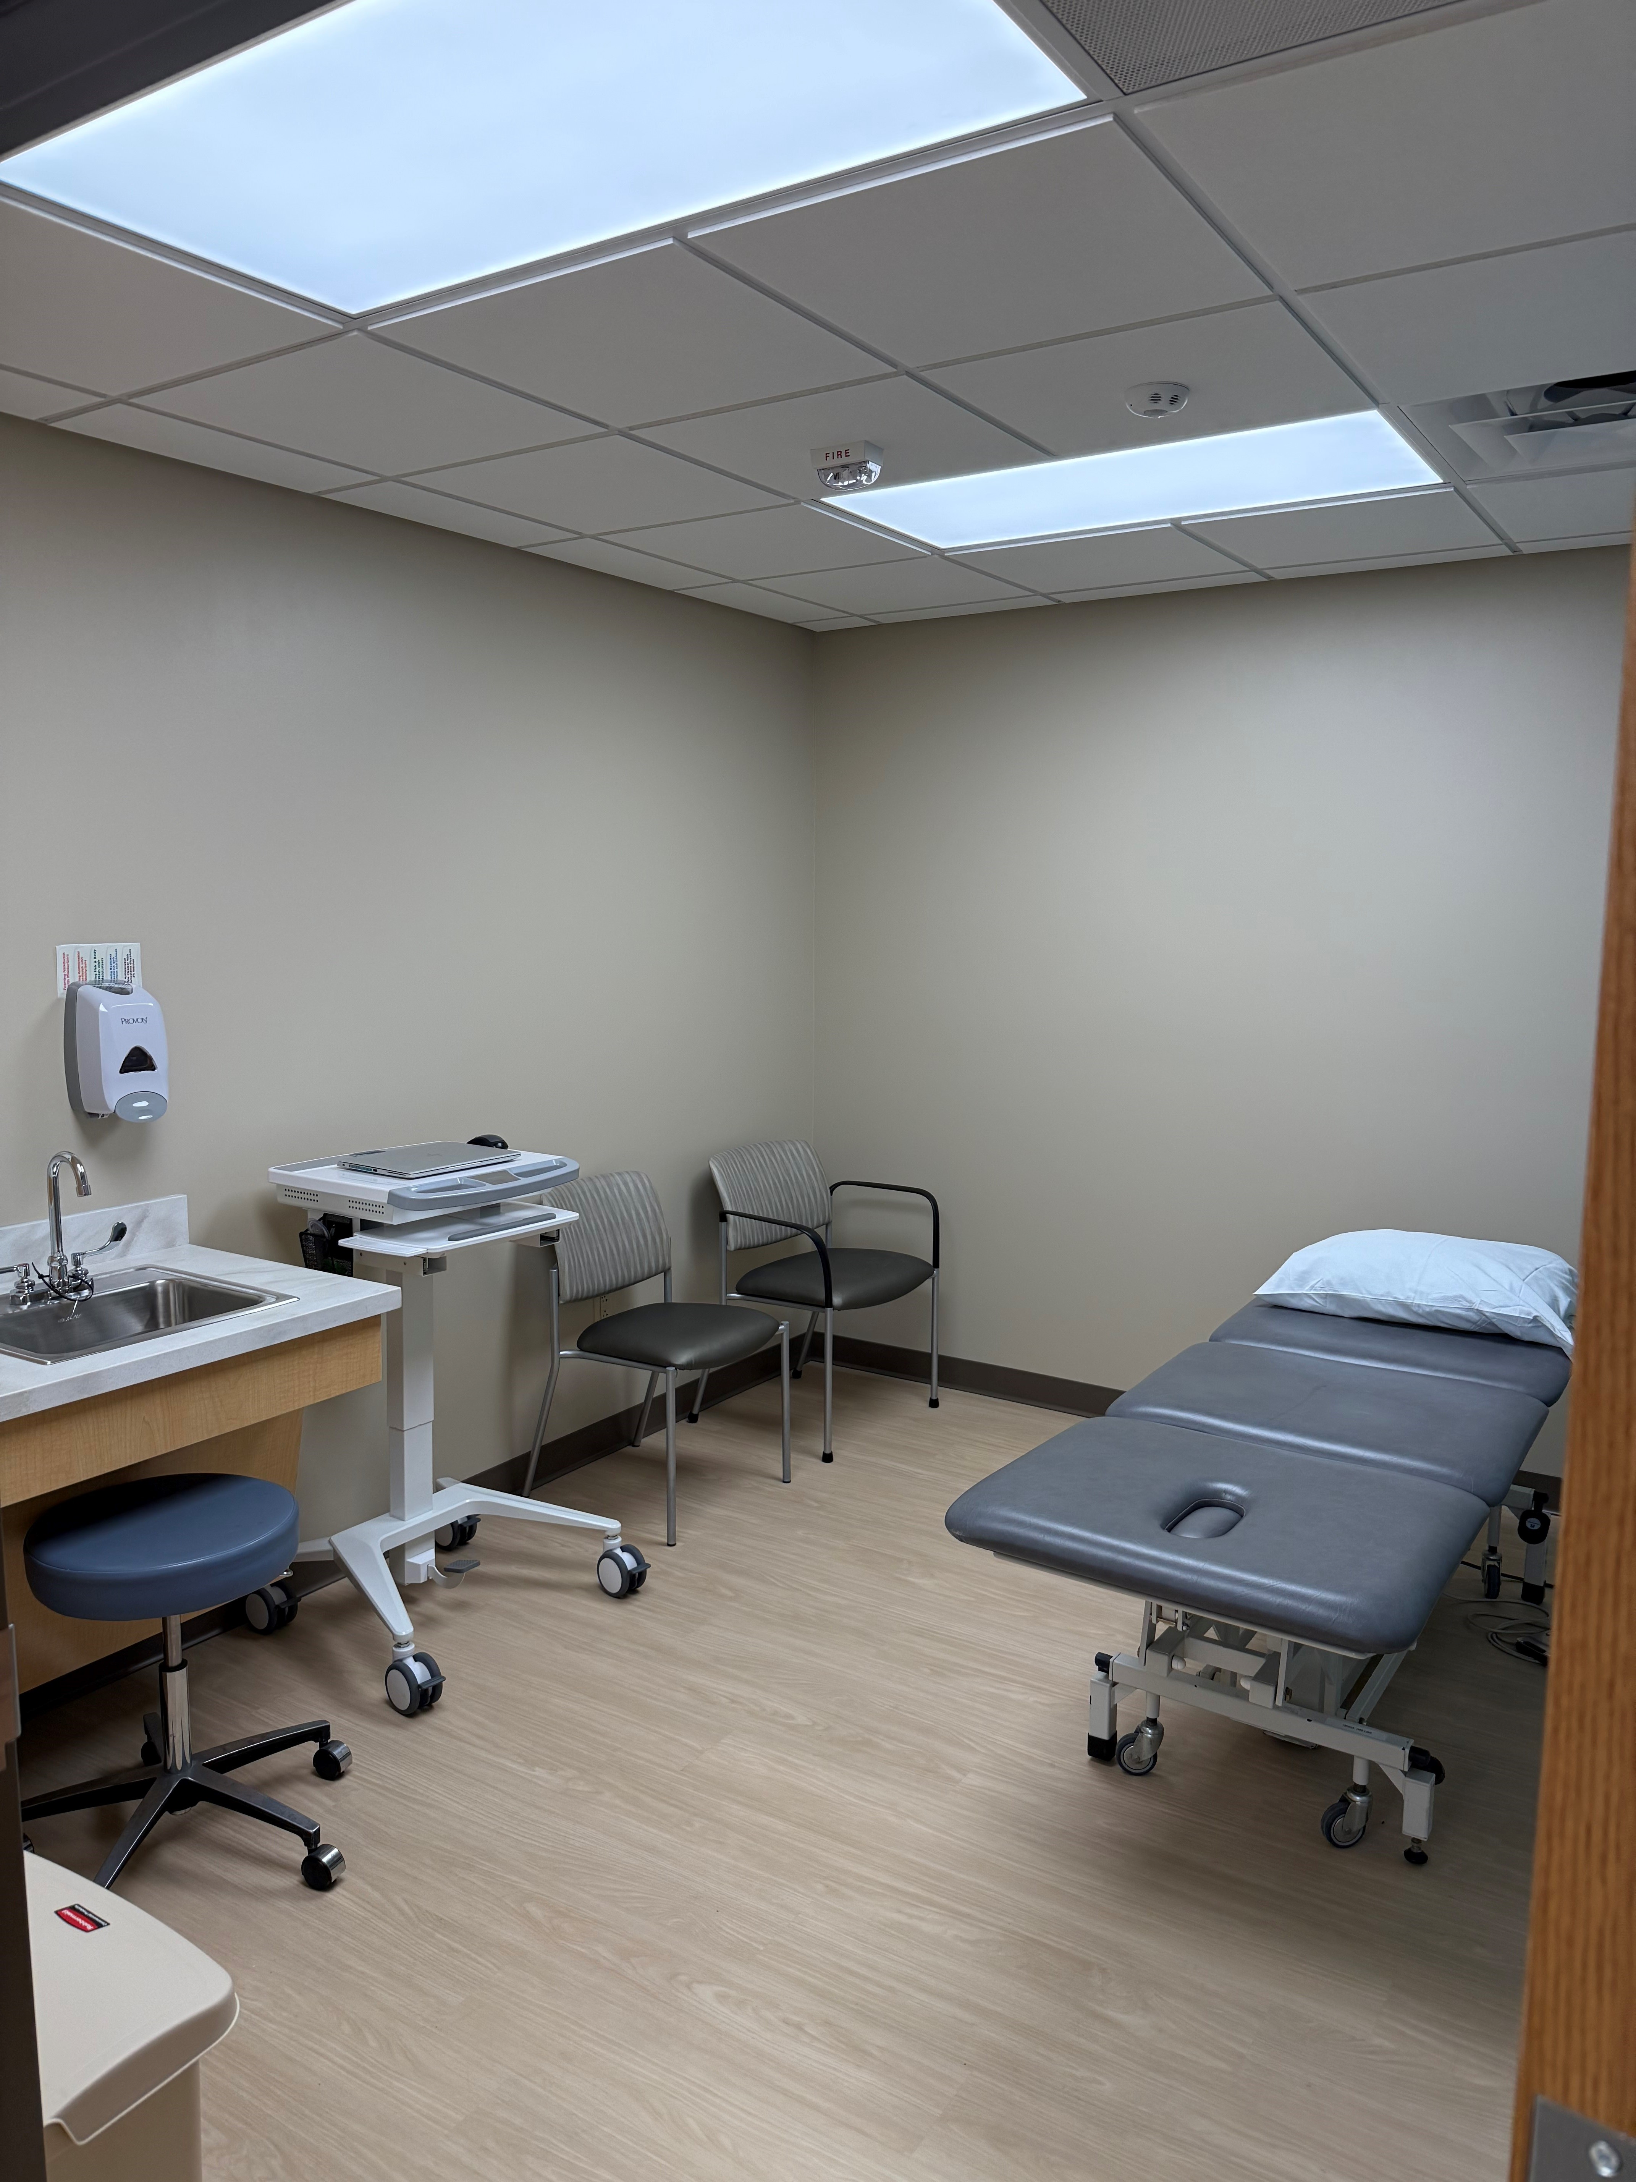
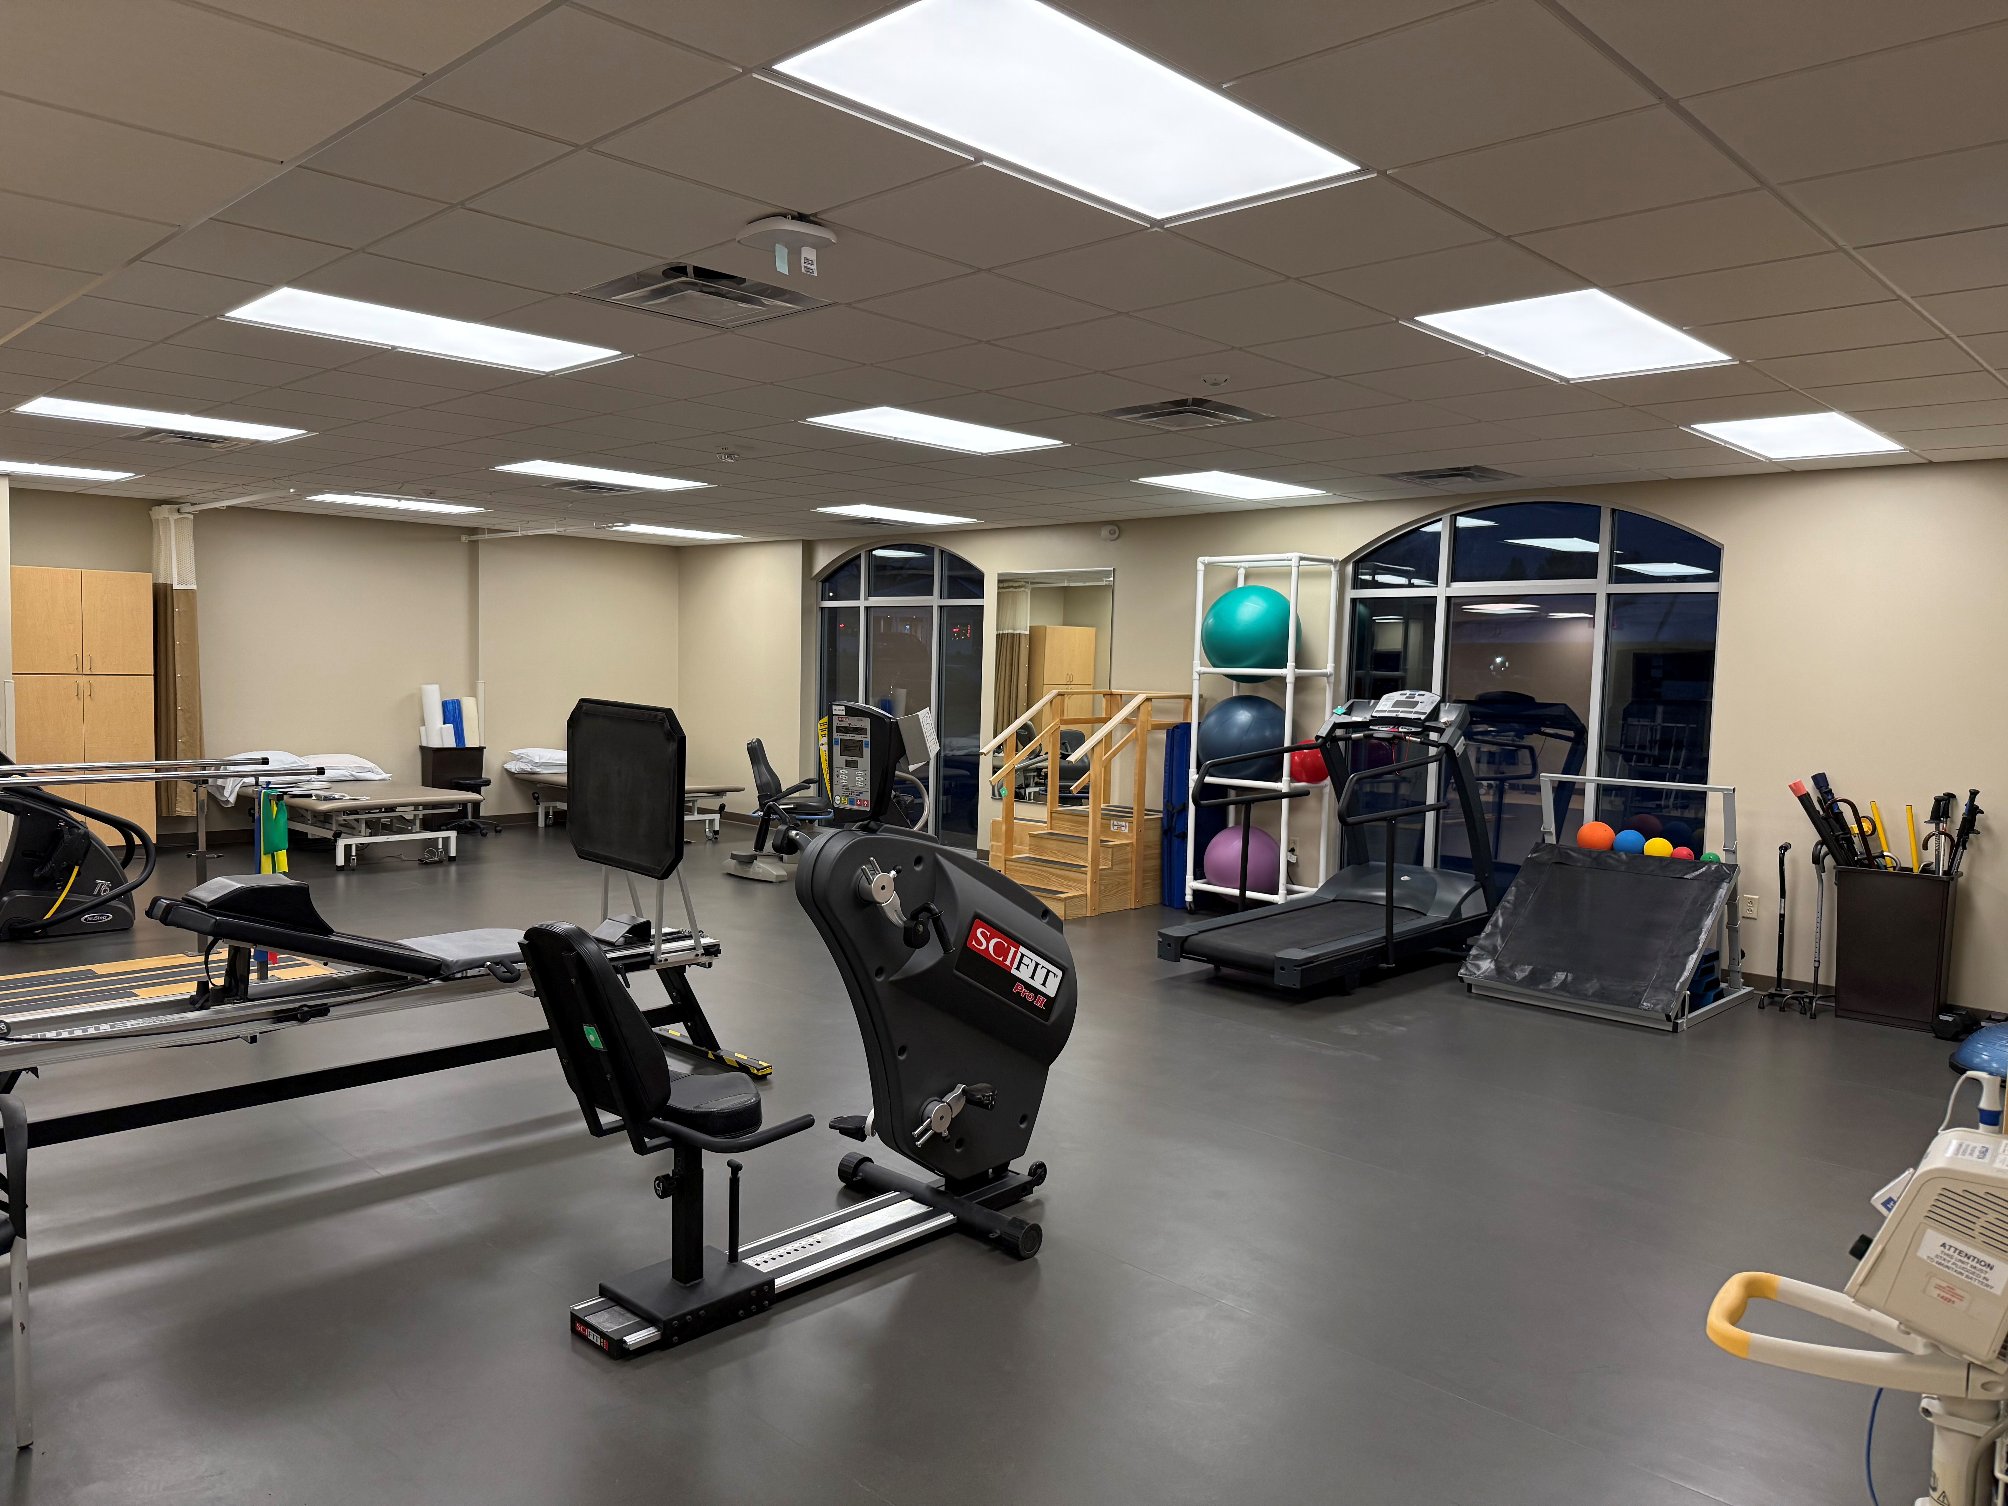
Oregon Location Expansion
Moved into new space on November 20th
Expanding Urgent Care hours (February 2025):
Monday-Friday: 8 AM - 8 PM
Saturday-Sunday: 9 AM - 5 PM

Slide 59
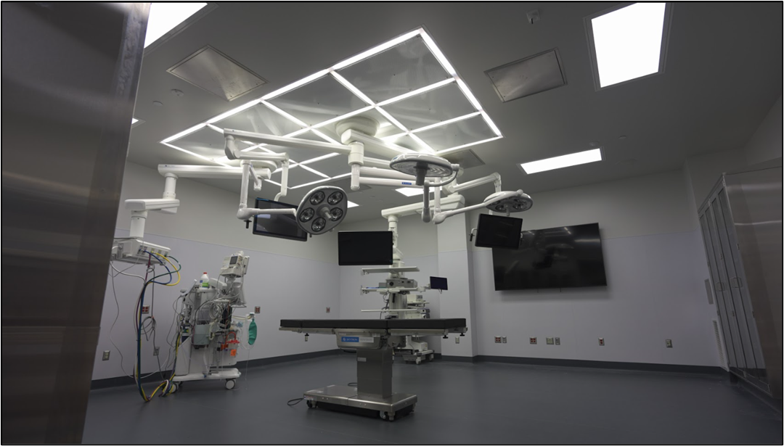
Operating Rooms & Sterile Processing Department Renovation
OR 4: Operational, Under Budget
OR 3: Operational, Under Additional Budget Dollars Approved
SPD: Phasing Has Started, Issues identified pertaining to soft water and adding a disinfection system.

Slide 60
Integrated Telehealth Partners
ITP provides round the clock providers that support our ED providers with crisis management, medication evaluations, placement coordination and ongoing therapy needs.
Fiscal Year 2023
38 Consults
31 Assessments
4 Phone Consults
3 Reassessments
11 Cases Required Placement
Annual Cost to SH: $31,000

Slide 61
CONSENT AGENDA

Slide 62
MCE Meeting Minutes – October 2024
Reviewed Utilization Report noting variances
Discussed two lab tests
Creatine kinase (CK) which is an enzyme found in muscles, heart, and brain which is elevated if there is damage
Fluid cell counts which aid in diagnosing inflammation and infections
Updated on IV Fluid Shortage and status at SH

Slide 63
MEC Meeting Minutes – November 2024
Further lab test discussions brought up at MCE
Discussion about adding Cottage Grove to scholarships in the future
Improving communication related to direct admissions/transfers from other hospitals

Slide 64
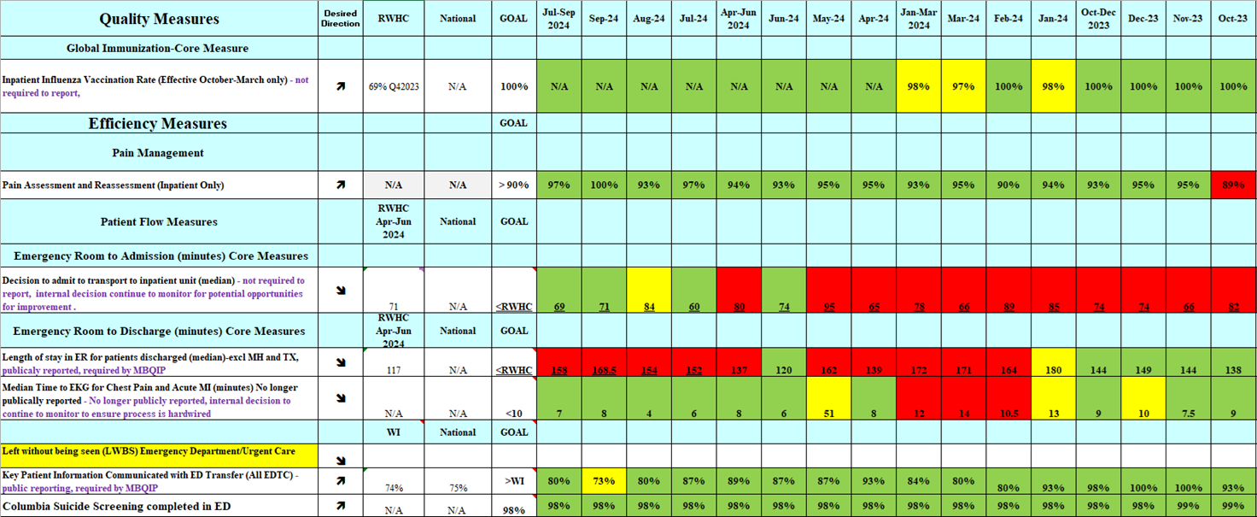

Slide 65
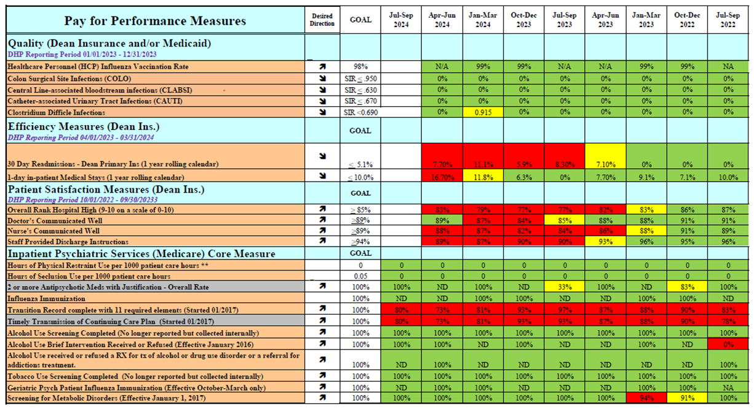

Slide 66
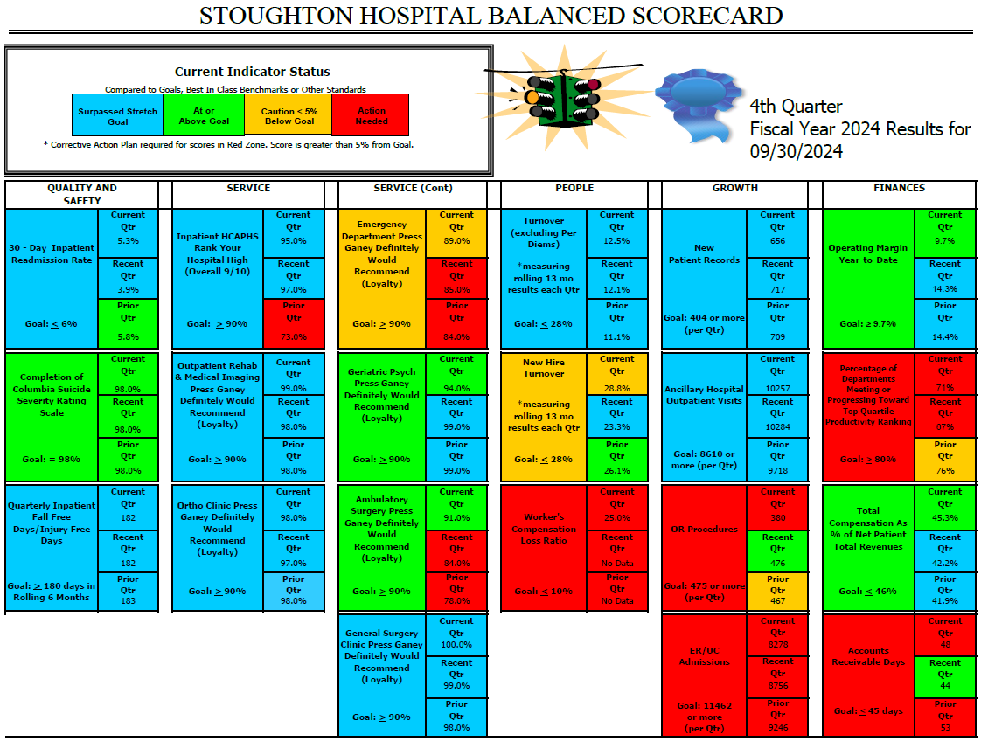

Slide 67
Patient Safety Meeting Recap – September 2024
Medication Management Review: Focus on Controlled Substance Documentation (QM Project for CRNAs)
Monitoring of Falls and impact of Virtual Sitter (implemented March 2024)
Root Cause Analysis regarding tonsillectomy case completed
New Stroke Coordinator, Amy Dunn, ED RN

Slide 68
Infection Prevention Meeting Recap – September 2024
Respiratory Surveillance Reporting (in September Influenza A was low in WI, increased activity with rhinovirus/enterovirus and COVID, norovirus was low
Pharmacy Temperature and Humidity issues resolved with new sensor
Blood culture contamination rate reduction with device implementation continues to be monitored.
ICRAs (Infection Control Risk Assessments)
Active ICRAs OR3 (no closed) and Oregon
Upcoming SPD

Slide 69
* Request Motion to Approve Consent Agenda. *

Slide 70
CEO Summary
Dan DeGroot

Slide 71
Service Development
Non-surgical Muskuloskeletal Services Update
Four options being explored (Pauline Cass is supporting)
Cardiology
Working to increase APP utilization to increase new patient referral capacity.
Meeting with independent group on 12/02 to explore outreach potential.
SSM
Has formally waived their right of first refusal to both services.

Slide 73
Foundation Director / PR / Marketing Summary
Laura Mays

Slide 74
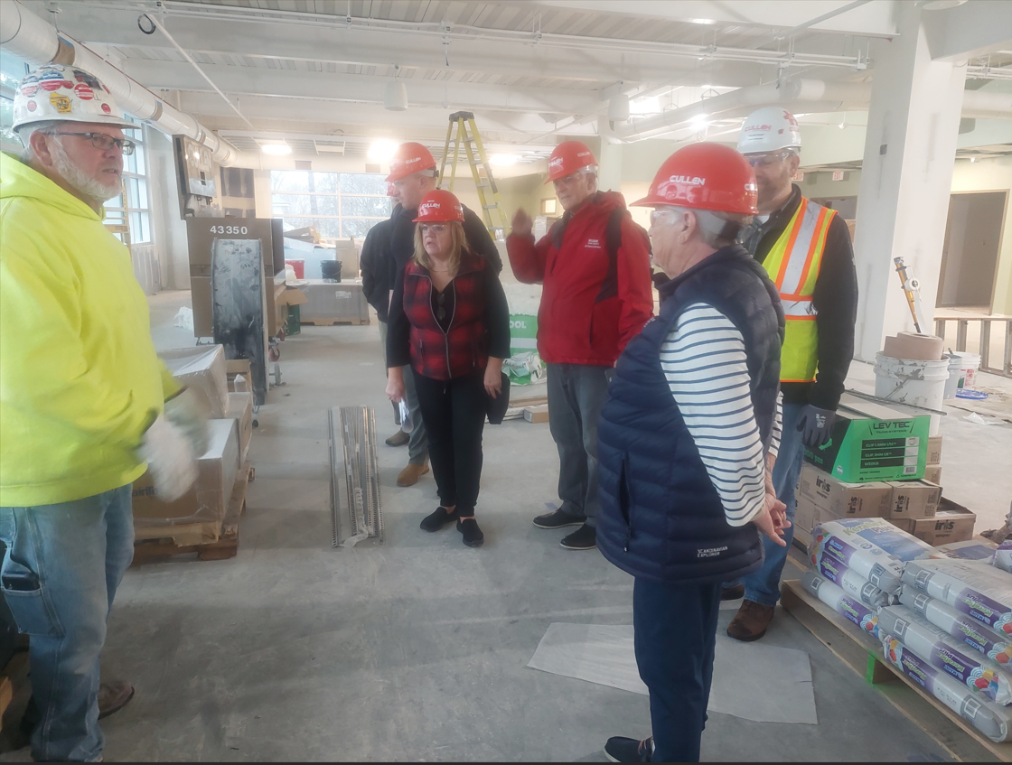
Foundation Board – SHOC Tour

Slide 75
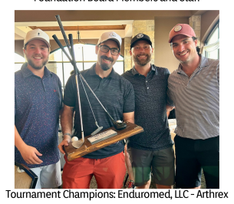
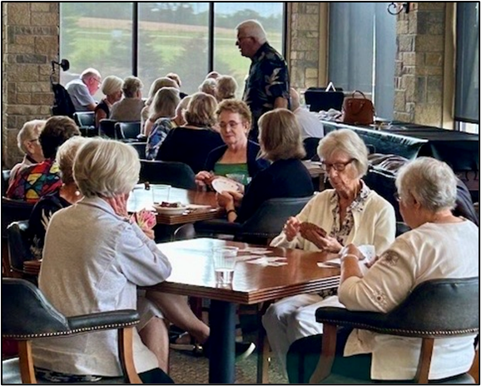
20th Annual Swinging for Health Golf Outing & Card Party
We raised over:
$57,000
to go towards Stoughton Health and the
Expansion of Oregon Urgent Care and Rehab Services

Slide 76
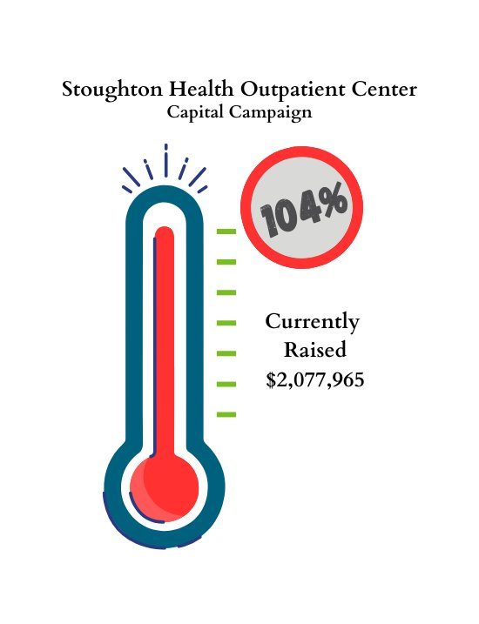

Slide 78
PR/Marketing

Slide 79
Partners of Stoughton Hospital Upcoming Opportunities for Support

Slide 80
Director, Engagement & Experience Summary
Mary Hermes

Slide 81
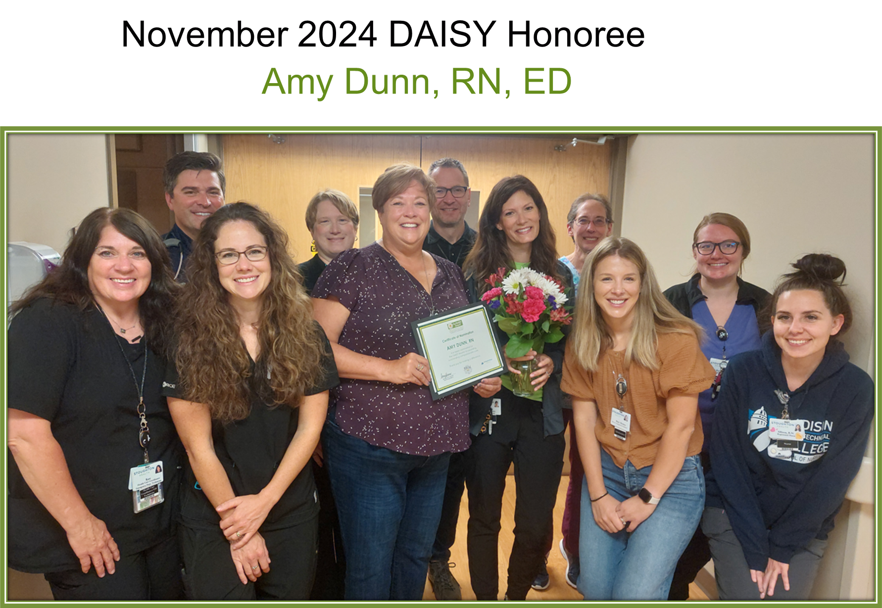
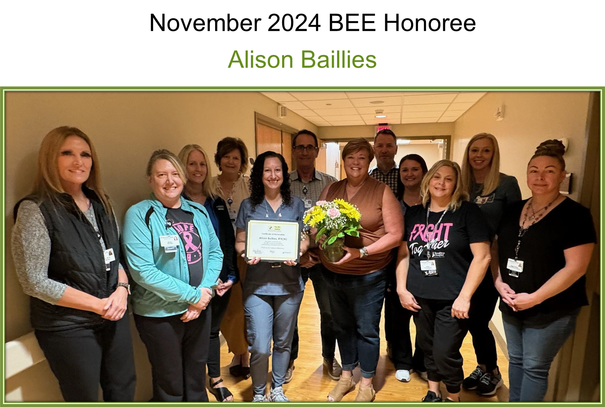
Congratulations!
Next recognition ceremony in May during Nurse's Week

Slide 82
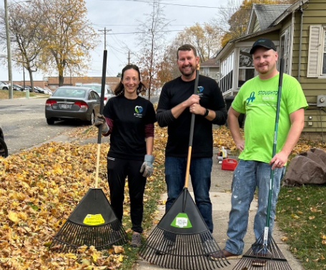
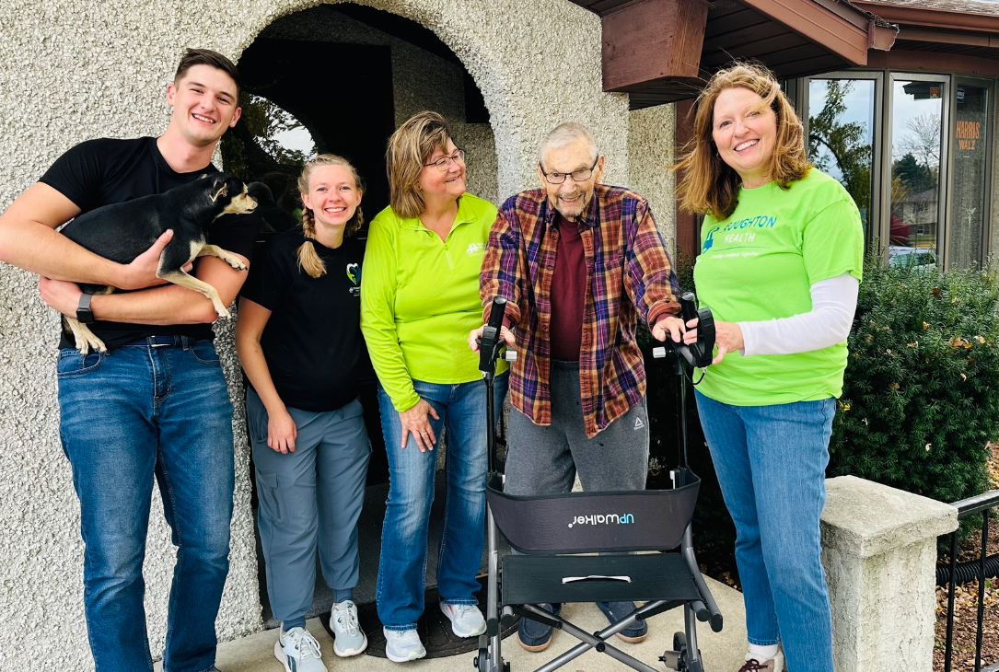
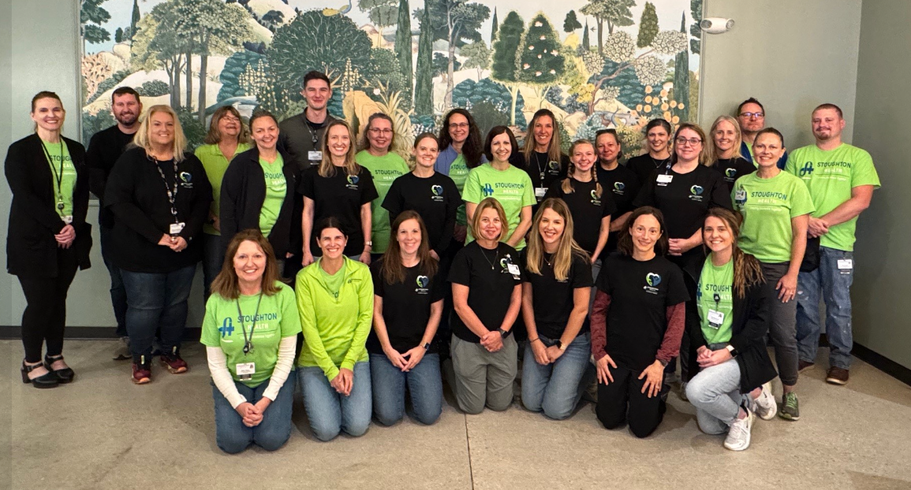
Excellence Together Team Event
in partnership with the Stoughton Senior Center

Slide 83
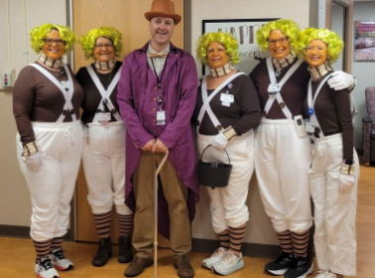
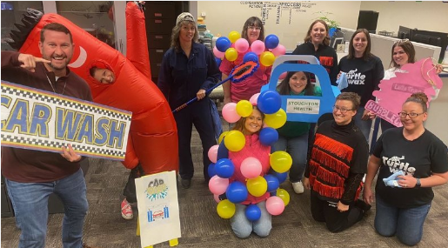
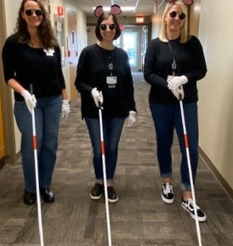
Excellence Together Halloween Costume Contest

Slide 84
November Leadership Development Day
Theme: Change management and leading teams through times of uncertainty​
"Hope for the best but be prepared for the worst. The best way to plan for the unexpected is to be ready for it."​
Change readiness team assessments ​
Department action planning​
Zone of control, influence and concern​

Slide 85
Department Action Planning
Setting team norms to shape expectations and accountability​
Implementing monthly department newsletter​
Adjusting department meetings:​
Agendas ahead of meeting​
Setting collaborative agendas​
Role-specific department meetings​

Slide 87
Chief of Staff Report
Dr. Aaron Schwaab

Slide 88
One Year Appointments
Swapnil Bagade, MD, Radiology, Madison Radiology, Courtesy
Brycen Bodell, MD, Radiology, Madison Radiology, Courtesy
Matthew Buckler, MD, Radiology, Madison Radiology, Courtesy
George Carberry, MD, Radiology, Madison Radiology, Courtesy
Brian Cole, MD, Radiology, Madison Radiology, Courtesy
Douglas Conners, MD, Radiology, Madison Radiology, Courtesy
Cameron Cummings, MD, Radiology, Madison Radiology, Courtesy
Tiffany Dube, MD, Radiology, Madison Radiology, Courtesy
Steven Falconer, MD, Radiology, Madison Radiology, Courtesy
Michael Firestone, MD, Radiology, Madison Radiology, Courtesy
Daniel Macksood, MD, Radiology, Madison Radiology, Courtesy
Joseph McLaughlin, MD, Radiology, Madison Radiology, Courtesy
Lisa Roller, MD, Radiology, Madison Radiology, Courtesy
Andrew Crowell, DDS, Dental, Children’s Dental Center of Madison
Arpen Patel, MD, Pain Management, Paint Management Group, Courtesy
Zachary Lind, DPM, Podiatry, Stoughton Health, Active
Jimmy Clark, PA-C, SWEA, AHP
Michael Falahat, MD, Emergency Medicine, SWEA, Active
Mollie Jesberger, APNP, SWEA, AHP
Katherine Luce, PA-C, SWEA, AHP
Flagged Files: None at this time
* Request Motion to Approve One Year Appointments. *

Slide 89
Two Year Re-Appointments
Lori Wendricks-House, MD, OBGYN, SSM Health
Jennifer Gunderson, PA, SWEA, AHP
Ted Samawi, DO, Emergency Medicine, SWEA, Active
Greg Myer, APNP, SWEA, AHP
David Kerbl, MD, Cardiology, UW Health, Courtesy
Cameron Cummings, MD, Radiology, Madison Radiology, Courtesy
Flagged Files: None at this time.
* Request Motion to Approve Two Year Re-Appointments. *

Slide 90
Open Discussion

Slide 91
Adjourn

