Slide 1
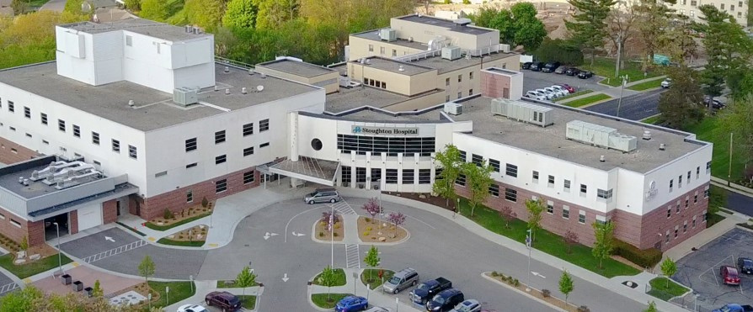


Stoughton Health Governing Board Meeting
January 22, 2025

Slide 2
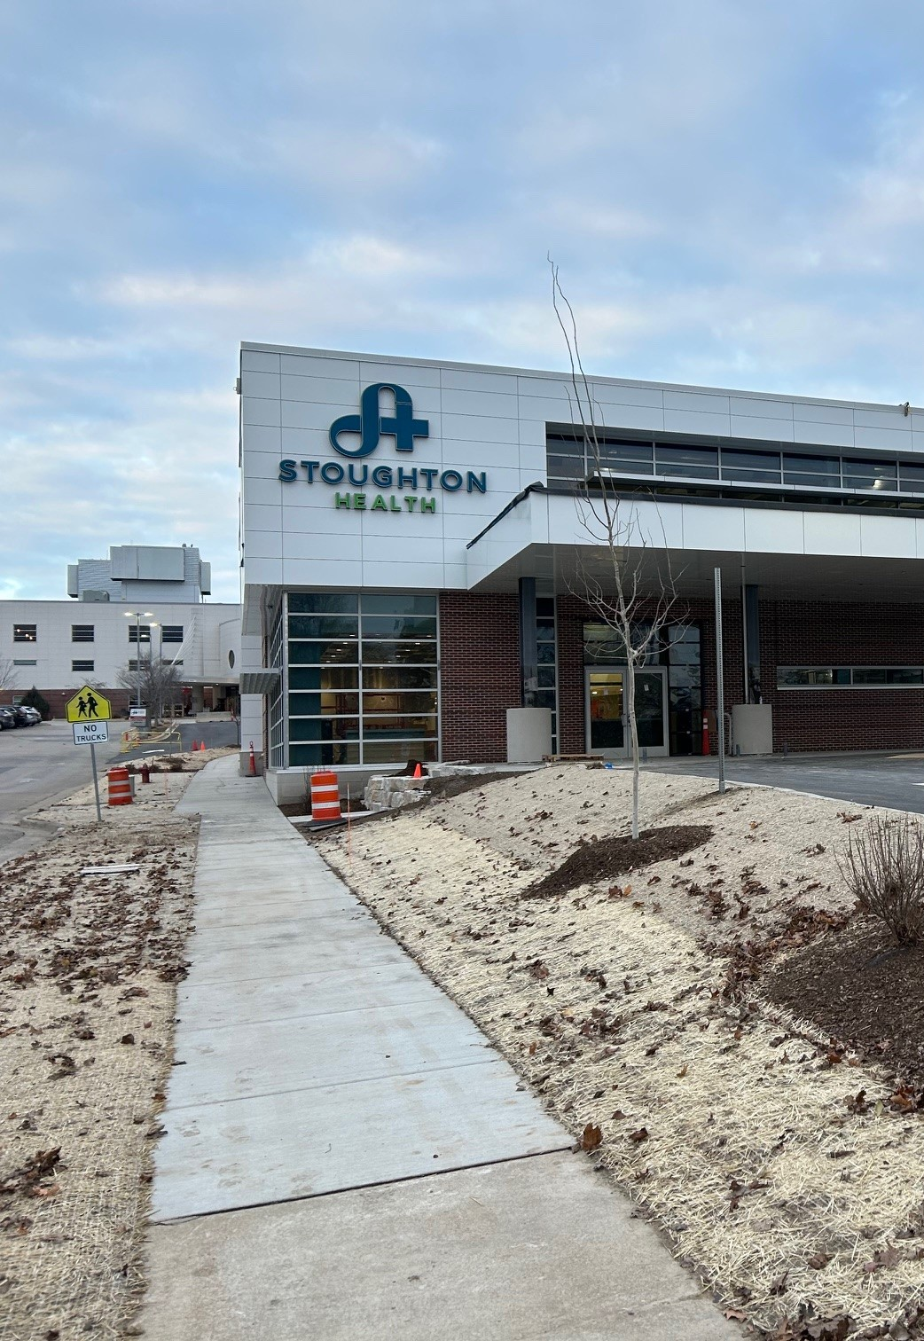

Agenda
Call to Order / Introduction of Andy Boryczka
Review/Approve November 25, 2024 Governing Board Meeting Minutes
Trustee Education – Stoughton Health Service Line Overview
New Business/Old Business
SSM Updates
Committee Updates
Administration Team Updates
  Chief of Staff Report
  Open Discussion / Adjournment

Slide 3

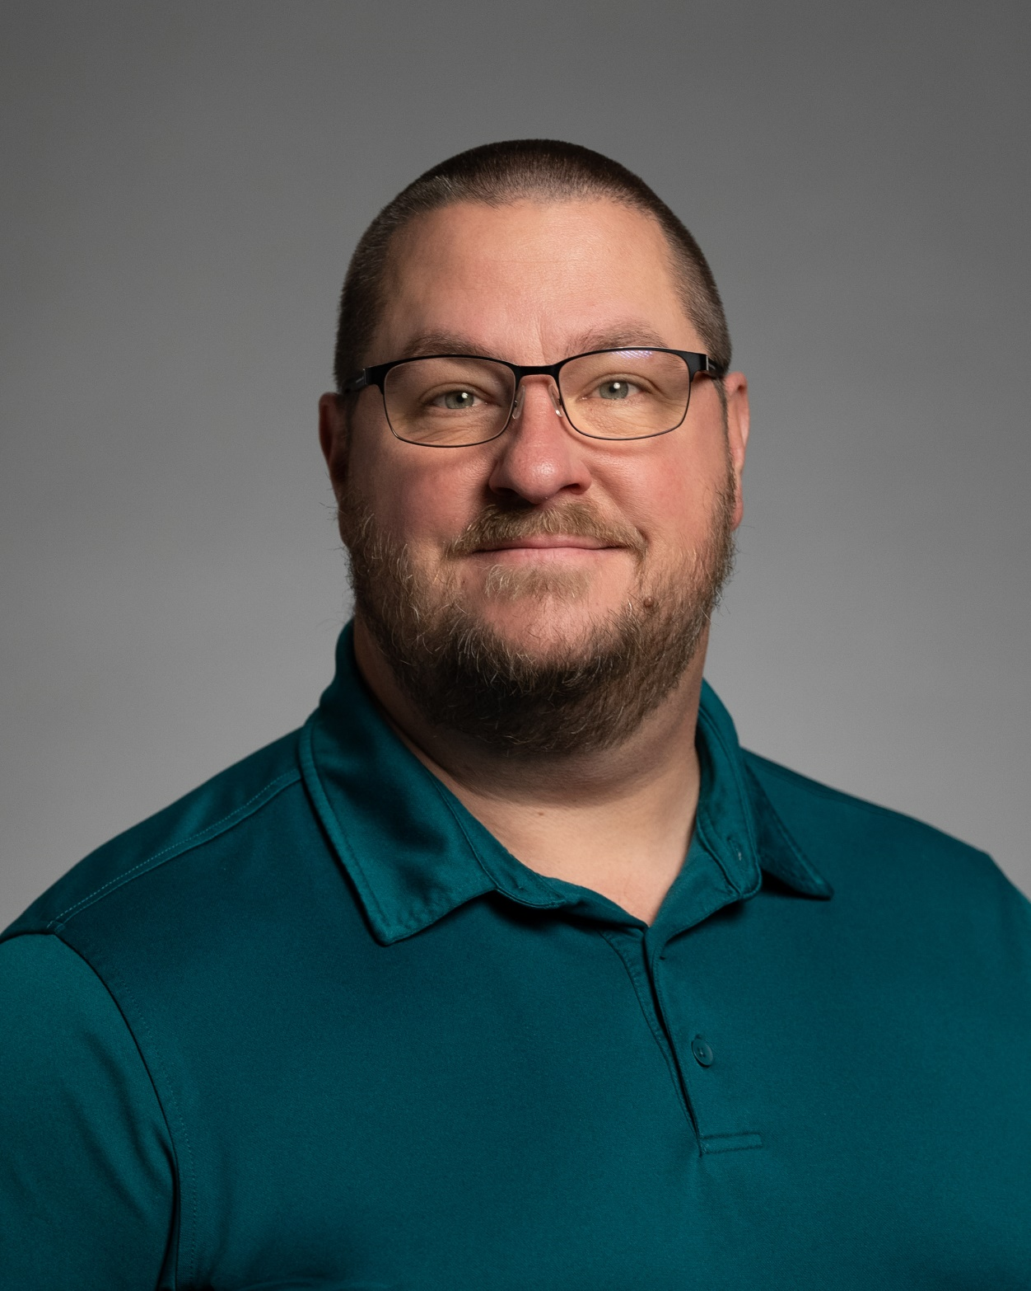
Introduction of Andy Boryczka (Boris-ka)
Directed employee engagement at Agrace Hospice and Palliative Care from 2014 to 2024
University of Wisconsin Madison certified professional life coach 2019
Non-profit / volunteer manager since 2003
Presented locally and nationally on employee engagement, culture building and volunteer management

Slide 4


Meeting Minutes
Request Motion to Approve November 25, 2025 Governing Board Meeting Minutes.

Slide 5



Trustee Education
Stoughton Health Service Line Overview
Chris Brabant, CEO

Slide 6


Stoughton Health Services
Services for You & Your Family
Ambulatory Infusion Center
Breast Care Services
Cardiac & Pulmonary Rehabilitation
Emergency Care
Foot Care Clinic
GERD Treatment/LINX Procedure
Geriatric Psychiatry Inpatient Program
Health Screenings
Lab
Medical Imaging
Pulmonary Function Testing
Physical, Occupational, and Speech Therapy
Urology Services
Screenings
Sleep Disorders Center
Stress Testing
Surgical Services
Transitional Care (Swing Bed)
Urgent Care
Vein Treatment
Medical Clinics
Cardiology
General Surgery
OrthoTeam Clinic & Shoulder Center
Wound Care
Podiatry

Slide 7
Ambulatory Infusion Center
Provides outpatient IV therapy or treatment. Services and treatments include:
Anti-infective medication, solumedrol and other specialty medications
Hydration and antiemetics
Transfusion of blood products
IV Immune Globulin
Intramuscular and/or subcutaneous injections
Care and maintenance of peripheral catheters, midlines, PICC lines and implanted chest ports
Patient and family education

Slide 8

Breast Care Services
Screening
Diagnostic
Biopsy
Surgery
Physical Therapy

Slide 9
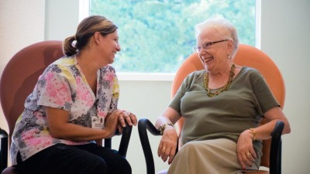
Geriatric Psychiatry
Provides inpatient treatment for depression, anxiety, Alzheimer’s disease and other forms of dementia, bipolar disorder, schizophrenia, and psychosis in adults 55 and older.

Slide 10
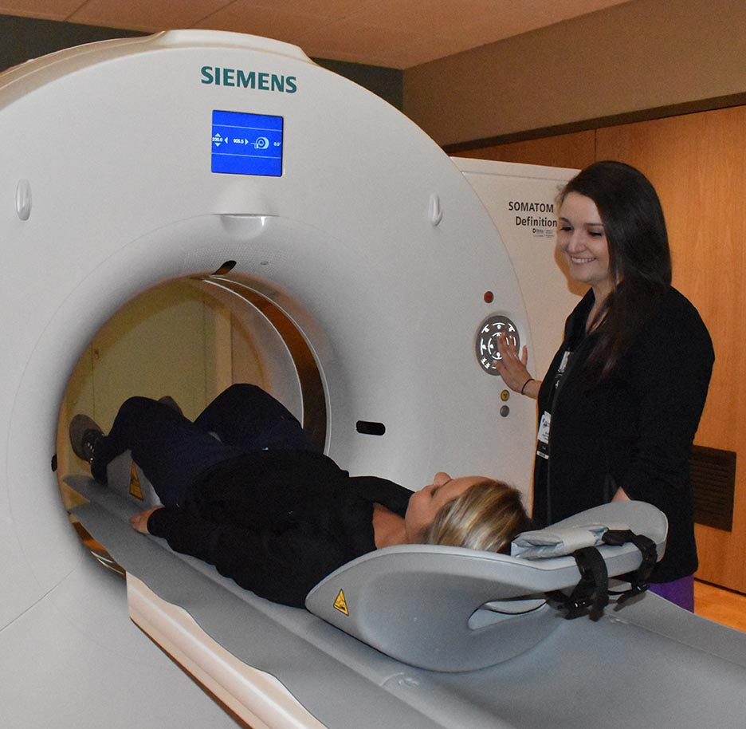
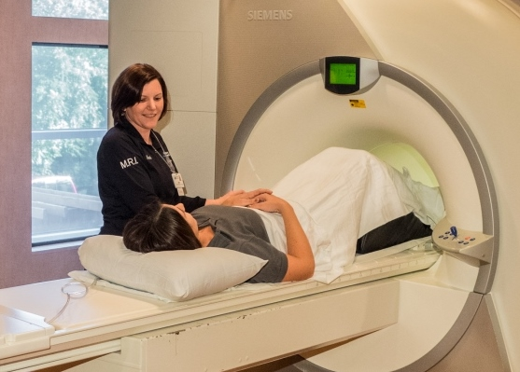
Medical Imaging
Bone Density
CT
Echocardiography
Stress Echocardiography
MRI
3D Mammography
Nuclear Medicine
Stereotactic Breast Biopsy
Therapeutic Injections and Ultrasound

Slide 11


Physical, Occupational, and Speech Therapy
A physician’s referral is not needed unless you have Medicare or Medicaid.

Slide 12
Screenings
Stoughton Health offers a variety of screenings to help you make more informed decisions about your health and wellness. Screenings are offered at the Community Health & Wellness Center located at 3162 County Road B in Stoughton. Our base screening includes:
Blood pressure
Height and weight
Body fat percentage
Visceral fat level
Skeletal muscle mass
Bone Density
Vision
Blood glucose (sugar)
Cholesterol – including HDL and LDL
Triglycerides
Injury risk
Hearing
Balance

Slide 13
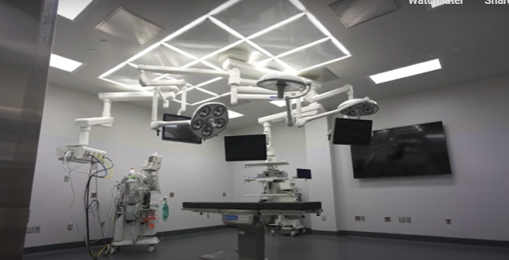
Surgical Services
ENT
Colonoscopy/Endoscopy
General Surgery
Ophthalmology
Orthopedic
Pediatric Dentistry
Podiatric Surgery
Plastic (breast)

Slide 14
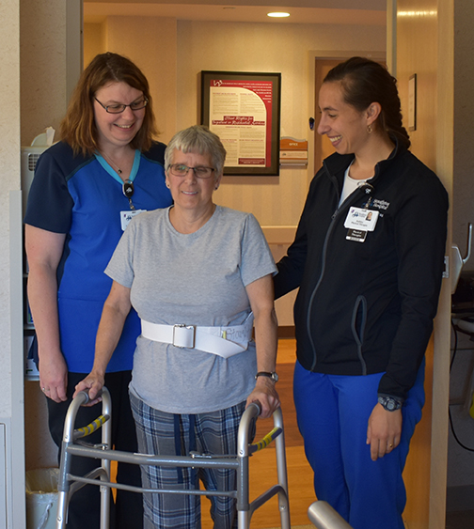
Transitional Care (Swing Bed)
Stoughton Health’s Transitional Care, also known as Swing Bed (a Medicare term), is for patients that need additional therapies or nursing care to fully recover following a hospitalization.

Slide 15
Urgent Care
McFarland Urgent Care
Monday – Friday, 8 a.m. to 8 p.m. | Saturday & Sunday, 9 a.m. to 5 p.m.
Oregon Urgent Care (expanded hours coming February 2025)
Monday – Friday, 5 p.m. to 10 p.m. | Saturday & Sunday, 10 a.m. to 8 p.m.
Stoughton Urgent Care
6 a.m. to 11 p.m. (including weekends & holidays)
Cottage Grove Urgent Care
Monday – Friday, 8 a.m. to 8p.m. | Saturday & Sunday, 9 a.m. to 5 p.m.

Slide 16

Updates
Matt Kinsella / Dawit Tesfasilassie

Slide 17

Committee Updates
Executive Committee
Finance Committee
Governance Committee
Quality Committee
Audit Compliance/Risk Management Committee

Slide 18

Executive Committee
Overview of December 18, 2024 Executive Committee Meeting Minutes
  Review/Approve Purchase of Alano Club (Al-Anon) House
Upcoming Meeting: Wednesday, February 26, 2025, Time TBD

Slide 19
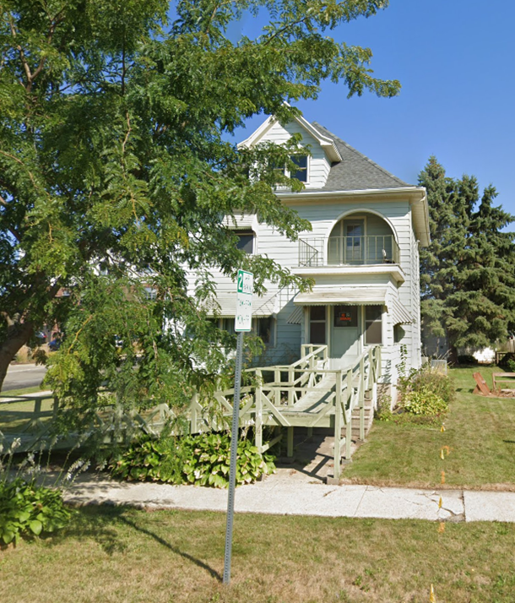
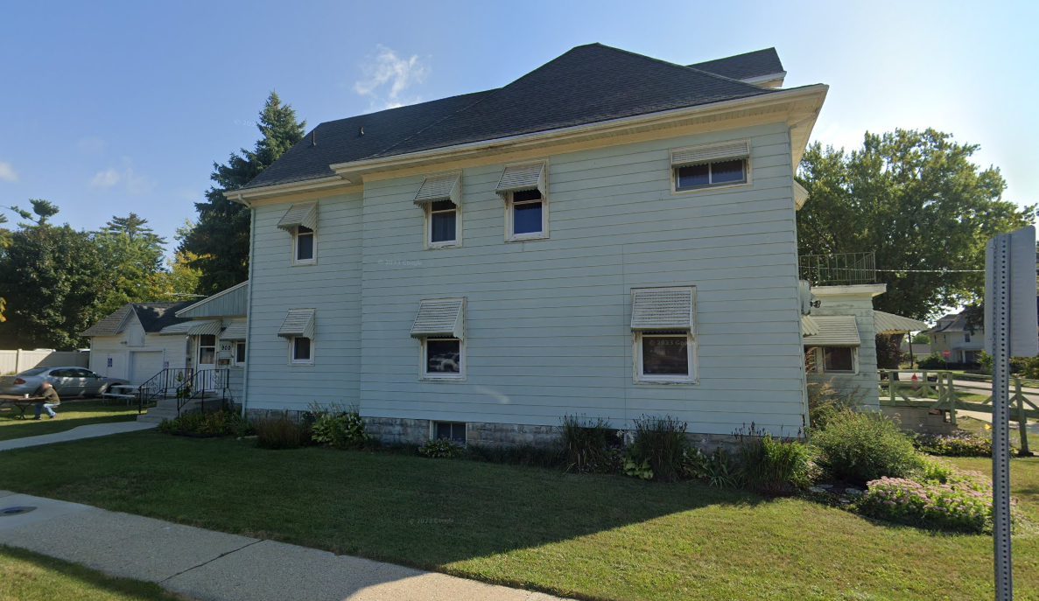
Capital Request:
Alano Club (Al-Anon) Property
900 Giles Street
Request Motion to Approve offer to purchase Alano Club (Al-Anon) Property at 900 Giles Street for $400,000, not to exceed $435,000 with closing and other costs. Funds used would be outside of routine capital budget.

Slide 20
Finance Committee
Upcoming Meeting: Friday, February 21, 2025, Time TBD

Slide 21
Governance Committee
Overview of January 9, 2025 Meeting Minutes
  Conflict of Interest Statements
  2025 Board Committee Members and Meeting Cadence
Upcoming Meeting: Thursday, April 17, 2025, Time TBD

Slide 22

Conflict of Interest Form Review
Annual Process
IRS Form 990 Disclosure of the Process
Electronic form emailed Monday, January 20, 2025
Complete by January 31, 2025

Slide 23
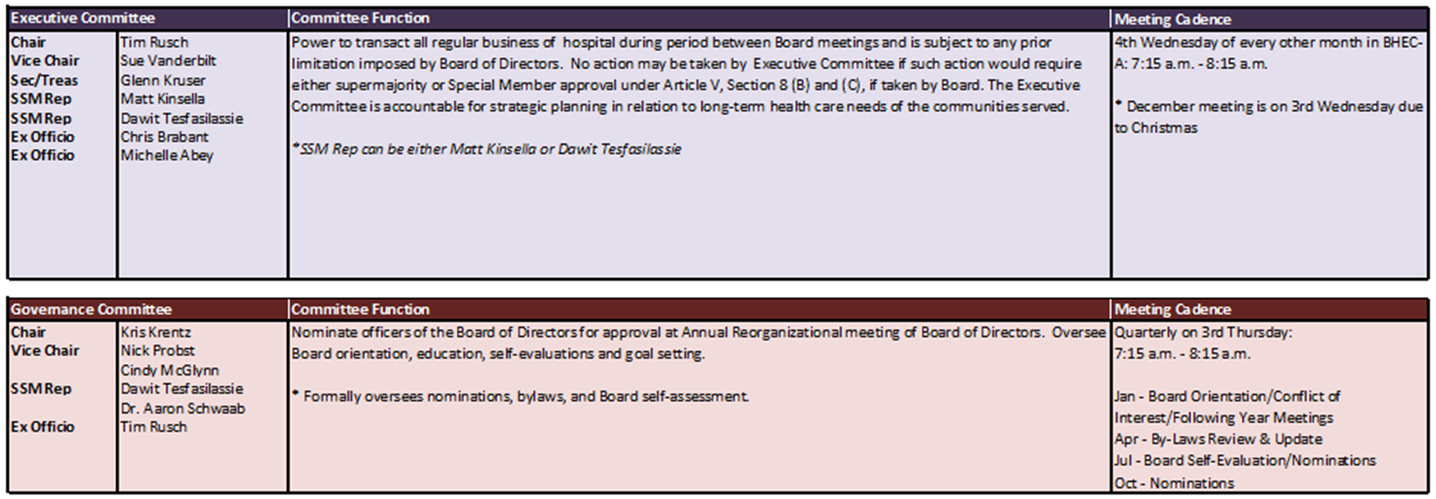
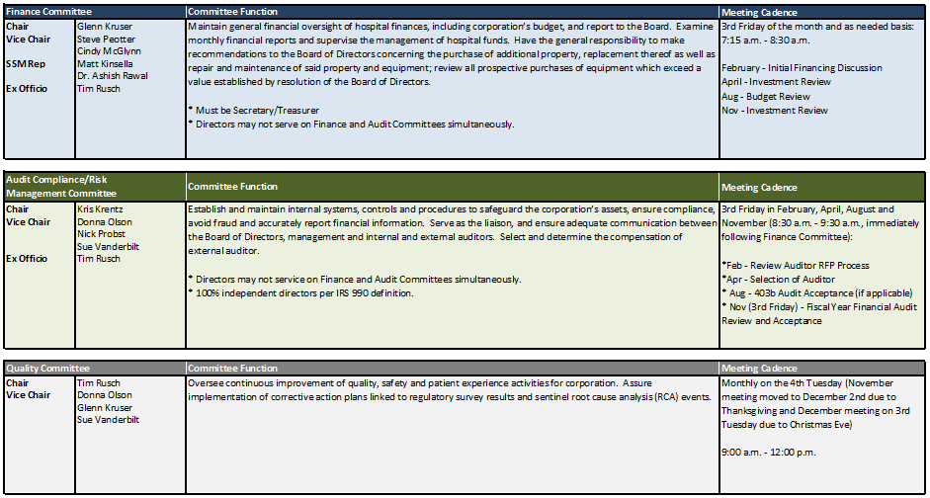
2025 Committee Members

Slide 24
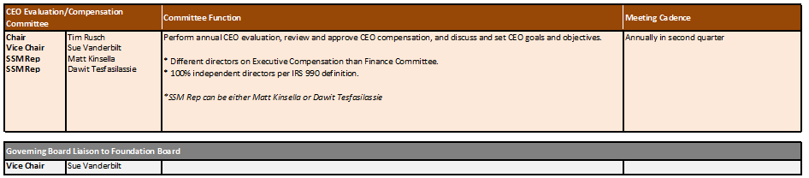
2025 Committee Members

Slide 25
Survey Results - Meeting Start Times
90% of Board members prefer Audit Compliance/Risk Management Committee meeting follow Finance Committee

Slide 26
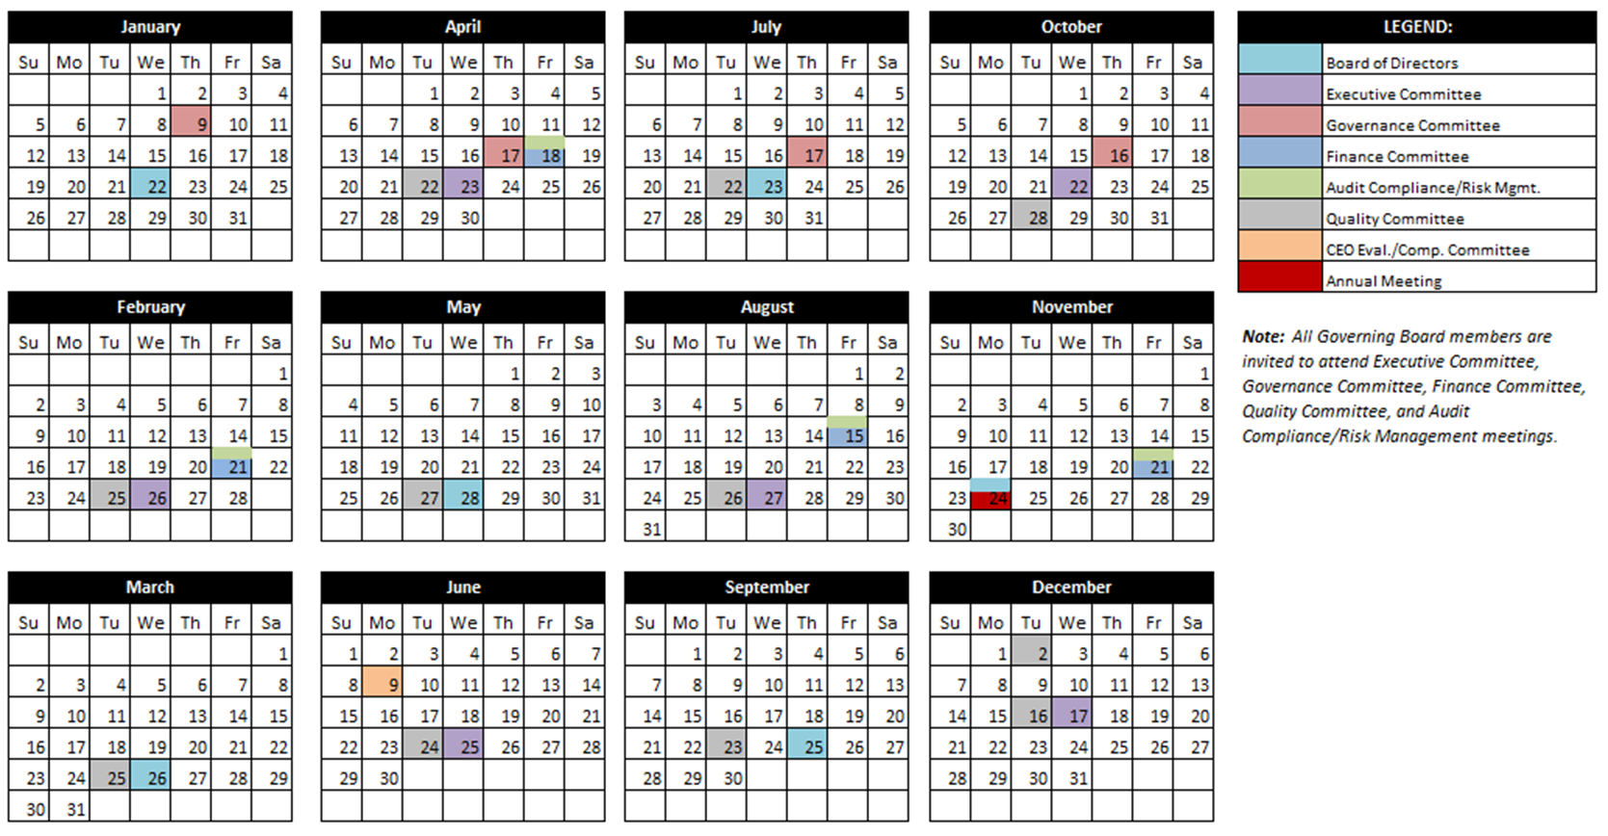
2025 Proposed Board and Committee Meeting Cadence
Request Motion to Approve 2025 Board Committee Members and Meeting Calendar.

Slide 27
Quality Committee
QM Council Updates
  Review QM Council Meeting Minutes
    December 3, 2024
    December 17, 2024
  Review QM Council Dashboards
    Cohort B – December 3, 2024
    Cohort A – December 17, 2024
Upcoming Meeting: Tuesday, February 25, 2025 at 9:00 a.m.

Slide 28

Closed QM Projects
December 3rd Meeting – Cohort B
Formulary Management | Pharmacy
ED Storeroom Labeling | Accounting
Community Benefit Reporting | Public Relations
Operating Room (OR) Human Traffic and Door Openings for Total Knee Replacements | Surgical Services
December 17th Meeting – Cohort A
Medication Barcode Scanning Compliance | ED/Cardiopulmonary
Strengthening Skills – Vasectomy Clinic | Specialty Clinics/Ortho Clinics
Sleep Center Inventory Management | Sleep Lab
Life Safety Codes | Plant Operations
Paper Orders in Medical Imaging | Medical Imaging/Reg/HIM
Provider Based Billing for Specialty Clinics | HIM

Slide 29
Audit Compliance/Risk Management Committee
Upcoming Meeting: Friday, February 21, 2025, immediately following Finance Committee Meeting

Slide 30
CEO Summary
Chris Brabant

Slide 31
Overview of First Eight Weeks
Community meetings
Advocacy
RWHC
WI Health News (WHN) Panel Discussions
WHA
Medica/Dean Health
Getting to know the colleagues / physicians / BOD
Quality meeting, recording updates, rounding
What we’re working on
Cardiology
Ortho Recruitment
Musculoskeletal
SHOC
Oregon
Board retreat planning
Strategic planning
Meeting with SSM colleagues

Slide 32

WHA Advocacy Day

Slide 33

2025 Governing Board Retreat
Date: September 4-5, 2025
Location: Grand Geneva Resort, Lake Geneva, WI
Guest Speaker: Jamie Orlikoff

Slide 34

Governing & Foundation Board Social
Date: January 22, 2025
Time: 5:30 p.m. – 7:30 p.m.
Location: 183 W. Main Street, Stoughton

Slide 35
Potential Service Line Expansion
Expanded Cardiology Service
Non-Surgical Musculoskeletal Service

Slide 36
CFO Summary
Michelle Abey

Slide 37
December 2024 Financial Statements
Operating Income
$1,417,658
Balance Sheet Metrics
Outpatient Revenues
Expense Variances
Request Motion to Approve December 2024 Financial Statements.

Slide 38
January Month-to-Date

Slide 39
Quarterly Corporate Compliance Committee Report
Certifications & Accreditations
Grievances
DSPS Complaint
Section 1557
New subpoenas
Request Motion Approve the Quarterly Corporate Compliance Committee Report.

Slide 40
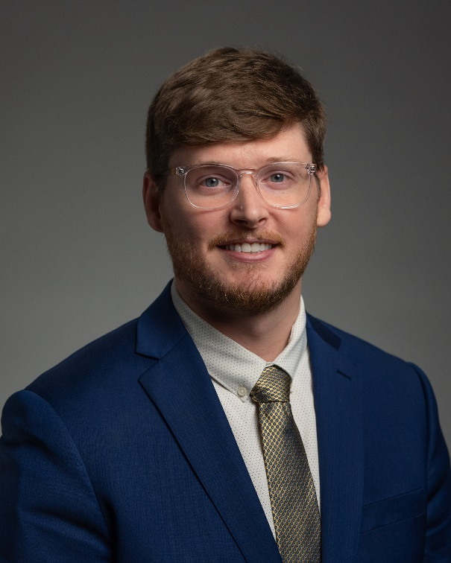
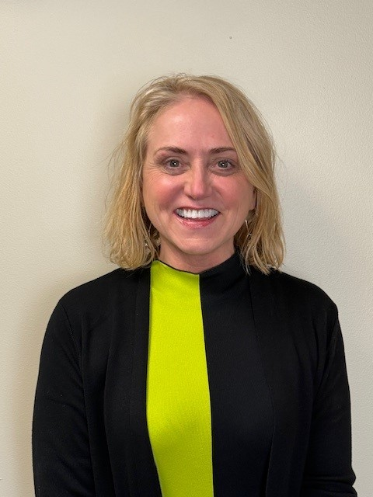
Multi-Specialty Clinic Updates
Podiatry Clinic Opened December 16, 2024
  1 Surgical Case in December
  28 Clinic Visits
  Dean Health Plan Paneling Update
  “Foot Freedom: Tackling Common Issues” – January 30, 2025 – 5:30 – 6:30 pm
Dr. Zachary Lind
Welcome Specialty Clinic Manager – JoDeen Hettenbach
JoDeen Hettenbach

Slide 41
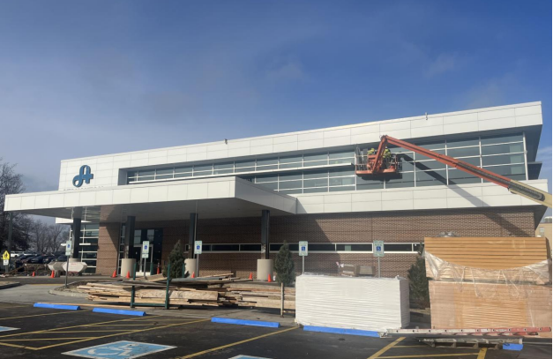
Stoughton Health Outpatient Center (SHOC) Updates
JP Cullen – Turnover of the Building – late February
DHS Inspection – week of February 23rd
First Patients – week of April 21st
Spend through 12/31/2024: $23,080,726

Slide 42
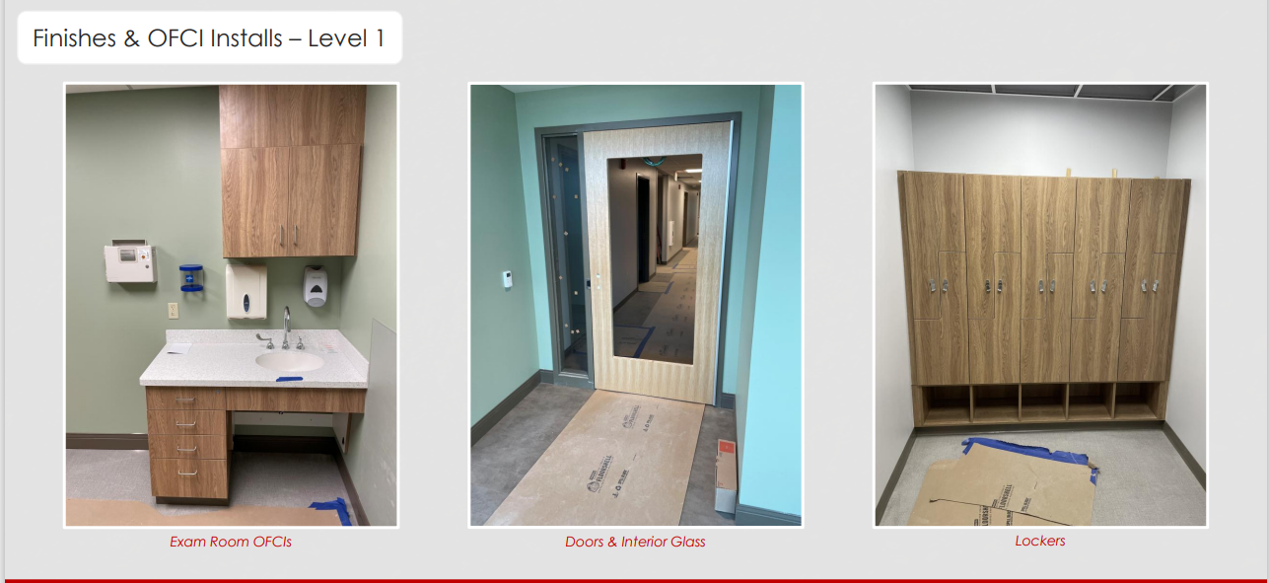
Stoughton Health Outpatient Center (SHOC) Updates

Slide 43
CNO Summary
Amy Hermes

Slide 44
Cottage Grove Urgent Care

Slide 45
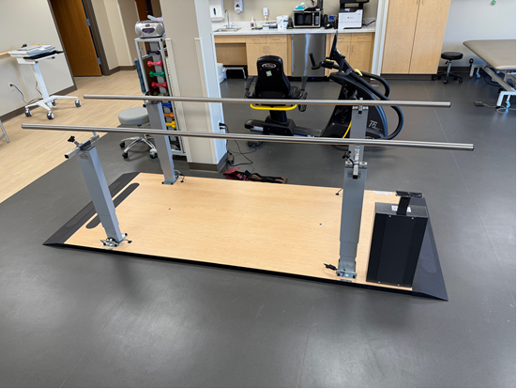
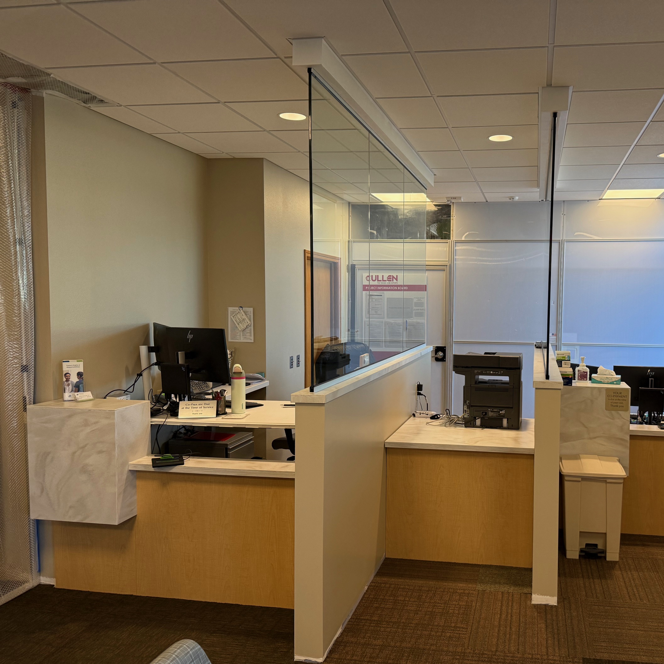
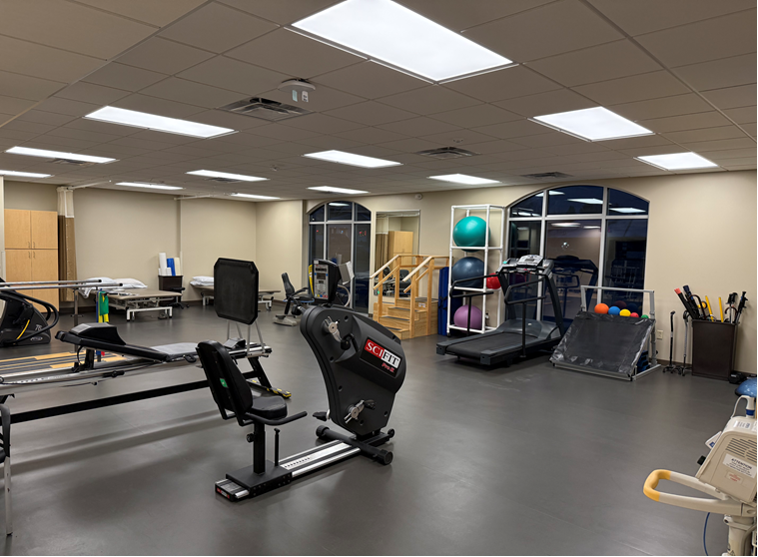
Oregon Location Expansion
Oregon Expanded Hours will begin February 24th:
Monday-Friday 8 a.m. to 8 p.m.
Saturday and Sunday 9 a.m. to 5 p.m.
Ribbon Cutting/Open House will be February 24th from 4:30 p.m. to 6 p.m.

Slide 46
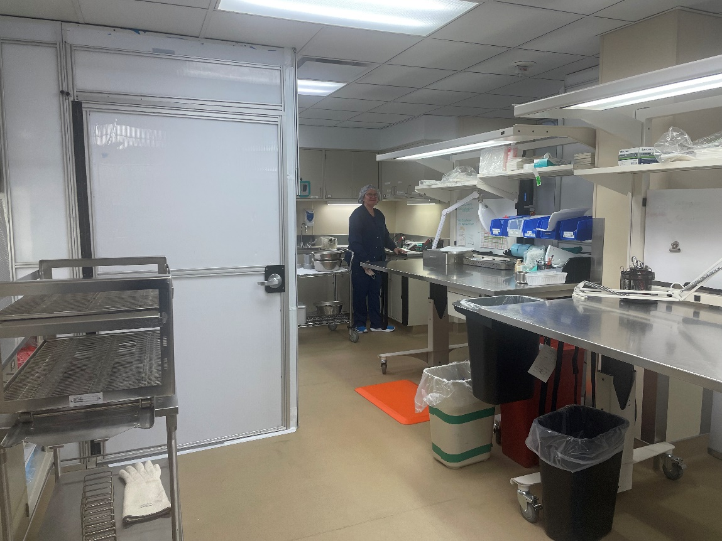
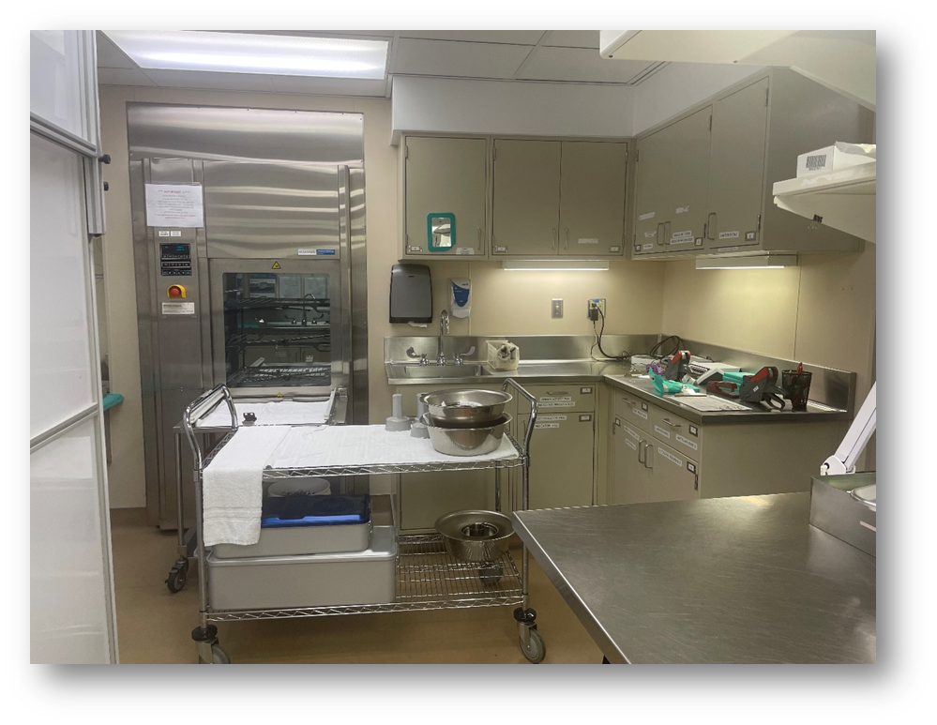
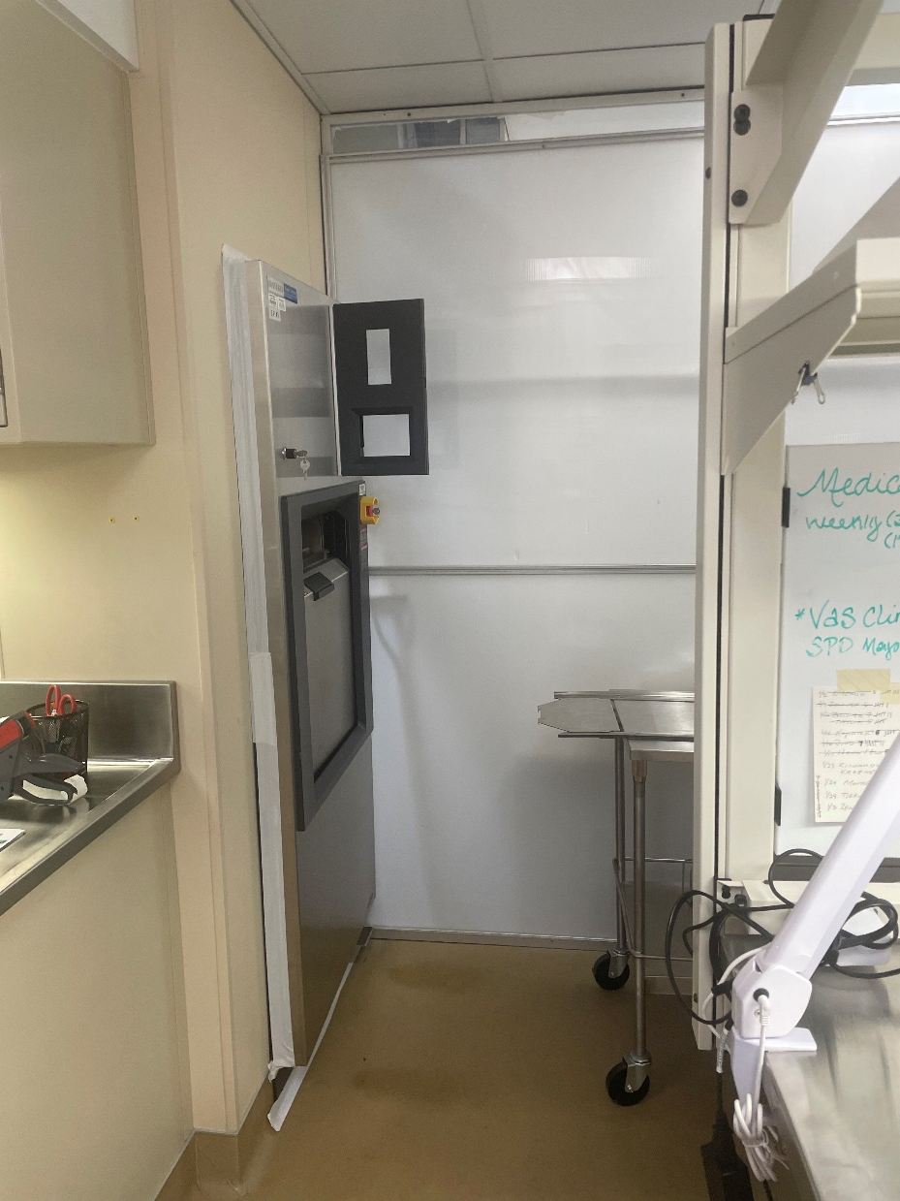
Sterile Processing Department (SPD)
Projected Completion Date ➔ Mid-May 2025

Slide 47
Root Cause Analysis (RCA)
Surgical Services / Sharps-Biohazard
EVS was transporting regular waste from Surgical Services to the dumpster for disposal. When EVS staff picked up the last large white garbage bag, the bag wasn’t tied, and waste spilled out all over the bottom of the transport container. As EVS staff was picking up the trash, they picked up an empty vial box and underneath it was a needle that was bent. Additionally, there were large amounts of partial vials containing solutions laying all over the bottom of the carriage. EVS carefully picked up the needle and secured it in a container to put in a sharps container.
  Sharp item was a metal blunt tip cannula used for cataract surgery. Process is to dispose of these in a sharps container, reviewing and working with team on factors that contributed to this event.
  Vials found can be disposed of in regular trash if no medication remains. Ensuring that practices in all areas are consistent with policy.

Slide 48
MCE Meeting Minutes – November 2024
Capital request for Lab Analyzer moving from Q4 to Q1 FY2025.
IV Fluid Conservation Efforts: Current supply should be sufficient. Baxter will be 90% operational by December.
Corrective Action plans were accepted by DNV on 11/5/2024. Objective evidence for the two NC-1 findings is due 2/04/2025. (One of the NC-1 Findings: Provider education related to use of restraints/seclusion)

Slide 49
MEC Meeting Minutes –January 2025
Discussion related to Madison Radiology/Lucid Health regarding recent imaging concerns. Dr. McGuire provided updates.
Stabilization of staffing in patient care areas. Use of less travelers, but those used have been consistent.
Decreased Hospital Consumer Assessment of Healthcare Providers and Systems (HCAHPS) significantly lower in patients understanding discharge instructions. Team working on strategies to improve.

Slide 50
2025 Balanced Score Card Updates
Quality/Safety Pillar
Goals and stretch goals remained the same for all measures.
% of Departments greater than or equal to the Top Quartile Productivity Ranking Percentage of Departments Meeting or Progressing Toward Top Quartile Productivity Ranking - goal and stretch remained the same.
New Measure: Press Ganey “Patients are Satisfied with Discharge Instructions” for Inpatients.
People Pillar
Finance Pillar
Growth Pillar
Goals and stretch goals changed for all measures.
New Measure: Percentage of Employee’s (excluding Per Diems) receive their first week schedule by Friday, prior to New Employee Orientation.
New Measure: Percentage of 6-month probationary Department Checklists are completed prior to their 6-month anniversary date.
Retired Measure: Workers Compensation Loss Ratio.
Goals and stretch goals changed for all measures.
Goals and stretch goals changed for all other measures.
.

Slide 51
Patient Safety – November 2024
Safety Zone Portal reports reviewed; no trending identified within specific categories.
Antibiotic stewardship: Apiari is still working on creating a dashboard. Latest information shows the ED/outpatient dashboards are ready to go but Apiari is having difficulty with our inpatient data. SSM created a tiered approach to restricted antimicrobials to be adopted by all affiliates. This was completed at the beginning of this year but is now included in our Antimicrobial Stewardship policy.
Pharmacist present in the ED for a few hours every day as a resource.
Staff duress buttons installed. Will be reviewing costs to add to the Sleep Disorders Center.
Stroke Alert button ready and functioning.

Slide 52
Infection Prevention – November 2024
Updated Hand Hygiene Policy to include no nail embellishments.
Reviewing research/best practices for decolonization of MRSA (methicillin-resist staph aureus) for all surgical patients prior to surgery.
Discussion regarding temperature and humidity control in the operating rooms and sterile process, especially given construction projects.
Blood Culture Pilot continuing for one more quarter.

Slide 53
Infection Prevention – November 2024
Statewide virus activity: (updated information as of January 6, 2025)
  Influenza activity is Increasing in Wisconsin (14.2%) and Nationally (18.7%)
    Influenza A is the dominant strain circulating (98%)
  SARS-CoV-2 activities are increasing (10.4%)
  Norovirus High (41.6%)
  RSV positivity increasing (11.4%)
  Pertussis remains elevated (1.6%)
  Group A Streptococcus High (15.8%)
As of November 7, 2024, a total of 277 measles cases were reported by 32 jurisdictions (including Wisconsin)

Slide 54
Consent Agenda
MCE Meeting Minutes – November 2024
MEC Meeting Minutes – January 2025
  2025 Balanced Score Card Updates
Patient Safety Meeting Minutes – November 2024
Infection Prevention Meeting Minutes – November 2024
Request Motion to Approve Consent Agenda.

Slide 55

Wisconsin Nurses Association
Strategic Goals
Elevate the profession of nursing throughout the state of Wisconsin (supporting work on workplace violence, nurses caring for nurses, practice and research)
Advance the practice of nursing in Wisconsin to improve health and health care (improving public health, innovations in nursing models of care, improving mental health screening
Promote and support the professional success of nurses (anti-human trafficking education, legislative advocacy related to APPs and nurse educator pay, mentorship pay

Slide 56
VP, HR, Campus Planning, Operational Support Services Summary
Chris Schmitz

Slide 57

HR/Current Traveler Usage
Contracted Staff
Med/Surg
9%
ED
3%
Surgery
16%
Pay increase for employed staff
Effective January 12th

Slide 58
HR/Facilities Updates
2025
Energage Employee Engagement Survey
Strategic Planning
18-month Leadership Development

Slide 59
Current Open Positions
12 Full Time
5 Part Time
9 Occasional
Openings closed in last 2 months – 23

Slide 60
Security Risk Vulnerability Assessment
DNV Requirement to Complete a Security Risk Vulnerability Assessment
2025 Assessment Completed
Key Concern
Entry with a Weapon
Key Mitigation Measures
Camera signage added to eliminate disruptive behavior in ED waiting
Access removed from FNS and limited, recorded entry
Offsite facility moved to centralized monitoring
Annual staff training to include desktop training exercise around run, hide, fight concept as it relates to personal workspaces
Security vulnerability assessments needed for all outlying clinics

Slide 61
Foundation/Marketing/PR/ Business Dev. Director Summary
Laura Mays

Slide 62
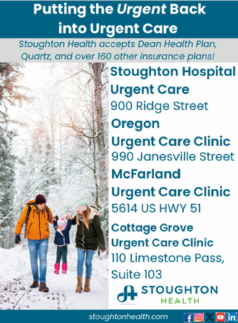


PR/Marketing Report

Slide 63



Upcoming Events/Fundraisers

Slide 64
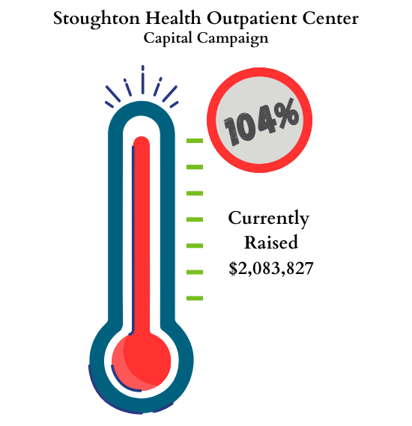
Annual Appeal Comparison
Foundation Dashboard
Year | Number of Donors | Total
2021 | 110 | $25,144
2022 | 93 | $14,700
2023 | 81 | $13,115
2024 | 60 | $15,531

Slide 65
Director, Engagement & Experience Summary
Andy Boryczka

Slide 66
Director, Engagement & Experience Updates
Culture at Stoughton Health is excellent based on overall retention and engagement scoring
The goal moving forward is to evolve our culture to meet the changing needs of our staff and the communities we serve
What does this create?
How will you be supported?
How will we do it?
What do we expect?
Why do we exist?
Culture
Excellence Together
AAACTS
Excellence Standards of Performance
Mission, Vision and Values

Slide 67
Director, Engagement & Experience Updates
Our Excellence Together teams provide the perfect support to our daily work to make sure we are living our values every day
My goal is to bring my knowledge to and experience to these teams to help us all rise
What does this create?
How will you be supported?
How will we do it?
What do we expect?
Why do we exist?
Culture
Excellence Together
AAACTS
Excellence Standards of Performance
Mission, Vision and Values

Slide 68
Director, Engagement & Experience Updates
Re-imagining the intranet as a hub for daily information and communication
Ensuring alignment between workgroups, frontline staff and administrative vision
Expanding our Patient and Family Council (PFAC) to meet our growing needs
Creating sustainable programming models that scale as Stoughton Health does
Positively impact:
  Staff engagement and
  Staff retention
Improve:
  Patient experience and
  Patient satisfaction

Slide 69
Chief of Staff Report
Dr. Aaron Schwaab

Slide 70

Request Motion to Approve One-Year Appointments.
One-Year Appointments
1. Sarah Thordsen, MD, Cardiology, UW Health, Courtesy
2. Aditya Sahai, MD, Cardiology, UW Health, Courtesy
3. Cydney Zemen, MD, Cardiology, UW Health, Courtesy
4. Michael Twohig, MD, Radiology, Madison Radiology, Courtesy
5. Nirhior Bhowmik, MD, Radiology, Madison Radiology, Courtesy
6. David Jensen, MD, Radiology, Madison Radiology, Courtesy
7. Eric Goth, MD, Radiology, Madison Radiology, Courtesy
8. Andrew Ceranske, MD, Radiology, Madison Radiology, Courtesy
9. Peter Morrison, MD, Radiology, Madison Radiology, Courtesy
10. Ejaz Shamim, MD, Radiology, Madison Radiology, Courtesy
11. David Shlensky, MD, Radiology, Madison Radiology, Courtesy
12. Donald Renfrew, MD, Radiology, Madison Radiology, Courtesy
13. Moataz Behairy, MD, Radiology, Madison Radiology, Courtesy
14. James Plasky, APNP, SWEA, Allied Health Professional
15. Joan James, MD, Psychiatry, ITP
Flagged Files: None at this time

Slide 71
Two-Year Re-Appointments
Request Motion to Approve Two-Year
Re-Appointments.
1. Steve Lyon, MD, ENT, SSM Health, Active
2. Ashish Rawal, MD, Orthopedic Surgery, Sto Health, Active
3. Shawyon Shadman, MD, Radiology, Madison Radiology, Courtesy
4. Tara Kane, APNP, Psychiatry, ITP, AHP
5. Michael Berger, CRNA, Anesthesia, Sto Health, AHP
6. Oluwabukola Shoaga, MD, Hospital Medicine, Beam Healthcare, Active
7. Marissa Decker, MD, OBGYN, SSM Health, Courtesy
8. Noreen King, MD, OBGYN, SSM Health, Courtesy
9. Nicholas Reason, MD, Radiology, Madison Radiology, Courtesy
10. Amr Youssef, MD, Cardiology, UW Health, Courtesy
11. Puneet Dhillon, MD, Hospital Medicine, Beam Healthcare, Active
12. Sarah Endicott, APNP, Psychiatry, Independent, AHP
13. Jason Sansone, MD, Orthopedic Surgery, Orthopedic & Spine Centers of WI, Active
14. Clark Collins, PA-C, Ortho PA, Sto Health, AHP
15. Nicole Reilly, MD, Cardiology, UW Health, Courtesy
Flagged Files: None at this time.

Slide 72

Open Discussion

Slide 73

Adjourn
Thank you for attending!

