Slide 1
Stoughton Hospital Association Annual Meeting
November 25, 2024

Slide 2
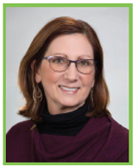
Governing Board Report
Donna Olson
Board Chair

Slide 3
Roll Call / Acknowledgement of 2024 Directors
Donna Olson
Board Chair
Tim Rusch
Vice Chair
Glenn Kruser
Secretary/Treasurer
Dr. Aaron Schwaab
Dr. Ashish Rawal
Matt Kinsella
Dawit Tesfasilassie
Kris Krentz
Cindy McGlynn
Steve Peotter
Nick Probst
Sue Vanderbilt
Chief of Staff
Medical Staff Rep.
SSM Rep.
SSM Rep.
Director
Director
Director
Director
Director

Slide 4
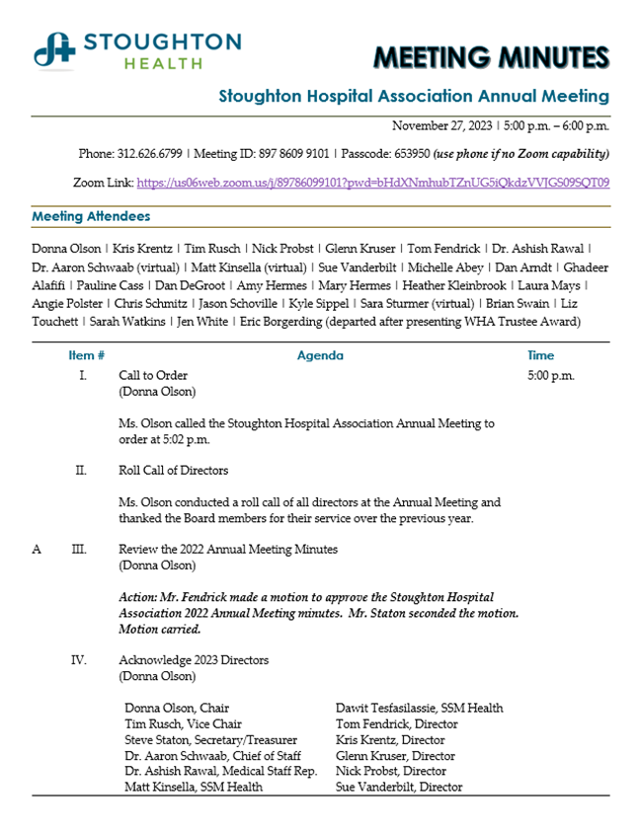
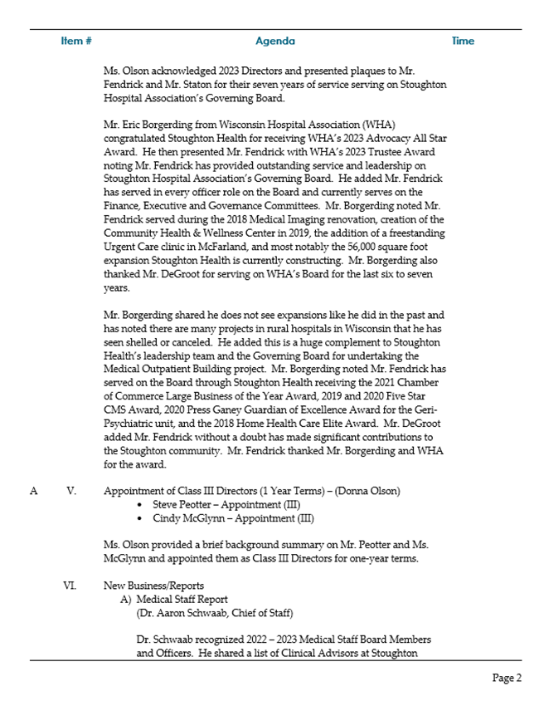

Slide 5
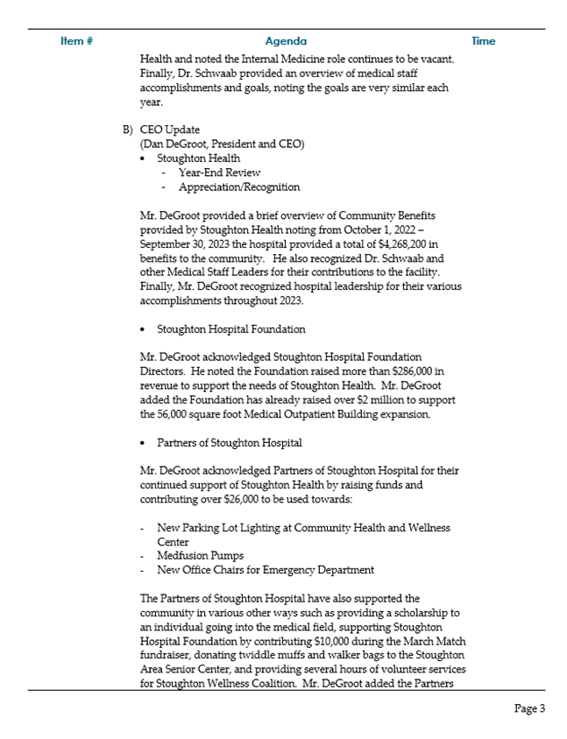
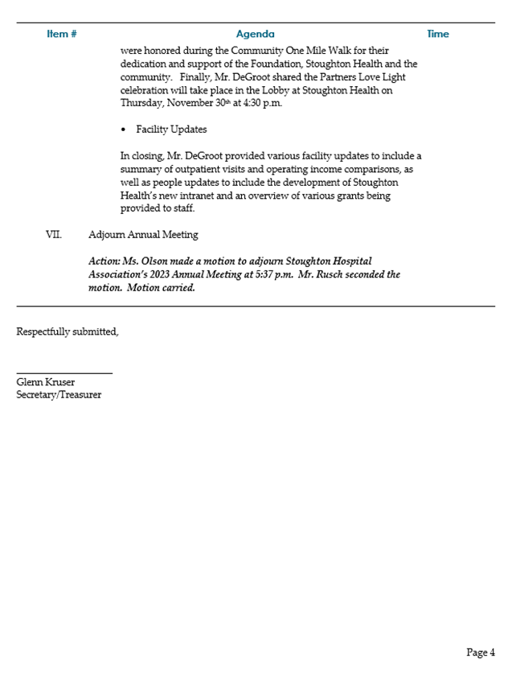

Slide 6
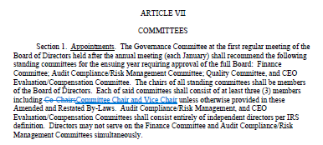
By-Law Amendment/Approval

Slide 7
Appointment of Class I Directors 3-Year Terms
Steve Peotter
Director
Cindy McGlynn
Director

Slide 8
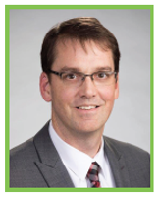
Medical Staff Report
Dr. Aaron Schwaab
Chief of Staff

Slide 9
2024 Medical Staff Board Members
Dr. Aaron Schwaab
Chief of Staff
Dr. Ashish Rawal
Vice Chief of Staff
Dr. Abigail Dahlberg
Secretary/Treasurer
Dr. Drew Dean
Dr. Guirish Agni
Director
Dr. Deanne Eccles
Director
Dr. Shawn McGuire
Director
Dr. Mark Menet
Director
Dr. Steven Diebold
Director
Director
Deb Dahlke, CRNA
Director

Slide 10
2024 – 2025 Medical Staff Officers
Dr. Aaron Schwaab
Chief of Staff
Dr. Ashish Rawal
Vice Chief of Staff
Chief Medical Officer
Surgical Services Medical Advisor
Governing Board Rep.
Dr. Abigail Dahlberg
Treasurer/Secretary

Slide 11
Clinical Advisors
Anesthesia-Deb Dahlke, CRNA
Cardiac Rehab – Dr. Eugene Kaji
Emergency Services – Dr. Steve Diebold
Hospitalist Program – Dr. Mark Menet
Medical Imaging – Dr. Shawn McGuire
Pathology – Dr. Joel Mendelin
Sports Medicine – Dr. Deanne Eccles
Surgery – Dr. Aaron Schwaab

Slide 12
Stoughton Health Medical Staff
2023 Stoughton Health Medical Staff = 170 members
56 Active
114 Courtesy
45 Allied Health Professionals
2024 Stoughton Health Medical Staff = 187 members
54 Active
133 Courtesy
59 Allied Health Professionals

Slide 13
Medical Staff Accomplishments
Medical Staff Participation on Multiple Stoughton Health Committees.
Participation with Physician Health Talks and Presentations to the Community.
Continued with the annual Medical Staff Scholarships ($2,000 each for a total of $10,000) to 5 local schools:
Evansville
Edgerton
Oregon
McFarland
Stoughton

Slide 14
Medical Staff Goals
Continue to create a culture at Stoughton Health where providers from different affiliations work together.
Strengthen referral relationships between primary and specialists.
Facilitate the introduction of new providers to specialist services offered locally.
Continue to use services that are available at Stoughton Health before referring elsewhere.
Support fellow doctors at Meet & Greets, Anniversary parties, Farewell parties, etc.

Slide 15
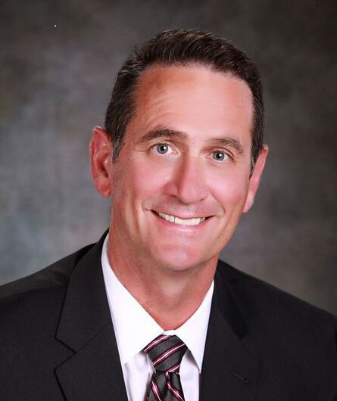
CEO Update
Dan DeGroot
President and CEO

Slide 16
Mission, Vision & Values

Slide 17
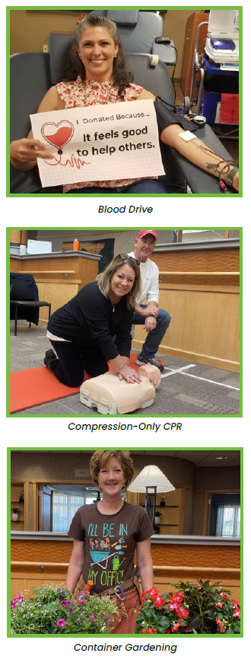
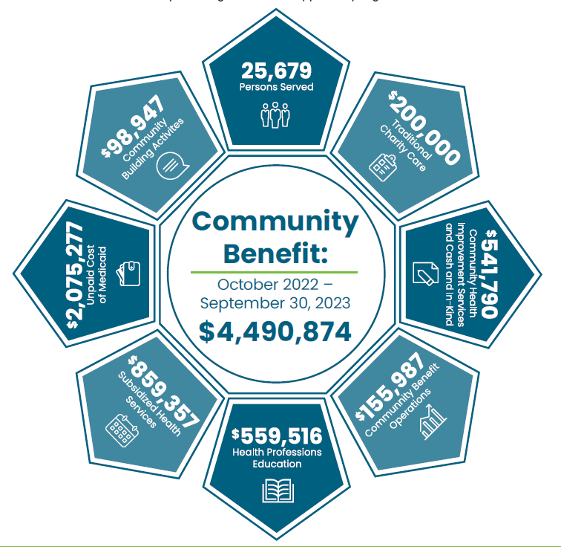
Giving Back to Our Community

Slide 18
Appreciation and Recognition
Dr. Aaron Schwaab
Chief of Staff
Dr. Ashish Rawal
Vice Chief of Staff
Chief Medical Officer
Surgical Services Medical Advisor
Governing Board Rep.
Dr. Abigail Dahlberg
Treasurer/Secretary

Slide 19
Manager Accomplishments
Excellent DNV Survey (2024)
Clean Financial Audit (FY2024)
Opening of Cottage Grove Urgent Care
Stoughton Health Outpatient Center (SHOC) Construction on schedule to open in Spring 2025
Expansion of Oregon Location with additional urgent care hours in 2025.
Completion of 4th Operating Room Construction & Renovation of the 3rd Operating Room.
Continuing recruitment for Second Orthopedic Surgeon.

Slide 21
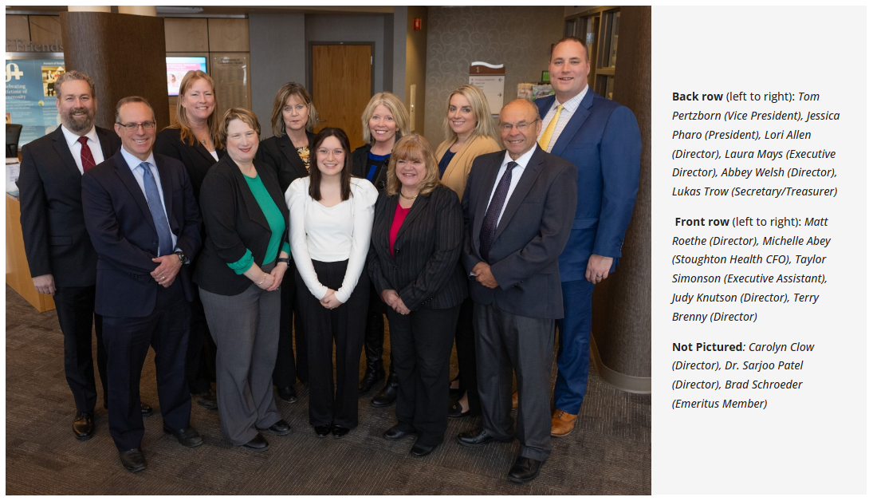
Stoughton Hospital Foundation 2024 Board of Directors

Slide 22
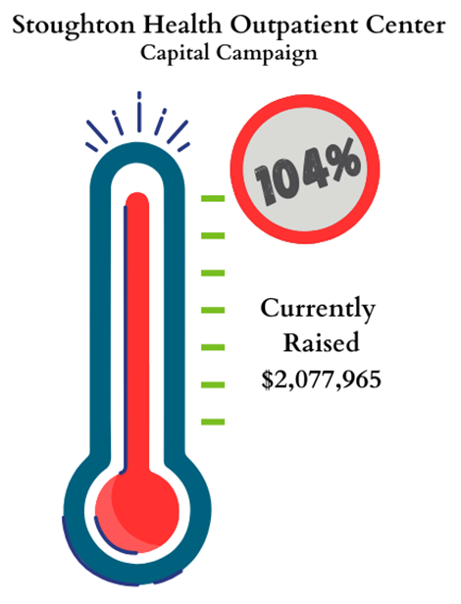
Stoughton Hospital Foundation Oct. 2023 – Sept. 2024 Highlights
In total more than $912,000 in revenue added to support the needs of Stoughton Health.
Raised net over $57,000 in proceeds from the 20th Annual Swinging for Health Golf Outing.
$1,500 was awarded to Stoughton High School students and Stoughton Hospital employees pursuing a degree in healthcare.
Over 35% of our Employees give in support of the Stoughton Hospital Foundation.

Slide 23
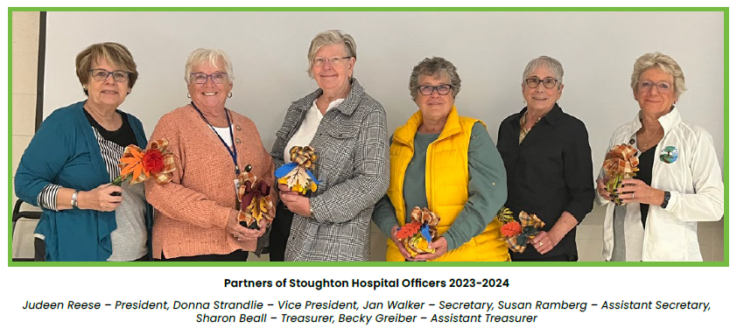
Partners of Stoughton Hospital 2023 – 2024 Board Officers

Slide 24
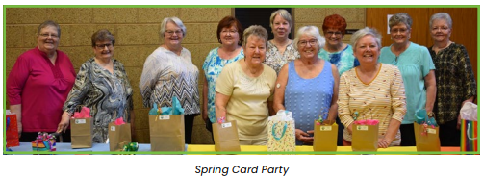
Partners of Stoughton Hospital Report
2024 Fundraising activities to help support hospital needs and requests through:
Gift Shop Sales
Flower Sales (Flash Flower Sale, Pansy and Mum sales)
Monthly Cookie Bakes
Spring Card Party
Love Light Celebration
Holiday Bake Sale
Stoughton Community Farmers Market

Slide 25
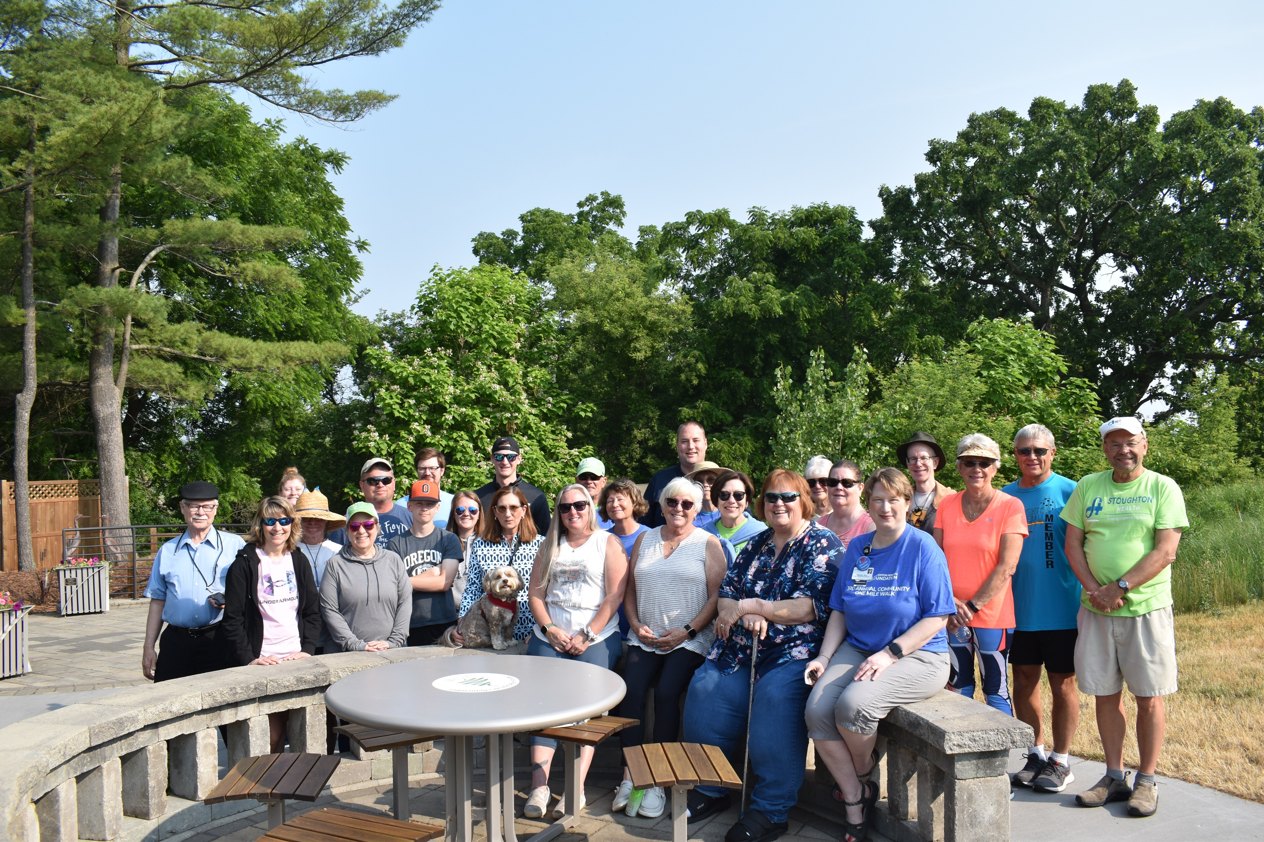
Partners of Stoughton Hospital Report
The Partners were committed to raising funds and contributed over $16,000 towards:
Blanket warmers in various nursing units
$10,000 – March Match fundraiser
New point of sale system in the gift shop
Sponsored a hole at the Swinging for Health Golf Outing
The Partners also:
Provided many hours of volunteer service with the following:
- Stoughton Wellness Coalition, including participation at medication and sharps disposal events
- Operation of the Partners of Stoughton Hospital Gift Shop
- Volunteering at the Foot Clinic at the Community Health & Wellness Center
Provided walker bags for rehab patients and twiddle muffs for geriatric psychiatry patients
Funded the annual scholarship for an individual going into healthcare.
The Partners also held a “You Matter” awareness campaign, a community BINGO Party at the Senior Center, a food drive, provided “emergency chocolate” to Stoughton Health employees during hospital week, and hosted a Spring Gathering and Volunteer Appreciation Event.

Slide 26
Partners of Stoughton Hospital Upcoming Opportunities for Support

Slide 27
Service Pillar
Inpatient Admissions FY2024

Slide 28
Service Pillar Outpatient Visits FY2022-FY2024

Slide 29
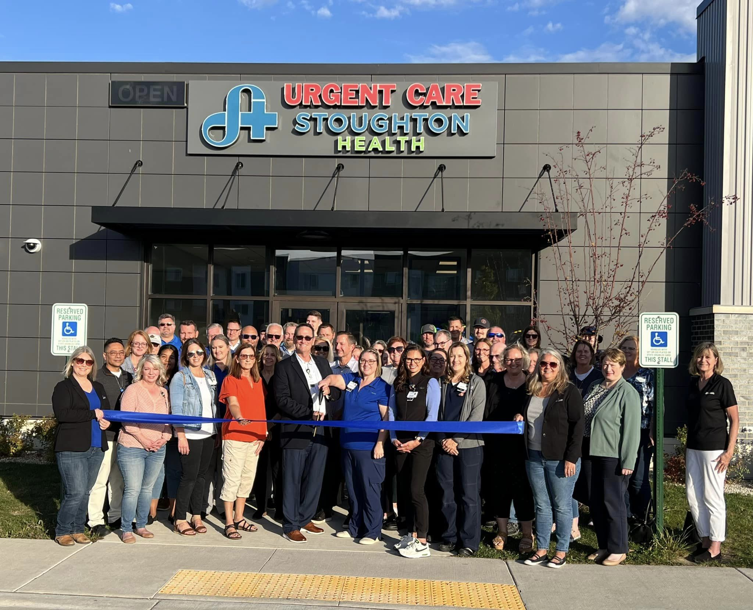
Growth Pillar – Opening of Cottage Grove Urgent Care
Grow our services locally and mitigate outmigration
Continue to expand outpatient services we provide to our primary service areas
Cottage Grove Urgent Care Hours:
Monday-Friday: 8 AM - 8 PM
Saturday-Sunday: 9 AM - 5 PM
110 Limestone Pass, Suite 103

Slide 30
Finance Pillar Operating Income Comparison

Slide 31
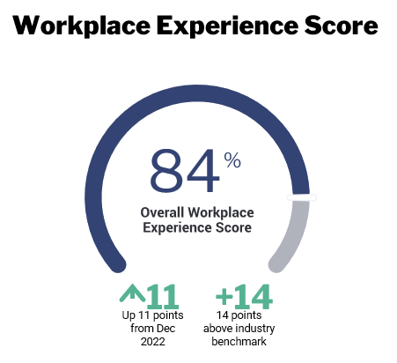
People Pillar
Launch of the Daisy & Bee Awards for Nursing & Clinical Support Staff
Employee Engagement Survey Results
Workforce Development Grant benefit offering (totaling nearly $75,000) – 6 graduates and 7 in progress:
Coding
Medical Billing
Clinical Educator
Rad Techs
APNP
RN

Slide 32
Adjourn

