Slide 1
Stoughton Health Governance Committee Meeting
January 9, 2025
7:15 a.m. - 8:15 a.m.

Slide 2
Agenda
Call to Order – Kris
Review and Approve July 18, 2024 Governance Committee Meeting Minutes – Kris
2025 Board Member Composition and Terms – Michelle
2025 Proposed Board and Committee Meeting Cadence / Committee Members – Michelle
Conflict of Interest Form Process – Michelle
Board Education: 2024 Review / 2025 Planning – Michelle
Board Self-Evaluation – Michelle
Open Discussion – All
Adjournment – Kris

Slide 3
Governance Committee Meeting Minutes
Request Motion to Approve July 18, 2024 Governance Committee Meeting Minutes.

Slide 4
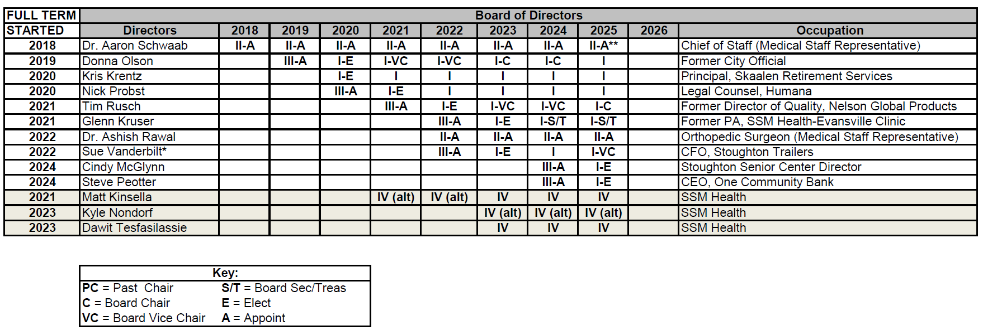
2025 Board Composition & Terms

Slide 5
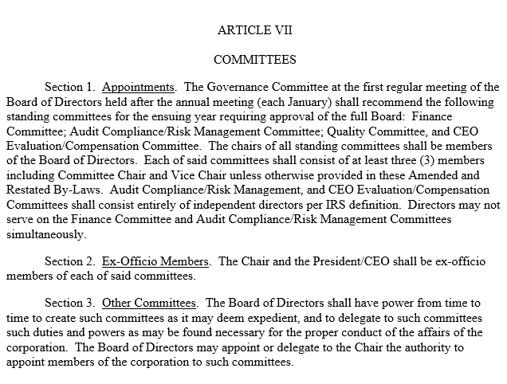
Committee Appointments – By-Law Review

Slide 6
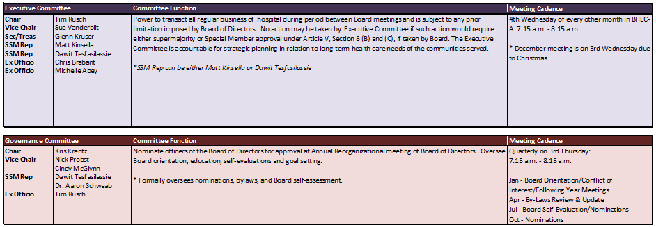
2025 Committee Members

Slide 7
2025 Committee Members

Slide 8
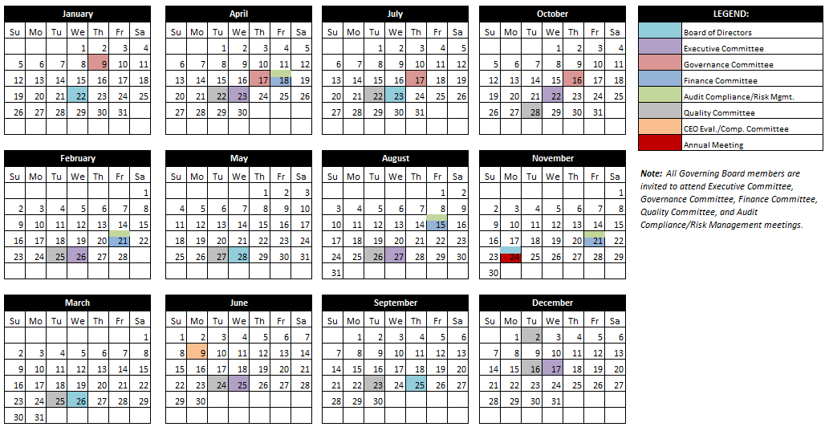
2025 Proposed Board and Committee Meeting Cadence

Slide 9
Request Motion to Recommend to the Governing Board Approval of the 2025 Board Committee Members & Meeting Calendar.

Slide 10
Conflict of Interest Form Review
Annual Process
IRS Form 990 Disclosure of the Process
Form to be emailed electronically
Complete by January 31, 2025

Slide 11
Board Education: 2024 Review
Solar Solutions – Future Potential
Medical Staff Structure/Credentialing Process
Medical Imaging Service Line Overview
Pharmacy 340b
Compliance/Regulatory Requirements
SSM Health/Stoughton Health Affiliation Agreement
Artificial Intelligence
Departmental Presentations (Services/Volumes/Performance)
Chris Schmitz | 1/24/2024
Jen White/Erin Meronk | 3/27/2024
Sara Sturmer/Michelle Abey | 5/22/2024
Pauline Cass | 7/24/2024
Quarles & Brady | 9/13/2024
Dan DeGroot | 9/13/2024
CliftonLarsonAllen | 9/13/2024
Cardiac HEAL Program | Jonathan Milton/Tina DeGroot | 11/25/2024

Slide 12
Board Education: 2025 Planning
Cyber Security/Hacks/Ransomware
Comprehensive Service Portfolio
MFP (Detailed Workflow Strategy
Parameters/Guard Rails (Investment Strategy)
Social Determinants of Health (SDOH) – Medicare Requirement for Reporting
Workplace Safety Plan
Diversity, Equity and Inclusion – Movement to Hire
Technology (Clinic/IT/Access/Ortho Robot/3D Stereotactic Breast Biopsy
M3/SSM Information Technology
Amy Hermes/Michelle Abey
Liz Touchett
Michelle Abey/Matt O’Neil - ZCM
Amy Hermes/Clinical Quality
Amy Hermes
Chris Schmitz
All

Slide 13
Board Self-Evaluation Results
Excellent/Leading – Highest Scoring in:
Remain objective and work toward the good of Stoughton Hospital (4.5)
Open to New Ideas (4.5)
Maintain discretion and confidentiality (4.5)
Derive satisfaction & a feeling of accomplishment from serving on the Board (4.5)
Competent– Lowest Scoring in:
Constructively challenge strategy & direction when necessary (3.4)
Address conflict & help manage it constructively & productively (3.7)
Seek information & opinions from others (3.8)

Slide 14
Board Self-Evaluation Comments
I think I continue to be an active member of the Board. The staff has done a good job of offering educational opportunities on topics generated by directors. Nothing stands out to me at this point that hasn’t been covered.
I believe the Board at Stoughton is well balanced and effectively managed.
Would like to see more time spent on forward looking strategy such as market, growth, comparison to the hospital market that Stoughton plays in to see what the next 1-3 years look like.
I could be more aggressive in vocalizing my opinions, concerns or agreements with issues being discussed.
As healthcare continues to change at a rapid pace, I appreciate the opportunity to receive updates/education at conferences, the retreat, board meetings and email.
As a new board member, I've found the experience to be enjoyable. I'm hopeful my capabilities can grow to better serve the Stoughton Health community.
After 4 years, still trying to understand the complexity of the health care industry.

Slide 15
Open Discussion

Slide 16
Adjourn
Thank you for attending!

