Slide 1

Finance Committee Meeting
February 28, 2025

Slide 2
Meeting Agenda
Call to Order – Steve Peotter
Review & Approval of November 22, 2024 Finance Committee Minutes – Steve Peotter
January 2025 Financials – Michelle Abey
February Month-to-Date Financial Update – Michelle Abey
Policy 2.10: Financial Assistance Policy Changes – Michelle Abey
Discussion of Debt Management Strategy – Michelle Abey
  Debt Summary as of January 31, 2025
  2015 Bond Rate Reset 9/01/2025
  Pre-Payment of Debt Scenarios
  Cash & Investment Strategy
Future Capital Purchase Discussion– Robotics – Dr. Ashish Rawal
Open Discussion
Adjournment – Steve Peotter

Slide 3



Review & Approval of November 22, 2024 Committee Minutes
Highlights from the meeting include:
  October Financials
  Financial Assistance Policy/EMTALA Policies
  Community Health Needs Assessment
  Ivenix Infusion Pumps
  Investment Review
*Request Motion to Approve November 22, 2024 Finance Committee Meeting Minutes.*

Slide 4
January 2025 Financials
Operating Income
$1,165,452
Balance Sheet Metrics
Outpatient Revenues
Expense Variances

Slide 5
January 2025 Financials
*Request Motion to Approve January 2025 Financials.*

Slide 6
February Month-to-Date Financials

Slide 7
Policy 2.10: Financial Assistance Policy Changes
Recommended Changes:
Self Pay Discount – 39% to 45%
100% Financial Assistance – 150% of Federal Poverty Level (FPL) to 200% of FPL
Additional Advanced Practice Providers Added
*Request Motion to Recommend to the Governing Board Approval of Changes to
Policy 2.10 – Financial Assistance Policy*

Slide 8
Discussion of Debt Management Strategy

Slide 9
Discussion of Debt Management Strategy
Current Debt Covenants:
  Days Cash On Hand – minimum of 45 days
  Debt Service Coverage Ratio – 1.25X
  2015 Bond Specific Covenants
    Maintain an Account Balance of at least $3,000,000 at First Business Bank
    Loan to value < 75%

Slide 10

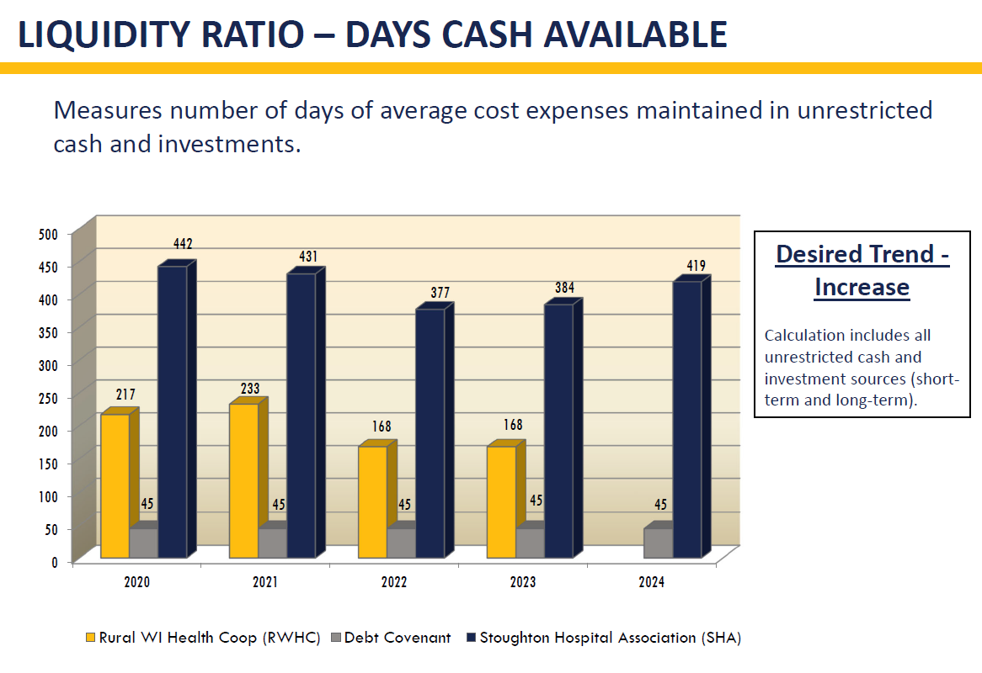

Slide 11
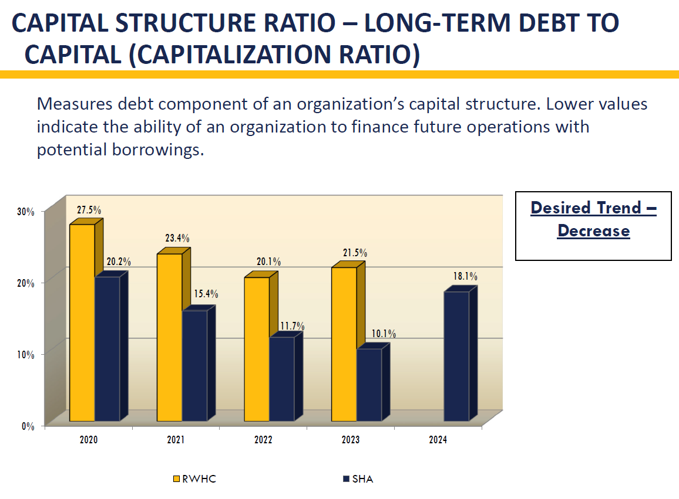

Slide 12
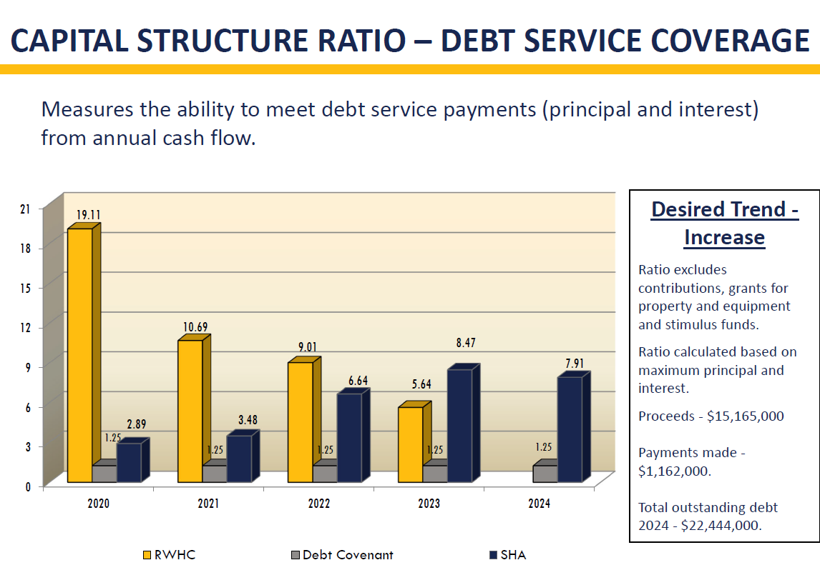

Slide 13
2015 Bond Rate Reset-September 1, 2025
Options as of the Reset Date:
  Pay off the bonds - $5,290,135 – pending legal review
  Reset Interest Rates for 1, 3, 5, 7 or 10 year term
    Rate based upon Federal Home Loan Bank (FHLB) or Secured Overnight Financing Rate (SOFR) plus 200 basis points (2%) multiplied by the Tax-Exempt Multiplier of 0.81%
      Example 5-year rate as of 2/27/2025 = 5.08%
  Pre-Pay 10% of the Outstanding Amount without penalty - $529,000, Reset Interest Rates for 1, 3, 5, 7 or 10 year term

Slide 14
Discussion of
Debt Management Strategy
Current Debt Service

Slide 15
Discussion of Debt Management Strategy
Cash & Investment Strategy (if changes need relative to direction for debt refinancing/pre-payment)
  368 = Budgeted Days Cash on Hand at September 30, 2025
  322 = Estimated Days Cash on Hand at September 30, 2025 with:
    2015 Bonds Paid off
    Prepayment of 20% ($3M) on 2023 Bonds
    Prepayment of 10% ($130,000) on 2018 Bonds

Slide 16


Future Capital Purchase Discussion: Robotics
Dr. Ashish Rawal

Slide 18
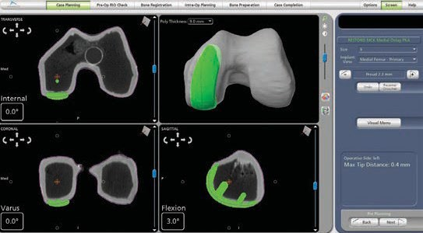
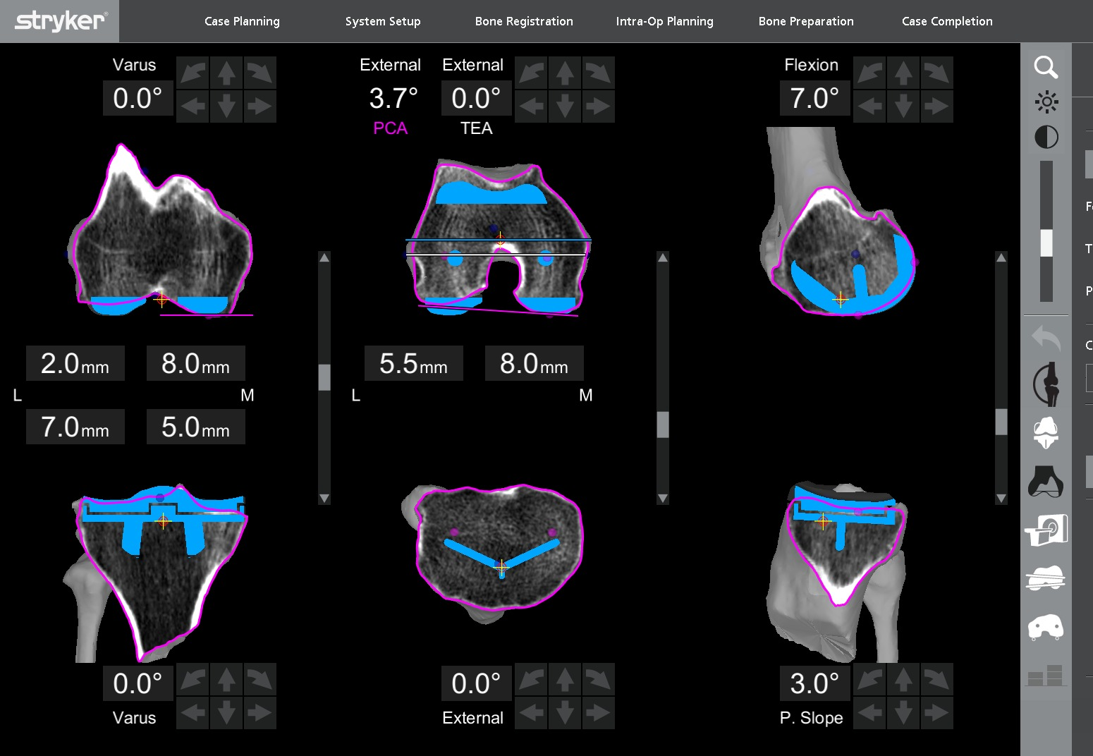
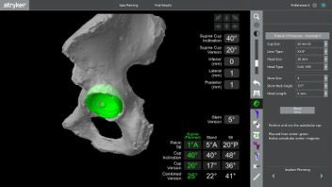
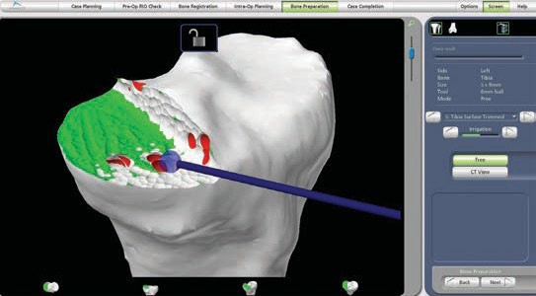
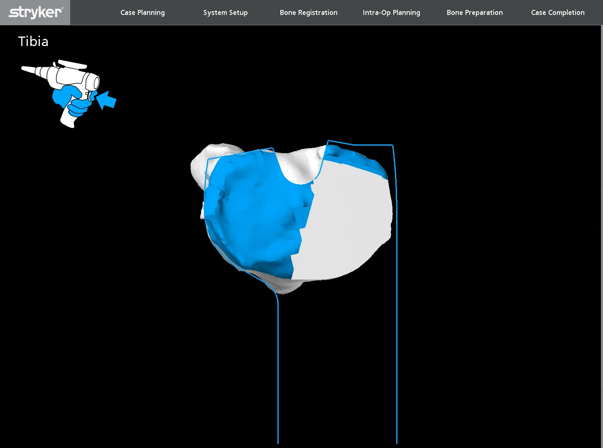
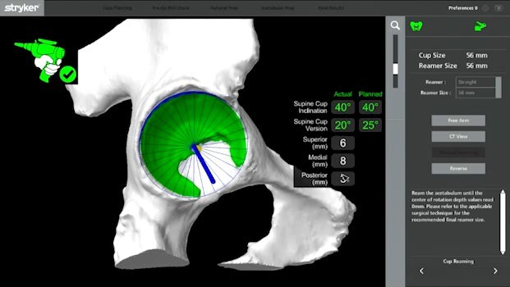
Mako SmartRobotics™
Combines three key components, 3D CT-based planning, AccuStop™ haptic technology and Insightful Data Analytics**, into one platform which which has demonstrated enhanced outcomes for total hip, total knee and partial knee patients compared to manual surgery.¹⁻³
Know more.
Cut less.^{†4-8}
**Access to data analytics offering requires execution of a separate agreement.
† For Mako Total Knee application, “cut less” refers to less soft tissue damage and greater bone preservation compared to manual surgery.⁴⁻⁸ For the Mako Total Hip and Partial Knee applications, “cut less” refers to greater bone preservation as compared to manual surgery.⁴⁻⁸

Slide 19
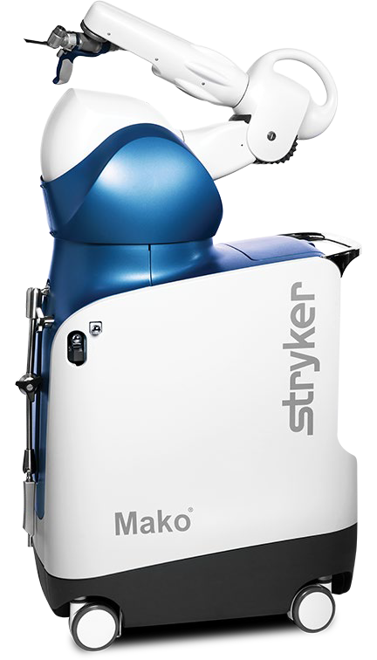

Clinical success | Total Knee
Mako Total Knee has demonstrated…
Two distinct, prospective, consecutive series, single-surgeon studies comparing patients who underwent conventional jig-based total knee replacement
versus Mako Total Knee surgery (40 patients⁵ and 30 patients¹⁴ in each cohort) concluded that Mako Total Knee with Triathlon was associated with:
Less bone and soft tissue damage ⁵ (p<0.05)
Less need for opiate analgesics¹⁴ (p<0.001)
Less time to hospital discharge¹⁴ (26% reduction in LOS) Less need for inpatient physical therapy sessions¹⁴ (p<0.001) Less postoperative pain¹⁴ (p<0.001)

Slide 20
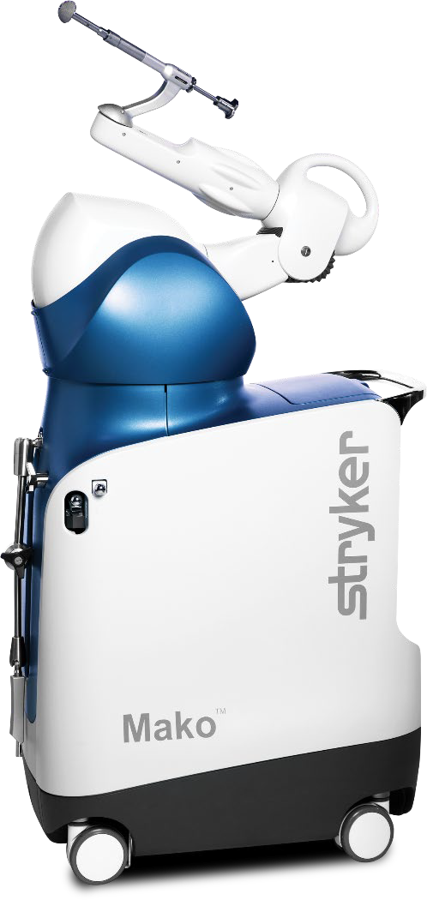
Clinical success | Total Hip
Mako Total Hip has demonstrated…
Enhanced acetabular component placement accuracy and reduced dislocation rates when compared with manual THA¹⁵
Favorable short-term patient reported outcomes¹⁶⁻¹⁸
The highest Forgotten Joint Score reported in literature for THA¹⁸
Decreased length of stay¹⁹

Slide 21
Open Discussion
Adjournment

