Slide 1
Inpatient
Onboarding New Employees
1st Presentation Date: 12/17/2024, 02/25/2025
Document Last Presented: 04/22/2025

Slide 2
Quality Story:
PLAN
Onboarding – Inpatient
Goal(s): What are you trying to accomplish?
KOM Target: Enhance onboarding of new employees by addressing orientation checklists to ensure that they are practical, concise, and consistently implemented with all new employees by June 2025. Phase 1: Redesign the Inpatient Registered Nurse orientation checklist by March 1st, 2025. Phase 2: Rework current orientation binder to create an improved onboarding experience for nursing staff (in collaboration with Clinical Education) by April 1st. Phase 3: Following phases will include replicating the same process in addressing orientation checklists for other disciplines (CNAs, HUCs, CM, and SS). Current KOM Status: Phase 1: Goal Met. Phase 2: In Progress. Phase 3: Not started.
Background: Explain what the original situation was. Why was a change recommended? (e.g. variation, poor outcome, etc.)
There has historically been challenges with onboarding new staff, leading to opportunities for improvement with adequate orientation checklists, qualified preceptors, and consistent scheduling. Administration has challenged each department to enhance onboarding practices.
Driver: Explain why the project is critical to SH. Why does it relate to the strategic plan?
This project will enhance employee satisfaction and promote staff retention. In turn, it will also affect patient satisfaction and each pillar (quality/safety, service, people, growth, and finance).
Team:
Project Leader: Heather Kleinbrook Members: Alissa Knudson, Jennifer Wagner, Michelle Sondreal, Sam Sime, Naomi Franklin, Patty Ryan Inpatient nursing team. Sam Stoltz. Nikki Rowin.

Slide 3
Changes:
DO
List the changes that have been made leading to improvements.
What? | Why? | When?
Present and review progress regarding project in staff meetings. | Continue to garner staff support and acceptance of project. | December 2024 and ongoing.
Monthly meetings with team and added stakeholders (clinical nurse educator, informatics nurse) | Keep project on track. Ensure meeting goals and target dates. Designated group project work. | January 15th, 2025 and February 12th, 2025.March 12th, April 15th
Finalize RN orientation checklist and share with Addy Miller for formatting. Completed and shared with staff or additional edits. | Completion of checklist with specific orientation items, strategies and resources for learning, and evidence of competence. | February 12th, 2025 and ongoing.
Begin work on RN Orientation binder (Collaboration with Clinical Nurse Educator and Informatics Nurse), case studies and critical thinking tools. | Rework current binder to make it relevant to current needs. Develop relevant case studies congruent to common diagnoses seen on the unit. Engage Informatics nurse in next meetings. | February 12th, 2025 and ongoing.

Slide 4
Measures:
STUDY
Include graphs of your measurement, results of surveys, etc. Include benchmarks or comparative data when available.
Action Item | Due Date | Goal Met
IP Manager to work with CNO and nurse leaders to determine need to pre- and post- task rating system. Is this a regulatory requirement? | December 1st, 2024. | Goal Met.
Nurse Leaders to consider request of project team to utilize assistance of Clinical Nurse to assist with onboarding process. | December 10th, 2024. | Goal Met.
Invite Clinical Nurse to next Project Meeting (January 15th) if appropriate. | December 10th, 2024. | Goal Met.
Redesign the Inpatient Registered Nurse orientation checklist. | March 2025. | Goal Met. Working with Addy on formatting final draft.
Work with Informatics nurse on development of Epic orientation checklist specific to Inpatient Department | April 2025 | In Progress.
Rework current orientation binder to create an improved onboarding experience for nursing staff (in collaboration with Clinical Education). | April 2025. | In Progress.
Implement new onboarding process with new hire. | TBD | Not Met.
Recreate process to address CNA, HUC, CM, and Social Work checklists | TBD | Not Met.

Slide 5
Findings:
ACT
Results: Did you accomplish your goals?
Project is progressing and team is meeting goals.
Lessons Learned: What did you learn as a result of this project? Unexpected discoveries? Problems or barriers?
Revamping the orientation process is a huge undertaking, involving multiple staff members and resources. Historically, nursing attempted to have orientation checklists similar for all departments, but this is not practical as each department has different needs. Would benefit from added support of clinical education nurse to assist with initial orientation items that cover all nursing disciplines (call light system, glucometers, lifts, assessments, IVs, catheter care, wounds, fall prevention, etc.). Consider extending clinical education orientation to more than 1 day. Great work is being done on this project and the team is really proud of the collaboration and work being done. Consider nursing CNE on orientation/preceptor expectations (Sam Stoltz) to standardize process. Opportunity to conduct exit interviews asking employees about orientation experience (Engagement and Experience). Opportunity for internal preceptor training or train the trainer education.
Next Steps: What actions are you going to take based on your findings? (e.g. roll out to additional units; modify and make additional improvements; abandon the effort; change course?)
Continue working on enhancing orientation checklists, utilizing case studies and scenarios for learning. Consider use of a learning needs assessment – each new hire will have different needs based on experience. Consider how clinical nurse educator can assist with project and take on some of the orientation load. Team to approve and submit final draft of orientation checklist to Addy Miller. Implementation of new orientation binder with new hire.
Project Leader is Recommending the Following:
QM Council approval for completion of project?: Enter YES or NO Project still in progress, project to continue: Enter YES or NO

Slide 6
Medical-Surgical Department
Increase in Swing Bed Admissions
1st Presentation Date: 06/27/2023
Document Last Presented: 04/22/2025

Slide 7
Quality Story:
PLAN
Swing Bed
Goal(s): What are you trying to accomplish?
KOM Target: Increase Swing Bed patient admissions to >41 this year (Jan – Dec 2025) to match pre-COVID numbers. 10 admissions to SWB to date. January = 3, February = 6, March = 1
Background: Explain what the original situation was. Why was a change recommended? (e.g. variation, poor outcome, etc.)
During COVID, Swing Bed admissions declined due to the need to maintain open beds for acute care patients. Now that we are moving to our new post-COVID norm, it feels like we are in a place to open more beds to transitional care patients.
Driver: Explain why the project is critical to SH. Why does it relate to the strategic plan?
Supports several areas of the strategic plan. Most obvious, it supports the bottom line financially, but it also keeps beds filled which guarantees staff hours and boosts staff satisfaction. It also enhances relationships with other hospitals by taking their patients to open beds for more acute needs which makes us good partners.
Team:
Project Leaders: Heather Kleinbrook Members: Case Managers, Social Workers, Inpatient Rehab Staff, Nurses, and Hospitalists

Slide 8
Changes:
DO
List the changes that have been made leading to improvements.
What? | Why? | When?
Discussion and identification of potential Swing Bed candidates in Daily Huddle | Want to keep appropriate SWB candidates in our organization for further care. Review outside referrals for appropriateness and coverage. | 04/26/23 and ongoing daily
Address Project in Staff meetings | Encourage staff buy-in and enforce positive aspects of SWB stays. | 06/13/23 and ongoing
Marketing Push – collaborative effort to create new marketing material with PR team | Market to outside sources to promote program and services to increase appropriate utilization. | March 2025
Meeting with SSM Madison – Mike Godfrey, Amy Hermes, and IP Services | Educate on SH SWB Program and market program to increase appropriate referrals. Mike to have Stacy Salasa (lead RN) connect with IP Services Manager to set up a visit for SH to go to SSM to present on SWB program. | March 12, 2025 – TBD
Develop communication tool using Epic Inbox to receive direct referrals from SSM Madison. | Allow pipeline for referrals and direct communication. Heather met with Nikki Rowin on 3/11/2025 to discuss needs and address Epic functionality. SW have access but uncertain of CM access. Nikki to investigate. | March 2025 - TBD
Set up quarterly meetings with SSM Madison Team and SH Team. | Continue to relationship building, identify what is going well as well as opportunities for improvement with referral process. 3/13/25 – Addy working on setting up quarterly meetings with SSM and SH teams. | March 2025 - TBD

Slide 9
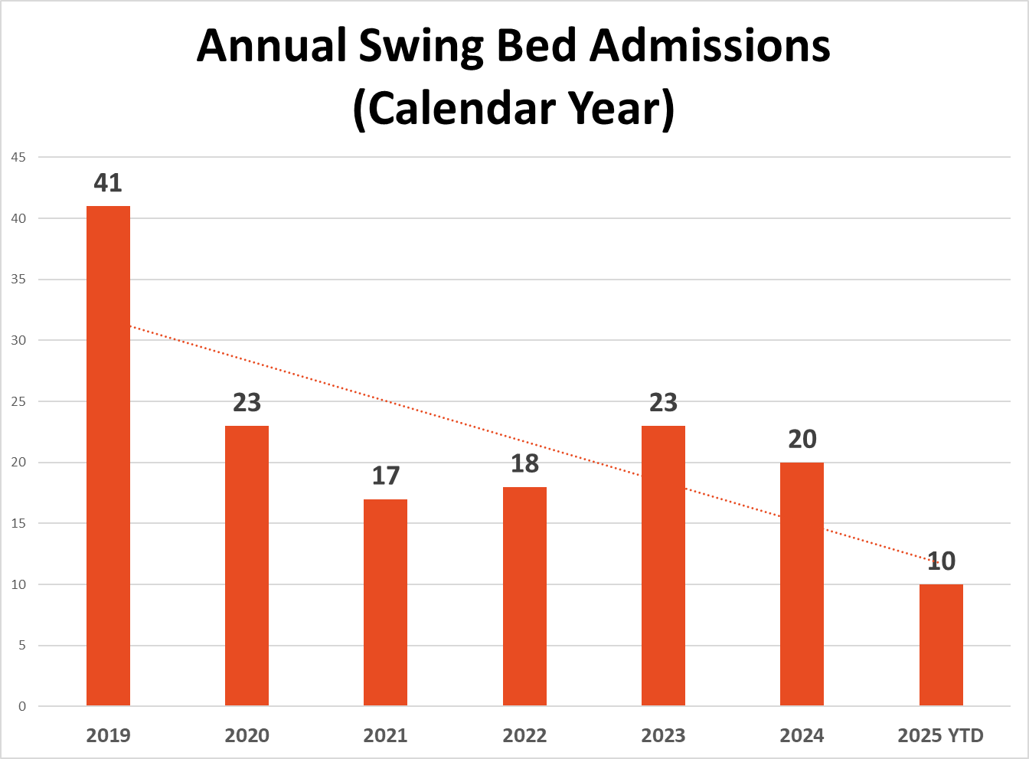
Measures:
STUDY
Include graphs of your measurement, results of surveys, etc. Include benchmarks or comparative data when available.

Slide 10
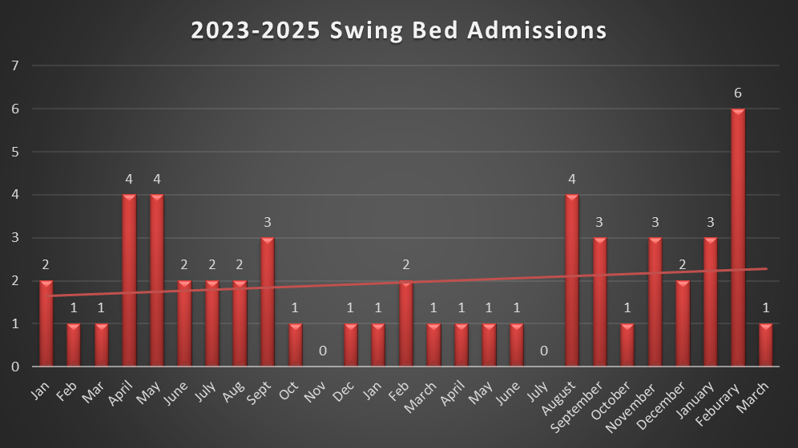
Measures:
STUDY
Include graphs of your measurement, results of surveys, etc. Include benchmarks or comparative data when available.

Slide 11
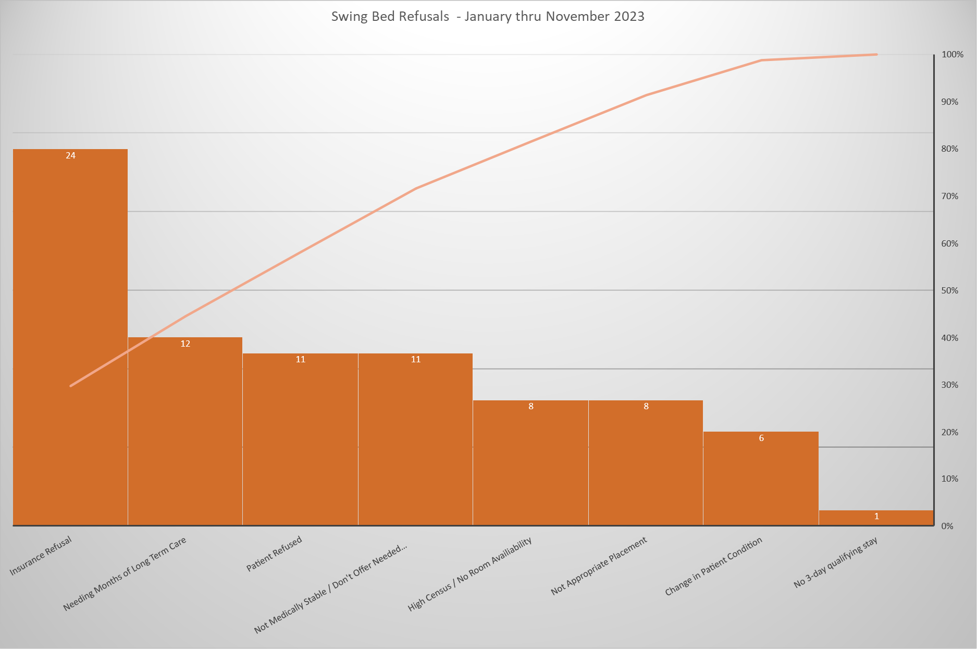
Measures:
STUDY
Include graphs of your measurement, results of surveys, etc. Include benchmarks or comparative data when available.

Slide 12
Findings:
ACT
Results: Did you accomplish your goals?
Ongoing.
Lessons Learned: What did you learn as a result of this project? Unexpected discoveries? Problems or barriers?
Enhanced the referral review process among team members. Consistent review of potential admissions in daily huddle. Team aware of need to increase SWB referrals/patients. Providing Patient Choice, however promoting positives of SWB program and encouraging appropriate candidates to utilize Stoughton Health vs going elsewhere for rehab needs. Completed Pareto and as suspected, insurance is greatest barrier to SWB admissions. IP Manager reached out to SSM-Madison, SSM-Janesville, and UW Hospital via telephone call/message and emails to discuss SWB referrals in the month of November and again in February 2025. Not a single call-back or response from any of the facilities.
Next Steps: What actions are you going to take based on your findings? (e.g. roll out to additional units; modify and make additional improvements; abandon the effort; change course?)
Continue to encourage SWB utilization among SH inpatients. Quarterly meetings to be set up with SSM-Madison for continued collaboration. Nikki Rowin to set up staff with EPIC needs for direct line of referrals. Heather waiting for response from SSM-Madison to visit and market SWB program to their team.
Project Leader is Recommending the Following:
QM Council approval for completion of project?: Enter YES or NO Project still in progress, project to continue: Enter YES or NO

Slide 13
Geriatric Psychiatry
Onboarding New Employees
1st Presentation Date: 08/27/2024, 12/17/2024, 02/25/2025
Document Last Presented: 04/22/2025

Slide 14
Quality Story:
PLAN
Onboarding - GPU
Goal(s): What are you trying to accomplish?
KOM Target: Enhance onboarding of new employees by developing an orientation binder encompassing all Geriatric Psychiatry disciplines, addressing all aspects of patient care. Specific discipline checklists will serve as attachments. Phase 1: Draft binder for all staff review. Phase 2: GP staff review and provide feedback to project team. Phase 3:Finalization of binder with feedback of newly hired team members. Phase 4: Implement process with new employee (May 2025). Current KOM Status: Phase 1: Goal met. Phase 2: Goal Met. Phase 3: Goal Met. Phase 4: In Process.
Background: Explain what the original situation was. Why was a change recommended? (e.g. variation, poor outcome, etc.)
There has historically been challenges with onboarding new staff, leading to opportunities for improvement with orientation processes, qualified preceptors, and consistent scheduling of orientation time. Administration has challenged each department to enhance onboarding practices.
Driver: Explain why the project is critical to SH. Why does it relate to the strategic plan?
This project will enhance employee satisfaction and promote staff retention. In turn, it will also affect patient satisfaction and each pillar (quality/safety, service, people, growth, and finance).
Team:
Project Leader: Heather Kleinbrook Members: Tammy Arndt, Erin Boettcher, Stacy Wendt, GP nursing team

Slide 15
Changes:
DO
List the changes that have been made leading to improvements that occurred in the last 60 days.
What? | Why? | When?
Present and review progress regarding project in GP staff meeting. | Continue to garner staff support and acceptance of project. Achieve favorable feedback from all staff on new orientation binder. | April 2nd and 3rd, 2025
Monthly Team Meetings. Extend Invite to Sam Stoltz | Keep project on track. Ensure team is meeting goals and target dates. Designated time for group project work. Input from Clinical Nurse Educator on processes and implementation. | March 12th April 7th April 7th
Develop EPIC Competency Checklist | Need to capture EPIC training for new employees who may not have exposure to EPIC, as well as train on GP specifics. | April 2025.
Develop abbreviated GP RN Checklist | Need to capture tasks not identified in orientation binder, along with method of competency. | April 2025.
Develop process for managing binders | Need to identify owners to ensure new employees are getting binders, as well as having responsibility of ordering supplies, making copies, updating information, etc. | April 2025.

Slide 16
Measures:
STUDY
Include graphs of your measurement, results of surveys, etc. Include benchmarks or comparative data when available.
Action Item | Due Date | Goal Met
Project team to have draft binder for all staff review. | December 2024 | Met.
GP staff to review draft binder and provide feedback to project team. | February 2024 | Met.
Finalize onboarding binder and ask new hires to review and provide feedback. | March 2025 | Met.
Implement onboarding process with new hire. | May 2025 | In progress.
Recreate process to address CNA, HUC, SW, and Activity Therapist. | June 2025 | Not Met.

Slide 17
Findings:
ACT
Results: Did you accomplish your goals?
RN Orientation Binder is complete. Plan to implement with new hire on May 12th, 2025.
Lessons Learned: What did you learn as a result of this project? Unexpected discoveries? Problems or barriers?
Historically, nursing attempted to have orientation checklists similar for all departments, but this is not practical as each department has different needs. Project Team initially began working on re-developing individual checklists by job code/position but found that pivoting to develop an orientation binder for all new GP staff encompassing “all things GPU” to replace general orientation checklists was more productive and beneficial to new employees. Abbreviated orientation checklists will remain for each discipline as needed to address job-specific items. Getting feedback from new employees has been instrumental to project. Staff have verbalized liking the new orientation process.
Next Steps: What actions are you going to take based on your findings? (e.g. roll out to additional units; modify and make additional improvements; abandon the effort; change course?)
Gather team for first meeting and address goals. Continue to work on binder and abbreviated checklist development. Work with nursing leaders to determine how clinical nurse educator can support onboarding needs. Continue timely meetings dedicated to project work to implement process with CNAs, HUCs, and Social Workers. Implement new onboarding workflow with new RN hire – May 12th – use feedback from that experience to make changes/adjustments as needed. Order binders.
Project Leader is Recommending the Following:
QM Council approval for completion of project?: Enter YES or NO Project still in progress, project to continue: Enter YES or NO

Slide 18
Emergency Services
Isolation Signage
1st Presentation Date: August 22, 2023
Document Last Presented: April 22, 2025

Slide 19
Quality Story:
PLAN
Isolation Signage
Goal(s): What are you trying to accomplish?
KOM Target: 95% of ED patients being admitted will have isolation signage indicated Current KOM Status: 75%
Background: Explain what the original situation was. Why was a change recommended? (e.g. variation, poor outcome, etc.)
Patients that come through the ED do not always have proper signage in place. Since COVID, staff have not been as diligent. This exposes other departments as well as not communicated when patient is admitted.
Driver: Explain why the project is critical to SH. Why does it relate to the strategic plan?
Prevent other staff from getting ill and decrease transmission to other patients.
Team:
Project Leader: Tina Strandlie, Bill Wilson Members: ED Staff

Slide 20
Changes:
DO
List the changes that have been made leading to improvements.
What? | Why? | When?
Staff not following policy | Staff consistently wear PPEs and have steadily improved signage but we are not at 95%. We have several new staff (two from inpatient) who missed this last time. Working with preceptors on educating staff. I will put laminated cards on all computers stating ISOLATION PRECAUTIONS. I have done this in the past when staff are missing documentation and it works. | On going – 4/10/2025
Communication with inpatient | Discussed with staff barriers. Staff stated (on the day shift) when they call to alert staff the patient is coming up, they can already see in the chart isolation precautions have been implemented. They would have to cancel it, put it in and inpatient would have to re add it | On going
Staff accountability | Several staff have this as their goal for 2025 | April 2025

Slide 21
Measures:
STUDY
Bill Wilson continues to collect data for this project

Slide 22
Measures:
STUDY
Bill Wilson continues to collect data for this project

Slide 23
Findings:
ACT
Results: Did you accomplish your goals?
No
Lessons Learned: What did you learn as a result of this project? Unexpected discoveries? Problems or barriers?
The majority of the staff are consistently implementing signage every time. There are a few outliers that haven’t and they have to develop an action plan to prevent this from happening.
Next Steps: What actions are you going to take based on your findings? (e.g. roll out to additional units; modify and make additional improvements; abandon the effort; change course?)
I hope June is the last time I have to present on this.
Project Leader is Recommending the Following:
QM Council approval for completion of project?: Enter YES Project still in progress, project to continue: Enter YES

Slide 24
Emergency Management
Mass Casualty Plan
1st Presentation Date: June 27th, 2023
Document Last Presented: April 22, 2025

Slide 25
Quality Story:
PLAN
Active Threat Drill
Goal(s): What are you trying to accomplish?
KOM Target: House wide Education on Active Threat on April 16, 2025 Current KOM Status: 100% completed
Background: Explain what the original situation was. Why was a change recommended? (e.g. variation, poor outcome, etc.)
It has been several years since we had an active threat drill and it did not go well. Staff did not receive proper education, there were more questions then answers, staff felt unprotected and without the tools they need. It also caused extreme anxiety from several staff.
Driver: Explain why the project is critical to SH. Why does it relate to the strategic plan?
Recently there was an active threat event at a school 12 miles from our hospital. We decided it was time we educated the staff properly and work with our Stoughton PD for the safety of staff/patients/visitors.
Team:
Project Leader: Tina Strandlie, Jen White, Jason Schoville, Andrew Boryczka, Kala Bingham (Dean), Sergeant Carson Hoeper (Stoughton PD) Members: Emergency Management Committee

Slide 26
Changes:
DO
List the changes that have been made leading to improvements.
What? | Why? | When?
Leadership Day Training | Sergeant Carson attend Leadership day to educate leaders on Active threat drill | 2/27/2025
Small group to meet for handouts, video and cascade learning | Develop format for April 16th education | 3/26/2025
Email sent to Everyone by Chris B | Allow employees to review materials prior to April 16th, start to think about their areas and safety | 3/29/2025
Emergency management Meeting to finalize plans | Received input from other managers on the drill and what expectations will be. Review the video and handouts. | 4/7/2025

Slide 27
Active Threat Drill
April 16, 2025 will be Safety Day at Stoughton Health.
We need to develop talking point for managers to prevent threats from entering. See Something Say something, always aware of your surroundings, don’t be afraid to ask someone what their business is, vendors walking around without proper name badges etc. The best way to prevent an escalating active threat, is to stop it.
We have found a video that is directed to healthcare workers. It isn’t as intimidating but it hits all the points we want the staff to be aware of.
Run, Hide, Fight bulletin was branded by Stoughton Health. It is from the FBI website. This will be laminated an posted in all work areas as well as bathrooms.
Safety plan will be completed by all managers with staff input
The safety plan will be used as a cascade learning document for staff who were unable to attend
All safety plans will be posted on the Intranet for everyone to view
The first hour of the event is primary work spaces. All managers will be in their team areas to develop the safety plan. The second hour will be managers/Admin/GP those that will be in their own work areas to develop a plan.
Four SPD officers will be in house – 2 in SHOC, 1 at Community Health Wellness and the other will be with Jason or Plant Ops to walk through hospital.
Rally points (safe locations for staff to go to during the event that are off campus) will be shared with staff including a map
Forum meeting is scheduled for April 17th. We will do a hot wash and discuss next steps. Reunification.

Slide 28
Findings:
ACT
Results: Did you accomplish your goals?
Emergency management requirements is an ongoing process.
Lessons Learned: What did you learn as a result of this project? Unexpected discoveries? Problems or barriers?
We aren’t experts in this field. Some have been to conferences and were able to bring back lessons learned. Our core group of 5 have been working together to develop this initial step. This active event isn’t just the hospital but all of our outlying clinics and buildings. Emergency management/Environment of Care/Safety have grown considerably in the last several years plus the addition of our new spaces, we recommend hiring a full time person to manage this.
Next Steps: What actions are you going to take based on your findings? (e.g. roll out to additional units; modify and make additional improvements; abandon the effort; change course?)
Reunification, Mass Casualty Event and drilling
Project Leader is Recommending the Following:
QM Council approval for completion of project?: NO Project still in progress, project to continue: Yes

Slide 29
Emergency Services
Patient Follow up after missing work and worker’s comp restrictions
1st Presentation Date:2/25/2025
Document Last Presented:April 22, 2025

Slide 30
Quality Story:
Patient Follow-up After Missing Work and Work Comp Restrictions
PLAN
Goal(s): What are you trying to accomplish?
KOM Target: Implementation of Preventative Health Nurse Practitioner to provide follow up visit after missing work due to injury or illness or to clear from work comp restrictions by June 2025. There will be 4 phases. Phase 1: Establish Billing practice. Phase 2: Communication with local businesses for available services. Phase 3: Develop process flow for patients including registration/clinic space/EPIC AVS updates. Phase 4: Implementation (small test of change before full implementation with mock patients from beginning to end) Current KOM Status: Phase 1: in progress. Phase 2: not met. Phase 3: not met Phase 4:not met
Background: Explain what the original situation was. Why was a change recommended? (e.g. variation, poor outcome, etc.)
Patient call the ED/UC for return to work note or evaluation after an injury or illness to return to work. This could either be worker’s comp, personal injury, or illness. We would like to streamline this for Jen Mora to see these patients with a scheduled visit.
Driver: Explain why the project is critical to SH. Why does it relate to the strategic plan?
Reduce non-emergent/urgent visits to the urgent cares and ED. This will also provide patient satisfaction because it is difficult for them to get into see a primary care provider.
Team:
Project Leader: Tina Strandlie, Jen Mora Members: Sarah Watkins

Slide 31
Changes:
DO
List the changes that have been made leading to improvements.
What? | Why? | When?
Initial meeting | Communication Billing Implementation | April 2025
Local Businesses-worker’s comp claims and return to work non-worker’s comp | Jen contact for available services | April 2025
EPIC | Change AVS to include Jen’s number for follow up visit- anyone that gets note to miss work and any work comp visit | After implementation
Billing | How does this service get paid
Needle sticks other companies | Patients from outside agencies that have needle sticks can be in the ED for hours. Jen can expedite this as she can now order labs. | May 2024
Educate ED providers/staff | ED staff will need to be aware of adding Jen’s information to AVS for follow up | After implementation

Slide 32
Measures: Total worker’s comp in ED 2024
STUDY
Row Labels | Count of Disch Date
Jan | 37
Feb | 30
Mar | 32
Apr | 42
May | 56
Jun | 44
Jul | 48
Aug | 52
Sep | 40
Oct | 56
Nov | 39
Dec | 42
Grand Total | 518

Slide 33
Findings:
ACT
Results: Did you accomplish your goals?
This a work in progress. Due to evaluations and SHOC building implementation we haven’t had time needed to focus on this project
Lessons Learned: What did you learn as a result of this project? Unexpected discoveries? Problems or barriers?
Next Steps: What actions are you going to take based on your findings? (e.g. roll out to additional units; modify and make additional improvements; abandon the effort; change course?)
Action: | Assigned To: | Due Date:
Establish billing practice | Jen/Tina/Sarah | May 1st
Determine clinic space/scheduling | Jen | May 1st
Project Leader is Recommending the Following:
QM Council approval for completion of project?: Enter YES or NO Project still in progress, project to continue: Enter YES or NO

Slide 34
Emergency Services/ Urgent Care
Onboarding– New Hires
1st Presentation Date: June 25, 2024
Document Last Presented: April 22, 2025

Slide 35
Quality Story:
PLAN
Orientation
Goal(s): What are you trying to accomplish?
KOM Target: Implement improved onboarding of new employees by ensuring application to hire to first 6 months are smooth, organized and easy for staff to navigate by April 30, 2025 (5 phases/steps to completion) Current KOM Status: Phases 1, 2 and 3: completed; Phase 4: in process; Phases 5 & 6: not yet met
Background: Explain what the original situation was. Why was a change recommended? (e.g. variation, poor outcome, etc.)
Onboarding plays a crucial role in employee retention. A strong onboarding program sets a positive first impressions, ensuring a smooth transition for new staff, familiarization with processes, resources and the culture of the organization. This leads to staff feeling valued and correlates with lower turnover rates.
Driver: Explain why the project is critical to SH. Why does it relate to the strategic plan?
Employee satisfaction and projected decrease in turnover related to not feeling valued or that they don’t belong. This ultimately can improve quality of care delivered and patient satisfaction.
Team:
Project Leader: Tina Strandlie, Kelly Harrington Members: ER & Urgent Care Staff

Slide 36
Changes:
List the changes that have been made leading to improvements that occurred in the last 60 days.
DO
What? | Why? | When?
Define stages of Onboarding | As employees are onboarded, they slowly become more acclimated and develop awareness of the culture at an organization. | Feb 2025
Determine timing/length of each stage |  | Feb/March 2025
Define what the support looks like in each stage, compare current versus desired practices. | It’s important to change and grow throughout various stages to ensure staff growth is continuing and not stagnant | Feb/Mar 2025
Explore customization of onboarding stages or scheduling and timing based on employee attributes, skills and background. |  | April 2025

Slide 37
Measures:
STUDY
Individual goals/steps built to create a successful onboarding experience
Action Item | Due Date | Goal Met
Review UC, ER checklists to separate out what is a clinical skill that needs to be taught/reviewed vs onboarding/basic acclimation to the unit | Jan 15, 2024 | Goal Met
Define stages of Onboarding, points of intersection with new employees that require different levels of support. | Feb 28, 2025 | Goal Met
Define what the Onboarding support looks like in each stage. | Mar 31, 2025 | Goal Met
Finalize ER/UC onboarding stages and support with staff input, reflecting on their onboarding experiences, including presentation at staff meetings. | April 30, 2025 | In process
Implement consistent onboarding with all new employees in ER/UC and obtain feedback from staff during routine manager check-ins during probationary period | May 30, 2025 | Not met
Collaboration with HR about potential expansion of Onboarding supports into organization-wide practices. | TBD | Not met

Slide 38
Findings:
ACT
Results: Did you accomplish your goals?
Project in process
Lessons Learned: What did you learn as a result of this project? Unexpected discoveries? Problems or barriers?
Orientation previously included all ancillary departments and time spent in each department. This has not happened for several years and we are bringing it back. Sam Stoltz will be the new Education person and I said I would start the process for her as I have 3 new hires – 2 RNS and a manager. Kelly has prior experience, and we will be co-leads. Onboarding becoming the focus, and while it’s integral with orientation, it’s very different.
Next Steps: What actions are you going to take based on your findings? (e.g. roll out to additional units; modify and make additional improvements; abandon the effort; change course?)
Change project direction and ensure impact is value-added to all new hires and ER/UC leadership.
Project Leader is Recommending the Following:
QM Council approval for completion of project?: NO Project still in progress, project to continue: YES

Slide 39
Laboratory
CAP Self – Inspection Follow-up
1st Presentation Date: 4.2025
Document Last Presented:

Slide 40
Quality Story:
PLAN
Lab CAP Self-Inspection Follow-up.
Goal(s): What are you trying to accomplish?
KOM Target: - Correct all deficiencies identified during the Laboratory CAP self inspection by July 1st 2025. A total of 18 potential deficiencies were identified. Current KOM Status: 5 of 18 Currently completed.
Background: Explain what the original situation was. Why was a change recommended? (e.g. variation, poor outcome, etc.)
As part of the Laboratory’s accreditation with the College of American Pathologists (CAP) we are required to complete a self inspection every other year opposite our on-site survey and correct any deficiencies prior to that survey. The lab completed this self evaluation in January and February this year. A total of 18 possible deficiencies were identified for correction.
Driver: Explain why the project is critical to SH. Why does it relate to the strategic plan?
The standards are intended to help ensure quality of laboratory services in accordance with standards.
Team:
Project Leader: Kyle Sippel Members: Lab Staff and medical direction.

Slide 41
Changes:
DO
What? | Why? | When?
Self inspection was completed, and list of deficiencies was compiled. |  | Feb 2025
Addresses specific deficiencies individually – see Measure slide for deficiency specifics.

Slide 42
Measures:
STUDY
Include graphs of your measurement, results of surveys, etc. Include benchmarks or comparative data when available.
Deficiency | Completion |  | Deficiency | Completion
1. No record for pathologist visits and activities | Yes |  | 10. Current policy for sample labeling does not match our current practice
2. Director Approval for on call pathologists as clinical consultants | Yes |  | 11. Outpatient transfusion are not being sent home with instructions for RXNs.
3. No formal policy for pathology samples that do not need to be sent for pathology and which samples that can be done as microscopic only. | Yes |  | 12. Completed reactions forms need to be scanned into EPIC and procedure needs to reflect this. Or consider the on-line RXN procedure | Yes
4. No lot crossover procedures for non-waived kits. |  |  | 13. Thermometers in the Freezer are both located on the top. Need to look at both fridge and freezer for different temp zones.
5. No procedures to address scanning items into Epic and verification of the scan |  |  | 14. Unable to determine records of control establishment for new lots once archived
6. Patient ID procedures does not address hearing or speaking impaired, or language barriers. |  |  | 15. Unable to find documentation of corrective actions for lots that are archived.
7. No training for valets transporting specimens. | Yes |  | 16. Use of bright field microscopy, need to update CSF cell count from WBC to TNC.
8. No Temperature monitoring in Central supply. |  |  | 17. Not procedure for colter operations found
9. Reagent package inserts are not always available. |  |  | 18. ESR procedures not included what to do for interferences .

Slide 43
Findings:
ACT
Results: Did you accomplish your goals?
No
Lessons Learned: What did you learn as a result of this project? Unexpected discoveries? Problems or barriers?
No significant deficiencies identified related to patient safety or result quality. Most deficiencies are related to a minor variation from the CAP standard or situations were our policies does not match our practice and needs updating. No Significant challenges encountered at this time.
Next Steps: What actions are you going to take based on your findings? (e.g. roll out to additional units; modify and make additional improvements; abandon the effort; change course?)
Continue to work through each deficiency one by one. Will need to coordinate with Dacia in Material Services regarding storage monitoring in her area.
Project Leader is Recommending the Following:
QM Council approval for completion of project?: Enter NO Project still in progress, project to continue: Enter YES

Slide 44
Sleep Lab
Succession Planning
1st Presentation Date: 8.2024
Document Last Presented: 2.2025

Slide 45
Quality Story:
PLAN
Sleep Center Succession Planning
Goal(s): What are you trying to accomplish?
KOM Target: Create a succession plan for all duties currently being performed by Dottie, Star, and Kathy (retiring staff) – 4 main non-clinical tasks areas have been identified. Create a succession plan including necessary policy and procedure, plus identify who will be responsible and create a training plan with designated time to take over. Current KOM Status: 1 of the 4 identified areas has been completed.
Background: Explain what the original situation was. Why was a change recommended? (e.g. variation, poor outcome, etc.)
The sleep lab for years had 2 techs. These tech are responsible and have the knowledge and training for all departmental operations including patient and order management, regulatory compliance (AASM accreditation), supply management, and scheduling for example. Both staff have expressed the expectation to retire with the next couple years. 1 has given official notice of retirement upon completion of our regulatory re-accreditation with AASM in 2026. 2 new sleep tech have recently been hired but currently have minimal involvement in these non-clinical duties. At this point we do not have a specific plan for who will cover these non-clinic duties as well as overall staffing and coverages as they potentially reduce hours and fully retire. Additionally, the registration staff person who is responsible for scheduling and daytime communication with patients has also indicated the desire to retire in near future.
Driver: Explain why the project is critical to SH. Why does it relate to the strategic plan?
The project will ensure an orderly transition of all the non-clinical duties to newer staff. We will be able to ensure all tasks have been re-assigned and the new responsible persons have been properly trained. This will also help us to determine our specific needs related overall departmental staffing and the best way to replace the clinical hours and meet the needs of our patients. This project will also help to provide additional knowledge related to these operations and accreditation requirements for the non-sleep tech manager.
Team:
Project Leader: Kyle Sippel Members: Sleep Tech, Sarah Watkins, Registrations.

Slide 46
Changes:
DO
List the changes that have been made leading to improvements.
What? | Why? | When?
Tasks needing to be passed along were identified. 4 Specific tasks were identified. - Supply Management, policy management, AASM regulatory compliance, and Natus system management. |  | Nov and Dec 2024 - Ongoing
Staff continue to identify different tasks that are currently being completed that will need to be re-assigned. A logbook was created for these different tasks. | This log book will service as our actual succession plan as we progress though the process. | March 2025 – ongoing
Dottie has begun to provide detail and instructions in the logbook for each task to begin to create the basis for procedures. | It is necessary to create a specific SOP for these tasks to ensure things a deligated appropriately and new staff are trained. | March 2025 – ongoing
Staffing succession: Natalee our new ASTEP intern has begun her training in Sleep medicine. |  | March 2025 – Ongoing Goal for Certification – March 2026

Slide 47
Measures:
STUDY
Include graphs of your measurement, results of surveys, etc. Include benchmarks or comparative data when available.
Tasks identified requiring succession planning.
Task | Lead | Responsible | Training TimeFrame | Status
Supply Management | Dottie | Emily | 2024 | Completed 2.2025
Policy Management | Dotttie/Star | Emily and Kyle | 2025 | Goal End of 2025
AASM Regulatory Compliance | Dottie | Emily | 2025 | Goal June 2026 This will be developed and trained as we complete the 2026 re-certification process.
Natus Maintenance | Dottie | Emily | 2025 | Goal End of 2025
Sleep Intern | Dottie coordinator Other Trainers Star and Emily | Natalee | 2025-1st Qtr 2026 | Goal – Registry by March 2026

Slide 48
Findings:
ACT
Results: Did you accomplish your goals?
No
Lessons Learned: What did you learn as a result of this project? Unexpected discoveries? Problems or barriers?
Next Steps: What actions are you going to take based on your findings? (e.g. roll out to additional units; modify and make additional improvements; abandon the effort; change course?)
Continue with Natalee’s training – April 2026 Continue to review and complete the necessary references for the identified non-clinical tasks - December 2025 Create the actual succession plan with processes and time frames for transitions – December 2025 As able, begin to train Emily and Manger for completion of some of these tasks. Emily should be involved with Dottie when she is working on these different tasks to begin to learn. As the actual transition will take place over the next year and a half, Project will be closed once appropriate references have been created and a formal succession plan is in place with timeframes.
Project Leader is Recommending the Following:
QM Council approval for completion of project?: Enter NO Project still in progress, project to continue: Enter YES

Slide 49
Sleep Lab
Visitor Sleeping
1st Presentation Date: 2.2025
Document Last Presented: 2.2025

Slide 50
Quality Story:
PLAN
Sleep Center – Visitor Sleeping
Goal(s): What are you trying to accomplish?
KOM Target: Implementation of a new guest sleeping options by June 2025 – 4 steps on the project identified. Current KOM Status: 1 of the 4 steps completed.
Background: Explain what the original situation was. Why was a change recommended? (e.g. variation, poor outcome, etc.)
Many of our sleep studies require a parent or caregiver to stay over night with the patient. Sometimes that care giver can sleep in room2, but quite often there is patient that room or the age/situation requires the caregiver is in the room with the patient. Currently we have a roll-away bed that the caregiver will sleep on. This bed is quite old, and springs are starting to loosen. Additionally, it needs to have dedicated lined and needs to be maintained by EVS. We have been approached by EVS manager to see if we could look for an alternative option that would be easier time and physically to maintain. She stated that it is very low, and staff are having to bend over quite far to change linen and make up mattress which is causing some back discomfort.
Driver: Explain why the project is critical to SH. Why does it relate to the strategic plan?
The project would remove some repetitive low bending by EVS staff improving ergonomics and minimizing back strain.
Team:
Project Leader: Kyle Sippel Members: Angie Rowin – EVS, Sleep Staff, Dacia – Mat Services.

Slide 51
Changes:
DO
List the changes that have been made leading to improvements.
What? | Why? | When?
Sleep worked with Angie from EVS to discuss different options. Removable bed vs sleeping recliner. Staff evaluated a recliner option that we currently had in Day Surgery. The determined it would work well. | Determine the best options for the dept. A recliner options was felt best. | Dec 2024
Materials Services reviewed all options available under our Vizient contracts for a sleep recliner. A suitable options was not found under our contracts. |  | Feb-March 2025
Manufacture information was provided to Dacia regarding a chair in use in Day Surgery. Sleep is using this currently when patients need a recliner. She will be reaching out to them to acquire a quote and more information. |  | 4/3/2025

Slide 52
Measures:
STUDY
Include graphs of your measurement, results of surveys, etc. Include benchmarks or comparative data when available.
Task | Assigned to | Completed | Notes
Determine best options for guest sleeping arrangements for room 1 | Evs Manager and sleep staff | 12.2024 | Staff decided on a recliner option, similar to chair in day surgery.
Materials services to provided options with physical sample for staff to evaluate | Materials Services Manager | Ongoing | * Could not find a good options from a Vizient contract. Looking into the manufacture of the DS chair.
Staff to select the appropriate chair model |  |  | Chair should be able to sleep guest as well as to perform a sleep study for patients who only sleep in a recliner.
Chair to be purchased and installed.

Slide 53
Findings:
ACT
Results: Did you accomplish your goals?
No
Lessons Learned: What did you learn as a result of this project? Unexpected discoveries? Problems or barriers?
Could not find a good options from a Vizent contract. Looking into the manufacture of the DS chair. A question as asked by Chris in Admin regarding the quality of the rooms and do they need to be updated. This was discussed somewhat. Our beds are newer, but possibly some paint or other updates could be beneficial. Further discussion yet to be had outside of this project.
Next Steps: What actions are you going to take based on your findings? (e.g. roll out to additional units; modify and make additional improvements; abandon the effort; change course?)
Work with Dacia to get a quote and possible example if different from the chair in DS from that vendor. – June 2025 If that is not viable options to continue to look to find a better vendor to purchase the chair. - TBD
Project Leader is Recommending the Following:
QM Council approval for completion of project?: Enter NO Project still in progress, project to continue: Enter YES

Slide 54
Plant Operations
New Employee Orientation Competency checklist
1st Presentation Date: 02/25/2025
Document Last Presented: 04/22/2025

Slide 55
Quality Story:
PLAN
Employee Orientation Competency checklist
Goal(s): What are you trying to accomplish?
KOM Target: Implement an improved new employee orientation competency checklist by December 2025. (4 building location checklists to reach completion) Current KOM Status: 1956 building checklist has been completed.
Background: Explain what the original situation was. Why was a change recommended? (e.g. variation, poor outcome, etc.)
Help new employees understand the systems that operate within the building. For new employee orientation, we will separate building systems by years they were built so training will include building systems that operate inside that building partition including Life Safety systems, electrical, plumbing and Security. This separation will help new employees understand the building systems that operate within the building envelope. Our plan is to break this up into building sections which will give us time to break down and report each section as we progress to the 100% goal.
Driver: Explain why the project is critical to SH. Why does it relate to the strategic plan?
Having new Plant Operations staff understand the facility faster will promote longevity and improve their confidence with Maintenance & Security.
Team: Rob Maurer and Jason Schoville
Project Leader: Rob Maurer Members: Current Plant Operations Staff

Slide 56
Changes:
DO
List the changes that have been made leading to improvements.
What? | Why? | When?
Kickoff meeting to review project needs and determine schedule. | To bring the team together to share project goals, identify opportunities and discuss next steps. | February 12, 2025
Revise check list by building section/year built | Training will include building systems that operate inside that building partition including Life Safety systems, electrical, plumbing and Security. This will make it easier for training purposes as it can be confusing when its not separated out. | 1956 building – April 2025 1975/1995 – TBD SHOC - TBD Offsite locations – TBD
1956 Orientation Competency Checklist. | Deliverable for April QM meeting | April 2, 2025, completion date

Slide 57
Measures:
STUDY
Current Orientation checklist
1956 Building | Training Date | Initials of Trainer
Lower Level
240Kw Cat Generator
AirGas O2 tank
Water Heater
Softener System
Radiant heat loop
Belt room Electrical Main Panel Distribution
Elevator C equipment room
Water shutoff valve for 1st, 2nd and 3rd floor
Tool room
Public Relations and IT Rooms
1st floor
EVS Storage/Ceiling tile/Carpet room
2nd Floor
Administration Wing
Manager Hallway
Sleep Lab rooms
3rd Floor-Door Codes
Geriatric Psych
Seclusion Room
4th floor-56 Penthouse
AHU#2- Serves 2nd floor and 3rd floor
56 Hot water loop for HVAC
AHU#4- Serves Lower Level and 1st Floor
56 Roof
Condensing units for AHU2 and AHU4
Exhaust Fans

Slide 58
Findings:
ACT
Results: Did you accomplish your goals?
Yes, we completed the first step in renovating the orientation checklist
Lessons Learned: What did you learn as a result of this project? Unexpected discoveries? Problems or barriers?
We found that we will need to add an additional separate pages for Life Safety, Security and Clinics.
Next Steps: What actions are you going to take based on your findings? (e.g. roll out to additional units; modify and make additional improvements; abandon the effort; change course?) Who is responsible? When is action due?
Action 1: Revise checklist for 1956 building Assigned to: Jason and Rob Due By: 04/2025 Action 2: Checklist for 1975 building Assigned to: Jason and Rob Due By: 06/2025 Action 3: Assigned to: Due By:
Project Leader is Recommending the Following:
QM Council approval for completion of project?: Enter YES or NO Project still in progress, project to continue: Enter YES or NO

Slide 59
Plant Operations
SHOC-Monthly compliance asset management
1st Presentation Date:4-22-2025
Document Last Presented:

Slide 60
Quality Story:
PLAN
SHOC-Monthly Compliance and asset mgmt.
Goal(s): What are you trying to accomplish?
KOM Target: Adding all monthly compliance assets to the Facility One smart print while creating Preventative Maintenance work orders to ensure compliance is being met (goal is to complete within 6 months ~ October 2025). Current KOM Status: Starting project.
Background: Explain what the original situation was. Why was a change recommended? (e.g. variation, poor outcome, etc.)
New building, fresh start to ensure monthly compliance tasks are completed by NFPA code. Paperwork for the fire extinguishers is completed but having the assets on the print helps Plant Operations locate device faster.
Driver: Explain why the project is critical to SH. Why does it relate to the strategic plan?
To inhibit any infractions from DNV regarding the SHOC building and to build an asset management system identical to what was accomplished at the Main Hospital building.
Team:
Project Leader: Rob Maurer, Jason Schoville Members: Plant Operations Team

Slide 61
Changes:
DO
List the changes that have been made leading to improvements.
What? | Why? | When?
CAD drawings sent to Facility One | Adding information to Smart-Print | 1-16-2025
Reached out to EUA for better CAD drawing | Found the lower-level print was missing valuable information. | 2-21-2025
Roof, 1st floor SHOC added to Smart-print | Met with Facility One Client Manager. | 3-1-2025
Lower-level CAD drawing issue | Facility One CAD designers readjusting CAD print to align with current building | 3-17-2025
Lower-level CAD drawing completed by F1 designers | Multiple issues corrected. | 4-11-2025
Lower-level imported into SH Facility One program | Final step in starting project. | 4-11-2025

Slide 62
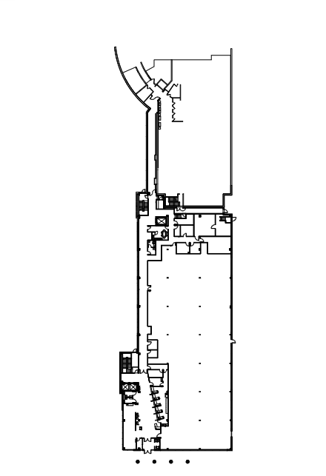
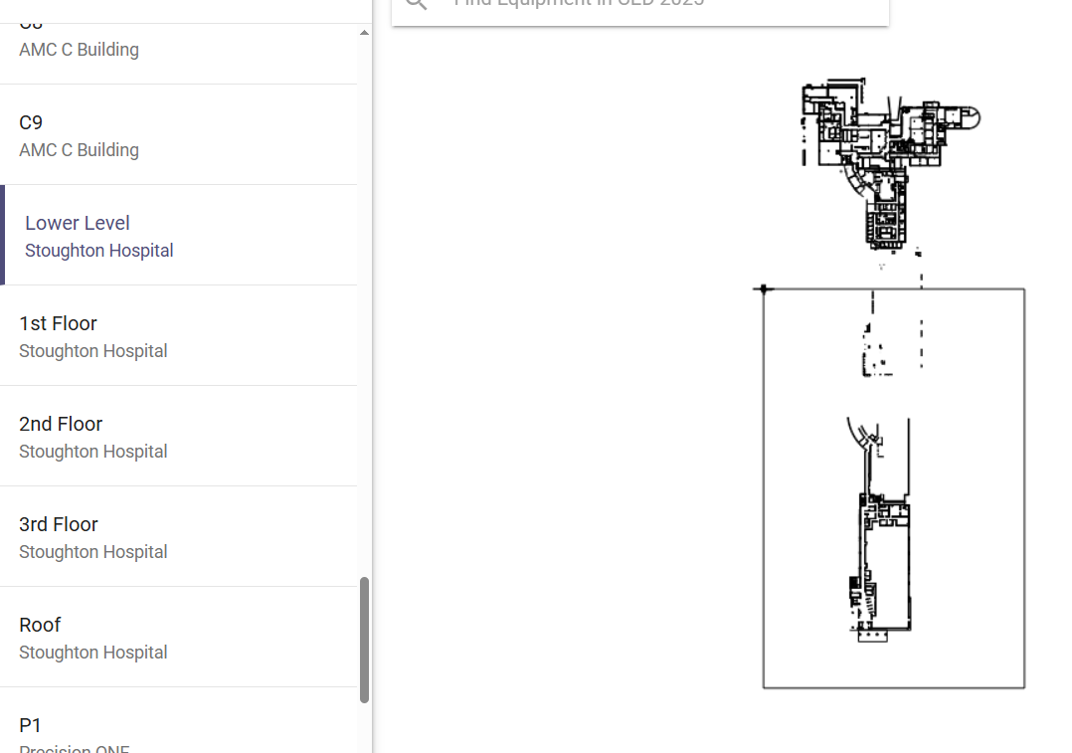
Measures:
STUDY
Include graphs of your measurement, results of surveys, etc. Include benchmarks or comparative data when available.
Issues with drawing
Cleaned up version of
drawing

Slide 63
Findings:
ACT
Results: Did you accomplish your goals?
Project is underway
Lessons Learned: What did you learn as a result of this project? Unexpected discoveries? Problems or barriers?
Having correct CAD drawings from EUA would have simplified this process. I have a CAD program to view but do not have the ability to edit or clean up the drawing. Relying on other professionals to complete the task at hand became problematic.
Next Steps: What actions are you going to take based on your findings? (e.g. roll out to additional units; modify and make additional improvements; abandon the effort; change course?) Who is responsible? When is action due?
Action 1: Add fire extinguishers-Create PM Assigned to: Rob Maurer Due By: 6-1-25 Action 2: Assigned to: Due By: Action 3: Assigned to: Due By:
Project Leader is Recommending the Following:
QM Council approval for completion of project?: Enter YES or NO Project still in progress, project to continue: Enter YES or NO

Slide 64
Medical Imaging
New Employee On-boarding
1st Presentation Date: 4/22/2025
Document Last Presented:4/22/2025

Slide 65
Quality Story:
PLAN
New Employee On-boarding
Goal(s): What are you trying to accomplish?
KOM Target: Review and Improve New Employee Onboarding by 7/15/2025. (5 phases to completion) Current KOM Status: NEW project – Initiate Phase 1
Background: Explain what the original situation was. Why was a change recommended? (e.g. variation, poor outcome, etc.)
Onboarding plays a crucial role in employee retention. A strong onboarding program sets a positive first impression, smooth transition for new staff, familiarization with processes, resources and the culture of the organization. This leads to staff feeling valued and correlates with lower turnover rates.
Driver: Explain why the project is critical to SH. Why does it relate to the strategic plan?
New employee retention is tied to proper onboarding and training. Having a standardized onboarding process can increase retention as well as satisfaction in the workplace. This supports our People standard at Stoughton Health.
Team:
Project Leader: Sara Sturmer Members: Medical Imaging Staff

Slide 66
Changes:
List the changes that have been made leading to improvements that occurred in the last 60 days.
DO
What? | Why? | When?
Collect existing documents for review. | Initiate review to identify opportunities | April 2025

Slide 67
Measures:
STUDY
Include graphs of your measurement, results of surveys, etc. Include benchmarks or comparative data when available.
Phase 1
Review and update existing New Employee Checklists
Validate checklists available for each location, job description, and for contracted agency.
Phase 2
Review and update existing Orientation Training Checklist by job description. Clarify instructions and condense, if necessary.
Phase 5
Share on-boarding process with employees and implement consistency with new employees.
Phase 3
Phase 4
Update existing New Employee Welcome Letter to include 1st week employment schedule and future training expectations.
Provide to new employee Friday prior to orientation and email HR copy.
Improve Orientation Binder with updated forms, relevant documents including those above for training new employee.
Involve new and past employees in review of items on checklist to ensure understanding and accuracy.

Slide 68
Findings:
ACT
Results: Did you accomplish your goals?
New project, just getting started.
Lessons Learned: What did you learn as a result of this project? Unexpected discoveries? Problems or barriers?
We have a system that needs a little tweaking to improve organization and clarity.
Next Steps: What actions are you going to take in the next 60 days ?
Action: | Assigned To: | Due Date:
Review checklist | Sara | 5/1/2025
Project Leader is Recommending the Following:
QM Council approval for completion of project?: Enter YES or NO Project still in progress, project to continue: Enter YES or NO

Slide 69
Registration Onboarding
1st Presentation Date: August 27, 2024
Document Last Presented: April 22, 2025

Slide 70
Quality Story:
PLAN
Goal(s): What are you trying to accomplish?
KOM Target: Improvement of Onboarding Process Current KOM Status: 100% Complete
Background: Explain what the original situation was. Why was a change recommended? (e.g. variation, poor outcome, etc.)
All departments were asked to evaluate our onboarding processes. Our hospital-wide turnover of new employees for June 2024 was 32.76% and July was 38.18%.
Driver: Explain why the project is critical to SH. Why does it relate to the strategic plan?
Onboarding can play an important role in retaining new hires. A formal onboarding process helps set up your employees for success. It should include orientation, any necessary materials, meetings with stakeholders, shadowing and training, and an ongoing mentorship. We added a new position to the Revenue Cycle to specifically focus on onboarding and project management.
Team:
Project Leader: Sarah Watkins, Beverly Pope Members: Susie Wendt

Slide 71
Changes:
DO
List the changes that have been made leading to improvements.
What? | Why? | When?
Continued Meetings With Registration Coordinator | To keep this project moving and have input, review documents, etc. | Will continue after leave
Work with Registration on tasks training/updates | Verify staff understand their assigned tasks | February 2025
Completed OneNote update | Payer information is complete as this is the most challenging portion of Registration for new employees | April 2025
Monitoring and Checklist usage | To stay consistent and verify all staff know expectations of work and tasks | April 2025

Slide 72
Measures:
STUDY
Action Item | Completion | To Be Completed
Initiation | Completed | 9/30/2024
Planning | Completed | 02/07/2024
Execution | Completed | 02/28/2025
Monitor and Controlling | Completed | 04/01/2025
Closure | Completed | 04/22/2025

Slide 73
Findings:
ACT
Results: Did you accomplish your goals?
Yes we have accomplished our goals.
Lessons Learned: What did you learn as a result of this project? Unexpected discoveries? Problems or barriers?
We want to build a process that can be replicated across departments. Having strong training tools is important to the success of new staff.
Next Steps: What actions are you going to take based on your findings? (e.g. roll out to additional units; modify and make additional improvements; abandon the effort; change course?)
Continue to monitor tasks Continue to request feedback when new hires start Hardwire process and review yearly for updates or changes needed, starting January 2026
Project Leader is Recommending the Following:
QM Council approval for completion of project?: Yes Project still in progress, project to continue: No

Slide 74
Registration
Ortho Surgery Scheduling
1st Presentation Date: 02/25/2025
Document Last Presented: 04/22/2025

Slide 75
Quality Story:
PLAN
Ortho Surgery Scheduling
Goal(s): What are you trying to accomplish?
Our goal is to transition the scheduling of appointments that accompany an orthopedic surgical procedure from the Ortho nurse to the scheduling team. KOM Target: Implementation of Scheduling Appointments following Surgical Scheduling. Current KOM Status: Planning of the project (Step 2/5)
Background: Explain what the original situation was. Why was a change recommended? (e.g. variation, poor outcome, etc.)
Currently the Ortho Nurse schedules approximately 4 appointments with every surgical case. We have 440 Orthopedic surgical cases budgeted for 2025, this means in today’s flow Kristin is scheduling roughly 1760 appointments.
Driver: Explain why the project is critical to SH. Why does it relate to the strategic plan?
To give more time back to the Orthopedic nurse to focus on patient care and support the clinic. There is also an opportunity to schedule additional visits, like therapy visits at the time of the initial scheduling, thus reducing touches.
Team:
Project Leader: Jennifer Bothum Members: Kristin Brickl, Nic Kvamme, Jo Deen Hettenbach, Sarah Watkins

Slide 76
Changes:
DO
What? | Why? | When?
Ortho schedule meetings | To prepare for SHOC transition/opening | February
Provider Template updates | Schedule efficiency | March
Project Meeting - Scheduling Coordinator & Ortho Nurse & Scheduler | Gather scheduling protocols by procedure | March/April
Protocol Grid Creation | RN uses smart phrases in EPIC, transferring to Excel for Scheduling Reference | April

Slide 77
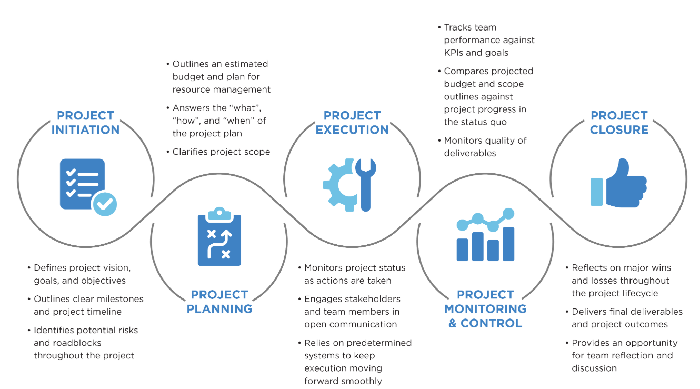
Measures:
STUDY

Slide 78
Findings:
ACT
Results: Did you accomplish your goals?
No, it’s a work in progress
Lessons Learned: What did you learn as a result of this project? Unexpected discoveries? Problems or barriers?
Probably should have settled into SHOC first before tackling this project RN has a lot of information and knowledge in her head
Next Steps: What actions are you going to take in the next 60 days ?
Action: | Assigned To: | Due Date:
Documenting all scheduling protocols in grid | Jennifer | July 15, 2025
Ensure there is documented protocols for the most common procedures | Jennifer | July 15, 2025
Training and documenting flows | Jennifer | August 15, 2025
Project Leader is Recommending the Following:
QM Council approval for completion of project?: No Project still in progress, project to continue: Yes

Slide 79
HIM
New Employee Onboarding
1st Presentation Date: 2/25/2025
Document Last Presented: 4/22/2025

Slide 80
Quality Story:
PLAN
New Employee Onboarding
Goal(s): What are you trying to accomplish?
KOM Target: Improving the onboarding process Current KOM Status: Step 3/5 -Execution
Background: Explain what the original situation was. Why was a change recommended? (e.g. variation, poor outcome, etc.)
All departments were asked to evaluate our onboarding process. The hospital-wide turnover for new employees in January 2025 was 13.61%
Driver: Explain why the project is critical to SH. Why does it relate to the strategic plan?
Onboarding can play an important role in retaining new hires. A formal onboarding process helps set up your employees for success. It should include orientation, any necessary materials, meetings with stakeholders, shadowing and training, and an ongoing mentorship. We added a new position to the Revenue Cycle to specifically focus on onboarding.
Team:
Project Leader: Sarah Watkins, Victoria Valdez Members: Bev Pope

Slide 81
Changes:
DO
What? | Why? | When?
Revenue Cycle Position: Project and Onboarding Analyst | To have someone on the team to focus on the various projects and onboarding of all new revenue cycle employees | July 2024
Recurrent Meetings with Bev | To coordinate training schedules for our new employees | Ongoing
Created/shared first 3 week schedule template | To coordinate with Bev and make scheduling easier and consistent | Finalized 3/28
Met with staff | For onboarding feedback

Slide 82
Measures:
STUDY
Action Item | Completion | Completed
Initiation | Completed | January 2025
Planning | Completed | 3/4/2025
Execution | In process
Monitor and Control
Closure

Slide 83
Findings:
ACT
Results: Did you accomplish your goals?
No
Lessons Learned: What did you learn as a result of this project? Unexpected discoveries? Problems or barriers?
When we do this on the fly, things fall through the cracks. Planning ensures consistent training and that nothing is missed. Staff retiring do not always make the best trainers, but we can use them to offset inventory while onboarding occurs. Building structure in the department
Next Steps: What actions are you going to take based on your findings? (e.g. roll out to additional units; modify and make additional improvements; abandon the effort; change course?)
Victoria will execute coder onboarding plan with new hire, 4/14/25 Victoria will review and update training documents if necessary, 4/14/25 Victoria and new coder will update training schedule if necessary, 4/18/25 Victoria will do a 30 day check in with new coder to see what worked and what didn’t, 5/14/25 Plan for closure next round in June, 6/26/25!
Project Leader is Recommending the Following:
QM Council approval for completion of project?: No Project still in progress, project to continue: Yes

Slide 84
HIM
HIM Department Coding Policy Review
1st Presentation Date: 2/25/2025
Document Last Presented: 4/22/2025

Slide 85
Quality Story:
PLAN
HIM Department Coding Policy and Procedures
Goal(s): What are you trying to accomplish?
KOM Target: Completion of coding policy reviews and updates Current KOM Status: 15% completion
Background: Explain what the original situation was. Why was a change recommended? (e.g. variation, poor outcome, etc.)
Coding department policies did not have a schedule for reviews/updates. This project will get them current and moved into the policy and procedure manual in SharePoint. This will keep everyone on the same page to ensure consistency, have policies reviewed annually, and keep current with coding and workflow updates.
Driver: Explain why the project is critical to SH. Why does it relate to the strategic plan?
There isn’t a schedule keeping coding policies on an annual review schedule to be compliant.
Team:
Project Leader: Victoria Valdez Members: Coding Department

Slide 86
Changes:
DO
What? | Why? | When?
Gathering policies | Understanding of the work that needs to be done-so I can measure progress | January-present
Met with Addy | To learn the P&P publishing process | 3/11/2025
Review and draft policies UC/ED facility P&P drafted Day surgery | To ensure they are current and compliant | Began in March
Complete policy list to be created | To determine KOM %

Slide 87
Measures:
STUDY
Department Policy | Reviewed | Drafted | Published
UC/ED Facility Leveling | Yes | Yes | No
Clinic Facility E/M | Yes | Yes | No
Ortho Clinic
Outpatient Diagnostic
Cardiology
Podiatry/Wound Clinic
General Surgery
Series Accounts
Day Surgery | Yes | Yes | No
Observation
CAH-IP | In process
Urology
Accounts in Waiting
Failed Simple Visits
Combined Accounts
Claim Edits
Cancer Registry
Retail Services
Labs not meeting medical necessity
Denials

Slide 88
Findings:
ACT
Results: Did you accomplish your goals?
No
Lessons Learned: What did you learn as a result of this project? Unexpected discoveries? Problems or barriers?
I have learned the process of drafting and publishing a P&P!
Next Steps: What actions are you going to take based on your findings? (e.g. roll out to additional units; modify and make additional improvements; abandon the effort; change course?)
Victoria and team will continue reviewing and drafting policies, 6/26/25 Victoria will begin publishing policies, 5/31/25 Victoria will use published policies for training new staff
Project Leader is Recommending the Following:
QM Council approval for completion of project?: No Project still in progress, project to continue: Yes

Slide 89
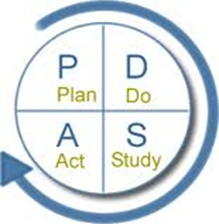
Epic Contract Building
A tool used to document and communicate
Performance Improvement Projects
1st Presentation Date: 06/28/2022
Document Last Presented: 04/22/2025

Slide 90
Quality Story: Contract Building
Goal(s):
What goal are you trying to accomplish?
To build contracts in Epic for our contracted insurance payers
KOM Target: Complete Epic Build of All Contracted Insurance Payers
Current KOM Status (02/25/2025): Total of 31 Insurance Plans
31 in Production
P
L
A
N
Background:
Explain what the original situation was. Why was a change recommended? (e.g. variation, poor outcome, etc.)
Previous to the Epic Instance Merge in 2018, we had a number of our contracts built in Epic to track reimbursement. We have struggled to get contracts built in the new instance and need to make this a priority.
Driver:
Explain why the project is critical to SH. How does it relate to the strategic plan?
The purpose of building contracts in Epic is two-fold. First, the contract module compares the actual reimbursement to the expected reimbursement according to that contract’s terms.
Second, Epic allows us to model any changes during contract negotiations. We can estimate the effect on reimbursement and negotiate terms effectively.
Team:
Project Champion: Sarah Watkins
Project Leader: Beverly Pope
Members: Beverly Pope, Mary Erdman

Slide 91
Changes:
List the changes that have been made leading to improvements.
D
O
What? | Why? | When?
Weekly meetings for building | Continue forward progress on other contracts | Ongoing
Ticket entered for Variance WQ still pending | Accounts for a contract that is not active yet are falling into the WQ incorrectly. | Ongoing
Bi-monthly auditing | Verify contract build is accurate | Ongoing
Tracking of variance reimbursement | Tracking totals of reimbursement when not paid according to contract | Ongoing
Change in workflow of working variances | Mary is familiar with the contracts and has access to the language | March 2024
Completed Medicare Build | Reached first goal set, now moving to Medicare | April 2024
Notes:
New link for new vendor

Slide 92
Measures:
S
T
U
D
Y
Current Contracts
Aetna
Anthem Wisconsin (BCBS)
Dean/Medica
Dean/Medica (McFarland
and Cottage Grove UC)
Cigna
Group Health
Humana
Medicare
Medicare Advantage Plans
Quartz
Security Health
Trilogy
UHC
UHC Medicare
United Healthcare
WPS
Contracts are Completed!

Slide 93
Findings:
Results:
Did you accomplish your goals?
Yes, we have completed our build of contracts
A
C
T
Lessons Learned: What did you learn as a result of this project? Unexpected discoveries? Problems or barriers?
Stay the course
Slow and steady wins the race
Depending on people outside our organization is not always easy
Next Steps: What actions are you going to take based on your findings? (e.g. roll out to additional units, modify and make additional improvements; abandon the effort; change course)
Continue to track variances in production and follow up for correct reimbursement
Update contracts as needed for additions or changes and build new contracts when they are implemented
Use contract modeling for comparisons when negotiating terms with current payers
Project leader is recommending the following:
CI Council approval for completion of project: Yes
Project still in progress, project will continue: No

Slide 94
Patient Financial Services
Self-Administered Drugs Analysis
1st Presentation Date:4/22/2025
Document Last Presented:

Slide 95
Quality Story:
PLAN
Self-Administered Drugs Analysis
Goal(s): What are you trying to accomplish?
KOM Target: Maximize Revenue when billing Self-Administered Drugs Current KOM Status: Review 25% Complete
Background: Explain what the original situation was. Why was a change recommended? (e.g. variation, poor outcome, etc.)
Self-administered drugs are defined as medications that can be prescribed by a provider and taken at home. These are billed under Revenue Code 637 when acquired for and given to the patient while at Stoughton Health. Payers typically do not cover these charges, so we write them off.
Driver: Explain why the project is critical to SH. Why does it relate to the strategic plan?
Some of these drugs can be expensive, so it’s a good opportunity to review to ensure most appropriate coding/billing. Also, billing rules and industry standards are ever changing.
Team:
Project Leader: Jordan Sweeney Members: Billing Department, Pauline Cass, Sarah Watkins

Slide 96
Changes:
List the changes that have been made leading to improvements that occurred in the last 60 days.
DO
What? | Why? | When?
Pulled a report of all self-administered drugs written off in FY2024. | Gather information/volume/cost | 12/2024
Met with mentor and Pharmacy Manager, Pauline Cass. | Mentor through emerging leaders and data analysis | Monthly
Met with Sarah Watkins | Review findings | Monthly
Research | Reviewing payer policies, reaching out to affiliates | February-March
Consulted with PARA | Revenue Cycle consultants to assist with research | March
Identified opportunity with cataract eyedrops | Qualify for billing with revenue code 250 | March

Slide 97
Measures:
STUDY
Data Analysis
463 unique medications
120 lines reviewed
26% Complete
Revenue Opportunities
120 lines reviewed
1 opportunity identified

Slide 98
Findings:
ACT
Results: Did you accomplish your goals?
No, I have not completed my goal.
Lessons Learned: What did you learn as a result of this project? Unexpected discoveries? Problems or barriers?
Payer policies and industry standards are ever changing The same medication can be billed a number of ways (dosage/method of admin)
Next Steps: What actions are you going to take in the next 60 days ?
Action: | Assigned To: | Due Date:
Data analysis completion | Jordan | May 15, 2025
Epic ticket on updating billing codes for opportunity identified | Jordan | April 16, 2025
Additional tickets as needed | Jordan | May 31, 2025
Audit claims once ticket is worked | Jordan | June-July 2025
Project Leader is Recommending the Following:
QM Council approval for completion of project?: NO Project still in progress, project to continue: YES

Slide 99
Anesthesia
Controlled Substance Documentation
1st Presentation Date: June 25, 2024
Document Last Presented: April 22, 2025

Slide 100
Quality Story:
PLAN
Controlled Substance Documentation
Goal(s): What are you trying to accomplish?
KOM Target: 0-1 Waste discrepancies per month and maintained for a minimum of 6 months to ensure hardwiring 0 Administration Discrepancies per month and maintained for a minimum of 6 months to ensure hardwiring Current KOM Status: Waste Discrepancies Unmet: (see graphs) for past 3 months have been 1-2 Administration Discrepancies Met: 0 for past 6 months
Background: Explain what the original situation was. Why was a change recommended? (e.g. variation, poor outcome, etc.)
Organizations using controlled substances must have policies and procedures in place for disposing of these substances and to avoid potential drug diversion as well as environmental pollution. Facilities must maintain adequate and detailed records, but individual healthcare systems impose their own specific requirements. Some, for example, require drug disposal to be witnessed. However, recordkeeping systems must be robust and frequently audited to prevent diversion. Navigating this system can be complex, and since all regulations are subject to change, it requires vigilance and expertise.
Driver: Explain why the project is critical to SH. Why does it relate to the strategic plan?
Quality/Safety and Financial: The consequences of poor or lax monitoring can be significant. In addition to risk of patient and employee harm, fines of up to $10,000 per violation can be levied against facilities that are judged to have lapses in accountability.
Team:
Project Leader: Amy Hermes and Deb Dahlke Members: CRNA Team

Slide 101
Changes:
DO
List the changes that have been made leading to improvements.
What? | Why? | When?
Lead CRNA working on policies with Pharmacy Manager for department related to waste documentation. | To have defined practice expectations. | July 2024
Meeting held with CRNAs and Pharmacy to further discuss workflows. | Brainstorming solutions. Concept of “end of case” time out to help with documentation of waste. | July 2024
2 CRNAs have worked at SSM where they have had Epic alerts reminding them, they still had waste to document. | Looking into this option for Stoughton to help with human factor of forgetting. | July 2024
Have been made aware that Epic Alerts for this aware are not possible. | Not allowable for affiliate organizations. | September 2024
Increased communication with OR RN Charge for wastes. | OR RN Charges can assist as a witness for the wastes. | September 2024
Ascom phones approved for purchase. | Improved communication between all OR team members. | October 2024
Ascom phones arrived in December but have not yet been implemented. | IT aware, unsure of implementation date. | TBD by IT.

Slide 102
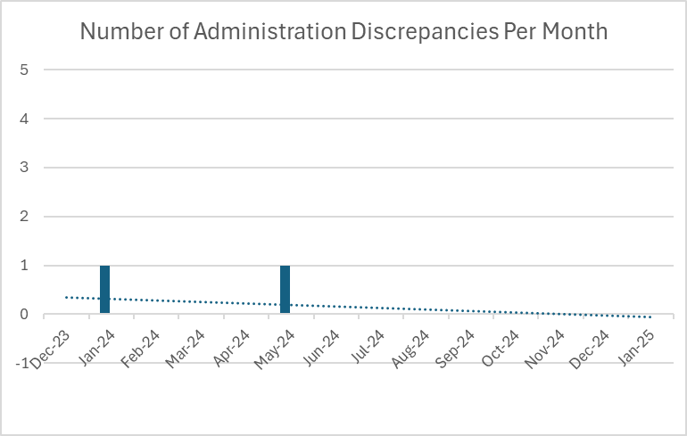
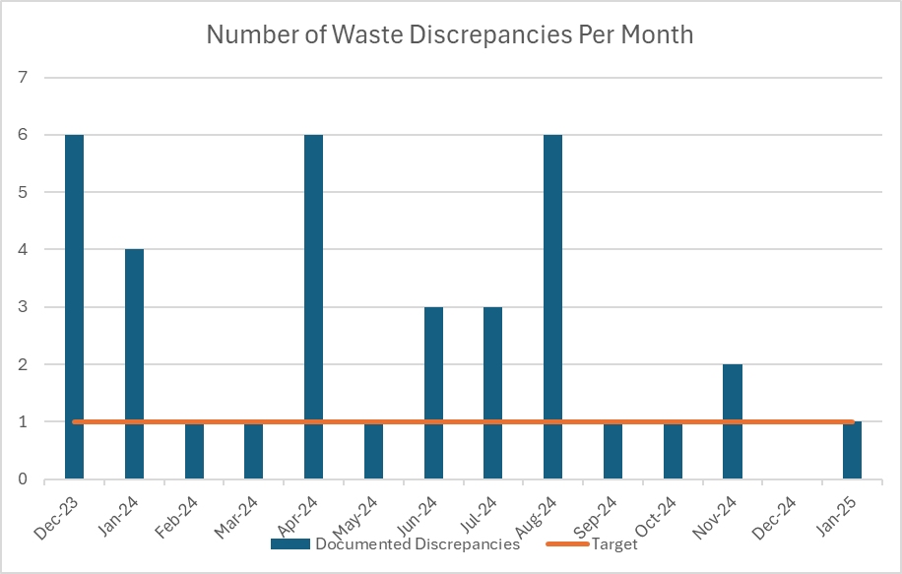
Measures:
STUDY
Include graphs of your measurement, results of surveys, etc. Include benchmarks or comparative data when available.

Slide 103
Findings:
ACT
Results: Did you accomplish your goals?
Met goal for both Administration Discrepancies and Waste Discrepancies.
Lessons Learned: What did you learn as a result of this project? Unexpected discoveries? Problems or barriers?
.
Next Steps: What actions are you going to take based on your findings? (e.g. roll out to additional units; modify and make additional improvements; abandon the effort; change course?)
Project Leader is Recommending the Following:
QM Council approval for completion of project?: YES. We are monitoring inventory discrepancies which may become a future QM project for next cycle. Project still in progress, project to continue: NO, but will continue to monitor monthly as we do all areas to ensure improvement is maintained.

Slide 104
Stoughton Health Leadership Team
DVC Score-Satisfaction Domain
1st Presentation Date: June 25, 2024
Document Last Presented: April 22, 2025

Slide 105
Quality Story:
PLAN
DVC Score – Satisfaction Domain
Goal(s): What are you trying to accomplish?
KOM Target: Satisfaction Domain Max Performance Score 20% Current KOM Status: November DVC Scorecard (timeframe 01/01/2023 – 12/31/2023) currently at 17.5%
Background: Explain what the original situation was. Why was a change recommended? (e.g. variation, poor outcome, etc.)
The Dean Value-based Contract (DVC) is a written contractual arrangement in which the payment for health care goods and services is tied to predetermined, mutually agreed upon terms that are based on clinical circumstances, patient outcomes, and other specified measures of the appropriateness and effectiveness of the services rendered. It identifies a set of outcomes, mutually recognized by payors and specifies a formula that determines the net price to be reimbursed for goods and services rendered. The measures being monitored are Quality (various infection rates), Satisfaction ( rank your hospital high, provider and nurse communication, discharge instructions), Efficiency (30day readmissions, 1 day hospital stays.
Driver: Explain why the project is critical to SH. Why does it relate to the strategic plan?
The drivers for this QM is overall achieving the patient satisfaction and loyalty evident by the HCAHPs score. Given reimbursement from Dean tied to the patient satisfaction measures under the Satisfaction Domain, the other driver of this QM is financial. We want to be able to achieve high satisfaction/loyalty along with receiving the highest rate for performance.
Team:
Project Leader: Amy Hermes Members: Patient Care Leader Team (Heather Kleinbrook, Pauline Cass, Dr. Menet, Jen Wagner, others as identified)

Slide 106
Changes:
DO
List the changes that have been made leading to improvements.
What? | Why? | When?
Monthly meetings scheduled to focus on Discharge Information | This is our consistently lowest score which needs to be focused on. | March 2025. This meeting had very limited attendance due to high patient care demands.
Responsiveness of hospital staff | This question was noted to be lower in February. Although not part of this QM, Amy will be following up on the questions that roll up under this section to report off at next HCAPS meeting. | April 2025
Patient Concierges are rounding daily and providing feedback to Inpatient Services Manager. | Allows for follow up in real-time. Most comments have been very positive. | Ongoing
Quarterly meeting with Patient Concierges to discuss process and scripting. | Meeting held. The Patient Concierges comfortable with the process and enjoying the interaction with the patients. | March 2025
Discharge Folders | These were rolled out on March 1. RNs involved in this process working on monitoring for staff compliance. | March 2025 and ongoing.
Follow Up Phone Calls | CM team is completing follow up phone calls on all inpatients, assessing perception of discharge process and thoughts for improvements. | March 2025 and ongoing.

Slide 107
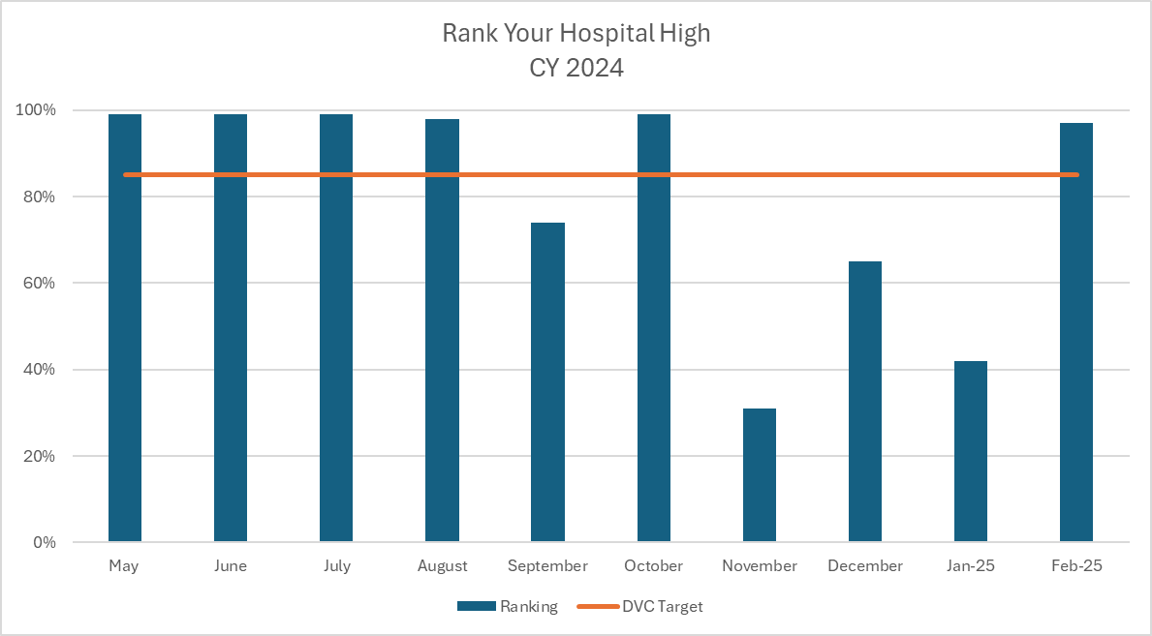
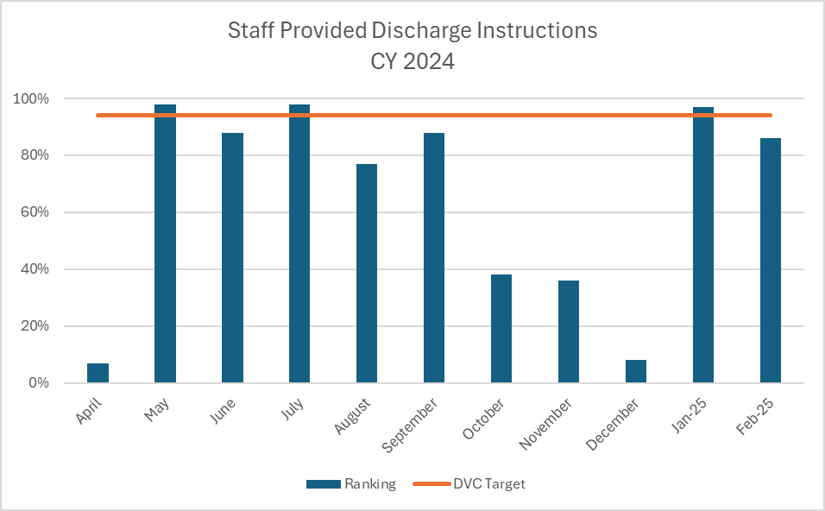
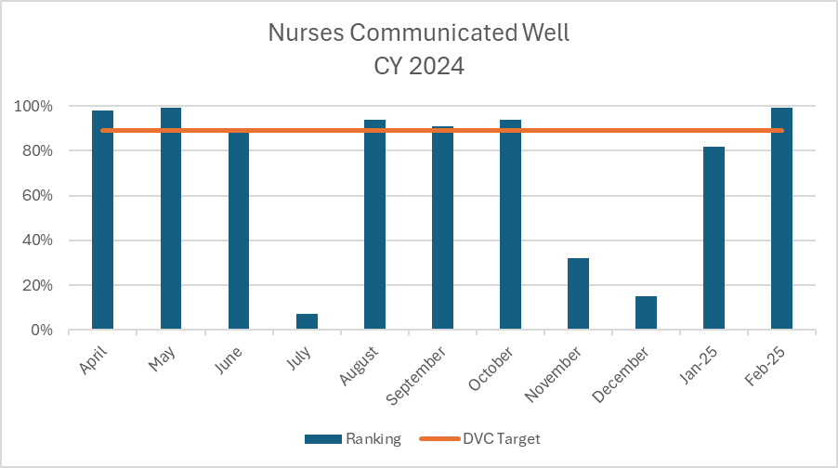
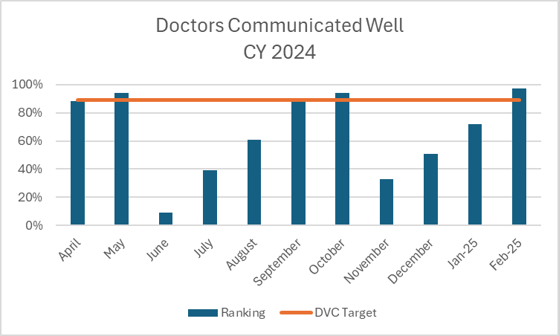
Measures: Graphs represent CY2024 and CY 2025
STUDY
Current DVC Ranking 97%
Goal 85%
Current DVC Ranking 86% Goal 94%
Current DVC Ranking 99%
Goal 89%
Current DVC Ranking 97% Goal 89%

Slide 108
Findings:
ACT
Results: Did you accomplish your goals?
Year end DVC Scorecard released in November: Satisfaction Domain was 17.5% out of a max of 20%. All areas achieved 5% except for Discharge Instructions which achieved 2.5%. We did see some positive improvements in our February scores.
Lessons Learned: What did you learn as a result of this project? Unexpected discoveries? Problems or barriers?
Patient Concierge rounding is going well, not only for the patients but also for the team doing the rounding. They are enjoying the patient interaction and seeing the value for doing this.
Next Steps: What actions are you going to take based on your findings? (e.g. roll out to additional units; modify and make additional improvements; abandon the effort; change course?)
Continue with concentrated efforts on Discharge Instructions. Will do a deeper dive into others that maybe lowering our overall rank your hospital high and work with Director of Engagement and Experience, PFAC and Customer Experience Team on ways to increase.
Project Leader is Recommending the Following:
QM Council approval for completion of project?: NO Project still in progress, project to continue: YES

