Slide 1

Finance Committee
April 18, 2025

Slide 2
Agenda
Review/Approve February 28, 2025 Finance Committee Meeting Minutes
March 2025 Financials
April Month-to-Date Gross Revenue Update
Capital Requests:
  Ultrasonic Washer
  Mako Robot
Debt Management Strategy
  Debt Summary as of March 31, 2025
  Recommendations
Community Health Needs Assessment Implementation Strategy Review and Approval
Open Discussion
Adjournment

Slide 3

Review and Approval of February 28, 2025 Finance Committee Meeting Minutes
Request Motion to Approve February 28, 2025 Finance Committee Meeting Minutes.

Slide 4
March 2025 Financials
Operating Income
$1,391,701
Balance Sheet Metrics
Revenues
Expense Variances
Request Motion to Approve March 2025 Financials.

Slide 5
April
Month-to-Date
GROSS REVENUES Update

Slide 6
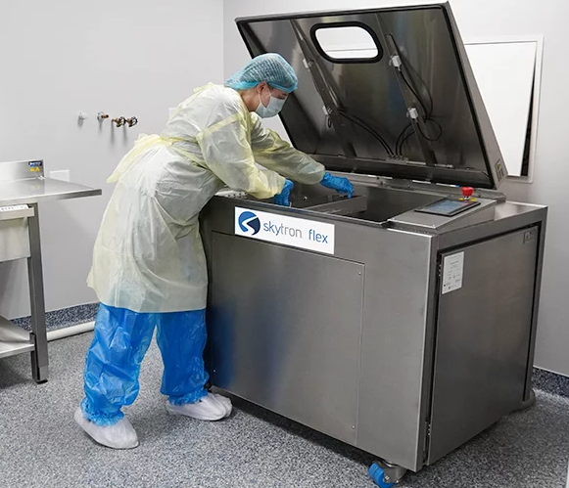
Capital Request: Skytron Flex Ultrasonic Washer Disinfector
With the upcoming implementation of robotics, the sterile processing department (SPD) will need to purchase a new ultrasonic washer disinfector that can effectively integrate with robotic systems for cleaning surgical instruments.
This surgical instrument washer-disinfector is versatile and can process large loads of cannulated, non-cannulated, and robotic instruments.
The need for an ultrasonic washer was carefully vetted with the SPD project team to confirm that there is adequate electrical and plumbing infrastructure to support the new equipment.
Request Motion to Recommend to the Executive Committee/Governing Board approval of FY2025 Capital for $110,740 for an Ultrasonic Washer.

Slide 7
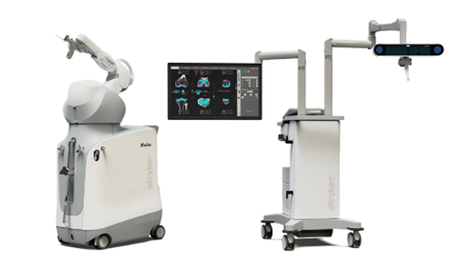
Capital Request: Stryker Mako SmartRobotics Robot
The Stryker Mako SmartRobotics system is a robotic-arm assisted surgery platform used in joint replacement procedures allowing surgeons to create personalized surgical plans based on 3D CT scans and guide the robotic arm during surgery for precise implant placement
The Mako system is expected to evolve further, with future applications such as the shoulder surgery module coming in 2026.
Key benefits of the Mako system include:
  Increased surgical precision and alignment accuracy.
  Faster recovery times and reduced postoperative pain compared to traditional methods.
  Minimally invasive procedures that reduce trauma to surrounding tissues.
  Recruit orthopedic surgeons who are accustomed to using the advanced technology.
  Attract individuals who view robotics as a cutting-edge advancement in healthcare.
Request Motion to Recommend Approval to the Governing Board to purchase a Mako Robotic System for $920,000 from the FY2025 Capital Budget.

Slide 8
Debt Summary – March 31, 2025

Slide 9
Retirement of 2015 Bonds at Interest Reset Date &
Prepayment - 2018 & 2023 Bonds
Effect on Days Cash on Hand = ~ 55 days

Slide 10
Recommended Motions
Motion to recommend to the Governing Board Approval of Resolution As Presented in Packet to Retire 2015 Bonds at Interest Reset Date – September 1, 2015
Motion to recommend to Governing Board Approval of Resolution as Presented for Prepayment of 2018 & 2023 Bonds at the amount allowed to be prepaid without penalty – prepayment date estimated to be June 17, 2025

Slide 11
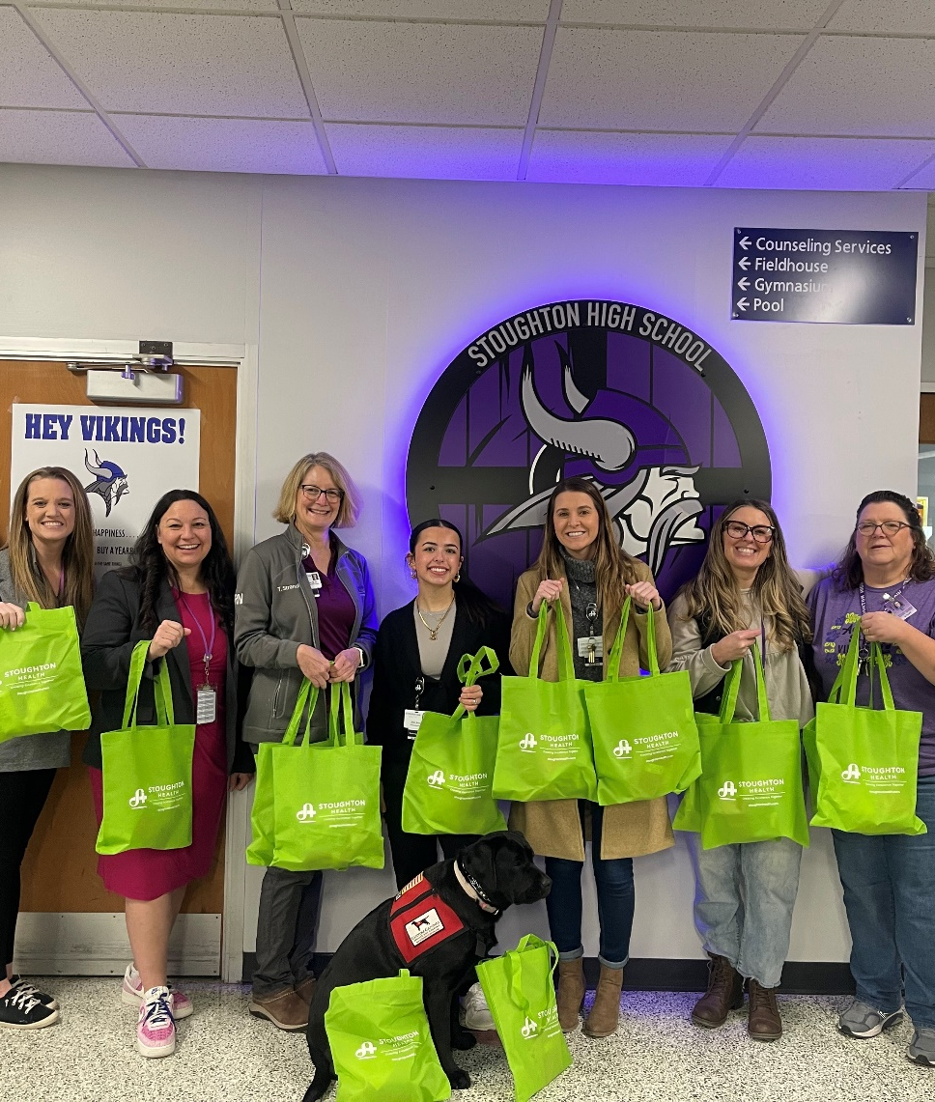
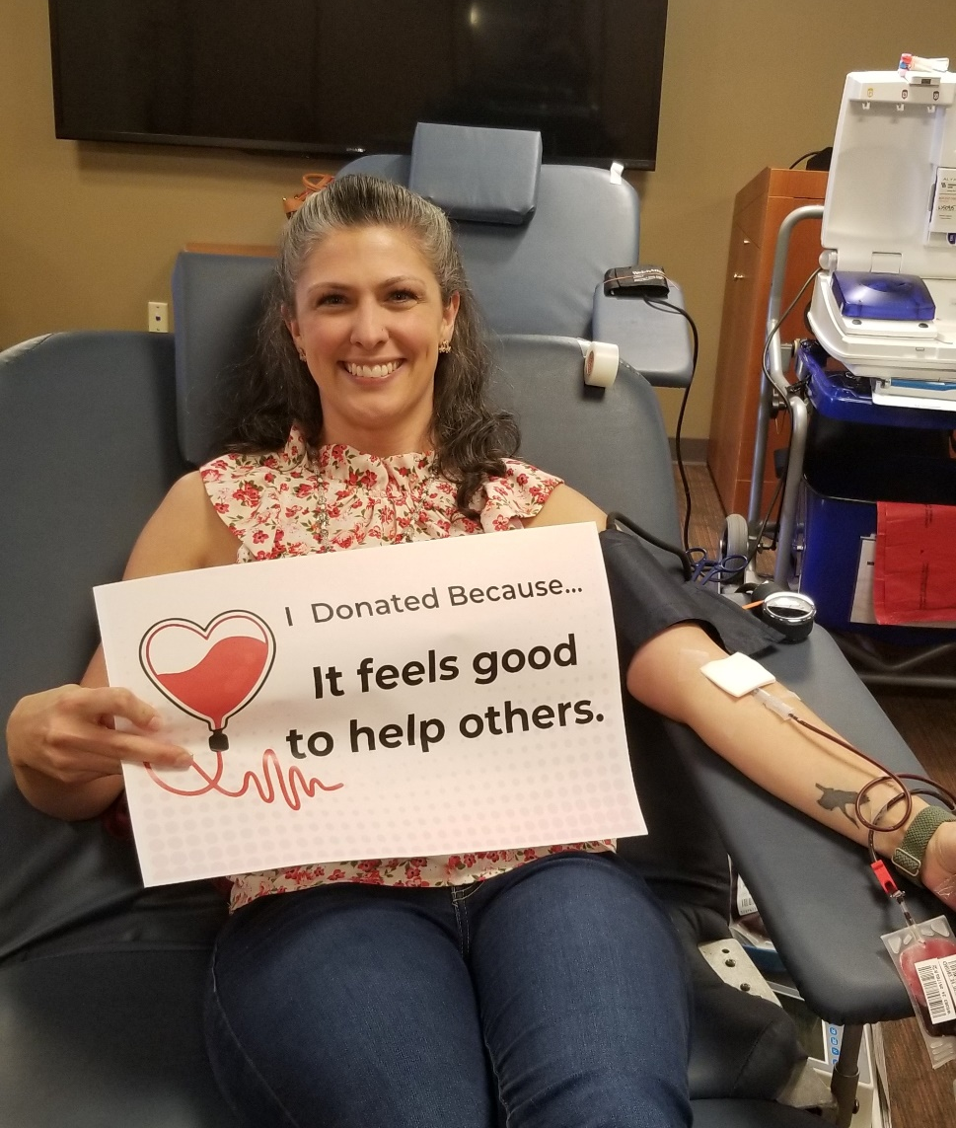
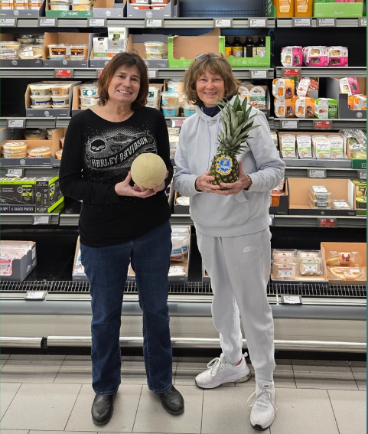
Community Health Needs Assessment Implementation Strategy
Laura MaYS

Slide 12
Why do a Community Health Needs Assessment(CHNA)?)?
Improve overall community health
Promote collaboration and partnerships to address top community health needs
Improve communication across health sectors
Reinforce a commitment that the people’s health is the hospital’s top priority
Required by the IRS

Slide 13

CHNA Requirements: Overview
Courtesy of SSM Healthcare, used with permission

Slide 14




Healthy Dane Partners

Slide 15
Key priorities identified
Chronic Conditions
Injury & Safety
Mental Health & Substance Use
Reproductive Justice

Slide 16
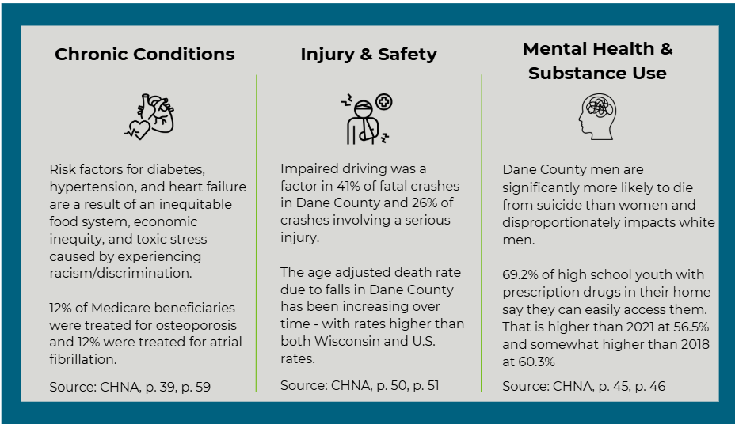
Stoughton Health Implementation Plan Priorities

Slide 17
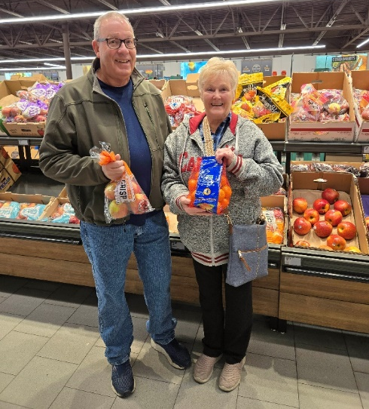
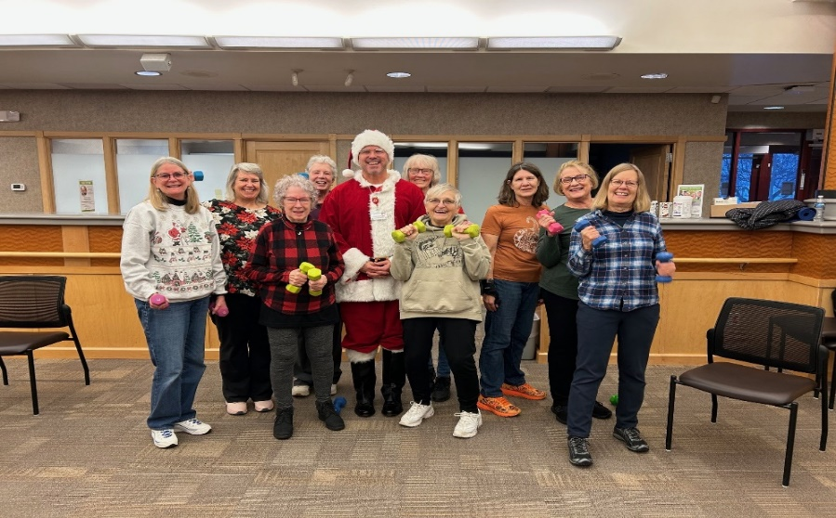
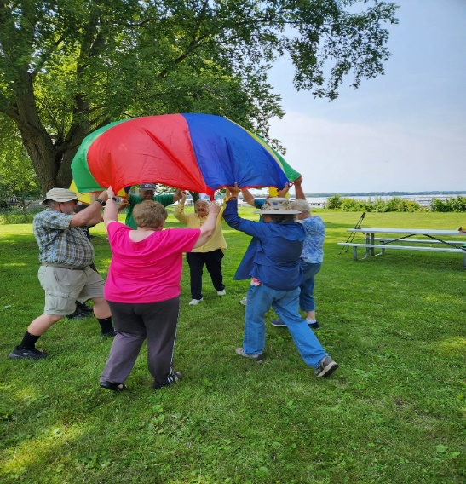
Chronic Conditions
Healthy Shopping
Goals:
Decrease in hospitalization rate for diabetes (Type 1&2) in Dane County to less than 11.5/10,000 population and decrease Stoughton zip code specific rates to less than 16.3/10,000 population. Source: HealthyDane.org
Decrease in hospitalization rate for heart failure in Dane County to less than 25.1/10,000 and decrease Stoughton zip code specific rates to less than 25.3/10,000 population. Source: HealthyDane.org
Healthy Shopping
Strong Bodies Exercise
Parkinson's Exercise class

Slide 18
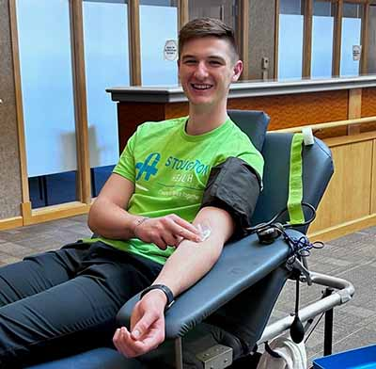
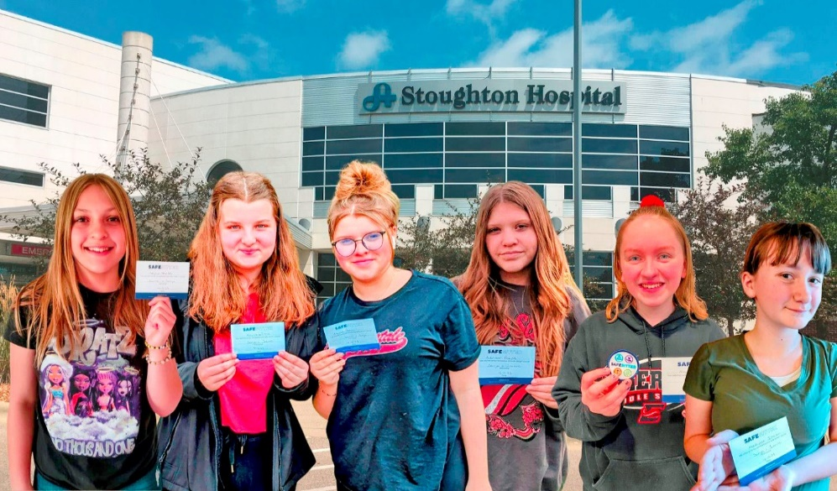
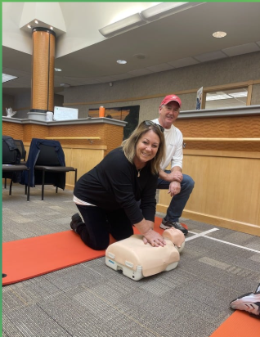
Injury & safety
Healthy Shopping
Goal:
Reduce the age-adjusted death rate due to unintentional injuries in Dane County to less than 70/100,000 population. Source: HealthyDane.org
Blood Drives
Safe Sitter Class
COCPR Class Participant

Slide 19
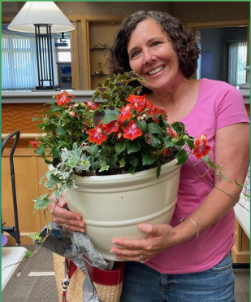
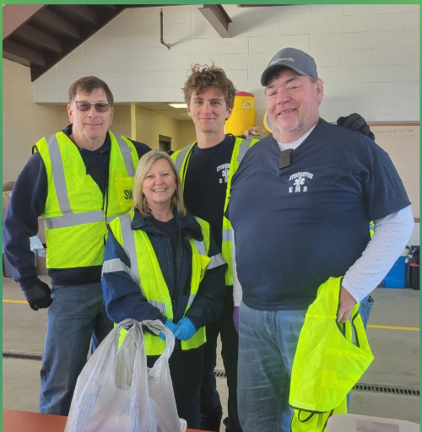
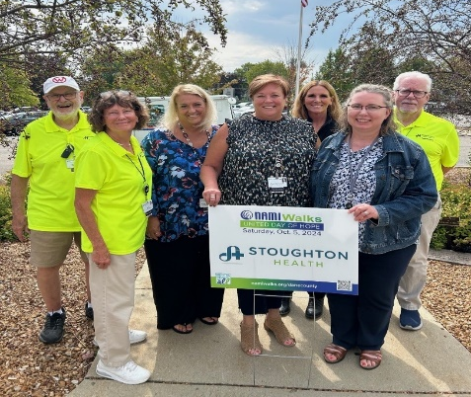
Mental Health & Substance Use
Mental Health & Substance Use
Goals:
Reduce 30-day alcohol use by 2% from 11% to 9%, by 9/1/26 in Stoughton High School youth in grades 9-12 as measured by the Youth Risk Behavior Survey and/or Dane County Youth Assessment data.
Reduce 30-day use of tobacco by 2%, from 8% to 6%, by 9/1/26 in 9-12 grades measured by Youth Risk Behavior Survey and/or Dane County Youth Assessment data.
Decrease the percentage of Medicare beneficiaries (65+) who are treated for depression to less than 17%. Source: HealthyDane.org
Gardening for Wellness
Sharps and Medication Drop
NAMI Walk

Slide 20
Community Partners – MORE THAN HEALTHCARE
Alzheimer’s Association Wisconsin Chapter
American Cancer Society
American Heart Association
Dane County Behavioral Health Services
Catholic Charities
Civic Organizations
Greater Wisconsin Agency on Aging Resources, Inc.
Journey Mental Health
Caring for our Community Committee
Local Area Businesses
Local Area Churches
Local Area EMS
Local Area Fire Departments
Local Area Libraries
Local Area Nursing Homes & Assisted Livings
Local Area Police Departments
Local Area Senior Centers
Local Area School Districts
Local Area Youth Centers
National Alliance of Mental Health of Dane County
Neighborhood Free Health Clinic
Ocean Hawk Counseling
Oregon Area Wellness Coalition
Oregon Mental Health
Oregon School District
Parish Nurses
SAFE Communities
Skaalen Retirement Services
Stoughton Area Resource Team (START)
Stoughton Hospital Foundation
Stoughton Wellness Coalition
Tellurian
The Partners of Stoughton Hospital
Wisconsin Institute on Healthy Aging

Slide 21
Community Health Needs Assessment Implementation Plan Approval
Request Motion to Recommend Approval of the Community Health Needs Assessment Implementation Plan to the Governing Board.

Slide 22

Open Discussion

Slide 23
Adjournment
Thank you for attending!

