Slide 1
Audit Compliance / Risk Management Committee
April 18, 2025

Slide 2
Agenda
Review/Approve February 28, 2025 Audit Compliance/Risk Management Committee Meeting Minutes
Discussion of Process Selection
FY2025 Audit, Tax & Cost Report Preparation Request for Proposal Process (RFP) Presentations
Eide Bailly LLP
Wipfli LLP
Discussion/Evaluation of Presentations/Selection of Audit Firm
Open Discussion
Adjournment

Slide 3
Review and Approval of February 28, 2025 Audit Compliance/Risk Management Committee Meeting Minutes
Request Motion to Approve February 28, 2025 Audit Compliance/Risk Management Committee Meeting Minutes.

Slide 4
Discussion of Process Selection
Firm Qualifications
Experienced at auditing NFP hospitals
Proposed Team Qualifications
Personnel are experienced with NFP Hospitals
Impact on Hospital Personnel
Minimal or no change in Hospital personnel efforts expected.
Has Medicare/Medicaid reimbursement experience with CAH’s
Firm size is appropriate in relation to audits to be performed.
Firm appears to understand nature of audit work to be performed.
Audit firm’s description of work to be performed demonstrates understanding of organization.
Personnel are experienced with CAH Hospitals.
Number of auditors that will be assigned to our audit is appropriate.
The outlined audit team ius appropriate (i.e. Partner, manager, etc.).
Firm will be able to meet timeframes outlined.
Firm has consulting capabilities appropriate to Hospital needs.
Has appropriate technology for transmitting information and making requests.
Suggested in-person versus remote time allocation is appropriate.
* Fees
Notes:
Two of the five firms’ fees were significantly higher than the other three and after review of the proposals didn’t appear to be providing any additional services to justify the higher fees, thus were eliminated from consideration. The final three firms were rated by both Michelle & Dacia separately and then scores on the following scoresheet were combined and EideBailly & Wipfli had the highest scores so were selected to present at the Audit Committee.

Slide 5
Eide Bailly LLP

Slide 6
Proposal for services
April 18, 2025

Slide 7
INTRODUCTIONS
Joe Splinter, Partner – Dubuque
Gwen Moser, Partner – Dubuque
Jared Heim, Partner – Dubuque

Slide 8
Proposal Highlights

Slide 9
Proposal Highlights
Healthcare Experience
+3,500 Healthcare clients
+500 CAH clients
+675 Medicare and Medicaid cost reports filed annually
Nonprofit Experience
+3,600 Nonprofit clients
Eide Bailly’s “Save our Charities” non-profit financial statement template selected by the AICPA for distribution as best practices

Slide 10
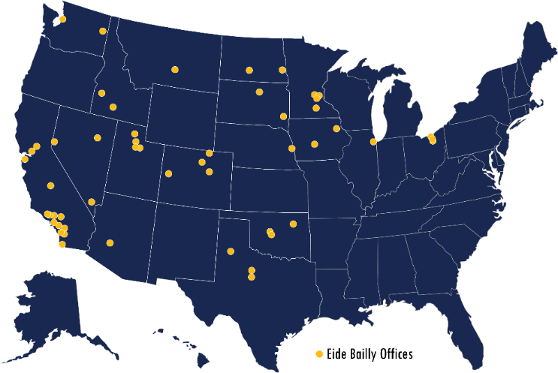
Proposal Highlights
Healthcare Team
+400 firm-wide professionals
Audit, reimbursement, tax, and consulting
Local and national presence
Firm involvement
HFMA
NRHA
AICPA Healthcare and
Nonprofit Expert Panels, etc.

Slide 11
Proposal Highlights
Firm Resources
Webinars
Business of Healthcare series
CAH series
RHC series
Accounting updates
Compliance matters
Conferences
EB CAH annual conference
Medicare Provider Enrollment Compliance annual conference
Others

Slide 12
Additional services / expertise
Provider enrollment
Physician compensation studies
Strategic financing / feasibility studies
Charge master reviews
Revenue cycle review
Business office operations
Medical record support
Technology and data analytics
Tax credits

Slide 13
Our continued commitment
Timely and quality service
Senior-level staffing and involvement throughout all phases of services
Add value to services
Fair and transparent fees
Ongoing communication
Connecting you to our resources

Slide 14
Thank you!

Slide 15
Wipfli LLP

Slide 16
Stoughton Health
Proposal for Services

Slide 17
Introductions
Overview
Firm Background
01
Our Approach
02
Your Investment
03
Client Service Team 04
Why Wipfli 05

Slide 18
Wipfli
Paul Traczek, CPA
Partner
Healthcare Practice
Introductions
David Goodman, CPA
Senior Manager Healthcare Practice

Slide 19
Firm Background
4

Slide 20
A Firm Dedicated to the Industry
Industry Expertise
In a healthcare environment of rapid change, you seek a business partner who knows the industry.
We want to be your business advisor and not just your audit, cost report, and tax services firm.
We continually look for opportunities and efficiencies that could enhance your operations, strengthen internal controls, and contribute to your success.
A resource throughout the year for honest, practice advice.
5

Slide 21
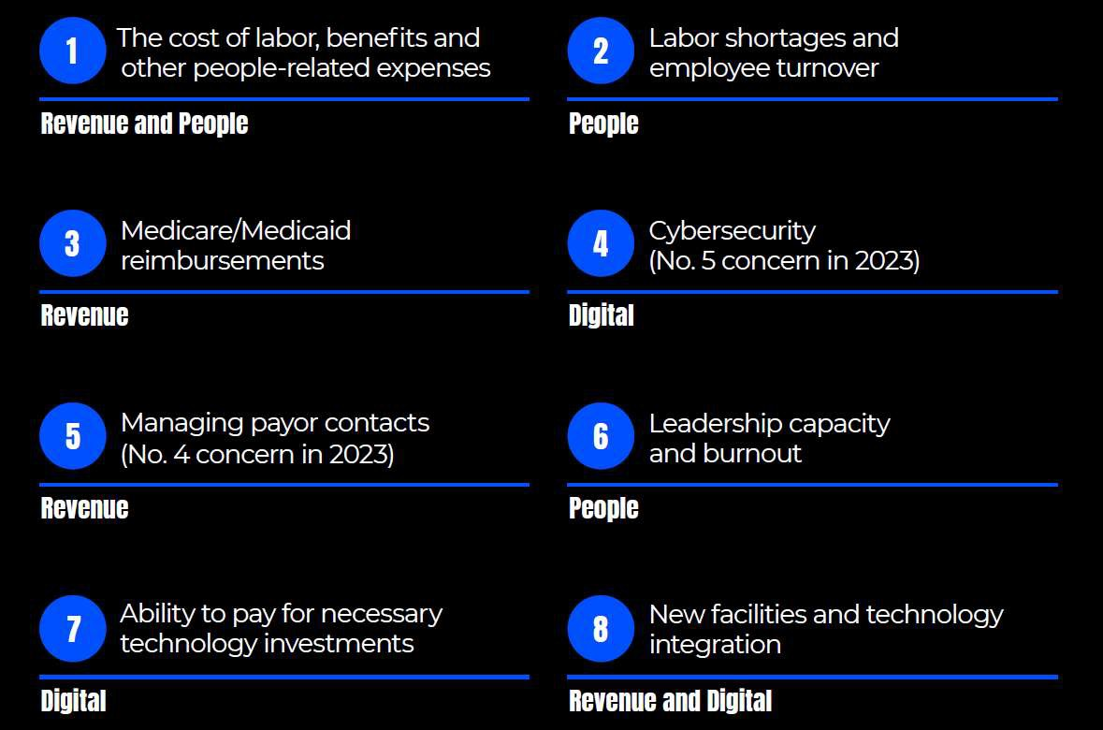
Top Challenges for Rural Healthcare Organizations

Slide 22
> 4,000 Healthcare clients served
530+ hospitals and health systems
1,540+ physician practices
1,040+ senior services providers
500+ foundations
During 2024, Wipfli provided audit, reimbursement, and/or tax services to approximately 50% of all Wisconsin hospitals, including approximately 70% of all Critical Access Hospitals.
Wipfli currently also provides audit and tax services to the Rural Wisconsin Health Cooperative and the Wisconsin Hospital Association, and your proposed audit and reimbursement service team provides CFO and Accounting Manager Roundtable Services to the RWHC member hospitals.
Healthcare by the Numbers

Slide 23
Need more from audit and accounting services than just sound reporting? Our team can deliver actionable insights by combining our technical know-how with business practicality for healthcare organizations.
Healthcare delivery is evolving. So are patient expectations.
Healthcare organizations need digital solutions that push patient care forward, while helping the organization satisfy regulatory compliance, manage risk, meet business demands and gain peace of mind.
Audit & Accounting
Digital Services & Cybersecurity Solutions
Solutions designed to reduce costs while enhancing patient experience, improving clinical outcomes, addressing healthcare inequities and prioritizing workforce well-being.
Healthcare Data & Analytics
Healthcare Services
Truly successful physician compensation plans move beyond mechanically dividing up a pool of money to recognizing and rewarding desired performance.
We analyze your data, people, technology, and procedures at the patient and organizational level.
Provide recommendations that deliver short-term positive impact and game plan for long-term market and industry changes.
Physician Compensation Design & Validation
Revenue Cycle Management
Seasoned experts help obtain full payment while staying within the boundaries of compliance so that the bottom line thrives.
Reimbursement & Provider Compliance
Capital & Facility Planning
Analyze, optimize, and implement capital and facility planning with strategic business decisions.
Address the "quadruple aim" from a strategic, service delivery, and operational perspective.

Slide 24
Healthcare associate experience
287
Certified public accountants
Strategy and operations executives
associates
Market and demand analysis specialists
Leadership and talent management consultants
Medicare/Medicaid reimbursement specialists
Facility development and implementation specialists
21
Healthcare digital strategists
Former hospital and health system executives
partners
Data analytics specialists
Strategic financial planners
9
June 2024

Slide 25
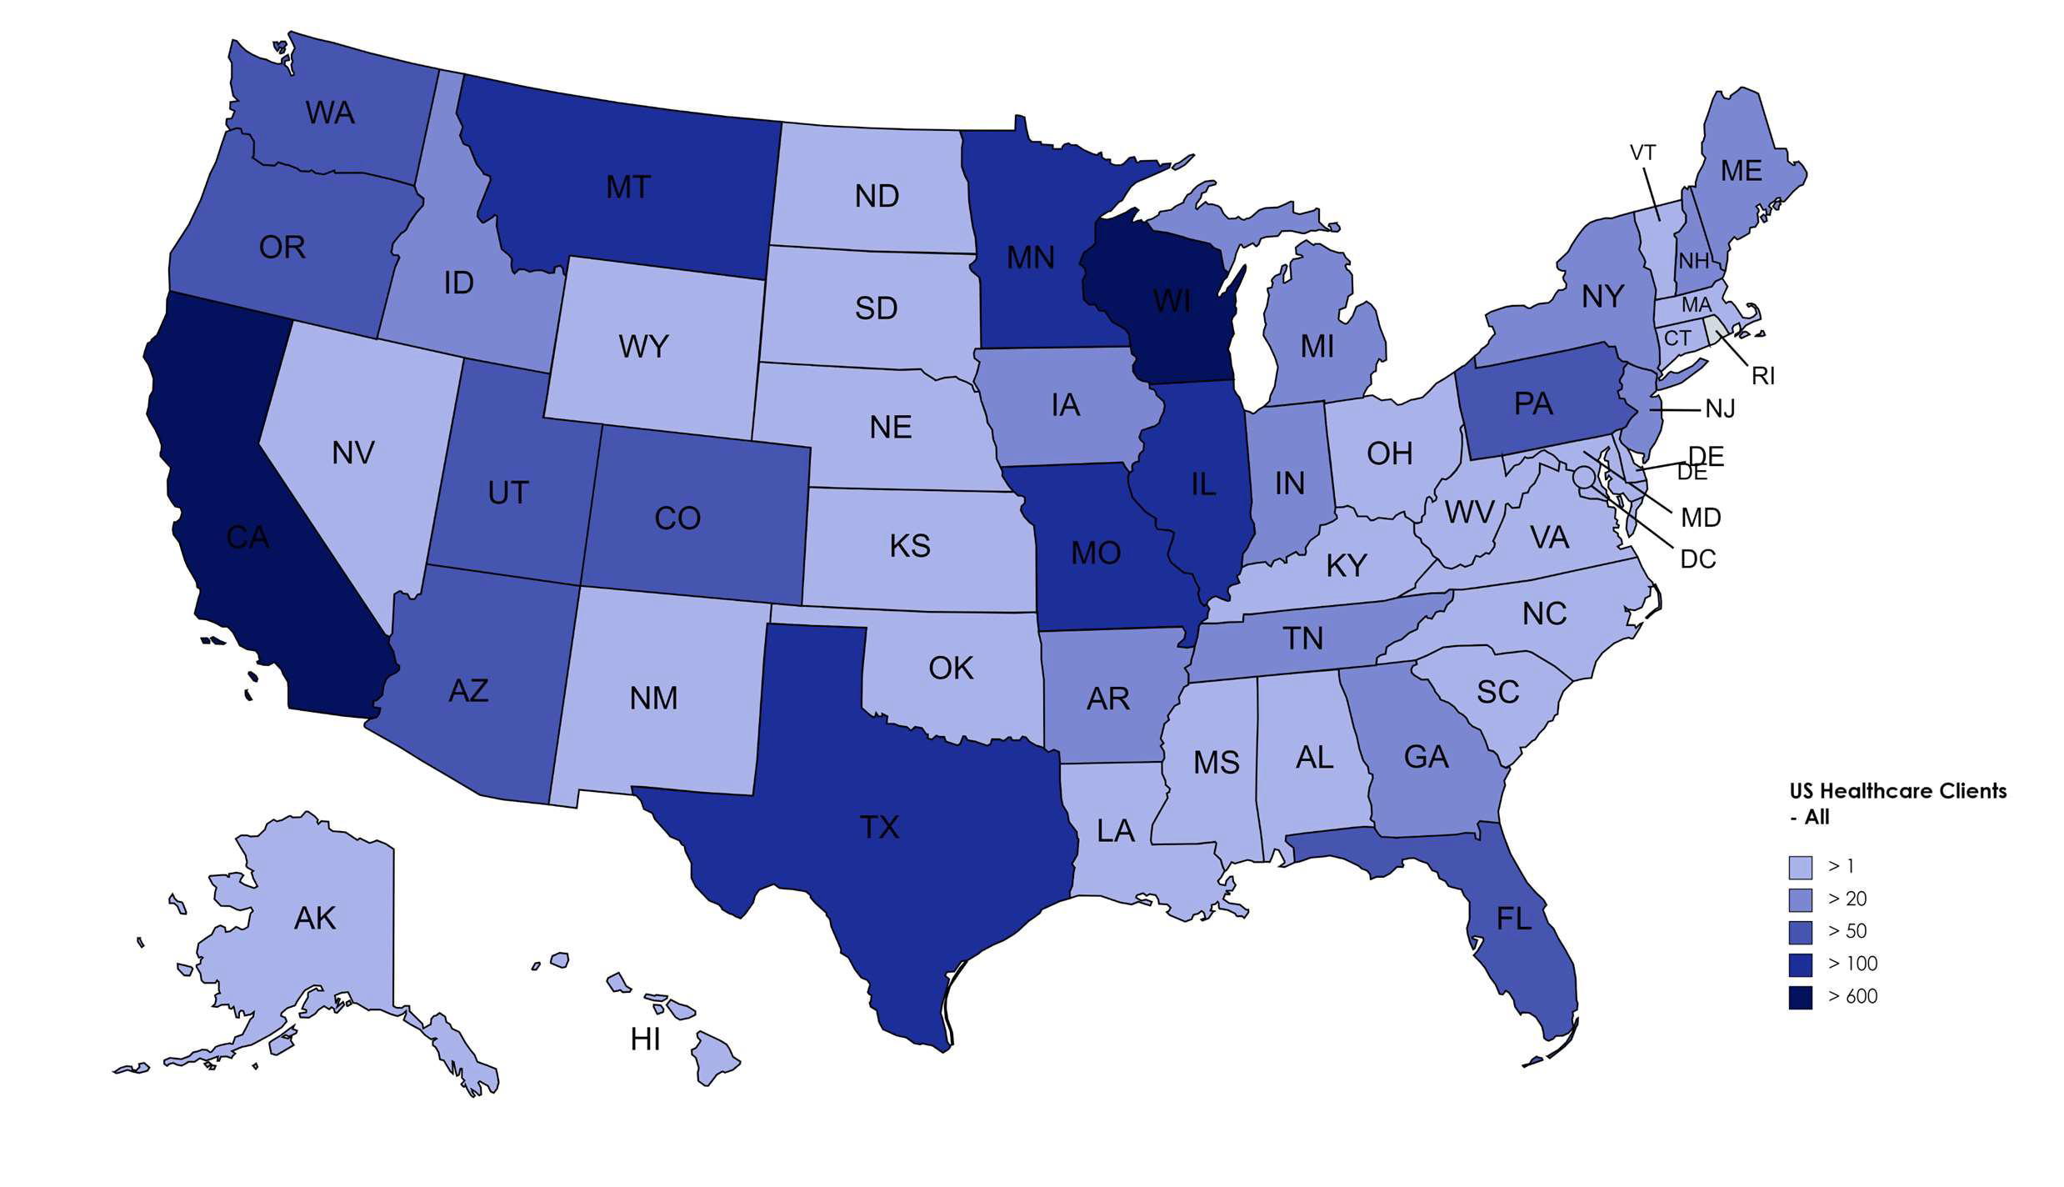
Healthcare clients by the state
10

Slide 26
Our Approach
11

Slide 27
Audit Approach
Involvement of Senior Level Executives
“No Surprises”
Open Communication With Management and Board of Directors
Efficient, Cost-Effective Engagement
(“In and Out”)
Focus on Risk Areas
Access to a Deep Bench of Healthcare Specialists
Audit Approach
Results
Well-Researched Practical Solutions to Your Questions
Maintain Strong Relationship Between Board and Wipfli
Use the Depth and Breadth of our Healthcare Experience to Understand Your Business
Share With You Opportunities for Improvement While We Seek to Continually Improve Our Process
No Add-On Extra Billings for Routine Questions
Regular Check-Ins With Fiscal Staff

Slide 28
Audit Approach
Services are led by one partner, one director/senior accountant, and staff accountant to allow efficiency, consistency, and flexibility.
We have the ability to accommodate requests of preliminary and offsite work while meeting agreed-upon due dates.
One engagement partner, one concurring partner, and one director/senior accountant will review the financial statements and audit file for consistency and accuracy.
We believe in planning and communicating throughout the year.
− We expect and want your questions on technical and other matters throughout the year.
− Interim work is an option.
− We will be an extension of your management team.
We believe in meeting your needs.
− “Getting In and Out” based on your needs.
− Wipfli has continued to invest in technology and AI to improve audit approach and client interactions.
− We respect the demands on your time.

Slide 29
Cost Report Approach
Planning
The audit team also prepares the cost reports
Eliminates duplication and ultimately saves time for all involved
A separate cost report prep-guide will be provided at the same time as the audit prep-guide
Cost report preparation
Post cost report filing
Reimbursement opportunities
Preliminary work occur after audit fieldwork but prior to audit finalization
Constant communication with client
Reviewed by Senior Manager and Partner
Our team is always available for consultation with the fiscal intermediary when necessary
Discussed with client as soon as possible
Determination made if applicable to current year or future year
Detailed action plan discussed with client

Slide 30
Independence
Compliance Services
Consulting Services
One team for audit/reimbursement with the support of our entire healthcare practice
Benefits
One team gains knowledge of the client
Reimbursement impact of this knowledge
Example of value
All consulting work is approved by the Board of Directors or Management depending on organization policy and/or AICPA guidelines
Engagement partner is informed and kept abreast of findings

Slide 31
Your Investment
16

Slide 32
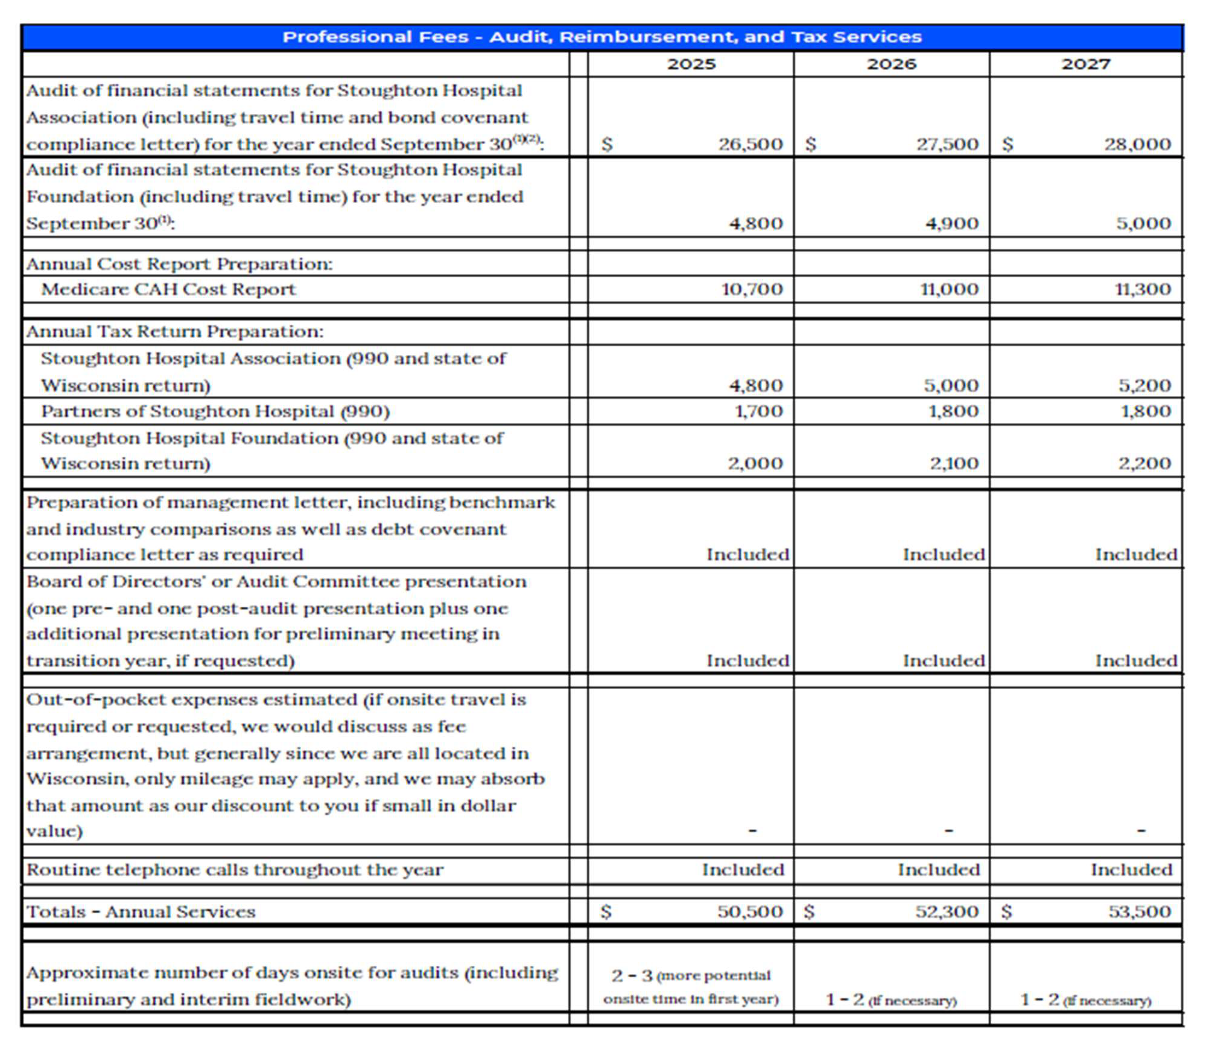
Engagement Services and Proposed Fees
The fee estimate for the audit of the financial statements for years 2025 to 2028 is based on Auditing and Accounting Standards currently in effect. Any standards becoming effective after the date of this proposal that would have a significant impact on the audits will be addressed with management as they are released.
17

Slide 33
Client Service
Team
18

Slide 34
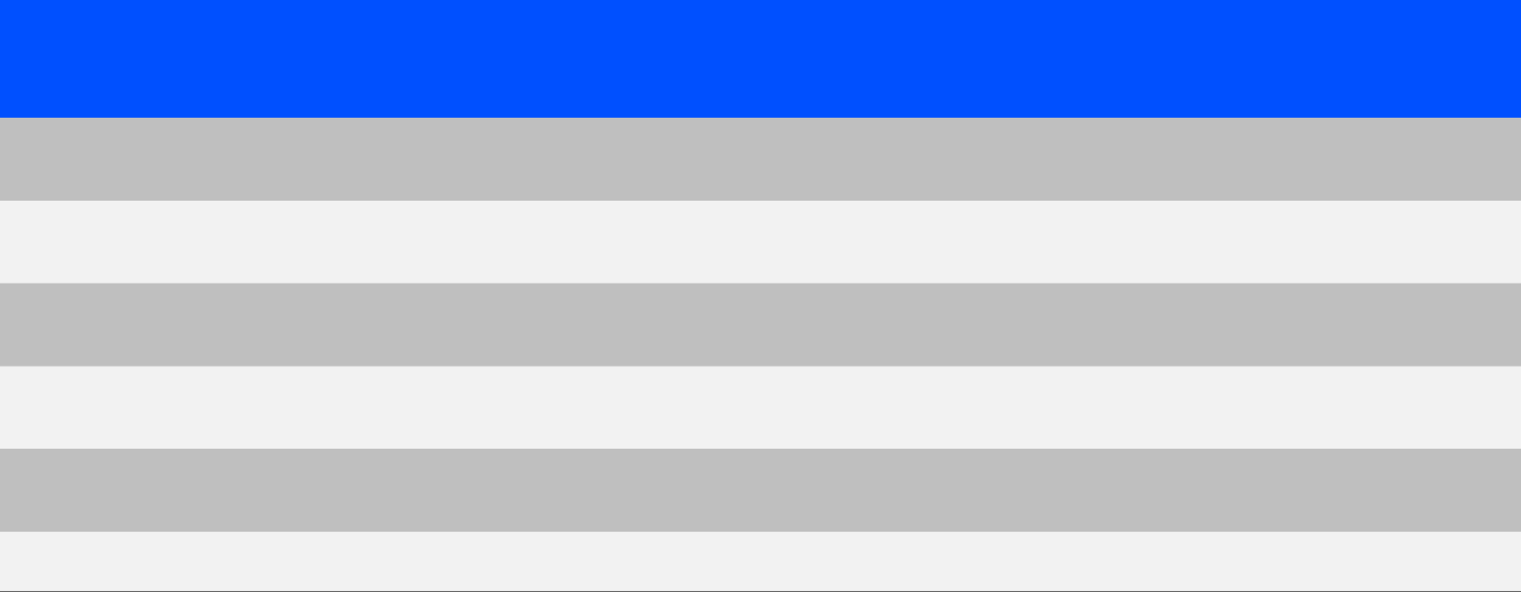
Your Wipfli Team
Name | Title | Focus Area | Prior Experience With Entity(ies)
Paul Traczek | Coordinating Audit Partner | Financial Statement Audits, Medicare Cost Report | No
Josh Boyle | Concurring Audit Partner | Financial Statement Audits Quality Review | No
David Goodman | Senior Manager | Financial Statement Audit, Medicare Cost Report | No
Danielle Chilson | Senior Accountant | Financial Statement Audits, Medicare Cost Report | No
Rob Foy | Staff Accountant | Financial Statement Audits, Medicare Cost Report | No
Michael Peterson | Senior Manager | Tax Returns | No
See the full proposal for full individual profiles
19
1

Slide 35
Why Wipfli

Slide 36
Why Choose Wipfli – Top 10 Reasons!
10. Wipfli gives back to the communities we live in annually through our Community Day of Giving, including our offices in Wisconsin.
9. Wipfli’s healthcare practice sponsors many education sessions for our clients and prospects throughout the year. Topics this past year have included rural health clinics, digital assets, cybersecurity, and capital planning. These sessions come at no additional cost to you.
Wipfli supports healthcare in Wisconsin:
Active supporter of Wisconsin Hospital Association (WHA), the American Hospital Association (AHA), as well as HFMA Chapters within Wisconsin and joint HFMA efforts throughout the Midwest, and the Wisconsin Office of Rural Health.
Participate in numerous projects and training sessions for CFOs and business office managers with these various associations upon request without charge to the association or organization
7.
6.
Wipfli is an active member of the AICPA healthcare Audit Quality Center
Wipfli has long-standing relationships with both Medicare (National Government Services and the CMS Regional Office in Chicago) and Medicaid (Wisconsin Department of Health Services), including development of several reports with the state of Wisconsin such as the Medicaid crossover bad debt file for use on Medicare cost reports among other efforts – Our audit team knows reimbursement!
Wipfli’s healthcare service team approaches rural healthcare differently than our competitors.
5.
The auditors and reimbursement specialists are one in the same. The same team will provide service for audit, cost report, and tax returns (990s) with specialized experts available as well for in depth consultation related to non-profit tax, retirement plan, or other consultation when needed.
Wipfli publishes an annual “state of rural healthcare” report utilizing survey data from over 100 different hospitals throughout the country.
4. Wipfli's healthcare practices were built around clients the size of Stoughton Hospital, and our healthcare practice was built on audit and reimbursement services to Wisconsin hospitals.
Wipfli values communication and does not charge for routine communication – we like to hear from you.
Wipfli’s proposed service team has a combined over 50 years of experience working on audits and reimbursement projects with other hospitals like Stoughton Hospital
Wipfli values our client relationships – you will be treated like our #1 client!
3.
2.
1.

Slide 38
Thank you!
Paul Traczek, CPA
David Goodman, CPA
Partner – Healthcare Practice
ptraczek@wipfli.com 715.858.6619
Senior Manager – Healthcare Practice
dgoodman@wipfli.com 608.270.2962
wipfli.com
© 2025 Wipfli LLP. All Rights reserved. “Wipfli” refers to Wipfli LLP.
23

Slide 39
Discussion/Evaluation of Presentations/ Selection of Audit Firm
Request Motion to Approve Selected Audit Firm.

Slide 40
Open Discussion

Slide 41
Adjournment
Thank you for attending

