Slide 1
Welcome!
Christopher Schmitz
VP Human Resources, Facility Operations
and Campus Planning

Slide 2
IT Department

Slide 3
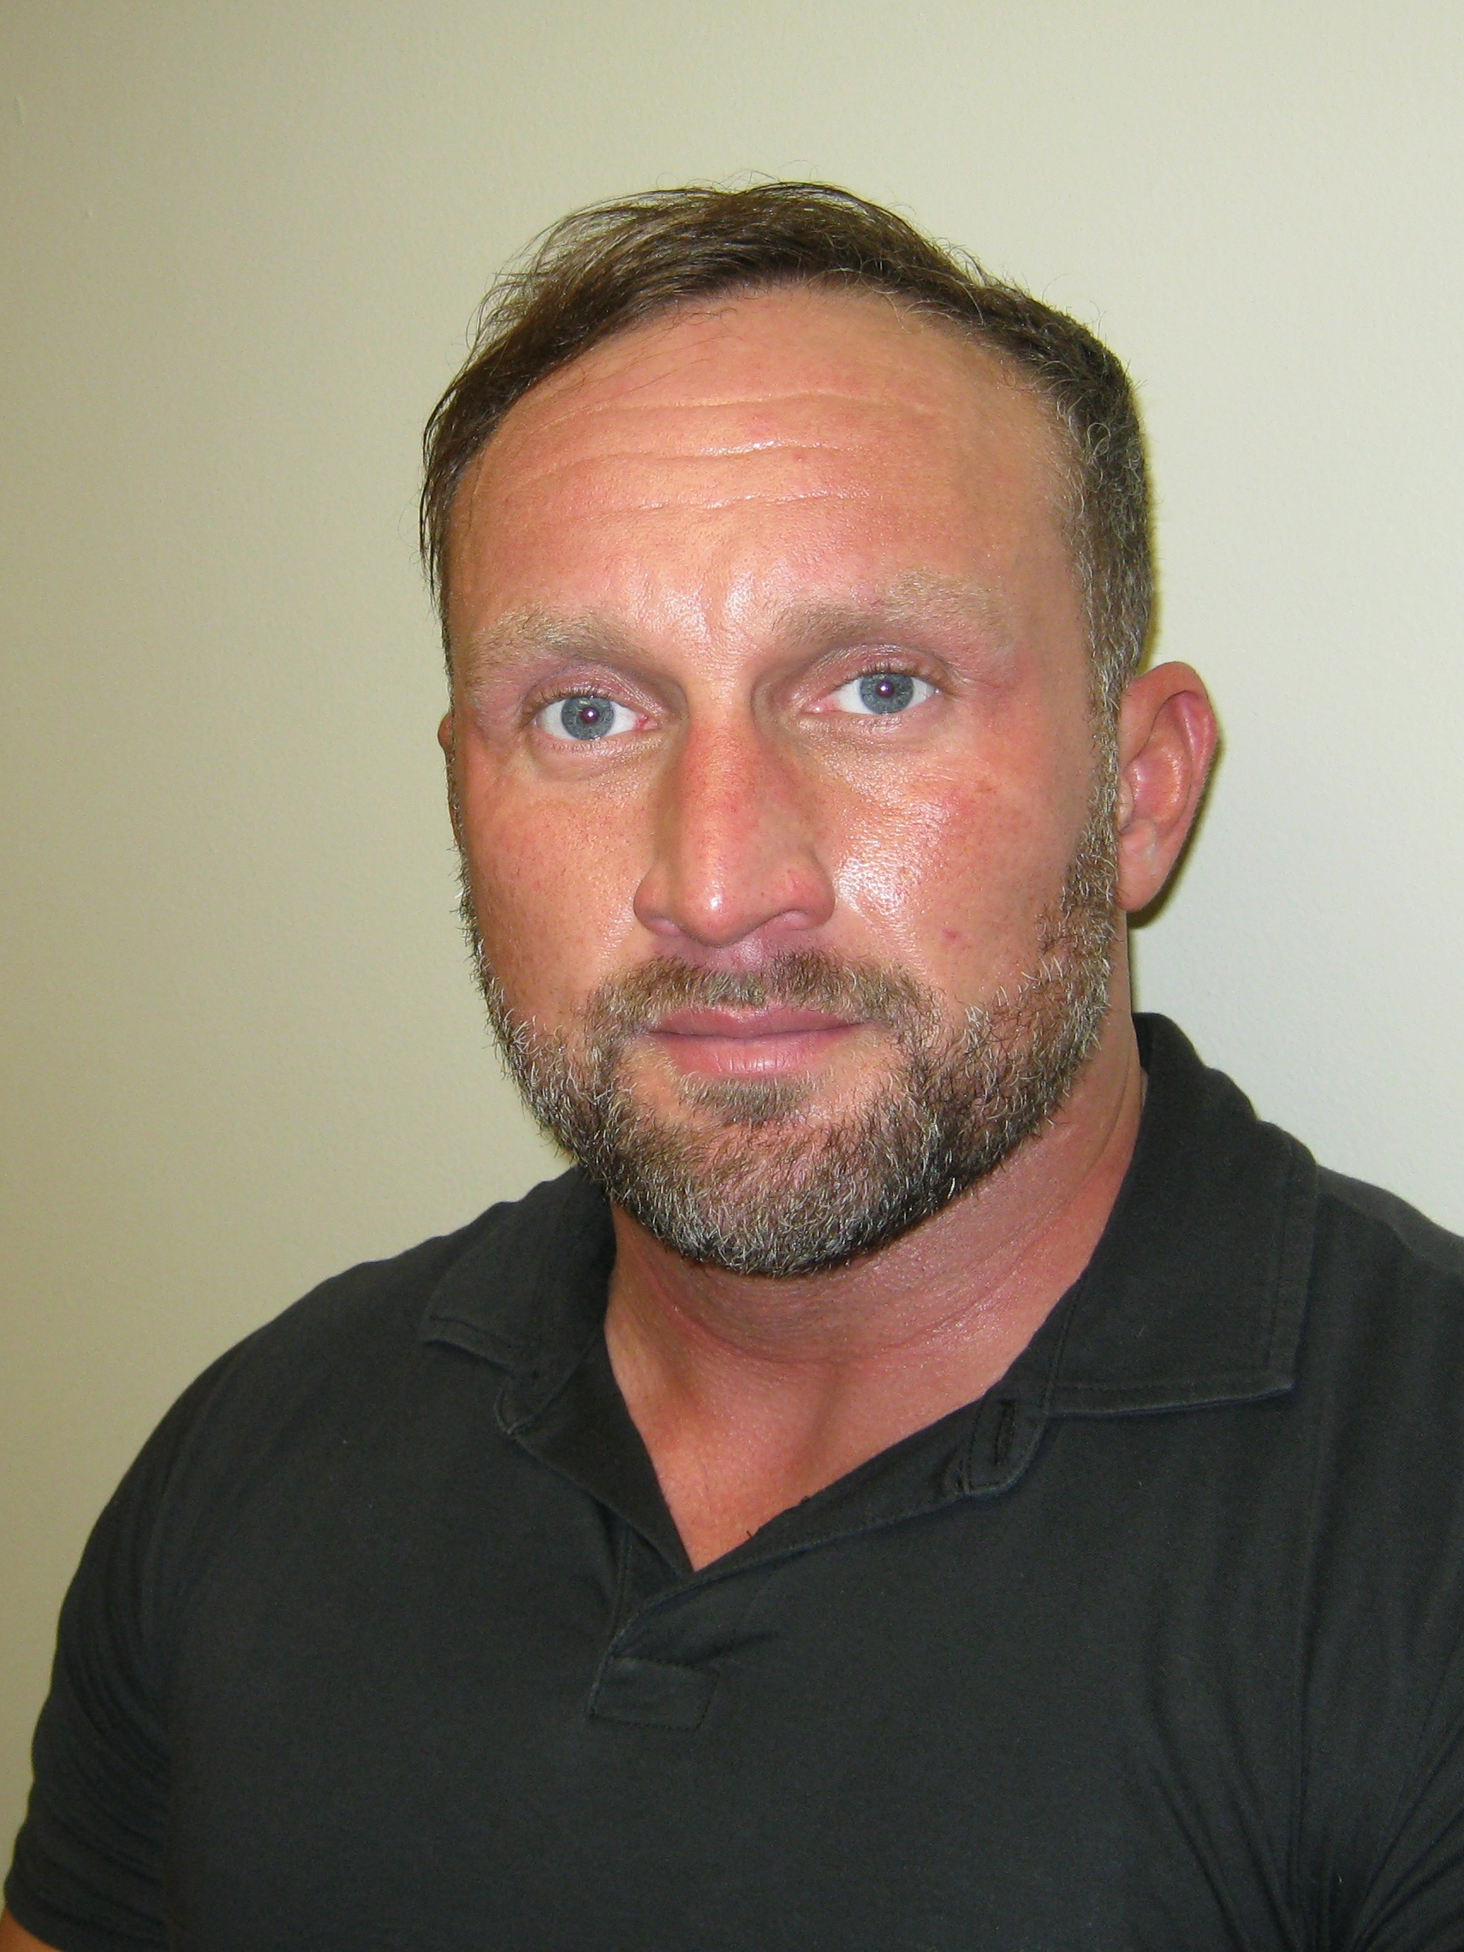
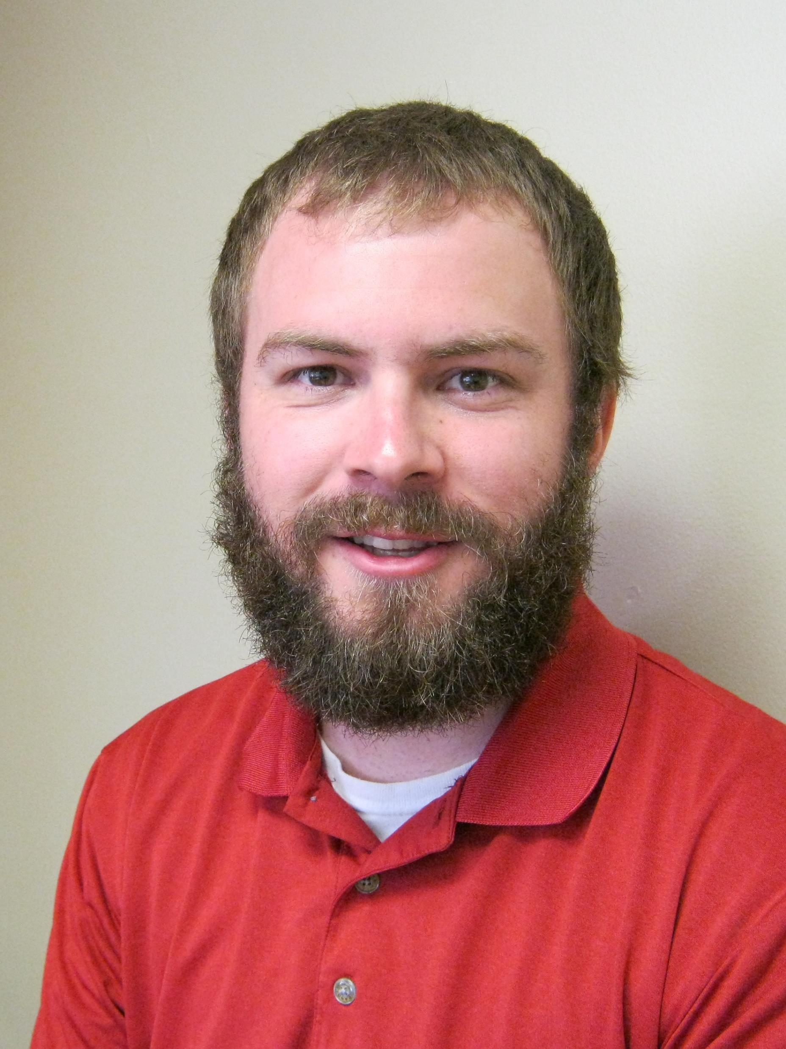

Meet the IT Team Members
Joe Rowley
Jason Lazenby
Josh Bartz

Slide 4
Technical Support Options
Technical Support Options
Issue Type | Support Group | Contact
Epic | SSM Help Desk | x2200 or eHelp (using the IS Tech Support link on the Intranet)
Computer Hardware | SSM Help Desk | x2200 or eHelp (using the IS Tech Support link on the Intranet)
Password/Email | SSM Help Desk | x2200 or eHelp (using the IS Tech Support link on the Intranet)
Network | SSM Help Desk | x2200 or eHelp (using the IS Tech Support link on the Intranet)
Phone | SSM Help Desk | x2200 or eHelp (using the IS Tech Support link on the Intranet)
Non-vendor Software | SSM Help Desk | x2200 or eHelp (using the IS Tech Support link on the Intranet)
Medical Equipment | BioMed | 608-221-8995
TV | Maintenance | x2233
Cash Registers | MMHayes | 1-8888-381-8054
Vendor Hardware | Various | Please reach out to the support vendor for support of items including Horizon, Pyxis, Natus, EKG, IV Pumps, etc.

Slide 5
Reminder – Day 2
Day Two Safety/Clinical Orientation
  Meet at 8:00 a.m. in the front Lobby.
  Please remember to bring back your NEO folder
Amy Hermes
Sam Stoltz
CNO/VP, Patient Services
Clinical Services Education Coordinator

Slide 6
Group Introduction
Welcome
  Introductions
  Know your Intranet Resources
Stoughton Health’s Fit
What are my primary goals
Evaluation Sheets
  Recruitment Source
Your Personal Goal
Bread Challenge

Slide 7
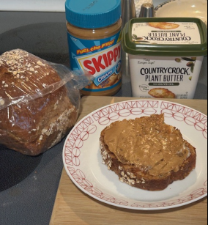
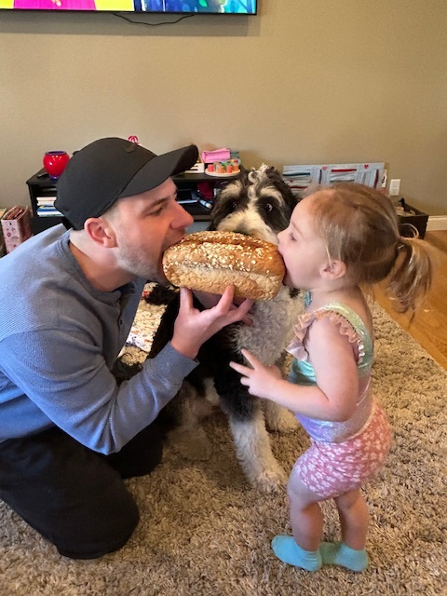
We welcome all new hires with a loaf of bread from the Close to Home Café
New hire Cameron sharing the loaf with his daughter and taunting the dog!
New hire Dani enjoyed hers with a spread of Skippy.
Share how you enjoyed your loaf of bread by emailing in your photos to hr@stoughtonhealth.com

Slide 8
Organizational Chart &
Mission, Vision, Values
Presented by: Chris Brabant, CEO Michelle Abey, CFO

Slide 9
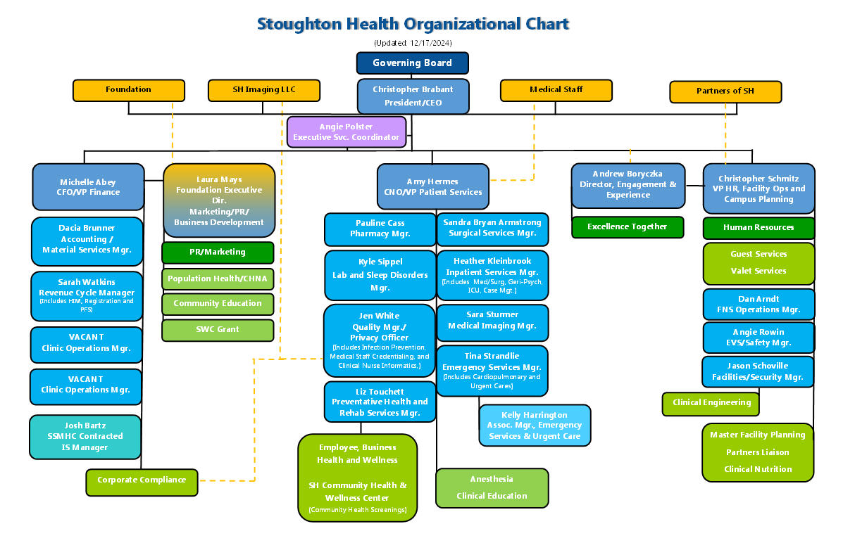

Slide 10

Stoughton Health Mission
Our Mission is to provide safe, quality health care with exceptional personalized service.

Slide 11
Vision
We grow to meet the changing needs of the communities we serve and become their health partner of choice.

Slide 12
Values
Our patients and community are our number one priority.
Employees are committed to providing Excellence Together through:
    Attitude
    Accountability
    Appearance
    Communication
    Teamwork
    Service

Slide 13

Strategic Goals
Q
U
A
L
I
T
Y
/
S
A
F
E
T
Y
G
R
O
W
T
H
S
E
R
V
I
C
E
F
I
N
A
N
C
E
P
E
O
P
L
E
MISSION: The mission of Stoughton Health is to provide safe, quality health care with exceptional personalized service.
VISION: We grow to meet the changing needs of the communities we serve and become their health partner of choice.
VALUES: Our patients and community are our number one priority. Employees are committed to providing Excellence Together through:
*Attitude *Accountability *Appearance *Communication *Teamwork *Service

Slide 14
Stoughton Health
Strategic Goals
Dashboard - 1 measure / goal
Strategic Goals Dashboard
C | Continuous improvement of quality, safety, patient experience
E | Efficiency – make healthcare more affordable
P | Partner with payers/providers
P | Partner with people
T | Technology utilization to enhance access/convenience
Data
HCAHPS – would you recommend
Cost per day of care monthly (salary $/APD)
a.) # of payer partner patients seen per month vs. last year same month b.) # of new patient records this month vs. last year same month
Workforce, community
UC visits + ED visits + # of Health Screenings + # of Tele/Virtual visits + Webpage hits = X

Slide 15

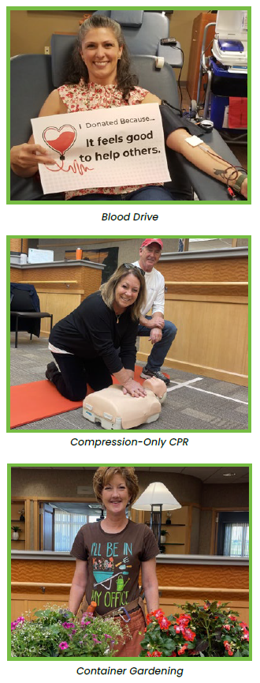
Community Benefit – FY2023

Slide 16
Stoughton Health’s Excellence Together
Culture
Notes:
Welcome and introduction

Slide 17
Origin Story
In 2006 the CEO shared inspiration with the administrative team
Administrative team realized the value and allocated resources
Customer service task force was formed
  Interview and selection of consultant was done by employee group
Notes:
Every great super hero team has an origin story, here is ours.
Legend has it...

Slide 18
Origin Story
Employees named our journey “Excellence Together”
Engaged our leaders
Formed our teams
Created mandatory training for all staff – Customer Service University (CSU)
Notes:
You'll all be signed up for CSU and attend over the next few months
So For Staff and By Staff has been in the bones of the program from the beginning.

Slide 19
Customer Service
Who are Stoughton Health’s Customers?
Notes:
Who are our customers at Stoughton Health?
This is an operational definition as you get started here at SH. Customers are anyone – staff, patients, family, guests – that we encounter

Slide 20
Our Mission
The mission of Stoughton Health is to provide safe, quality healthcare with exceptional personalized service.
Our Vision
We grow to meet the changing needs of the communities we serve and become their health partner of choice.
Our Values
Our patients and community are our number one priority.
Notes:
Chris talked about our M / V / V at the start. Let's review...
These are the very foundations of our culture here at SH

Slide 21
The Excellence Standards of Performance
How we live the mission, vision, and values of Stoughton Health.
We expect the best of ourselves and one another, working to exceed the expectations of those we serve.
Stoughton Health has incorporated these Standards as an integral part of our Excellence Together culture.
Notes:
The Excellence Standards of Performance are what we expect of ourselves every day
How do you know what expectations others have?

Slide 22
Service Standards - AAACTS
Attitude
Accountability
Appearance
Communication
Teamwork
Service
Notes:
These are Hows to our culture.
By living these virtues every day we can achieve our mission
Attitude – choosing to assume best intent and be kind
Accountability – owning our imperfections and helping others with theirs
Appearance – bringing as much of our authentic selves to work every day – smile – we have the priviledge of serving others every day
Communication – being pro-active and respectful
Teamwork – coming together to the very best work
Service – striving to do our best to take care of everyone we encounter
Reference Handouts

Slide 23
Excellence Together Teams
Support our lived culture and our focus on exceptional, personalized service
Is for staff and by staff and supported by administration
Notes:
These are groups of staff that work on specific areas of our AAACTS to keep them alive and well in the organization

Slide 24
Excellence Together Teams
Director of Engagement and Experience
Excellence Together Team Leaders
Provider Partnership
Employees For Employees
Customer Experience
Standards
Communications
Wellbeing
Measurement
Notes:
Walk through the org chart
If once you get started you are interested in finding out more reach out to Andy Boryczka, Director of Engagement and Experience

Slide 25
Putting It All Together
Culture
What does this create?
How will we be supported?
How will we do it?
What do we expect?
Why do we exist?
Excellence Together
AAACTS
Excellence Standards of Performance
Mission, Vision and Values
Notes:
Walk through the diagram

Slide 26
Directors of Impressions
7 seconds! – the amount of time it takes for people to judge their first impression:
Environment
Body language
Appearance
Tone of voice
Notes:
Strive to be your best self every day at SH. We're here to support you in doing this and it is important.
You'll here more about this in CSU

Slide 27
Directors of Impressions
Moments of Truth:
Interaction points along the customer journey
Customer compares their experience with their expectation
You are always improving or reducing people's opinion through your actions
Notes:
You are now part of the great culture here. You represent yourself, me and everyone that's here and come before. Respect that and your best.
Make the leap of faith for others.

Slide 28
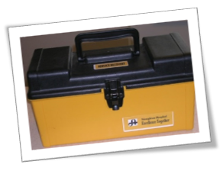
Service Recovery
A process in place when first impressions or moments of truth do not meet our own standards:
When our external customers anticipated or perceived expectations have or are not being met
Notes:
They have gift cards and a form to complete when you give one out.
If someone has an unmet expectation, these can be offered.
Look for the toolbox in your department/work area (ask someone where it is if you don’t see it).
You'll learn more about these at Customer Service University

Slide 29
Service to Each Other
We are human and will sometimes fall short of expectations with one another.
Out of respect we are committed to letting each other know so that we can improve.
Go directly to the individual involved and express your concerns in an empathetic and constructive way.
Notes:
Interpersonal problems, conflicts and frustration are normal obstacles in a fast paced, quality oriented work environment.
If you need help starting the conversation ask Andy or your manager or another leader who's style you feel works for you.
Interpersonal Conflict Resolution
Policy 9.81
In your packet

Slide 30
Why Our Culture is Successful
Excellence Together
CEO
Leadership Team
Excellence Together Team Leaders
Employees
Volunteers
Notes:
Employee driven and administratively supported
Our commitment to excellence is not optional
Woven into the fabric of our organization, not pinned
Sustainable culture created to outlive any administration
Ownership creates employee empowerment
We are all responsible for the great culture here at SH

Slide 31


Slide 32
Stoughton Health
HIPAA Staff Training In-service

Slide 33
HIPAA Definition
Health Insurance Portability and Accountability Act.
  Went into effect in 1996 giving everyone the right to access their own health information
Purpose is to protect privacy and security of Patient Health Information (PHI)

Slide 34
What is PHI?
Name
Medical Record Number
Account Number
Birth Date
Social Security Number
Address
Admission, Service, or Discharge Date
Photos (i.e.: patient’s wounds)
Anything that could be used to identify a patient

Slide 35
HIPAA Training
All Stoughton Health employees and volunteers receive training upon hire
Annual mandatory in-service for HIPAA for all employees and volunteers

Slide 36
Why is protecting PHI Important?
It’s a Patient’s Rights
Review and/or receive a copy of their medical information
Request to correct their medical information
Request restrictions on certain uses and disclosures
Receive confidential communication of their medical information

Slide 37
Patients’ Rights (continued)
Receive a record of disclosures of their medical information
Obtain a paper copy of “Your Medical Information Rights”
File a complaint

Slide 38
Patient Permission Not Needed
Treatment
Payment
Operations

Slide 39
Treatment
You do not need permission to use or disclose PHI in the process of treating patient or making arrangements for treatment.

Slide 40
Payment
You do not need permission to use or disclose PHI if you are creating bills or coordinating billing with patients, health insurance companies, and others.

Slide 41
Operations
You do not need permission to use or disclose PHI for “operational” activities like training students, preventing fraud and abuse, meeting licensing and accreditation requirements, and conducting quality assurance activities.

Slide 42
“Need to Know Basis”
Only those who need to know should have access to patient health information
“Minimum Necessary”
Access only the minimum necessary to perform the job

Slide 43
Important Note
Stricter rules apply to patients being treated on our Geriatric-Psychiatry Unit or those receiving treatment for alcohol or drug abuse problems.
Your manager will explain the differences in future sessions

Slide 44
HIPAA Breach/Violations Reporting
HIPAA Privacy Officer
  Enter all potential HIPAA breaches into SafetyZone Portal (SZP)
Hospital Managers/Administration
US Dept. Health & Human Services

Slide 45
HIPAA Violation Disciplinary Actions
Stoughton Health Disciplinary Action
  Including termination of employment for serious offenses
Civil & criminal fines
Prison Sentences

Slide 46
Your right to report waste, fraud and abuse without fear of reprisal
Whistleblower is someone who reports to a protected source information reasonably believed to evidence:
Violations of law, rule or regulation
Waste, fraud, and abuse
Mismanagement
Substantial and specific danger to public health or safety

Slide 47
Who can be a protected whistleblower?
Federal employees (civilian or military)
Applicants for Federal employment
Federal contractor and subcontractor employees
  Stoughton Health falls under this as we provide services and receive reimbursement for Medicare
Federal grantee and sub grantee employees

Slide 48
How to Report Fraud:
Stoughton Health Customer Concern Line at 1-877-416-2407
  Caller may remain anonymous
Stoughton Health Intranet
Privacy Officer
Manager
Administrative Team
Online: TIPS.HHS.GOV or 1-800-477-8477

Slide 49
What You Need to Know
It is okay to fax PHI to another health care provider for treatment purposes
You may leave a message for a patient on an answering machine or with a family member
Disposing of PHI - empty your wastebasket into the confidential bin

Slide 50
What You Need to Know
Never access your own or a family member’s electronic health record.
Don’t look at any record unless you need it to do your job.
Report to your supervisor or Privacy Officer anything that doesn’t seem right.

Slide 51
What You Need to Know
Keep patient data secure by logging off EPIC before stepping away from a computer.
Be aware of your surroundings such as when people are walking or standing in view of the computer screen. Minimize or exit patient information so they are unable to see the screen.

Slide 52
What You Need to Know
Do NOT discuss patient information in any public area such as hallways, elevators, dining area, etc.
Never leave patient labels or paperwork where it might be seen by prying eyes.
Always be on the lookout for labels or paperwork that a patient may have left behind

Slide 53
Before You Go . . .
Remember - our patients’ privacy is in your hands!
Contact Jen White, Privacy Officer at ext. 2365 for questions or concerns

Slide 54
Just Culture
Jen White, RN, Quality Manager

Slide 55

What is Your Job at Stoughton Health?
Every employee at Stoughton Health is to ensure patient safety
NASA story

Slide 56
Why is it important to look at events that may/may not reach a patient?
  It is estimated that 200,000 – 400,000 people die in hospitals each year in the US as a result of medical errors that could have been prevented.
  2023 John Hopkins estimated approximately 795,000 patients in the US die and/or permanently disabled due to diagnostic errors each year.

Slide 57
Speaking Up for Safety
Not about pointing blame at others
Process focus
Creating a safe culture where employees are comfortable speaking up to a co-worker, manager or physician
Addressing a potential error before it occurs
Report near misses and actual events in our Safety Zone Portal
No fear of reprisal

Slide 58
High Reliability Organization
How might the next patient be harmed by what we are doing or not doing?
Identify Good Catches to better our patients
Errors will occur; the key is to design processes so that harm does not reach the patient

Slide 59
Just Culture Safety Approach

Slide 60
Just Culture Defined
Human Error – Inadvertent; a slip; lapse mistake
At Risk Behavior – Behavioral choice that increases risk where risk is not recognized, or is mistakenly believed to be justified (Ex: taking short cuts)
Reckless Behavior – Conscious disregard

Slide 61
Case Example
On a snowy winter night, John had to run to the store to buy milk. His car was parked in the driveway. John got into his car and turned his head to back out of his driveway. Although he carefully looked at the path behind his car, his vision was limited. He inadvertently hit his neighbor’s mailbox and destroyed it.

Slide 62
Just Culture Defined
Human Error – Inadvertent; a slip; lapse mistake
At Risk Behavior – Behavioral choice that increases risk where risk is not recognized, or is mistakenly believed to be justified (Ex: taking short cuts)
Reckless Behavior – Conscious disregard

Slide 63
Case Example
On a snowy winter night, John had to run to the store to buy formula for his colicky newborn infant. His wife had not slept in 24 hours and tensions ran high. John got into the car, looked at his upset wife in the doorway and backed out of the driveway without looking in the rear view mirror. Is his haste, he hit his neighbor’s mailbox and destroyed it.

Slide 64
Just Culture Defined
Human Error – Inadvertent; a slip; lapse mistake
At Risk Behavior – Behavioral choice that increases risk where risk is not recognized, or is mistakenly believed to be justified (Ex: taking short cuts)
Reckless Behavior – Conscious disregard

Slide 65
Case Example
On a snowy winter night, John hopped in his car – yelled, “Yee Haa!” – closed his eyes and hit the gas. He never saw his neighbor’s mailbox.

Slide 66
Just Culture Defined
Human Error – Inadvertent; a slip; lapse mistake
At Risk Behavior – Behavioral choice that increases risk where risk is not recognized, or is mistakenly believed to be justified (Ex: taking short cuts)
Reckless Behavior – Conscious disregard

Slide 67

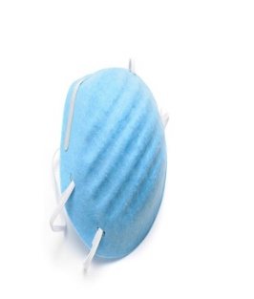

Everyone is a Safety Officer at Stoughton Health!!

Slide 68

Any Questions?

Slide 69

Quality Management (QM)

Slide 70

Why is QM Important?
Creates efficiencies
Creates a safer environment for patient, visitors and employees
Improves job satisfaction by being part of improvement opportunities and creating change

Slide 71
How are QM projects identified?
Our Strategic Plan identifies priorities for improvement opportunities for innovation
Teams close to the process focus (unit-based, specialized committees)
Measures on our Balanced Scorecard, Clinical Quality and Safety Report Card, Department QM plans
New evidence-based processes and practices

Slide 72
YOUR QM Responsibility
Get involved by:
  Learn department goals, how they are measured, and action plans
  Become an active team member working to meet department goals
  Participate in department meetings
  Check the Communications Boards

Slide 73
Quality Management (QM)
We use a systematic approach to improve processes and outcomes.
  Plan Do Study Act (PDSA)
Key to Success:
  Small Tests of Change
Other tools in our toolbox:
  Fishbone diagram
  Pareto chart
  Pie chart
  Process mapping/swim lanes
Notes:
Why Small Tests of Change?
Increases the belief that the change will result in an improvement
Decide whether the proposed change will work in your department
Evaluate how much improvement can be expected from the change
Minimize resistance to change
Decide which of several proposed changes will lead to the desired improvement

Slide 74
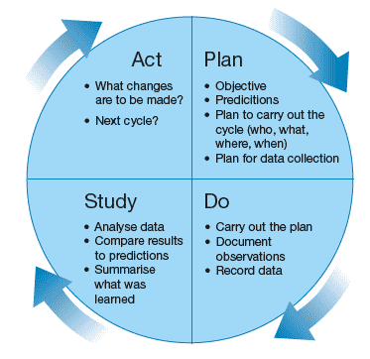

Slide 75
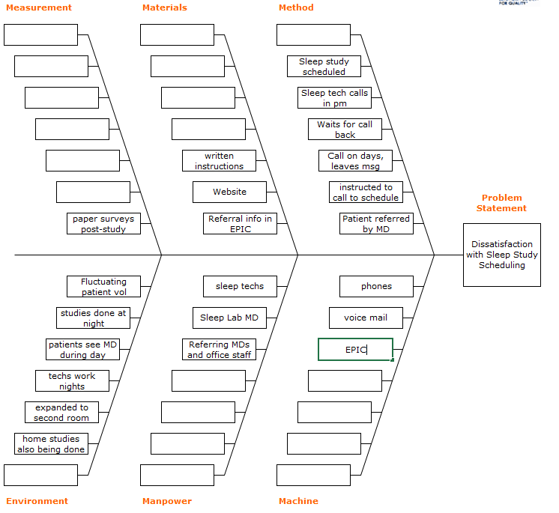
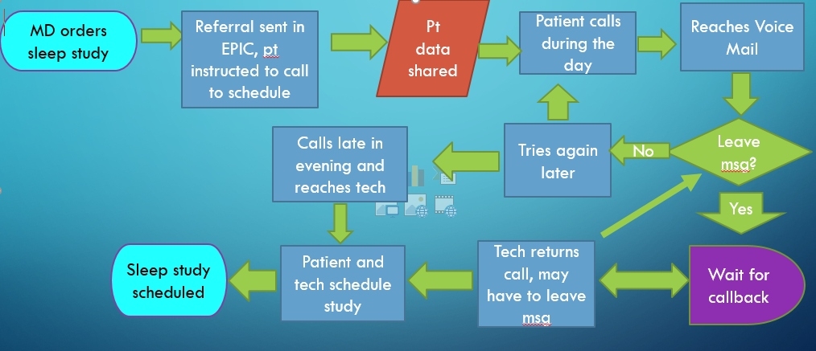
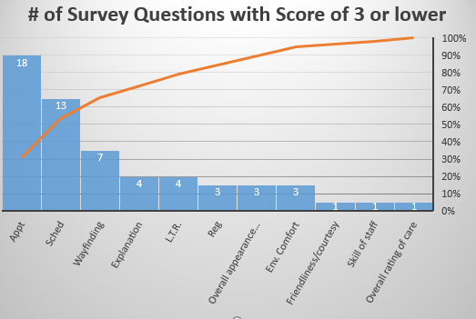
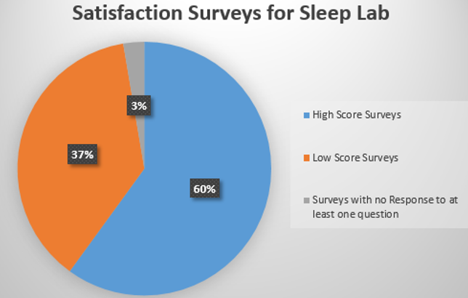
Tools in the Toolbox
Notes:
Pareto Chart:
Helps the team focus on the causes that will have the greatest impact if solved by showing their relative frequency or size in a descending bar graph
Displays the relative importance of a problem in a simple easy to interpret format
The PARETO Principle says that 20% of the sources cause 80% of the problem

Slide 76

5 Slides in 5 Minutes
Department QM Projects

Slide 77
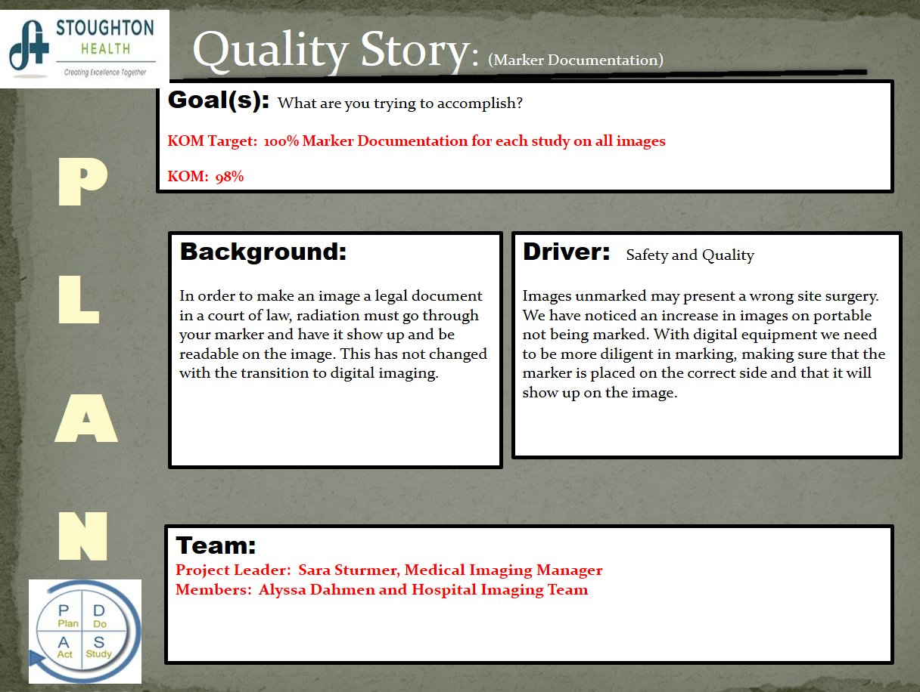

Slide 78
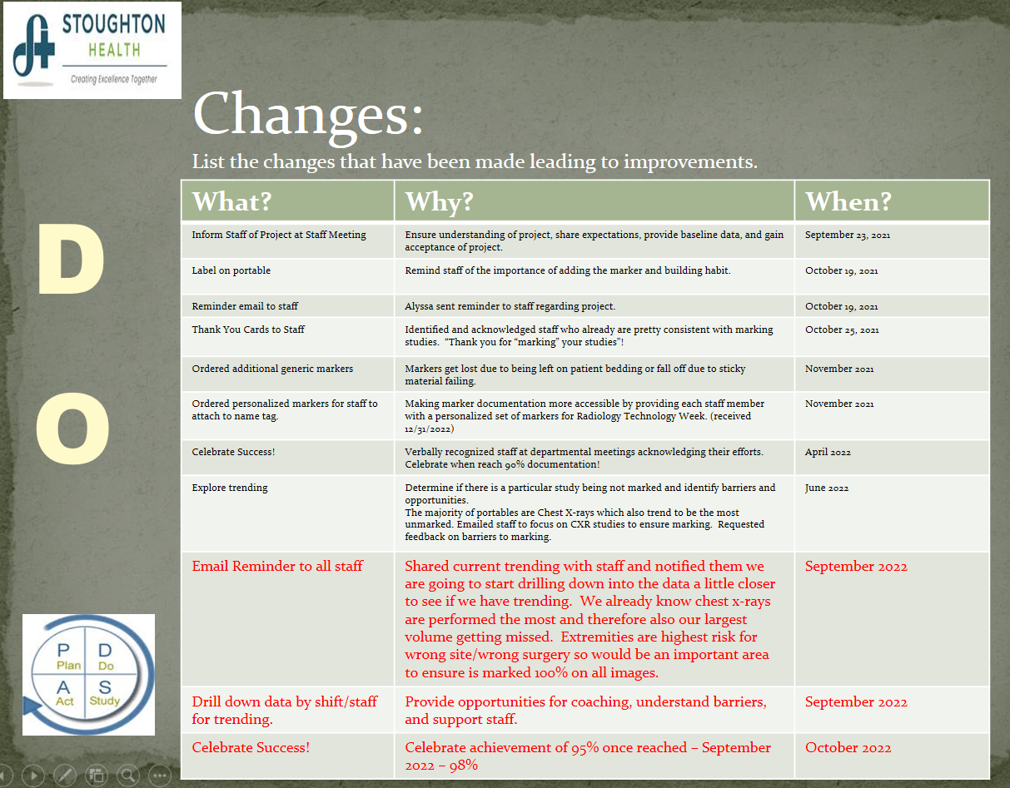

Slide 79
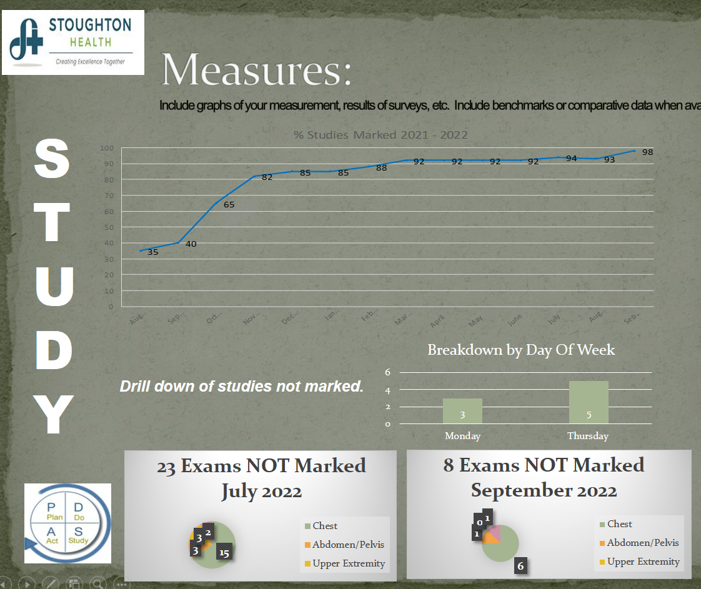

Slide 80
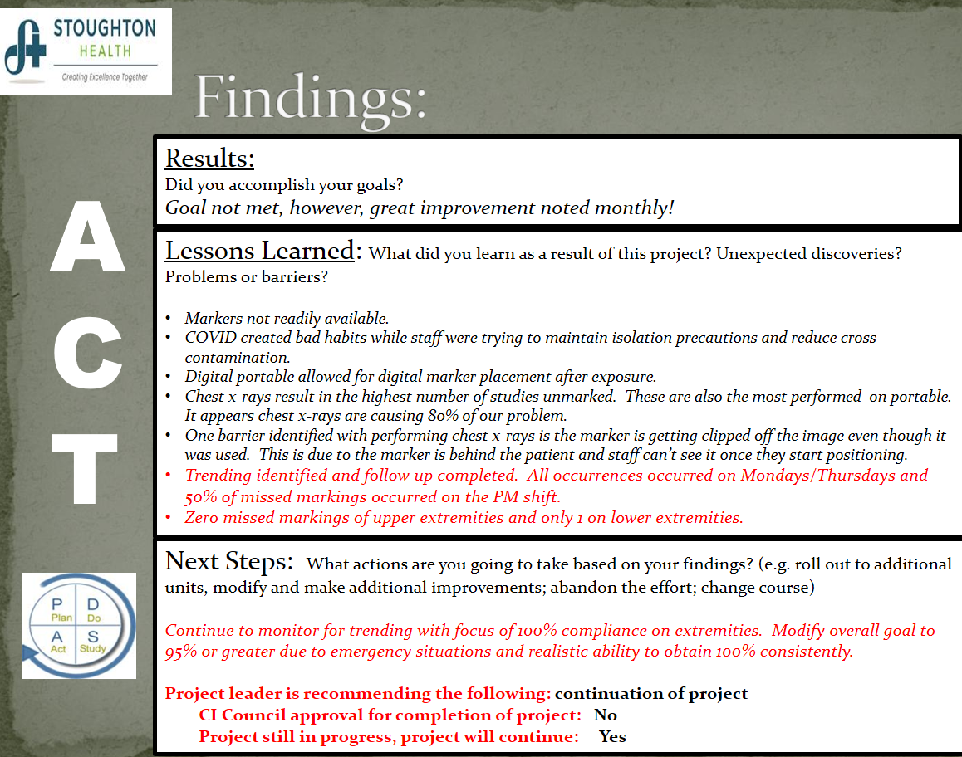

Slide 81
Corporate Compliance
Everyone is responsible for protecting our customers from fraud and abuse and assuring Stoughton Health performs in an ethical and legal manner.
Customer Concern Line
  1-877-416-2407
  Calls may remain anonymous*

Slide 82
Patient Rights
Our hospital respects, protects, and promotes Patient Rights.
Patient Rights are available upon admission and placed in patient rooms
Patient Rights are required by DNV, Centers for Medicare and Medicaid Services, and WI Dept. of Health Services

Slide 83
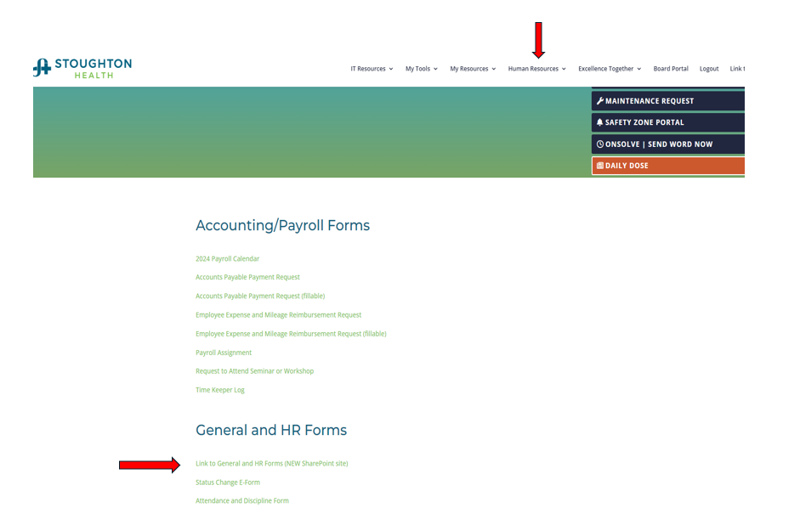
Risk Management –
It’s a Patient Rights
Albanian (6235A), Spanish (6235S) and English versions of the Patient Rights & Responsibility are on the Intranet under Forms, General Forms.
Albanian (6235A), Spanish (6235S) and English versions of the Patient Rights & Responsibility are on the Intranet under
Forms, General Forms.
Notes:
Will need to update when new intranet is up.

Slide 84
Patient Rights
We do not discriminate against our patients
Patients have right to be free from mental, physical, sexual or verbal abuse, neglect or exploitation
CONFIDENTIALITY and access their medical record

Slide 85
Patient Rights
PARTICIPATE IN CARE PLANNING and treatment
RECEIVE INFORMED CONSENT prior to an invasive procedure unless an emergency
Refuse treatment, to the extent possible by law, and be informed of consequences of refusing treatment
Involve or refuse students in care

Slide 86
Patient Rights
Wear personal clothing and symbolic items, as long as they do not interfere with your care
Be free from seclusion and restraint and only legally acceptable restraint used as last resort or in emergency

Slide 87
Patient Grievances
Patients have a right to file a grievance with the hospital, CMS, DNV, or DHS. Responsibility for the grievance process is delegated to Administrative Council and Client Rights Specialist, Jennifer White.
Employees have a responsibility to immediately report suspect or known patient abuse, neglect, harm, theft of patient property, or non-compliance with CMS requirements to their Manager and Jennifer White.
Notes:
Should we explain the difference between a complaint and a grievance or share the policy and remind them about the toolboxes and the SZP?

Slide 88
Patient Complaint vs Grievance
Complaint: An expression of dissatisfaction by a patient or their representative about the quality of care and/or services provided that can be resolved by the staff present at the time of the complaint.
  Post-hospital verbal communications which includes feedback obtained via patient satisfaction surveys regarding patient care that would routinely have been handled by staff present if the communication had occurred during the stay/visit are not require to be defined as a grievance.
  Facebook or social medial posts do not constitute a grievance; however, follow up with the complaint and asking for additional information is recommended.
  Billing issues are not usually considered grievances for the purposes of these requirements other than a Medicare beneficiary billing complaint related to rights and limitations provided by 42 CFR 489.

Slide 89
Patient Complaint vs Grievance
Grievance: A written or verbal complaint (when the verbal complaint about patient care is NOT resolved at the time of the complaint by staff present) by a patient or the patient’s representative regarding the patient’s care, abuse or neglect or issues related to Stoughton Health’s compliance with the Centers for Medicare & Medicaid Services (CMS) Hospital Conditions of Participation (CoP).
If the complaint is related to Behavioral Health (i.e. Geriatric Psych), please follow policy 8.22 Patient Grievance Policy

Slide 90
Patient Complaint/Grievance Reminders
If a concern/complaint can not be resolved, escalate to a care coordinator, manager, quality department or administration to start the grievance process.
Enter event into SZP as soon as possible/by the end of your shift.
Remember the toolbox items are available to hand out to patients/visitors

Slide 91
Questions?
Jen White, Quality Manager
Rhonda Tesmer, Clinical Quality Specialist

Slide 92

Infection Prevention & Control
Infection prevention and control is a term used that describes ways we can prevent the spread of infection in healthcare settings.
Infections can cause:
Pain, suffering and often, permanent scarring, even death
Infections cause extra days in the hospital and lead to higher costs for patients and their families.
Hospital acquired infections lead to approximately 99,000 deaths annually with direct and indirect cost of $97 billion and $147 billion each year.

Slide 93

Hand Hygiene Compliance
Following contact with patients and/or a contaminated environment, microorganisms can survive on hands for differing lengths of time (2–60 minutes).
Performing hand hygiene is the first and most important step for preventing the spread of infection in health care.
Hand hygiene includes the use of alcohol hand rub (preferred if your hands are not visibly soiled) or soap and water.

Slide 94
Alcohol-based Hand Rub
Preferred in patient care areas if your hands are not visibly soiled.
Place a golf-ball size portion of alcohol hand rub in your hands
Apply thoroughly, covering all surfaces: front, back and between your fingers
Rub hands together rapidly for 20 seconds until dry
Alcohol is flammable – avoid sparks or flames when applying

Slide 95
Times for Hand washing
Wash hands with soap and water
if visibly soiled
if contaminated with blood or body fluids
before eating or food handling
after using the bathroom
when caring for all persons with diarrhea

Slide 96
Hand washing Technique
Turn on warm water
Use soap and water to lather up
Rub thoroughly all surfaces of your hands
for at least 20 seconds
Pay particular attention to your nails and cuticles
Rinse with water
Dry hands with a paper towel
Turn off the water with a paper towel
Let’s do a hand washing exercise using GloGerm!

Slide 97
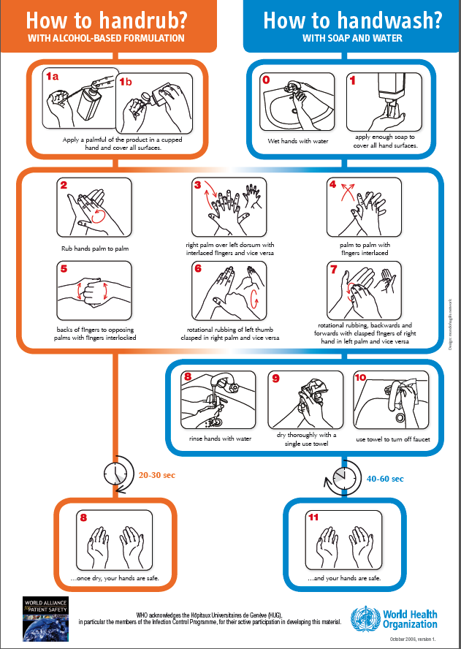

Slide 98
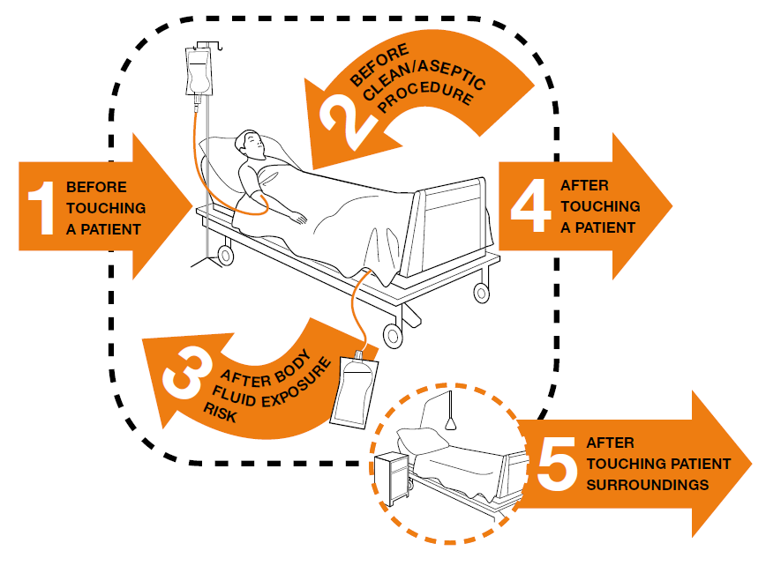
Hand Hygiene Compliance
Most of us remember to “wash in” and “wash out” when entering or exiting patient rooms, but there are many more moments when hand hygiene is indicated for the safety of our patients.

Slide 99
Hand Hygiene
During a sequence of health-care activities, certain indications for hand hygiene may coincide at the same moment.
  For example, one instance on hand hygiene would be acceptable if a caregiver entered a patient room and performed hand hygiene (before patient contact) and then went directly to care for a patient’s foley catheter (before clean/aseptic procedure).
  In contrast, two instances of hand hygiene would be required if a caregiver entered a patient room, took the patients blood pressure and then was going to care for the patient’s foley catheter, hand hygiene would be indicated both upon entry to the room (before patient contact) and before caring for the foley catheter (before clean/aseptic procedure).
  If you’re in doubt as to whether or not to perform hand hygiene at any given time, perform hand hygiene!

Slide 100
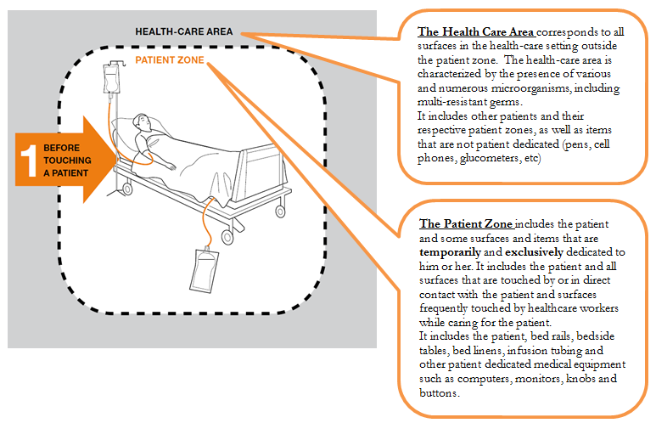
Hand Hygiene
It is also important to have an understanding of the health care area and the patient zone (WHO):

Slide 101
Hand Hygiene
The Patient Zone:
  For example, when a person enters the patient zone he/she may touch the patient dedicated monitor and apply the blood pressure cuff to the patient’s arm, document the blood pressure on the patient dedicated computer, and remove the blood pressure cuff from the patient’s arm. Hand hygiene would be indicated prior to entering the patient zone and upon leaving the patient zone.
  In contrast, if a person enters the patient zone and applies the blood pressure cuff and then answers their portable phone (Health Care Zone), hand hygiene would be required again before removing the blood pressure cuff.

Slide 102
Other Aspects of
Hand Hygiene
Artificial nails, nail embellishments, wraps, and nail extenders are not allowed in patient care areas, FNS, EVS and Pharmacy compounding – they are germ magnets
Nail polish is allowed if not cracked. Nail polish is not allowed when performing surgical scrub role or pharmacy compounding.
Keep nails short - 1/4 inch or less, no longer than 2mm (0.08 inches) if performing surgical scrub role
Use hospital provided unscented lotions

Slide 103
Glove Use
Glove Use Indications:
1. Before a sterile procedure (Sterile gloves are used for invasive procedures, as indicated.)
2. When anticipating contact with blood or another body fluid. (including contact with non-intact skin and mucous membranes)
3. Contact with a patient (and his/her immediate surroundings) during contact or contact plus precautions.
The use of gloves when not indicated does not contribute to a reduction of cross-transmission and it may also result in missed opportunities for hand hygiene.

Slide 104
Standard Precautions protect you and our patients
Follow Hand Hygiene Rules
Respiratory Hygiene (cover coughs)
Use personal protective equipment, if indicated
Clean and disinfect patient care equipment and environmental surfaces per your unit’s protocol
Handle soiled linen carefully
Reduce risk of blood and body fluid exposures
No sign is placed because these precautions are the basics that we start with!
Notes:
Barriers to use in anticipated exposure see Standard Precautions handout
Refer to Cough Etiquette Poster for discussion on first point of patient contact.

Slide 105
Standard Precautions
Used, at minimum, for all patients.
Assume that every person is potentially infected or colonized with an organism that could be transmitted in the healthcare setting.
Wear PPE according to the level of anticipated contamination. For example (CDC):
Taking vital signs? | Generally none
Suctioning oral secretions? | Gloves and mask/goggles or a face shield – sometimes gown
Transporting a patient in a wheel chair? | Generally none required
Responding to an emergency where blood is spurting? | Gloves, fluid-resistant gown, mask/goggles or a face shield
Drawing blood from a vein? | Gloves
Cleaning an incontinent patient with diarrhea? | Gloves with or without gown
Irrigating a wound? | Gloves, gown, mask/goggles or a face shield

Slide 106
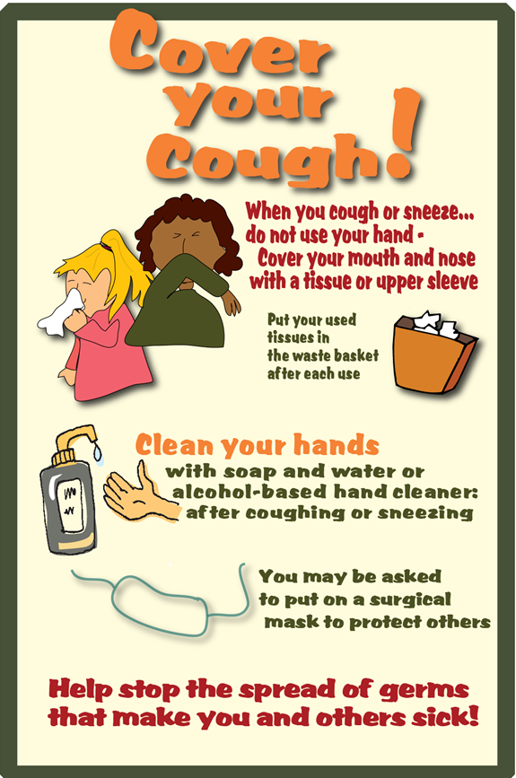
Respiratory Hygiene

Slide 107
Transmission Based Precautions
(Isolation Precautions)
Used above and beyond Standard Precautions when there is an increased risk of spread of disease or condition.
Signage is placed outside of patient rooms to indicate the increased protection that is necessary.
Staff should not enter room without the specified PPE. If staff has questions, they should ask a member of the patient’s care team.

Slide 108
Contact Precautions
(Used for MRSA, MRSA History or other multi drug resistant organisms such as CRE and ESBL)

Slide 109
Contact Plus Precautions
(used for suspected of confirmed C.Difficile, Norovirus)
Note the need for using soap and water for hand hygiene, not hand sanitizer for all patients in Contact Plus Precautions
Notes:
Contact Precautions and PPEs - excessive wound drainage, fecal incontinence, discharges, MDROs infected or colonized
Droplet - close contact with large particles. Pertussi, N. meningitidis, SARS, influenza, adenovirus, and group A strep
Airborne - measles, chickenpox, M tb. Non immune should not care for patients regardless of respirator; immune should wear respirator for complete protection.
Protective environment - applies to patients with hematologic malignancies
Refer to sample CDC chart for type and duration of precautions.
Refer to sample CDC chart for conditions warranting empiric precautions.

Slide 110
Droplet Precautions
(Used for pneumonia, n. meningititis, influenza)

Slide 111
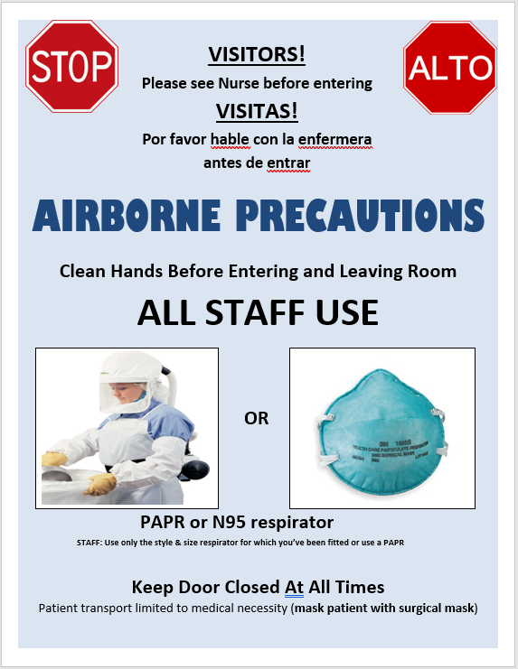
Airborne Precautions
(used for suspect or confirmed TB, disseminated shingles, chicken pox)
Patients will be placed in a negative pressure room.
You will notified by Cardiopulmonary Staff if you need training on N95/Powered Air Purifying Respirator (PAPR).
Mask the patient, if possible, and always keep door closed.

Slide 112
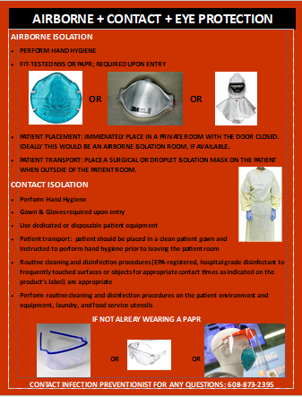
Covid-19 Precautions

Slide 113
TB Transmission
Our hospital is classified as low risk
Employees are screened for TB upon hire and as needed; annual TB screening is not required for employees.
Know the signs/symptoms of TB
  Persistent Cough lasting three or more weeks AND one or more of the following symptoms:
    Coughing up blood
    Fever
    Night sweats
    Unexplained weight loss
    Fatigue
Risk for TB infection:
  Birth, residence or travel (for > 1 month) in a country with a high TB rate
    Includes any country other than the United States, Canada, Australia, New Zeland, or a country in western or northern Europe
    Travel is of extended duration or including likely contact with infectious TB.
  Close contact to someone with infectious TB disease
Patients who screen positive for potential TB should immediately be placed in appropriate isolation.
Notes:
Cough lasting longer than 3 weeks with fever, chills, night sweats, weight loss, or coughing up blood.
Discuss PCR testing if there is time.

Slide 114
Personal Protective Equipment (PPE)
Guidelines:
PPE is not allowed outside of patient rooms (except during
transport of patient in isolation)
It is critical that you don and doff PPE carefully
Avoid touching your face when wearing PPE
Change PPE if torn or heavily contaminated
Avoid touching fronts of PPE when removing
Perform hand hygiene before donning PPE and after PPE disposal

Slide 115

Infection Prevention Matters
Video-Prevention Healthcare-Associated Infections (HAI)
Partnering to Heal intro video without subtitles

Slide 116
Hospital Acquired Infections
  We monitor and report the following Hospital–associated infections to CDC
  CLABSI (Central line-associated bloodstream infections)
  CAUTI (Catheter-associated urinary tract infections)
  SSI (Surgical site infections related to Hip and Knee Replacement, Colon Surgery, and Abdominal Hysterectomy)
  CRE (antibiotic-resistant Klebsiella, Enterobacter, and Escherichia (E.coli) in urine, stool, wound cultures
  MRSA bloodstream and C. Difficile infections

Slide 117
Communicable Disease Reporting and Outbreaks
Examples of diseases that are reportable to public health are:
  Covid-19, Influenza or RSV hospitalizations lasting longer than 24 hours
  Suspect or confirmed Pertussis (Whooping Cough, Measles, Chickenpox, or TB (Tuberculosis)
  Foodborne or waterborne gastroenteritis, food poisoning outbreaks
  Sexually transmitted diseases

Slide 118
Employee Health
What you can do to reduce risk..
Assure you are vaccinated against communicable diseases
COVID-19 vaccination is not required but is encouraged
Influenza vaccination is required for all healthcare personnel (employees, volunteers, licensed healthcare professionals including medical staff) unless have submitted a signed waiver
Employees are required to contact their manager or Care Coordinator via phone and encouraged to report their symptoms when sick. Return to work guidance will be provided.
Be sure to report your symptoms accurately and know when you are too sick to work or when your illness can be spread to others.
Notes:
Go over any employee health issues that need completion with employees at end of orientation.
Discuss goal of 80% employees vaccinated.

Slide 119
Safe Injection Practices
  Cases of patients contracting potentially fatal but easily preventable infections have occurred when providers do not follow safe injection practices!

Slide 120
Safe Injection Practices
  *Never administer meds from the same syringe to more than one patient. After a needle has been used, it is considered contaminated and should not be re-used
  *Never enter a med vial with a used needle or syringe. Do not use IV bags as a common source of supply for more than one patient
  *Minimize the use of multi-dose vials. Never use medication packaged as single-dose for more than 1 patient
  Speak up if you observe misuse of vials, needles, or syringes!

Slide 121
Blood borne Pathogen Exposure Safety
Assure you are vaccinated against Hepatitis B if you could be exposed
Use needles and sharps with safety features that click/snap or needleless devices. Do not disable any safety features.
Use a one-handed method to safely dispose of sharps into the sharps container
Replace sharps containers when the level reaches the full indicator line.

Slide 122
Significant Exposures
Transmission of HIV, Hepatitis B and Hepatitis C viruses can occur if you are exposed to infected blood or other potentially infectious material
Injuries may occur:
during use and disposal of needles and sharps
via splashes or sprays to mucous membranes (eyes, nose, mouth)
If you are injured
perform first aid – Stop bleeding, flush and wash with soap and water
report the injury to your supervisor and in Safety Zone Portal as soon as possible
Seek medical evaluation within the hour if possible. Call the Employee Illness/Significant Exposure Hotline 608-873-2383 for treatment guidance and instructions.
Jen Mora, Preventative Health Nurse Practitioner will provide significant exposure follow-up

Slide 123
Any Questions?
Contact:
Bill Wilson, Infection Preventionist
608-877-3407 Ext. 3407 wwilson@stoughtonhealth.com
Infection Prevention Hotline 608-873-2395 Ext. 2395
Jen White, Quality Manager
Jen Mora, Preventative Health Nurse Practitioner
Rhonda Tesmer, Clinical Quality Specialist

Slide 124
Lunch Break
Tour to follow lunch

Slide 125
Meet the Human Resources Team
Christopher Schmitz
VP of Human Resources
Tonya Stenback
HRIS Analyst and Benefits Administrator
Melissa Kitelinger
Jenifer Kenrick
Employee Relations & Organizational Development Consultant
Human Resource Representative

Slide 126
Employee Recognition
Diversity/Equity/Inclusivity
Policy & Procedures

Slide 127
Employee Recognitions
Daily Recognitions:
  Kudos Line
  Shine Award
    Stoughton Health Incredibly Noteworthy Employee
  Thank You Cards
  Personal Preference Profiles
Monthly Recognitions:
  Birthday Celebration with Administrators
  Standards Honors (Monthly nominees – twice/annual luncheon)
  Daisy Award (Monthly nominees – twice/annual celebration)
  Bee Award (Monthly nominees – twice/annual celebration)
  Quarterly Recognitions:
  Employee Anniversary Recognitions
Annual Recognitions:
  Fall Party/Family Picnic
  Holiday Open House

Slide 128
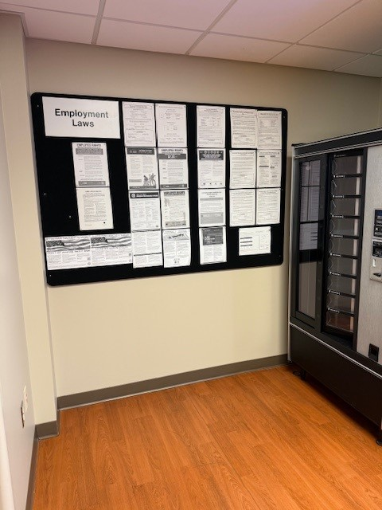
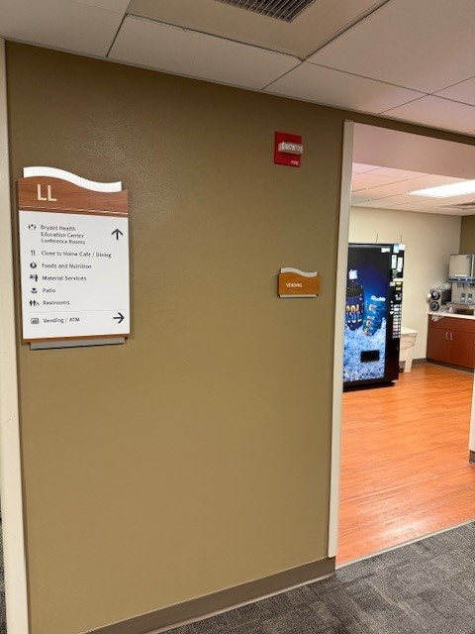
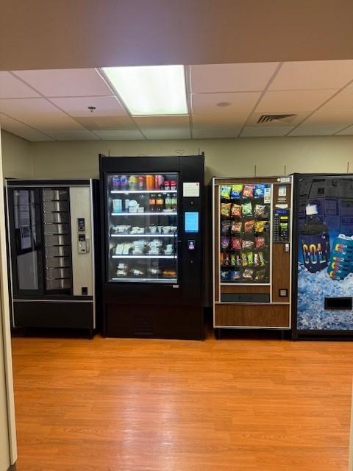
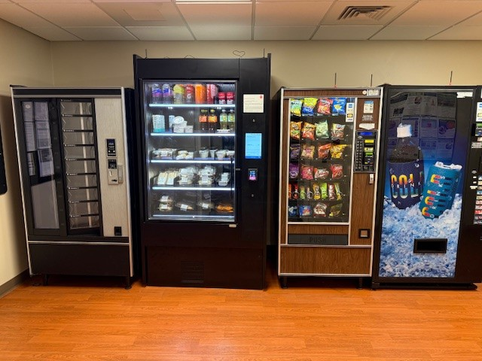
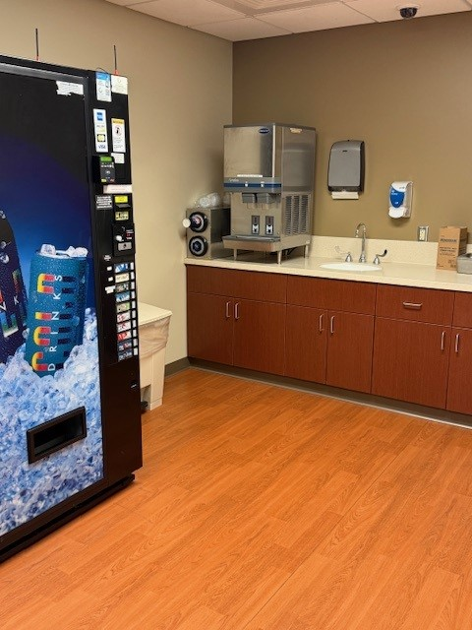
Labor Law Postings/Vending Area

Slide 129
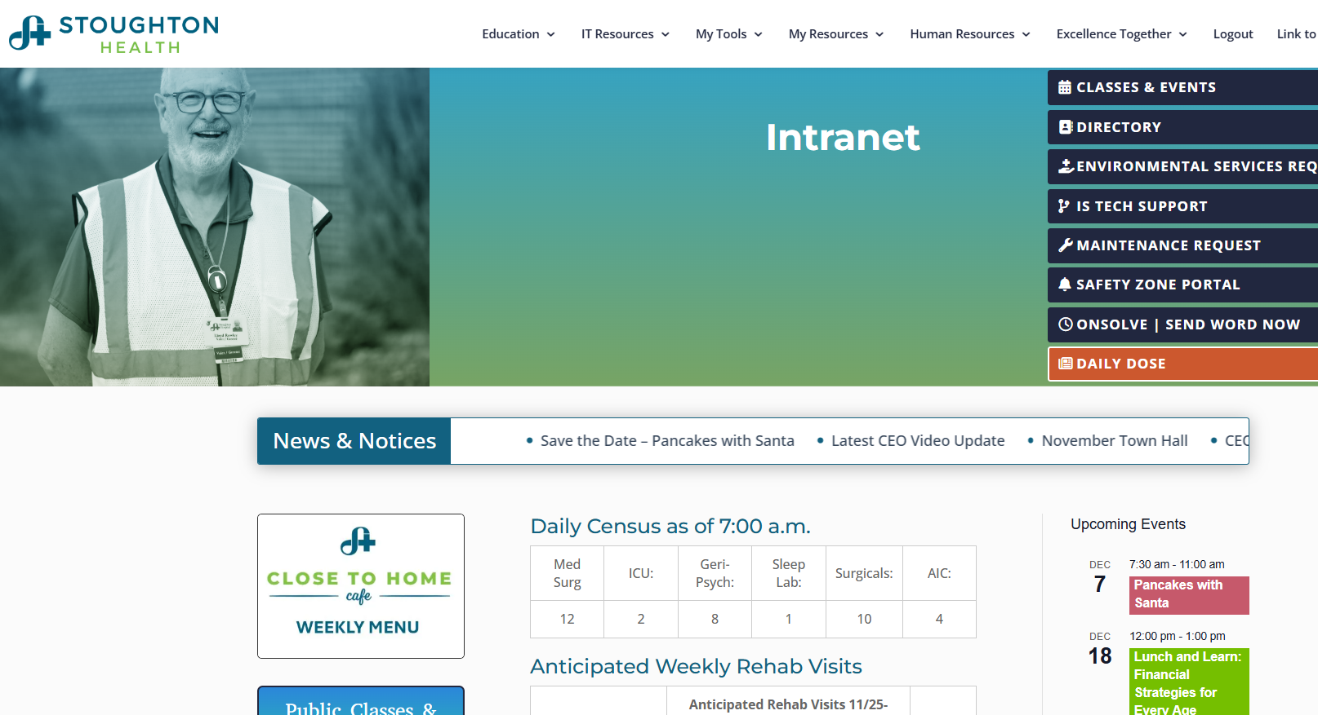
Notes:
Ask participants have they gone on the SH Intranet site yet?
Ask each person to follow along on their computer
Can each person access the HR tab

Slide 130
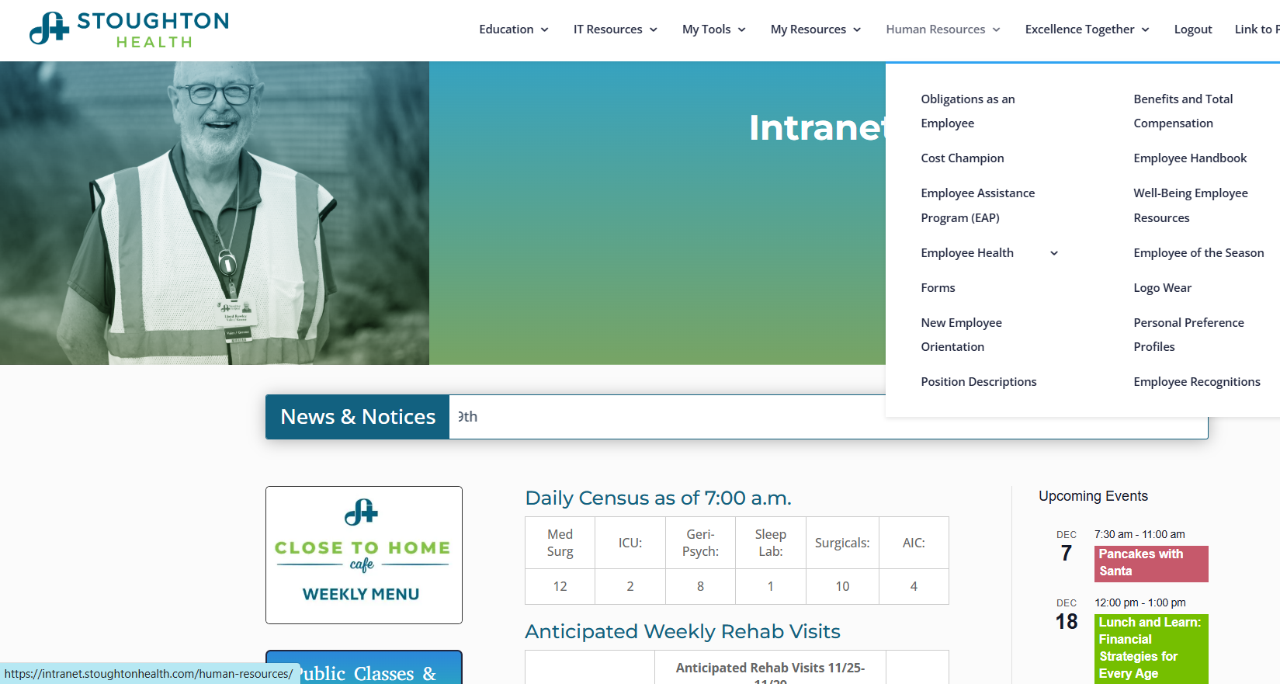

Slide 131
Diversity
At Stoughton Health, we believe that creating Excellence Together starts with a foundation of inclusion, compassion and respect for our patients and each other.
Diversity is generally defined as acknowledging, understanding, accepting, valuing, and celebrating differences among people with respect to age, class, ethnicity, gender, physical and mental ability, race and sexual orientation.
Please refer to the Diversity handout in your packet. Let’s take a moment to review this.
Notes:
Have orientees review handout in their packets.
After a minute or so, ask the group, “Can anyone share a time when you felt included or excluded?” “How did that make you feel?”

Slide 132
Diversity, cont.
  We are committed to fostering a culture of inclusion across all areas of our organization and do not discriminate.
  We strive to be a fair, equitable, healthy and inclusive organization that aligns with and supports our patients, our workforce and the communities we serve.
Notes:
We are creating a new Excellence Together Team called “Caring for Everyone”.
Caring for Everyone is a staff group that is dedicated to creating a healthcare environment where all individuals feel welcomed, respected, and valued.
If you are interested in joining or offering ideas for this group, please reach out to Andy Boryczka, Director of Engagement & Experience.

Slide 133

Notes:
A diverse workforce is a reflection of a changing world and marketplace.
Diverse work teams bring high value to organizations.
Respecting individual differences will benefit the workplace by creating a competitive edge and increasing work productivity.

Slide 134
HR Policies – See Handouts
Employee Dress Code #9.19
Attendance Policy #9.46
Anti-Harassment/Bullying #9.22
Your Obligations as an Employee of Stoughton Health #9.86

Slide 135
Summary of Employee Dress Code Policy #9.19
Our appearance, both inside and outside the hospital, is a reflection of the care we provide to our customers. (Patients are the first priority)
Stoughton Health’s Smart Casual dress code policy provides a consistent professional appearance to our customers and colleagues. The goal is to be sure we maintain a positive appearance and not to offend customers, clients, or colleagues.
Good personal hygiene is also essential in a hospital.
This policy may apply differently to general office areas in the hospital vs. patient care areas due to various safety, legal and infection control regulations
Notes:
Has your manager talked with you about the dress code for your department?
Go over each person’s dress code with them individually or as a group if multiple clinical folks. (For example, no specific colors for scrubs and no cartoon characters)
If you have questions about the dress code, we encourage you to talk to your manager directly. Or, you are welcome to ask HR and we will find out and get back to you.

Slide 136
Summary of Employee Dress Code Policy #9.19
Smart casual is neat and professional, but less formal than “business casual”. Smart casual is clean, yet comfortable, semi-formal appearance.
Employees are expected to dress smart casual attire unless the day’s tasks require otherwise. Dress for your audience.
Department managers have the right to set the dress code specific to their department(s).

Slide 137
Employee Dress Code Policy #9.19 cont. (Examples of Correct Procedures)
Hair (including facial hair) should be trimmed and well groomed.
Some of our coworkers and guests are highly sensitive to strong odors. Colognes, perfumes and scents of any kind should be used sparingly as to not offend anyone.
Stoughton Health logo wear is permissible. Stoughton Health permits SH logo-wear t-shirts.
The leadership teams reserve the right to define what is inappropriate for the workplace. This includes reserving the right to cover tattoos and piercings inappropriate for a job-specific function.
If it has to involve Human Resources then it’s probably inappropriate.
Employee badges will be worn at chest level at all times for customer service and safety.
Appropriate undergarments are to be worn.
All footwear must be clean, safe, and appropriate to the job being performed.
Denim is permissible, free of holes, fading, or embellishment, and appear clean.
Uniforms may be required in some departments.

Slide 138
Any Questions
Re: Dress Code?

Slide 139
Summary of Attendance & Unplanned Absence Policy #9.46
An unplanned absence is defined as any absence from scheduled work that was not previously approved through a PTO or leave of absence request. Tardiness is defined as not being at your workstation and "ready to work" at your scheduled start time.
An employee must notify their manager of their request to make a schedule change as early as possible, but at least one manager workday’s notice is required. A manager has the right to accept or deny any request.
Six (6) or more occurrences of unplanned absences or six (6) or more tardies in a rolling twelve month period is considered excessive and may result in disciplinary action, up to and including termination.
New employees may be subject to stricter guidelines than mentioned above.
Consecutive days off for the same situation will count as only one occurrence. If an employee is off work, returns to work, but then relapses within three calendar days for the same illness the absence will be counted as one occurrence, not as multiple occurrences.

Slide 140

Attendance Policy – Unplanned Absences
New Employees -6 Month Probationary Period
  1st Unplanned Absence –Friendly warning from manager
  2nd Unplanned Absence –Final Written Warning
  3rd Unplanned Absence –Termination of Employment

Slide 141
Attendance Policy –
Unplanned Absences Cont.
All Employees (after first 6 months)
  1st – 3rd Unplanned Absences -No Coaching
  4th – 5th Unplanned Absences -Verbal Reminders
  6th Unplanned Absence –Documented Coaching
  7th Unplanned Absence -Documented Disciplinary Warning
  8th Unplanned Absence –Documented Final Disciplinary Warning
  9th Unplanned Absence -Termination of Employment

Slide 142

Who to call if you are sick?
Call your manager.
If it’s PM’s, Evenings, or Weekends, call the Care Coordinator at 608-873-2358.
You can never go wrong by calling the Care Coordinator. They will relay the message to the appropriate people.
Your department manager should also go over this procedure with you.
Notes:
Handout reference card to each orientee.
Reference card will be pre-filled with each employee's manager’s phone number.
Can also offer that folks can pull out their phones and add the number to their contacts, if easier.

Slide 143
Any Questions
Re: Attendance & Unplanned Absence?

Slide 144
Summary of Anti-Harassment/Bullying Policy #9.22
Stoughton Health is an equal opportunity employer committed to maintaining a workplace free from any type of discrimination, including freedom from sexual or other harassment (with regard to an individual's race, color, religion, sexual orientation, gender identity, national origin, age, disability, etc.), or other derogatory or objectionable conduct.
Stoughton Health also considers workplace bullying unacceptable and will not tolerate it under any circumstances. In keeping this commitment, Stoughton Hospital deems this behavior toward any of its employees or customers to be strictly prohibited.
Definition: “Harassment” Conduct that has the purpose or effect of unreasonable interference with work performance, or which creates an intimidating, hostile, or offensive working environment.
Definition: “Bullying” is offensive, intimidating, malicious or insulting behavior involving the misuse of power that makes a person feel vulnerable, upset, humiliated, undermined or threatened. “Power” does not always mean being in a position of authority, but can include both personal strength and the power to coerce through fear or intimidation. Bullying can take the form of physical, verbal and non-verbal conduct.

Slide 145
Summary of Anti-Harassment/Bullying Policy #9.22
Any employee who has been subjected to harassment/and or bullying or believes they have observed prohibitive harassment/and or bullying occurring in the workplace should report the incident immediately to the Human Resources Vice President without fear of retaliation.
Harassment/Bullying Reporting forms are available from the Human Resources Department.
Notes:
Common practice – See it, Report it or Hear it, Report it

Slide 146
Any Questions Re:
Harassment/
Bullying?

Slide 147
Summary of Your Obligations as an Employee of SH #9.86
As a health care employer, Stoughton Health must meet many different regulatory requirements from various federal, state, local and accrediting agencies. These requirements are stringent but intended to ensure your safety and the safety of our patients.
As an employee of Stoughton Health, it is your obligation to hold yourself accountable and comply with any requirements in a timely manner.
As an employee of Stoughton Health, your work performance will be measured on the following evaluation criteria:
  Position description/performance evaluation measures
  Adherence to department specific policies and procedures
  Adherence to guidelines and procedures outlined in the Employee Handbook
  Adherence to general policy and procedures
  Adherence to Standards of Performance

Slide 148
Summary of Your Obligations as an Employee of SH #9.86
There are a variety of conditions of employment that we are expected to be accountable for:
  Mandatory meetings/education due dates
  Staff meetings
  Policy review
  Health requirements/vaccinations
  Licensing and certification renewal
  Completing and turning requests in on time
  Annual Self Evaluations
  Self accountability (annual self evals, mandatory meetings)
  Responding to all work emails in a timely manner (Expectation to check work emails at least once per shift)
  Telephone scripting/etiquette
  Social media posting accountability
  HIPAA privacy

Slide 149
Summary of Your Obligations as an Employee of SH #9.86
Please review policy 9.86 for more specific details and your obligations.
Notes:
All employees are required to be compliant with the many regulatory requirements we have.
If not compliant by due dates, then you will not be permitted to work, and your potential annual pay raise will be withheld.
Because of the serious consequences of non-compliance, Stoughton Heath must take a firm stand and managers will coach and discipline employees as appropriate who do not meet these requirements by the communicated deadlines.

Slide 150
Any Questions Re:
Your Obligations as an Employee?

Slide 151
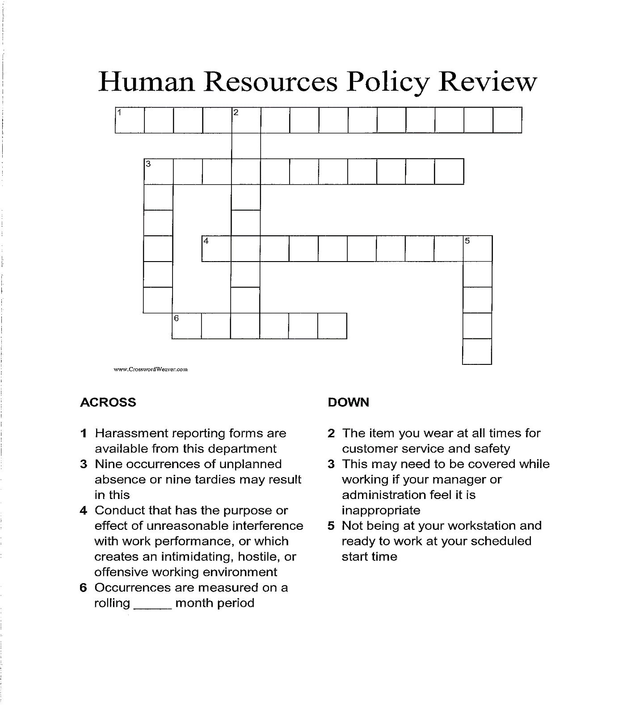

Slide 152
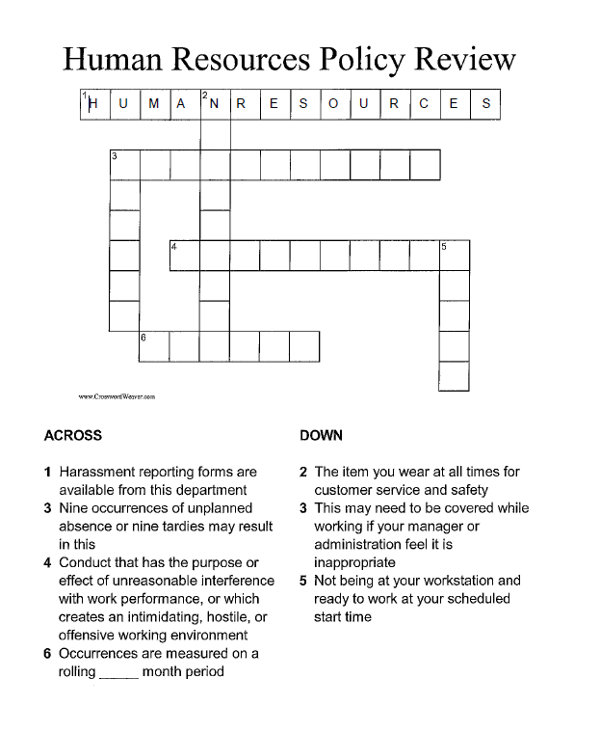

Slide 153
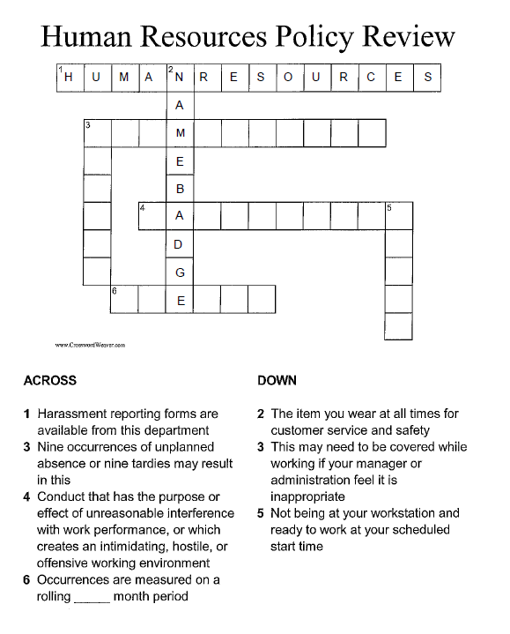

Slide 154
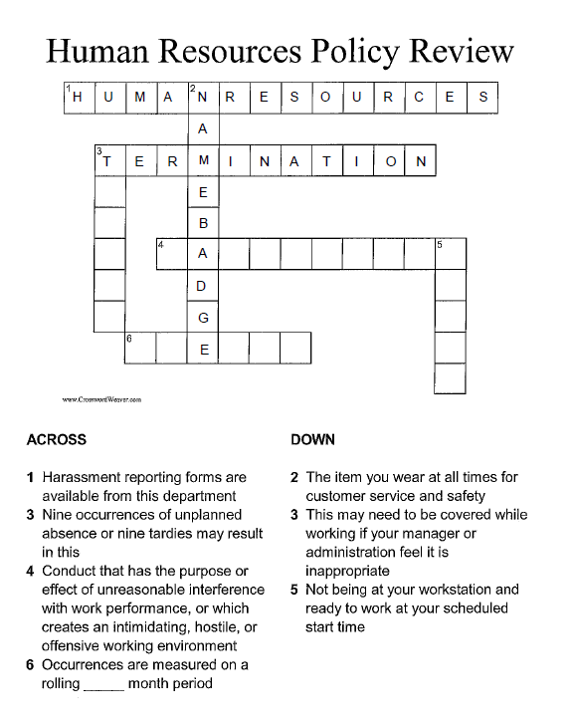

Slide 155
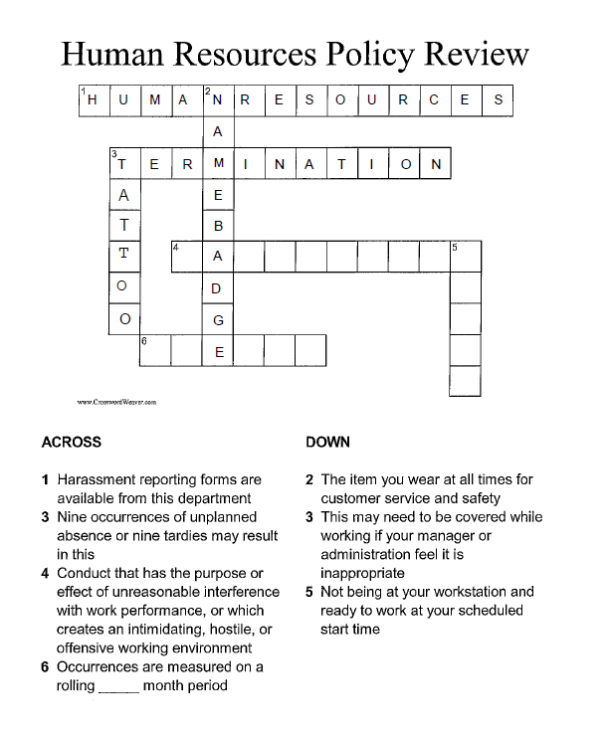

Slide 156
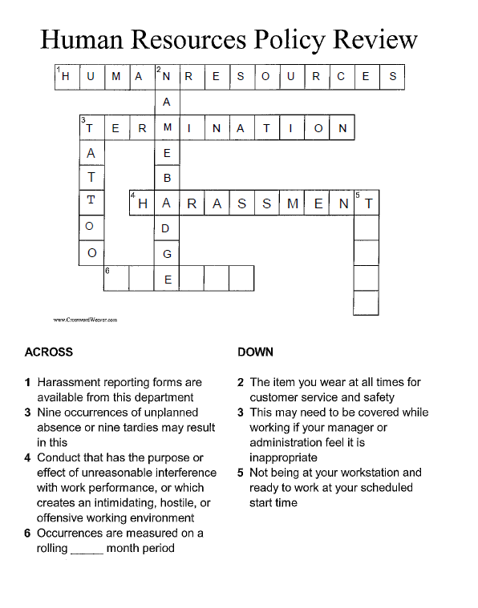

Slide 157


Slide 158
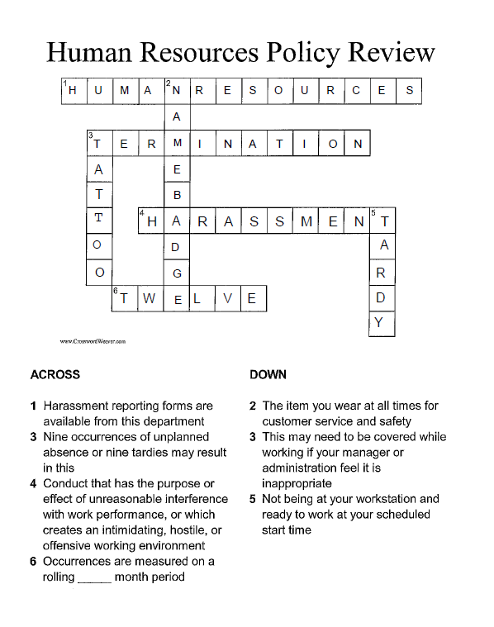

Slide 159
Employee Health & Safety
Stoughton Health Department of Rehabilitation Services

Slide 160
Introduction
Most common injuries
  Strains of the back and shoulder
  Overuse in elbow, wrist, hand
80% of the adult population can be affected by back pain at some point in their lifetime
Work-related musculoskeletal disorders account for >30% of all nonfatal occupational injury cases each year
  20% of job-related injuries involve the back
  Impacts employers $20 billion annually in direct workers compensation costs
Notes:
Maybe update to your stats

Slide 161
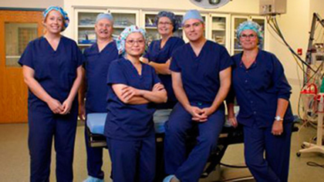
Stoughton Health is Dedicated to Keeping our Workforce Healthy!
The rehab department performs ergonomic assessments of each department of the hospital
  Provides recommendations for a safer workplace
Injury prevention exercises
Ergonomic assessments
  Optional for employees as needed
  Sign up on the Safety Zone Portal

Slide 162

Injury Prevention Exercise Program
30% reduction in workplace injury rates after adding stretching programs
Highly recommended to do these exercises prior to the start of each shift to warm up your muscles for the day
Refer to any of these exercises as needed throughout your work shift
These exercises can be found on the Intranet

Slide 163

Injury Prevention Exercises

Slide 164

When Injuries Happen at Work
Prevention is key, but injuries do happen. Take the following steps to minimize your lost days from work:
  Alert your manager that an injury occurred
  Submit an event on the Safety Zone Portal
    If injury is musculoskeletal you will be contacted by our Occupational Health RN to set up a PT/OT screen.
    If you need immediate first aid, seek out our Urgent Care/ED

Slide 165
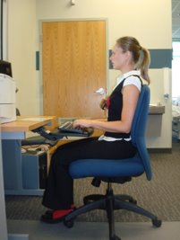
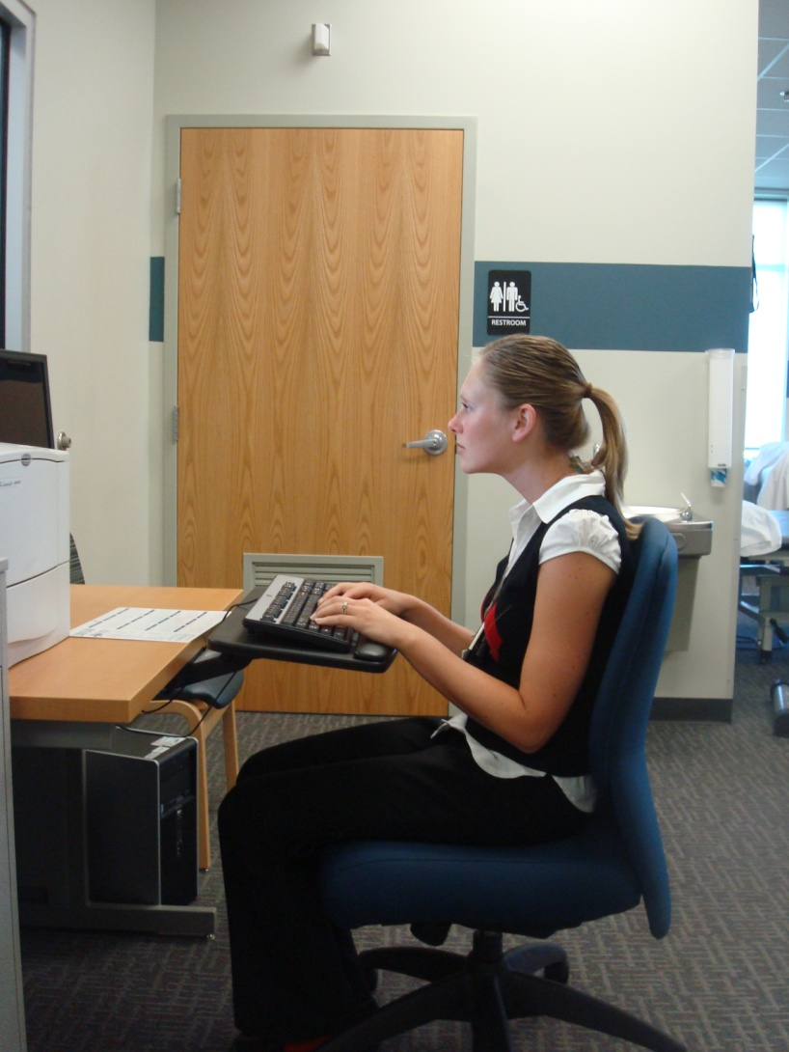
Body Mechanics
Key take–away items:
  Good posture with engaged core when lifting
  Workstation set-up
    Chair
    Desk – Keyboard, mouse, and monitor
  Telephone use – hands free when available
Notes:
*Discussion about good set-up for chair/computer:
-feet on floor or stool, sit back in chair with good lumbar support, chair height where hips are slightly above knees, arms at sides with elbows at 90 deg angles with wrists straight (neutral)
-computer height at eye level
-no big reaching for mouse or phone
-Telephone: use headset for frequent phone use
-Standing: keyboard at waist level, with monitor still at eye level; stand on anti-fatigue mat with supportive shoes
-use of 2 monitors: sit in between the monitors, positioned angled in toward you

Slide 166
Other Factors for Consideration
Physical Fitness and Exercise
  150 min/wk cardio and 2x/week of strength training
  10% rule – doing too much too soon
Good Nutrition
  Excess weight leads to changes in posture and increases wear/tear on the joints
Stress Management
  Back pain flares after periods of increased tension
Smoking/Vaping
  Restricts blood flow and slows healing
  Impacts returning to work

Slide 167
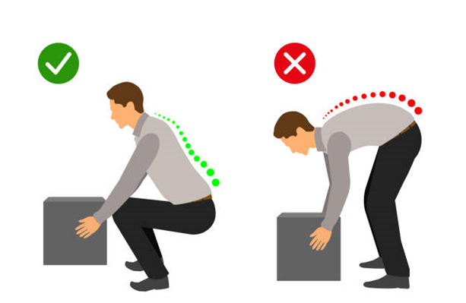
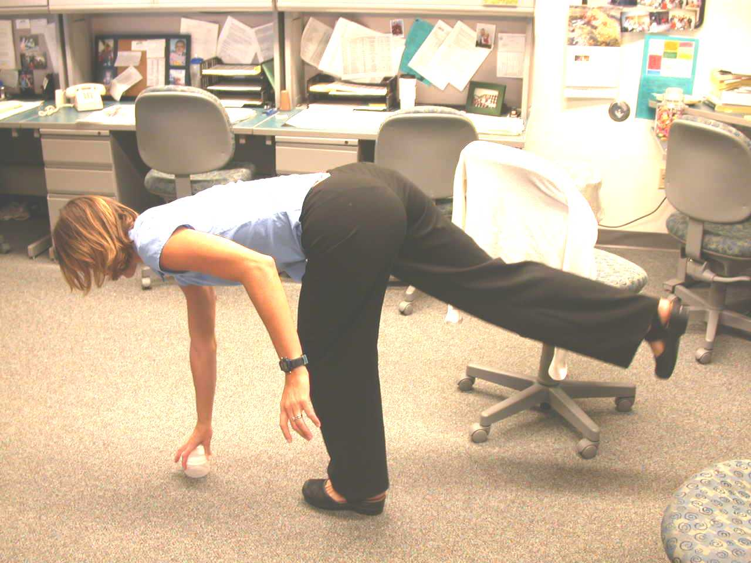
Safe Lifting Techniques
Heavier Loads
  Squat Lift
  Mechanical vs 2-person lift for very heavy loads
Lighter Loads
  Golfer’s lift
Notes:
Squat Lift (speaker demonstrates squat lift):
Use a wide balanced stance
Keep the load as close to your body as possible
Tighten the stomach muscles as you lift
Lift with your legs and stand up in a smooth, even motion
Avoid holding object away from your body while twisting
Speaker Demonstrates golfer's lift

Slide 168

Well-Being Program
Holistic approach to well-being
  7 spokes of the well-being wheel
    Physical, mental, emotional, creative, social, spiritual, financial
  Incentive for staff participation
    Based on FTE and successful completion of monthly challenge
Health Risk Assessment and Screening
  Service available to employees on an annual basis
    Early detection is key
    Healthy workforce = Happy workforce

Slide 169
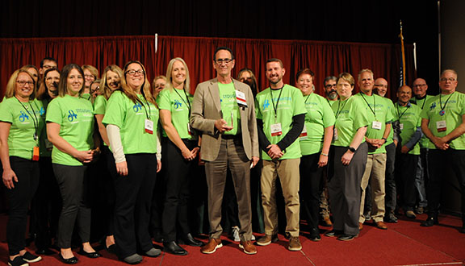

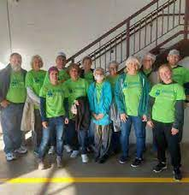


Community Involvement
Stoughton Health values the local community!
Shows support through several events
  Relay for Life
  Heart Walk
  Alzheimer’s Walk
  Other community events in Stoughton and surrounding areas

Slide 170

Summary
Prevention is key
  Use the intranet for injury prevention exercises
  Reach out if you need an ergonomic assessment via safety zone portal
  Participation with Well-being program is encouraged
Early action helps
  If an injury happens, don't delay, report right away

Slide 171


Slide 172
Safety

Slide 173

Overview
Keeping Yourself Safe
Employee Safety and Patient Safety Focus
Patient/Other/Employee Event Reporting
Maintenance Work Orders
Emergency Alerts
Hazard Communication Standard: “Right To Know”
Life Safety
Environment of Care
Notes:
Preparation:
Grab fire extinguisher from wall by computer room
New Employee Safety Orientation (will have to fill out today for personnel file) 3. Give them each a Emergency Alert Sheet Will need MRI form and safety orientation test sheet same day.

Slide 174

A Safe Workplace is a Happy Workplace
Workplace Safety Tips
Beware of your surroundings & potential risks
Use tools, Machinery & equipment properly.
Report any unsafe conditions or hazards
Always wear proper PPE
Keep work are clean & free from clutter
Practice good posture when sitting or lifting
Never take shortcuts
Chemicals used correctly, labeled & stored properly.
Remain aware of new and reviewed safety procedures
Submit Maintenance Work Orders for repairs
Report All Hazards, Safety Concerns, using the “Safety Zone Portal.”
Daily Take an Active Role!
Notes:
Ask if who could name a potential hazard in their work environment or the facilities and what could you do to reduce the risk and prevent injury.

Slide 175


Patient Safety
National Patient Safety Goals
“Speak Up” brochures - Patient/Family
Patient/Family Concerns/Feedback
Notes:
Safety part of mission statement on nametag (word “safe” put in a few years ago)
NSPG – Stoughton one of first hospitals to open charts to WHA for Checkpoint; very transparent
Patient Safety Coordinator = TINA; she submits data to WHA
BEFORE signing safety sheet today, you acknowledge that you can report concerns without fear for job.

Slide 176


The Right to Report “Patient Safety” Concerns
Anyone with a patient concern, especially healthcare workers, have a right to notify healthcare regulatory agencies if you feel the hospital has not adequately prevented or corrected problems that can have or have had a serious impact on Patient Safety and Quality of Care.

Slide 177

Employee/Patient/Other Event Reporting
9
Stoughton Health Intranet (SHI)
My Tools section
Safety Zone Portal (SZP)
All events will be documented and submitted
on the shift it occurred using the SZP for:
  Patient/Other Form
  Employee Form
Notes:
Open Intranet and find SZP
Click on Submit Event
Choose Employee and Fill out
NEVER fill out Social Security
Under Event Type, click on Employee Incident. Must do this in addition to choosing employee at top of screen.
Don’t forget to ask for help.
Additionally, show patient/other form and briefly run through the process.
Focus on Good Catch/Near Miss and the importance of documenting these events.

Slide 178
Emergency Alerts
ALERTS | Description
Amber Alert | Missing child
Command Center External Alert | Large number of patients coming to ER
Command Center Internal Alert | Major hospital system not functioning
Fire Alert + Location | Fire on hospital /Clinic Campus
Lock Down Alert | Need to lock all entrances
Search Department Alert + Phone # to report to | Bomb threat received
Security Alert: Weapon | Person out of control with weapon
Security Alert: Code Strong | Person out of control
Wandering Patient Alert + Descriptor (e.g. elderly male, white hair, blue shirt) | Hospital patient has wandered off
Severe Weather Alert - Tornado Warning | Threat of a tornado in our area
Notes:
Switched to plain language May 2, 2011
Emergency alerts can also be found on employee name badge

Slide 179

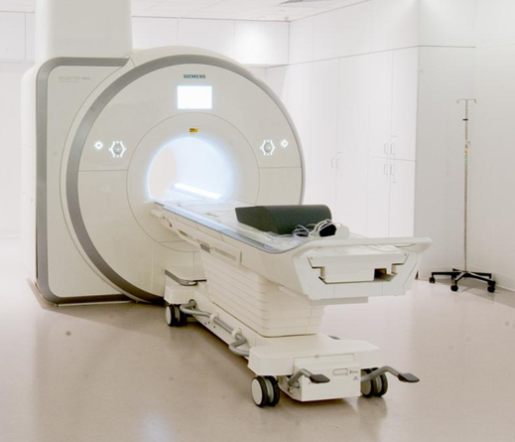
MRI Safety
Remember…
THE MAGNET IS ALWAYS ON!
24/7 – 365 days of the year!
The magnetic field is invisible.
Not dangerous for patients or personnel… if appropriate safety procedures are followed.

Slide 180
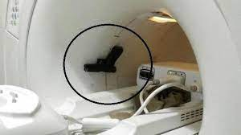
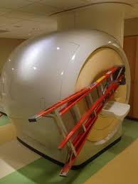
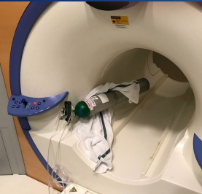
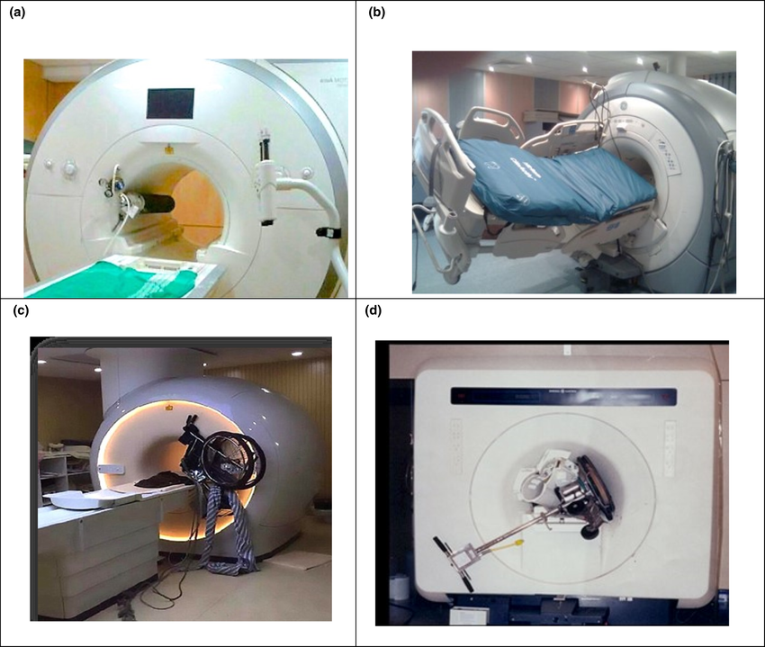
Serious or fatal incidents can occur if safety procedures are not followed...
MRI scan at a Rochester, N.Y., hospital pulled a gun out of a police officer's hand and discharged a shot.
ABC News
July 31, 2001 -- A 6-year-old boy died after undergoing an MRI exam at a New York-area hospital when the machine's powerful magnetic field jerked a metal oxygen tank across the room, crushing the child's head.
The force of the device's 10-ton magnet is about 30,000 times as powerful as Earth's magnetic field, and 200 times stronger than a common refrigerator magnet.
MELBOURNE, AUSTRALIA —The Alfred Hospital has announced a review of its safety procedures after the death of a man whose pacemaker malfunctioned during a magnetic resonance imaging scan. Hospital spokesman David Faktor admitted safety procedures were not properly followed during MRI treatment on April 1.
The Herald Sun-News Corporation
Seattle (AP) An expensive MRI machine at Virginia Mason Medical Center sustained at least $200,000 in damage when a metal floor buffer was mistakenly placed nearby and was sucked in by the machine's powerful magnet. A member of the housekeeping staff improperly took the buffer near the machine, despite a warning sign not to use metal objects near it. Jan. 10, 2005

Slide 181

What Are the MRI Safety Codes
Why is screening for the MRI so important?
First, the magnet is always on.
Second, the magnetic field is 40,000 times stronger than the earth’s gravity.
What does this mean? Large to very small non-approved magnetic items brought into Zones 3 & 4 can become a flying projectile objects that can fly up to
40 mph depending on shape, size and distance from the scanner.
Magnetically effected items inside the body, such as metal shavings certain color ink used in tattoos, tattoo eyeliner, bullets, or implanted pacemakers, etc. it can cause harm if not investigated initially.
That’s why it is critical and a must to screen everyone in Zone 1 and 2 prior to entering Zones: 3 and 4.

Slide 182
MRI Safety Zones
Each Zone represents a progressively greater level of access restriction.
Zone 1 | Zone 2 | Zone 3 | Zone 4
This zone has no detectable magnetic field and there is no restriction on access. The public is free to move around without being screened. This zone would include the waiting area and hallways outside of the restricted MRI hallways. | This zone still has no detectable magnetic field, but we do restrict access because it is close to the MRI scanners. Patients, families, and visitors must be escorted into Zone 2. | This zone is only one door away from the MRI scanner, which always has its magnetic field on. There could be a detectable magnetic field in this zone. Patients, families, employees, and visitors must first be screened by either one of our MRI core staff or MRI safe staff and have on either an Orange Zone 3 MRI screened sticker or Red Zone 4 MRI screened sticker to enter this area. | This zone is the actual MRI scanner. In this zone you must be accompanied by either an MRI core staff member or MRI safe staff member. You must have already gone through our MRI safety screening and have all items locked up in locker we provide for you. You will also be given a Red Zone 4 MRI safety sticker to be able to enter this zone.
The combined area of Zone 3 and Zone 4 is defined as the MRI Suite.

Slide 183

Chemical Safety
Hazardous Communication Standard
  Your Right To Know
  Safety Data Sheets (SDS)
SDS SHEETS
  Provide chemical information on all products used at work to protect and keep you safe.
  Before you handle any chemical read the label.
Where to Locate SDS’s?
  Stoughton Hospital Intranet
  My Tools column
  Clicking on MSDS Resources
Notes:
MSDS Resources can be found on the Stoughton Hospital Intranet.
Go to P for Purell Hand Sanitizer Foam
PDF on left is scanned copy of MSDS
Who makes product? GOJO
Click Locations and open
Expand corporate
Can bring up your own department
If questions, can e-mail me: arowin@stohosp.com

Slide 184


Life Safety-FIRE
RACE
Rescue
Alarm
Contain
Extinguish or Evacuate
Notes:
Rescue: Anyone in danger
Alarm: Pull alarm and call switchboard (0)
Contain: Close doors
Extinguish (if comfortable) or Evacuate:
Evacuate means moving from one fire compartment (areas between doors) to another, NOT go outside always go DOWN, stairs only. Can use MEDSLED

Slide 185


What are fire compartments?
    Areas between fire doors
Annual education
Fire Extinguishers locations:
    Stairwells and corridors

Slide 186

https://www.youtube.com/watch?v=PQV71INDaqY
Notes:
PASS
Pull pin, Aim at base, Squeeze 8-10 feet away because of pressure, Sweep HAVE BACK TO DOOR
Heavy powder comes out to deprive of oxygen

Slide 187
Environment of Care Committee
Representatives from several departments
Conducts unannounced fire drills quarterly on each shift.
  During internal construction projects, one extra fire drill per shift will be conducted.
Manages written plans for all regulatory agencies:
  Safety
  Security
  Hazardous Materials and Waste
  Life Safety-Fire
  Medical Equipment
  Utility Systems
Environment of Care policies and procedures
Administrators of the “Safety Zone Portal” event reporting tool.
Environment Of Care/Infection Control Inspections
  Patient departments twice a year
  All non-patient departments once a year
Reports to Administration and Governing Board

Slide 188

  EVERYONE is a part of the EOC safety team!
PATIENT SAFETY

Slide 189
Marketing/Foundation

Slide 190
Telephone
Training/Overview

Slide 191


Slide 192
Stoughton Health Scripting
Answering a Call:
Thank you for Calling Stoughton Health Registration, this is Sarah, how may I help you?
Transferring a Call:
I’m going to go ahead and transfer you to that number, I can also give you that number to call directly next time (if applicable). If no one answers go ahead and leave a message and they will return your call.
Ending a Call:
Is there anything else I can help you with today?

Slide 193
Stoughton Health Scripting (cont.)
Voice Mail:
Individual
“You have reached the office of Sarah Watkins, Revenue Cycle Manager. I am currently away from my desk. If you need immediate assistance, please press 0 and someone will assist you otherwise please feel free to leave me a message and I’ll return your call. Thank you for calling Stoughton Health where we are proud to provide you with exceptional personalized service.”

Slide 194
Stoughton Health Scripting (cont.)
Department
“You have reached the Patient Financial Services Department at Stoughton Health. We are currently away from our desk. If you need immediate assistance, please press zero to be connected to _____________), otherwise leave a message and someone will return your call as soon as possible. Thank you for calling Stoughton Health where we are proud to provide you with exceptional personalized service.”

Slide 195
Stoughton Health Scripting (cont.)
Overhead Paging:
Hospital – Dial 7111 + 01#
Hospital & Dean Clinic – Dial 7111 + 00#
**These are on the back of your name badge as well**

Slide 196
Stoughton Health
Payroll

Slide 197



Debby Tofte
Accounts Payable & Payroll Specialist
873.2353
Mary Filipowicz
Accountant
877.3431
Danielle Kapanke
Accountant/Financial Analyst
877.3423

Slide 198


Slide 199


Slide 200


Slide 201


Slide 202
Please contact Payroll with any questions at:
accounting@stoughtonhealth.com
Thank you for your attention today. Please turn in your pink evaluation form.
Also, please remember to bring back your New Employee Orientation folder along with your computer logins/passwords tomorrow as you will need them.
Any Questions?

