Slide 1
Cardiology Clinic
Cardiac HEAL Program
1st Presentation Date: September 5th, 2024
Document Last Presented: March 25th, 2025

Slide 2
Quality Story:
PLAN
Cardiac HEAL Program
Goal(s): What are you trying to accomplish?
KOM Target: Creation and initiate Secondary Prevention Program (Complete – November 2024) Identify and Implement documentation template [Billing/Coding] (Complete – October 2024) Evaluate quality of life metrics for heart failure in pilot group via health-related quality of life tool (COOP). (Pending – April 2025) Current KOM Status: KOM 1 & 2 – complete, KOM 3 – pending
Background: Explain what the original situation was. Why was a change recommended? (e.g. variation, poor outcome, etc.)
A community needs assessment identified chronic illness, with heart failure (HF) as a priority. The Cardiology Clinic serves many patients with chronic conditions, including HF. Heart failure was identified by the team as the priority chronic illness diagnosis. A gap in current practice exists, as not all HF patients qualify for secondary preventative services like Cardiac Rehab due to LVEF and other factors. An opportunity was identified to create a secondary prevention program focused on exercise, lifestyle modification, and patient-driven goals for change management. The Cardiac-HEAL program aims to enhance cardiovascular health and quality of life for HF patients through evidence-based programming, exercise, advanced lifestyle modifications, and guideline-directed medical therapy (GDMT).
Driver: Explain why the project is critical to SH. Why does it relate to the strategic plan?
1. Cardiac HEAL program aligns with Community Needs Assessment 2. Aim to improve patients Health Related Quality of Life (HRQoL) Cardiac HEAL Program will focus on: Physical Fitness Overall Health Quality of Life 3. Potential for Cost Savings. Literature suggests that secondary prevention programs can translate into cost savings by reducing readmission rates. (cost on average is $15K – 25K per patient). 4. New Revenue stream Cardiac HEAL sessions allow for billable
Team:
Project Leader: Jonathan Milton Members: Tina DeGroot, Nikki Rowin, Rhonda Tesmer, Victoria Valdez, Andrew Saul, Sarah Callan

Slide 3
Changes:
DO
List the changes that have been made leading to improvements.
What? | Why? | When?
Gather project team | To ensure the necessary stakeholders are involved in the project | Sep-24
Discuss opportunities and goals | To align the team on the purpose and objectives of the program | Sep-24
Develop program | To create a clear framework for the program's design and execution | September 2024 - October 2024
Create / Analyze documentation template | To ensure the program is compliant with billing and coding standards | September 2024 - October 2024
Initiate pilot program | To start testing the program with a select group of patients | November 2024
Run Pilot | To provide evidence-based interventions for heart failure patients | November 2024 - March 2025
Collect and analyze data | To assess the program's impact and identify areas for improvement | Apr-25
Evaluate outcomes | To refine the program based on initial results and feedback | May-25
Discuss next steps | To determine whether the program should be expanded or modified | May-25

Slide 4
Measures:
STUDY
Include graphs of your measurement, results of surveys, etc. Include benchmarks or comparative data when available.

Slide 5
Findings:
ACT
Results: Did you accomplish your goals?
Pilot concludes – Mid March 2025 – Then data analysis will begin.
Lessons Learned: What did you learn as a result of this project? Unexpected discoveries? Problems or barriers?
Early Initial thoughts: Identified need for new HRQoL tool (consider replacing COOP) Expand age group to Adult & Older Adult (not limited to only the older adult) Identified need for probably more structured 4 session program Following program --> Transition and offer Group Medical Visits (GMVs) -- more to come...
Next Steps: What actions are you going to take based on your findings? (e.g. roll out to additional units; modify and make additional improvements; abandon the effort; change course?)
-TBD
Project Leader is Recommending the Following:
QM Council approval for completion of project?: Enter YES or NO Project still in progress, project to continue: Enter YES or NO

Slide 6
Occupational Health
Health Promotion and Injury Prevention in the Workplace
1st Presentation Date: 12/3/2024
Document Last Presented: 03/25/2025

Slide 7
Quality Story:
PLAN
Injury Prevention
Goal(s): What are you trying to accomplish? Prevent injuries, reduce burden of work compensation injuries, early return to work, reduce worker’s compensation cost, employee retention
KOM Target: This project will be a completion project to full implementation of return-to-work process, new and current employee functional screening by December 2025. Indirect impact will include increased employee retention, increased employee engagement, and decreased worker compensation loss ratio. (6 steps to reach completion) Steps: 1) Develop functional screens for assessing physical ability to meet physical demands of the job. 2) Implement functional screens for new employees. 3) Update job descriptions with new job strength charts. 4)Determine plan for completing physical screens on current employees: including what departments are priority for assessment, frequency for each department, and follow up if do not meet demands. 5) Consult legal for employees that do not pass functional screens for new employees, current employees, and employees returning to work after surgery, injury, or illness. 6)Complete functional screens on current employees. Current KOM Status: 35% completed Develop functional screens for assessing physical ability to meet physical demands of the job. Completed Implement functional screens for new employees. Completed Update job descriptions with new job strength charts. In progress Determine plan for completing physical screens on current employees: including what departments are priority for assessment, frequency for each department, and follow up if do not meet demands. Not started Consult legal for employees that do not pass functional screens for new employees, current employees, and employees returning to work after surgery, injury, or illness. Not started Complete functional screens on current employees. Not started
Background: Explain what the original situation was. Why was a change recommended? (e.g. variation, poor outcome, etc.)
After attending Combined Sections Meeting through APTA (American Physical Therapy Association) in which an organization shared their injury prevention/worker’s comp process. This started the conversation about preventing injuries with the goal of significantly and positively impacting the departments to reduce injuries. This will be done by modifying behaviors through education, resources and activities. A decrease in work injuries, reduced burden of worker comp cost, and early return to work support employee well-being to retain employees.
Driver: Explain why the project is critical to SH. Why does it relate to the strategic plan?
Preventing injuries before they happen supports our overall employee well-being, shows our employees we care for them, and leads to retaining our workforce. We provide safe, quality care to the community and to our employee community as well. When an injury does occur, quick access to first aid is pivotal to decreased days off and increased employee satisfaction.
Team:
Project Leader: Liz Touchett Members: Jen Mora

Slide 8
Changes:
DO
List the changes that have been made leading to improvements.
What? | Why? | When?
Evaluate new employees utilizing job strength functional screen | Evaluating to make sure new employees can fully meeting the physical demands of the job to reduce risk of injury in the workplace. Feedback on whether screenings meet needs or not. | December 2024
Job categories and workflow beyond the physical job description – return to work, new hire, competencies, manager roles | Review workflows identified and compliance with ADA laws beyond the scope of the rehab QM project. | January 2025
Develop frequency and process for evaluating current employees' ability to meet physical demands of their job | Employees are evaluated prior to starting work, but do not get re-evaluated at this time. With an aging workforce, we should be evaluating employees on a regular basis to ensure they are still physically able to meet job duties. | Start April 2025
Evaluate current employees based on above process. | Evaluating current employees to determine their ability to physically meet demands of current role reduces risk of injury by identifying employees that may not be able to meet the physical demands and developing a process for strengthening or re-assignment of job roles. | TBD
Update job descriptions | Work with HR to make sure job descriptions have the correct job category | Start April 2025
Meet with Forum to review job categories and discuss implementation of functional screens for current employees | The managers know their employee’s job duties best, so they can verify the correct job strength category is determined. | March 2025

Slide 9
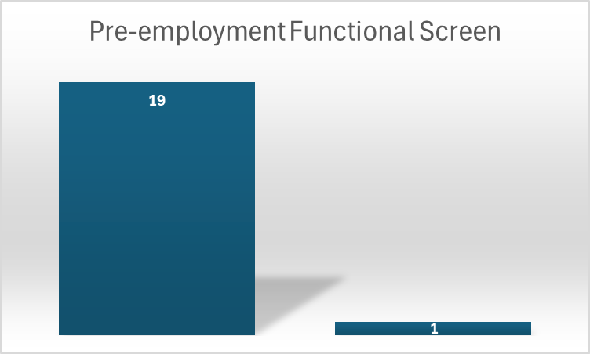
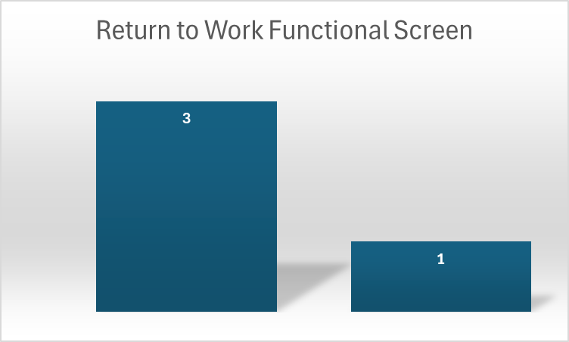
Measures:
Include graphs of your measurement, results of surveys, etc. Include benchmarks or comparative data when available.
STUDY
STUDY
20 pre-employment physicals, 19 passed and 1 not completed-started December 1st
4 Return to Work Functional Screens completed, 3 passed, 1 limitations due to injury- Started January 1st

Slide 10
Findings:
ACT
Results: Did you accomplish your goals?
Development and Implementation of pre-employment and return to work functional screens – completed February 2025
Lessons Learned: What did you learn as a result of this project? Unexpected discoveries? Problems or barriers?
Complexity of return-to-work process and needing to involve legal.
Next Steps: What actions are you going to take based on your findings? (e.g. roll out to additional units; modify and make additional improvements; abandon the effort; change course?)
This project will impact all hospital staff, so it’s important to get all managers and administration support. HR will also need to assist with the changing of job descriptions. Finalize job categories in March 2025. Begin updating job descriptions April 2025. Determine cadence and implement functional screens of employees by fall 2025.
Project Leader is Recommending the Following:
QM Council approval for completion of project?: NO Project still in progress, project to continue: YES

Slide 11
Rehab Services
Inpatient Workflow
1st Presentation Date: 11/26/2024
Document Last Presented: 03/25/2025

Slide 12
Quality Story:
PLAN
Inpatient Workflow
Goal(s): What are you trying to accomplish?
KOM Target: All inpatient and medical evaluations to be completed within 48 hours (about 2 days) of admissions. (Note that during the week staff’s true goal is to have the evaluation completed in 24 hours.) Geri-psych evaluations to be completed within 72 hours (about 3 days) Current KOM Status: We currently are not tracking.
Background: Explain what the original situation was. Why was a change recommended? (e.g. variation, poor outcome, etc.)
We currently do not have any written standards for inpatient evaluations.
Driver: Explain why the project is critical to SH. Why does it relate to the strategic plan?
As surgical services grow so must our therapy services to ensure quality care for our clients.
Team:
Project Leader: Melissa Monte Members: Skyler Debilzen, Emily Devine, Kathy Forbes, Emily Grosse, Diane Johnson

Slide 13
Changes:
DO
List the changes that have been made leading to improvements.
What? | Why? | When?
For 2 months we had inpatient therapists track how many evaluations and treatments there were each day, what time surgical patients were ready to be evaluated at how many sessions were shorted or skipped due to staffing. | To help us determine how late we will need to have a therapist available for evaluations and an estimate about how many hours we need staffing for each day of the week. | Completed January 2025 (compiled data on next slide)
Eliminating use of flowsheets to write therapy notes. Reached out to nursing staff to ensure their needs are met with this change. | The use of flowsheets takes training staff more challenging and time consuming since our outpatient staff do not utilize the flowsheets. | On March 20th, during unit meeting, staff will be educated on the change.
Scheduling inpatient post-op PT evaluations | Helps with staffing and communication with nursing. | Ongoing

Slide 14
Measures:
STUDY
Include graphs of your measurement, results of surveys, etc. Include benchmarks or comparative data when available.
Compiled data:
Mondays:
OT Eval/Treat= 1.5/3.3
PT Eval/Treat= 3.8/3.7
Tuesdays:
OT Eval/Treat= 3.4/2.0
PT Eval/Treat= 2.1/6.2
Wednesdays:
OT Eval/Treat= 2.2/1
PT Eval/Treat= 1.4/3.8
Thursdays:
OT Eval/Treat= 1.6/2.0
PT Eval/Treat= .8/3.1
Fridays:
OT Eval/Treat= 1.6/2.2
PT Eval/Treat= 1.6/3
Limiting Factors:
Rawal on vacation the week of December 23rd and 30, so fewer surgeries those weeks, which throws off the average
There were days missed due to staff forgetting or not having time to enter information into spreadsheet
Other Considerations:
Certain assessments (ie: KELS) that take a long time to administer and there is no way of knowing when those requests are going to be made.
Shortened sessions occurred M-R with greatest amount occurring on Tuesday
First surgical patient not ready until 2:00p, so we learned not to schedule until after that.

Slide 15
Findings:
ACT
Results: Did you accomplish your goals?
No, we need to start formally tracking if any evaluations are not being completed within the expected time frame. Our therapist prioritize the evaluations, which means that other treatment sessions are being cut short or put off to another day.
Lessons Learned: What did you learn as a result of this project? Unexpected discoveries? Problems or barriers?
Our team has come up with an appropriate starting time for post-op PT evaluations day of. Our team feels that moving away from the flowsheets with help with training staff members to work inpatient. Ongoing challenge - the variability of the caseload from day to day and week to week
Next Steps: What actions are you going to take based on your findings? (e.g. roll out to additional units; modify and make additional improvements; abandon the effort; change course?)
We need to start tracking those evaluations not completed in a timely manner. Our team has been tasked with problem solving for those days with unexpected low and high census.
Project Leader is Recommending the Following:
QM Council approval for completion of project?: NO Project still in progress, project to continue: YES

Slide 16
Pharmacy
New Employee Onboarding
1st Presentation Date: March 25, 2025
Document Last Presented: March 25, 2025

Slide 17
Quality Story:
PLAN
New Employee Onboarding
Goal(s): What are you trying to accomplish?
KOM Target: 100% Completion of New Employee Onboarding Program implementation by May 2025 Current KOM Status: 4/6 steps completed (67% completion)
Background: Explain what the original situation was. Why was a change recommended? (e.g. variation, poor outcome, etc.)
The SH goal for new employee turnover is less than 28.6%. Since June 2024, we have not met this goal as an organization, with turnover rates between 30.16% and 38.18%. Standardized, comprehensive department onboarding programs were recommended to help us reach this goal.
Driver: Explain why the project is critical to SH. Why does it relate to the strategic plan?
New employee retention is integrally tied to proper onboarding and training. Having a standardized onboarding process can increase retention as well as satisfaction in the workplace. This supports our People standard at Stoughton Health.
Team:
Project Leader: Pauline Cass Members: Tom Kostecki, Brianna Jacques, Elizabeth Jacobson, Ryan Lund, Paige Swatek, Ari Zimbric, Erin Roberts

Slide 18
Changes:
DO
What? | Why? | When?
Met with all new employees from the past year | To gather suggestions for improvement to onboarding process | December 2024-January 2025
Developed pre-employment checklist | To ensure readiness for new employees on Day 1 | December 2024
Developed manager checklist | To ensure all administrative items are covered Week 1 | February 2025

Slide 19
Measures:
STUDY
Successful New Employee Onboarding
Checklist for pre-start date activities developed
Manager checklist for first week developed
Binder created which contains hospital and department-specific information
Training checklist developed for first 4 weeks of employment
Preceptor training guide developed
Weekly Touch base forms developed for preceptor and employee
This Photo by Unknown Author is licensed under CC BY-SA
This Photo by Unknown Author is licensed under CC BY-SA

Slide 20
Findings:
ACT
Results: Did you accomplish your goals?
Goals still in progress
Lessons Learned: What did you learn because of this project? Unexpected discoveries? Problems or barriers?
Staff wants more feedback during the onboarding process—this prompted the addition of daily preceptor touch bases and more formal weekly feedback sessions Information retention has been increased using a tell/show/do/review method
Next Steps: What actions are you going to take based on your findings? (e.g. roll out to additional units; modify and make additional improvements; abandon the effort; change course?)
Action: | Assigned To: | Due Date:
Develop preceptor training guide | Pauline | April 30, 2025
Develop weekly touch base forms | Pharmacy Staff | April 30, 2025
Project Leader is Recommending the Following:
QM Council approval for completion of project?: NO Project still in progress, project to continue: YES

Slide 21
Surgical Services
Ambulatory Infusion Center (AIC)
Improving Workflow
Presentation Date: March 25, 2025

Slide 22
Quality Story:
Ambulatory Infusion Center (AIC)
Improving Workflow
PLAN
Goal(s): What are you trying to accomplish?
KOM Target: Process analysis and reimplementation with process improvement Reduction/elimination in Pharmacy time spent on AIC treatment plans Current KOM Status: In process
Background: Explain what the original situation was. Why was a change recommended? (e.g. variation, poor outcome, etc.)
Breakdown of communication and workflows within AIC, Prior-Auth, and pharmacy. Patients being scheduled prior to obtaining all approvals successfully. Leading to patient dissatisfaction, and potential delay in patient care.
Driver: Explain why the project is critical to SH. Why does it relate to the strategic plan?
A key target for prior authorization pharmacy and scheduling in an ambulatory care center is to minimize the time spent on the prior authorization process while maximizing successful approvals, ensuring timely access to necessary medications for patients while adhering to insurance guidelines; this can be achieved by streamlining workflows, utilizing technology, and proactively identifying medications that require prior authorization to avoid delays in patient care.
Team:
Project Leader: Sandra Bryan-Armstrong Members: Sarah Watkins, Jennifer Bothum, Pauline Cass, and Tom pharmacy, Ambulatory Surgery Team

Slide 23
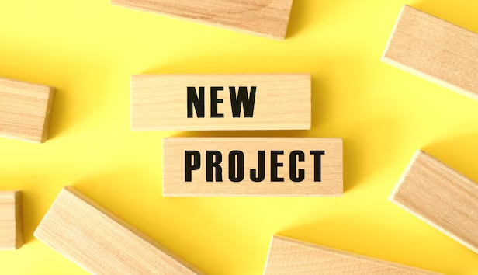
Measures:
STUDY
Include graphs of your measurement, results of surveys, etc. Include benchmarks or comparative data when available.

Slide 24
Changes:
DO
List the changes that have been made leading to improvements.
What? | Why? | When?
Bev did a current state analysis | We were evaluating our night and weekend AIC patient discrepancies took time to document workflow. | February
Jen and prior auth team meeting coming to standardize process | Ensure accuracy and make sure all our I’s are dotted and T’s are crossed. | March
Tom in pharmacy to be looped in then we get to that point. | Pharmacy plays a role in infusions. Will support DS team when transitioning over care plan entry. | April/May

Slide 25
Findings:
ACT
Results: Did you accomplish your goals?
Identifying metrics
Lessons Learned: What did you learn as a result of this project? Unexpected discoveries? Problems or barriers?
New Project
Next Steps: What actions are you going to take based on your findings? (e.g. roll out to additional units; modify and make additional improvements; abandon the effort; change course?)
1) Pharmacy will join the project in April/May.
Project Leader is Recommending the Following:
QM Council approval for completion of project?: NO Project still in progress, project to continue: YES

Slide 26
Surgical Services
Stabilization of Staffing
1st Presentation Date: 3.26.24
Document Last Presented: 3.25.25

Slide 27
Quality Story:
PLAN
Stabilization of Staffing
Goal(s): What are you trying to accomplish?
KOM Target: 50% Reduction of agency use by July 1, 2024. 100% reduction of agency use by October 1, 2025 Current KOM Status: Agency usage at the start of the project was 6.3 FTE. As of April 2025, we are at 2.0 FTE, which reflects a 68% reduction. By May 10, 2025, we will be at 1.0 FTE, marking an 84% reduction.
Background: Explain what the original situation was. Why was a change recommended? (e.g. variation, poor outcome, etc.)
Wisconsin annual personnel survey early submissions reported registered nurse (RN) vacancy rates in the double digits for the first time since 2005. The frontline technical positions of certified nursing assistant (CNA), surgical tech, respiratory therapist and licensed practical nurse (LPN) round out the top five vacancy rates in the 2021 early surveys with digit vacancy rates in 2021 for seven of the 17 professions tracked in WHA’s annual workforce reports.
Driver: Explain why the project is critical to SH. Why does it relate to the strategic plan?
While the use of agency has allowed for surgeries to continue as normal, financially this cannot be sustained. Continuity is important for both the safety of our patients, but also in establishing and sustaining “our team” which is important of the culture of the surgical services department.
Team:
Project Leader: Amy Hermes, Sandra Bryan-Armstrong Members: HR, Jane McGuire

Slide 28
Changes:
DO
List the changes that have been made leading to improvements.
What? | Why? | When?
Hire RNs that can scrub and circulate | Cross training is beneficial, and scrub RNs are cheaper than Surgical Tech travelers. | 0.6 FTE Scrub RN started July 22, 2024 and replaced one Travel 0.8 FTE surgical tech.
Hire operating room assistant | Operating room assistants can be trained as endo techs and to hold retractors. Leaving surgical tech to tech. Each surgical case requires 1 surgical tech, all total joints require 2. One to tech and one to hold retractors. | Ongoing recruitment – Hired Mallory PRN Sterile Processing tech as Operating Room Assistant working on training. November 2024.
Hired ST Weekender On Call Position | Reduce burden of call for ST team members
In process of hiring OR RN Weekender On Call Position | Reduce burden of call for OR RN team members | Allie. RN started January 6th as the RN Weekender ON-Call Circulating RN and PACU RN. She will pick up a 0.5 FTE and is willing to train as a scrub RN.
Hired a Surgical Tech Student From St. Ambrose College. Completed all her Didactic portion. | Hiring experienced STs is difficult. Growing our own provides a commitment and decreases turnover and stability of team. | Ayva started December 16th as 0.8 FTE. Ayva sat for her certification on 2/28/25 and passed. She currently has 54 out of the 125 required cases to be fully certified. Goal Summer 2025.
Surgical Tech clinical rotations – Black Hawk Tech Posted PRN positions (First Assist/Surgical Tech, Circulating RN, SPD Tech) | Recruitment of Surgical Tech Students Per diem staff help support the team while also providing an opportunity to recruit potential new candidates. | Ongoing. Hunter is one of our surgical tech students who has applied for a PRN position in SPD. He is set to graduate in May 2026 and plans to transition into the tech role after graduation. Ongoing

Slide 29
Measures:
STUDY
Include graphs of your measurement, results of surveys, etc. Include benchmarks or comparative data when available.

Slide 30
Findings:
ACT
Results: Did you accomplish your goals?
Agency usage at the start of the project was 6.3 FTE. As of April 2025, we have made a 68% reduction, bringing us to 2.0 FTE. By May 2025, we project an 84% reduction.
Lessons Learned: What did you learn as a result of this project? Unexpected discoveries? Problems or barriers?
Surgical techs continue to be difficult to hire. To address this, we’ve hired RNs with surgical tech experience, which is more cost-effective than utilizing surgical tech travelers. We’ve also hired a surgical tech for the weekender on-call position, which is considered PRN as it only involves call hours, and an OR RN for the same role. These positions are not counted as full-time equivalents (FTEs). Additionally, we have posted PRN positions for First Assist Surgical Techs, OR RN circulators, and SPD techs. Being creative with staffing has been crucial to stabilizing the team, and cross-training staff has further supported team stability.
Next Steps: What actions are you going to take based on your findings? (e.g. roll out to additional units; modify and make additional improvements; abandon the effort; change course?)
Continued work with STAT 605 to “grow our own STs” Connected with Madison College ST Advisory Committee Continue to work with Black Hawk Tech taking SPD and ST students. Continue to promote PRN positions. Continue to cross train staff.
Project Leader is Recommending the Following:
QM Council approval for completion of project?: No Project still in progress, project to continue: Yes

Slide 31
Environmental Services
Hazardous Waste Accumulation Area Inspection
Presentation Date: March 25, 2025
Document Last Presented: December 3, 2024

Slide 32
Quality Story:
PLAN
Hazardous Waste Accumulation Area Inspection
Goal(s): What are you trying to accomplish?
KOM Target: Full implementation of a Hazardous Waste Accumulation Inspection program. (4 steps to reach full implementation) Current KOM Status: 75% (3 of 4 steps have been completed)
Background: Explain what the original situation was. Why was a change recommended? (e.g. variation, poor outcome, etc.)
During DNV survey it was documented and cited that no weekly documented inspection for a small quantity generator of the central accumulation area. Weekly inspection is a must looking for leaking and for deterioration of containers caused by corrosion or other factors.
Driver: Explain why the project is critical to SH. Why does it relate to the strategic plan?
This project supports full compliance with the NIAHO standards and conditions of participation of our accreditation program and CMS. As well as our quality and safety pillars.
Team: Environmental Services (EVS) and Environment of Care (EOC)
Project Leader: Angie Rowin Tippit Members: Pauline Cass, Emily Syring and Jason Schoville. As well as key members of the EOC Committee.

Slide 33
Changes:
DO
List the changes that have been made leading to improvements.
What? | Why? | When?
Create a document for weekly inspections of hazardous accumulation area. Document must include identification, description, date, including looking for leaking containers, deterioration, corrosion or other factors. | To be in full compliance with NIAHO standards and Conditions of Participation. A method for monitoring frequency, measures of effectiveness and evidence of compliance. | October 8th, 9th, and 10th. The Hazardous Waste Accumulation Area Inspection Log was created and implemented with first and second inspection occurred on 10/9/2024 and 10/10/2024. Completed
Weekly scheduling of inspections of hazardous accumulation site scheduled on Outlook for both manager and coordinator. | Ongoing scheduling was created in Outlook for weekly calendar tasks/reminders to complete inspection/monitoring. | 10/30/2024 Completed
Education was provided to manager and coordinator. | Required within 60 calendar days of survey end date. | 10/10/2024 Completed
Hazardous Material and Medical Waste Management Plan was updated to include the Hazardous Waste Accumulation Area Inspection Log. | Required within 60 calendar days of survey end date. | 10/31/2024 Completed Revised on 03/12/2025
Standing agenda item for Environment of Care Committee meetings to be review HWAAI | Meetings occur Every other month | On agenda in December of 2024 but tabled.
Audit findings will be completed for 3 consecutive Environment of Care Committee meetings. | To demonstrate compliance/conformity to sustain compliance. | First report April 2025 Second report June 2025 Third Report August 2025

Slide 34
Measures:
STUDY
Include graphs of your measurement, results of surveys, etc. Include benchmarks or comparative data when available.
Action Steps: | Completion:
Hazardous Waste Accumulation Log | Completed: October 8, 2024
Two times a week inspections | Completed: Weekly inspections started October 8, 2024.
Hazardous Materials Education | In progress: to be completed by end of March
Hazardous Waste Accumulation Log audit findings a standing EOC meeting agenda item. | In progress: will start on April 2025 agenda.

Slide 35
Findings:
ACT
Results: Did you accomplish your goals?
No: In progress
Lessons Learned: What did you learn as a result of this project? Unexpected discoveries? Problems or barriers?
Switching from a very small generator (VSG) to a small generator in 2024 changes the compliance in some areas of collection with Hazardous Materials and Medical Waste Management. In 2025, we moved back to VSG as we did not accumulate over 220 lbs. each month. However, we will continue this best practice of monitoring at collection site.
Next Steps: What actions are you going to take based on your findings? (e.g. roll out to additional units; modify and make additional improvements; abandon the effort; change course?)
Finalize Hazardous Materials and Medical Waste Management Plan - March 31, 2025 Hazardous Waste Awareness training for selected EVS staff - March 31, 2025 Continue weekly inspections – On going. Report audit finding results at 3 consecutive EOC meetings to ensure compliance with the DNV NIAHO standards and conditions of participation of our accreditation program and CMS planning. – August 2025
Project Leader is Recommending the Following: To continue process of improving, monitoring and managing of waste.
QM Council approval for completion of project?: Enter YES or NO Project still in progress, project to continue: Enter YES or NO (till September 23, 2025)

Slide 36
Environmental Services Onboarding New Employees
3rd Presentation Date March 25, 2025
Document last presented: December 3, 2024

Slide 37
Quality Story:
PLAN
Onboarding New Employees
Goal(s): What are you trying to accomplish?
KOM Target: Implement updated/improved new employee onboarding by June 1, 2025 (4 Phases to reach full implementation) Current KOM Status: Phase one: Review/Revise current check-off list, completed. Phase two: Planning, in progress. Phase three: Education, in progress and Phase four, implementation, in progress.
Background: Explain what the original situation was. Why was a change recommended? (e.g. variation, poor outcome, etc.)
All departments were challenged to evaluate our onboarding processes. The hospital-wide turnover for new employees in February 2025 was 12.25.
Driver: Explain why the project is critical to SH. Why does it relate to the strategic plan?
Onboarding plays an important role in retaining new hires. A formal onboarding process helps promote success of new staff. The key to new hire satisfaction is a well-planned orientation, a positive/supportive environment, assigning a mentor, proper training, and proper tools/materials.
Team:
Project Leader: Angela Rowin Tippit and Emily Kirby Members: Some EVS staff.

Slide 38
Changes:
DO
List the changes that have been made leading to improvements.
What? | Why? | When?
Review EVS New Hire checklist and job description. | Checklist needs revision and improvement to improve the new hires experience. | September 2024 completed. Revisions were made in November/December. However, revision are ongoing as we go the process.
Team meetings to discuss continued planning of education and implementation. | Team building, staff acceptance, input, and to garner staff support. | September 2024 to June of 2025.
Present project at next staff meeting and review checklist. | Staff engagement. | December 2024
Competencies have been added to onboarding checklist | By observing all new staff education has been completed in training. | March 2025

Slide 39
Measures:
STUDY
Action steps | Completion
Review/Revise | Completed: December 2024
Planning | In progress
Education | In Progress
Implementation | Not started

Slide 40
Findings:
ACT
Results: Did you accomplish your goals?
No
Lessons Learned: What did you learn as a result of this project? Unexpected discoveries? Problems or barriers?
It is a work in progress…beginning stages. We agree the new employee checklist for new hires is the first step to review/revise/improve. Manager/Coordinator have drafted a reviewed/revised form and found that this is a continued work in progress. It is a difficult time with recruiting, staffing, increased work loads but are willing to take on the added work to make this successful. The challenges of completing an improved checklist. Did we capture everything? We continue to make and add improvement changes.
Next Steps: What actions are you going to take based on your findings? (e.g. roll out to additional units; modify and make additional improvements; abandon the effort; change course?)
Bring department checklist final draft to seek input from staff at next EVS team meeting-on March 27th. Review/Revise all job descriptions by May 15th. Together as a team what is everyone's role to ensure a positive onboarding experience is achieved with new staff. i.e.; education, mentors, break buddies, positive communication, etc. by March/April.
Project Leader is Recommending the Following:
QM Council approval for completion of project?: No Project still in progress, project to continue: Yes

Slide 41
Food and Nutrition Services
Hot Meals for Patients for Dinner
1st Presentation Date: 3/28/23
Document Revised on: 03/13/2025

Slide 42
Quality Story:
PLAN
Hot Meals for Patients for Dinner
Goal(s): What are you trying to accomplish?
KOM Target: Trial providing one hot entrée with sides by June 2023. Intent is to maintain steady Press Ganey food satisfaction scores by offering hot dinner options. Current trending reports great variability of overall food satisfaction ranging from 6th – 90th percentile. Target Percentile: 90th or greater. Current KOM Status: Med Surg: 76th percentile for quality of meals this past quarter, 67th percentile for last quarter. Geri-Psych 97th percentile for Quality of meals for two quarters, 99th for this past quarter.
Background: Explain what the original situation was. Why was a change recommended? (e.g. variation, poor outcome, etc.)
We originally orchestrated a thoughtful menu with a diverse number of menu items. Since COVID and the staffing shortage we have had to pair down our offerings. Those patients with a history of receiving hot menu options perpetuate score quality low, based on expectations or previous experiences.
Driver: Explain why the project is critical to SH. Why does it relate to the strategic plan?
Research on providing a great employee experience tells us that patients judge us by 3 things Floor, Food and Service. If one of these is out of place or not up to the patient’s standards, then our Press Ganey scores will reflect negative patient satisfaction.
Team:
Project Leader: Dan Arndt & Autumn Kumlien Members: Ricky Quesada, Roxanne Lehman, Melanie Jess, Dianne Kelly, Shelby Thorson, Cindy Blanchar, Natalee Gerber & Kevin Propp

Slide 43
Changes:
DO
List the changes that have been made leading to improvements.
What? | Why? | When?
Eliminating hot food offerings as a dinner choice implemented to accommodate for lack of staff so needed to shorten the menu and make trays disposable. | COVID-19 and lack food service workers in the greater Dane county area. | June 2021.
Patients commented on food selection using Press Ganey Scores. | We have a regular base of patients that remember what we used to offer. | Pre-COVID.
Meat Lasagna or Vegetarian Lasagna with Green Beans and a Dinner roll was trialed. | To accommodate the need and or request for hot meals from patients within our staffing capabilities. | April 2023
Hot Bar is now being offered for lunch and or dinner Monday-Friday. | To offer a hot food option for patients for the dinner hour. | June 2023-Present
Presented a Prep Cook requisition to Administrative Council. | Utilize Prep cook to help prepare diet friendly options for specialized diets. | October 2023-Present
Started offering Grilled Cheese/Grilled Ham and Cheese during the dinner hour as a hot sandwich option. | Patients were requesting hot sandwich option. | October 2023-Present

Slide 44
Changes:
DO
List the changes that have been made leading to improvements.
What? | Why? | When?
FNS hired Kevin Propp, Assistant Chef & Baker, with previous experience working for Stoughton Health in the FNS department. | This took some duties & responsibilities off our patient cook, which freed her up to prepare more patient menu items. | November 2023
Trialing “new” diet friendly menu items. | Patient Cook now has more time to devote to the patient menu with hiring of Assistant Chef. | December 2023
Rough draft of “new” patient menu completed. | To begin to offer patients more diet friendly meal options. | January 2024
Training for cooking of new patient menu items. | So, each staff member can deliver a constantly good product | May 2024
New Menu items will need to be tested for using the IDDS testing model. | So patients who have IDDS specific diets could order the new items per diet. | July 2024
All new items have been tested and categorized according to IDDS. | So, patients who have IDDS specific diets could order the new items per diet. | August 2024
Implemented New Menu and brought back the use of China. | To give patients more options and create a more formal dining experience. | October 20, 2024
Implemented a stand along survey that Guest Services rounds a few days a week | To get real time feedback and to see how the Press Ganey comments compare to this feedback. | November 1, 2025

Slide 45
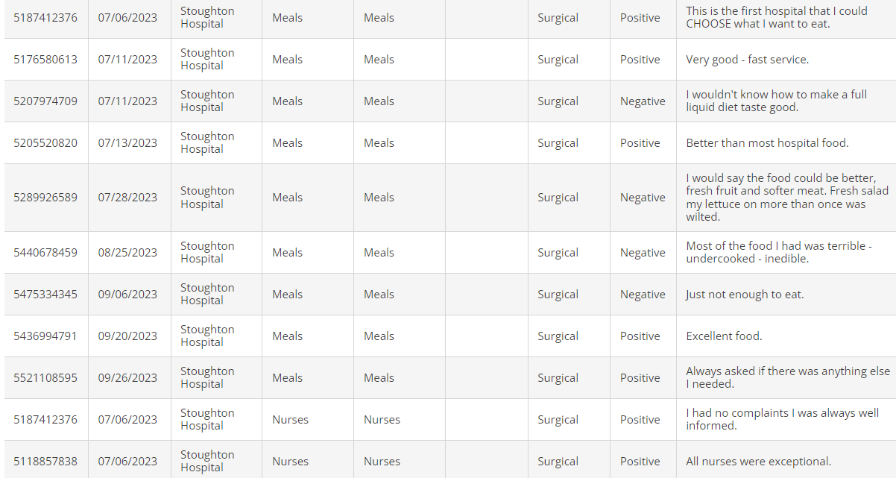
Measures:
STUDY
Press Ganey (Med-Surg.)
Most Recent below..

Slide 46
Measures:
STUDY
Press Ganey
Geri-Psych
Most Recent below..

Slide 47
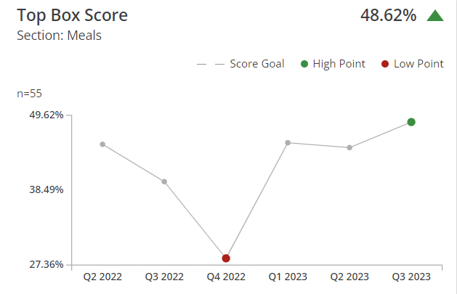
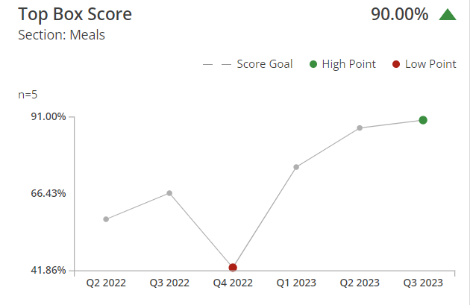
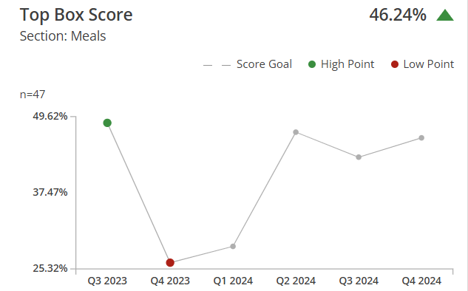
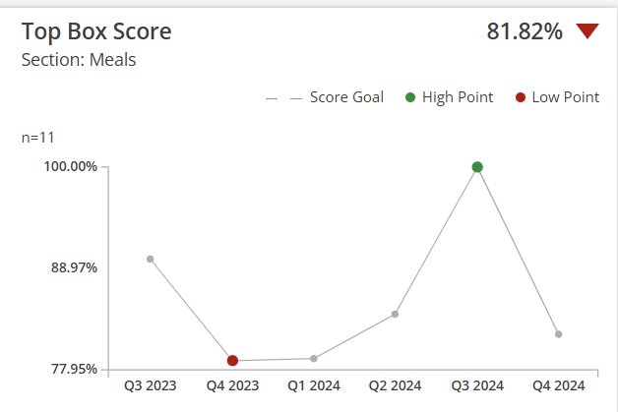
Geri-Psych.
Med-Surg.
Most Recent below..
Most Recent below..

Slide 48
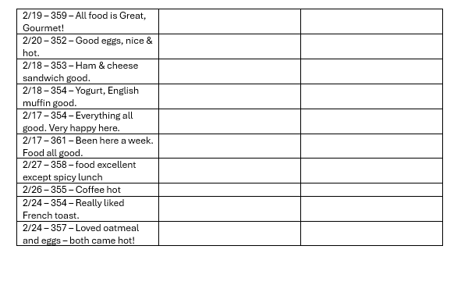

Slide 49
Findings:
ACT
Results: Did you accomplish your goals?
1. Med Surg is continuously improving as shown in previous slides. Geri-Psych remains above the 90th percentile for the third quarter in a row.
Lessons Learned: What did you learn as a result of this project? Unexpected discoveries? Problems or barriers?
So far, we have discovered that there are a few patients who like this offering, but many still get sandwiches. We did also discover that this offering caused anxiety over the need for increased cooking skills by P.M FNS staff. When making one hot entrée special for dinner it is very hard to accommodate our top three restrictive diets ordered (cardiac, diabetic, low sodium). After researching this more, we discovered that our Food Service distributors do not make diet friendly options that are of our quality. We have found the need for a prep cook, to help create diet friendly menu options.
Next Steps: What actions are you going to take based on your findings? (e.g. roll out to additional units; modify and make additional improvements; abandon the effort; change course?)
Continue to Train staff on how to cook “new” menu items. Test new menu items to help classify IDDS. Print updated menus Once staffing is back to normal will implement new menu. For now, new menu is offered Monday-Friday and its word of mouth. New Menu is now implemented, now we will be tracking and trending for the next 6 months to see if our implementation has made a difference. Compare Press Ganey Survey results within house survey results.
Project Leader is Recommending the Following:
QM Council approval for completion of project?: NO Project still in progress, project to continue: YES

Slide 50
Food and Nutrition Services
Patient Meal Ordering Software
1st Presentation Date: 3-13-25
Document Last Presented:

Slide 51
Quality Story:
PLAN
Patient Meal Ordering Software
Goal(s): What are you trying to accomplish?
KOM Target: New software program is researched, picked, approved, and 100% implemented by May of Fiscal Year 2026 (5 phases to reach full implementation) Current KOM Status: Phase 1: Research Phase, just getting started
Background: Explain what the original situation was. Why was a change recommended? (e.g. variation, poor outcome, etc.)
In November 2024 Horizon our current system gave us a notice that our system was going to be reaching its “end of life” with service updates.
Driver: Explain why the project is critical to SH. Why does it relate to the strategic plan?
This system is very critical to Stoughton Health because it interfaces with Epic to ensure patients will be on the correct diet and the food they receive corresponds with there diet.
Team: Kevin Propp, Roxanne Lehman, Melanie Jess, Shelby Thorson, Ricky Quesada, Victoria Camiou.
Project Leader: Autumn Kumlien and Dan Arndt

Slide 52
Changes:
List the changes that have been made leading to improvements that occurred in the last 60 days.
DO
What? | Why? | When?
FNS Operations Manager, FNS Nutrition Coordinator and VP HR/Facility Operations met and determined new patient ordering software is needed. | Received notification that Horizon is reaching end of life | December 2024

Slide 53
Measures:
STUDY
Include graphs of your measurement, results of surveys, etc. Include benchmarks or comparative data when available.
Phase 1 | Research | In Progress
Phase 2 | Approval and Purchase
Phase 3 | Interface completion
Phase 4 | Education
Phase 5 | Go-Live (May 2026)

Slide 54
Findings:
ACT
Results: Did you accomplish your goals?
Lessons Learned: What did you learn as a result of this project? Unexpected discoveries? Problems or barriers?
Next Steps: What actions are you going to take in the next 60 days ?
Action: | Assigned To: | Due Date:
Kickoff meeting to introduce project, determine key stakeholder and begin researching platform options. | Dan | June 2025
Determine/finalize what platform to purchase. | Dan | August 2025
Project Leader is Recommending the Following:
QM Council approval for completion of project?: NO Project still in progress, project to continue: YES

Slide 55
Orthopedic Team
Total Hip Arthroplasty/Total Knee Arthroplasty Patient Reported Outcome-Based Performance Measures (THA/TKA PRO-PM Program).
Program 1st Presented: March 25th, 2025 :
Document Last Presented:

Slide 56
Quality Story:
PLAN
THA & TKA PRO-PM Program
Goal: To enhance and prioritize patient-centered care and improve treatment outcomes by collecting and utilizing patient reported self assessment data to inform clinical decision–making, drive quality improvement and public reporting for our initial total hip & total knee arthoscopy cases.
KOM Target: 1.To achieve a 90% THA & TKA PRO-PM program pt completion rate among eligible hip and knee surgery patients within three months 8.1.2025 of implementation (5.1.2025) with the Oberd Registry. Current KOM Status: Soft launch Implementation of the Oberd tool workflows & education of staff and pts
Background:
Implementation of a THA & TKA PRO-PM Program offers advantages to the practice for enhanced clinical decision makings from the pts perspective, ability to track patients progress over time and facilitates shared decision-making empowering patients to participate in their care. These valid measures from the program may also be used to support payer contracts and marketing reputations.
Driver: Explain why the project is critical to SH. Why does it relate to the strategic plan?
Patient reported outcome measure programs enhance quality improvement initiatives that are patient centered for shared decision making and enhanced patient experience. The THA & TKA PRO –PM program will support the Orthopedic groups practice efficiency and public reporting for improved payer contracting and marketing reputation for referral growth.
Team:
Project Leaders: Clark Collins, PA, Kristin Brickl, RN & JoDeen Hettenbach Members: Orthopedic Providers, Clinical Team, JoDeen Hettenbach, QM reporting lead, Marketing & Oberd Registry Lead

Slide 57
Changes:
List the changes that have been made leading to improvements that occurred in the last 60 days.
DO
What? | Why? | When?
Vendor Assessment Selection, compliance and Contract Completion | Fiscal stewardship, HIPAA Compliance, Reporting support and IT compatibility. | Fall, 2024
Training and Education Training on Oberd Registry | 1. Provide initial overview to all staff members on administration, data entry, and interpretation. Begin workflow draft & pilot with team. | Feb 2025
Submit THA/TKA PRO-PM for a QM program approval | THA/TKA PRO-PM programs is an important program for improving patient centered care, enhanced clinical shared decision making and public reporting quality metrics. | March 20th, 2025.
Draft and Pilot Workflow – | Vetting workflow with IPAD tools with pts and staff to insure ease of use, workable and sustainable. Consideration of both staff and pt burden to administer the tool. Meet with Oberd a small workgroup 4th week to review current reporting and drafts | March 19th

Slide 58
Measures:
STUDY

Slide 59
Findings:
ACT
Results: Did you accomplish your goals?
Not yet – in progress
Lessons Learned: What did you learn because of this project? Unexpected discoveries? Problems or barriers?
Next Steps: What actions are you going to take in the next 60 days ?
Action: | Assigned To: | Due Date:
Monthly review of Data for process improvement and sharing with key stakeholders. | Clark and Kristin | 4.12
Provide comprehensive training to all Ortho staff members & key stakeholders on administration, workflow, data entry, and interpretation and reporting of the THA/TKA PRO – PM program. | Clark and Kristin | 4.12
Draft and Distribute workflow, pt educational materials for patients explaining the purpose and benefits of PROMs | JoDeen | 3.28
Project Leader is Recommending the Following:
QM Council approval for completion of project?: Enter YES or NO Project still in progress, project to continue: Enter YES or NO

Slide 60
Material Services
Nurse Server Cabinet Design and Restocking Process
1st Presentation Date: 5/23/2023
Document Last Presented: 03/25/2025

Slide 61
Quality Story:
PLAN
Nurse Server Cabinet Design and Restocking Process
Goal(s): What are you trying to accomplish?
KOM Target: Reduce the time it takes to restock nurse servers and check for expired supplies by 20% Reduce the quantity on 25% of the items in the nurse servers. Current KOM Status: Reduced the quantity on 44% of the existing items in the nurse servers. 60 items were transferred over to the new nurse servers. After meeting with nursing, we were able to eliminate 1 item in the new nurse servers. Nursing requested 12 new items be added to enhance patient care for a total of 71 items. Our new employee Chelsi tracked her time in March for 2 weeks. Her time was significantly better than in September when Evon last tracked her time. She recorded an average time of 46 minutes.
Background: Explain what the original situation was. Why was a change recommended? (e.g. variation, poor outcome, etc.)
The current process for storing and restocking supplies in the nurse server cabinets is inefficient and unorganized. It takes a long time to determine what needs to be restocked. Supplies do not have their own compartments in the drawers which makes it difficult to count and check for expiration dates. It has been a long time since the par levels have been determined so quantities may need to be updated.
Driver: Explain why the project is critical to SH. Why does it relate to the strategic plan?
This project supports the Finance pillar. Having a more efficient process will save the Material Services team time and will allow them to work on other duties. Reduce the potential for supplies expiring in the nurse servers to keep patients safe and to avoid waste.
Team:
Project Leader: Roberta Sarow Members: Material Services Department

Slide 62
Changes:
DO
List the changes that have been made leading to improvements.
What? | Why? | When?
Change par levels | To reduce the quantity of supplies which will make stocking and checking expiration dates more efficient | Par levels were changed the first week in April shortly prior to the new cabinets being installed. A new par level analysis report was run in August. Only a couple par levels were increased at the request of nursing.
Identified and made a list of nurse server supplies. | For easier tracking. | June 2023 An additional 12 items were added to the nurse servers at the request of nursing to enhance patient care.
Analyze usage of supplies in nurse servers. | To determine if we can reduce the par level | July-Oct 2023. We will redo the analysis now that the nurse servers have been installed and the list of supplies has been updated. The initial analysis has data that are now over 1 year old.
Changed procedure to electronic ordering directly in the Med Surg supply room by using a laptop. | We had been using an inefficient method of writing down the supplies needed on paper then bringing that paper downstairs to enter in the computer. | Started using a laptop in late December.

Slide 63
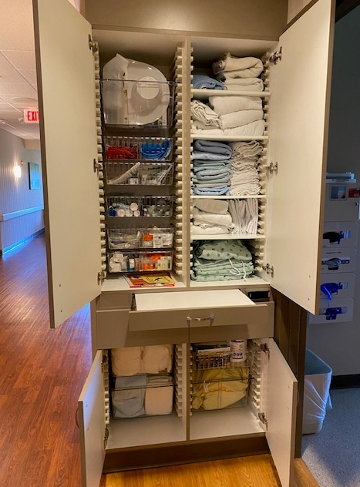
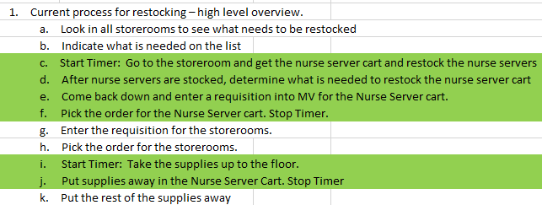
Measures:
STUDY
Average time last Aug after new Nurse Stations were installed: 1:23
Average time last September: 1:01
Goal : 55 minutes
Current average time for March : 46 minutes

Slide 64
Findings:
ACT
Results: Did you accomplish your goals?
Usage has been analyzed. We will work with nursing staff for approving par levels once the nurse servers are installed. We have asked nursing to start approving suggested par levels prior to the nurse servers being installed. Our goal to reduce the amount of supplies in the nurse servers was not met due to the fact that the new nurse servers are bigger and allow for more supplies. This increased the time to stock the nurse servers by an average of 15 min. per day right now but we will try to improve on this. Even though we added more items to the nurse servers, checking expiration dates should be about the same time since we decreased many par levels. Evon got closer to our goal of 55 min. on the second attempt at tracking her time. The current average daily time for Evon is now 1:01. We have seen some time reduction and improved customer service for the nurses due to this project so far. We were able to accomplish our goal with a new employee and the use of a laptop.
Lessons Learned: What did you learn as a result of this project? Unexpected discoveries? Problems or barriers?
We had unexpected additional supplies added to the nurse servers to help nursing staff enhance patient care. We were able to reduce par levels on many items. Nursing’s goal was for us to stock more supplies in the nurse servers. We should have brought all of the stakeholders in the project together earlier to understand what everyone wants to achieve. We learned that using a laptop was an important key to exceeding our goal.
Next Steps: What actions are you going to take based on your findings? (e.g. roll out to additional units; modify and make additional improvements; abandon the effort; change course?)
Update the analysis with recent usage data to determine if the par levels that were calculated are still appropriate. Adjust par levels based on updated analysis, if appropriate. Measure how long it takes to stock nurse servers after changes have been made. We will now move to explore electronic requisitioning instead of using paper. We feel we can find additional efficiencies by doing this.
Project Leader is Recommending the Following:
QM Council approval for completion of project?: Yes Project still in progress, project to continue: No

Slide 65
Material Services
Improvement for ordering department supplies
1st Presentation Date: March 25, 2025
Document Last Presented:

Slide 66
Quality Story:
PLAN
Improvement for ordering department supplies
Goal(s): Improve department ordering process.
KOM Target: To review and improve the ordering processes in all identified department areas by completing 4 main steps. Current KOM Status: 5%. Completed one of 18 currently identified ordering areas/department.
Background: Explain what the original situation was. Why was a change recommended? (e.g. variation, poor outcome, etc.)
The ordering templates in Multiview, which each department uses, are outdated with items which are no longer used and don’t always include current needed items. Departments don’t currently have par levels set, this creates issues with too much or not enough department stock. Storeroom items aren’t all labeled with Item numbers, creating confusion when ordering. High use items should be made stock and stored in Material Services. Not all items have product id #’s, creating extra work manual work to order.
Driver: Explain why the project is critical to SH. Why does it relate to the strategic plan?
This project supports the Finance pillar by creating more efficient ordering processes, so departments spend less time ordering. Reduce the need for emergency or overnight deliveries.
Team:
Project Leader: Dacia Brunner Members: Nancee Linnerud

Slide 67
Changes:
DO
List the changes that have been made leading to improvements that occurred in the last 60 days.
.
What? | Why? | When?
Worked with EVS to update the ordering templates. | Remove unnecessary items which are no longer used and added item numbers in MV for all material used. | Jan 2025
Re-organized and labeled the EVS closets with product id #’s and par levels. | Material Services knows exactly what to order and how much. | Jan/Feb 2025
Moved EVS stockroom to Material Services | Decision was made it was more time effective for Materials Team to manage and order this material directly. System auto orders so a staff member does not need to check supply. | Jan/Feb 2025
Working on OR/Sterile Supply and Day Surgery Templates | Working on Deleting old items and ensuring correct items are stocked and all used material has item numbers in MV | Feb/March 2025

Slide 68
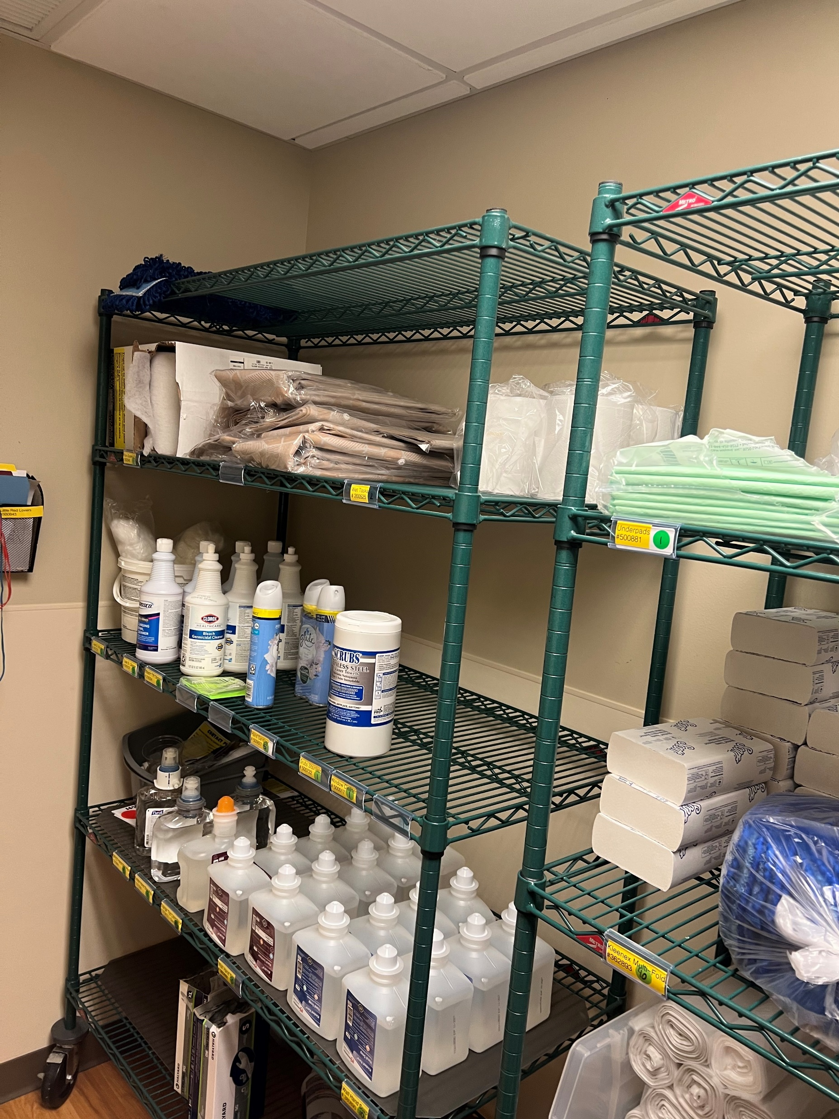
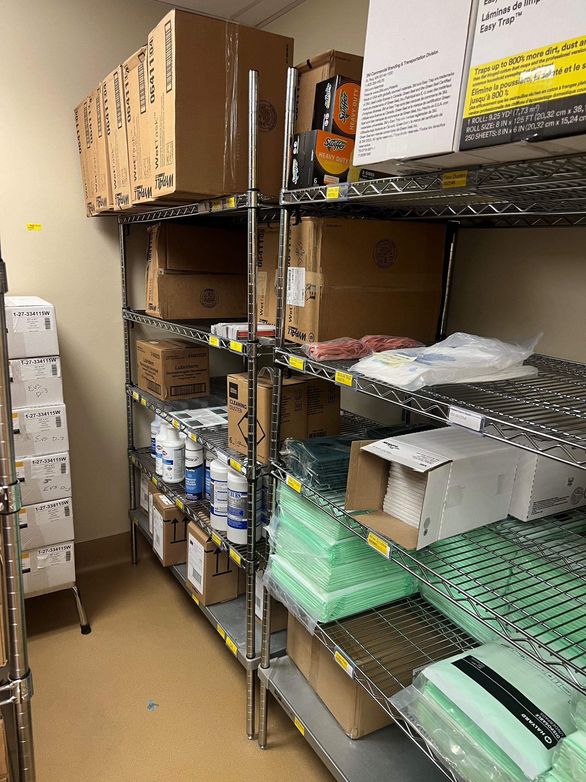
Measures:
STUDY
Ordering AREA | Template Updated | Correct items Stocked | Storerooms Labeled | Electronic Ordering
EVS | X | X | X | X
OR/Sterile Supply | X | X
Day Surgery | X | X
Anesthesia
Urgent Care locations
PT/OT locations
Urology
General Surgury
Foot Clinic
Otho
Lab/Sleep Lab
Geri Psych
Podiatry
Wound
Respiratory Therapy
Imaging/Scanning
Pharmacy
Cardiology

Slide 69
Findings:
ACT
Results: Did you accomplish your goals?
EVS was our first department and yes, we have accomplished our goal for this department. 1 – Templates are updated. 2-Correct Items are being Stocked. 3-Storerooms are labeled. 4 – Ordering is being done electronically. EVS They believe they are saving 4 hours weekly by not having to order supplies and stock closets.
Lessons Learned: What did you learn as a result of this project? Unexpected discoveries? Problems or barriers?
Updating the ordering templates creates less confusion when individuals are placing orders. It also ensures correct items are stocked in materials storeroom when usage determines that is most efficient. Labeling stockrooms with Item numbers and Par levels is key to time savings and accuracy when placing supply orders in Multiview. Taking a laptop to place orders directly into Multiview while in the stockrooms creates one less step.
Next Steps: What actions are you going to take in the next 60 days ?
Action: | Assigned To: | Due Date:
Complete OR/Sterile and Day Surgery storeroom labeling | Nancee/Roberta/Dacia | 05/2025
Update Urology and General Surgery Templates and Item Numbers | Nancee | 05/2025
Finish Updating Anesthesia template and Item Numbers | Roberta/Nancee | 05/2025
Project Leader is Recommending the Following:
QM Council approval for completion of project? NO Project still in progress, project to continue: YES

Slide 70
Accounting
Cash Spreadsheet Overhaul
1st Presentation Date: 09/24/2024
Document Last Presented: 3/25/2025

Slide 71
Quality Story:
PLAN
Cash Spreadsheet Overhaul
Goal(s): What are you trying to accomplish?
KOM Target: Improve cash reconciliation file functionality with formulas and increase reporting received to reduce daily reconciliation questions. Current KOM Status: 0% Target Completion: June 30th 2025
Background: Explain what the original situation was. Why was a change recommended? (e.g. variation, poor outcome, etc.)
The current cash posting spreadsheet is based off the spreadsheet used to post to SAP. Formulas have not always been updated and items have not always been added in a user-friendly way – both on the PFS (inputs) side but also on the Accounting side. Improvements will also help training/usage for new staff.
Driver: Explain why the project is critical to SH. Why does it relate to the strategic plan?
Daily cash posting and monthly accounting reconciliations can be time consuming and streamlining and overhauling the current spreadsheet will help to increase our efficiency and accuracy. This will free up time to work on other projects – and increased accuracy will help find and fix issues prior to impacting external customers.
Team:
Project Leader: Danielle Kapanke & Kendra Saul Members: Accounting and PFS teams.

Slide 72
Changes:
DO
List the changes that have been made leading to improvements.
What? | Why? | When?
Start time study of current process. | Assess the average time to post and reconcile so that we can establish a baseline. | Ongoing – some data coming in – realizing the this is very dependent on the day, and difficult to track.
Meet with PFS posting Team. Kendra will be approaching from the PFS side as a part of Emerging Leaders. | Assess their usage/review of the spreadsheet and determine what could work better. | December – Kick off meeting on 12/16 PFS and Acct present
Review spreadsheet and brainstorm talking points from the accounting side. | Work with Mary to figure out where things can be tweaked. | December – Discussed at kick off meeting
Start experimenting with formula improvements for items identified in meeting. | See what capabilities Excel has to streamline this process. | April-June 2025
Identify additional reports to reduce investigation time | Work with PFS | April- June 2025

Slide 73
Measures:
STUDY
Kick off Meeting take aways – 12/16/24
* Tabs are ok – better than on sheet
* PFS wants variances easier to identify
* PFS also wants more ability to verify balances/fix variances on their own
* Legacy amounts are not needed everywhere – but should be an option
* Additional columns for batch numbers aren’t needed – but ARE using rows
* Develop PFS capability to recon credit cards daily – may need end of month touch base, but not biweekly
Schedule additional meetings with Kendra/Mary to review progress and identify specific changes in file.

Slide 74
Findings:
ACT
Results: Did you accomplish your goals?
NO – Started exploring needs and wants - working closely with Kendra on how this can also benefit from the PFS side. Starting to work on layout and design for new process.
Lessons Learned: What did you learn as a result of this project? Unexpected discoveries? Problems or barriers?
Kickoff meeting was helpful to see different uses and needs with the spreadsheet. Continue this dialogue as we move forward.
Next Steps: What actions are you going to take based on your findings? (e.g. roll out to additional units; modify and make additional improvements; abandon the effort; change course?)
Additional team meeting to determine specific formulas to add and update in file. List items that cause reconciliation issues and determine if reports exist that can assist. Remove old items no longer used from file to increase ease of use of reconciliation file.
Project Leader is Recommending the Following:
QM Council approval for completion of project?: No Project still in progress, project to continue: Yes

Slide 75
Accounting
Upgrade Multiview and Convert QuickBooks
1st Presentation Date: 1/23/2024
Document Last Presented: 3/25/2025

Slide 76
Quality Story:
PLAN
Upgrade MV and Convert QuickBooks
Goal(s):
KOM Target: Upgrade Multiview to V23 by April 30, 2025. After the upgrade to V23, reassess the need to convert Quick Books to Multiview. Current KOM Status: We are an estimated 75% completed with Upgrade of Multiview.
Background:
Since this project was started, Multiview released a new version of their software (V23). Unlike prior version releases, the change from V22 (our current version) to V23 is significant and changes the software to a web-based interface. Prior version releases have had minimal changes and impact to the way we use the software. Since this one is such a big change, MV is requiring us to upgrade our test environment and perform testing in that environment before upgrading our production environment. It is important that we ensure the system is working correctly before we upgrade to the new version in our production environment so we can continue to process transactions. We also need to become familiar with the software so we can be more efficient when we start using it.
Driver:
We need to upgrade to the new version so we can take advantage of enhancements to the software. This needs to be completed before we can continue with the assessment of whether to convert Quickbooks financials to Multiview Financials.
Team:
Project Leader: Brian Swain Members: Accounting Team

Slide 77
Changes:
DO
What? | Why? | When?
Convert our test environment from V22 to V23. | We need to test the new version before upgrading our production environment. | August 2024
Research changes made in V23 by reading the release notes and understand how they impact Stoughton Health. | Understanding how changes may impact our processes needs to be completed before the upgrade so adjustments to these processes can be made first. | November 2024 – March 2025
Identify key processes and functions performed in MV and develop a plan to test them in V23 in our test environment. | To know what to test and who should perform the testing so we can make a detailed upgrade plan. | December 2024 – March 2025
Develop a testing plan and have the team members that currently perform the tasks in V22 perform them in the test environment on V23. | This will allow us to ensure that the system is working properly, and we know how to complete key tasks before going live in our production environment. | December 2024 – March 2025
Schedule the conversion to V23 and troubleshoot any issues. | To complete the upgrade and resolve any issues as soon as possible. | April 2025

Slide 78
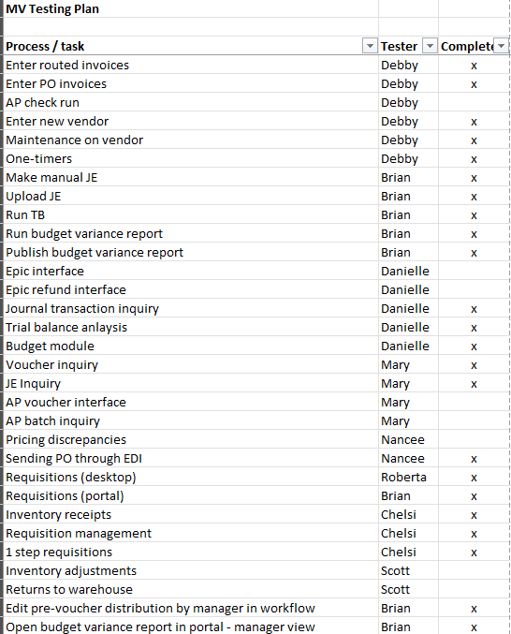
Measures:
STUDY
As of the date these slides were prepared, we have converted our test environment to V23 and tested approximately 75% of the tasks on our testing plan. See below for a snip of that plan.

Slide 79
Findings:
ACT
Results:
Testing is going well. Based on the tasks that we have tested, we have found that all the functionality in V22 is also in V23, it just looks different.
Lessons Learned: What did you learn as a result of this project? Unexpected discoveries? Problems or barriers?
A change in V23 allows invoice approvers to change / update information within workflow. In V22 only the distribution coding could be changed. There will be some settings that need to be changed and/or setup behind the scenes in order to obtain access profiles and security roles to match between V22 and V23. This is the result of some changes in the forms that are available or not available in V23. V23 takes some time to get used to. The change from a forms-based interface to a web-based interface is a much different look and feel.
Next Steps: What actions are you going to take based on your findings? (e.g. roll out to additional units; modify and make additional improvements; abandon the effort; change course?)
Schedule the conversion of the production environment the week of April 14th Test with a few selected Managers and Staff that Requestion materials in MV to develop training materials Send out communication to all MV users with training material prior to April conversion date Help users as they begin using V23 after upgrade conversion in Mid- April Troubleshoot any processes that need further addressing in V23 after upgrade
Project Leader is Recommending the Following:
QM Council approval for completion of project?: NO Project still in progress, project to continue: YES

Slide 80
PR/Marketing
Onboarding New Employees
1st Presentation Date: 03/25/2025
Document Last Presented:

Slide 81
Quality Story:
PLAN
New Employee Onboarding
Goal(s): What are you trying to accomplish?
KOM Target: Implement updated/improved new employee onboarding by 9/30/2025. (4 steps to reach full implementation) Current KOM Status: Step 1: Initiation, completed.
Background: Explain what the original situation was. Why was a change recommended? (e.g. variation, poor outcome, etc.)
The PR/Marketing department used a generalized onboarding checklist that was not tailored to the PR/marketing team or the Community Health & Wellness Center (CHWC). Developing a more customized process was recommended to better align with specific department needs and administration’s initiative to improve onboarding across all departments.
Driver: Explain why the project is critical to SH. Why does it relate to the strategic plan?
A strong onboarding process sets employees up for long-term success. Tailoring it to the PR/Marketing department enhances engagement, productivity, and collaboration. This initiative aligns with the strategic plan by building a knowledgeable workforce and improving overall efficiency.
Team: PR/Marketing
Project Leader: Kate Stanard Members: Laura Mays, Linda Schaefer, Kelly Perna

Slide 82
Changes:
List the changes that have been made leading to improvements that occurred in the last 60 days.
DO
What? | Why? | When?
Set initial meeting with PR Director. | Develop goals and interventions to meet project needs. | February 17, 2025
Review current onboarding checklist/process for the PR/Marketing department. | Reviewing the current process helped identify gaps and ensure a more tailored, effective onboarding approach. | March 5, 2025

Slide 83
Measures:
STUDY
Action Item | Completion
Initiation | Completed
Planning | In progress
Execution
Closure

Slide 84
Findings:
ACT
Results: Did you accomplish your goals?
Ongoing.
Lessons Learned: What did you learn as a result of this project? Unexpected discoveries? Problems or barriers?
Historically, PR/Marketing attempted to have orientation checklists similar for all departments, but this is not practical as each department has different needs. We learned that the marketing department needs a tailored onboarding process due to our offsite location and unique needs that differ from other departments. The main barrier is starting fresh with a new checklist, using other departments as a base while also adding new items specific to our marketing department.
Next Steps: What actions are you going to take in the next 60 days ?
Action: Set up meeting with department. | Assigned To: Kate | Due Date:3/30/2025
Have employees review job description | PR/Marketing Team | 4/30/2025
Begin making changes to general checklist | Kate | 4/30/2025
Review/gather additional marketing specific policies to add to checklist | Kate | 4/30/2025
Develop plan for new employees first week in department, mentor, welcome potluck, tour of building, go over panic button, etc | Kate | 5/15/2025
Project Leader is Recommending the Following:
QM Council approval for completion of project?: Enter YES or NO Project still in progress, project to continue: Enter YES or NO

Slide 85
Foundation
Employee Giving
1st Presentation Date: 9/24/2024
Document Last Presented: 12/3/2024

Slide 86
Quality Story:
PLAN
Employee Giving
Goal(s): What are you trying to accomplish?
KOM Target: Have 40% of employees give to the Stoughton Hospital Foundation. 155 employees out of 386 employees (number of employees on 10/1/2024) Current KOM Status: % of Employees giving FY24 final: 35%, 134/383 employees FY25 current: 34%, 132/386 employees (as of 3/13/2025)
Background: Explain what the original situation was. Why was a change recommended? (e.g. variation, poor outcome, etc.)
Stoughton Hospital Foundation Strategic Plan has a goal that states to increase employee total participation rate to at least 40%. With constant changes of the number of employees and use the number of employees from the first day of the fiscal year, it is growing increasingly harder to reach the goal of at least 40%.
Driver: Explain why the project is critical to SH. Why does it relate to the strategic plan?
Financial - greater % of employees giving back helps when writing for grants or asking for money.
Team:
Project Leader: Taylor Simonson Members: Laura Mays and Taylor Simonson

Slide 87
Changes:
DO
List the changes that have been made leading to improvements.
What? | Why? | When?
Added ask in new employee orientation |  | Post COVID-19
Created EWC (employees who care) | To give an incentive to employees who choose to donate through payroll deduction | October 2022
Jump or Join at the Benefits Fair | To increase the number of employees enrolled in payroll deduction. 9 employees increased giving 9 employees started payroll deduction | November 13, 2024
Researched # of Per Diam Employees | Explore if makes a difference and follow up from previous presentation | November 13, 2024
Held a Hospital Department Basket Raffle | Create additional ways for employees to donate | March 5-14, 2025

Slide 88
Measures:
STUDY
Include graphs of your measurement, results of surveys, etc. Include benchmarks or comparative data when available.
147 of
337
144 of
358
134 of
383
132
of
386
As of 3/13/2024
FY 2022 FY 2023 FY 2024 FY 2025

Slide 89
Measures:
STUDY
Include graphs of your measurement, results of surveys, etc. Include benchmarks or comparative data when available.
Results of Per Diem Employees (FY24)
134 of
383
24 of
84
110 of
299
All Employees Per Diem Without Per Diem
35%
28%
27%

Slide 90
Findings:
ACT
Results: Did you accomplish your goals?
Lessons Learned: What did you learn as a result of this project? Unexpected discoveries? Problems or barriers?
People are looking for new opportunities. It is good to do a rotation to make things new and exciting, like adding in competitions.
Next Steps: What actions are you going to take based on your findings? (e.g. roll out to additional units; modify and make additional improvements; abandon the effort; change course?)
Buddy Program – an employee currently giving recurring payroll, helps get another to join, and gets an incentive. Explore competition options for departments
Project Leader is Recommending the Following:
QM Council approval for completion of project?: NO Project still in progress, project to continue: YES

Slide 91
Human Resources
UKG Centralized Coaching and Discipline
1st Presentation Date: 5/28/24
Document Last Presented: 3/25/25

Slide 92
Quality Story:
PLAN
UKG Centralized Coaching and Discipline
Goal(s): What are you trying to accomplish?
KOM Target: 100% employee coaching or discipline using UKG platform. Current KOM Status: Original UKG solution 100% completed with Forum meeting on 07/18/24. There is a need to pivot to another tool for ease functionality of intended process. Current status on OnBase solution 100% completed.
Background: Explain what the original situation was. Why was a change recommended? (e.g. variation, poor outcome, etc.)
Stoughton Health has no centralize process for assuring employee coaching over discipline decision making. Stoughton Health has made great progress accepting new UKG performance evaluation tool. The goal is to centralize our processes to assure greater consistency when disciplining employees.
Driver: Explain why the project is critical to SH. Why does it relate to the strategic plan?
Inconsistency in how we deal with employee performance creates issues around fairness and a liability for the organization. SH strives to be a transparent and employee friendly organization.
Team:
Project Leader: Chris Schmitz Members: Tonya Stenback, Melissa Kitelinger and Jenifer Kenrick

Slide 93
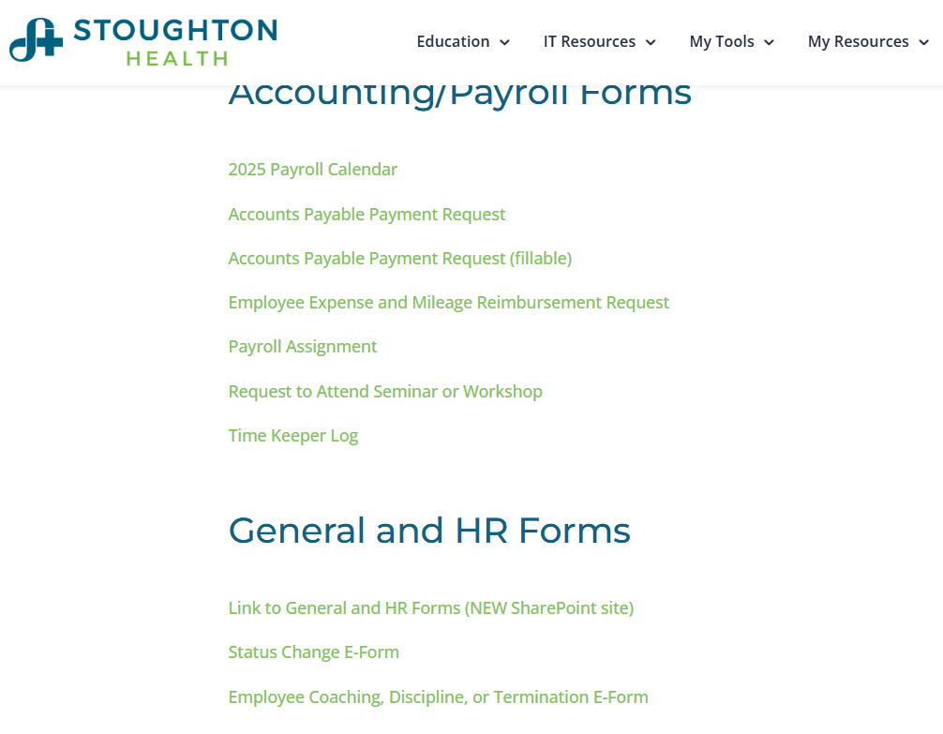
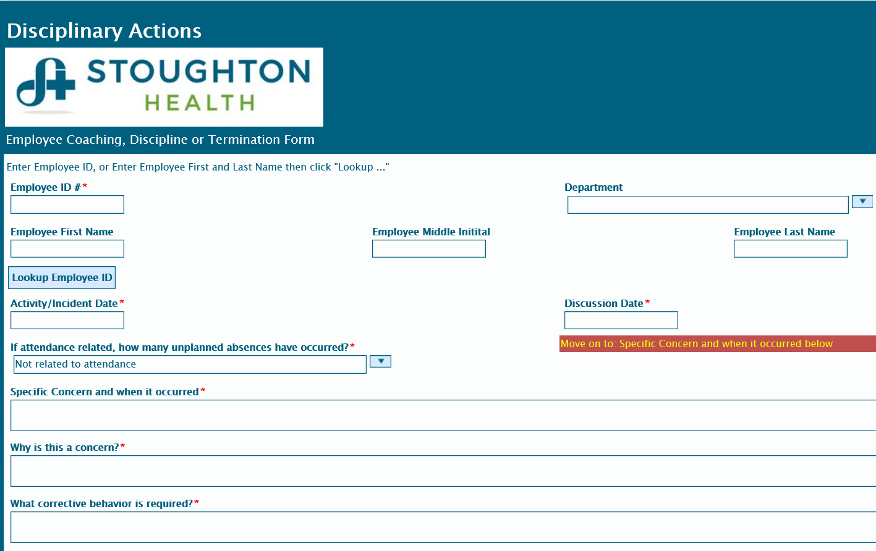
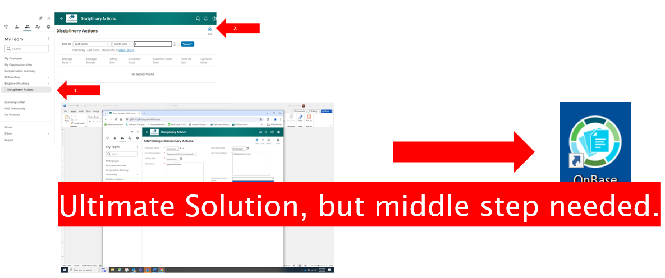
Changes:
List the changes that have been made leading to improvements that occurred in the last 60 days.
DO
What? | Why? | When?
Moved from UKG solution to OnBase solution. | UKG required too many authorization steps which held up process approvals from advancing. | Request made Fall 2024 to embrace OnBase solution. Start of this solution first required resources from SSM IT.
OnBase solution designed by SSM IT. | Per SH HR request. | Tested January and February 2025.

Slide 94
Measures:
STUDY
Fully completed using new disciplinary process.

Slide 95
Findings:
ACT
Results: Did you accomplish your goals?
Yes! Tool is now completed by leader then submitted to HR electronically. HR prints off form, secures necessary signatures, meets with employee and scans signed document into OnBase personnel file.
Lessons Learned: What did you learn because of this project? Unexpected discoveries? Problems or barriers?
Sometimes a simpler solution provides better results. While there is functionality to the UKG tool, OnBase simply provided a more streamlined and customized process that worked for SH.
Next Steps: What actions are you going to take in the next 60 days ?
Action: | Assigned To: | Due Date:
Train Leaders on new form/process | Chris | To Forum 3/20/25
Save training materials for new leaders | Chris
Measure leader sentiments on using new process | Chris | 5/27/25
Project Leader is Recommending the Following:
QM Council approval for completion of project?: Enter YES or NO Project still in progress, project to continue: Enter YES or NO

