Slide 1


Inpatient
Onboarding New Employees
1st Presentation Date: 12/17/2024
Document Last Presented: 12/17/2024

Slide 2
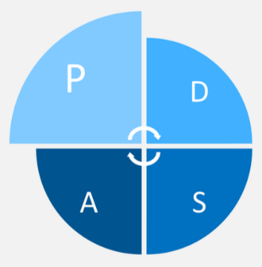

Quality Story:
PLAN
Onboarding – Inpatient
Goal(s): What are you trying to accomplish?
KOM Target: Enhance onboarding of new employees by addressing orientation checklists to ensure that they are practical, concise, and consistently implemented with all new employees by June 2025. Phase 1: Redesign the Inpatient Registered Nurse orientation checklist by March 1st, 2025. Phase 2: Following phases will include replicating the same process in addressing orientation checklists for other disciplines (CNAs, HUCs, CM, and SS) and determining best workflow for new employees with the help of the Clinical Nurse Educator. Current KOM Status: Phase 1: In Progress, completed 1of 4 steps needed to implement Phase 2: Not started
Background: Explain what the original situation was. Why was a change recommended? (e.g. variation, poor outcome, etc.)
There has historically been challenges with onboarding new staff, leading to opportunities for improvement with adequate orientation checklists, qualified preceptors, and consistent scheduling. Administration has challenged each department to enhance onboarding practices.
Driver: Explain why the project is critical to SH. Why does it relate to the strategic plan?
This project will enhance employee satisfaction and promote staff retention. In turn, it will also affect patient satisfaction and each pillar (quality/safety, service, people, growth, and finance).
Team:
Project Leader: Heather Kleinbrook Members: Alissa Knudson, Jennifer Wagner, Michelle Sondreal, Sam Sime, Naomi Franklin, Patty Ryan Inpatient nursing team. Will need to recruit Clinical Education Nurse for support.

Slide 3
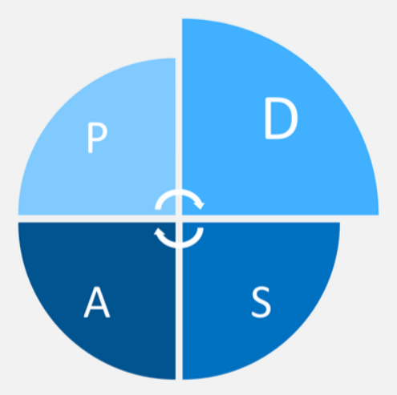

Changes:
DO
List the changes that have been made leading to improvements.
What? | Why? | When?
Email to all IP nurses asking for participation in project. | Develop stakeholder team to address project. | Email sent August 16th, 2024, with responses needed by September 15th.
Set initial meeting of team. | Bring team together. | October 10th, 2024
Present and review project in Inpatient staff meeting. | Continue to garner staff support and acceptance of project. | October 10th, 2024 December 20th and 12th, 2024
Hold first team meeting. | Develop goals and interventions to meet project needs. | October 10th, 2024
2nd Team Meeting | Review member work on checklists. Determine consensus on important items for checklists. Discuss opportunities for case studies/scenarios and medication education. Discuss items that could be completed during initial clinical orientation. | November 21st, 2024
Consider opportunity to utilize clinical nurse to assist with new employee onboarding. | Opportunity to solicit assistance from clinical nurse to help with general new employee onboarding prior to the candidate hitting the floor for unit orientation. This would enhance the experience for the new hire and allow the unit preceptor to focus on unit-specific training/competency. | December 2024
Present and review progress regarding project in GP staff meeting. | Continue to garner staff support and acceptance of project. | December 10th and 12th, 2024

Slide 4
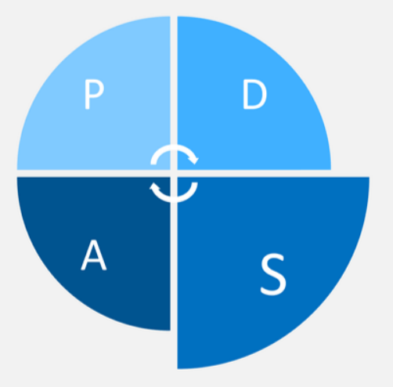

Measures:
STUDY
Include graphs of your measurement, results of surveys, etc. Include benchmarks or comparative data when available.
Action Item | Due Date | Goal Met
IP Manager to work with CNO and nurse leaders to determine need to pre- and post- task rating system. Is this a regulatory requirement? | December 1st, 2024. | Goal Met.
Nurse Leaders to consider request of project team to utilize assistance of Clinical Nurse to assist with onboarding process. | December 10th, 2024. | In Progress
Invite Clinical Nurse to next Project Meeting (January 15th) if appropriate. | December 10th, 2024. | In Progress
Implement new RN orientation checklist with new RN employee | March 2025.
Recreate process to address CNA, HUC, CM, and Social Work checklists | TBD

Slide 5
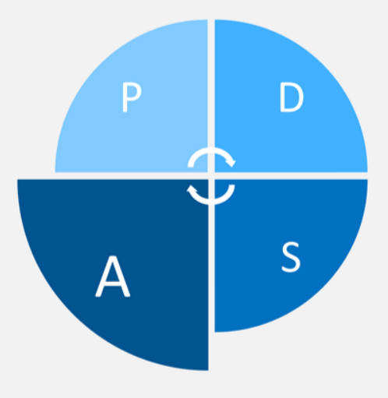

Findings:
ACT
Results: Did you accomplish your goals?
New Project.
Lessons Learned: What did you learn as a result of this project? Unexpected discoveries? Problems or barriers?
It is difficult to recruit team members willing to engage in extra project work when the unit is becoming busier. Most staff members agree that there is need for improvement but aren’t willing to put in the effort to address the need. The same staff members tend to take on the extra work as they are engaged in the unit and its success. Revamping the orientation process is a huge undertaking, involving multiple staff members and resources. Historically, nursing attempted to have orientation checklists similar for all departments, but this is not practical as each department has different needs. Would benefit from added support of clinical education nurse to assist with initial orientation items that cover all nursing disciplines (call light system, glucometers, lifts, assessments, IVs, catheter care, wounds, fall prevention, etc.). Consider extending clinical education orientation to more than 1 day.
Next Steps: What actions are you going to take based on your findings? (e.g. roll out to additional units; modify and make additional improvements; abandon the effort; change course?)
Continue working on enhancing orientation checklists, utilizing case studies and scenarios for learning. Consider use of a learning needs assessment – each new hire will have different needs based on experience. Consider how clinical nurse educator can assist with project and take on some of the orientation load.
Project Leader is Recommending the Following:
QM Council approval for completion of project?: Enter YES or NO Project still in progress, project to continue: Enter YES or NO

Slide 6
Medical-Surgical Department
Increase in Swing Bed Admissions
1st Presentation Date: 06/27/2023 10/24/2023, 12/18/2023, 02/27/2024, 04/23/2024, 06/25/2024, 08//27/2024
Document Last Presented: 12/17/2024

Slide 7
Quality Story:
PLAN
Swing Bed
Goal(s): What are you trying to accomplish?
KOM Target: Increase Swing Bed patient admissions to >41 this year (Jan – Dec 2024) to match pre-COVID numbers. Current KOM: YTD 2024 = 21 SWB admissions. Not on target to meet goal. August = 4, September = 3, October = 1, November = 3.
Background: Explain what the original situation was. Why was a change recommended? (e.g. variation, poor outcome, etc.)
During COVID, Swing Bed admissions declined due to the need to maintain open beds for acute care patients. Now that we are moving to our new post-COVID norm, it feels like we are in a place to open more beds to transitional care patients.
Driver: Explain why the project is critical to SH. Why does it relate to the strategic plan?
Supports several areas of the strategic plan. Most obvious, it supports the bottom line financially, but it also keeps beds filled which guarantees staff hours and boosts staff satisfaction. It also enhances relationships with other hospitals by taking their patients to open beds for more acute needs which makes us good partners.
Team:
Project Leaders: Heather Kleinbrook Members: Case Managers, Social Workers, Inpatient Rehab Staff, Nurses, and Hospitalists

Slide 8
Changes:
DO
List the changes that have been made leading to improvements.
What? | Why? | When?
Meeting with stakeholders and follow-up discussion in daily huddle | Share goals and expectations with stakeholders – develop standard referral process – discuss data collection | 04/26/2023
Meeting with Paula Knowlton, Stroudwater | Obtain education on SWB reporting and data collection for future sharing of metrics. | 04/27/2023
Discussion and identification of potential Swing Bed candidates in Daily Huddle | Want to keep appropriate SWB candidates in our organization for further care. Review outside referrals for appropriateness and coverage. | 04/26/23 and on-going
Meetings with UW Hospital | Discuss how we can be partners in working together to accept appropriate SWB referrals to Stoughton Health. | 3/13/23 4/24/23 On-going
Introduction of project to all staff | Encourage staff buy-in and enforce positive aspects of SWB stays. | 06/13/23 and 06/15/23
Meeting with CNO and Marketing | Promote SWB program throughout area to increase appropriate referrals. | September 3rd, 2024
Consider opportunity for portable dialysis utilization. | Service line could result in increased referrals. | June 2024, ongoing
Marketing Push – social media campaign, mailings to social workers within 30-mile radius, podcast (Angie Bakken), For the Life of You submission, updated SWB brochure with patient testimonial | Market to outside sources to promote program and services to increase appropriate utilization. | September 2024, October 2024
IP Manager reached out to SSM Madison, SSM Janesville, and UW Hospitals to promote services. (Mike Godfrey, Darci Pitkin, Bartho Caponi, Katie Meicher, and Tammy Wymer). | Market program to increase appropriate referrals. | November 2024

Slide 9
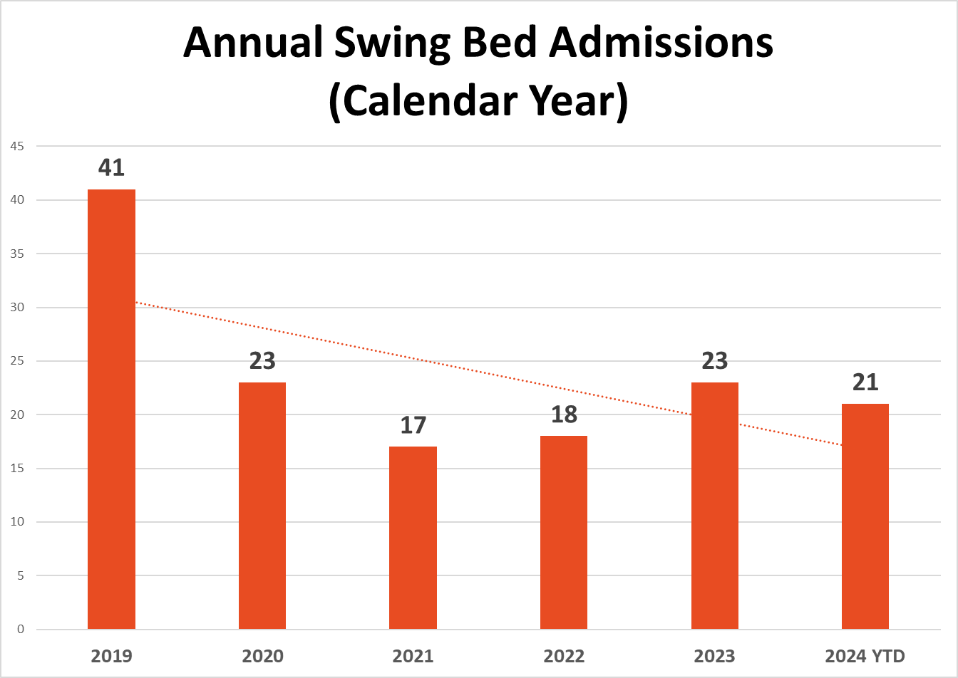
Measures:
STUDY
Include graphs of your measurement, results of surveys, etc. Include benchmarks or comparative data when available.

Slide 10
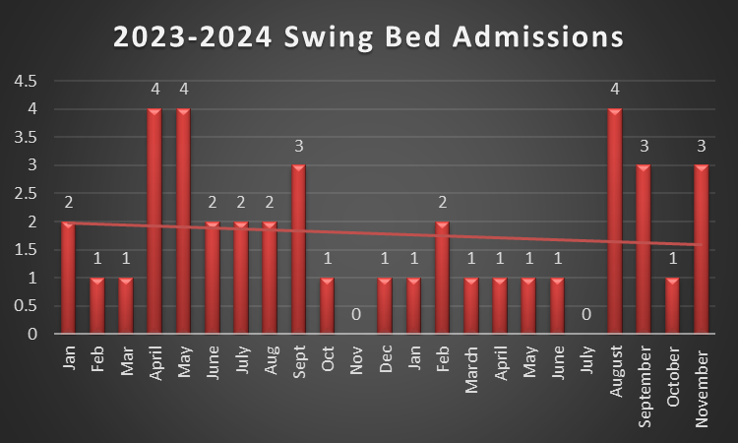
Measures:
STUDY
Include graphs of your measurement, results of surveys, etc. Include benchmarks or comparative data when available.

Slide 11
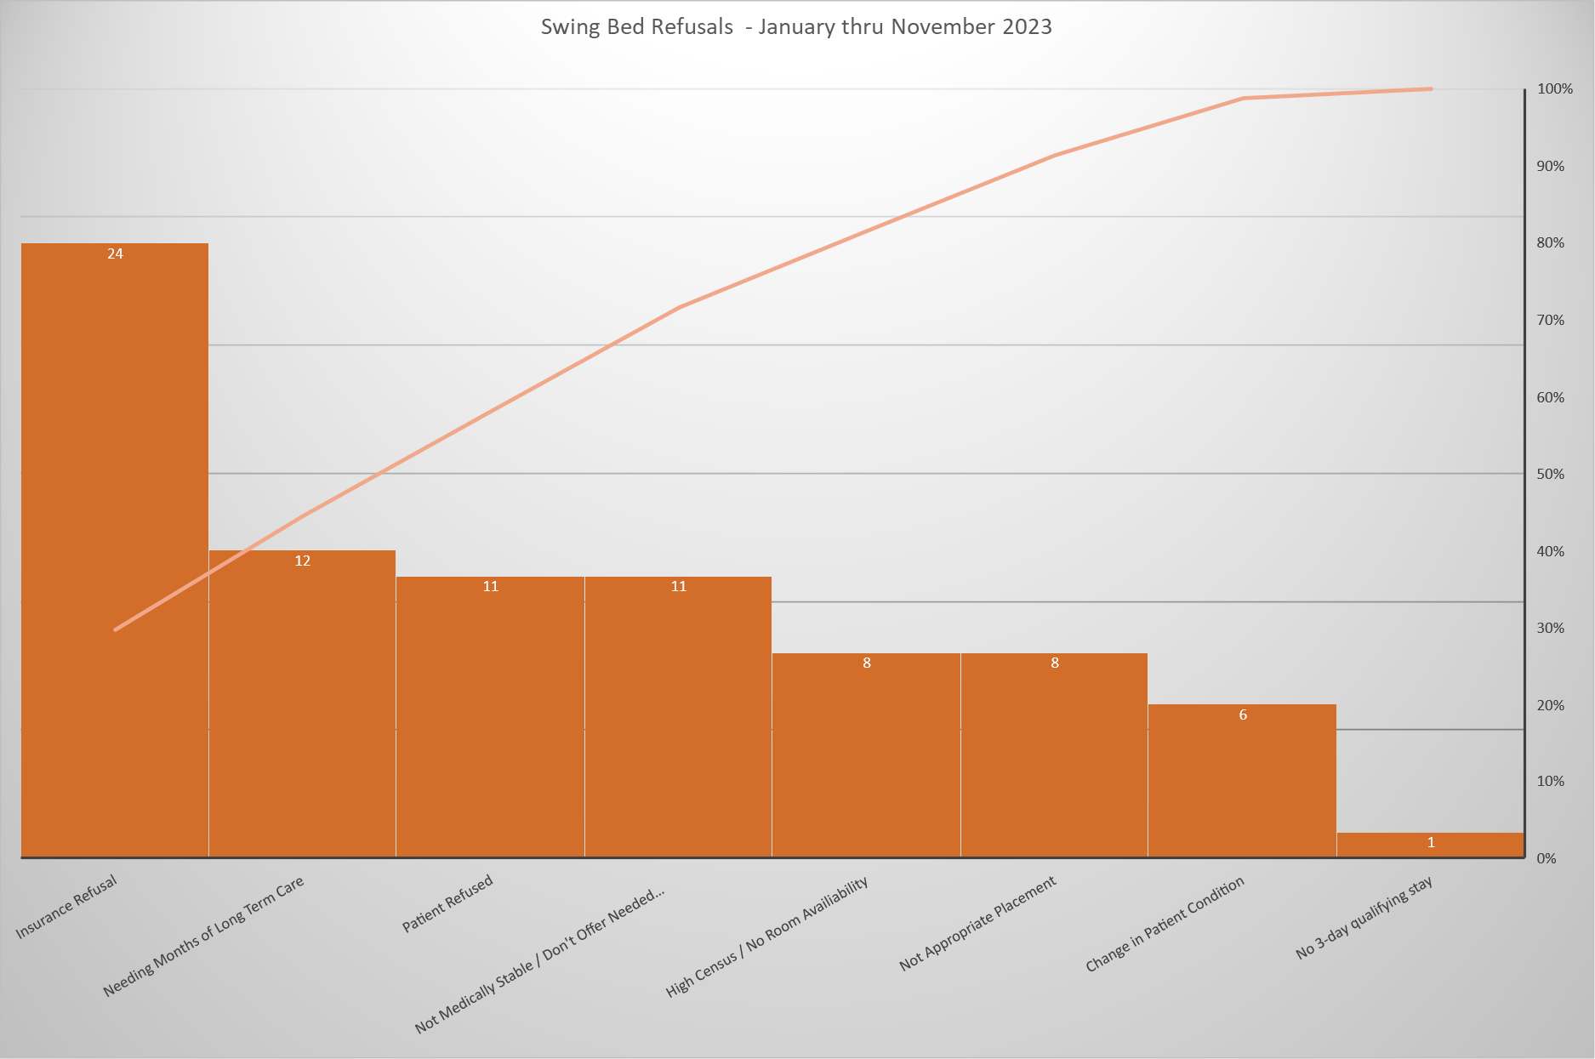
Measures:
STUDY
Include graphs of your measurement, results of surveys, etc. Include benchmarks or comparative data when available.

Slide 12
Findings:
ACT
Results: Did you accomplish your goals?
Ongoing.
Lessons Learned: What did you learn as a result of this project? Unexpected discoveries? Problems or barriers?
Enhanced the referral review process among team members. Consistent review of potential admissions in daily huddle. Team aware of need to increase SWB referrals/patients. Providing Patient Choice, however promoting positives of SWB program and encouraging appropriate candidates to utilize Stoughton Health vs going elsewhere for rehab needs. Completed Pareto and as suspected, insurance is greatest barrier to SWB admissions. Insurance continues to be a barrier with covering SWB services. We had 126 SWB referrals January 2023 through December 2023, only 5 were orthopedic referrals. There are increasing referrals that are social admissions/placement issues, not true swing bed – appropriate referrals (mental health). IP Manager reached out to SSM-Madison, SSM-Janesville, and UW Hospital via telephone call/message and emails to discuss SWB referrals in the month of November. Not a single call-back or response from any of the facilities.
Next Steps: What actions are you going to take based on your findings? (e.g. roll out to additional units; modify and make additional improvements; abandon the effort; change course?)
Continue to encourage SWB utilization among SH inpatients. Case Managers keeping log of referrals and reasons for decline for manager to review.
Project Leader is Recommending the Following:
QM Council approval for completion of project?: Enter YES or NO Project still in progress, project to continue: Enter YES or NO

Slide 13
Geriatric Psychiatry
Utilization Review
1st Presentation Date: 12/17/2024
Document Last Presented:12/17/2024

Slide 14
Quality Story:
PLAN
Utilization Review
Goal(s): What are you trying to accomplish? Decrease amount of time Geriatric Psychiatry Staff are spending on Utilization Review.
KOM Target: Decrease amount of staff time spent on Utilization Review of GP patients by 50% and identify other support options to ease the burden on bedside staff, allowing them more time spent with patients. Current KOM Status: New Project – In data collection phase. Currently, the registered nurse is spending a significant amount of time each day on utilization review. Average amount of time: September = 37 minutes/day, October = 40 minutes/day, November = 46 minutes/day. This does not include time spent on prior authorizations for patients that may/may not even be admitted. This is critical time spent away from patients.
Background: Explain what the original situation was. Why was a change recommended? (e.g. variation, poor outcome, etc.)
Historically, the GP Nursing Staff have completed prior authorizations and clinical updates to insurance companies on patients with this need. As the landscape of insurance coverage has changed, including an increase in Medicare Advantage plans, more and more time is being spent on utilization review. This increase in time takes the nurse away from the bedside and results in less face time with patients.
Driver: Explain why the project is critical to SH. Why does it relate to the strategic plan?
Improvement in this area will be a great satisfier to patients who will receive greater attention from staff, as well as increase staff satisfaction as they are finding themselves spending more and more time administratively than with their patients. Having additional support may also decrease denials and improve the bottom line by eliminating missed clinical updates from busy floor staff.
Team:
Project Leader: Heather Kleinbrook Members: Stacy Wendt, Tammy Arndt, Samatha Reilly (Registration/Revenue Cycle Access Specialist), Sarah Watkins

Slide 15
Changes:
DO
List the changes that have been made leading to improvements.
What? | Why? | When?
Develop project team. | Organize group of committed team member, determine scope of project, establish goals. | 09/04/2024
Develop and implement a data audit form | Need a standard tool to collect data. | 09/04/2024
Collect data | Necessary to have solid data to drive project and determine project goals/outcomes. | September 2024 – ongoing.
Share project and data with staff | Keep all GP staff involved and invested in project. | 12/04/24 and 12/05/24.

Slide 16
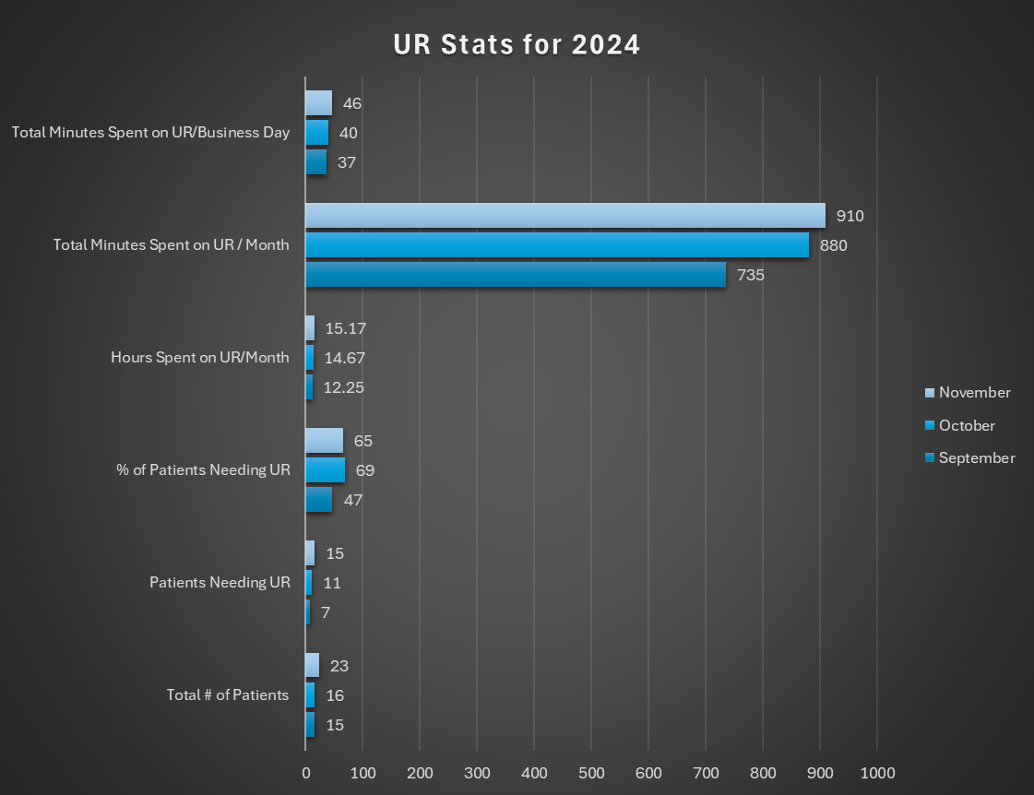
Measures:
STUDY
Include graphs of your measurement, results of surveys, etc. Include benchmarks or comparative data when available.

Slide 17
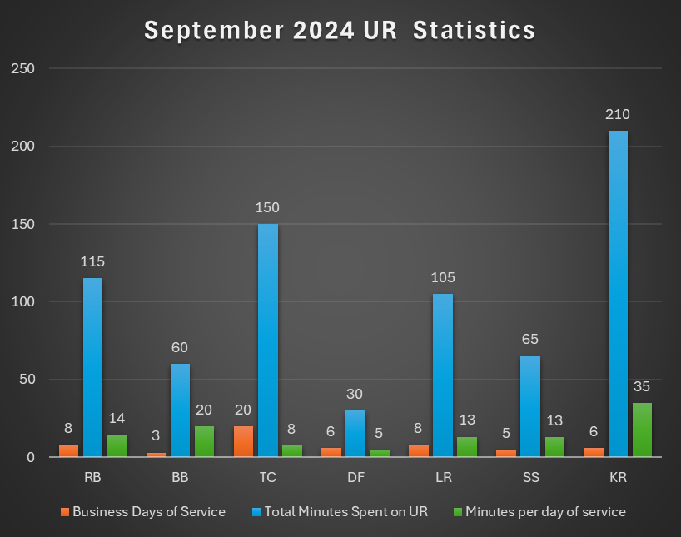
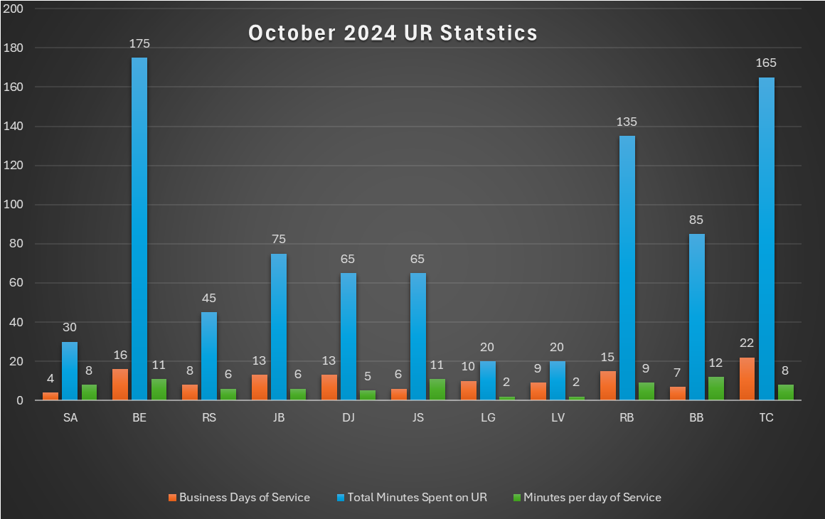
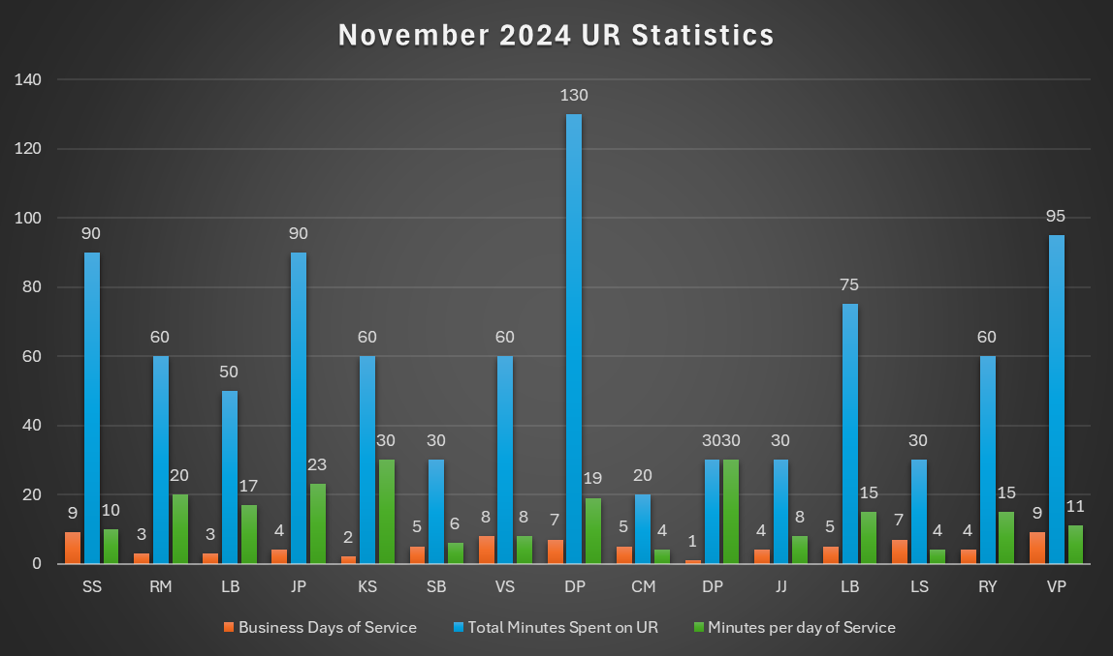
Measures:
STUDY
Include graphs of your measurement, results of surveys, etc. Include benchmarks or comparative data when available.

Slide 18
Findings:
ACT
Results: Did you accomplish your goals?
New project – in data collection phase
Lessons Learned: What did you learn as a result of this project? Unexpected discoveries? Problems or barriers?
Staff have felt overburdened with completing utilization review, and until this project, there wasn’t concrete data backing this up. Project has allowed data to be captured showing staff exactly how much time is spent completing utilization review on patients. There may be a need to consider a shift from the registered nurses completing utilization review as it is taking significant time away from bedside nursing and other unit needs. Samantha Reilly, Registration/Revenue Cycle Access Specialist, has been an added benefit by offering support and assisting with the UR process, yet amount of time nursing is spending on this task is still significant.
Next Steps: What actions are you going to take based on your findings? (e.g. roll out to additional units; modify and make additional improvements; abandon the effort; change course?)
Continue to data mine and consider options for shifting this duty elsewhere. The challenge this creates is that insurance updates often require the expertise of clinical staff to complete. Determine if there are other options for different disciplines to be involved with utilization review for the increasing amount of GP patients with this need.
Project Leader is Recommending the Following:
QM Council approval for completion of project?: Enter YES or NO Project still in progress, project to continue: Enter YES or NO

Slide 19
Geriatric Psychiatry
Onboarding New Employees
1st Presentation Date: 08/27/2024
Document Last Presented: 12/17/2024

Slide 20
Quality Story:
PLAN
Onboarding - GPU
Goal(s): What are you trying to accomplish?
KOM Target: Enhance onboarding of new employees by developing an orientation binder encompassing all Geriatric Psychiatry disciplines, addressing all aspects of patient care. Specific discipline checklists will serve as attachments. Implementation by 03/01/2025. Phase 1: Draft binder completed for all staff to review. Phase 2: GP staff to review and provide feedback to project team by January 8th, 2025. Phase 3: Implement process with new employee (March, 2025). Current KOM Status: Phase 1: Goal met. Phase 2: In progress Phase 3: Not started
Background: Explain what the original situation was. Why was a change recommended? (e.g. variation, poor outcome, etc.)
There has historically been challenges with onboarding new staff, leading to opportunities for improvement with orientation processes, qualified preceptors, and consistent scheduling of orientation time. Administration has challenged each department to enhance onboarding practices.
Driver: Explain why the project is critical to SH. Why does it relate to the strategic plan?
This project will enhance employee satisfaction and promote staff retention. In turn, it will also affect patient satisfaction and each pillar (quality/safety, service, people, growth, and finance).
Team:
Project Leader: Heather Kleinbrook Members: Tammy Arndt, Erin Boettcher, Stacy Wendt, GP nursing team

Slide 21
Changes:
DO
List the changes that have been made leading to improvements.
What? | Why? | When?
Email to all GP nurses asking for participation in project. | Develop stakeholder team to address project. | Email sent July 28th, 2024, with responses needed by August 5th.
Set initial meeting of team. | Bring team together. | August 15th, 2024
Present and review progress regarding project in GP staff meeting. | Continue to garner staff support and acceptance of project. | August 7th and 8th, 2024 October 2nd and 3rd, 2024 December 5th and 6th, 2024
Hold first meeting. | Develop goals and interventions to meet project needs. | September 12th, 2024
Team Meeting. | Review member work on checklists – what is important and what is not? Discuss opportunities for case studies/scenarios and medication education. Are checklists the best use of determining competency or just a means of “checking the boxes”? | October 18th, 2024
Project Pivot: Focus on orientation binder vs individual checklists. | Research on what other psych units utilize for onboarding found facilities using an orientation binder for all disciplines. This approach seemed conducive to our needs and goals and will be the focus moving forward. | November 18th, 2024
Team members working with all department staff to identify topics required to include in orientation binder. | Important to ensure all education items are included in binder and that all staff have a voice in the project. | November 18th, 2024 – ongoing.

Slide 22
Measures:
STUDY
Include graphs of your measurement, results of surveys, etc. Include benchmarks or comparative data when available.
Action Item | Due Date | Goal Met
Project team to have draft binder for all staff review. | December 3rd, 2024. | Met.
GP staff to review draft binder and provide feedback to project team. | January 8th, 2025. | In Progress.
Implement onboarding process with new employee | March 2025.

Slide 23
Findings:
ACT
Results: Did you accomplish your goals?
Ongoing.
Lessons Learned: What did you learn as a result of this project? Unexpected discoveries? Problems or barriers?
It is difficult to recruit team members willing to engage in extra project work when the unit is becoming busier. Most staff members agree that there is need for improvement but aren’t willing to put in the effort to address the need. The same staff members tend to take on the extra work as they are engaged in the unit and its success. Historically, nursing attempted to have orientation checklists similar for all departments, but this is not practical as each department has different needs. Project Team initially began working on re-developing individual checklists by job code/position but found that pivoting to develop an orientation binder for all new GP staff encompassing “all things GPU” to replace general orientation checklists was more productive and beneficial to new employees. Abbreviated orientation checklists will remain for each discipline as needed to address job-specific items. Getting feedback from new employees has been instrumental to project. Would benefit from added support of clinical education nurse to assist with initial orientation items that cover all nursing disciplines (call light system, glucometers, lifts, assessments, IVs, catheter care, wounds, fall prevention, etc.). Consider extending clinical education orientation to more than 1 day.
Next Steps: What actions are you going to take based on your findings? (e.g. roll out to additional units; modify and make additional improvements; abandon the effort; change course?)
Gather team for first meeting and address goals. Continue to work on binder and abbreviated checklist development. Work with nursing leaders to determine how clinical nurse educator can support onboarding needs. Continue timely meetings dedicated to project work.
Project Leader is Recommending the Following:
QM Council approval for completion of project?: Enter YES or NO Project still in progress, project to continue: Enter YES or NO

Slide 24
Emergency Services
Isolation Signage
1st Presentation Date: August 22, 2023
Document Last Presented: December 17, 2024

Slide 25
Quality Story:
PLAN
Isolation Signage
Goal(s): What are you trying to accomplish?
KOM Target: 95% of ED patients being admitted will have isolation signage indicated Current KOM Status: 56%
Background: Explain what the original situation was. Why was a change recommended? (e.g. variation, poor outcome, etc.)
Patients that come through the ED do not always have proper signage in place. Since COVID, staff have not been as diligent. This exposes other departments as well as not communicated when patient is admitted.
Driver: Explain why the project is critical to SH. Why does it relate to the strategic plan?
Prevent other staff from getting ill and decrease transmission to other patients.
Team:
Project Leader: Tina Strandlie, Bill Wilson Members: ED Staff

Slide 26
Changes:
DO
List the changes that have been made leading to improvements.
What? | Why? | When?
Communication
Accountability
Outlier/staff credit | Per observation – staff always have masks on and very low sick calls in the ED | October and November 2024
Staff | November there were 8 misses and 8 different RNs
Staff meeting | Discuss at every staff meeting | October 2024

Slide 27
Measures:
STUDY
Bill Wilson continues to collect data for this project

Slide 29
Findings:
ACT
Results: Did you accomplish your goals?
No
Lessons Learned: What did you learn as a result of this project? Unexpected discoveries? Problems or barriers?
In reviewing the November data: a total of 22 patients were put on precaution. Of those 4 tested out and didn’t need precautions. 18 were used as part of the study. 7 patients did not have appropriate precautions. One patient was put on precautions on arrival and it was removed at admission. Because it was removed 20 minutes before admission, it was counted against us. 10 patients had appropriate documentation.
Next Steps: What actions are you going to take based on your findings? (e.g. roll out to additional units; modify and make additional improvements; abandon the effort; change course?)
Working with Nikki regarding Isolation precaution pop ups. During COVID there was an automatic pop up for fever or cough and isolation precautions needed to be initiated. We are consistently missing prior skin infections (some several years old that have not have been retested) for contact precautions.
Project Leader is Recommending the Following:
QM Council approval for completion of project?: Enter YES Project still in progress, project to continue: Enter YES

Slide 30
Emergency Management
Mass Casualty Plan
1st Presentation Date: June 27th, 2023
Document Last Presented: December 17th, 2024

Slide 31
Quality Story:
PLAN
Mass Casualty Drill
Goal(s): What are you trying to accomplish?
KOM Target: Mass Casualty Drill by September 2024 Current KOM Status: 100% on October 24th, 2024 Emergency Management is ongoing. Most recent events/training include: 2 events have occurred - IVF conservation and Community Exposure 1 training - Decon training completed.
Background: Explain what the original situation was. Why was a change recommended? (e.g. variation, poor outcome, etc.)
The hospital has not had a mass casualty drill in a few years. Prepare staff and leaders what to do during a real event. Real Event
Driver: Explain why the project is critical to SH. Why does it relate to the strategic plan?
Safety for our patients and staff in the event of a mass casualty Working with community partners.
Team:
Project Leader: Tina Strandlie and Julie Staddler Members: Emergency Management Committee

Slide 32
Changes:
DO
List the changes that have been made leading to improvements.
What? | Why? | When?
Decon Training completed | New/alternate staff were trained during drill. | August 16th, 2024
IV Shortage collaboration | Notified early part of October 2024 of supply disruption due to Hurricane Helene. Decision made to form a taskforce to ensure adequate fluids were available for patients | October 15th
Significant exposure at local restaurant | Collaborated with multiple outside agencies to determine the cause, stop the exposure and follow up | October 22 – 25th, 2024

Slide 33
Exposure Event – 10/22-10/25/2024
10/22/2024 – two patient brought in by EMS for possible carbon monoxide exposure after eating at local restaurant.
10/24/2024 – two patients brought in by EMS for possible carbon monoxide exposure after eating at local restaurant. Dizzy, nauseated. Another patient brought in by EMS with severe dizziness, nausea and “something isn’t right.” Upon discharge stated to RN she feels like she was drugged. RN in collaboration with MD ordered a urine drug screen. Patient was positive for THC. Patient stated she has only tried a THC gummy once years ago and felt the same way.
All patients had eaten at the same establishment in 24 hours.
ED Manager notified Chief Ripp as unknown what other patients may have been transported to other hospitals. Notified of a possible exposure related to restaurant. Chief Ripp notified Public Health who called the ED Manager.
To protect HIPAA – ED Manager obtained PH Rep information and had the patient that was positive call to give a statement. Patient also notified Stoughton PD. Approximately 2pm on 10/24/24 restaurant was closed and investigation started.
3pm on 10/24/24 patients started to arrive walk in or via ambulance related to exposure in a 2 hour time span, total of 9 patients. The department was already full with patients. Not all patients were tested. Multiple police agencies were in department interviewing patients.

Slide 34
Follow up to Exposure
Community partners – Public Health, Stoughton Fire, Stoughton EMS, Stoughton Police Department
Stoughton Fire investigated both homes and restaurant for possible carbon monoxide
EMS transported a total of 9 patients to our ED
Per Public Health report:
  Total 85 probably cases
  During the inspection with Public Health staff on October 24, the Stoughton Police Department
  tested a container labeled as Delta-9 THC infused oil from a different business located in the
  shared community kitchen. The oil was tested with a Duquenois-Levine Reagent. There was no
  oil left in the container used by Famous Yeti’s to make the pizza dough. Therefore, a bulk
  container located in the same vicinity as the borrowed oil was tested.
Ages affected were 1 – 91 years of age
27 people went to an emergency room and 3 were admitted over night (no admissions to Stoughton inpatient)
Stoughton saw a total of 14 (based on symptoms and stating they ate at restaurant)
After Action: Jen White took the lead to ensure HIPAA was maintained and worked with ED staff. Staff did not speak with reporters. Some staff suggested they needed more help but others felt it was manageable as no one was life threatening and when the influx occurred they knew what the exposure was. Educate staff on patterns of patient presentation. Could this have been caught sooner?

Slide 35
IV Fluid Conservation
Stakeholders: Amy Hermes (IC), P. Cass, T. Strandlie, D. Brunner, N. Linnerud, R. Sarow, S. Armstrong, J. White, R. Tesmer, H. Kleinbrook, N. Rowin
House wide count of all available IV fluids and sterile waters. Fluids were pulled to one holding area in each department to monitor usage. Providers were notified to use IV fluids only if a patient was unable to tolerate PO. Radiology stopped using mini bags.
P. Cass notified Cardinal for assistance in obtaining IV fluids from them
Surgeries were not disrupted. Weekly check in on available fluids and what was needed
Expired Fluids were being kept in the event they would be needed
Baxter restoration plan is ahead of schedule with full operation by end of December
P. Cass was able to secure IV fluids from Cardinal and were getting shipments in a timely manner
N. Rowin worked with EPIC to change orders to prevent over usage of IV fluids
Pharmacy was able to secure meds already mixed
11/19/2024 cautiously optimistic we will not experience a disruption of service
Lessons learned: Proactive in developing team to work collaboratively. Dacia, Nancee and Roberta came to meetings with accurate supplies available, what was coming in and what was being ordered. Pauline and staff working with another vendor. Staff understanding the importance of conserving IV fluids for those truly in need. Kept OR open, no cancelled cases. No areas noted for improvement.

Slide 36
Findings:
ACT
Results: Did you accomplish your goals?
Emergency management requirements is an ongoing process.
Lessons Learned: What did you learn as a result of this project? Unexpected discoveries? Problems or barriers?
For both incidents – administration/management recognized the problem quickly and implemented strategies to decrease further disruption.
Next Steps: What actions are you going to take based on your findings? (e.g. roll out to additional units; modify and make additional improvements; abandon the effort; change course?)
The exposure situation utilized community partners, although it wasn’t related to injury but exposure to a chemical which is very rare. We worked with Fire, PD, EMS and Public health.
Project Leader is Recommending the Following:
QM Council approval for completion of project?: NO Project still in progress, project to continue: Yes

Slide 37
Emergency Services and Cardiopulmonary
Medication Barcode Scanning Compliance
1st Presentation Date:August 27th, 2024
Document Last Presented December 17th, 2024

Slide 38
Quality Story:
Medication Barcode Scanning Compliance
PLAN
Goal(s): What are you trying to accomplish?
KOM Target: 95 % Current KOM Status: ED 95%, Cardiopulmonary 95%
Background: Explain what the original situation was. Why was a change recommended? (e.g. variation, poor outcome, etc.)
Pharmacy is now able to run reports on compliancy of scanning patients and the medication.
Driver: Explain why the project is critical to SH. Why does it relate to the strategic plan?
This is a safety feature that all staff should be following. It also ensures correct charges are dropping for the patient and medication.
Team:
Project Leader: Tina Strandlie Members: Pauline Cass and ER/Cardiopulmonary staff

Slide 39
Changes:
DO
List the changes that have been made leading to improvements.
What? | Why? | When?
First report of medication scanning | Determine who is not compliant | August 2024
Cardiopulmonary workflow | Determine why patient/meds are not scanned. IT said the scanner is fixed RT says it is not. Scanner fixed in stress lab Medication not scanned is the IV flush after Lexiscan admin | September 2024
No reason why med or patient was documented. This has improved to get to root cause | Patient not scanned without reason was 24%, down to 11% Med not scanned without a reason was 33%, down to 17% | October 2024
Email to staff that have the most missed scans | Awareness | August 2024

Slide 40
Measures:
STUDY
Patient and Medication Scanning Compliance By RN (RN 5 and 9 did not work during time frame)

Slide 41
Measures:
STUDY
Patient and Medication Scanning Compliance By Cardiopulm staff. Month of October

Slide 42
Findings:
ACT
Results: Did you accomplish your goals?
Yes.
Lessons Learned: What did you learn as a result of this project? Unexpected discoveries? Problems or barriers?
Staff need to notify pharmacy or put in ticket if bar code scanner not working. Staff need to be proactive putting reasons why scanning didn’t work (medication and/or patient)
Next Steps: What actions are you going to take based on your findings? (e.g. roll out to additional units; modify and make additional improvements; abandon the effort; change course?)
All staff did an amazing job of recognizing the importance of scanning. Due to emergency situations the ER will never be at 100%. Cardiopulmonary staff have change context to get to cardiology clinic to scan med/patient or it doesn’t flow. Prior to the Stress Test they have to change context back to enter data.
Project Leader is Recommending the Following:
QM Council approval for completion of project?: NO Project still in progress, project to continue: No

Slide 43
Specialty Clinic
Strengthening Skills- Vasectomy Clinic
1st Presentation Date: 5/28/2024
Document Last Presented: 12/3/2024

Slide 44
Quality Story:
PLAN
NEW QM: Strengthening Skills - Vasectomy Clinic
Goal(s): What are you trying to accomplish?
KOM Target: 100% Current KOM Status: 2 of 6 staff have completed all competency requirements.
Background: Explain what the original situation was. Why was a change recommended? (e.g. variation, poor outcome, etc.) | Driver: Explain why the project is critical to SH. Why does it relate to the strategic plan?
With nine different providers, each with unique practices and medication protocols, ensuring consistency becomes paramount to mitigate errors and enhance patient care. This QM project is to foster consistency and achieve exceptional patient care. Recommended due to variation in provider protocols and a need for support staff to be fully competent in all aspects of the clinic workflow. Clinic started October 2022-need for standardization/competency | The driver behind implementing the QM Program in the Vasectomy Clinic is the need to ensure patient safety and improve the overall quality of care. With nine providers performing vasectomies, with varied protocols and administering different medications, there is a risk of inconsistency and errors. The primary goal of the program is to address these challenges by strengthening skills, fostering consistency, and minimizing the risk of errors. This will be achieved by implementing standardized protocols, providing comprehensive training, and promoting collaboration amongst the team.
Team:
Project Leader: Tina Strandlie Members: Maren Stephens

Slide 45
Changes:
DO
List the changes that have been made leading to improvements.
What? | Why? | When?
Protocol Implementation: | Implementing standardized RN documentation as currently there is none. | Maren RN has received protocol/dot phrase and working with Valerie to implement. Valerie obtained rights for Maren and other RNs in EPIC to complete this. Valerie is doing this
Medication Cards/Dual sign off | Working with pharmacy and Valerie Farnsworth to have this in EPIC. Currently this is done on a piece of paper that is then cut in slices and added to the chart. Compounding medication competencies have been completed by all RNs except Maren RN, who will complete by November 20th. Other RNs have completed this as part of the requirement in other areas they work. | By end of November. A WOW (has a bar scanner on it) will be utilized during clinic. It is not necessary for a 2nd RN to sign off if it in EPIC
Regular Assessments | Vitals will be performed on all patients (based on protocols at SSM Urology clinic) and documented. RN will document prep and discharge teaching in EPIC. Provide consistency messaging to patient, if patient calls back other providers can see what occurred. | November 2024
Maintaining Sterile Technique | Two patients developed infections after the procedure. Both were morbidly obese and a new prep procedure was put in place. The patients did not develop a cellulitis and infection was caught early. It was determined not to be related to instruments. | Same provider for both patients but new prep will be done on all patients starting 11/15/24
Performance Monitoring: | Monitored a very busy clinic day. Determined that one or even two staff can’t provide the appropriate care depending on the provider. Working with Maren to assure proper staff are in place to accomplish best patient outcomes. | November 2024
Planning for move | Maren will meet with Dacia and Dwayne to do a walk thru of the new area in SHOC. They will go room by room to assure everything is ordered correctly and delivered on time by opening. | November 2024

Slide 46
Measures: New Projects
STUDY
This is a new project and 2 of 6 staff are fully competent in all aspects of the clinical procedures. Two employees resigned (Jen D, RN and Taylor S, MA) since we previously presented.
Staff/PRN | Assist | Draw Medication | Prep Tray | Cleaning/Setup | Prep Patients
Maren | Yes | Yes | Yes | Yes | Yes
Jen S | No | Yes | Yes | Yes | Yes
Erin | No | Yes | Yes | Yes | Yes
Maritha | Yes | Yes | Yes | Yes | Yes
Tamara | No | Yes | Yes | Yes | Yes
Kiara ED Tech | No | No | Yes | Yes | Yes

Slide 47
Findings:
ACT
Results: Did you accomplish your goals?
No
Lessons Learned: What did you learn as a result of this project? Unexpected discoveries? Problems or barriers?
I have been overseeing this clinic for the last month. I have never worked in a clinic and relying on Maren RN to guide me. It is a very busy clinic with lots of moving pieces in a very small area.
Next Steps: What actions are you going to take based on your findings? (e.g. roll out to additional units; modify and make additional improvements; abandon the effort; change course?)
Continue training PRN staff and implement competency dates – has been completed except the assist. I will work with Sam Stoltz as there was no clear direction of when the RN had reached competency for assisting the provider.
Project Leader is Recommending the Following:
QM Council approval for completion of project: No Project still in progress, project to continue: Yes

Slide 48
Laboratory/Infection Prevention
Blood Culture Contamination Rate Reduction
1st Presentation Date: 2/2024
Document Last Presented: 8/2024

Slide 49
Quality Story:
PLAN
Blood Culture Contamination Rate Reduction
Goal(s): What are you trying to accomplish?
KOM Target: <1% contamination Rate Current KOM Status: 0.7% (Sep-Nov 2024)
Background: Explain what the original situation was. Why was a change recommended? (e.g. variation, poor outcome, etc.)
In 2023 national standards for blood culture contamination rates were reduced <3% to a goal of <1%. Currently Stoughton Health has a standard of 2% or 2 or less contaminated blood cultures per month. We collect an average of 85 blood cultures per month with volumes varying depending on the time of year. We are consistently meeting the of 2 or less per month with our rates varying from 0.8% to 3.6% in past 12 months.
Driver: Explain why the project is critical to SH. Why does it relate to the strategic plan?
A contaminated blood culture can result in unnecessary antibiotic treatment, potential unnecessary admission, increase in patient stay, and increase in cost. Literature review lists the potential additional cost of patient care due to a contaminated blood culture may be up to $4000 or $5000.
Team:
Project Leader: Kyle Sippel Members: Bill Wilson IP, Alicia Hookstead Lab, Tina Strandlie, ER Staff, Lab Staff, Kurin product consultants.

Slide 50
Changes:
DO
List the changes that have been made leading to improvements.
What? | Why? | When?
General blood culture collection technique refresher training was sent out to both ER and Lab staff for review. Training included introduction to the Kurin Jet diversion device. | Appropriate collection technique is the most important step in preventing contamination. Collection refresher training was done to re-enforce proper technique | Sent out on 3/17/2024
Collection kits were made up for the ER to include the new diversion devices |  | 4/1/2024
Face to Face and hands on training with the Kruin Jet devices provided on 4/2/2024 by Kurin representative. Use of the diversion device went live at that time. |  | 4/2/2024
Laboratory monitoring practices adjusted to included better monitoring on volume and use of diversion device. | Increased monitoring will allow for better assessment of overall collection quality and more real time feed back for collectors that may be having issues. Will also monitor compliance with new procedures. | Began 4/1/2024
Continued Monitoring and Follow-up Gram Stain logs are being monitored at least weekly (usually daily) for any positive blood cultures. Positive cultures results will be monitored real time and if determined to be a contaminant, follow up will be had with the collector as soon a possible. | This allows for follow up in a time frame in which the collector may remember specifics of the collection and if procedures were followed or there were any variables that may have resulted in contamination. | April 2024 – Ongoing monitoring.

Slide 51
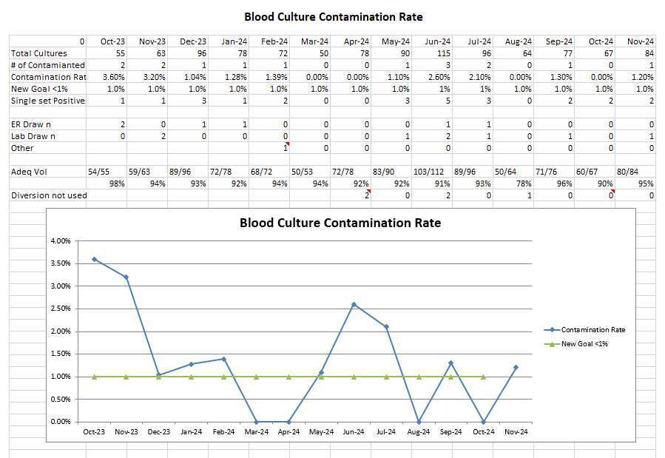
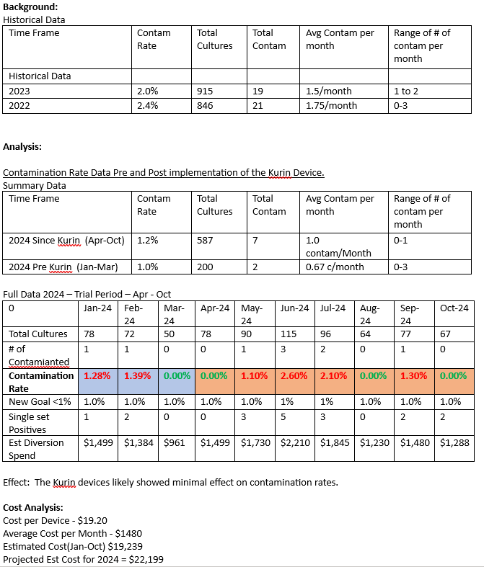
Measures:
STUDY
Diversion Device Trial Summary

Slide 52
Findings:
ACT
Results: Did you accomplish your goals?
No Current Rate 0.7% (2 cultures) (Sept – Oct 2024)
Lessons Learned: What did you learn as a result of this project? Unexpected discoveries? Problems or barriers?
Project Reminder- Collection Education done in Jan 2024 and Kurin diversion device trial began in April. Overall, our rates began improved in 2024. This improvement was seen beginning in January when initial education was done. Overall, did not see a different in the contamination rates with implementation of the diversion device. Pre Kurin device, - Jan-Mar– 1.0%, avg 0.67/month Device trial Apr – Oct device trial period – 1.2% avg 1/month We did see a trend in which the ER rates did decrease during the trial period, but the lab rates went up. ER – Pre 1/Month - Trial period – 0.3/month Lab – Pre 0.5/month – Trial period – 0.85/month Lab staff have expressed some concern with the needle setup, clumsiness of the device, and difficulty with use. For ER, the device provides an easier ability to fill at 90 degrees vs 45 degrees direct fill from catheter (not a recommend procedure)
Next Steps: What actions are you going to take based on your findings? (e.g. roll out to additional units; modify and make additional improvements; abandon the effort; change course?)
Study results were shared and discussed with the infection control committee. Since lab felt it had inventory for about 3 more months the committee recommended the trial period continue for an additional 2 month. Evaluation to continue.
Project Leader is Recommending the Following:
QM Council approval for completion of project?: NO Project still in progress, project to continue: Enter YES

Slide 53
Laboratory
Blood Gas Resulting Accuracy / Interfaced Results
NOTE: This is an off-shoot of the prior Blood Gas Instrumentation replacement project.
1st Presentation Date: 8.2024
Document Last Presented: 8.2024

Slide 54
Quality Story:
PLAN
Blood Gas Resulting Accuracy / Interfaced Results
Goal(s): What are you trying to accomplish?
KOM Target: Reduce the risk on resulting errors for Blood Gas results by implementation of an interface (4 steps required to full implementation) 0 resulting errors for Arterial and Venous blood gas results. Current KOM Status: 1 of 4 steps complete for interface build. 1 resulting errors in past 3months
Background: Explain what the original situation was. Why was a change recommended? (e.g. variation, poor outcome, etc.)
Currently all blood gas results are manually entered into the LIS from an instrument printout. These printouts are small and with any manually entered results; there is risk for incorrectly entering and releasing results. The laboratory recently implemented 2 new EPOC blood gas instruments. These instruments have the potential to interface directly to our EPIC system via a system call RALS or through the SSM Data Innovation direct interface system.
Driver: Explain why the project is critical to SH. Why does it relate to the strategic plan?
The blood gas instruments provide critical testing utilized in a number of patient conditions including significant trauma, cardiac, respiratory, infectious diseases and diabetic events. This project will provide will ensure the accuracy of the results that are released to providers as well as improve staff efficiency.
Team:
Project Leader: Kyle Sippel – Lab LIS Lead Members: Hospital IT, SSM Beaker Team

Slide 55
Changes:
DO
List the changes that have been made leading to improvements.
What? | Why? | When?
Instruments Live for patient use |  | May 1st 2024
Submitted a IHT request for building an interface for the EPOC instruments to Epic | A project of this level needs to be submitted and approved by IT for build | 6/12/2024
Reviewed both a direct interface options and use of the RALS middleware options and determined the RALS would be likely cheapest and easiest to maintain. |  | June 2024
Continued Follow-up with SSM and Abbott to determine status of talks to add Stoughton to the agreement. | SSM was in negations with Abbott RALS to discuss billing structure for affiliate use of the RALS system. No new affiliate build was being allowed. | Last update as of 11/15
Work with Epic Beaker to build out the Epic side of the interface. The tables are build are ready for RALS once discussion are completed. |  | Oct 2024

Slide 56
Measures:
STUDY
Include graphs of your measurement, results of surveys, etc. Include benchmarks or comparative data when available.

Slide 57
Findings:
ACT
Results: Did you accomplish your goals?
No, Current KOM Status: 1 of 4 steps complete for interface build. 1 resulting errors in past 3 months
Lessons Learned: What did you learn as a result of this project? Unexpected discoveries? Problems or barriers?
SSM is currently in negotiations with Abbott regarding Affiliate use of the RALS systems and contractual structure. No new affiliate RALS related project will be worked on until new billing structure has been determined and necessary contracts signed. Abbott felt these decisions should be soon. Update 11/15 - agreement portion adding the affiliates had been addressed however the individual approvals (such as Stoughton specifically) is still in the works. No new timeframe provided
Next Steps: What actions are you going to take based on your findings? (e.g. roll out to additional units; modify and make additional improvements; abandon the effort; change course?)
Continue to work with SSM and Abbott to get Stoughton approved on the agreement to allow for build.
Project Leader is Recommending the Following:
QM Council approval for completion of project?: NO Project still in progress, project to continue: YES

Slide 58
Laboratory
Fine Needle Aspiration Coverage
1st Presentation Date: 12/2024
Document Last Presented:

Slide 59
Quality Story:
PLAN
Fine Needle Aspiration Coverage
Goal(s): What are you trying to accomplish?
KOM Target: To provide coverage for staff assisted Fine Needle Aspiration (FNA) collected by Ultrasound (4 steps to complete implementation) Current KOM Status: 1 of 4 steps completed
Background: Explain what the original situation was. Why was a change recommended? (e.g. variation, poor outcome, etc.)
Fine Needle Aspirations are a procedure performed in Ultrasound in which fluid/cells are aspirated from a mass by the Radiologist. These procedures have been typically assisted by a pathologist to make slides and verify the adequacy of the sample. These procedures were done on Fridays, in coordination with pathologist and radiologist schedule. Lab was informed that the radiologist schedule would be changing to every other Tuesday. Pathology is unavailable to come to Stoughton on Tuesdays to cover; creating and issue with these procedures. Currently approximately 4-5 FNA done annually, almost all are Thyroid FNA.
Driver: Explain why the project is critical to SH. Why does it relate to the strategic plan?
This project is essential in order to ensure Medical Imaging can continue to offer the FNA procedures here at Stoughton Health.
Team:
Project Leader: Kyle Sippel - Lab Members: Dr. Joel Mendelin – Associated Pathology/Lab Medical Director , Sara Sturmer – Medical Imaging

Slide 60
Changes:
DO
List the changes that have been made leading to improvements.
What? | Why? | When?
After Conversation between Dr. Mendelin and radiology medical direction it was decided that due to minimal risk of adequacy issues, it was determined that a lab tech could be trained to assist the radiology with slide and sample preparation for Thyroid FNAs. If we were to have a request for a non-thyroid FNA or a guided Bx. Those would need be handled on a case-by-case basis to determine if lab could assist or if pathology would need to be available. | This would allow lab to ensure someone is available to assist with the majority of procedures that may be requested. | Oct 2024
Lab Staff Kyle Sippel went to SSM to work with a cytology tech and learn to proper procedures/techniques. |  | Oct 21st
A procedure is being written and reviewed to cover the new staff role in assisting with FNAs. | This will provide the guidelines for lab’s role and procedure for assisting with the FNA. | Ongoing

Slide 61
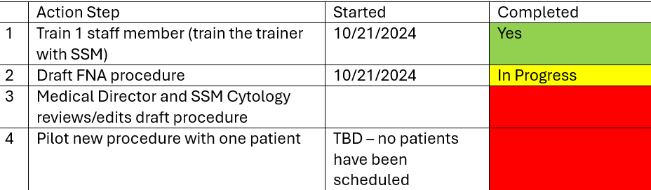
Measures:
STUDY
Include graphs of your measurement, results of surveys, etc. Include benchmarks or comparative data when available.
Project Status:
Draft of the updated FNA procedures has been written and currently under review by Medical Director and SSM Cytology.
1 Lab staff person has been trained
No procedures have been performed or schedule at this time.
  In no procedure some Medical will work with trained lab person to do a Mock procedure to verify competency and test the protocol.

Slide 62
Findings:
ACT
Results: Did you accomplish your goals?
No: Still Ongoing
Lessons Learned: What did you learn as a result of this project? Unexpected discoveries? Problems or barriers?
These procedures occur infrequently (4-5 annually). This will create some challenges with staff competency. Therefore, trained staff will be limited to no more that 2 at this time. Different types of FNAs may have some different parameters (such as actual core bx vs FNA). Lab staff are specifically trained for Thyroid FNA (100% of imaging procedures in past 2 years). Other imaging procedures needing assistance such as other site FNA or biopsies will be handled on a case-by-case basis with imaging, lab, and pathology.
Next Steps: What actions are you going to take based on your findings? (e.g. roll out to additional units; modify and make additional improvements; abandon the effort; change course?)
The procedure needs to be reviewed and approved by Lab Medical Direction. Procedures will be tested with the next schedule procedure. If we do not have a procedures scheduled soon, a Mock procedure will be set up to verify the protocol and competency.
Project Leader is Recommending the Following:
QM Council approval for completion of project?: NO Project still in progress, project to continue: Enter YES

Slide 63
Sleep Disorders Center
Inventory Management
1st Presentation Date: 2/2024
Document Last Presented: 8.2024

Slide 64
Quality Story:
PLAN
Sleep Center Inventory Management.
Goal(s): What are you trying to accomplish?
KOM Target: Full development and implementation of a standardized ordering and supply management process including ordering tools with Par levels, expiration monitoring, room stocking and utilization of the Multiview system by November 1st 2024. Current KOM Status: 8 of 8 project plan steps completed
Background: Explain what the original situation was. Why was a change recommended? (e.g. variation, poor outcome, etc.)
During a recent environmental safety walk through there were multiple different expired products identified both in our patient rooms and stock room. Staff also stated we have had other supply issues related to not having the appropriate supply in the patient room, not having a supply at all, or newer supplies being used before older supplies; leading to expirations. During the EOC follow up discussion it was determined that Sleep Lab does not have consistent supply ordering and management process that is known by all sleep staff. There are no pre-set quantities or other ordering tools. Additionally, supply ordering is being done on paper vs within the Multiview system.
Driver: Explain why the project is critical to SH. Why does it relate to the strategic plan?
A standardized supply ordering and inventory management process will ensure supplies are available where and when they are needed, limit supply expiration, help to prevent expired supplies from being used, and allow for multiple staff to be able to complete the supply ordering process when necessary. Additionally moving supply requisitioning into Multiview will save time and improved efficiency for the hospital purchasing staff.
Team:
Project Leader: Kyle Sippel Members: All sleep tech, Purchasing.

Slide 65
Changes:
DO
List the changes that have been made leading to improvements.
What? | Why? | When?
Supply inventory and other changes were submitted to Materials Services department to build out the Multivew system for all sleep supplies |  | Completed early July
Staff reviewed our overall supply usage over the past year to determine the amount of each product utilized. This information was then used to begin to set standards of when to order a supply and how much to order at a time. | This information was used to create the first draft of an ordering tool to be used by staff. | June 2024
Standardized order tool was created to indicate minimum inventory levels and quantity to order | Create consistency in when and how much is ordered to prevent short coming or outdates. Additionally, it would allow any staff person to complete a supply order. | July 2024 Tool use began in Aug 2024.
Staff have begun to modify departmental ordering SOP to account for use of the new Tool |  | Began in early Aug – 11.2024
Staff have developed par levels for each of the sleep rooms for supplies that are stored in main storeroom. | This will create consistency and prevent overordering due to having more supplies in each room than needed. Will also make the ordering process more efficient by allowing bulk supply PAR levels to be set based on the main storeroom and staff not having to go to each room to count supplies when ordering. | Began in early Aug – 11.2024

Slide 66
Measures:
STUDY

Slide 67
Findings:
ACT
Results: Did you accomplish your goals?
Yes
Lessons Learned: What did you learn as a result of this project? Unexpected discoveries? Problems or barriers?
Departmental SOP will need to be updated for new tool and procedures. PAR levels and standardized procedures for stocking the sleep rooms themselves are needed.
Next Steps: What actions are you going to take based on your findings? (e.g. roll out to additional units; modify and make additional improvements; abandon the effort; change course?)
Continue to hardwire new processes and how staff communicate with ordering staff.
Project Leader is Recommending the Following:
QM Council approval for completion of project?: Yes Project still in progress, project to continue: Enter NO

Slide 68
Sleep Lab
Succession Planning
1st Presentation Date: 8.2024
Document Last Presented: 8.2024

Slide 69
Quality Story:
PLAN
Sleep Center Succession Planning
Goal(s): What are you trying to accomplish?
KOM Target: Create a succession plan for all duties currently being performed by Dottie, Star, and Kathy (retiring staff) – 1) Complete ‘how to manual’ for 4 areas/tasks by 02/01/2025. 2) Train designated staff to assigned areas by 12/31/2025 to reach full implementation. Current KOM Status: 1) 1 training manual has been completed, 3 manuals in progress. 2) 1 designated staff has been trained.
Background: Explain what the original situation was. Why was a change recommended? (e.g. variation, poor outcome, etc.)
The sleep lab for years had 2 techs. These tech are responsible and have the knowledge and training for all departmental operations including patient and order management, regulatory compliance (AASM accreditation), supply management, and scheduling for example. Both staff have expressed the expectation to retire with the next couple years. 1 has given official notice of retirement upon completion of our regulatory re-accreditation with AASM in 2026. 2 new sleep tech have recently been hired but currently have minimal involvement in these non-clinical duties. At this point we do not have a specific plan for who will cover these non-clinic duties as well as overall staffing and coverages as they potentially reduce hours and fully retire. Additionally, the registration staff person who is responsible for scheduling and daytime communication with patients has also indicated the desire to retire in near future.
Driver: Explain why the project is critical to SH. Why does it relate to the strategic plan?
The project will ensure an orderly transition of all the non-clinical duties to newer staff. We will be able to ensure all tasks have been re-assigned and the new responsible persons have been properly trained. This will also help us to determine our specific needs related overall departmental staffing and the best way to replace the clinical hours and meet the needs of our patients. This project will also help to provide additional knowledge related to these operations and accreditation requirements for the non-sleep tech manager.
Team:
Project Leader: Kyle Sippel Members: Sleep Tech, Sarah Watkins, Registrations.

Slide 70
Changes:
DO
List the changes that have been made leading to improvements.
What? | Why? | When?
Potential risk of knowledge lose was identified with pending retirements. Staff have begun to compile a list of duties they are doing that will need to be transitioned. | This will be essential to ensure all duties are efficiently passed onto newer staff. | Began in Aug.
A business review of the sleep program was completed. | This review was done to determine how the department’s performance financially. This will help to evaluate who staff levels will be replaced and if additional staffing could be added prior to retirements to ensure smooth transitions. | Began in July and Aug.
New processes have been developed for supply management and the responsibility for ordering of supplies has been transitioned to Meghan. |  | Aug 2024.
Tasks needing to be passed along were identified and who will have primary responsibility. 4 Specific tasks were identified. - Supply Management, policy management, AASM regulatory compliance, and Natus system management. |  | 9.2024

Slide 71
Measures:
STUDY
Include graphs of your measurement, results of surveys, etc. Include benchmarks or comparative data when available.
Task/Manual | Lead | Manual started | Manual Completed | Designated Staff | Training Start Date | Training Completed
Supply Management | Dottie/Star | July 2024 | August 2024 | Megan | August 2024 | August 2024
Policy Management | Dottie/Star | October 2024 | In Progress | Emily and Kyle | TBD
AASM Regulatory Compliance | Dottie/Star | October 2024 | In Progress | Emily | TBD
Natus Maintenance | Dottie/Star | October 2024 | In Progress | Emily | TBD

Slide 72
Findings:
ACT
Results: Did you accomplish your goals?
No
Lessons Learned: What did you learn as a result of this project? Unexpected discoveries? Problems or barriers?
Progress was slow as we were completing Emily re-certification. This has been completed and now we are starting to focus on these additional duties. One of the techs we were planning on assuming some of these duties has recently begun to split time with respiratory therapy and expresses a potential to move to RT fully in April. This tech was responsible for all our supply management. This will leave us with the 2 retiring staff and Emily. We will be beginning the recruitment process ASAP with the intent the the new person will be able to assist with some of these administrative duties. Additionally, Manger has asked to be more in-depth trained to assist with some non-technical duties.
Next Steps: What actions are you going to take based on your findings? (e.g. roll out to additional units; modify and make additional improvements; abandon the effort; change course?)
Begin to train Emily on the AASM standards and our accreditation process. Revisit the responsibilities list as we look to recruit a new sleep tech.
Project Leader is Recommending the Following:
QM Council approval for completion of project?: Enter NO Project still in progress, project to continue: Enter YES

Slide 73
Plant Operations
Life Safety Codes
1st Presentation Date:12-18-2023
Document Last Presented: 12-17-2024

Slide 74
Quality Story:
PLAN
Life Safety Codes
Goal(s): What are you trying to accomplish?
KOM Target:100% Current KOM Status: Working towards adding NFPA codes to preventative maintenance tasks relating to compliance measures identified by regulatory agencies. Currently at 100%
Background: Explain what the original situation was. Why was a change recommended? (e.g. variation, poor outcome, etc.)
To enhance clarity and emphasize the importance of high priority work orders, we have implemented a system that highlights these orders in pink. Additionally, we have included relevant codes alongside each work order to provide a clear explanation of the compliance regulations. This addition empowers individuals with questions or concerns to easily reference the codes and gain a deeper understanding of the underlying regulatory requirements.
Driver: Explain why the project is critical to SH. Why does it relate to the strategic plan?
To stress the importance and value of these work orders. If we do not stay with in compliance not only will we be cited for infractions, but it could be a life safety situation.
Team:
Project Leader: Rob Maurer & Jason Schoville Members: Plant Operations Team

Slide 75
Changes:
DO
List the changes that have been made leading to improvements.
What? | Why? | When?
Listing the NFPA codes along side the compliance preventative maintenance procedures. | This will help to have a better understanding and meaning of the code that is listed for the work order it pertains to. | Goal- 25% completion at every presentation.
 | With all of the construction, covering shifts and, major electrical issues I did not meet my goal of 50%. | 40% Complete at this time. Goal-60% complete by the next presentation.
 | This will be a very big help in training new hires. | 70% complete at this time.
 |  | 85% completed
 |  | 100%

Slide 76
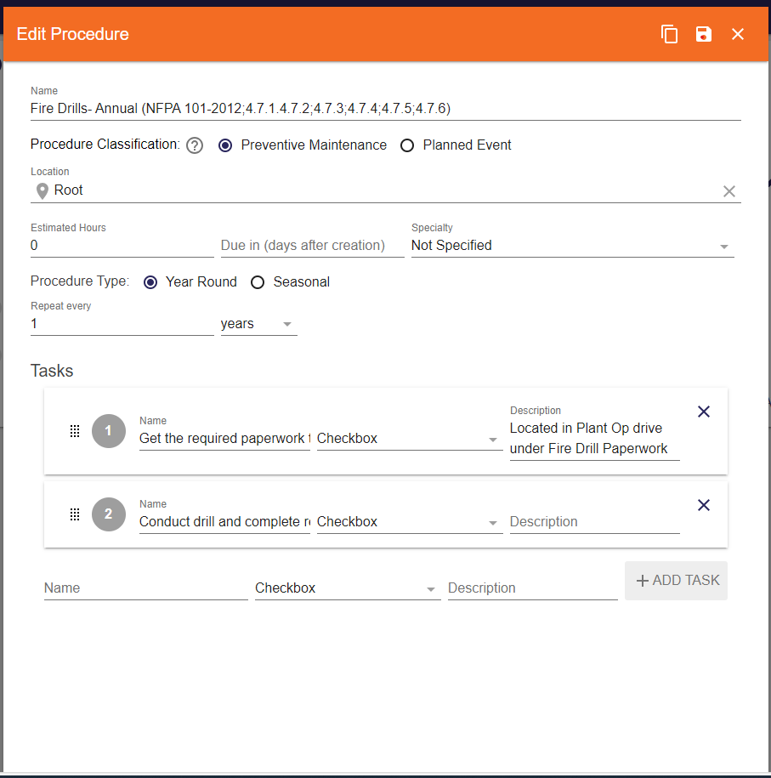
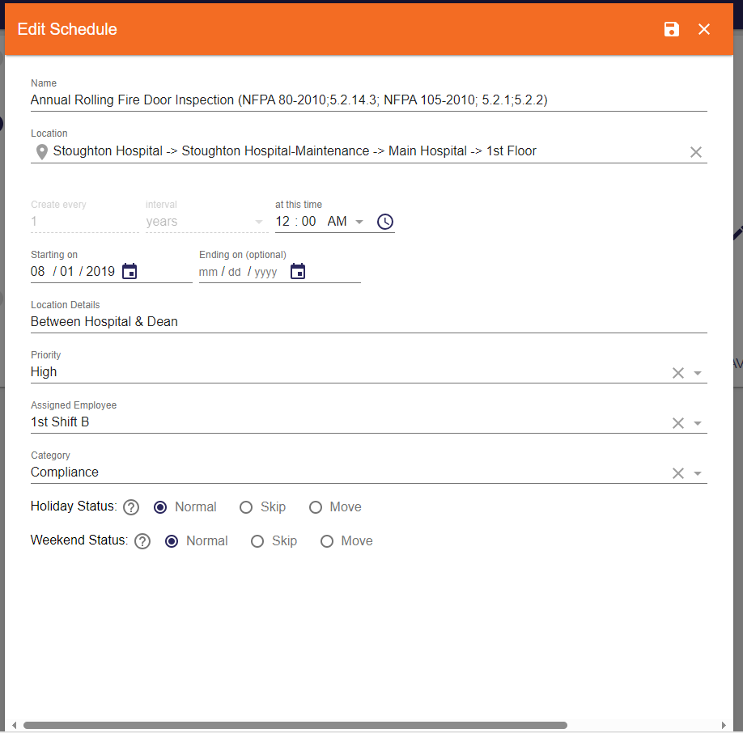
Measures:
STUDY
Include graphs of your measurement, results of surveys, etc. Include benchmarks or comparative data when available.
The arrow is showing where the NFPA codes will be listed that must be followed to be in compliance with this particular work order.
This slide explains the procedure of the work order, shows a list of task, and shows the date on when the work order will re-occur. When the task are completed they will be checked off to show they have been done. At that time the work order can be closed out.
Again the arrow is showing where the NFPA codes will be listed for this particular work order.
This slide shows what the schedule is and how often it will occur. Also it will spell out the locations, who it is assigned to, and what the priority level is for the work order.
NFPA Stands for (National Fire Protection Association)

Slide 77
Findings:
ACT
Results: Did you accomplish your goals?
100% completion
Lessons Learned: What did you learn as a result of this project? Unexpected discoveries? Problems or barriers?
I learned that there are many codes and adding this information to the preventative maintenance work order will help educate other team members to these codes. No unexpected discoveries, problems or barriers. Discovered that along with the NFPA code books that we have we also have NFPA codes on our Plant Ops file which is a great help in finding and adding the NFPA codes to the work orders. I have learned how valuable and how important the NFPA (National Fire Protection Association) is.
Next Steps: What actions are you going to take based on your findings? (e.g. roll out to additional units; modify and make additional improvements; abandon the effort; change course?)
Continue to monitor and add any new Life Safety Codes to our system.
Project Leader is Recommending the Following:
QM Council approval for completion of project?: Enter YES or NO Project still in progress, project to continue: Enter YES or NO

Slide 78
Medical Imaging/ AIC
Imaging Use of Power Ports
1st Presentation Date: June 25, 2024
Document Last Presented: December 17, 2024

Slide 79
Quality Story:
PLAN
Imaging Use of Power Ports
Goal(s): What are you trying to accomplish?
Collaborate with Ambulatory Infusion Center to implement a workflow for imaging staff to access patient ports. KOM Target: Implementation by October 2024 Current KOM Status: 50%
Background: Explain what the original situation was. Why was a change recommended? (e.g. variation, poor outcome, etc.)
Patients with a port are being referred to Stoughton Health for CT Scans. We are seeing an increase in oncology patients that have a port and also have poor IV access. Several attempts may be needed to obtain an IV, delaying care for this patient as well as emergency patients needing CT scans. Per current Medical Imaging policy, ports are not allowed as imaging staff can not access the port.
Driver: Explain why the project is critical to SH. Why does it relate to the strategic plan?
Patient satisfaction is our driver along with patient safety. These patients are coming to Stoughton Health due to scheduling availability, location convenience, and for our personalized service. We currently do not feel we are able to meet their satisfaction when ports can’t be used. Not all ports are power rated to be used for contrast injection requiring education and policy.
Team:
Project Leader: Sara Sturmer Members: Medical Imaging, Sarah Corbett, and Becky Beck

Slide 80
Changes:
DO
List the changes that have been made leading to improvements.
What? | Why? | When?
Sandra Bryan-Armstrong and Sara Sturmer agreed to work on project together with our teams. | Delegate team members and set up initial meeting. | July 2024
Collaborate with RWHC Radiology Sites | Understand processes other sites already have in place including policies | July 2024
Imaging Brainstorming Session | Shared ideas regarding scheduling, communication, procedures, charging | August 7, 2024
Kick Off Meeting Scheduled | Establish goals, roles and responsibilities. | August 16, 2024
Piloted 1 Patient as small test of change | Patient requested her exam be performed at Stoughton Health and for us to use her Port. Collaborated with referring physician, Day Surg RN and imaging team. Successfully completed injection. | November 20, 2024

Slide 81
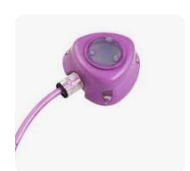
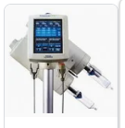
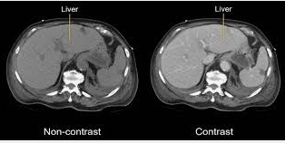
Measures:
STUDY
Include graphs of your measurement, results of surveys, etc. Include benchmarks or comparative data when available.
First Successful Injection with Port
Most implanted ports are made to be used during imaging tests. These ports let you have high speed injections of contrast.

Slide 82
Findings:
ACT
Results: Did you accomplish your goals?
New project just getting started.
Lessons Learned: What did you learn as a result of this project? Unexpected discoveries? Problems or barriers?
-AIC can access the port for imaging staff and imaging can use this for scans. -Other rural sites are now using ports per established protocols. -Increase in outpatients with ports being referred to Stoughton Health for their imaging. -Learned heparin was needed post injection and our pyxis does not have this medication. May need to add. -Technologist felt comfortable w/ injection of contrast through the port and process similar to PICC Lines.
Next Steps: What actions are you going to take based on your findings? (e.g. roll out to additional units; modify and make additional improvements; abandon the effort; change course?)
-Meet to review project and set intermittent goals. -Create policy -Perform education -Implement process
Project Leader is Recommending the Following:
QM Council approval for completion of project?: NO Project still in progress, project to continue: YES

Slide 83

MI/Reg/HIM
Paper Orders in Medial Imaging
1st Presentation Date: 06/25/2024
Document Last Presented: 12/17/2024

Slide 84
Quality Story:
PLAN
Paper orders- Medical Imaging
Goal(s): What are you trying to accomplish?
Goal is to implement scanning of outside orders into Epic as they are received to improve efficiencies and access across departments. KOM Target: TBD Current KOM Status: Research/Analysis
Background: Explain what the original situation was. Why was a change recommended? (e.g. variation, poor outcome, etc.)
Medical Imaging receives a number of faxed orders. These orders are put into a binder until the patient has their appointment. Once the appointment is complete the paper is sent down to HIM for scanning. We would really like to evaluate if this is still best practice.
Driver: Explain why the project is critical to SH. Why does it relate to the strategic plan?
These orders sitting on paper in the department affect a number of areas and people including Medical Imaging, Registration, Financial Clearance ( prior authorization) and HIM. We would like to ensure efficiency and Epic functionality to ensure if there’s an opportunity to scan the document into the EHR prior to the appointment, we are.
Team:
Project Leader: Sara Sturmer Members: Lisa Bear, Victoria Valdez, Jennifer Bothum, Susie Wendt, Sarah Watkins, Jenny Petersen, Maureen Vick

Slide 85
Changes:
DO
What? | Why? | When?
Reviewed Edgerton’s flow for handling paper orders | To determine if there was an opportunity to update our flow, it did not. | 08/05/2024
Tested SSM/Epic Flow Recommendation | To determine if paper order stayed attached to the future order, it did not. | 09/05/2024
OnBase Review Recommendation | Another option offered and reviewed. | 10/10/2024
Further Collaboration & Research with HIM and Affiliates | Collaborated on front end flow and ROI requirements/implications. | 10/17/2024
Sara Sturmer/Sarah Watkins project review | To determine if there is opportunity here to improve this process/next steps. | 12/02/2024

Slide 86
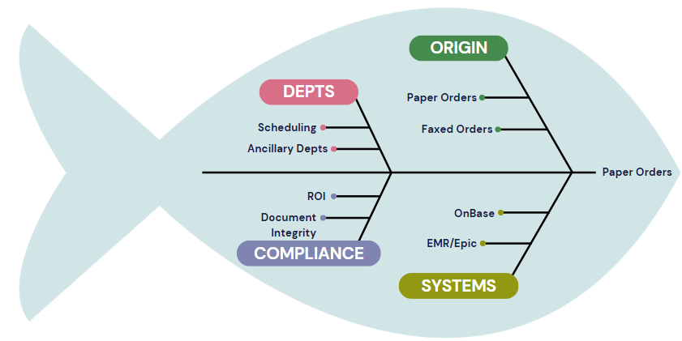
Measures:
STUDY

Slide 87
Findings:
ACT
Results: Did you accomplish your goals?
No. While our goal was to implement a more efficient process- we first needed to determine if there was an opportunity for improvement. After much research/review we have determined that there is not.
Lessons Learned: What did you learn as a result of this project? Unexpected discoveries? Problems or barriers?
Many of our affiliates are handling the same with a manual process There isn’t a better process
Next Steps: What actions are you going to take based on your findings? (e.g. roll out to additional units; modify and make additional improvements; abandon the effort; change course?)
Continue to collaborate with affiliates and watch for Epic enhancements that might allow for process improvement.
Project Leader is Recommending the Following:
QM Council approval for completion of project?: Yes Project still in progress, project to continue: No

Slide 88
Registration Onboarding
1st Presentation Date: August 27, 2024
Document Last Presented: December 17, 2024

Slide 89
Quality Story:
PLAN
Goal(s): What are you trying to accomplish?
KOM Target: Improvement of Onboarding Process Current KOM Status: 20% Complete, in the Planning Stage now
Background: Explain what the original situation was. Why was a change recommended? (e.g. variation, poor outcome, etc.)
All departments were asked to evaluate our onboarding processes. Our hospital-wide turnover of new employees for June 2024 was 32.76% and July was 38.18%.
Driver: Explain why the project is critical to SH. Why does it relate to the strategic plan?
Onboarding can play an important role in retaining new hires. A formal onboarding process helps set up your employees for success. It should include orientation, any necessary materials, meetings with stakeholders, shadowing and training, and an ongoing mentorship. We added a new position to the Revenue Cycle to specifically focus on onboarding and project management.
Team:
Project Leader: Sarah Watkins, Beverly Pope Members: Susie Wendt

Slide 90
Changes:
DO
List the changes that have been made leading to improvements.
What? | Why? | When?
Continued Meetings With Registration Coordinator | To keep this project moving and have input, review documents, etc. | Ongoing
Update Job Descriptions | Processes and workflows have changed, so updates were needed | September - December 2024
Attended Additional Onboarding Training | Online Webinar that discussed difference between orientation and onboarding | October 2024
Develop a Task List of duties/WQs assigned by shifts | Simplifies training, makes follow up easier | November 2024-December 2024
Review Opening and Closing Processes/Documentation | This is a simple area to implement checklists specific to locations and allows the team to be on the same page for workflow | December 2024
Develop an Insurance Training Process | This is the most difficult aspect of Registration and yet so important to the Revenue Cycle. | December 2024

Slide 91
Measures:
STUDY
Action Item | Completion | To Be Completed
Initiation | Completed | 9/30/2024
Planning | In process | 02/07/2024
Execution
Monitor and Controlling
Closure

Slide 92
Findings:
ACT
Results: Did you accomplish your goals?
No but we are working toward it.
Lessons Learned: What did you learn as a result of this project? Unexpected discoveries? Problems or barriers?
We want to build a process that can be replicated across departments. Having strong training tools is important to the success of new staff.
Next Steps: What actions are you going to take based on your findings? (e.g. roll out to additional units; modify and make additional improvements; abandon the effort; change course?)
Update Registration OneNote Test insurance training with current staff
Project Leader is Recommending the Following:
QM Council approval for completion of project?: No Project still in progress, project to continue: Yes

Slide 93
PFS/HIM
Provider Based Billing for Specialty Clinics
1st Presentation Date: 12/19/2023
Document Last Presented: 12/17/2024

Slide 94
Quality Story:
PLAN
Provider Based Billing for Specialty Clinics
Goal(s): What are you trying to accomplish?
KOM Target: To complete change in billing practice for specialty clinics effective 10/1/2024 Current KOM Status: 100% Completed
Background: Explain what the original situation was. Why was a change recommended? (e.g. variation, poor outcome, etc.)
The Specialty Clinics visits are billed differently than other services at Stoughton Health. This was decided for continuity with the Madison clinic. As we continue to expand our Specialty Clinics, we are getting denials on some charges/supplies used. We have lost revenue on both the denials and the time spent appealing them.
Driver: Explain why the project is critical to SH. Why does it relate to the strategic plan?
We were advised we could increase our revenue by moving to provider-based billing. This would allow us to bill both a facility fee and a professional fee for services. We also found we were receiving denials on some charges because of how we have been billing. This change will eliminate these denials as well.
Team:
Project Leader: Sarah Watkins Members: Michelle Abey, Beverly Pope, Victoria Valdez, Jordan Sweeney

Slide 95
Changes:
DO
What? | Why? | When?
Regularly scheduled check-ins | To keep all team members on track and moving forward with the project | Ongoing
Patient Notification | Letter and emails sent to patients to notify of changes | August and September 2024
Signage | Another requirement to inform patients of this change | September 2024
Scripting | Met with Rev Cycle Teams to give scripting for questions they might receive | September 2024
Fee Schedule Built | To include facility charges | September 2024
Testing | Ensure the build works correctly | September 2024
Training | Coding staff to enter both facility and professional charges | September 2024
Implementation | This is our goal for go-live | 10/1/2024
PBB Locations Pulling in 340B Savings | These accounts are now receiving 340B Savings | 10/1/2024
Audits | Ensure accurate coding/billing | ongoing

Slide 96
Measures:
STUDY
Action Item | Completion
Research | Completed
Epic Build | Completed
Training | Completed
Implementation/Audits | Completed
Projected 2023 340b Savings
Medication | Est per Vial Savings | Quantity in 2023 | Estimated 2023 Savings
Cortisone Injection | $36.00 | 4 | $144.00
Zilretta Injection | $138.00 | 457 | $63066.00
Orthovisc Injection | $30.00 | 88 | $2640.00
Total |  |  | $65850.00

Slide 97
Findings:
ACT
Results: Did you accomplish your goals?
Yes
Lessons Learned: What did you learn as a result of this project? Unexpected discoveries? Problems or barriers?
Regular follow up and check ins are important to keep things moving forward-both internally and externally A regular barrier is the timeliness of our Epic tickets getting worked Keeping all stakeholders informed is an important piece Most people do not like change. However, if you plan and communicate, you can lessen the impact on those affected.
Next Steps: What actions are you going to take based on your findings? (e.g. roll out to additional units; modify and make additional improvements; abandon the effort; change course?)
Routine maintenance and auditing
Project Leader is Recommending the Following:
QM Council approval for completion of project?: Yes Project still in progress, project to continue: No

Slide 98
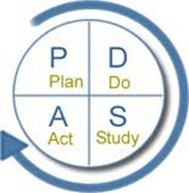
Epic Contract Building
A tool used to document and communicate
Performance Improvement Projects
1st Presentation Date: 06/28/2022
Document Last Presented: 12/17/2024

Slide 99

Quality Story: Contract Building
Goal(s):
What goal are you trying to accomplish?
To build contracts in Epic for our contracted insurance payers
KOM Target: Complete Epic Build of All Contracted Insurance Payers
Current KOM Status (12/4/2024): Total of 31 Insurance Plans
          7 in Production
          3 ready to move to Production
          2 building/testing
          19 pending
P
L
A
N
Background:
Explain what the original situation was. Why was a change recommended? (e.g. variation, poor outcome, etc.)
Previous to the Epic Instance Merge in 2018, we had a number of our contracts built in Epic to track reimbursement. We have struggled to get contracts built in the new instance and need to make this a priority.
Driver:
Explain why the project is critical to SH. How does it relate to the strategic plan?
The purpose of building contracts in Epic is two-fold. First, the contract module compares the actual reimbursement to the expected reimbursement according to that contract’s terms.
Second, Epic allows us to model any changes during contract negotiations. We can estimate the effect on reimbursement and negotiate terms effectively.
Team:
Project Champion: Sarah Watkins
Project Leader: Beverly Pope
Members: Beverly Pope, Mary Erdman

Slide 100
Changes:
List the changes that have been made leading to improvements.
D
O
What? | Why? | When?
Weekly meetings for building | Continue forward progress on other contracts | Ongoing
Ticket entered for Variance WQ still pending | Accounts for a contract that is not active yet are falling into the WQ incorrectly. | Ongoing
Bi-monthly auditing | Verify contract build is accurate | Ongoing
Tracking of variance reimbursement | Tracking totals of reimbursement when not paid according to contract | October 2024
Goal Setting | Reviewed remaining contracts and set goals for completion | December 2024
Notes:
New link for new vendor

Slide 101

Measures:
S
T
U
D
Y
Current Contracts
Aetna
Cigna
Group Health
Humana
Quartz
UHC (McFarland UC)
UHC Medicare (McFarland UC)
There is currently $238.02 outstanding in appeals.

Slide 102
Findings:
Results:
Did you accomplish your goals?
Not yet, but we are working toward our goal. Plan to complete commercial plans by February 2025 and Medicare (including HMOs) by April 2025
A
C
T
Lessons Learned: What did you learn as a result of this project? Unexpected discoveries? Problems or barriers?
Stay the course
Slow and steady wins the race
Depending on people outside our organization is not always easy
Next Steps: What actions are you going to take based on your findings? (e.g. roll out to additional units, modify and make additional improvements; abandon the effort; change course)
Continue to work with affiliates and SSM-IHT to complete more contracts
Continue to track variances in production and follow up for correct reimbursement
Project leader is recommending the following:
CI Council approval for completion of project: No
Project still in progress, project will continue: Yes

Slide 103
Anesthesia
Controlled Substance Documentation
1st Presentation Date: June 25, 2024
Document Last Presented: December 10, 2024

Slide 104
Quality Story:
PLAN
Controlled Substance Documentation
Goal(s): What are you trying to accomplish?
KOM Target: 0-1 Waste discrepancies per month and maintained for a minimum of 6 months to ensure hardwiring 0 Administration Discrepancies per month and maintained for a minimum of 6 months to ensure hardwiring Current KOM Status: Waste Discrepancies Unmet: (see graphs) for past 3 months have been 1-2 Administration Discrepancies Met: 0 for past 6 months
Background: Explain what the original situation was. Why was a change recommended? (e.g. variation, poor outcome, etc.)
Organizations using controlled substances must have policies and procedures in place for disposing of these substances and to avoid potential drug diversion as well as environmental pollution. Facilities must maintain adequate and detailed records, but individual healthcare systems impose their own specific requirements. Some, for example, require drug disposal to be witnessed. However, recordkeeping systems must be robust and frequently audited to prevent diversion. Navigating this system can be complex, and since all regulations are subject to change, it requires vigilance and expertise.
Driver: Explain why the project is critical to SH. Why does it relate to the strategic plan?
Quality/Safety and Financial: The consequences of poor or lax monitoring can be significant. In addition to risk of patient and employee harm, fines of up to $10,000 per violation can be levied against facilities that are judged to have lapses in accountability.
Team:
Project Leader: Amy Hermes and Deb Dahlke Members: CRNA Team

Slide 105
Changes:
DO
List the changes that have been made leading to improvements.
What? | Why? | When?
Lead CRNA working on policies with Pharmacy Manager for department related to waste documentation. | To have defined practice expectations. | July 2024
Meeting held with CRNAs and Pharmacy to further discuss workflows. | Brainstorming solutions. Concept of “end of case” time out to help with documentation of waste. | July 2024
2 CRNAs have worked at SSM where they have had Epic alerts reminding them, they still had waste to document. | Looking into this option for Stoughton to help with human factor of forgetting. | July 2024
Have been made aware that Epic Alerts for this aware are not possible. | Not allowable for affiliate organizations. | September 2024
Increased communication with OR RN Charge for wastes. | OR RN Charges can assist as a witness for the wastes. | September 2024
Ascom phones approved for purchase. | Improved communication between all OR team members. | October 2024

Slide 106
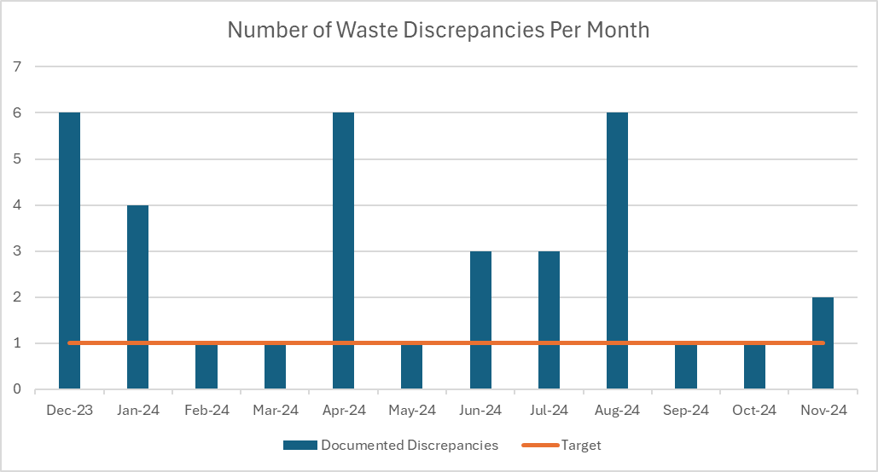
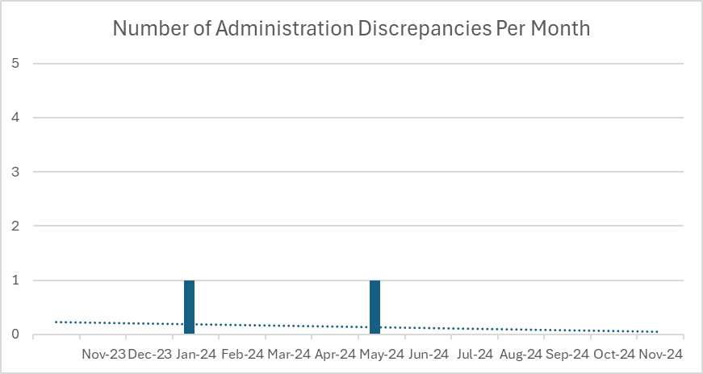
Measures:
STUDY
Include graphs of your measurement, results of surveys, etc. Include benchmarks or comparative data when available.

Slide 107
Findings:
ACT
Results: Did you accomplish your goals?
Met goal for Administration Discrepancies. Did not meet goal for documentation of waste discrepancies but improvement noted over past 3 months..
Lessons Learned: What did you learn as a result of this project? Unexpected discoveries? Problems or barriers?
After finding out that the Epic Alert was not going to be available, needed to explore other options for communication. Workflows are different for each case, so having a “go to person” to ask to assist with witnessing waste seems to be the best solution.
Next Steps: What actions are you going to take based on your findings? (e.g. roll out to additional units; modify and make additional improvements; abandon the effort; change course?)
Did not some trending with one particular CRNA, follow up done with noted improvement for past 3 months. Ascom phone roll out will also help to improve communications.
Project Leader is Recommending the Following:
QM Council approval for completion of project?: NO Project still in progress, project to continue: YES

Slide 108
Stoughton Health Leadership Team
DVC Score-Satisfaction Domain
1st Presentation Date: June 25, 2024
Document Last Presented: December 17, 2024

Slide 109
Quality Story:
PLAN
DVC Score – Satisfaction Domain
Goal(s): What are you trying to accomplish?
KOM Target: Satisfaction Domain Max Performance Score 20% Current KOM Status: November DVC Scorecard (timeframe 01/01/2023 – 12/31/2023) currently at 17.5%
Background: Explain what the original situation was. Why was a change recommended? (e.g. variation, poor outcome, etc.)
The Dean Value-based Contract (DVC) is a written contractual arrangement in which the payment for health care goods and services is tied to predetermined, mutually agreed upon terms that are based on clinical circumstances, patient outcomes, and other specified measures of the appropriateness and effectiveness of the services rendered. It identifies a set of outcomes, mutually recognized by payors and specifies a formula that determines the net price to be reimbursed for goods and services rendered. The measures being monitored are Quality (various infection rates), Satisfaction ( rank your hospital high, provider and nurse communication, discharge instructions), Efficiency (30day readmissions, 1 day hospital stays.
Driver: Explain why the project is critical to SH. Why does it relate to the strategic plan?
The drivers for this QM is overall achieving the patient satisfaction and loyalty evident by the HCAHPs score. Given reimbursement from Dean tied to the patient satisfaction measures under the Satisfaction Domain, the other driver of this QM is financial. We want to be able to achieve high satisfaction/loyalty along with receiving the highest rate for performance.
Team:
Project Leader: Amy Hermes Members: Patient Care Leader Team (Heather Kleinbrook, Pauline Cass, Dr. Menet, Jen Wagner, others as identified)

Slide 110
Changes:
DO
List the changes that have been made leading to improvements.
What? | Why? | When?
Discussion started at Patient Leadership Meeting | Many departments interact with MS impact the overall satisfaction. | June 13, 2024
Forum Discussion to be held August 15 at Leadership Day | As above, while some of these measures are MS specific, Rank Your Hospital High, is impacted by several areas. | August 15, 2024
Information related to nursing and communication scores being shared with team. | Provide information on the importance of DVC escalator, impact on finances, and to work on improving areas as needed. | Ongoing
Meeting held with key stakeholders to specifically discuss discharge information. | Lowest ranking are in satisfaction domain. Heightened awareness and brainstorming opportunities for improvement | October 2024
Meeting scheduled for December 2024 | Review of initiatives implemented and results. | December 2024

Slide 111
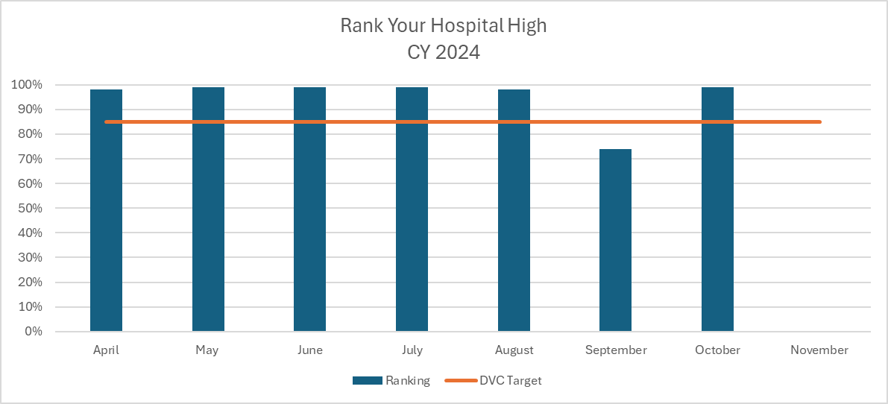
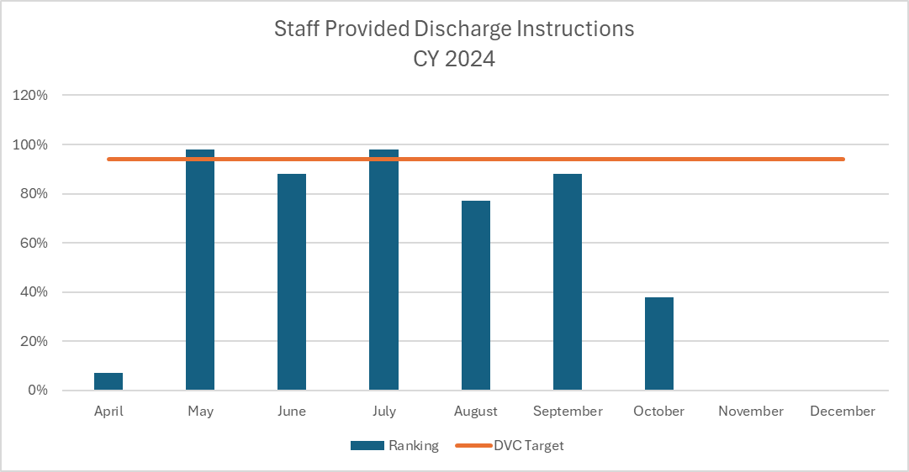
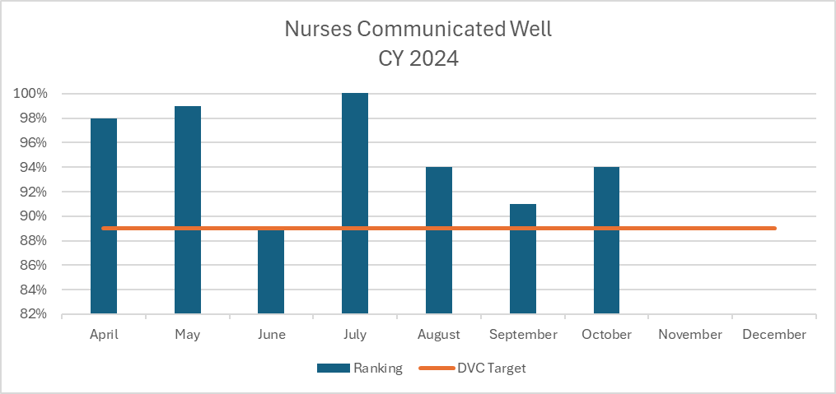
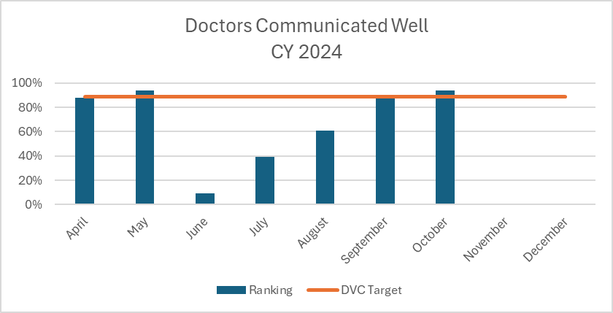
Measures:
STUDY
Include graphs of your measurement, results of surveys, etc. Include benchmarks or comparative data when available.
Current DVC Ranking 79%
Goal 85%
Current DVC Ranking 87% Goal 94%
Current DVC Ranking 87%
Goal 89%
Current DVC Ranking 87% Goal 89%

Slide 112
Findings:
ACT
Results: Did you accomplish your goals?
Year end DVC Scorecard released in November: Satisfaction Domain was 17.5% out of a max of 20%. All areas achieved 5% except for Discharge Instructions which achieved 2.5%.
Lessons Learned: What did you learn as a result of this project? Unexpected discoveries? Problems or barriers?
New project, lag time in reporting. While we can’t fix the scores we have currently, we need to make sure we are moving in the right direction going forward.
Next Steps: What actions are you going to take based on your findings? (e.g. roll out to additional units; modify and make additional improvements; abandon the effort; change course?)
Will continue to monitor all areas of the domain with a more concentrated efforts on discharge instructions.
Project Leader is Recommending the Following:
QM Council approval for completion of project?: NO Project still in progress, project to continue: YES

